Slide 1
Comp 110 Loan Case Study
Instructor: Jason Carter

Slide 2
Contents
Revisit, through non-graphical objects, concepts illustrated in previous sections

Slide 3
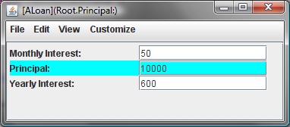
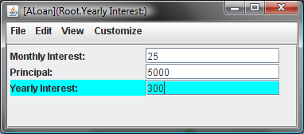
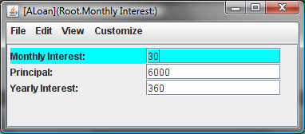
Loan Object

Slide 4
Properties classification
public class ABMISpreadsheet {
double height;
public double getHeight() {
return height;
}
public void setHeight(double newHeight) {
height = newHeight;
}
double weight;
public double getWeight() {
return weight;
}
public void setWeight(double newWeight) {
weight = newWeight;
}
public double getBMI() {
return weight/(height*height);
}
}
Editable
Independent
Read-only
Dependent

Slide 5
Loan Object
Editable
and dependent

Slide 6
1-Way vs. 2-Way Dependencies
weight
bmi
height
monthly interest
principal
yearly interest

Slide 7
Top-Down Programming
Interface
Representation
Algorithm
Class

Slide 8
Bottom-Up Programming
Interface
Class

Slide 9
Loan Object

Slide 10
Loan Interface
public interface Loan {
public int getPrincipal();
public void setPrincipal(int newValue);
public int getYearlyInterest();
public void setYearlyInterest(int newVal);
public int getMonthlyInterest();
public void setMonthlyInterest(int newVal);
}

Slide 11
ALoan Representation
write
read
setYearlyInterest()
getYearlyInterest()
int
principal
setPrincipal()
getPrincipal()
setMonhtlyInterest()
getMonthlyInterest()
Representation = set of instance variables that stores object state

Slide 12
Loan Object
Stored
Editable
and dependent
Computed

Slide 13
ALoan Algorithm
write
read
F1⁻¹
F1
setYearlyInterest()
getYearlyInterest()
int
principal
setPrincipal()
getPrincipal()
F2⁻¹
F2
setMonhtlyInterest()
getMonthlyInterest()

Slide 14
Setting and Getting the Stored Property (edit)
public void setPrincipal(int newPrincipal) {
}
int
principal
int
principal
setPrincipal()
getPrincipal()
public int getPrincipal() {
}

Slide 15
Setting and Getting the Stored Property
public void setPrincipal(int newPrincipal) {
principal = newPrincipal;
}
int
principal
int
principal
setPrincipal()
getPrincipal()
public int getPrincipal() {
return principal;
}

Slide 16
Setting and Getting Computed Property (edit)
public void setYearlyInterest(int newInterest) {
principal = (newInterest /INTEREST_RATE )*100;
}
F1⁻¹
int
principal
int
principal
setYearlyInterest()
getYearlyInterest()
F1
public int getYearlyInterest() {
return principal*INTEREST_RATE/100;
}

Slide 17
Setting and Getting Computed Property
public void setYearlyInterest(int newInterest) {
principal = newInterest/INTEREST_RATE*100;
}
F1⁻¹
int
principal
int
principal
getYearlyInterest()
getYearlyInterest()
F1
public int getYearlyInterest() {
return principal*INTEREST_RATE/100;
}

Slide 18
Setting and Getting Computed Property (edit)
public void setMonthlyInterest(int newVal) {
principal = 12*newVal/INTEREST_RATE*100;
}
F2⁻¹
int
principal
int
principal
setMontlyInterest()
getMonthlyInterest()
F2
public int getMonthlyInterest() {
return getYearlyInterest()/ 12;
}

Slide 19
Setting and Getting Computed Property (edit)
public void setMonthlyInterest(int newVal) {
setYearlyInterest (newVal*12);
}
F2⁻¹
int
principal
int
principal
setMontlyInterest()
getMonthlyInterest()
F2
public int getMonthlyInterest() {
return getYearlyInterest()/12;
}

Slide 20
Modified Loan Interface
public interface Loan {
public final int INTEREST_RATE = 6;
public int getPrincipal();
public void setPrincipal(int newValue);
public int getYearlyInterest();
public void setYearlyInterest(int newVal);
public int getMonthlyInterest();
public void setMonthlyInterest(int newVal);
}

Slide 21
Middle-Out Programming
Interface
Representation
Algorithm
Class

Slide 22
AnotherLoan Representation
write
read
setYearlyInterest()
getYearlyInterest()
int
yearlyInterest
setPrincipal()
getPrincipal()
setMonhtlyInterest()
getMonthlyInterest()

Slide 23
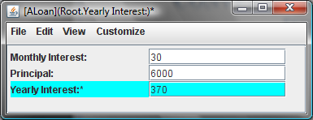
Conversion Errors with Principal Representation

Slide 24
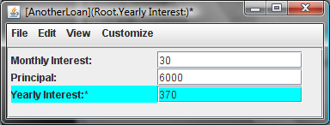
No Conversion Errors with Yearly Interest Representation

Slide 25
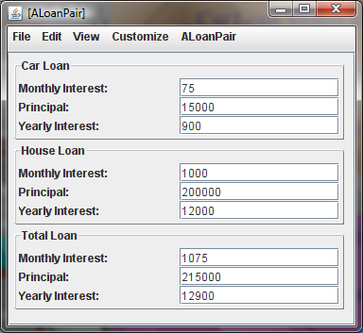
LoanPair
Car Loan Principal
Car Loan Yearly Interest
Car Loan Monthly Interest
House Loan Principal
…
Principal
Yearly Interest
Monthly Interest
Car Loan
House Loan
Total Loan

Slide 26
Primitive vs. Object Properties
Primitive Properties
Car Loan Principal
Car Loan Yearly Interest
Car Loan Monthly Interest
House Loan Principal
…
Principal
Yearly Interest
Monthly Interest
Object
Properties
Car Loan
House Loan
Total Loan
Reusing Loan!

Slide 27
LoanPair Interface (edit)
public interface LoanPair {
}

Slide 28
LoanPair Interface (edit)
public interface LoanPair {
}

Slide 29
Typing Objects
ALoan
AnotherLoan
Loan

Slide 30
LoanPair Interface
public interface LoanPair {
public Loan getCarLoan();
public void setCarLoan(
Loan newValue);
public Loan getHouseLoan();
public void setHouseLoan(
Loan newValue);
public Loan getTotalLoan();
}
Actual Parameters
ALoan
AnotherLoan

Slide 31
LoanPair Interface: Restricted
public interface LoanPair {
public Loan getCarLoan();
public void setCarLoan(
ALoan newValue);
public Loan getHouseLoan();
public void setHouseLoan(
ALoan newValue);
public Loan getTotalLoan();
}
Actual Parameters
ALoan
AnotherLoan

Slide 32
Space-efficient Implementation
Independent
Stored
Dependent
Computed
Car Loan
House Loan
Total Loan

Slide 33
Space-efficient Representation
write
read
setCarLoan()
getCarLoan ()
Loan carLoan
getTotalLoan()
Loan houseLoan
setHouseLoan()
getHouseLoan()

Slide 34
Getter Method
getCarLoan ()
Loan carLoan
public Loan getCarLoan(){ return carLoan;
}
Accessing uninitialized object variable!

Slide 35
Default Values for Variables
Primitive Variables
variables
memory
Legal double values
double computedBMI;
computedBMI;
0.0
double weight;
weight;
0.0
Object Variables
Loan loan;
loan;
null
Illegal Loan value

Slide 36
Getter Method
getCarLoan ()
Loan carLoan
public Loan getCarLoan(){ return carLoan;
}
ObjectEditor does not try to invoke methods if return value is null!

Slide 37
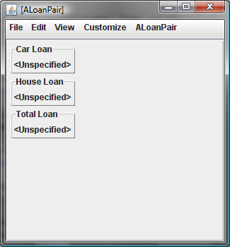
ObjectEditor Display of null

Slide 38
How to Initialize Object Variable?
getCarLoan ()
Loan carLoan
public Loan getCarLoan(){ return carLoan;
}
Create instance of ALoan or AnotherLoan and assign to variable

Slide 39
Initialization of Object Variables
Loan carLoan = new ALoan();
Loan houseLoan = new AnotherLoan();
Loan houseLoan = new Loan();

Slide 40
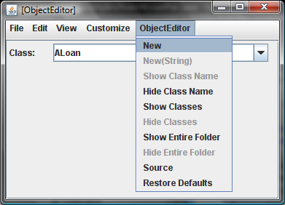
Interactive vs. Programmed Instantiation
new ALoan()

Slide 41
ALoanPair
write
read
setCarLoan()
getCarLoan ()
Loan carLoan = new Aloan()
getTotalLoan()
Loan houseLoan = new AnotherLoan()
setHouseLoan()
getHouseLoan()

Slide 42
getTotalLoan()
Loan carLoan
getTotalLoan()
Loan houseLoan
public Loan getTotalLoan(){ return carLoan + houseLoan;
}
+ not defined for Loan!

Slide 43
Programmer-Defined Add Algorithm
public Loan add(Loan loan1, Loan loan2) {
// create Loan instance
// set one of its properties to sum of corresponding properties of loan 1 and loan2
// other properties are dependent and will be set automatically
// return Loan instance
}

Slide 44
Programmer-Defined Add
public Loan add(Loan loan1, Loan loan2) {
Loan retVal = new ALoan();
retVal.setPrincipal(loan1.getPrincipal() + loan2.getPrincipal());
return retVal;
}
public Loan add(Loan loan1, Loan loan2) {
Loan retVal = new ALoan();
retVal.setYearlyInterest(loan1.getYearlyInterest() +
loan2.getYearlyInterest());
return retVal;
}
public Loan add(Loan loan1, Loan loan2) {
Loan retVal = new ALoan();
retVal.setMonthlyInterest(loan1.getMonthlyInterest() +
loan2.getMonthlyInterest());
return retVal;
}

Slide 45
Returning AnotherLoan
public Loan add(Loan loan1, Loan loan2) {
Loan retVal = new AnotherLoan();
retVal.setPrincipal(loan1.getPrincipal() + loan2.getPrincipal());
return retVal;
}
public Loan add(Loan loan1, Loan loan2) {
Loan retVal = new AnotherLoan();
retVal.setYearlyInterest(loan1.getYearlyInterest() +
loan2.getYearlyInterest());
return retVal;
}
public Loan add(Loan loan1, Loan loan2) {
Loan retVal = new AnotherLoan();
retVal.setMonthlyInterest(loan1.getMonthlyInterest() +
loan2.getMonthlyInterest());
return retVal;
}

Slide 46
Combining Object Creation and Initialization
public Loan add(Loan loan1, Loan loan2) {
Loan retVal = new ALoan();
retVal.setPrincipal(loan1.getPrincipal() + loan2.getPrincipal());
return retVal;
}
Object Creation
Object Initialization
public Loan add(Loan loan1, Loan loan2) {
return new ALoan(loan1.getPrincipal() +
loan2.getPrincipal()));
}
Combined creation and initialization

Slide 47
Adding Constructor in ALoan
write
read
setYearlyInterest()
getYearlyInterest()
int
principal
setPrincipal()
getPrincipal()
initialize
setMonhtlyInterest()
getMonthlyInterest()
ALoan()
Constructor

Slide 48
Constructor vs. Regular Method
public class ALoan implements Loan{
int principal;
public int getPrincipal() {
return principal;
}
public void setPrincipal(int newVal) {
principal = newVal;
}
…
}
Missing return type name
public ALoan(int initPrincipal) {
setPrincipal(initPrincipal);
}
Combined return type and method name
public ALoan ALoan(int initPrincipal) {
setPrincipal(initPrincipal);
}
Not a constructor!

Slide 49
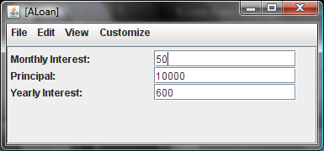
Instantiation Requires Parameters
new ALoan()
new ALoan(10000)

Slide 50
Constructor
Method that constructs a new object based on its parameters
new ALoan(10000)
Actually, just initializes object
Object constructed by Java
Front-end to object construction
Cannot be declared in interface
Chooses implementation

Slide 51
Multi-Parameter Constructor
public ALoanPair (Loan initCarLoan, Loan initHouseLoan) {
setCarLoan(initCarLoan);
setHouseLoan(initHouseLoan);
}
new ALoanPair(new ALoan(10000), new ALoan(10000))
Usually as many constructor parameters as are required to initialize independent instance variables

Slide 52
Default Constructor
public class ALoan implements Loan{
int principal;
public int getPrincipal() {
return principal;
}
public void setPrincipal(int newVal) {
principal = newVal;
}
…
}
Default
public ALoan();
}
Inserted in object code, not in source code
new ALoan()
Invoking the default constructor

Slide 53
Programmer-Defined Add
Accesses instance variables
Instance Method
public Loan getTotalLoan(){
return ALoan.add(houseLoan, carLoan);
}
Class Method
public static Loan add(Loan loan1, Loan loan2) {
return new ALoan(loan1.getPrincipal() + loan2.getPrincipal()));
}
Access no instance variable

Slide 54
Polymorphic Methods
public static Loan add(Loan loan1, Loan loan2) {
return new ALoan(loan1.getPrincipal() + loan2.getPrincipal()));
}
Methods that take actual parameters of different types
ALoan instance
AnotherLoan instance
Actual parameters of different types

Slide 55
Non-Polymorphic Methods
public static Loan add(ALoan loan1, ALoan loan2) {
return new ALoan(loan1.getPrincipal() + loan2.getPrincipal()));
}
public static Loan add(AnotherLoan loan1, AnotherLoan loan2) {
return new ALoan(loan1.getPrincipal() + loan2.getPrincipal()));
}
public static Loan add(ALoan loan1, AnotherLoan loan2) {
return new ALoan(loan1.getPrincipal() + loan2.getPrincipal()));
}
Code duplication!

Slide 56
Overloading vs. Polymorphism
add (new ALoan(10000), new ALoan(5000));
add (new ALoan(10000), new AnotherLoan(5000));
public static Loan add(Loan loan1, Loan loan2) {
return new ALoan(loan1.getPrincipal() + loan2.getPrincipal()));
}
public static Loan add(ALoan loan1, ALoan loan2) {
return new ALoan(loan1.getPrincipal() + loan2.getPrincipal()));
}
public static Loan add(ALoan loan1, AnotherLoan loan2) {
return new ALoan(loan1.getPrincipal() + loan2.getPrincipal()));
}
Polymorphism
Overloading

Slide 57
Primitive vs. Object Types
types
Object types
Classes
Primitive types
ABMICalculator
ABMISpreadsheet
double
int
ALoan
AnotherLoan
Interfaces
BMISpreadsheet
Loan
type = set of operations

Slide 58
Structured vs. Atomic Types
types
Structured types
Classes
Primitive types
ABMICalculator
ABMISpreadsheet
double
int
ALoan
AnotherLoan
Interfaces
BMISpreadsheet
Loan
Instances of structured type decomposed into one or more smaller values

Slide 59
Loan Interface
public interface Loan {
public int getPrincipal();
public void setPrincipal(int newValue);
public int getYearlyInterest();
public void setYearlyInterest(int newVal);
public int getMonthlyInterest();
public void setMonthlyInterest(int newVal);
}

Slide 60
ALoan Representation
write
read
setYearlyInterest()
getYearlyInterest()
int
principal
setPrincipal()
getPrincipal()
setMonhtlyInterest()
getMonthlyInterest()

Slide 61
AnotherLoan Representation
write
read
setYearlyInterest()
getYearlyInterest()
int
yearlyInterest
setPrincipal()
getPrincipal()
setMonhtlyInterest()
getMonthlyInterest()

Slide 62
Physical vs. Logical Structure
Physical
principal;
ALoan Instance
int
Logical
int
YearlyInterest;
Principal;
ALoan Instance
int
MonthlyInterest;
int

Slide 63
LoanPair Interface
public interface LoanPair {
public Loan getCarLoan();
public void setCarLoan(Loan newValue);
public Loan getHouseLoan();
public void setHouseLoan(Loan newValue);
public Loan getTotalLoan();
}

Slide 64
ALoanPair
write
read
setCarLoan()
getCarLoan ()
Loan carLoan
getTotalLoan()
Loan houseLoan
setHouseLoan()
getHouseLoan()

Slide 65
Physical vs. Logical Structure
Variable name
Physical
principal;
carLoan;
Loan
int
ALoanPair Instance
principal;
houseLoan;
Loan
int
Class or primitive type of value stored in variable

Slide 66
Physical vs. Logical Structure
Property name
Logical
Loan
int
TotalLoan;
YearlyInterest;
ALoanPair Instance
CarLoan;
Principal;
Loan
int
HouseLoan;
MonthlyInterest;
Loan
int
Class or primitive type of property value

