Slide 1
Comp 110
Recitation 1
Java/Eclipse Installation
Instructor: Jason Carter

Slide 2
Agenda
Questions
Announcements
Software Installation

Slide 3


Announcements
Honor Code Pledge
  Check Assignments on Blackboard to sign the Pledge
Office Hours
  Tues 2:00-3:00, Weds. 4:00-5:00
  Or by appointment
Assignment 1 handed out today

Slide 4
Software Installation
Assumption: You have Windows 7
There are separate instructions for Mac users

Slide 5
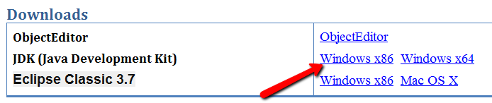
Java Installation
Open the Following Website in Firefox or Internet Explorer: http://cs.unc.edu/~carterjl/teaching.html
Click the Link for Windows x86.

Slide 6
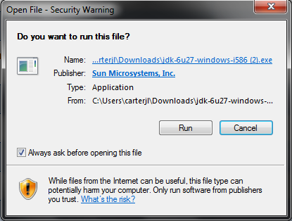
Java Installation
Click on Run

Slide 7
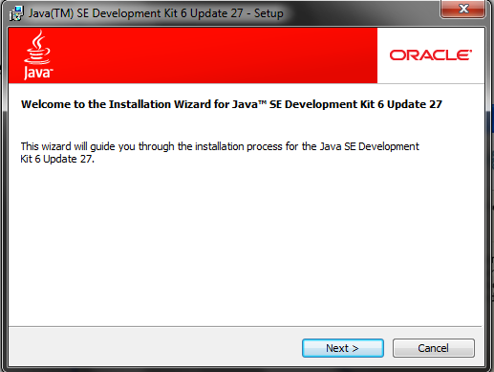
Java Installation
Press Next on the following screen

Slide 8
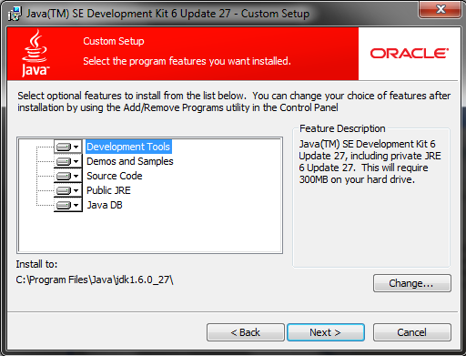
Java Installation
Press Next on the following screen

Slide 9
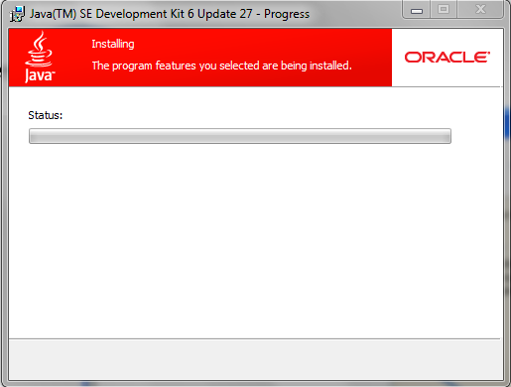
Java Installation
Wait for the features to be installed

Slide 10
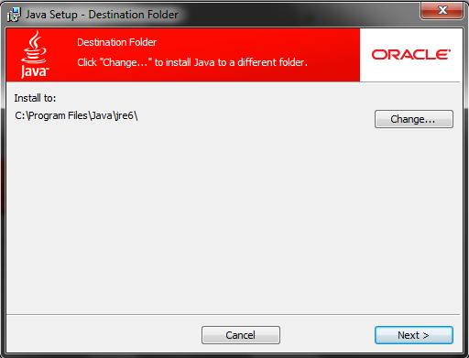
Java Installation
Press Next on the following screen

Slide 11
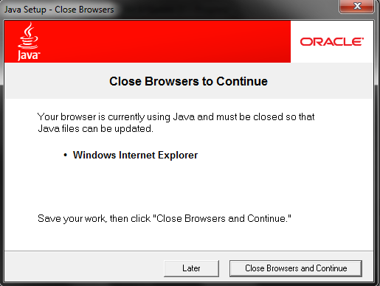
Java Installation Warning
Press Close Browsers and Continue

Slide 12
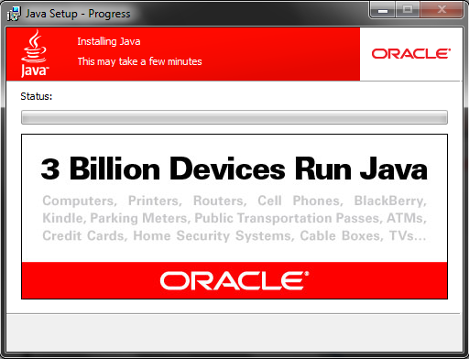
Java Installation
Wait….

Slide 13
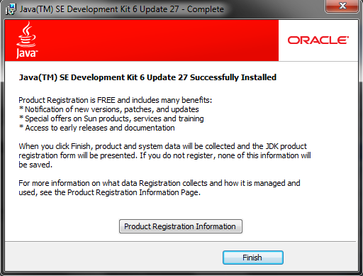
Java Installation
Click the Finish button

Slide 14
Comp 110
Eclipse Setup
Instructor: Jason Carter

Slide 15
Eclipse – One Time Setup
Separate folder setup instructions for Windows and Mac users
Once we get to using Eclipse, instructions are the same
If you run into a problem with any of these steps, please contact me and I will help you

Slide 16
Windows Users – Setting up the Workspace Folders
Open “My Computer”
  Click on “Start” and then “My Computer”
Open your “C:” drive
Create a new folder called “comp110workspace”
  Do not include the quotes in the name
Open the “comp110workspace” folder
Create a new folder called “comp110”
  Do not include the quotes in the name
Open the “comp110” folder
  Leave the window showing the folder contents open

Slide 17
Setting Up Eclipse Folder
Open “My Computer”
  Click on “Start” and then “My Computer”
Open your “C:” drive
Open your “Program Files” or “Program Files(x86)” Folder
Create a new folder called “eclipse”
  Leave the window showing the folder contents open

Slide 18
Windows Users – Setting up the Workspace Folders
From the course website, download Eclipse Classic 3.7 Windows x86 and the ObjectEditor package onto your desktop
  For all the files, you must save them onto your desktop by choosing the “Save link as…” or “Save target as…” option
If you are using Internet Explorer
  Save the file to the you desktop by clicking on the desktop icon on the left-hand-side of the Save window
If you are using Mozilla Firefox
  Download the files to your desktop
Drag the ObjectEditor file, oeall13.jar, you saved from the desktop to the “comp110” folder you opened up earlier

Slide 19

Windows Users – Setting up Eclipse
Drag the Eclipse file, eclipse-SDK-3.7-win32 zip, to the file you opened earlier, “eclipse”
Unzip your Eclipse , go to its extracted folder, and create a shortcut of the file “eclipse.exe” onto your desktop
To create a shortcut
  Open “My Computer” by clicking “Start” then “My Computer”
  Open “C:” drive
  Open “Program Files”
  Open “eclipse”
  With the right-mouse button, drag eclipse.exe onto your desktop
  When you drop, choose the “Create shortcuts here” option
You can delete, eclipse-SDK-3.7-win32 zip
  Leave the window showing the “eclipse” folder contents open

Slide 20
Mac Users – Setting up the Workspace Folders
Open your “Documents” folder
Create a new folder called “comp110workspace”
  Do not include the quotes in the name
Open “comp110workspace”
Create a new folder called “comp110”
  Do not include the quotes in the name
Open the “comp110” folder

Slide 21
Mac Users – Setting up the Workspace Folders
From the course website, download Eclipse Classic 3.7 MAC OS Xand the ObjectEditor package onto your desktop
  For all the files, you must right-click and then choose the “Save link as…” or “Save target as…” option
If you are using Safari or Mozilla Firefox
  Download the files to your desktop
Drag the files you save from the desktop to the “comp110” folder you opened up earlier

Slide 22
Comp 110
Eclipse Helper Setup
Instructor: Jason Carter

Slide 23



Eclipse Helper
Automatically predict when students are
having difficulty with some aspect of code
Notify a TA that the students are having a problem
I should see if Student₁ needs help.
Making slow progress.
Student₁
Student₂

Slide 24
What Eclipse Helper Does
Log your programming actions
Monitor your progress.
Student
Log of Programming Actions
int i = 0;
1. Edit line of code
2. Set breakpoint

Slide 25
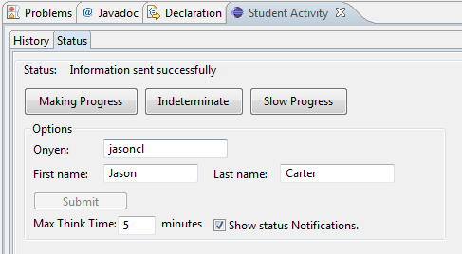
Getting Help
Software predicts slow progress
Press the slow progress button
Notifies me that you need help

Slide 26
Asking And Receiving Help
When you ask for help or if I or a TA asks if you need help
Tell us
1. What you are trying to do?
2. What is causing the difficulty?
3. What did you try to do to overcome the difficulty?
4. Approximately how much time did you spend having the problem.

Slide 27

Training the Software
Software will predict your status and give you a notification
Correct the software by pressing the button that corresponds to your status

Slide 28

Slow Progress
Your progress has decreased possibly because you are having difficulty.

Slide 29

INDETERMINATE
You are uncertain if you are making progress or having difficulty. This status is mostly used by the algorithm when it is uncertain.
Notes:
When you were making progress, but all of a sudden you find yourself having difficulty.

Slide 30
Making Progress
You are making progress.

Slide 31
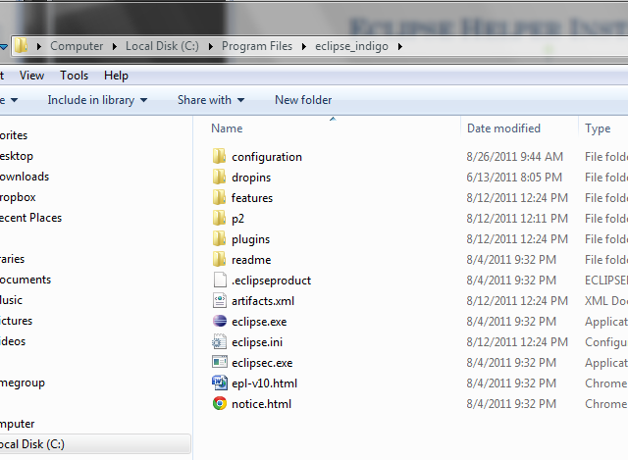
Eclipse Helper Installation
From the course website download the file named Eclipse Helper
Go to the folder you opened earlier called “eclipse”

Slide 32
Eclipse Helper Installation
Open the plugins folder

Slide 33
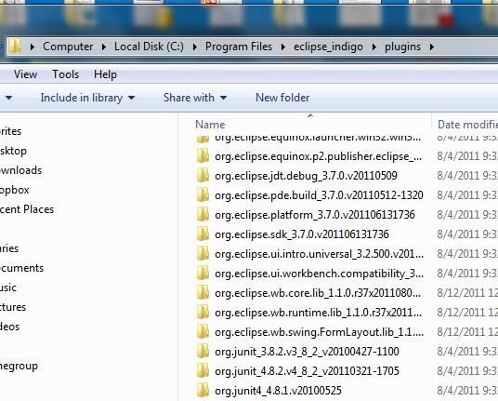
Eclipse Helper Installation
Plugin Folder should look like this

Slide 34
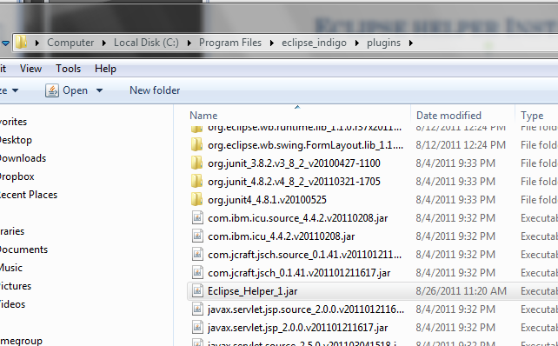
Eclipse helper Installation
Drag the file named Eclipse_Helper_1.jar into the plugin folder

Slide 35
Windows Users – Starting Eclipse
Double click on the eclipse icon on your desktop

Slide 36
Mac Users – Starting Eclipse
Open your “Applications” folder
Open the “eclipse” folder
Double-click on eclipse.exe

Slide 37
Setting up the Eclipse Workspace
From this point on, the instructions are the same for Windows and Mac users

Slide 38
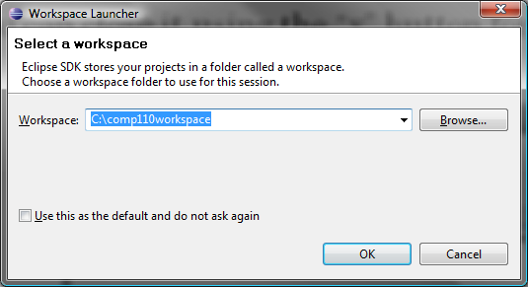
Setting up the Eclipse Workspace
When you first start Eclipse, you may see the Workspace launcher screen
  If you do, click OK
    Do not work what the workspace location is right now

Slide 39
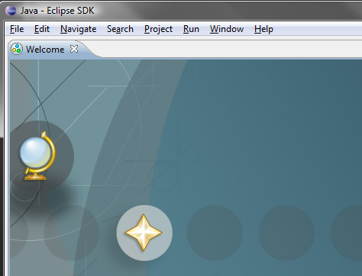
Setting up the Eclipse Workspace
When you first start Eclipse, you may see the Startup tab
  If you do, you can close it using the “x” button for the tab

Slide 40
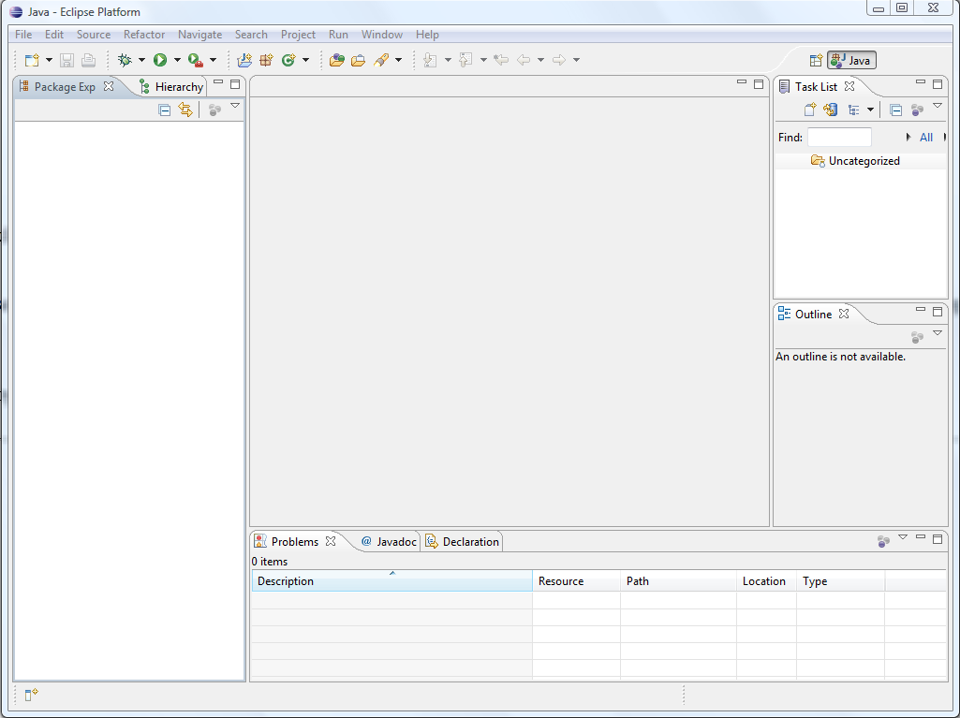
Setting up the Eclipse Workspace
You should now see something like this

Slide 41
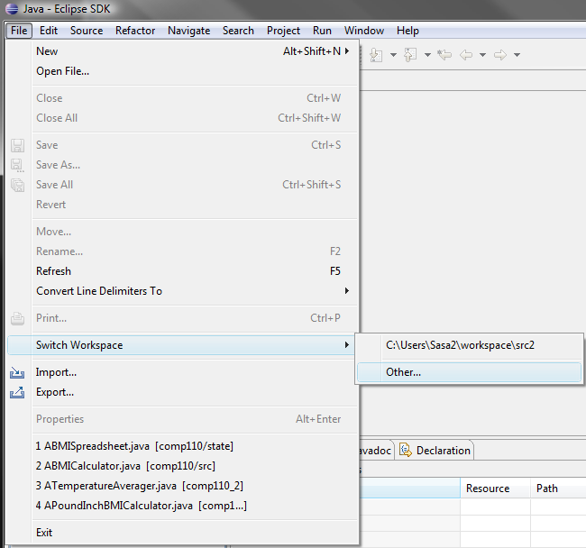
Setting up the Eclipse Workspace
Click on “File” then “Switch Workspace” then “Other”

Slide 42
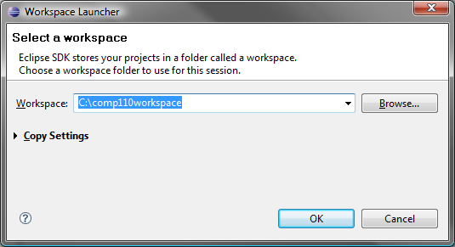
Setting up the Eclipse Workspace
Using the browse button, browse to the “comp110workspace” folder you created earlier
  Click OK once you select the “comp110workspace” folder
  You will see something like this
    For Mac users, the highlighted text will be a little different, but must also end with “comp110workspace”
Click OK

Slide 43
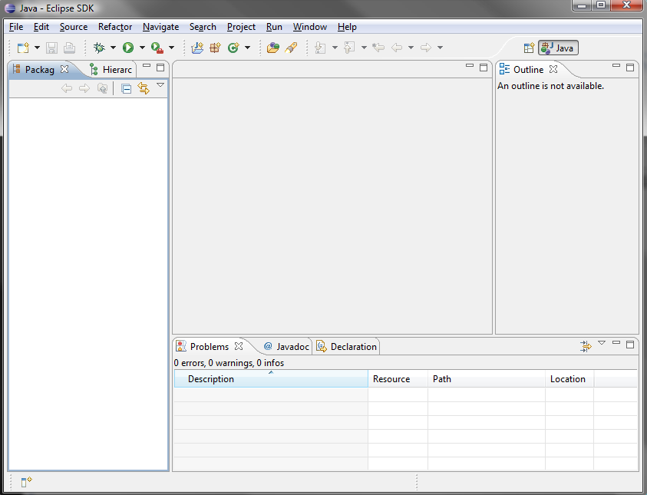
Setting up the Eclipse Workspace
Eclipse will restart
If you get the welcome screen again, close it as before
Then you should see something like this

Slide 44
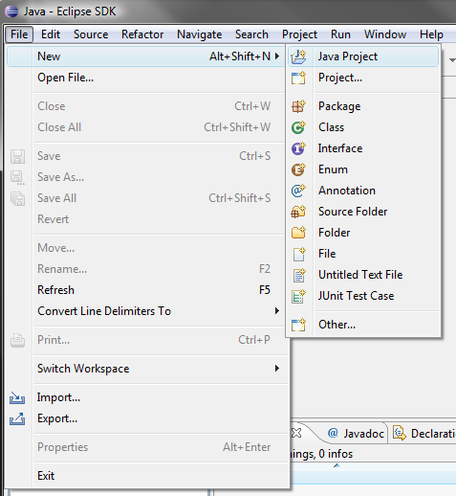
Setting up the Comp110 Project
Create a new Java Project by clicking on “File” then “New” and then “Java Project”

Slide 45
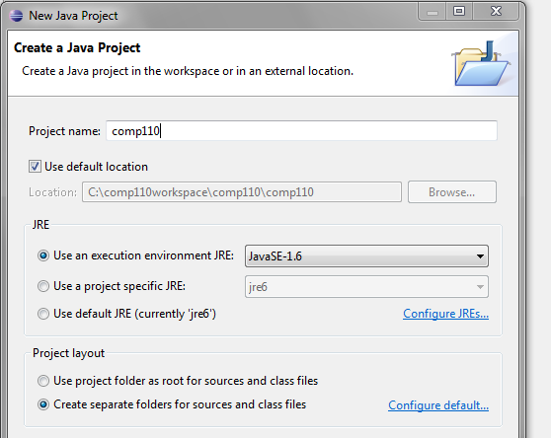
Setting up the Comp110 Project
Enter the project name as “comp110”
  You should see something like this
Click Next at the bottom of the window

Slide 46
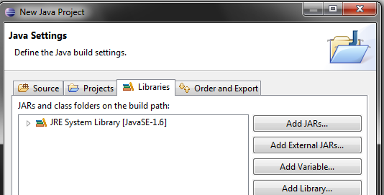
Setting up the Comp110 Project
Click on “Libraries”
  You should see something like this
  In particular JRE System Library should be in the list
Click on “Add External JARs…”

Slide 47
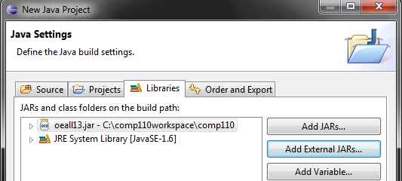
Setting up the Comp110 Project
Browse to the “comp110” folder you created in the “comp110workspace” folder
Double-click on oeall13.jar
You should see something like this
  oeall13.jar should be in the list
Click on Finish at the bottom of the window

Slide 48
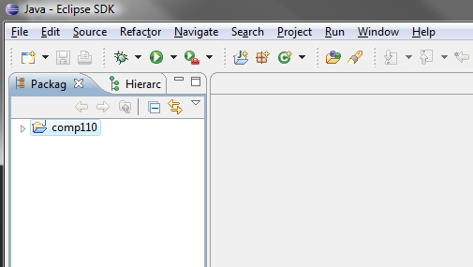
Setting up the Comp110 Project
You should see something like this

Slide 49
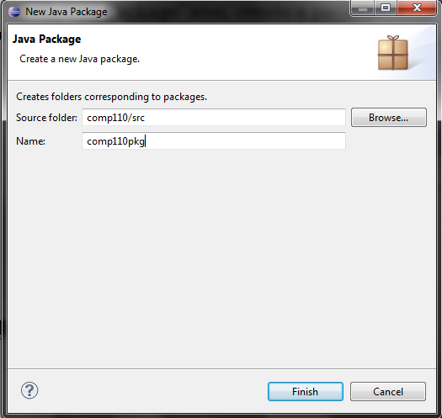
Create A JAVA Package
On the tool bar, select “File->New->Package” or click the “New Java Package” icon, create a package called comp110pkg

Slide 50
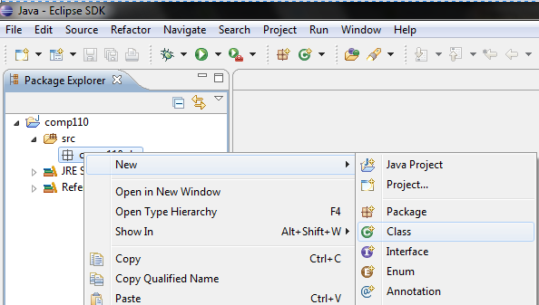
Adding a New Class
Right-click on “comp110pkg” then “New” and then “Class”

Slide 51
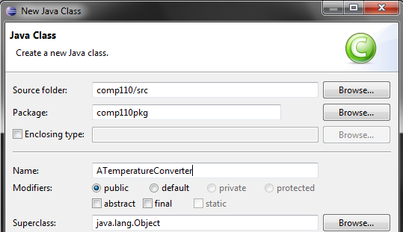
Adding a New Class
Call the class “ATemperatureConverter”
  Do not change any other settings or enter other information
Click Finish at the bottom of the window
Notes:
Why “A” initial?

Slide 52
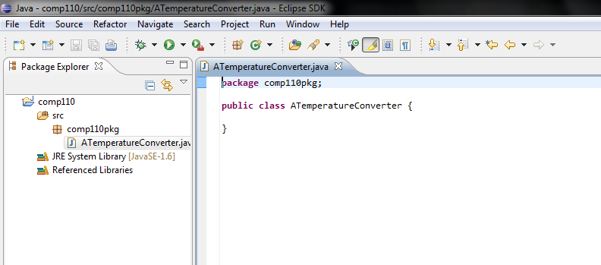
Adding a New Class
You should see something like this
Eclipse has already made the class header for you
You can now write the class body in the edit window

Slide 53
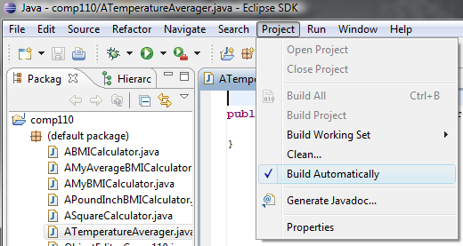
Compiling in Eclipse
By default, Eclipse auto-compiles for you so you never have to
To turn auto-compile on or off, click on “Project” and then check or uncheck the “Build Automatically” option
  If it is checked, then auto-compile is on

Slide 54
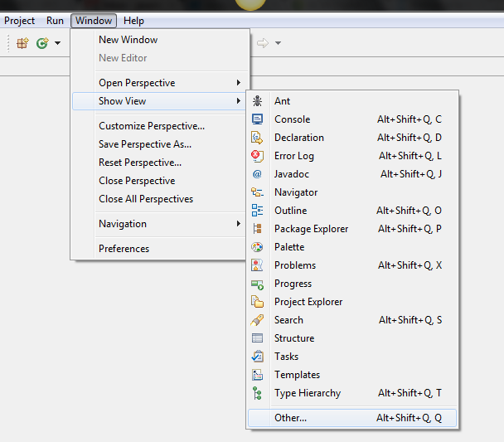
Eclipse helper – One Time Setup
To start Eclipse Helper, Click on the “Window” Menu
Go to Show View
Click Other

Slide 55
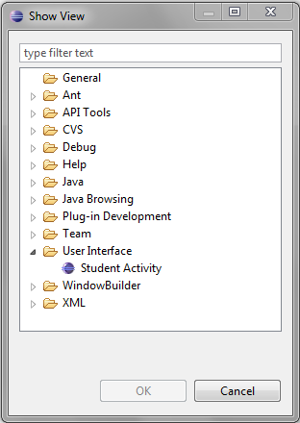
Eclipse helper – One Time Setup
A “Show View” window should pop up
Open the User Interface Folder
Double Click Student Activity

Slide 56
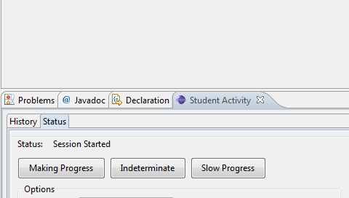
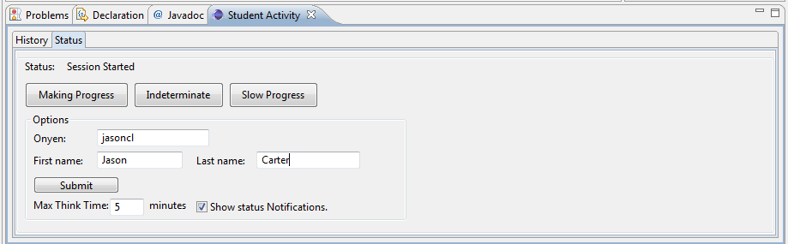
Eclipse Helper – One Time Setup
The Student Activity View should appear at the bottom of Eclipse
Click here and drag the window up until you see this view

Slide 57
Eclipse Helper
Enter your:
  onyen
  First name
  Last name
Press Submit
Should see a message that says “Information sent successfully"

Slide 58
Submitting An Assignment
http://cs.unc.edu/~carterjl/teaching.html

Slide 59
Eclipse and You
You have successfully setup Eclipse for all the programming we will do in our course
Feel free to explore Eclipse and use it for your assignments from now on
If you have any questions or problems about Eclipse, feel free to ask me

Slide 60
EXTRA Slides

Slide 61
Problems and Solutions

Slide 62

Possible Compile Errors
If you get the following error message
  ‘javac’ is not recognized …
Verify that the following folder exists
  C:\Program Files\java\jdk1.6.0_02\bin
  You can use Windows Explorer to see if it exists
If it does not exist, you must follow the steps for installing Java
If it exists, then you must follow the steps for setting up the environment

Slide 63
Possible Starting Errors
If you get the following error message:
  You must repeat the steps for Compiling Your First Java Program

Slide 64
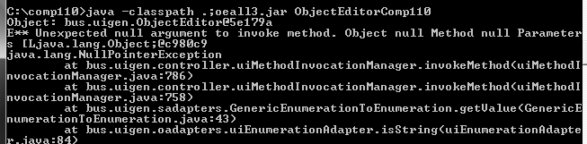
Possible Starting Errors
If you get something similar to the following
  You need to re-download the ObjectEditor from the course webpage
    Make sure you download it to the “c:\comp110” directory
    You can overwrite the one already in the directory

Slide 65
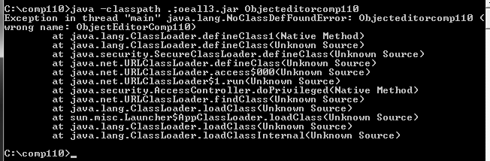
Possible Starting Errors
If you get the following
  Check the spelling of the command
  Make sure you have the correct case. Here, Objecteditorcomp110 should be ObjectEditorComp110

Slide 66
Possible Starting Errors
If you an error stating something about not being able to open a zip file, then please download oeall3.jar again
  You can overwrite the one you already have

