Slide 1
Degree-driven algorithm design for computing the Voronoi diagram
David L. Millman
Jack Snoeyink
University of North Carolina - Chapel Hill
FWCG08
Oct 31, 2008

Slide 2
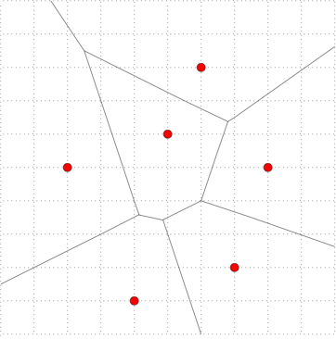
Voronoi diagrams

Slide 3
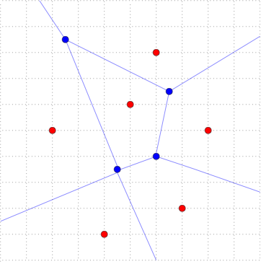
Voronoi diagrams
Implicit Voronoi
Diagram [LPT97]

Slide 4
Implicit Voronoi Diagram [LPT97]
Topological component
  Planar embedding
Geometric Component
  Each vertex (v_{x},v_{y}) of Voronoi diagram of S

Slide 5
Basic Problem
Given:
sites S ={s₁,s₂,…,s_{n}} w/ b-bit integer coords
Construct:
implied Voronoi V*(S) with minimum precision.
Note: precision < 5b bits precludes computing the Voronoi Diagram…

Slide 6
Previous Work
Handling the precision requirements of geometric computation:
Rely on machine precision
Exact Geometric Computation [Y97]
Arithmetic Filters [FV93][DP99]
Adaptive Predicates [P92][S97]
Topological Consistency [SI92]
Degree-driven algorithmic design [LPT97]
Notes:
Fortune and VanWyk… Filters
Priest thesis for predicates

Slide 7
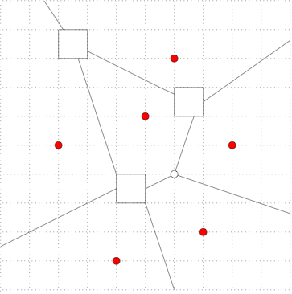
Cell Graph
Non-Grid Cell
Vertex
Cell Vertex
Cell Edge
Grid Cell Vertex

Slide 8
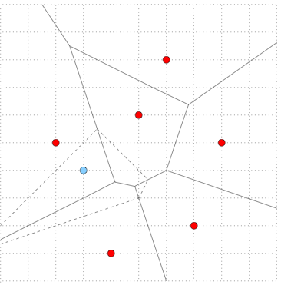
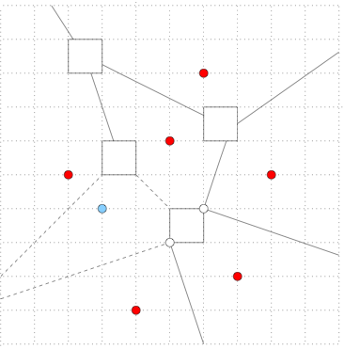
Randomized Incramental [SI92]

Slide 9
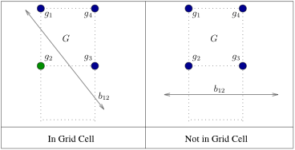
bisectorInCell
Given:
Two sites s₁, s₂, and a grid cell G
Decide:
Whether b₁₂ passes through G

Slide 10
Arithmetic Degree
Arithmetic degree
  monomial, sum of the arithmetic degree of its variables
  polynomial, largest arithmetic degree of its monomials
Notes:
Using Liotta, Preperata and Tamassia’s def…

Slide 11
bisectorInCell
Given:
Two sites s₁, s₂, and a grid cell G
Decide:
Whether b₁₂ passes through G
Degree 2 and constant time

Slide 12

stabbingOrdering
Given:
Two bisectors b₁₂ & b₃₄ that stab a grid cell G
Determine:
The order in which the bisectors intersect the cell walls
Degree 3 and constant time

Slide 13
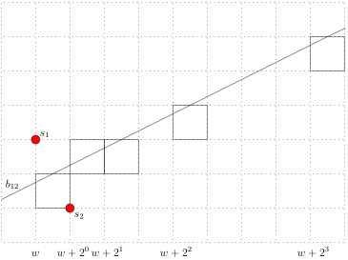
bisectorWalk
Given:
Two sites s₁, s₂ and a direction to walk
bisectorWalk:
a traversal of a subset of the cells that b₁₂ passes though.
Degree 2 and log(g)

Slide 14
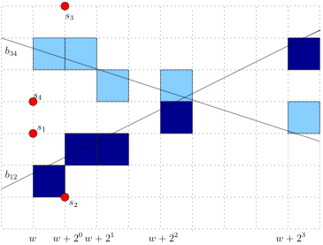
bisectorIntersection
Given:
Four sites s_{i}, i={1,2,3,4}
Find:
The grid cell that contains the intersection of bisectors b₁₂ & b₃₄
Degree 3 and log(g)

Slide 15
Results
Method for computing the implicit Voronoi diagram using predicates of max degree 3.
Running time is in O(n (log n + log g)), where g is the max bisector length.
First construction of the implicit Voronoi
w/o computing the full Voronoi diagram.

Slide 16
Future Work
Can we do this in degree 2?
Generalizing to other diagrams
Diagrams with non-linear bisectors
Identify the grid cell containing a bisector intersection in constant time

Slide 17
Happy Halloween
Thank you!

