Slide 1
Types of Interactors
Prasun Dewan
Department of Computer Science
University of North Carolina at Chapel Hill
dewan@cs.unc.edu
Code available at: https://github.com/pdewan/ColabTeaching

Slide 2
Pre-Requisites
Model-Interactor Separation

Slide 3
Interactor Types
Interactor
Types of interactors?
UI Code
Computation Code
Model

Slide 4
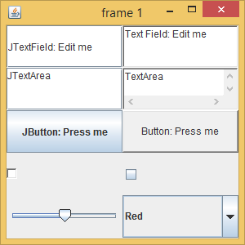
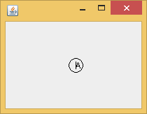
Types of Interactors
Console-based UI
GUI
Graphics
Three levels of abstraction

Slide 5
Abstraction Layers
Console-based Interactor
Toolkit-based (GUI) Interactor
Window-based (Graphics) Interactor
Console Text Component
Widgets (Text Component, Button, Slider)
Windows
Flexibility vs. Automation Tradeoff in Abstraction Design

Slide 6
Abstraction Layers (Review)
Console-based Inetractor
Toolkit-based (GUI) Interactor
Window-based (Graphics) Interactor
Console Text Component
Widgets (Text Component, Button, Slider)
Windows
Flexibility vs. Automation Tradeoff in Abstraction Design

Slide 7
Relationship between Interactor and Different kinds of Objects
Interactor/Editor/View
Helper UI-Specific Objects
Helper objects can be at varying levels of abstraction
Model

Slide 8
Windows
Window Client
Window are untyped rectangular screen areas in which each point is a pixel
‘a’ ^, w1, x, y
Input indicates keyboard and/or mouse operations
Output draws text, shapes
draw ‘a’, w1, x, y
Window System
user presses ‘a’
draws ‘a’ at cursor position
User

Slide 9
Example
Draws the last character entered at the last position at which the mouse was clicked
Draws a carat next to the character and a circle around it

Slide 10
Using Java Window to Define a Widget
public class ACircledCharacterDrawer extends JFrame implements MouseListener, KeyListener {
…
// called when an enqueued paint event for this component is dequeued
public void paint (Graphics g) {
super.paint(g); // clears the window
// better to use FontMetrics to center circle
g.drawOval(charX - X_OFFSET, charY - Y_OFFSET, DIAMETER, DIAMETER);
g.drawLine(charX, charY, charX, charY - CARAT_LENGTH);
g.drawString("" + lastChar, charX, charY);
}
public void keyTyped(KeyEvent event) {
setChar(event.getKeyChar());
}
public void setChar(char newValue) {
lastChar = newValue;
repaint();// enqueues a paint event
}
public void mousePressed(MouseEvent event) {
charX = event.getX();
charY = event.getY();
repaint(); // enqueues a paint event
}
Widget = Window + reusable functionality
Window
Output painter
Input notification method
Reusable functionality
In Java >= 1.1 input is provided through the observer pattern
This subclass of a window is listening to its own window events (registration methods in constructor not shown)
Notification method called by a lower-level abstraction == callback

Slide 11
Widgets and Toolkit
Widget Client
Widgets are typed windows
textEntered()
Input callbacks are widget specific (e.g. slider moved, text changed, text inserted)
getText()
Output and other calls are widget specific (change text or slider position)
setText()
Widget
Toolkit = Set of all Widgets
e.g. AWT, Swing
User enter a line of text
Updates text
User

Slide 12
Widget Use Example
JTextField jTextField = new JTextField("JTextField: Edit me");
AJTextFieldListener jTextFieldListener = new AJTextFieldListener(jTextField);
jTextField.addActionListener(jTextFieldListener);
jTextField.getDocument().addDocumentListener(jTextFieldListener);
Widget creation and observer registration
public class AJTextFieldListener implements ActionListener, DocumentListener{
JTextField jTextField;
public AJTextFieldListener(JTextField aJTextField) {
jTextField = aJTextField;
}
public void actionPerformed(ActionEvent e) {
System.out.println("New text entered:" + jTextField.getText());
}
public void insertUpdate(DocumentEvent e) {
int newPos = e.getOffset();
char newChar = jTextField.getText().charAt(newPos);
System.out.println("Character " + newChar + " inserted at " + newPos);
}
…
Notification of new line entered
Notification of new character insertion

Slide 13
Atomic vs Composite Widgets/Windows
Atomic component of a widget/window tree
Atomic window (JFrame)
Root component is top-special level window (Frame or JFrame)
JFrame
Top-level window manipulated by (customizable) window manager which puts border and provides operations to move, resize, iconify it
JTextField

Slide 14
Creating, Laying-out and Displaying a Hierarchy
Parent node
(Sub)tree layout
JFrame frame = new JFrame(theTitle);
frame.setLayout(new GridLayout(5, 2));
JTextField jTextField = new JTextField("JTextField: Edit me");
…
frame.add(jTextField);
…
frame.setSize(300, 300);
frame.setVisible(true);
…
Child node
Link creation
Display Tree
Here child created independent of parent and can be re-parented
In some systems a child is created as part of a parent: parent specified when child created

Slide 15
Different kinds of (Predefined) Helper UI Abstractions
Interactor
System.out, System.in
Interactor parses input unparses output
Interactor
Widget Hierarchies
Interactor creates widget hierarchies, defines widget callbacks and invokes widget calls
Interactor
Window Hierarchies
Interactor creates windows hierarchies, processes mouse and key events, and draws shapes
Additional programmer-defined objects can and should be defined (e.g. different classes of widget listeners)

Slide 16
Interactor-UI Abstraction Decoupling
Interactor
System.out, System.in
Interactor’
Interactor
Widget Hierarchies
Interactor
Interactor
Window Hierarchies
Interactor
An interactor can be bound to different kinds of UI abstractions
A UI abstraction can be bound to different kinds of interactors

Slide 17
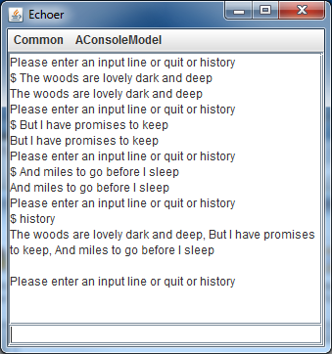
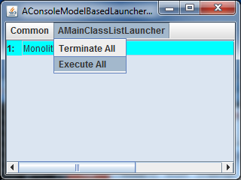
Separation in Console-based UIs
Interactor
System.out, System.in
Interactor’
Eclipse Interactor
Custom interactor for launching multiple processes

Slide 18
Interactors can be Structured
Interactor
Interactor
Interactor
When user interfaces are composed
Sub-interactors can interact directly with models or through parent interactors

Slide 19
Summary of Concepts in Interactors
Window, Widget, and Console Layers
Calls (callbacks) invoked by higher (lower) layer on lower (higher) layer
Window: Rectangular Area
Input (callbacks): Key, Mouse Events
Output (calls) : shape draw calls (drawLine, …)
Widget: Window embellished with higher-level behavior
Input (calls): arbitrary (e.g. new text changed)
Output (callbacks): arbitrary (e.g. change text)
Console: a text widget used to enter and display text lines
Window/Widget Hierarchies:
Trees associated with layouts
Usually made visible after they have been created
An interactor uses one of more of the UI abstractions above as helper objects
Interactor and the UI abstraction objects are decoupled
System.in, System.out used in different kinds of interactors

Slide 20
Model/Interactor Pattern
Interactor
Types of interactors?
UI Code
✓
Computation Code
Model
Types of models?

