Slide 1
Replicated vs. Centralized Model Sharing
Prasun Dewan
Department of Computer Science
University of North Carolina at Chapel Hill
dewan@cs.unc.edu
Code available at: https://github.com/pdewan/ColabTeaching

Slide 2
Next
How to implement model-based sharing?
How do build higher level abstractions for model-based sharing?

Slide 3
Echoer to IM
More than one architecture to implement this user interface

Slide 4
Single-user Architecture
Interactor
Model

Slide 5
Collaborative Architectures: Centralized vs Replicated
Interactor
Interactor
Interactor
Model
Model
Model
Interactor
What are these architectures, what are their pros and cons?

Slide 6
Replicated
Interactor
Interactor
Model
Model

Slide 7
Single-User vs Replicated Algorithm: Running Example
UI Thread
For each input I
I should be followed by matching ListEditInput, ListEditMade, ListEditNotified, ListEditObserved, ListEditDisplayed
For each replica, I should be followed by matching ListEditSent to Others
Receiving Thread
For each ListEditReceived R
R should be followed by matching ListEditMade, ListEditNotified, ListEditObserved, ListEditDisplayed
For each replica, R should be followed by matching ListEditSent

Slide 8
General Model-Interactor Pattern: from ListEdit ops to Edit Ops
UI Thread
For each input I
I should be followed by matching EditInput, EditMade, EditNotified, EditObserved, EditDisplayed
For each replica, I should be followed by matching EditSent to Others
Receiving Thread
For each EditReceived R
R should be followed by matching EditMade, EditNotified, EditObserved, EditDisplayed
For each replica, R should be followed by matching EditSent

Slide 9
Single-user vs Replicated (Cycles)
History
elementAdded
observableAdd
input
EchoerInteractor
toOthers
Replicated
History
toOthers
Communicator
observableAdd
observableAdd
objectReceived
input
IMInteractor
IMCoupler

Slide 10
Single-user vs Replicated: Replicated and Non Replicated Write Methods
Each write method has a single-user and replicated version
History
elementAdded
observableAdd
Both notify observers
EchoerInteractor
Local input triggers replicated version
Remote input triggers single-user version
Replicated
History
toOthers
Communicator
replicatedAdd
observableAdd
objectReceived
input
IMInteractor
IMCoupler
Multiple write methods setP(), replicatedSetP()

Slide 11
Single-user vs Replicated: Can Detect if Incoming Event has Been Processed before
Notification has information about old state of changed object
History
elementAdded
observableAdd
Can determine if this object is at old state or new state
EchoerInteractor
Write method not called if object is at new state
toOthers
Replicated
History
toOthers
Communicator
observableAdd
observableAdd
objectReceived
objectReceived
input
IMInteractor
IMCoupler

Slide 12
Models vs. Notifications
Received message contains new property value
Beans
Property collections
Differ in properties
Lists
Variable length indexed lists
Differ based on subsets of list operations exposed
Table model is another important kind not needed in this course
Assuming no side effects
If new property value same as current property value, do not call write method
Received message can contain new size
If object is of new size, do not call write method
Received message contains new key value
If new key value same as old, do not call write method

Slide 13
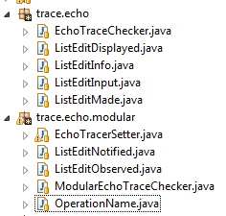
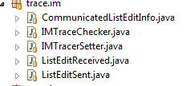
Single-User vs. Multi-User Steps

Slide 14
General Model-Interactor Pattern: from ListEdit ops to Edit Ops
UI Thread
For each input I
I should be followed by matching EditInput, EditMade, EditNotified, EditObserved, EditDisplayed
For each replica, I should be followed by matching EditSent to Others
Receiving Thread
For each EditReceived R
R should be followed by matching EditMade, EditNotified, EditObserved, EditDisplayed

Slide 15
Replicated Model: Issues
Interactor
Interactor
Model
Model
Consistency issues of causality and concurrent operations (to be addressed later)

Slide 16
Replicated Architecture (Review)
Interactor
Interactor
Model
Model
Multiple physical models represent a single logical model

Slide 17
Replicated Model-Interactor Algorithm
UI Thread
For each input I
I should be followed by matching EditInput, EditMade, EditNotified, EditObserved, EditDisplayed
For each replica, I should be followed by matching EditSent
Receiving Thread
For each EditReceived R
R should be followed by matching EditMade, EditNotified, EditObserved, EditDisplayed
Problems?

Slide 18
Replication Guarantee
UI Thread
For each input I
I should be followed by matching EditInput, EditMade, EditNotified, EditObserved, EditDisplayed
For each replica, I should be followed by matching EditSent
Receiving Thread
For each EditReceived R
R should be followed by matching EditMade, EditNotified, EditObserved, EditDisplayed
Each model executes the same set of operations
Not the same sequence!
Consistency issues of causality and concurrent operations (to be addressed later)

Slide 19
Assume Stronger Guarantee
UI Thread
For each input I
I should be followed by matching EditInput, EditMade, EditNotified, EditObserved, EditDisplayed
For each replica, I should be followed by matching EditSent
Receiving Thread
For each EditReceived R
R should be followed by matching EditMade, EditNotified, EditObserved, EditDisplayed
Assume that each model executes the same sequence of operations
Performance issues?
Correctness issues?

Slide 20
Performance
Input n
Interactor
Interactor
Inefficient replicated computations!
Model
Model
Computation vs. communication costs
Find prime factors
Find prime factors

Slide 21
Reading a Centralized External Resource
Input load
Interactor
Interactor
Bottleneck!
Model
Model
read f
read f
a
File f

Slide 22
Problems
UI Thread
For each input I
I should be followed by matching EditInput, EditMade, EditNotified, EditObserved, EditDisplayed
For each replica, I should be followed by matching EditSent
Receiving Thread
For each EditReceived R
R should be followed by matching EditMade, EditNotified, EditObserved, EditDisplayed
Assume that each model executes the same sequence of operations
Multiple computations and bottlenecks
Correctness issues?

Slide 23
Problems
Is executing the same operation multiple times equivalent to executing the operation a single time?

Slide 24
Reading a Centralized External Resource
Interactor
Interactor
Model
Model
read f
read f
a
File f
Change read to write?

Slide 25
Writing to a Centralized External Resource
Each replica writes to the file!
Input b
Interactor
Interactor
Behavior of centralized and replicated different
Write is not idempotent
Model
Model
Executing idempotent operations once is the same as executing them multiple times, operation is a function of only its arguments
write f, b
write f, b
abb
ab
File f
a
Assumption:
Only idempotent operations

Slide 26
Replicate External Resources
Input a
Interactor
Interactor
Model
Model
write f, a
write f, a
ab
ab
Other examples of idempotent operations in practice?

Slide 27
Sending Mail Together
Mail msg
Interactor
Interactor
Model
Model
Assumption:
Only idempotent operations
mail msg
mail msg
Mail Server
Do not always have the option of replicating resources

Slide 28
Replicated Model: Issues
Interactor
Interactor
Model
Model
Consistency issues of causality and concurrent operations (to be addressed later)
Correctness and performance issues when model is non deterministic, accesses central resources, and has side effects

Slide 29
Replicated vs Centralized
Interactor
Interactor
Interactor
Model
Model
Model
✓
Interactor

Slide 30
Centralized Session Member Types
Interactor
Slave
Model
Master
Interactor
Slave

Slide 31
Single-User vs Centralzed Algorithm: Running Example
Slave UI Thread
For each input I
I should be followed by matching ListEditInput and ListEditSent to Master
I should be followed by matching ListEditInput, ListEditMade, ListEditNotified, ListEditObserved, ListEditDisplayed
Master Receiving Thread
For each ListEditReceived R
R should be followed by matching ListEditMade, ListEditSent to Others
Slave Receiving Thread
For each ListEditReceived R
R should be followed by matching ListEditDisplayed

Slide 32
Centralized Architecture
None of the replication issues
Interactor
Feedback times involve round trip delays
Model
Feed through incurs extra hop (beyond relaying)
Refresh and query operations also involve round trip delays (e.g. searching history)
Interactor
Can we fix the last problem?
Caching!

Slide 33
Caching vs. Replica
Model cache is data repository without side effects
Interactor
Model Cache
Updated in response to distributed messages from real central model
Model
No divergence of caches, real model has the real state
Like real model it fires events to local observers
Write operations require round trip
Read operations access local data

Slide 34
Distribution/Collaboration Awareness in Classes
Interactor
Model Cache
Each interactor is distribution and collaboration aware: it sends messages to central model
Model
As is model cache, it receives messages form central model

Slide 35
Distribution Unaware Interactor With Model Cache/Proxy
Model cache is a proxy that forwards interactor operation without changing is data
Interactor
Model Cache
Less distribution awareness and more automation
Model
Model cache is still distribution aware, both sending and receiving messages
Some distribution awareness is necessary in application if we use general purpose group communication layer

Slide 36
Example Centralized Algorithm (No Caching)
Slave UI Thread
For each input I
I should be followed by matching ListEditInput and ListEditSent to Master
Master Receiving Thread
For each ListEditReceived R
R should be followed by matching ListEditMade, ListEditSent to Others
Slave Receiving Thread
For each ListEditReceived R
R should be followed by matching ListEditDisplayed

Slide 37
Example Centralized Algorithm (Caching)
Slave UI Thread
For each input I
I should be followed by matching ListEditInput, ListEditForwarded to Slave Proxy and ListEditSent to Master via Slave
Master Receiving Thread
For each ListEditReceived R
R should be followed by matching ListEditMade, ListEditSent to Others
Slave Receiving Thread
For each ListEditReceived R
R should be followed by matching ListEditMade, ListEditNotified in Slave and ListEditDisplayed

Slide 38
General Centralized Algorithm: ListEdit → EDIT
Slave UI Thread
For each input I
I should be followed by matching EditInput, EditForwarded and EditSent to Master via Slave
Master Receiving Thread
For each EditReceived R
R should be followed by matching EditMade, EditSent to Others
Slave Receiving Thread
For each EditReceived R
R should be followed by matching EditMade, EditNotified in Slave and EditDisplayed

Slide 39
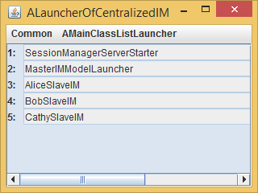
Centralized Architecture

Slide 40
Caching with GroupMessages
History
Master puts name of original sender in marshalled edit operation used my slave coupler to compose new element value
elementAdded
observableAdd
input
EchoerInteractor
Master History
toOthers
Communicator
Source is master rather than peer
centralizedAdd
objectReceived
MasterCoupler
toClient
Slave History
Communicator
observableAdd
proxyAdd
objectReceived
input
SlaveInteractor
SlaveCoupler

Slide 41
Replicated Add: Simple Marshalling
public synchronized void replicatedAdd(ElementType anElement) {
int anIndex = size();
super.observableAdd(anIndex, anElement);
if (communicator == null) return;
ListEdit listEdit = new
AListEdit<ElementType>(OperationName.ADD,
anIndex, anElement, ApplicationTags.IM);
communicator.toOthers(listEdit);
}
toOthers(msg)
public interface ListEdit<ElementType> extends Serializable {
int getIndex();
void setIndex(int anIndex);
ElementType getElement();
void setElement(ElementType anElement);
…
}

Slide 42
Centralized Add: Aware Marshalling
public synchronized void centralizedAdd(ElementType anInput, String aClientName) {
int anIndex = size();
super.add(anIndex, anInput);
UserEdit<ElementType> userEdit = new
AUserEdit<ElementType>(OperationName.ADD, anIndex,
anInput, ApplicationTags.IM, aClientName);
communicator.toOthers(userEdit);
}
public interface UserEdit<ElementType> extends ListEdit<ElementType>{
public String getUserName();
public void setUserName(String userName) ;
}

Slide 43
Motivating Unicast in Multicast Layer
whisper playername = your whisper here ... so only the player(s) named, and in the room, can hear your whisper.
toClient(client, msg)
public class ASlaveSimpleList<ElementType>
extends ASimpleList<ElementType>
implements SlaveSimpleList<ElementType> {
…
public synchronized void proxyAdd(ElementType anElement) {
int anIndex = size();
ListEdit listEdit = new AListEdit<ElementType>
(OperationName.ADD, anIndex, anElement,
ApplicationTags.IM);
communicator.toClient(MasterIMModelLauncher.CLIENT_NAME,
listEdit);
}
}

Slide 44
Replicated Model
Interactor
Interactor
Model
Model
Consistency issues of causality and concurrent operations (to be addressed later)
Correctness and performance issues when model accesses central resources, is non deterministic, and has side effects

Slide 45
Centralized Model
Interactor
All updates routed through central model and local cache’s guaranteed to be consistent
Each operation executed only once, so no problems of non idempotent operations, central bottlenecks, and expensive operations
Model
Round trip delay to get local feedback
Interactor
Central bottleneck which may not always be available
Combine the advantages?
Causal multicast and OT for consistency
Multi operation execution?

Slide 46
Distinguished “Replica” Model
Interactor
Interactor
Model’
Model
A distinguished model executes operations that are expensive, non-idempotent, or access central resources

Slide 47
Distinguished “Replica” Model
Interactor
Interactor
Model
Model
Both solutions are application-specific
Model’
A central model executes operations that are expensive, non-idempotent, or access central resources

Slide 48
Application-Independent Architectures
Interactor
Interactor
Interactor
Model
Model
Model
Interactor
Can we automate these architectures?

Slide 49
General Replicated Algorithm
UI Thread
For each input I
I should be followed by matching EditInput, EditMade, EditNotified, EditObserved, EditDisplayed
For each replica, I should be followed by matching EditSent to Others
Receiving Thread
For each EditReceived R
R should be followed by matching EditMade, EditNotified, EditObserved, EditDisplayed
For each replica, R should be followed by matching EditSent

Slide 50
Automatic General Centralized Algorithm
Slave UI Thread
For each input I
I should be followed by matching EditInput, EditForwarded and EditSent to Master via Slave
Master Receiving Thread
For each EditReceived R
R should be followed by matching to Others
Slave Receiving Thread
For each EditReceived R
R should be followed by matching EditMade, EditNotified in Slave and EditDisplayed

Slide 51
Centralized and Replicated Model Sharing
Model Sharing
Group Communication (Multicast)
Interprocess Communication
(Sockets, RMI, ..)
Goal is to reduce/eliminate the collaboration awareness in application code
Can assume language/compiler support

Slide 52
Centralized and Replicated Model Sharing (Review)
Model Sharing
Group Communication (Multicast)
Interprocess Communication
(Sockets, RMI, ..)
Goal is to reduce/eliminate the collaboration awareness in application code
Can assume language/compiler support

Slide 53
Original Example

Slide 54
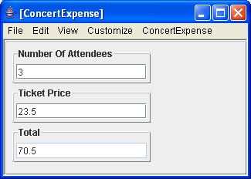
Another Example
public class AConcertExpense implements ConcertExpense {
float unitCost = 0;
int numberOfAttendees = 0;
public float getTicketPrice() { return unitCost; }
public void setTicketPrice(float newVal) {
unitCost = newVal;
}
public int getNumberOfAttendees() { return numberOfAttendees; }
public void setNumberOfAttendees(int newVal) {
numberOfAttendees = newVal;
}
public float getTotal() {
return unitCost*numberOfAttendees;
}
}

Slide 55
Automating General Replicated Algorithm
Interception of operations and proxy generation possible with language/compiler support
Somehow need to distinguish between edit and non edit model methods
UI Thread
For each input I
I should be followed by matching EditInput, EditMade, EditNotified, EditObserved, EditDisplayed
For each replica, I should be followed by matching EditSent to Others
Operations to be automated
Receiving Thread
For each EditReceived R
R should be followed by matching EditMade, EditNotified, EditObserved, EditDisplayed
For each replica, R should be followed by matching EditSent

Slide 56
Automatic General Centralized Algorithm
Proxy generation possible with language/compiler support
Somehow need to distinguish between edit and non edit model methods
Slave UI Thread
For each input I
I should be followed by matching EditInput, EditForwarded and EditSent to Master via Slave
Master Receiving Thread
Operations to be automated
For each EditReceived R
R should be followed by matching to Others
Slave Receiving Thread
For each EditReceived R
R should be followed by matching EditMade, EditNotified in Slave and EditDisplayed

Slide 57
Write vs Non Write Methods
Replica
float getTicketPrice ()
void setTicketPrice (float)
Collaboration-aware Proxies
Need a way to select methods that are broadcast.
Collaboration-aware Proxies
Replica
float getTicketPrice ()
void setTicketPrice (float)

Slide 58
Programmer-Specified Broadcast Methods
Replica (Model or Interactor)
float getTicketPrice ()
void broadcast setTicketPrice (float)
Collaboration-aware Proxies
Cycles within the same method stopped by Colab
Collaboration-aware Proxies
Replica (Model or Interactor)
float getTicketPrice ()
void broadcast setTicketPrice (float)
Stefik, M., G. Foster, D.G. Bobrow, K. Kahn, S. Lanning, and L. Suchman (January 1987), Beyond the Chalkboard: Computer Support for Collaboration and Problem Solving in Meetings. CACM, January 1987. 30(1): p. 32-47.

Slide 59
Potential for Spurious Broadcasts
Replica
void broadcast notify ()
void broadcast setTicketPrice (float)
Collaboration-aware Language Runtime
Must carefully choose which methods are broadcast
Collaboration-aware Language Runtime
Replica
void broadcast notify ()
void broadcast setTicketPrice (float)

Slide 60
Broadcast Method in Interactor
Interactor
void broadcast textChanged (evt)
Can broadcast methods in any object, not just model.
In Xerox Colab applications, interactor methods were broadcast

Slide 61
Multi-Layer Broadcast Increase Spurious Broadcast Problem
Interactor
void broadcast textChanged (evt)
Model
void broadcast setTicketPrice(float)
Must consider all calls to a method before making it broadcast.
Another solution to select methods to broadcast?

Slide 62
Model-based Solution
Somehow need to distinguish between edit and non edit model methods
In general an object is a blackbox and we do not know its write methods without explicit programmer specification

Slide 63
Restrict Model Types
Lists
Variable length indexed lists
Differ based on subsets of list operations exposed
Beans
Property collections
Differ in properties
Table model
Key, Value Collections
Can provide replicated lists and tables
Beans? Programmer-defined lists and tables
Works for a very restricted set of model types
Munson, J. and P. Dewan (1997), Sync: A Java Framework for Mobile Collaborative Applications. IEEE Computer, 1997. 30(6): p. 59-66..

Slide 64
Bean Pattern/Conventions
Typed, Named Unit of Exported Object State
public class C
{
Name P
Type T
Bean
public T getP() {
...
}
Read-only
Editable
public void setP(T newValue) {
...
}
Getter method
Setter method
Bean convention:
For humans and tools
}
obtainP
Violates Bean convention
newP

Slide 65
Restrict Model Patterns
Lists
Variable length indexed lists
Differ based on subsets of list operations exposed
Beans
Property collections
Differ in properties
Table model
Key, Value Collections
Can assume certain programming conventions for l such as for getters and setters to extract write methods
Reflection, introspection and proxy generation can then be used to broadcast/forward write methods and generate proxies and replicas
Works for a theoretically restricted set of model types
http://www.cs.unc.edu/~dewan/sync/, https://github.com/pdewan/Sync

Slide 66
Issues
How to determine methods to be broadcast?
How to find corresponding replicas?

Slide 67
Connecting Replicas?
Replica
float getTicketPrice ()
void setTicketPrice (float)
Collaboration-aware Proxies
Assume model classes are singletons.
Assume replica programs instantiate the same sequence of objects.
How are corresponding replicas found?
Collaboration-aware Proxies
Replicated shared window systems assumes same sequence of windows.
Replica
float getTicketPrice ()
Can use names of Java windows
void setTicketPrice (float)
Register and lookup of names

Slide 68
Connecting Replicas
Order of object instantiation
Names of objects
Works for AWT windows every window has a name
If two windows have the same name, assume they are the same
Explicit remote lookup and register
Central registry used to connect objects with names
A la session manager and RMI registry

Slide 69
Centralized: Connecting Proxies
Owner
Registry
Master
register()
m(…)
Proxy
lookup()
m(…)
m(…)
Proxy
User

Slide 70
Replicated: Connecting Replicas
Registry replica can be kept consistent and execute operations that need to be centralized (send mail, access file)
Owner
Sharing Server and Registry
Replica
register()
m(…)
Replica
lookup()
m(…)
m(…)
Replica/Proxy
User
If already registered, no-op to allow symmetric programs

Slide 71
RMI Registration
public class CounterServer {
public static void main (String[] args) {
try {
Registry rmiRegistry = LocateRegistry.getRegistry();
ConcertExpense concertExpense= new
AConcertExpense ();
UnicastRemoteObject.exportObject(concertExpense, 0);
rmiRegistry.rebind(ConcertExpense.class.getName(), counter);
);
} catch (Exception e) {
e.printStackTrace();
}
}
}

Slide 72
RMI Lookup
public class CounterClient {
public static void main (String[] args) {
try {
Registry rmiRegistry = LocateRegistry.getRegistry();
ConcertExpense concertExpense= (ConcertExpense )
rmiRegistry.lookup(ConcertExepnse.class.getName());
} catch (Exception e) {
e. printStackTrace();
}
RMI does not support centralized model sharing as it creates a pure proxy and not cache of model object and does not distinguish between read and write methods

Slide 73
Sync Symmetric Replica Program
package budget;
import bus.uigen.ObjectEditor;
import edu.unc.sync.Sync;
public class SyncBudgetSymmetric {
static String SERVER_NAME = "localhost/A";
static String MODEL_NAME = "demoBudget";
public static void main(String[] args) {
String[] syncArgs = {"--oe"};
Object model = Sync.replicateOrLookup(
SERVER_NAME,
MODEL_NAME,
AConcertExpense.class,
args[0],
syncArgs);
ObjectEditor.edit(model);
}
}
System instantiates if replicate

Slide 74
Server UI After Replicate

Slide 75
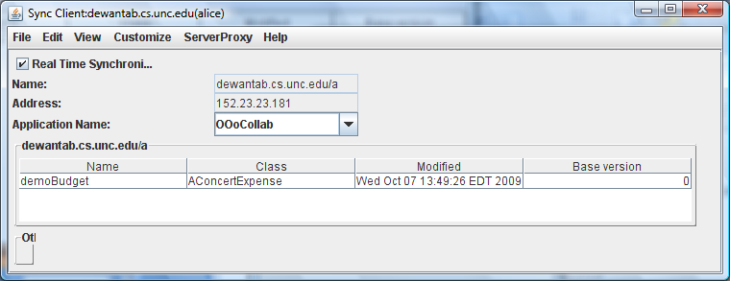
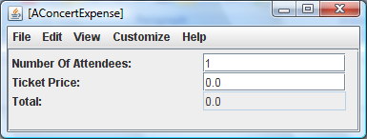
Alice UI After Replicate

Slide 76
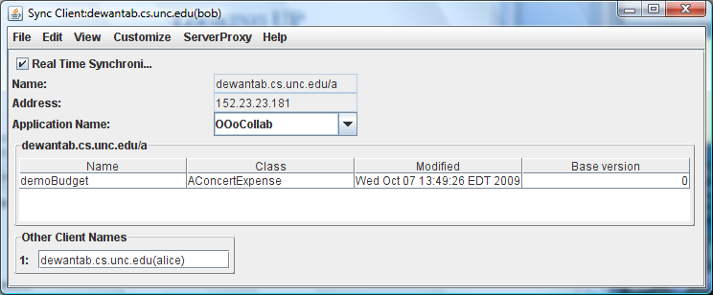
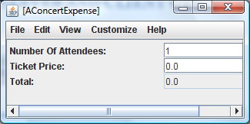
Bob UI After Bob’s Lookup

Slide 77
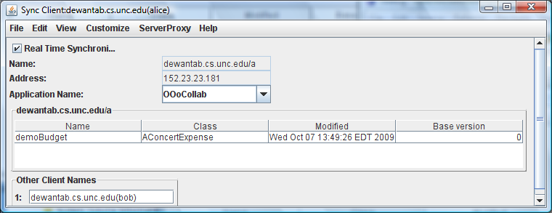
Alice UI After Bob’s Lookup

Slide 78
Issues
How to determine methods to be broadcast?
How to find corresponding replicas?
When should write methods be called on corresponding replicas?

Slide 79
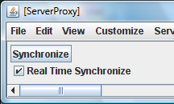
When to Synchronize
When both the sending and receiving application say synchronize
Sending site can say real-time synchronize to execute synchronize operation when a write method is executed at the sending site
Receiving site can say real-time synchronize to execute synchronize operation when a write method is received
Integrates synchronous and asynchronous (Dropbox, GoogleDrive, OneDrive) sharing

Slide 80
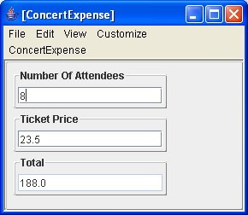
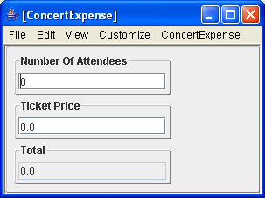
One Site Disconnected: It Syncs

Slide 81
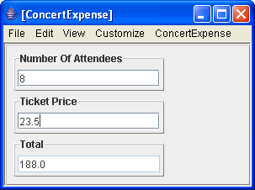
Receiver Immediately Updates

Slide 82
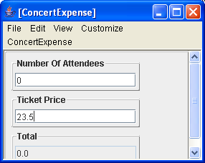
Both Sites Disconnected and Change

Slide 83
Top User Syncs

Slide 84
No Update in Bottom User

Slide 85
Bottom User Syncs

Slide 86
Bottom User Has Both Changes

Slide 87
Top User Syncs

Slide 88
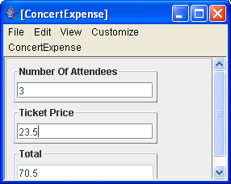
Both Users in Sync

Slide 89
Summary
Two ways to share a logical model among multiple users
Both involve local interactor at each user site
In replicated, symmetric models at each site
They service read and write methods for local interactors
Send updates to other models without necessarily waiting for them to be made.
Side effects can be executed multiple times and concurrent operations can lead to inconsistent
In centralized a centralized model at special (possibly user) site
Each site can cache the model for reads.
Writes wait until central model updates and are then cached at local site.
Cache stores only data and has no side effects
Indirection may require user-aware marshalling

Slide 90
Summary
Can automate model sharing
Identifying methods to be broadcast
Broadcast keyword or annotation
Cascaded broadcasts
Fixed types
No programmer-defined types such as beans
Using conventions or patterns for describing models
Restricted models
Tradeoff: Cycles vs. restricted models
Connecting corresponding objects
Sequence of objects instantiated
Singleton objects
Register/lookup
When to broadcast
In general on Explicit/Implicit Sync

Slide 91
Abstractions in Actual Implementation
Xerox Colab
Broadcast methods, immediate execution, implicit replica binding
Sync
Patterns and predefined shared string, record, sequence, explicit/implicit sync, register/lookup
LiveMeeting
Predefined shared int, string, real
Google Hangout
Single shared table
Stefik, M., G. Foster, D.G. Bobrow, K. Kahn, S. Lanning, and L. Suchman (January 1987), Beyond the Chalkboard: Computer Support for Collaboration and Problem Solving in Meetings. CACM, January 1987. 30(1): p. 32-47.
Munson, J. and P. Dewan (1997), Sync: A Java Framework for Mobile Collaborative Applications. IEEE Computer, 1997. 30(6): p. 59-66..
http://www.cs.unc.edu/~dewan/sync/, https://github.com/pdewan/Sync

Slide 92
Next
Model Sharing
Group Communication (Multicast)
Interprocess Communication
(Sockets, RMI, ..)
Non model sharing?

