Slide 1
IPC Design Space → GIPC
Instructor: Prasun Dewan (FB 150, dewan@unc.edu)

Slide 2
Design Space
Xinu
Pipes
Sockets
NIO
GIPC
Location
Intra-Proc
Intra-Host
Distributed
Distributed
Distributed
Reliable, In-Order?
Yes
Yes
Yes/No
Yes/No
Access?
Input
Free
Bound./Inp
Bound./Inp
Send block times
No
System Buf
System buf
SB/No
Explicit receive?
Yes
Yes
Yes
Yes
Rcv blck times?
Sync/No
Part Sync
Sync
Sync/No
Select?
No
No
No
Yes
Language?
No
No
No
No
No
Naming?
How can we improve distributed IPC without language support?
pid
filedescp
Host, Port#
Host, Port#
Reply?
No
No
No
No
Reply blck times?
N/A
N/A
N/A
N/A
Msg Unit
word
Byte
Byte
Byte
Buf size?
1 word

Slide 3
Goals
Customizable Implementation
Unlike RMI (should) run on Android
Informed by the IPC Design Space
How can we “improve” distributed IPC without language support?

Slide 4
Access
Xinu
Pipes
Sockets
NIO
GIPC
Location
Intra-Proc
Intra-Host
Distributed
Distributed
Distributed
Reliable, In-Order?
Yes
Yes
Yes/No
Yes/No
Access?
Input
Free
Bound./Inp
Bound./Inp
Inp/Session/Broadcast
Send block times
No
System Buf
System buf
SB/No
No input port abstraction allowing reliable data communication
Explicit receive?
Yes
Yes
Yes
Yes
Rcv blck times?
Sync/No
Must be simulated by multiple sockets and channels
Part Sync
Sync
Sync/No
Select?
No
No
No
No
Language?
No
No
No
No
No broadcast and session port
Naming?
pid
filedescp
Host, Port#
Host, Port#
Reply?
No
No
No
No
Reply blck times?
N/A
N/A
N/A
N/A
GIPC: Input, Broadcast, Sesssion Port, Simplex and Duplex, Cannot derive duplex ports from input port
Msg Unit
word
Byte
Byte
Byte
Buf size?
1 word

Slide 5
Two Dimensional Access
public enum PortKind {
CLIENT_INPUT_PORT,
SERVER_INPUT_PORT,
SESSION_PORT,
MULTI_SERVER_PORT
}
public enum PortAccessKind {
SIMPLEX,
DUPLEX,
GROUP
}
ByteBuffer message = …;
clientInputPort.send(message);
ByteBuffer message = …;
serverInputPort.send(message);
Any port in which the queue is kept with the receiver is called an input port

Slide 6
Message Kind and Unit
Xinu
Pipes
Sockets
NIO
GIPC
Location
Message unit?
Intra-Proc
Intra-Host
Distributed
Distributed
Reliable, In-Order?
Yes
Yes
Yes/No
Yes/No
Byte or Objects, and RPC hides both
Access?
Input
Free
Bound./Inp
Bound./Inp
Send block times
No
System Buf
System buf
SB/No
Explicit receive?
Yes
Yes
Yes
Yes
Rcv blck times?
Sync/No
Part Sync
Sync
Sync/No
ByteBuffer unit: no fragmentation on receive, unit sent == unit received
Select?
No
No
No
No
Language?
No
No
No
No
GIPC: Bytebuffer, Object and RPC orthogonal to other features
Naming?
pid
filedescp
Host, Port#
Host, Port#
Reply?
No
No
No
No
Reply blck times?
N/A
N/A
N/A
N/A
Msg Unit
word
Byte
Byte or Objects
Byte or Object
Buf, Object, RPC
Buf size?
1 word

Slide 7
Complete Port Description
public enum PortAccessKind {
SIMPLEX,
DUPLEX,
GROUP
}
public enum PortKind {
CLIENT_INPUT_PORT,
SERVER_INPUT_PORT,
SESSION_PORT,
MULTI_SERVER_PORT
}
public enum PortMessageKind {
BUFFER,
OBJECT,
RPC
}
public interface PortDescription {
PortKind getPortKind();
void setPortKind(PortKind aPortKind);
PortAccessKind getPortAccessKind();
setPortAccessKind(PortAccessKind aPortAccessKind);
PortMessageKind getPortMessageKind();
setPortMessageKind(PortMessageKind aPortMessageKind);
…
}
Monolithic Port class/interface?

Slide 8
Port Types?
Each combination of parameters is a different port type
Some types subsume others, so IS-A relationship preserved
Abstract types to capture similarities

Slide 9
Some IS-A Relationships
InputPort
Simplex Client InputPort <MessageType>
Simplex ServerInputPort <MessageType>
send ( MessageType m)
DuplexInput Port
send(String destination, MessageType m )
Duplex Client InputPort <MessageType>
DuplexServer InputPort <MessageType>

Slide 10
Generic Interface
InputPort
Object Communication
Byte Communication
Type independent Communication
Simplex Client InputPort <MessageType>
Simplex ServerInputPort <MessageType>
send ( MessageType m)
Port parameterized by type of message it communicates (ByteBuffer, Object)
DuplexInput Port
Input(Output)Stream and ObjectInput(Output)Stream have different APIS
send(String destination, MessageType m )
Cannot allow ByteBuffer and Object to be sent to same port
Duplex Client InputPort <MessageType>
DuplexServer InputPort <MessageType>

Slide 11
Send Buffer vs. Object
protected void processInput(String anInput) {
ByteBuffer message = ByteBuffer.wrap(anInput.getBytes());
simplexBufferClientPort.send(message);
}
protected void processInput(String anInput) {
simplexObjectClientPort.send(anInput);
}
Integration with RPC?
Can send messages and invoke methods on the same port

Slide 12
Remote Procedure Call: Example
rpcServerPort.register(COUNTER1, new ACounter());
RPCProxyGenerator rpcProxyGenerator = rpcClientPort.getRPCProxyGenerator();
counter11Proxy = (Counter) rpcClientPort.
generateRPCProxy(ACounter.class, COUNTER1);

Slide 13
Registration and Lookup
SimplexRPCServer InputPort
register(String aName, Object aRemoteObject)
DuplexRPCInputPort
RPCProxyGenerator getRPCProxyGenerator()
ADuplexRPCProxy Generator
Object generateRPCProxy (Class aType, String aName)
Object generateRPCProxy (String aRemoteEnd,
Class aType, String aName)
Callee registers method relative to port, and caller invokes methods relative to it
Data transfer can also be done with respect on the same port

Slide 14
Naming
Xinu
Pipes
Sockets
NIO
GIPC
Location
Intra-Proc
Intra-Host
Distributed
Distributed
Distributed
Socket and NIO use port within machine
Reliable, In-Order?
Yes
Yes
Yes/No
Yes/No
Access?
GIPC: Use more general concept of String Id as unique physical address
Input
Free
Bound./Inp
Bound./Inp
Send block times
No
System Buf
System buf
SB/No
Client and server have additional logical names unique within the scope of input port
Explicit receive?
Yes
Yes
Yes
Yes
Rcv blck times?
Sync/No
Sync
Sync
No
Logical names with each message to address destination as we have multiple parties
Select?
No
No
No
No
Language?
No
No
No
No
Naming?
pid
filedescp
Host, Port#
Host, Port#
Host, Id
Reply?
No
No
No
No
Reply blck times?
N/A
N/A
N/A
N/A
Msg Unit
word
Byte
Byte
Byte
Buf size?
1 word

Slide 15
Naming
SimplexServerInputPort<ByteBuffer> aServerInputPort =
BufferSimplexInputPortSelector.createServerSimplexInputPort(
SERVER_PORT, SERVER_NAME);
SimplexClientInputPort<ByteBuffer> clientInputPort =
BufferSimplexInputPortSelector.createClientSimplexInputPort(
SERVER_HOST, SERVER_PORT, SERVER_NAME, clientName);
System.out.println (inputPort.getLocalName())

Slide 16
Receive?
Xinu
Pipes
Sockets
NIO
GIPC
Location
Intra-Proc
Intra-Host
Distributed
Distributed
Blocking receive requires thread programming and runtime overhead if multiple ports
Reliable, In-Order?
Yes
Yes
Yes/No
Yes/No
Programming select is tedious
Access?
Input
Free
Bound./Inp
Bound./Inp
Send block times
No
System Buf
System buf
SB/No
No
Explicit receive?
Yes
Yes
Yes
Yes
No
Rcv blck times?
Sync/No
Sync
Sync
No
N/A
Select?
No
No
No
No
No
GIPC: No explicit receive, as in RPC
Language?
No
No
No
No
No
Naming?
pid
filedescp
Host, Port#
Host, Port#
Explicit (receive) can be built on top using monitors
Reply?
No
No
No
No
Reply blck times?
Underlying implementation may create >= 1 thread
N/A
N/A
N/A
N/A
Msg Unit
word
Byte
Byte
Byte
Buf
Buf size?
1 word

Slide 17
Two Dimensional Access (Review)
public enum PortKind {
CLIENT_INPUT_PORT,
SERVER_INPUT_PORT,
SESSION_PORT,
MULTI_SERVER_PORT
}
public enum PortAccessKind {
SIMPLEX,
DUPLEX,
GROUP
}
ByteBuffer message = …;
clientInputPort.send(message);
ByteBuffer message = …;
serverInputPort.send(message);
Any port in which the queue is kept with the receiver is called an input port

Slide 18
Some IS-A Relationships (Review)
InputPort
Simplex Client InputPort <MessageType>
Simplex ServerInputPort <MessageType>
send ( MessageType m)
DuplexInput Port
send(String destination, MessageType m )
Duplex Client InputPort <MessageType>
DuplexServer InputPort <MessageType>

Slide 19
Registration and Lookup (Review)
SimplexRPCServer InputPort
register(String aName, Object aRemoteObject)
DuplexRPCInputPort
RPCProxyGenerator getRPCProxyGenerator()
ADuplexRPCProxy Generator
Object generateRPCProxy (Class aType, String aName)
Object generateRPCProxy (String aRemoteEnd,
Class aType, String aName)
Callee registers method relative to port, and caller invokes methods relative to it
Data transfer can also be done with respect on the same port

Slide 20
Naming (Review)
SimplexServerInputPort<ByteBuffer> aServerInputPort =
BufferSimplexInputPortSelector.createServerSimplexInputPort(
SERVER_PORT, SERVER_NAME);
SimplexClientInputPort<ByteBuffer> clientInputPort =
BufferSimplexInputPortSelector.createClientSimplexInputPort(
SERVER_HOST, SERVER_PORT, SERVER_NAME, clientName);
System.out.println (inputPort.getLocalName())

Slide 21
Receive? (review)
Xinu
Pipes
Sockets
NIO
GIPC
Location
Intra-Proc
Intra-Host
Distributed
Distributed
Blocking receive requires thread programming and runtime overhead if multiple ports
Reliable, In-Order?
Yes
Yes
Yes/No
Yes/No
Programming select is tedious
Access?
Input
Free
Bound./Inp
Bound./Inp
Send block times
No
System Buf
System buf
SB/No
No
Explicit receive?
Yes
Yes
Yes
Yes
No
Rcv blck times?
Sync/No
Sync
Sync
No
N/A
Select?
No
No
No
No
No
GIPC: No explicit receive, as in RPC
Language?
No
No
No
No
No
Naming?
pid
filedescp
Host, Port#
Host, Port#
Use observer pattern for completion of send, receive, and all other operations : reactive programming
Reply?
No
No
No
No
Reply blck times?
Explicit (receive) can be built on top using monitors
N/A
N/A
N/A
N/A
Msg Unit
word
Byte
Byte
Byte
Buf
Underlying implementation may create >= 1 thread
Buf size?
1 word

Slide 22
Observer Pattern
Observer¹
eventOccured (…)
add(remove) Event Listener (Observer o)
Observable¹
Observer²
eventOccured (…)
Observable²
Observer³
eventOccured (…)
add(remove) Event Listener (Observer o)
Observer^{N}
eventOccured (…)

Slide 23
Receive Observable and Observer
ServerInputPort <MessageType>
add(remove)ReceiveListener (ReceiveListener<MessageType>)
ReceiveListener <MessageType>
messageReceived (String aSourceName, MessageType aMessage);
Simplex input port may be bound to different message types
InputPort, so aSourceName indicates logical name of sender. Can be used to “simulate “socket-like duplex ports
Receive notification when complete typed sent message received

Slide 24
Echoing Receive Listener
aServerInputPort.addReceiveListener(
new AnEchoingReceiveListener(aServerInputPort);
}
public class AnEchoingReceiveListener
implements ReceiveListener<ByteBuffer> {
InputPort inputPort;
public AnEchoingReceiveListener (InputPort anInputPort) {
inputPort = anInputPort;
}
public void messageReceived(String aRemoteEnd,
ByteBuffer aMessage) {
System.out.println(
inputPort.getLocalName() + "<--" + aRemoteEnd + ":" +
Misc.toString(aMessage));
}
}

Slide 25
Message Reuse and Blocking Semantics
Xinu
Pipes
Sockets
NIO
GIPC
Location
Intra-Proc
Intra-Host
Distributed
Distributed
Distributed
Reliable, In-Order?
Yes
Yes
Yes/No
Yes/No
Yes/No
Access?
Input
Free
Bound./Inp
Bound./Inp
Send block times
No
System Buf
System buf
SB/No
No
Explicit receive?
Yes
Reuse and blocking semantics
Yes
Yes
Yes
Rcv blck times?
Sync/No
Part Sync
Sync
Sync/No
Currently: Either block for system buffer or use complex select
Select?
No
No
No
No
Language?
No
No
No
No
Naming?
pid
filedescp
Host, Port#
Host, Port#
Reply?
GIPC: Have the IPC layer use observer pattern to notify when buffer written by non blocking send is reusable
No
No
No
No
Reply blck times?
N/A
N/A
N/A
N/A
Msg Unit
word
Byte
Byte or Objects
Byte or Object
Buf size?
1 word

Slide 26
Send Observer and Observable
ClientInputPort <MessageType>
add(remove)SendListener (SendListener<ByteBuffer>)
ByteBufferSendListener
messageSent(ByteBuffer aMessage , int aSendId)
Send notification when byte buffer allocated for message completely sent
Expected to be used for buffer management, so is not generic

Slide 27
Tracing Send Listener
aClientInputPort.addSendListener(
new ATracingSendListener(aClientInputPort));
public class ATracingSendListener
implements ByteBufferSendListener {
InputPort inputPort;
public ATracingSendListener(InputPort inputPort) {
inputPort = anInputPort;
}
public void messageSent(String aRemoteEnd,
ByteBuffer aMessage, int aSentId) {
System.out.println(clientInputPort.getLocalName() +
"-->" + aRemoteEnd + ":(" + aSentId + ")" + aMessage);
}
}
Listeners are port dependent

Slide 28
Explicit Connection?
SimplexServerInputPort<ByteBuffer> aServerInputPort =
BufferSimplexInputPortSelector.createServerSimplexInputPort(
SERVER_PORT, SERVER_NAME);
SimplexClientInputPort<ByteBuffer> clientInputPort =
BufferSimplexInputPortSelector.createClientSimplexInputPort(
SERVER_HOST, SERVER_PORT, SERVER_NAME, clientName);

Slide 29
Special Call: can add listeners before activity
SimplexServerInputPort<ByteBuffer> aServerInputPort =
BufferSimplexInputPortSelector.createServerSimplexInputPort(
SERVER_PORT, SERVER_NAME);
aServerInputPort.addSendListener(
new AnEchoingReceiveListener(aServerInputPort);
aServerInputPort.connect();
SimplexClientInputPort<ByteBuffer> clientInputPort =
BufferSimplexInputPortSelector.createClientSimplexInputPort(
SERVER_HOST, SERVER_PORT, SERVER_NAME, clientName);
aClientInputPort.addSendListener(
new ATracingSendListener(aClientInputPort));
clientInputPort.connect();
A la Thread start() and Frame setVisible()

Slide 30
Connection Interfaces
Set<String> getConnections()
InputPort
(dis)connect()
Blocking semantics?
String getLocalName()
Non blocking for performance and can build sync connect on top
extends
Replacement for select call?
Client InputPort
String getRemoteEndPoint();
Server InputPort
Both client and server have logical names used for linking (discussed earlier)

Slide 31
Connection Observer and Observable
InputPort
add(remove)ConnectionListener (ConnectionListener l)
ConnectionListener
connected(String aRemoteEndName)
notConnected(String aRemoteEndName, String anExplanation);
disconnected(String RremoteEndName, boolean anExplicitDisconnection, String anExplanation)
Same interface for server and client
Remote end name is logical name of other party, server connect called only after client connect message with its name has been received
Explanation based on exception’s getMessage
port may be disconnected explicitly or implicitly because of failure

Slide 32
Listeners Galore
InputPort
add(remove)ConnectionListener (ConnectionListener l)
ServerInputPort <MessageType>
add(remove)ReceiveListener (ReceiveListener<MessageType>)
Thread for executing listeners?
Can create a thread for each listener in the extreme case
ClientInputPort <MessageType>
add(remove)SendListener (SendListener<ByteBuffer>)
System (NIO selection by default) thread for performance, consistent with NIO philosophy of threadless asynchronous communication. For RPC a separate receiving thread is connected
Blocking listeners would have to create own thread rather than main thread

Slide 33
Abstracting Away The Launch Details
launch()
AbstractPortLauncher
Gets and initializes port
Creates proxies
get(Auxiliary, Tertiary)Port()
Registers (and possibly creates) remote objects, which can depend on proxy objects
createProxies()
registerRemoteObjects()
Adds connection listener to port
getConnectionListener()
Adds itself as connection listener to the port
doPostConnectAsyncOperations()
Connects to port(s)
createUI()
When connected to all, forks thread and calls doPostConnectAsyncOperations()
Default doPostConnectAsyncOperations() calls createUI()
Makes typical case easy and other cases possible
Typical case specifies the what and not the how

Slide 34
Abstract Duplex RPC Port
public class AnAbstractDuplexRPCClientPortLauncher extends AnAbstractPortLauncher {
public AnAbstractDuplexRPCClientPortLauncher(String aClientName,
String aServerHost, String aServerId, String aServerName) {
super(aClientName, aServerHost, aServerId, aServerName);
}
protected PortAccessKind getPortAccessKind() {
return PortAccessKind.DUPLEX;
}
protected PortKind getPortKind() {
return PortKind.CLIENT_INPUT_PORT;
}
protected PortMessageKind getPortMessageKind() {
return PortMessageKind.RPC;
}
Specifying the kind of port, not the exact port classes

Slide 35
Client Launcher
public class ADuplexCounterClientLauncher extends AnAbstractDuplexRPCClientPortLauncher {
Counter counter11Proxy, counter12Proxy, counter2Proxy;
public ADuplexCounterClientLauncher(String aClientName, String aServerHost,
String aServerId, String aServerName) {
super(aClientName, aServerHost, aServerId, aServerName);
}
protected void createProxies() {
counter11Proxy = (Counter) createProxy(
DuplexCounterServerLauncher.REGISTERED_COUNTER_CLASS,
DuplexCounterServerLauncher.COUNTER1);
...
}
protected void doPostConnectsAsyncOperations() {
System.out.println(counter11Proxy == counter12Proxy);
…
}
public static void main (String[] args) {
(new ADuplexCounterClientLauncher(CLIENT_NAME, "localhost",
DuplexCounterServerLauncher.COUNTER_SERVER_ID,
DuplexCounterServerLauncher.COUNTER_SERVER_NAME )).launch();
}
Specifying the what of proxies not which generator class to use

Slide 36
Abstract Launcher Code
protected void doPostConnectsAsyncOperations() {
createUI(mainPort);
}
protected void createUI(InputPort anInputPort){
}
doPostConnectsAsyncOperations in abstract class simply calls createUI()

Slide 37
Alternative Application Port Launcher
public class ADuplexCounterClientLauncher extends AnAbstractDuplexRPCClientPortLauncher {
Counter counter11Proxy, counter12Proxy, counter2Proxy;
public ADuplexCounterClientLauncher(String aClientName, String aServerHost,
String aServerId, String aServerName) {
super(aClientName, aServerHost, aServerId, aServerName);
}
protected void createProxies() {
counter11Proxy = (Counter) createProxy(
DuplexCounterServerLauncher.REGISTERED_COUNTER_CLASS,
DuplexCounterServerLauncher.COUNTER1);
...
}
protected void createUI(InputPort anInputPort){
System.out.println(counter11Proxy == counter12Proxy);
…
}
public static void main (String[] args) {
(new ADuplexCounterClientLauncher(CLIENT_NAME, "localhost",
DuplexCounterServerLauncher.COUNTER_SERVER_ID,
DuplexCounterServerLauncher.COUNTER_SERVER_NAME )).launch();
}
doPostConnectsAsyncOperations in abstract class simply calls createUI()
Most examples are interactive and use createUI

Slide 38
Reply
Xinu
Pipes
Sockets
NIO
GIPC
Location
Intra-Proc
Intra-Host
Distributed
Distributed
Distributed
Reliable, In-Order?
Yes
Yes
Yes/No
Yes/No
Access?
Input
Free
Bound./Inp
Bound./Inp
Reply convenient when duplex input port
Send block times
No
System Buf
System buf
SB/No
Explicit receive?
Yes
Yes
Yes
Yes
Destination implicit based on last sender
Rcv blck times?
Sync/No
Sync
Sync
No
Select?
No
No
No
No
Does not make sense for simplex port
Language?
No
No
No
No
Naming?
pid
filedescp
Host, Port#
Host, Port#
Reply?
No
No
No
No
Yes
Reply blck times?
N/A
N/A
N/A
N/A
Msg Unit
word
Byte
Byte
Byte
Buf size?
1 word

Slide 39
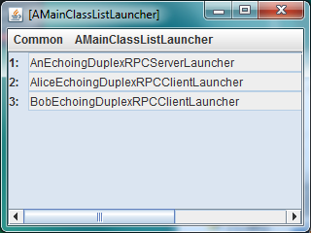
Full Example

Slide 40
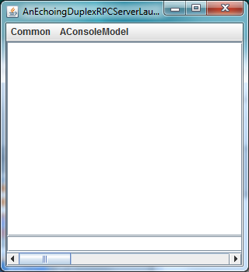
Unconnected Echo Server

Slide 41
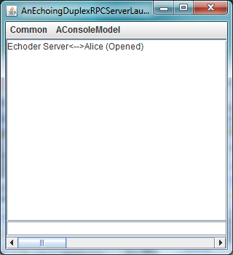
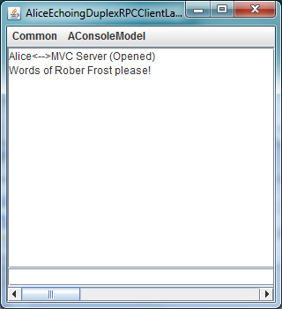
Singly-Connected Echo Server
Name of the server is not actually used to make connection, so client and server have different views of what the server name is

Slide 42
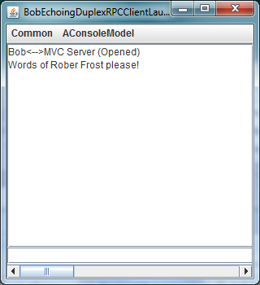
TWICE Connected Server

Slide 43
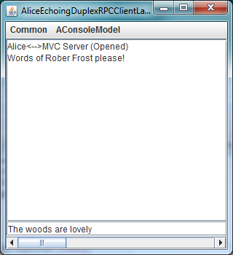
Alice Enters Text

Slide 44
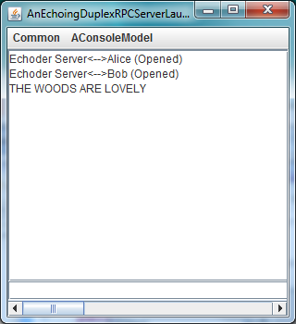
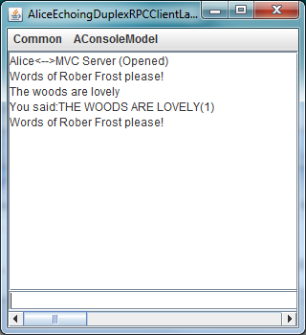
Uppercasing, Duplex Counted Echoing
Client keeps the count

Slide 45
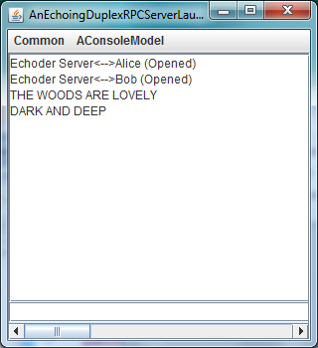
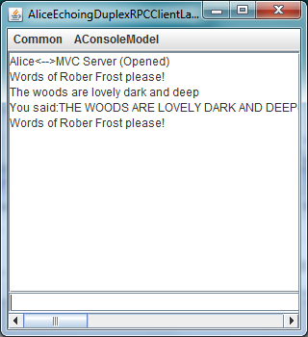
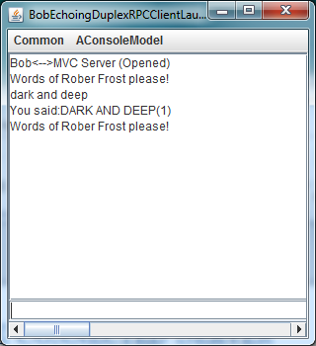
Bob Interaction

Slide 46
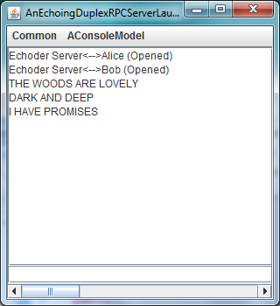
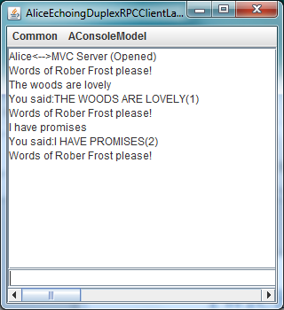
Second Alice Interaction

Slide 47
Port Structure
DuplexRPCClient InputPort
DuplexRPCServer InputPort
Uppercase Client
Uppercase Server
DuplexRPCClient InputPort
Uppercase Client

Slide 48
Distributed Objects
Duplex UpperCaser
toCountedUppercase ()
addListener()
getValue()
Counter
Instances of existing classes distributed
inc()
DuplexFrosty Model
setInput()
getInput()
getOutput()

Slide 49
Server: Constructor/Connection/Register
public class AnEchoingDuplexRPCServerLauncher
extends AnAbstractDuplexRPCServerPortLauncher
implements EchoingDuplexServerLauncher {
public AnEchoingDuplexRPCServerLauncher(String aServerName,
String aServerPort) {
super (aServerName, aServerPort);
}
protected ConnectionListener getConnectionListener
(InputPort anInputPort) {
return new ATracingConnectionListener(anInputPort);
}
protected void registerRemoteObjects() {
DuplexRPCServerInputPort aDuplexRPCServerInputPort =
(DuplexRPCServerInputPort) mainPort;
DuplexUpperCaser upperCaser = getUpperCaser();
aDuplexRPCServerInputPort.register(upperCaser);
}
mainPort assigned by super constructor

Slide 50
Server: Callback Proxy Generation
protected Counter counter;
protected void createProxies() {
counter = (Counter) ReplyRPCProxyGenerator.generateReplyRPCProxy
((DuplexRPCServerInputPort) mainPort, (registeredCounterClass()));
}
protected Class registeredCounterClass() {
return DuplexRPCClientMVCLauncher.REGISTERED_COUNTER_CLASS;
}
protected DuplexUpperCaser getUpperCaser() {
return new ADuplexUpperCaser(counter);
}
public static void main (String[] args) {
(new AnEchoingDuplexRPCServerLauncher(ECHOER_SERVER_NAME,
ECHOER_SERVER_ID)).launch();
}
Different proxy generator used because it is callback
As in RMI a server can be passed a Remote (proxy) object from the client

Slide 51
Server: Launcher
public static void main (String[] args) {
(new AnEchoingDuplexRPCServerLauncher(ECHOER_SERVER_NAME,
ECHOER_SERVER_ID)).launch();
}

Slide 52
Client: Constructor/Connection/Proxies
public class AnEchoingDuplexRPCClientLauncher
extends AnAbstractDuplexRPCClientPortLauncher
implements EchoingRPCClientLauncher {
public AnEchoingDuplexRPCClientLauncher(String aClientName,
String aServerHost, String aServerId, String aServerName) {
super(aClientName, aServerHost, aServerId, aServerName);
}
protected ConnectionListener getConnectionListener
(InputPort anInputPort) {
return new ATracingConnectionListener(anInputPort);
}
protected Class registeredUpperCaserClass() {
return ADuplexRPCServerMVCLauncher.REGISTERED_DUPLEX_UPPER_CASER_CLASS;
}
protected SimplexUpperCaser upperCaseProxy;
protected void createProxies() {
upperCaseProxy = (SimplexUpperCaser) DirectedRPCProxyGenerator.
generateRPCProxy((SimplexRPCClientInputPort) mainPort,
registeredUpperCaserClass());
}

Slide 53
Client: Register Objects
protected Counter counter;
protected void registerRemoteObjects() {
DuplexRPCClientInputPort aDuplexRPCClientInputPort =
(DuplexRPCClientInputPort) mainPort;
counter = new ACounter();
aDuplexRPCClientInputPort.register(counter);
}

Slide 54
Client: Build UI
protected void createUI(InputPort anInputPort) {
createMVC(anInputPort);
processConsoleInput();
}
protected FrostyConsoleInteractor frostyConsoleInteractor;
protected void createMVC(InputPort anInputPort) {
DuplexFrostyModel clientModel = getFrostyModel();
frostyConsoleInteractor = new ADuplexFrostyConsoleUI();
frostyConsoleInteractor.interact(clientModel);
}
protected DuplexFrostyModel getFrostyModel() {
return new ADuplexFrostyModel((DuplexUpperCaser)upperCaseProxy, counter);
}
protected void processConsoleInput() {
frostyConsoleInteractor.processConsoleInput();
}
}
Building the MVS structure using local object and proxy

Slide 55
Alice Launcher
public class AliceEchoingDuplexRPCClientLauncher {
public static final String USER_NAME = "Alice";
public static void main (String[] args) {
(new AnEchoingDuplexRPCClientLauncher(USER_NAME, "localhost",
SimplexRPCServerMVCLauncher.MVC_SERVER_ID,
SimplexRPCServerMVCLauncher.MVC_SERVER_NAME )).launch();
}}

Slide 56
Multi-Class Launcher
package inputport.rpc.duplex.echoer.example;
import bus.uigen.models.MainClassLaunchingUtility;
public class DemoerOfEchoingDuplexRPCInputPort {
public static void main(String args[]) {
demo();
}
public static void demo() {
Class[] classes = {
AnEchoingDuplexRPCServerLauncher.class,
AliceEchoingDuplexRPCClientLauncher.class,
BobEchoingDuplexRPCClientLauncher.class
};
MainClassLaunchingUtility.interactiveLaunch(classes);
}
}
Run this class and double click on each entry in sequence

Slide 57
Goals
Customizable Implementation
Unlike RMI runs on Android
Informed by the IPC Design Space
✓
How can we “improve” distributed IPC without language support?

