Slide 1
Distributed Systems
Instructor: Prasun Dewan (FB 150, dewan@unc.edu)

Slide 2
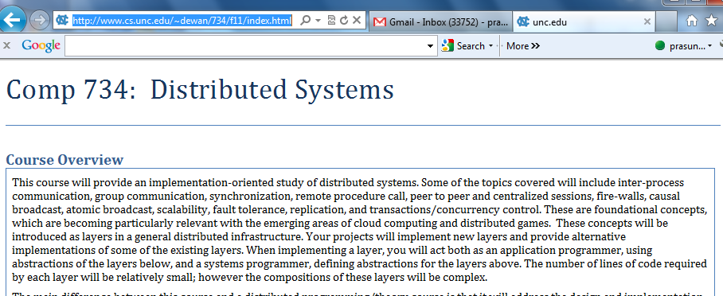
Course Home Page
http://www.cs.unc.edu/~dewan/734/f11/index.html

Slide 3
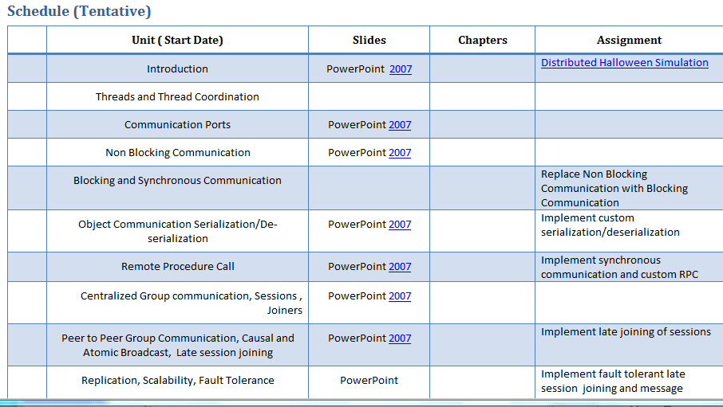
Lectures and Assignments
No book
PPT slides and sometimes word doc
Current assignment is on the web - start working ASAP on it
Outline of other assignments given

Slide 4
Software
Software to be continuously updated

Slide 5
Grade Distribution
Exams (Two midterms, no final) | 40%
Assignments (Home work) | 60%
Fudge Factor (Class participation, other factors) | 10%

Slide 6
Distributed Program?
A program “involving” multiple computers
Specific computers must be bound at run time
→ Program can run on a single computer
Definition involves processes

Slide 7
Program vs. Process vs. Thread
Program
Execution instance
Process
Thread
Thread
Process is execution instance of program, associated with program and memory
Processes are independent activities that can interleave or execute concurrently
Same program can result in multiple processes
Thread is also an independent activity, but within a process, associated with a process and a stack

Slide 8
Distribution of Processes/Threads
Process
Process
Thread
Thread
Thread
Thread
Different processes can execute on different (distributed) computers
Process
Thread
A single process executes on one machine
Thread

Slide 9
Distributed Program
Process
Process
Thread
Thread
Connection
Thread
Thread
Connected process pair : Some computation of a process can be influenced by or influence computation of the other process
Connected process group: each process is coupled to at least one other process in the group
Execution instance
Execution instance
Graph crated by creating pair-wise dependency links is not pratitioned– every node reachable from every other node

Slide 10
Logical vs. Physical Inter Process Connection Links
Process
Process
Physical coupling links are physical inter process communication links along which information flows in the network
Thread
Logical Connection
Thread
Thread
Thread
Logical links indicate computational dependencies
Physical m & Logical Connection
Physical & Logical Connection
Can have logical links without physical links
Physical links usually imply logical links
Process
Thread
Relayer
Thread

Slide 11
Distributed Applications
Distributed applications?
Non distributed applications?
In today’s world, what is or should not be distributed?

Slide 12
Some Distributed Domains
Distributed Repositories (Files, Databases)
Remotely Accessible Services (Printers, Desktops)
Collaborative Applications (Games, Shared Desktops)
Distributed Sensing (Disaster Prediction)
Computation Distribution (e.g. Simulations)
Full courses on some of these areas, with concepts specific to them (Distributed Databases, Collaborative Applications)
Will look at domain-independent concepts at the intersection of them
Will not take an application-centric view
Fundamental Issues?

Slide 13
Distribution Issues
Link setup and communication: How to create a group of physically/logically connected processes and communicate informing along these links?
Process
Process
Thread
Logical Connection
Thread
Scalability: How to allow group size to increase without degrading performance?
Thread
Thread
Distributed fault tolerance: How to recover when one end of the link goes down but the other does not?
Physical m & Logical Connection
Physical & Logical Connection
Process synchronization: How to block a (thread in a) process until the information it needs to proceed is received from a (thread in a) remote process
Process
Thread
Thread synchronization: How to block a thread until a condition for proceeding is enabled by a local thread
Relayer
Thread

Slide 14
Distribution vs. Concurrency Program
Process
Process
Connection
Distribution, no fine-grained concurrency
Process
Thread
Concurrency, not distribution
Thread
Process
Thread
Process
Thread
Connection
Distribution and fine-grained concurrency (typical)
Thread
Thread

Slide 15
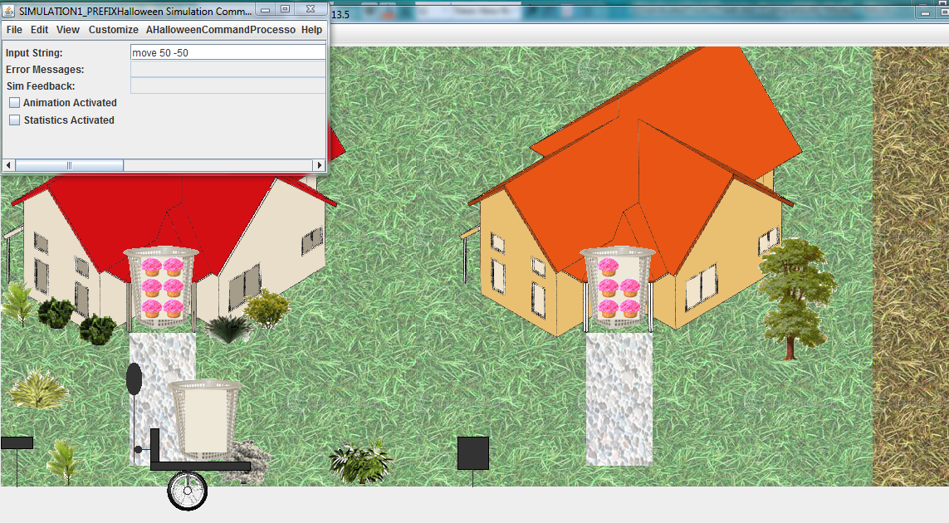
Demo: Halloween Simulation
Make Beau Anderson’s 401 Halloween implementation distributed

Slide 16
Non-Distributed vs. Distributed Program
Non-Distributed
Distributed
Creates a single process logically and physically unconnected to any other process
Creates a pair or larger group of connected processes
Must deal with sequential and possibly concurrency issues
Must also deal with distribution and usually concurrency issues

Slide 17
Systems ViewPoint
System
Computer abstractions to implement some class of programs
Operating System
Processes, Files, Memory Management , Threads…,
Database Management System
Query Language, Transactions, …
Programming Languages
Arrays, Loops, Classes, …
Distributed Systems
Data Communication, Remote Procedure Call (RPC), …
RPC assumes communication consists of procedure requests and return value responses
Byte/object communication consists of byte/object of exchange

Slide 18
Distributed Systems
Study of design and/or implementation of computer abstractions for developing distributed programs
Why distributed systems?
Why systems?
Alternatives to understand how to program some domain of applications?
Non distributed programs?

Slide 19
Alternatives to Understanding
Programming: Abstraction use
Programming: Use of a specific set of non distributed abstractions (e.g. , functional, MATLAB programming)
Distributed Programming : Use of a set of distributed abstractions (e.g. Socket/RPC Programming)
Systems: Abstraction design and/or implementation
Design and implementation of non distribution abstractions (Object-Oriented vs. Functional Languages, Compilers/Interpreters)
Design and implementation of distributed system abstractions (e.g. Data Communication /RPC Design and/or Implementation)
Theory: Models and algorithms
Non distributed model and algorithms ( Turing Machines, HeapSort,)
Distributed Models and Algorithms(e.g. 2-Phase commit, Group Comm. Model)

Slide 20
Rationale
Abstraction Design vs. Implementation
Abstraction design linked to implementation: Designs are done of only efficiently implementable abstractions
Abstractions vs. Theory (Models, Algorithms)
Abstractions are implemented operational models and have (the more) practical algorithms in them
Abstraction Design & Implementation vs. Use
Maturity with design and implementation issues allows you to better understand the semantics of a specific abstraction.
Abstract implementations require advanced programming/ software engineering techniques– “you cant really program if you have not written a compiler”

Slide 21
Teaching Abstraction Design & Implementation?
Lectures address design; assignments, implementation (e.g. Implement a PL interpreter in another PL)
Implementations can be complex and need instruction
Lectures give high-level pseudo code for complex algorithms; assignments full implementation (e.g. compilers)
Pain/gain ratio high, semester barely enough time for compiler
Lectures discuss complete code for a system of abstractions : assignments extend/modify this code
Code must be understandable and ideally also elegant

Slide 22
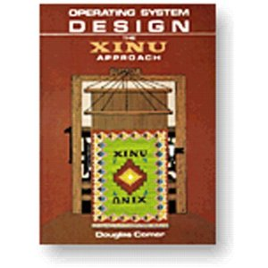
The Xinu Approach to Teaching OS
Layering
Interrupt Management
Approach not used in distributed computing
Thread Communication
Thread Synchronization
Need distributed system layers
Thread Management
Reuse of previous layers keeps code short (and hence presentable in class)
Can unravel a system in stages to a class
Layering good for software engineering as well as pedagogical reasons

Slide 23
Layers Exist in Networking
UDP
TCP/IP
IP
Link-Level Communication
Physical Communication
Physical communication in networking involves machines and used hardware machine addresses
Physical communication in distributed systems is between processes and indicates routing of information among processes

Slide 24
Distributed vs. Network Layers
Networking addresses physical connections and byte communication among processes
Process
Process
Thread
Logical Connection
Thread
Thread
Thread
No separate logical connections, object communication, synchronization, fault tolerance
Physical Connection
Physical Connection
Low-level (hidden from programmers) abstractions
Process
Thread
Thread

Slide 25
Distributed System vs. Networking Abstractions
Programming Language Abstractions
Just as programming language abstractions are built on top of assembly language abstractions
Assembly Language Abstractions
Distributed system abstractions are built on top of networked abstractions
Distributed Abstractions
Networked Abstractions
Knowledge of assembly/networked abstractions important to implement PL/distributed abstractions
Distributed Abstractions
Byte communication APIs, close to networked abstractions, is provided by operating systems (e.g. sockets), which hide networking abstractions
OS Byte Communication API

Slide 26
Domain Independent?
Distributed Repositories (Files, Databases)
Remotely Accessible Services (Printers, Desktops)
Collaborative Applications (Games, Shared Desktops)
Distributed Sensing (Disaster Prediction)
Computation Distribution (e.g. Simulations)
Distributed Abstractions
Will look at domain-independent concepts at the intersection of them
OS Byte Communication API
Even though OS abstractions developed to build distributed OS (file systems), they are by definition domain-independent

Slide 27
Language vs. OS Abstractions
Both operating systems and programming languages provide domain-independent abstractions
Operating systems support processes and language-independent abstractions for accessing protected info and sharing information among processes (files, IPC)
Programming languages must provide fine-grained abstractions needed within a process
They also provide an interface to OS abstractions through libraries or language constructs
They can also extend the OS abstractions (e.g. typed files)

Slide 28
Language vs. OS, Distributed Abstractions
Byte communication is all that operating systems provide
Non distributed programming languages such as C provide only OS abstractions
Distributed programming languages such as Java provide a richer variety of abstractions
Java provides threads and reflection, making it easy to implement our own replacements and extensions of Java abstractions
Will use Java as implementation language
To extend and replace Java abstractions/layers, knowledge of them useful

Slide 29
Java Abstractions
Blocking stream object communication (Object Stream)
Blocking byte communication (Sockets)
Non blocking byte communication (NIO)
Remote procedure call (RMI)

Slide 30
Java Layers
Remote procedure call (RMI)
Blocking stream object communication (Object Stream)
Go beyond Java layers?
Blocking byte communication (Sockets)
Non blocking byte communication (NIO)
OS Byte Communication

Slide 31
Alternative Java Layers
Remote procedure call (RMI)
Remote procedure call
Could have more efficient RPC and non blocking object communication
Blocking stream object communication (Object Stream)
Non blocking object communication
Two RPC’s?
Blocking byte communication (Sockets)
Non blocking byte communication (NIO)
OS Byte Communication

Slide 32
Improved Alternative Java Layers
Could do late binding between RPC and lower-level communication
Remote procedure call
Go beyond Java abstractions?
Blocking stream object communication (Object Stream)
Non blocking object communication
Cannot unite NIO and socket at byte or object level
Blocking byte communication (Sockets)
Non blocking byte communication (NIO)
Socket communication is low level
OS Byte Communication
NIO is even lower level
Programmers rely on usage patterns

Slide 33
Pattern vs. Abstraction (1-Computer Programming)
Pattern
public final static int RED = 0;
public final static int BLUE = 1;
public final static int GREEN = 2;
int color = RED;
public final static int LIKE= 0;
public final static int DISLIKE = 1;
public final static int NEUTRAL = 2;
int response = NEUTRAL;
Abstraction
public enum Color {RED, BLUE, GREEN};
Color color = Color. RED;
public enum Response {LIKE, DISLIKE, NEUTRAK};
Response response = Response.NEUTRAL;

Slide 34
Java NIOTutorial for Echo Server
public void run() { while (true) { try { // Process any pending changes synchronized(this.changeRequests) { Iterator changes = this.changeRequests.iterator(); while (changes.hasNext()) { ChangeRequest change = (ChangeRequest) changes.next(); switch(change.type) { case ChangeRequest.CHANGEOPS: SelectionKey key = change.socket.keyFor(this.selector); key.interestOps(change.ops); } } this.changeRequests.clear(); } ….. }
Vast majority of tutorial readers will copy and edit this pattern
Much better to identify a corresponding abstraction and implement it to understand channels
:
NioServer.java
EchoWorker.java
ServerDataEvent.java
ChangeRequest.java
NioClient.java
RspHandler.java

Slide 35
Problem with Java Abstraction Level
Remote procedure call
Cannot unite NIO and socket at byte or object level
Blocking stream object communication (Object Stream)
Non blocking object communication
Socket communication is low level
Blocking byte communication (Sockets)
Non blocking byte communication (NIO)
NIO is even lower level
Programmers rely on usage patterns
OS Byte Communication
New picture?

Slide 36
Improved Alternative Java Abstractions and Layers
Alternative high level layer to socket and NIO based byte communication
Remote procedure call
Can be bound to either lower level layer
New Object Communication
New Byte Communication
Design and implementation challenge
Blocking byte communication (Sockets)
Non blocking byte communication (NIO)
Picture complete? More abstractions and layers?
OS Byte Communication
Top down vs. bottom up view point

Slide 37
Improved Alternative Java Abstractions and Layers
Link setup and communication: How to create a group of physically/logically connected processes and communicate informing along these links?
Remote procedure call
Scalability: How to allow group size to increase without degrading performance?
New Object Communication
Distributed fault tolerance: How to recover when one end of the link goes down but the other does not?
New Byte Communication
Non blocking byte communication (NIO)
Blocking byte communication (Sockets)
Process synchronization: How to block a (thread in a) process until the information it needs to proceed is received from a (thread in a) remote process
OS Byte Communication
No direct support for group setup and communication, scalability, fault tolerance, and any process synchronization

Slide 38
New Abstractions: Design Challenge
Fault Tolerance
Pair-wise Synchronization
Group Synchronization
Group Communication and RPC
Scalability
Pair-wise Byte, and Object Communication,
Pair-wise RPC
Layering?

Slide 39
Improved Abstractions and Layers
Scalability
Fault Tolerance
Lectures discuss complete code for a system of abstractions : assignments extend/modify this code
Group Synchronization
Group Communication and RPC
Dividing responsibility between lectures and assignments?
Pair-wise Synchronization
Lecture layers will be replaced, augmented with assignment layers
Pair-wise Byte, and Object Communication,
Pairwise RPC

Slide 40
Course Plan Principle
Lectures
Assignments
Cover material for next assignment (and other relevant material)
Do next assignment
Boundary conditions?

Slide 41
Build Interesting Application
Lectures
Assignments
Distributed simulation with chosen semantics
Threads and Synchronization
Existing non distributed simulation
. Chosen existing distributed abstraction
Identify on your own issues in distributed computing raised by the application

Slide 42
Blocking vs. Non Blocking Sockets
Lectures
Assignments
High-level buffer communication
Java (Non Blocking) Channels
High-level buffer communication
Understand the differences between blocking and non blocking communication
Java (Blocking) Sockets

Slide 43
Recursion and Serialization
Lectures
Assignments
High-level object communication
High-level Buffer comm.
Java Object Streams
High-level object communication
Understand serialization and really understand recursion
High-level Buffer comm.
Custom Object Serialization

Slide 44
Synchronization and RPC
Lectures
Assignments
Remote Procedure Call
High-level Object comm.
Java Thread Synchronization
Remote Procedure Call
High-level Object Communication with Synchronization
Use and implement pairwise synchronization
High-level Object comm.
Java Thread Synchronization

Slide 45
Group Communication and Fault Tolerance
Lectures
Assignments
Fault Tolerance
Group Communication
High-level Object comm.
RPC
More Efficient Fault Tolerance
More Functional Group Communication
Use and implement group synchronization and fault tolerance and group communication
High-level Object comm.
RPC

Slide 46
Last Phase
Lectures
Assignments
More Efficient Fault Tolerance
Transactions?, Distributed Hashtables?, Multiprocessor systems?, ….
More Functional Group Communication
High-level Object comm.
RPC

Slide 47
Objectives
At the end of the course you will …..

Slide 48
Distributed Computing
Distributed Repositories (Files, Databases)
Remotely Accessible Services (Printers, Desktops)
Collaborative Applications (Games, Shared Desktops)
Distributed Sensing (Disaster Prediction)
Computation Distribution (e.g. Simulations)
Internet/Cloud computing increasing relevance of the fundamental concepts

Slide 49
Practical Relevance
For distributed applications, likely to use the code you implemented than existing abstractions
Can send objects over NIO socket channels
Existing Java RPC does not work on Android devices, but the one you implement will
Will implement many abstractions not part of standard Java

Slide 50
Software Engineering Principles
Classes
Existing classes will be used, inherited but not modified directly
Interfaces
Alternative implementations will create new classes implementing existing interfaces
Factories and Abstract factories
These will allow easy switching between different implementations
Generics
Implementation rather than use of generics to unite buffer and object communication
Will be both a distributed computing and software engineering course

Slide 51
Relevance to OS
Inter-process communication key to design of new OS’s, even non distributed OS
Extensive use of bounded buffers
Will study and use thread synchronization in depth
Will study how distributed OS are implemented
Will gain understanding of fundamental OS concepts except memory management

Slide 52
Introduction to Systems
Systems: Abstraction design and implementation
Design and implementation of non distribution abstractions (Object-Oriented vs. Functional Languages, Compilers/Interpreters)
Design and implementation of distributed system abstractions (e.g. Data Communication /RPC Design and/or Implementation)
Distributed systems covers concepts from many fields

