Slide 1

Threads and Thread Synchronization
Instructor: Prasun Dewan (FB 150, dewan@unc.edu)

Slide 2
Distribution vs. Concurrency Program
Process
Process
Connection
Distribution, no fine-grained concurrency
Process
Thread
Concurrency, not distribution
Thread
Process
Thread
Process
Thread
Connection
Distribution and fine-grained concurrency (typical)
Thread
Thread

Slide 3
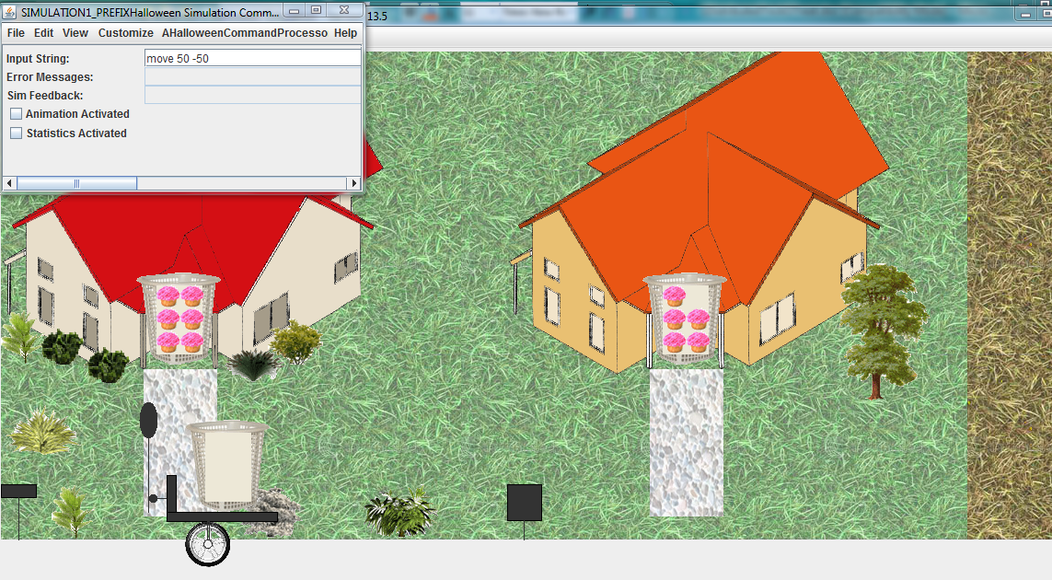
Demo: Halloween Simulation
Single thread implementation?

Slide 4
Waiting Single-Thread Solution
loop
wait for local user input
process user input
wait for remote user input
process remote user input
end
Should not impose order on user input
Not a chess game!

Slide 5
Polling Single-Thread Solution
loop
if (local user input received)
process user input
if (remote user input received
process remote user input
sleep (interval)
end
Busy waiting
Wastes computer resources
Reduces response time based on sleep time

Slide 6
Multiple Threads
loop
wait for local user input
process user input
end
loop
wait for remote user input
process remote user input
end
Much cleaner code
One reason threads were added to the OS Kernel

Slide 7
Threads and Syncyronization
Programming: Abstraction use
Systems: Abstraction design and implementation
Theory: Models and algorithms
Some repetition for those who have seen threads and synchronization before

Slide 8
Topics
Threads
Command objects
Bounded Buffer
Generics
Interrupts
Critical sections
Busy waiting
Semaphores
Monitors
  Entry procedures
  Conditions
    Hints and Absolutes
    Java and General Hints
Path Expressions

Slide 9
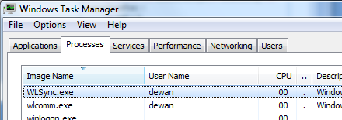
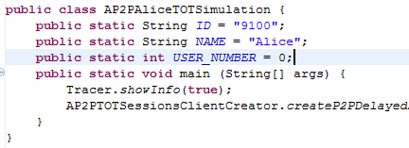
Program vs. Process vs. Thread
Program
Execution instance
Process
Thread
Thread
Process is execution instance of program, associated with program and memory
Thread is an independent activity, within a process, associated with a process and a stack

Slide 10
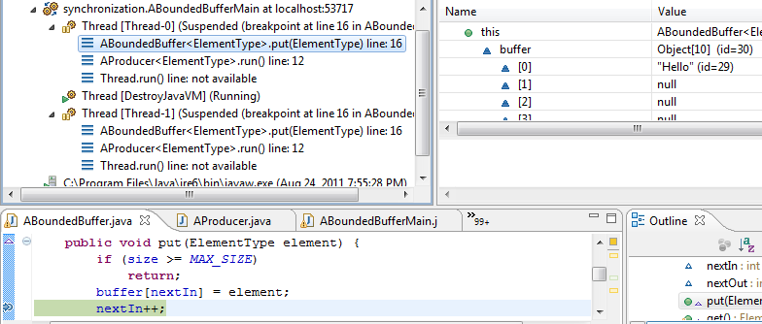
Thread as an Active Agent with Data Structures

Slide 11
Thread as a data Structure to Implementation
Thread
stack
registers
program counter
priority
status
To the thread implementation thread is a data structure
Thread implementation can be operating system, programming language, library

Slide 12
Thread as an Independent Activity
Ready Threads
Current Thread
Processor
Thread 1
Thread 3
Thread 5
Non Ready Threads
Thread 4
Thread 2
Thread 6
Whether current, ready, non ready captured by thread status
What triggers context switching?

Slide 13
Rescheduling
Ready Threads
Current Thread
Processor
Thread 5
Thread 1
Thread 3
Non Ready Threads
Thread 4
Thread 2
Thread 6
Context switching occurs as a result of time quantum expiring or some other higher priority thread becoming ready
With multiple CPUs, multiple current threads, and maybe even multiple ready queues

Slide 14
Thread as a data Structure
Thread
stack
registers
program counter
priority
status
Where does a thread start executing

Slide 15
What Does a Thread Execute?
Executes some identifiable portion of a program
Executes a method call asynchronously
Thread creator does not wait for method to terminate

Slide 16
Procedure Call vs. Thread Creation
buffer.put (“hello”);
System.out.println(“Put complete”);
Thread putThread = async buffer.put (“hello”);
System.out.println(“Put started”);
Not real Java code, Java syntax used to illustrate design choices
Why thread object?
What thread operations?

Slide 17
Thread as an Object
Thread
start()
suspend()
resume()
interrupt()
changePriority()
A thread is an object representing an independent execution of code and can be started., suspended, resumed, interrupted while sleeping, given lower/higher priority …

Slide 18
Procedure call vs. Thread Creation
Thread putThread = async buffer.put (“hello”);
System.out.println(“Put started”);
Without language syntax?

Slide 19
Procedure call vs. Thread Creation
Thread putThread = (new Thread (buffer, put, “ca va”)).start();
System.out.println(“Put started”);
Object address
Method address
Method parameters
Thread constructor must take varying number of arguments
Varying number of parameters to constructor /method not allowed in type safe languages
Method parameters not allowed in most OO languages

Slide 20
Command Object
Command Object =Embedded Operation + Parameters
execute ()
constructor (targetObject, param1, param2, …);
Provides an execute operation defined by a well-defined interface to execute some procedure
Constructor takes target object and parameters of operation as arguments
The execute operation takes no arguments
A command represents a procedure call

Slide 21
Java Runnable Command Object
Runnable Implementation
run()
constructor (targetObject, param1, param2, …);
package java.lang;
public interface Runnable {
public void run();
}
Command object defined by the Runnable interface

Slide 22
Example Runnable Implementation
public class AProducer implements Runnable {
BoundedBuffer<String> boundedBuffer;
String element;
public AProducer(
BoundedBuffer<String> aBoundedBuffer,
String aString) {
boundedBuffer = aBoundedBuffer;
element = anElement;
}
@Override
public void run() {
boundedBuffer.put(element);
}
}
Type parameter assigned as in List
run()
constructor (targetObject, param1, param2, …);

Slide 23
Thread Creation
public class ABoundedBufferMain {
public static void main(String[] args) {
BoundedBuffer<String> greetings =
new ABoundedBuffer();
Runnable producer1 =
new AProducer<String>(greetings, "Hello");
Runnable producer2 =
new AProducer<String>(greetings, "Ca Va");
(new Thread(producer1)).start();
(new Thread(producer2)).start();
}
}

Slide 24
Delegation vs. Inheritance Based Thread/Command Object
Thread
HAS-A
implements
AProducer
Runnable
implements
Thread
Runnable
IS-A
A command object is not a thread!
AProducer

Slide 25
Generic Elaboration
public class ABoundedBufferMain {
public static void main(String[] args) {
BoundedBuffer<String> greetings =
new ABoundedBuffer();
Runnable producer1 =
new AProducer<String>(greetings, "Hello");
Runnable producer2 =
new AProducer<String>(greetings, "Ca Va");
(new Thread(producer1)).start();
(new Thread(producer2)).start();
}
}
BoundedBuffer elaborated
How defined?

Slide 26
Generic Bounded Buffer Interface
public interface BoundedBuffer<ElementType> {
void put(ElementType element);
ElementType get();
}
Type parameter declared
Generic BoundedBuffer Interface

Slide 27
Java Generic Types (Type Parameters)
A scope name (class, interface, method) can be succeeded by a series of type parameters within angle brackets <A, B, C, …> that have the same value in all places
public interface I<T> {
  public void addElement (T t);
  public T elementAt (int index);
  public int size();
  }
A method, class, interface with type parameter is called a generic.
Create an elaboration of generic by giving actual value to type parameter
A single implementation is shared by all of its elaborations
I<String> stringI;
I<Point> pointI;
Assigning values to type parameters is a compile time activity for type checking only

Slide 28
Generic Bounded Buffer Class
public class ABoundedBuffer<ElementType>
implements BoundedBuffer<ElementType>{
// data structures
…
void put(ElementType element) {
…
}
ElementType get() {
…
}
}
Can we give them different names?
Why repeat type parameter in class and interface?
Multiple occurrences of a type variable assigned (unified to) the same value
If a class is elaborated with String then so is the interface

Slide 29
Generic Bounded Buffer Class
public class ABoundedBuffer
implements BoundedBuffer<String>{
// data structures
…
void put(String element) {
…
}
ElementType get() {
…
}
}
Unparameterized class elaborating parameter of interface
May want non genric class implementing generic interface

Slide 30
Renaming and Multiple Type Variables
public interface I1 <T>{
  …
  }
public interface I2 <T>{
  …
  }
public class C<T1, T2> implements I1 <T1>, I2<T2>{
  …
  }
Parameterized class may implement multiple parameterized interfaces

Slide 31
Generic Bounded Buffer Interface
public interface BoundedBuffer<ElementType> {
void put(ElementType element);
ElementType get();
}
Implementation?

Slide 32
A Bounded Buffer (Data Structures)
public class ABoundedBuffer<ElementType>
implements BoundedBuffer<ElementType>{
public static final int MAX_SIZE = 10;
Object[] buffer = new Object[MAX_SIZE];
int size = 0;
int nextIn = 0;
int nextOut = 0;
Convention: Class A<T> implements interface <T> containing public methods of A

Slide 33
Bounded Buffer (Methods)
public void put(ElementType element) {
if (size >= MAX_SIZE) {
return;
}
buffer[nextIn] = element;
nextIn = (nextIn + 1) % MAX_SIZE;
size++;
}
public ElementType get() {
if (size == 0) {
return null;
}
ElementType retVal = (ElementType) buffer[nextOut];
nextOut = (nextOut + 1) % MAX_SIZE;
size--;
return retVal;
}
}
Thread safe?
Requires polling to wait for non empty and empty slots
Will it work if multiple threads access it

Slide 34
Example Threads
public class ABoundedBufferMain {
public static void main(String[] args) {
BoundedBuffer<String> greetings =
new ABoundedBuffer();
Runnable producer1 =
new AProducer<String>(greetings, "Hello");
Runnable producer2 =
new AProducer<String>(greetings, "Ca Va");
(new Thread(producer1)).start();
(new Thread(producer2)).start();
}
}
“Hello” and “Ca Va” threads created

Slide 35
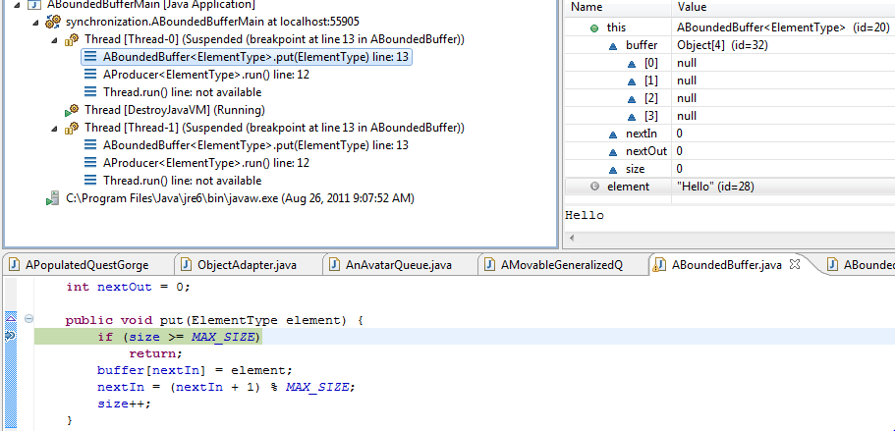
“Hello” Thread
“Hello” Thread Scheduled
“Hello” Thread Starts Executing put()

Slide 36
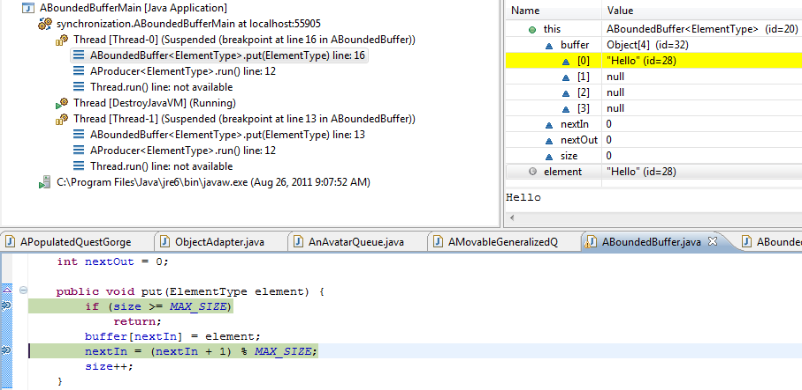
“Hello” Thread Proceeds
“Hello” Thread Adds Item
nextIn not incremented before rescheduling happens

Slide 37
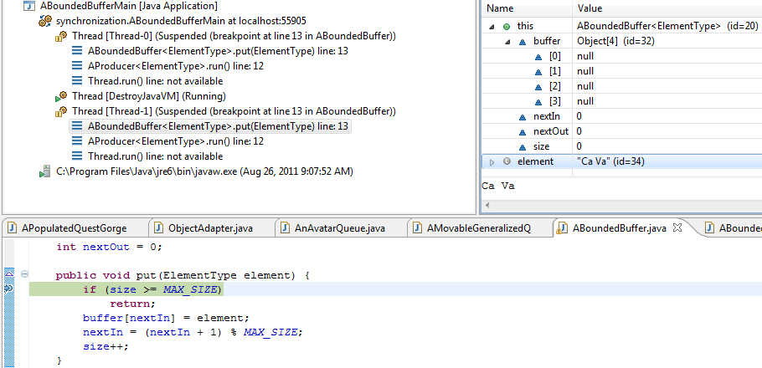
“Ca Va” Thread
“Ca Va” Thread Scheduled

Slide 38
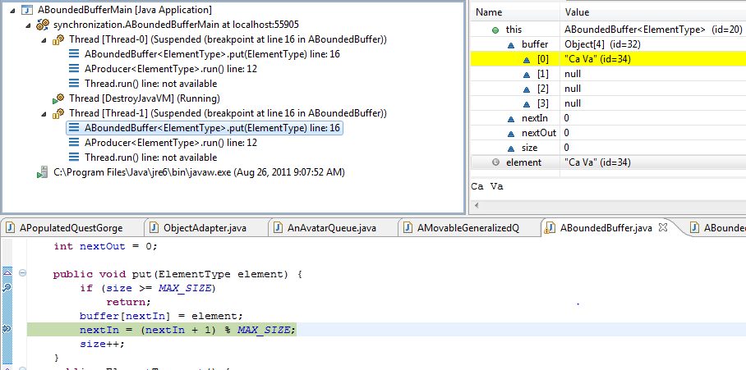
Context Switch to “Ca Va” Thread
Previous greeting overwritten
Non deterministic program
Program behavior depends on when rescheduling occurs

Slide 39

Critical Section
Critical Section
Code that can be executed only if certain conditions are met by other threads
Other threads should not be executing the same critical section
Other threads should not be executing other critical sections that access the same data

Slide 40
Critical Section (Review)
Critical Section
Code that can be executed only if certain conditions are met by other threads
Other threads should not be executing the same critical section
Other threads should not be executing other critical sections that access the same data

Slide 41
Critical Section
lock.lock()
Critical Section
lock.unlock()
public interface Lock {
void lock();
void unlock();
}

Slide 42
Critical Section (Review)
lock.lock()
Critical Section
lock.unlock()
public interface Lock {
void lock();
void unlock();
}

Slide 43
Use of Lock
public class ALockingBoundedBuffer<ElementType>
extends ABoundedBuffer<ElementType>{
Lock lock;
public ALockingBoundedBuffer(Lock aLock) {
lock = aLock;
}
public void put(ElementType element) {
lock.lock();
super.put(element);
lock.unlock();
}
public ElementType get() {
lock.lock();
ElementType retVal = super.get();
lock.unlock();
return retVal;
}
}
How to implement lock?

Slide 44
Disable Context Switching
public class AContextSwitchingLock implements Lock{
int originalInterrupts;
public void lock() {
originalInterrupts = System.disableInterrupts();
}
public void unlock() {
System.restoreInterrupts(originalInterrupts);
}
}
Context switching occurs as a result of a blocking call or an interrupt
Timer interrupt can cause time quantum to expire
Input/disk/network interrupt can cause higher priority thread to becoming eligible
Disable interrupts and make no blocking call in critical section

Slide 45
Pros and Cons
Coarse grained: stops all threads, even those that do not access same or any critical section
Insecure: a thread can cheat and hog processor time
Simple
Needed to implement critical sections in operating system
Need critical sections to implement critical sections!

Slide 46
Fine-Grained Critical Section
lock.lock()
Critical Section
Boolean status
lock.unlock()

Slide 47
Boolean Object Capturing Lock Status
public class ABooleanObject implements BooleanObject{
boolean value;
public boolean get() {
return value;
}
public void set(boolean newVal) {
value = newVal;
}
}
boolean is not an object
Boolean is not an mutable

Slide 48
Busy Waiting Lock
public class APollingLock implements Lock{
BooleanObject booleanObject = new ABooleanObject();
public void lock() {
while (booleanObject.get()) {
; // do nothing
}
booleanObject.set(true);
}
public void unlock() {
booleanObject.set(false);
}
}
Test of lock
Set of lock
Does this work?
Test and set not done atomically
Context switch can occur between test and set

Slide 49
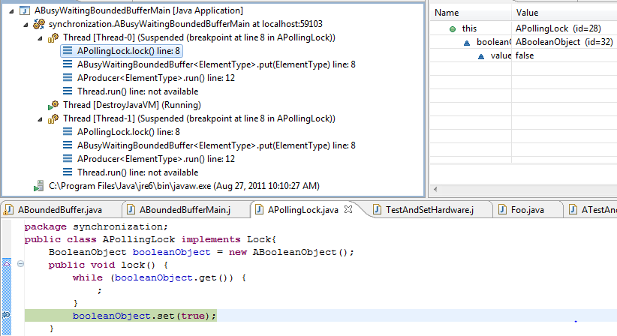
Thread 1 Gets Lock
Thread 1 gets lock and context switches

Slide 50
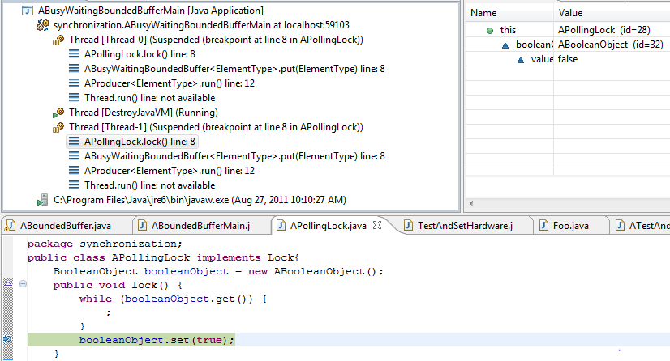
Thread 2 Also Gets Lock
Thread 2 gets lock

Slide 51
Busy Waiting Lock
public class APollingLock implements Lock{
BooleanObject booleanObject = new ABooleanObject();
public void lock() {
while (booleanObject.get()) {
; // busy waiting
}
booleanObject.set(true);
}
public void unlock() {
booleanObject.set(false);
}
}
Test of lock
Set of lock
Test and set not done atomically
Fix how?
Context switch can occur between test and set

Slide 52
Test and Set Hardware Instruction
public class TestAndSetHardware {
public static atomic boolean
testAndSet(BooleanObject aBooleanObject) {
boolean retVal = aBooleanObject.get(); // test
aBooleanObject.set(true); // set
return retVal; // return tested value
}
}
Function with side effects!
At the end of instruction, boolean object (memory slot) is always true
returns false if object was false at start of instruction

Slide 53
A Test and Set Lock
public class ATestAndSetLock implements Lock{
BooleanObject booleanObject;
public void lock() {
while (TestAndSetHardware.testAndSet(booleanObject)) {
;
}
}
public void unlock() {
booleanObject.set(false);
}
}
Also called spin locks, as tester is spinning

Slide 54
Busy Waiting Pros and Cons
Busy waiting: polling wastes computer resources
Higher priority polling thread would not allow lower priority thread in critical section to release lock
Needed to implement critical sections in multiprocessor operating system
Disabling interrupts on one processor does not disable on others
Fine-grained approach with out disadvantages?

Slide 55
Semaphore
public class ASemaphore implements Semaphore{
Queue<Thread> queue = new AQueue<Thread>();
int count;
public ASemaphore(int initialCount) {
count = initialCount;
}
public void semWait() {
int originalInterrupts = System.disableInterrupts();
count--;
if (count < 0) {
Thread currentThread = Thread.currentThread();
currentThread.setStatus(Thread.WAIT);
queue.add(currentThread);
}
System.restoreInterrupts(originalInterrupts);
}
Count and queue manipulation must be done atomically
Disable and restore interrupts to ensure atomicity

Slide 56
Semaphore (Contd)
public void semSignal() {
int originalInterrupts = System.disableInterrupts();
count++;
if (count <= 0) {
Thread nextThread = queue.remove();
nextThread.setStatus(Thread.READY);
Thread.reschedAndRestoreInterrupts(
originalInterrupts);
} else{
System.restoreInterrupts(originalInterrupts);
}
}
If count is positive, indicates how many semWait() can be done without blocking
If count is negative, its absolute value indicates queue size

Slide 57
Semaphore-Based Lock
public class ASemaphoreLock implements Lock {
// let first thread go
Semaphore semaphore = new ASemaphore(1);
public void lock() {
semaphore.semWait();
}
public void unlock() {
semaphore.semSignal();
}
}

Slide 58
Semaphore Pros and Cons
Fine-grained locking that works and is efficient
Like other schemes discussed so far, requires explicit lock and unlock
Programmer overhead in creating and using lock
Programmer may forget to lock
Worse, may forget to unlock
Program reader must look at code to find critical sections

Slide 59
Manual Use of Lock
public class ALockingBoundedBuffer<ElementType>
extends ABoundedBuffer<ElementType>{
Lock lock;
public ALockingBoundedBuffer(Lock aLock) {
lock = aLock;
}
public void put(ElementType element) {
lock.lock();
super.put(element);
lock.unlock();
}
public ElementType get() {
lock.lock();
ElementType retVal = super.get();
lock.unlock();
return retVal;
}
}
Create declarative rather than procedural solution

Slide 60
Declarative vs. Procedural Primitive
public class ALockingBoundedBuffer<ElementType>
extends ABoundedBuffer<ElementType>{
Lock lock;
public ALockingBoundedBuffer(Lock aLock) {
lock = aLock;
}
public void put(ElementType element) {
lock.lock();
super.put(element);
lock.unlock();
}
public ElementType get() {
lock.lock();
ElementType retVal = super.get();
lock.unlock();
return retVal;
}
}
Declarative: Directive to system by giving declaration specifying what
Other threads should not be executing other critical sections that access the same data
Procedural: Directive to system by executing statements specifying how
Connect lock to shared data and methods that manipulate them
A la Regular expressions vs. Finite State Automata

Slide 61
High-Level Support
Critical Section
Other threads should not be executing other critical sections that access the same data
Connect lock to shared data and methods that manipulate them

Slide 62
Class with All Atomic Methods
Class
method1()
method2()
method2()
S
method3()
When declaring a class, provide a label (e.g. synchronized) that says that on an instance a method cannot be executed if the same or another method is executing on that instance
method3()
Such a class is a monitor class, and its instance a monitor
Not all classes have critical sections, hence labeling can prevent unnecessary code and data structures in such non monitor classes

Slide 63
Labeling a Class as A Monitor
public synchronized ABoundedBuffer<ElementType>
implements BoundedBuffer<ElementType>{
public static final int MAX_SIZE = 10;
Object[] buffer = new Object[MAX_SIZE];
int size = 0;
int nextIn = 0;
int nextOut = 0;
Some methods of the class may not be critical sections

Slide 64
Atomic vs Non Atomic Methods
Class
method1()
S
method2()
method2()
S
method3()
method3()
S
When declaring a method, provide a label (e.g. synchronized). A single synchronized method can execute at one time on an instance

Slide 65
Labeling Methods as Atomic
public synchronized void put(ElementType element) {
if (size >= MAX_SIZE) {
return;
}
buffer[nextIn] = element;
nextIn = (nextIn + 1) % MAX_SIZE;
size++;
}
public synchronized ElementType get() {
if (size == 0) {
return null;
}
ElementType retVal = (ElementType) buffer[nextOut];
nextOut = (nextOut + 1) % MAX_SIZE;
size--;
return retVal;
}
}
A lock associated with class instance is automatically obtained on entry to the marked procedure and released on its exit
Such a method is classically called an entry procedure
Java calls it a synchronized method, we will call it an atomic method

Slide 66
Entry Queue
Entry Queue
public synchronized void put(
ElementType element) {
if (size >= MAX_SIZE) {
return;
}
buffer[nextIn] = element;
nextIn = (nextIn + 1) % MAX_SIZE;
size++;
nonEmpty.condSignal();
}
public synchronized ElementType get() {
if (size == 0) {
return null;
}
ElementType retVal =
(ElementType) buffer[nextOut];
nextOut = (nextOut + 1) % MAX_SIZE;
size--;
nonFull.condSignal()
return retVal;
}

Slide 67
Get Called
Cons. 1
Entry Queue
public synchronized void put(
ElementType element) {
if (size >= MAX_SIZE) {
return;
}
buffer[nextIn] = element;
nextIn = (nextIn + 1) % MAX_SIZE;
size++;
nonEmpty.condSignal();
}
public synchronized ElementType get() {
if (size == 0) {
return null;
}
ElementType retVal =
(ElementType) buffer[nextOut];
nextOut = (nextOut + 1) % MAX_SIZE;
size--;
nonFull.condSignal()
return retVal;
}

Slide 68
Get Proceeds and Put Called
Prod. 1
Entry Queue
public synchronized void put(
ElementType element) {
if (size >= MAX_SIZE) {
return;
}
buffer[nextIn] = element;
nextIn = (nextIn + 1) % MAX_SIZE;
size++;
nonEmpty.condSignal();
}
public synchronized ElementType get() {
if (size == 0) {
return null;
}
ElementType retVal =
(ElementType) buffer[nextOut];
nextOut = (nextOut + 1) % MAX_SIZE;
size--;
nonFull.condSignal()
return retVal;
}
Cons. 1

Slide 69
Producer in Entry Queue
Entry Queue
public synchronized void put(
ElementType element) {
if (size >= MAX_SIZE) {
return;
}
buffer[nextIn] = element;
nextIn = (nextIn + 1) % MAX_SIZE;
size++;
nonEmpty.condSignal();
}
public synchronized ElementType get() {
if (size == 0) {
return null;
}
ElementType retVal =
(ElementType) buffer[nextOut];
nextOut = (nextOut + 1) % MAX_SIZE;
size--;
nonFull.condSignal()
return retVal;
}
Cons. 1
Prod. 1

Slide 70
Put Called Again
Prod. 2
Entry Queue
public synchronized void put(
ElementType element) {
if (size >= MAX_SIZE) {
return;
}
buffer[nextIn] = element;
nextIn = (nextIn + 1) % MAX_SIZE;
size++;
nonEmpty.condSignal();
}
public synchronized ElementType get() {
if (size == 0) {
return null;
}
ElementType retVal =
(ElementType) buffer[nextOut];
nextOut = (nextOut + 1) % MAX_SIZE;
size--;
nonFull.condSignal()
return retVal;
}
Cons. 1
Prod. 1

Slide 71
Producer in Entry Queue
Entry Queue
public synchronized void put(
ElementType element) {
if (size >= MAX_SIZE) {
return;
}
buffer[nextIn] = element;
nextIn = (nextIn + 1) % MAX_SIZE;
size++;
nonEmpty.condSignal();
}
public synchronized ElementType get() {
if (size == 0) {
return null;
}
ElementType retVal =
(ElementType) buffer[nextOut];
nextOut = (nextOut + 1) % MAX_SIZE;
size--;
nonFull.condSignal()
return retVal;
}
Cons. 1
Prod. 2
Prod. 1

Slide 72
Consumer About To Return
Entry Queue
public synchronized void put(
ElementType element) {
if (size >= MAX_SIZE) {
return;
}
buffer[nextIn] = element;
nextIn = (nextIn + 1) % MAX_SIZE;
size++;
nonEmpty.condSignal();
}
public synchronized ElementType get() {
if (size == 0) {
return null;
}
ElementType retVal =
(ElementType) buffer[nextOut];
nextOut = (nextOut + 1) % MAX_SIZE;
size--;
nonFull.condSignal()
return retVal;
}
Cons. 1
Prod. 2
Prod. 1

Slide 73
Consumer Leaves
Entry Queue
public synchronized void put(
ElementType element) {
if (size >= MAX_SIZE) {
return;
}
buffer[nextIn] = element;
nextIn = (nextIn + 1) % MAX_SIZE;
size++;
nonEmpty.condSignal();
}
public synchronized ElementType get() {
if (size == 0) {
return null;
}
ElementType retVal =
(ElementType) buffer[nextOut];
nextOut = (nextOut + 1) % MAX_SIZE;
size--;
nonFull.condSignal()
return retVal;
}
Prod. 2
Prod. 1
Monitor unlocked

Slide 74
FIFO Service of Entry Queue
Entry Queue
public synchronized void put(
ElementType element) {
if (size >= MAX_SIZE) {
return;
}
buffer[nextIn] = element;
nextIn = (nextIn + 1) % MAX_SIZE;
size++;
nonEmpty.condSignal();
}
public synchronized ElementType get() {
if (size == 0) {
return null;
}
ElementType retVal =
(ElementType) buffer[nextOut];
nextOut = (nextOut + 1) % MAX_SIZE;
size--;
nonFull.condSignal()
return retVal;
}
Prod. 1
Prod. 2

Slide 75
Monitor Pros and Cons
Higher-level declarative solution
No programmer overhead in creating and using lock
No danger of forgetting to unlock
Can simply look at method headers to determine critical sections
Can forget to label method
Does not provide (general) thread synchronization

Slide 76
Synchronization vs. Mutual Exclusion
Thread general synchronization (Thread coordination): a thread waiting for another thread to do something
Thread mutual exclusion: : a thread waiting for another thread to leave a critical section
Threads are “competing” rather than “cooperating”
Thread synchronization: general synchronization other than mutual exclusion
Threads are “cooperating” rather than “competing”

Slide 77
Thread Synchronization Need
public synchronized void put(ElementType element) {
if (size >= MAX_SIZE) {
return;
}
buffer[nextIn] = element;
nextIn = (nextIn + 1) % MAX_SIZE;
size++;
}
public synchronized ElementType get() {
if (size == 0) {
return null;
}
ElementType retVal = (ElementType) buffer[nextOut];
nextOut = (nextOut + 1) % MAX_SIZE;
size--;
return retVal;
}
}
Should wait for non full buffer
Should wait for non empty buffer
Semaphores? How many?
Monitors do not support general thread synchronization

Slide 78
Thread Synchronization with Semaphores
public synchronized void put(ElementType element) {
nonFull.semWait();
buffer[nextIn] = element;
nextIn = (nextIn + 1) % MAX_SIZE;
size++;
nonEmpty.semSignal();
}
public synchronized ElementType get() {
nonEmpty.semWait();
ElementType retVal = (ElementType) buffer[nextOut];
nextOut = (nextOut + 1) % MAX_SIZE;
size--;
nonFull.semSignal();
return retVal;
}
}
Initial counts of semaphores?

Slide 79
Bounded Buffer (Data Structures)
public class ABoundedBuffer<ElementType>
implements BoundedBuffer<ElementType>{
public static final int MAX_SIZE = 10;
Object[] buffer = new Object[MAX_SIZE];
int size = 0;
int nextIn = 0;
int nextOut = 0;
Semaphore nonFull = new ASemaphore(MAX_SIZE);
Semaphore nonEmpty = new ASemaphore(0);
should be able to deposit MAX_SIZE buffers without waiting
General synchronization solution: Monitors + Semaphores?

Slide 80
Semaphores too Heavyweight
public synchronized void put(ElementType element) {
nonFull.semWait();
buffer[nextIn] = element;
nextIn = (nextIn + 1) % MAX_SIZE;
size++;
nonEmpty.semSignal();
}
public synchronized ElementType get() {
nonEmpty.semWait();
ElementType retVal = (ElementType) buffer[nextOut];
nextOut = (nextOut + 1) % MAX_SIZE;
size--;
nonFull.semSignal();
return retVal;
}
}
Semaphore takes steps to ensure atomic execution of semaphore operations
But method has already taken steps to ensure atomicity
Unnecessary expensive system calls to disable context switching

Slide 81
Condition (Synchronizer)
public class AConditionSynchronizer
implements ConditionSynchronizer{
Queue<Thread> queue = new AQueue<Thread>();
public void condWait() {
Thread currentThread = Thread.currentThread();
currentThread.setStatus(Thread.WAIT);
queue.add(currentThread);
}
public void condSignal() {
Thread nextThread = queue.remove();
nextThread.setStatus(Thread.READY);
Thread.reschedAndRestoreInterrupts(
originalInterrupts);
}
Non atomic operations – no disabling of context switching
int count is only one kind of condition for synchronization
No integer count
Synchronization condition checked by caller

Slide 82
Policy and Mechanism Tied In
public synchronized void put(ElementType element) {
nonFull.semWait();
buffer[nextIn] = element;
nextIn = (nextIn + 1) % MAX_SIZE;
size++;
nonEmpty.semSignal();
}
public synchronized ElementType get() {
nonEmpty.semWait();
ElementType retVal = (ElementType) buffer[nextOut];
nextOut = (nextOut + 1) % MAX_SIZE;
size--;
nonFull.semSignal();
return retVal;
}
}

Slide 83
Policy and Mechanism Orthogonal
public synchronized void put(ElementType element) {
if (size >= MAX_SIZE) {
nonFull.condWait();
}
buffer[nextIn] = element;
nextIn = (nextIn + 1) % MAX_SIZE;
size++;
nonEmpty.condSignal();
}
public synchronized ElementType get() {
if (size == 0) {
return nonEmpty.condWait();
}
ElementType retVal = (ElementType) buffer[nextOut];
nextOut = (nextOut + 1) % MAX_SIZE;
size--;
nonFull.condSignal()
return retVal;
}
}
Must check programmer-defined boolean expression before waiting
Policy for synchronizing and mechanism for blocking are orthogonal
Could we put check outside semaphore also

Slide 84
Lightweight Semaphore
public class ASemaphore implements Semaphore{
Queue<Thread> queue = new AQueue<Thread>();
public void semWait() {
int originalInterrupts = System.disableInterrupts();
Thread currentThread = Thread.currentThread();
currentThread.setStatus(Thread.WAIT);
queue.add(currentThread);
System.restoreInterrupts(originalInterrupts);
}
public void semSignal() {
int originalInterrupts = System.disableInterrupts();
Thread nextThread = queue.remove();
nextThread.setStatus(Thread.READY);
Thread.reschedAndRestoreInterrupts(
originalInterrupts);
}
}
Like regular semaphore, except no count
Like condition, except there is atomicity implementation

Slide 85
Lighter Weight Semaphore Use
public void put(ElementType element) {
if (size >= MAX_SIZE) {
nonFull.semWait();
}
buffer[nextIn] = element;
nextIn = (nextIn + 1) % MAX_SIZE;
size++;
nonEmpty.semSignal();
}
public ElementType get() {
if (size == 0) {
return nonEmpty.semWait();
}
ElementType retVal = (ElementType) buffer[nextOut];
nextOut = (nextOut + 1) % MAX_SIZE;
size--;
nonFull.semSignal()
return retVal;
}
}
Test of lock
Enqueuing
Test and enqueing are not atomic

Slide 86
Synchronizer Operations in Atomic Methods
public synchronized void put(ElementType element) {
if (size >= MAX_SIZE) {
nonFull.condWait();
}
buffer[nextIn] = element;
nextIn = (nextIn + 1) % MAX_SIZE;
size++;
nonEmpty.condSignal();
}
public synchronized ElementType get() {
if (size == 0) {
return nonEmpty.condWait();
}
ElementType retVal = (ElementType) buffer[nextOut];
nextOut = (nextOut + 1) % MAX_SIZE;
size--;
nonFull.condSignal()
return retVal;
}
}
Blocking/unblocking operations should be done atomically
Conditions for blocking/unblocking should also be checked atomically with blocking/unblocking operations
Force blocking/unblocking operations to be done only in atomic methods, which can then check and set arbitrary conditions atomically

Slide 87
Bounded Buffer with Condition (Synchronizers): Data Structures
public class ABoundedBuffer<ElementType>
implements BoundedBuffer<ElementType>{
public static final int MAX_SIZE = 10;
Object[] buffer = new Object[MAX_SIZE];
int size = 0;
int nextIn = 0;
int nextOut = 0;
ConditionSynchronizer nonFull =
new AConditionSynchronizer();
ConditionSynchronizer nonEmpty =
new AConditionSynchronizer();

Slide 88
Queues with Conditions
Entry Queue
public synchronized void put(
ElementType element) {
if (size >= MAX_SIZE) {
nonFull.condWait();
}
buffer[nextIn] = element;
nextIn = (nextIn + 1) % MAX_SIZE;
size++;
nonEmpty.condSignal();
}
public synchronized ElementType get() {
if (size == 0) {
nonEmpty.condWait();
}
ElementType retVal =
(ElementType) buffer[nextOut];
nextOut = (nextOut + 1) % MAX_SIZE;
size--;
nonFull.condSignal()
return retVal;
}
nonEmpty Condition Queue
nonFull Condition Queue

Slide 89
Get Called
Cons. 1
Entry Queue
public synchronized void put(
ElementType element) {
if (size >= MAX_SIZE) {
nonFull.condWait();
}
buffer[nextIn] = element;
nextIn = (nextIn + 1) % MAX_SIZE;
size++;
nonEmpty.condSignal();
}
public synchronized ElementType get() {
if (size == 0) {
nonEmpty.condWait();
}
ElementType retVal =
(ElementType) buffer[nextOut];
nextOut = (nextOut + 1) % MAX_SIZE;
size--;
nonFull.condSignal()
return retVal;
}
nonEmpty Condition Queue
nonFull Condition Queue

Slide 90
Get Proceeds and Put Called
Prod. 1
Entry Queue
public synchronized void put(
ElementType element) {
if (size >= MAX_SIZE) {
nonFull.condWait();
}
buffer[nextIn] = element;
nextIn = (nextIn + 1) % MAX_SIZE;
size++;
nonEmpty.condSignal();
}
public synchronized ElementType get() {
if (size == 0) {
nonEmpty.condWait();
}
ElementType retVal =
(ElementType) buffer[nextOut];
nextOut = (nextOut + 1) % MAX_SIZE;
size--;
nonFull.condSignal()
return retVal;
}
Cons. 1
nonEmpty Condition Queue
nonFull Condition Queue

Slide 91
Producer in Entry Queue
Entry Queue
public synchronized void put(
ElementType element) {
if (size >= MAX_SIZE) {
nonFull.condWait();
}
buffer[nextIn] = element;
nextIn = (nextIn + 1) % MAX_SIZE;
size++;
nonEmpty.condSignal();
}
public synchronized ElementType get() {
if (size == 0) {
nonEmpty.condWait();
}
ElementType retVal =
(ElementType) buffer[nextOut];
nextOut = (nextOut + 1) % MAX_SIZE;
size--;
nonFull.condSignal()
return retVal;
}
Cons. 1
Prod. 1
nonEmpty Condition Queue
nonFull Condition Queue

Slide 92
Get Called Again
Entry Queue
public synchronized void put(
ElementType element) {
if (size >= MAX_SIZE) {
nonFull.condWait();
}
buffer[nextIn] = element;
nextIn = (nextIn + 1) % MAX_SIZE;
size++;
nonEmpty.condSignal();
}
public synchronized ElementType get() {
if (size == 0) {
nonEmpty.condWait();
}
ElementType retVal =
(ElementType) buffer[nextOut];
nextOut = (nextOut + 1) % MAX_SIZE;
size--;
nonFull.condSignal()
return retVal;
}
Cons. 1
Cons. 2
Prod. 1
nonEmpty Condition Queue
nonFull Condition Queue

Slide 93
Consumer Waits for Condition
Entry Queue
public synchronized void put(
ElementType element) {
if (size >= MAX_SIZE) {
nonFull.condWait();
}
buffer[nextIn] = element;
nextIn = (nextIn + 1) % MAX_SIZE;
size++;
nonEmpty.condSignal();
}
public synchronized ElementType get() {
if (size == 0) {
nonEmpty.condWait();
}
ElementType retVal =
(ElementType) buffer[nextOut];
nextOut = (nextOut + 1) % MAX_SIZE;
size--;
nonFull.condSignal()
return retVal;
}
Cons. 1
Cons. 2
Prod. 1
nonEmpty Condition Queue
nonFull Condition Queue

Slide 94
Consumer Unlocks Monitor
Entry Queue
public synchronized void put(
ElementType element) {
if (size >= MAX_SIZE) {
nonFull.condWait();
}
buffer[nextIn] = element;
nextIn = (nextIn + 1) % MAX_SIZE;
size++;
nonEmpty.condSignal();
}
public synchronized ElementType get() {
if (size == 0) {
nonEmpty.condWait();
}
ElementType retVal =
(ElementType) buffer[nextOut];
nextOut = (nextOut + 1) % MAX_SIZE;
size--;
nonFull.condSignal()
return retVal;
}
Cons. 2
Prod. 1
nonEmpty Condition Queue
Cons. 1
nonFull Condition Queue
Before waiting , class invariant should be restored
Class invariant is a condition that is true before and after each public method in the class is called
E.g.: size should indicate the number of filled slots

Slide 95
Producer Enters
Entry Queue
public synchronized void put(
ElementType element) {
if (size >= MAX_SIZE) {
nonFull.condWait();
}
buffer[nextIn] = element;
nextIn = (nextIn + 1) % MAX_SIZE;
size++;
nonEmpty.condSignal();
}
public synchronized ElementType get() {
if (size == 0) {
nonEmpty.condWait();
}
ElementType retVal =
(ElementType) buffer[nextOut];
nextOut = (nextOut + 1) % MAX_SIZE;
size--;
nonFull.condSignal()
return retVal;
}
Prod. 1
Cons. 2
nonEmpty Condition Queue
Cons. 1
nonFull Condition Queue

Slide 96
Producer Signals, Consumer Dequeued
Entry Queue
Cons. 1
public synchronized void put(
ElementType element) {
if (size >= MAX_SIZE) {
nonFull.condWait();
}
buffer[nextIn] = element;
nextIn = (nextIn + 1) % MAX_SIZE;
size++;
nonEmpty.condSignal();
}
public synchronized ElementType get() {
if (size == 0) {
nonEmpty.condWait();
}
ElementType retVal =
(ElementType) buffer[nextOut];
nextOut = (nextOut + 1) % MAX_SIZE;
size--;
nonFull.condSignal()
return retVal;
}
Prod. 1
Cons. 2
nonEmpty Condition Queue
nonFull Condition Queue
Producer not exited
Where does consumer go next?

Slide 97
Signaled Thread in Monitor?
Entry Queue
public synchronized void put(
ElementType element) {
if (size >= MAX_SIZE) {
nonFull.condWait();
}
buffer[nextIn] = element;
nextIn = (nextIn + 1) % MAX_SIZE;
size++;
nonEmpty.condSignal();
}
public synchronized ElementType get() {
if (size == 0) {
nonEmpty.condWait();
}
ElementType retVal =
(ElementType) buffer[nextOut];
nextOut = (nextOut + 1) % MAX_SIZE;
size--;
nonFull.condSignal()
return retVal;
}
Prod. 1
Cons. 2
Cons. 1
nonEmpty Condition Queue
nonFull Condition Queue
Violates Monitor Definition

Slide 98
Signaled Thread in Entry Queue
Entry Queue
public synchronized void put(
ElementType element) {
if (size >= MAX_SIZE) {
nonFull.condWait();
}
buffer[nextIn] = element;
nextIn = (nextIn + 1) % MAX_SIZE;
size++;
nonEmpty.condSignal();
}
public synchronized ElementType get() {
if (size == 0) {
nonEmpty.condWait();
}
ElementType retVal =
(ElementType) buffer[nextOut];
nextOut = (nextOut + 1) % MAX_SIZE;
size--;
nonFull.condSignal()
return retVal;
}
Prod. 1
Cons. 1
Cons. 2
nonEmpty Condition Queue
nonFull Condition Queue
Cons. 1 will get the buffer first
Starvation possible

Slide 99
Signaled Thread in Urgent Queue
Entry Queue
public synchronized void put(
ElementType element) {
if (size >= MAX_SIZE) {
nonFull.condWait();
}
buffer[nextIn] = element;
nextIn = (nextIn + 1) % MAX_SIZE;
size++;
nonEmpty.condSignal();
}
public synchronized ElementType get() {
if (size == 0) {
nonEmpty.condWait();
}
ElementType retVal =
(ElementType) buffer[nextOut];
nextOut = (nextOut + 1) % MAX_SIZE;
size--;
nonFull.condSignal()
return retVal;
}
Prod. 1
Cons. 2
nonEmpty Condition Queue
nonEmpty.condSignal();
get();
nonFull Condition Queue
Signaled thread in urgent Q
Urgent Queue
Urgent Q serviced before Entry Q
Condition for Entering May Not Exist Later
Cons. 1
Signaler may violate condition or previously signaled thread may violate it

Slide 100
Signaled Thread in Monitor and Signaling Thread in Urgent Queue
Entry Queue
public synchronized void put(
ElementType element) {
if (size >= MAX_SIZE) {
nonFull.condWait();
}
buffer[nextIn] = element;
nextIn = (nextIn + 1) % MAX_SIZE;
size++;
nonEmpty.condSignal();
}
public synchronized ElementType get() {
if (size == 0) {
nonEmpty.condWait();
}
ElementType retVal =
(ElementType) buffer[nextOut];
nextOut = (nextOut + 1) % MAX_SIZE;
size--;
nonFull.condSignal()
return retVal;
}
Cons. 1
Cons. 2
nonEmpty Condition Queue
Signaling thread must restore monitor invariant before signaling
nonFull Condition Queue
Urgent Queue
Prod. 1

Slide 101
Signaled Thread About To Leave
Entry Queue
public synchronized void put(
ElementType element) {
if (size >= MAX_SIZE) {
nonFull.condWait();
}
buffer[nextIn] = element;
nextIn = (nextIn + 1) % MAX_SIZE;
size++;
nonEmpty.condSignal();
}
public synchronized ElementType get() {
if (size == 0) {
nonEmpty.condWait();
}
ElementType retVal =
(ElementType) buffer[nextOut];
nextOut = (nextOut + 1) % MAX_SIZE;
size--;
nonFull.condSignal()
return retVal;
}
Cons. 1
Cons. 2
nonEmpty Condition Queue
nonFull Condition Queue
Urgent Queue
Prod. 1

Slide 102
Urgent Queue Serviced First
Entry Queue
public synchronized void put(
ElementType element) {
if (size >= MAX_SIZE) {
nonFull.condWait();
}
buffer[nextIn] = element;
nextIn = (nextIn + 1) % MAX_SIZE;
size++;
nonEmpty.condSignal();
}
public synchronized ElementType get() {
if (size == 0) {
nonEmpty.condWait();
}
ElementType retVal =
(ElementType) buffer[nextOut];
nextOut = (nextOut + 1) % MAX_SIZE;
size--;
nonFull.condSignal()
return retVal;
}
Prod. 1
Cons. 2
nonEmpty Condition Queue
nonFull Condition Queue
Signaled process enters only to leave!
Urgent Queue
Unnecessary context switch

Slide 103
Make Signal a Return, Let Signaled Thread Enter
Entry Queue
public synchronized void put(
ElementType element) {
if (size >= MAX_SIZE) {
nonFull.condWait();
}
buffer[nextIn] = element;
nextIn = (nextIn + 1) % MAX_SIZE;
size++;
nonEmpty.condSignal();
}
public synchronized ElementType get() {
if (size == 0) {
nonEmpty.condWait();
}
ElementType retVal =
(ElementType) buffer[nextOut];
nextOut = (nextOut + 1) % MAX_SIZE;
size--;
nonFull.condSignal()
return retVal;
}
Prod. 1
Cons. 2
nonEmpty Condition Queue
nonEmpty.condSignal();
get();
nonFull Condition Queue
A single signal allowed
No statement allowed after signal
Make signal a hint

Slide 104
Hint vs. Absolute
Absolute: Application is provided information with absolute guarantee
A la non probabilistic algorithm
The server is on machine M a la the person is at address A
The condition for which you were waiting is true
Hint: Application is provided information that is likely to be true but can be checked
A la probabilistic algorithm
The server is probably on machine M, and if the message bounces, check with some central authority at some cost
The condition for which you are waiting is probably true, but must check

Slide 105
Hint vs. Absolute
Programmer must have code to check truth
If check fails, operations are more expensive
Usual case is efficient, unusual case is possible but not efficient
Servers do not move usually, condition does not usually get violated

Slide 106
Signal is a Hint
Entry Queue
public synchronized void put(
ElementType element) {
if (size >= MAX_SIZE) {
nonFull.condWait();
}
buffer[nextIn] = element;
nextIn = (nextIn + 1) % MAX_SIZE;
size++;
nonEmpty.condSignal();
}
public synchronized ElementType get() {
if (size == 0) {
nonEmpty.condWait();
}
ElementType retVal =
(ElementType) buffer[nextOut];
nextOut = (nextOut + 1) % MAX_SIZE;
size--;
nonFull.condSignal()
return retVal;
}
Prod. 1
Cons. 2
while (size >= MAX_SIZE) {
nonFull.condWait();
}
nonEmpty Condition Queue
nonFull Condition Queue
while (size == 0) {
nonEmpty.condWait();
}
Signaled thread in urgent Q, not guaranteed state at signal time
Urgent Queue
Signaled thread must recheck condition
Cons. 1
Make usual case efficient and other cases possible

Slide 107
Hint vs. Absolute Programming
if (!okToProceed) {
condSynchronizer.condWait();
}
while (!okToProceed) {
condSynchronizer.condWait();
}
Polling?
Not polling as each iteration has a wait
Allows broadcast: all waiting threads are unblocked

Slide 108
Broadcast
Entry Queue
public synchronized void put(
ElementType element) {
while (size >= MAX_SIZE) {
nonFull.condWait();
}
buffer[nextIn] = element;
nextIn = (nextIn + 1) % MAX_SIZE;
size++;
nonEmpty.condBroadcastSignal();
}
public synchronized ElementType get() {
while (size == 0) {
nonEmpty.condWait();
}
ElementType retVal =
(ElementType) buffer[nextOut];
nextOut = (nextOut + 1) % MAX_SIZE;
size--;
nonFull.condSignal()
return retVal;
}
Prod. 1
nonEmpty Condition Queue
nonFull Condition Queue
Cons. 2
Cons. 1
Urgent Queue

Slide 109
Broadcast
Entry Queue
public synchronized void put(
ElementType element) {
while (size >= MAX_SIZE) {
nonFull.condWait();
}
buffer[nextIn] = element;
nextIn = (nextIn + 1) % MAX_SIZE;
size++;
nonEmpty.condBroadcastSignal();
}
public synchronized ElementType get() {
while (size == 0) {
nonEmpty.condWait();
}
ElementType retVal =
(ElementType) buffer[nextOut];
nextOut = (nextOut + 1) % MAX_SIZE;
size--;
nonFull.condSignal()
return retVal;
}
Prod. 1
nonEmpty Condition Queue
nonFull Condition Queue
Put all threads on condition Q of condition synchronizer in urgent Q
Urgent Queue
Cons. 2
Cons. 1

Slide 110
First Signaled Thread Enters
Entry Queue
public synchronized void put(
ElementType element) {
while (size >= MAX_SIZE) {
nonFull.condWait();
}
buffer[nextIn] = element;
nextIn = (nextIn + 1) % MAX_SIZE;
size++;
nonEmpty.condBroadcastSignal();
}
public synchronized ElementType get() {
while (size == 0) {
nonEmpty.condWait();
}
ElementType retVal =
(ElementType) buffer[nextOut];
nextOut = (nextOut + 1) % MAX_SIZE;
size--;
nonFull.condSignal()
return retVal;
}
Cons. 1
nonEmpty Condition Queue
nonFull Condition Queue
Urgent Queue
Cons. 2

Slide 111
First Signaled Thread Finishes
Entry Queue
public synchronized void put(
ElementType element) {
while (size >= MAX_SIZE) {
nonFull.condWait();
}
buffer[nextIn] = element;
nextIn = (nextIn + 1) % MAX_SIZE;
size++;
nonEmpty.condBroadcastSignal();
}
public synchronized ElementType get() {
while (size == 0) {
nonEmpty.condWait();
}
ElementType retVal =
(ElementType) buffer[nextOut];
nextOut = (nextOut + 1) % MAX_SIZE;
size--;
nonFull.condSignal()
return retVal;
}
Cons. 1
nonEmpty Condition Queue
nonFull Condition Queue
Urgent Queue
Cons. 2

Slide 112
Second Signaled Thread Enters
Entry Queue
public synchronized void put(
ElementType element) {
while (size >= MAX_SIZE) {
nonFull.condWait();
}
buffer[nextIn] = element;
nextIn = (nextIn + 1) % MAX_SIZE;
size++;
nonEmpty.condBroadcastSignal();
}
public synchronized ElementType get() {
while (size == 0) {
nonEmpty.condWait();
}
ElementType retVal =
(ElementType) buffer[nextOut];
nextOut = (nextOut + 1) % MAX_SIZE;
size--;
nonFull.condSignal()
return retVal;
}
Cons. 2
nonEmpty Condition Queue
nonFull Condition Queue
Urgent Queue

Slide 113
Second Signaled Re-Enters Condition Q
Entry Queue
public synchronized void put(
ElementType element) {
while (size >= MAX_SIZE) {
nonFull.condWait();
}
buffer[nextIn] = element;
nextIn = (nextIn + 1) % MAX_SIZE;
size++;
nonEmpty.condBroadcastSignal();
}
public synchronized ElementType get() {
while (size == 0) {
nonEmpty.condWait();
}
ElementType retVal =
(ElementType) buffer[nextOut];
nextOut = (nextOut + 1) % MAX_SIZE;
size--;
nonFull.condSignal()
return retVal;
}
nonEmpty Condition Queue
nonFull Condition Queue
Cons. 2
Urgent Queue

Slide 114
Hint Pros and Cons
Extra check for each signaled thread
Signaled thread may in unusual cases wait again
Signaling thread does not have to restore invariant
Usual case avoids context switch (faster than extra check) or restricted signal (on return)
Allows broadcast semantics

Slide 115
Java Hint Semantics
public synchronized void put(
ElementType element) {
while (size >= MAX_SIZE) {
try{
this.wait();
} catch(Exception e) {}
}
buffer[nextIn] = element;
nextIn = (nextIn + 1) % MAX_SIZE;
size++;
this.notify();
}
public synchronized ElementType get() {
while (size == 0) {
try {
this.wait();
} catch (Exception e) {}
}
ElementType retVal =
(ElementType) buffer[nextOut];
nextOut = (nextOut + 1) % MAX_SIZE;
size--;
this.notify()
return retVal;
}
Entry Queue
Single Condition Queue
Single hint-based condition synchronizer and Q in each monitor, named by object (this)
Urgent Queue
Both producer and consumer waiting on same condition synchronizer but different conditions

Slide 116
Java Hint Semantics for Bounded Buffer
public synchronized void put(
ElementType element) {
while (size >= MAX_SIZE) {
try{
this.wait();
} catch(Exception e) {}
}
buffer[nextIn] = element;
nextIn = (nextIn + 1) % MAX_SIZE;
size++;
this.notify();
}
public synchronized ElementType get() {
while (size == 0) {
try {
this.wait();
} catch (Exception e) {}
}
ElementType retVal =
(ElementType) buffer[nextOut];
nextOut = (nextOut + 1) % MAX_SIZE;
size--;
this.notify()
return retVal;
}
Entry Queue
notifyAll for Bounded Buffer?
Single Condition Queue
this.notifyAll()
Prod. 1
Cons. 2
Buffer cannot be full and empty at the same time
Bounded Buffer is driving problem
Multiple conditions share a synchronizer, hence modified name
Urgent Queue
this.notifyAll()

Slide 117
Java vs. General Hint Semantics
Every object has an entry and condition queue
Probably why primitive values are not objects as in Smalltalk
May need broadcast semantics even when one thread eligible
Difficult to imagine cases when that happens
No need for special class labeling as monitor
No need to declare condition synchronizer

Slide 118
Always NonEmpty, NonFull Buffer
public void put(
ElementType element) {
buffer[nextIn] = element;
nextIn = (nextIn + 1) % MAX_SIZE;
}
public ElementType get() {
ElementType retVal =
(ElementType) buffer[nextOut];
nextOut = (nextOut + 1) % MAX_SIZE;
return retVal;
}
Puts cannot be executed concurrently
Gets cannot be executed concurrently
Puts and gets can be executed concurrently

Slide 119
Atomic Methods?
public synchronized void put(
ElementType element) {
buffer[nextIn] = element;
nextIn = (nextIn + 1) % MAX_SIZE;
}
public synchronized ElementType get() {
ElementType retVal =
(ElementType) buffer[nextOut];
nextOut = (nextOut + 1) % MAX_SIZE;
return retVal;
}
Puts and gets can be executed concurrently

Slide 120
Conditions?
public void put(
ElementType element) {
if (putLocked) {
wait();
buffer[nextIn] = element;
nextIn = (nextIn + 1) % MAX_SIZE;
putLocked = false;
notifyAll();
}
public ElementType get() {
ElementType retVal =
(ElementType) buffer[nextOut];
if (getLocked) {
wait();
getLocked = true;
nextOut = (nextOut + 1) % MAX_SIZE;
getLocked = false;
notifyAll();
return retVal;
}
Condition synchronizer operations and associated checks should occur in atomic methods

Slide 121
Synchronized Statement Block
putLock
public void put(
ElementType element) {
synchronized (putLock) {
buffer[nextIn] = element;
nextIn = (nextIn + 1) % MAX_SIZE;
}
}
public ElementType get() {
ElementType retVal =
(ElementType) buffer[nextOut];
synchronized (getLock) {
getLocked = true;
nextOut = (nextOut + 1) % MAX_SIZE;
return retVal;
}
}
getLock
putLock and getLock are monitors with no atomic methods associated with statement block
synchronize(object) { <statement list> } gets monitor lock at start of statement list and releases it on end, without entering monitor

Slide 122
Lock Declarations
public class ABoundedBuffer<ElementType>
implements BoundedBuffer<ElementType>{
public static final int MAX_SIZE = 10;
Object[] buffer = new Object[MAX_SIZE];
int nextIn = 0;
int nextOut = 0;
Object putLock = new Object();
Object getLock = new Object();
putLock and getLock are monitors with no atomic methods: Object instances

Slide 123
Synchronized Calling Another Synchronized Method in Same Monitor
Monitor 1
method1()
S
call
method2()
S
Once a thread has the monitor lock, it can execute any number of atomic(and non atomic) methods before returning from initial method

Slide 124
Synchronized Calling Another Synchronized Method in Same Monitor
Monitor 1
Monitor 2
method1()
method1()
S
S
method2()
method2()
S
S
When synchronized method in one monitor calls synchronized method in another monitor, it does not release lock of first monitor
Does not have to re-get lock and restore monitor invariant before calling external method, can execute both atomically
Can lead to deadlocks

Slide 125
Deadlock (Deadly Embrace)
Monitor 1
Monitor 2
method1()
method1()
S
S
method2()
method2()
S
S
Some designs release lock when calling external method

Slide 126
Waiting in Synchronized Method
Monitor 1
method1()
this.wait();
S
Lock released when wait called on this in a synchronized method

Slide 127
Waiting in External Monitor in Synchronized Method
Monitor 1
method1()
putLock.wait();
S
In Java: No-op (not illegal) when wait called on another monitor in a synchronized method

Slide 128
Waiting in External Monitor in Synchronized Method
synchronized(putLock) {
try {
putLock.wait();
} catch (Exception e) {}
…
}
In Java: Synchronized statement block can wait on monitor associated with block
Can wait on or notify condition queue of monitor iff you have that monitor lock

Slide 129
Sleeping in Synchronized Method
Monitor 1
method1()
Thread.sleep(t);
S
In Java: all waiting calls keep the lock
Even though waiting method can do nothing and Java knows it is waiting
Better semantics: require invariant to be restore when lock is gotten

Slide 130
Higher-Level Solution?
Entry Queue
public synchronized void put(
ElementType element) {
while (size >= MAX_SIZE) {
try{
this.wait();
} catch(Exception e) {}
}
buffer[nextIn] = element;
nextIn = (nextIn + 1) % MAX_SIZE;
size++;
this.notify();
}
Declarative for mutual exclusion
Single Condition Queue
Procedural for (other) synchronization
Cons. 2
Declarative Synchronization?
Hint: FSA vs. Regular Expressions?
Urgent Queue
Vocabulary is methods

Slide 131
Remove All Synchronization Code
public synchronized void put(
ElementType element) {
while (size >= MAX_SIZE) {
this.wait();
}
buffer[nextIn] = element;
nextIn = (nextIn + 1) % MAX_SIZE;
size++;
this.notify();
}
public synchronized ElementType get() {
while (size == 0) {
this.wait();
}
ElementType retVal =
(ElementType) buffer[nextOut];
nextOut = (nextOut + 1) % MAX_SIZE;
size--;
this.notify()
return retVal;
}
No synchronized keyboard
No wait and notify
No check for ok to proceed
No increment/decrement of size

Slide 132
Bounded Buffer (Data Structures)
public class ABoundedBuffer<ElementType>
implements BoundedBuffer<ElementType>{
public static final int MAX_SIZE = 10;
Object[] buffer = new Object[MAX_SIZE];
int size = 0;
int nextIn = 0;
int nextOut = 0;
No size field

Slide 133
Regular vs. Path Expressions
Regular
Path
Vocabulary = {a₁, .. a_{N}}
Vocabulary = {m₁, .. m_{N}}
Usually characters
Method calls
Defines legal sequences of vocabulary elements
Defines legal sequences of method calls in a module
a | d
get, put
either a or d is acceptable
either get or put can be called

Slide 134
Regular vs. Path Expressions
Regular
Path
R = a_{i}
P = m_{i}
R = R1 R2
P = P1;P2
R1 must be followed by R2
P1 must be called after P2
R = R1 | R2
P = P1,P2
R1 or R2 is legal
Call to P1 or P2 can be made
R*
P = [P]
Zero or more occurrences of R can be matched next
Zero or more occurrences of call to P can be executed
N: (P)
Up to N concurrent executions of P can be executed

Slide 135
Regular vs. Path Expressions (Review)
Regular
Path
Vocabulary = {a₁, .. a_{N}}
Vocabulary = {m₁, .. m_{N}}
Usually characters
Method calls
Defines legal sequences of vocabulary elements
Defines legal sequences of method calls in a module
a | d
get, put
either a or d is acceptable
either get or put can be called

Slide 136
Regular vs. Path Expressions (Review)
Regular
Path
R = a_{i}
P = m_{i}
R = R1 R2
P = P1;P2
R1 must be followed by R2
P1 must be called after P2
R = R1 | R2
P = P1,P2
R1 or R2 is legal
Call to P1 or P2 can be made
R*
P = [P]
Zero or more occurrences of R can be matched next
Zero or more occurrences of call to P can be executed
N: (P)
Up to N concurrent executions of P can be executed

Slide 137
Specifying Mutual Exclusion
[get, put]
public void put(
ElementType element) {
buffer[nextIn] = element;
nextIn = (nextIn + 1) % MAX_SIZE;
}
public ElementType get() {
ElementType retVal =
(ElementType) buffer[nextOut];
nextOut = (nextOut + 1) % MAX_SIZE;
return retVal;
}
[get], [put]
get, put
An arbitrary number of activations of get or put and get can be executed concurrently, [] implicit on outermost expression
1: (get, put]
Only one activation of get or put can be executed concurrently
put and get can be executed concurrently, as no shared size variable
1: (get) , 1: (put)
Only one execution of get or put can be active at any one time

Slide 138
Specifying Synchronization
public void put(
ElementType element) {
buffer[nextIn] = element;
nextIn = (nextIn + 1) % MAX_SIZE;
}
public ElementType get() {
ElementType retVal =
(ElementType) buffer[nextOut];
nextOut = (nextOut + 1) % MAX_SIZE;
return retVal;
}
Must define an order between get and put

Slide 139
Specifying Synchronization
public void put(
ElementType element) {
buffer[nextIn] = element;
nextIn = (nextIn + 1) % MAX_SIZE;
}
public ElementType get() {
ElementType retVal =
(ElementType) buffer[nextOut];
nextOut = (nextOut + 1) % MAX_SIZE;
return retVal;
}
[put; get]
put; get
Each activation of get preceded by put, an infinite number of concurrent put; get sequences
1 :(put; get)
A single put; get sequence can be active at any one time
The twp methods alternate, BB of size 1
Puts can execute concurrently with another put
N :(put; get)
No mutual exclusion!
Upto N activations of (put;get) can be active at any one time

Slide 140
Specifying Mutual Exclusion and Synchronization
public void put(
ElementType element) {
buffer[nextIn] = element;
nextIn = (nextIn + 1) % MAX_SIZE;
}
public ElementType get() {
ElementType retVal =
(ElementType) buffer[nextOut];
nextOut = (nextOut + 1) % MAX_SIZE;
return retVal;
}
Mutual Exclusion
1: (get) , 1: (put)
Only one execution of get or put can active
Synchronization
N :(put; get)
N activations of (put;get) can be active at any one time
Both
N : (path expression) gives global restriction, not within subexpression
N :(1:(put); 1:(get))
N activations of (put;get) can be active but only one activation of put and one activation of get

Slide 141
Reader Writer Problem
There can be an arbitrary number of readers or a single writer active at any one time
1: ([read], write)
Fair readers writers: writer does not wait for a reader who comes after it
Path expression cannot handle all synchronization schemes
Regular expression cannot handle all languages

Slide 142
Path Expressions
Method calls are matched according to specified path expressions
Method calls that do not match are blocked
After top-level path expression is matched , it can be matched again
1: (get, put)
Implementation unspecified: when is unblocking checking checked and which waiting method unblocked
Not practical but helps understand synchronization better

