Slide 1

GIPC Byte Data Communication
Instructor: Prasun Dewan (FB 150, dewan@unc.edu)

Slide 2
GIPC (Generalized IPC)
Scalability
Fault Tolerance
Focus first on byte pairwise byte communication
Group Synchronization
Group Communication and RPC
Pair-wise Synchronization
Pair-wise Byte, and Object Communication,
Pairwise RPC

Slide 3
GIPC Pair-wise Communication
Remote procedure call
Common generic interfaces for object and byte communication
Object Communication
Byte Communication
Blocking byte communication (Sockets)
Non blocking byte communication (NIO)
OS Byte Communication

Slide 4
Design Space
Xinu
Pipes
Sockets
NIO
GIPC
Location
Intra-Proc
Intra-Host
Distributed
Distributed
Distributed
Reliable, In-Order?
Yes
Yes
Yes/No
Yes/No
Access?
Input
Free
Bound./Inp
Bound./Inp
Send block times
No
System Buf
System buf
SB/No
Explicit receive?
Yes
Yes
Yes
Yes
Rcv blck times?
Sync/No
Part Sync
Sync
Sync/No
Select?
No
No
No
Yes
Language?
No
No
No
No
No
Naming?
How can we improve distributed IPC without language support?
pid
filedescp
Host, Port#
Host, Port#
Reply?
No
No
No
No
Reply blck times?
N/A
N/A
N/A
N/A
Msg Unit
word
Byte/Buf
Byte/Buf
Byte/Buf Prt
Buf size?
1 word

Slide 5
Explicit Receive
Xinu
Pipes
Sockets
NIO
GIPC
Location
Intra-Proc
Intra-Host
Distributed
Distributed
Distributed
Blocking receive requires thread programming and runtime overhead if multiple ports
Reliable, In-Order?
Yes
Yes
Yes/No
Yes/No
Yes/No
Programming select is tedious
Access?
Input
Free
Bound./Inp
Bound./Inp
Inp/Inp
Send block times
No
System Buf
System buf
SB/No
No
Explicit receive?
Yes
Yes
Yes
Yes
No
Rcv blck times?
Sync/No
Sync
Sync
No
N/A
Select?
No
No
No
No
No
GIPC: No explicit receive, as in RPC
Language?
No
No
No
No
No
Naming?
pid
filedescp
Host, Port#
Host, Port#
Use observer pattern for send, receive, and all other operations
Reply?
No
No
No
No
Reply blck times?
Explicit (receive) can be built on top using monitors
N/A
N/A
N/A
N/A
Msg Unit
word
Byte/Buf
Byte/Buf
Byte/Buf Prt
Buf
Underlying implementation may create >= 1 threads
Buf size?
1 word

Slide 6
Send Block Times and Message Unit
Xinu
Pipes
Sockets
NIO
GIPC
Location
Message unit for implicit receive?
Intra-Proc
Intra-Host
Distributed
Distributed
Distributed
Reliable, In-Order?
Yes
Yes
Yes/No
Yes/No
Yes/No
The unit sent by the sender
Access?
Input
Free
Bound./Inp
Bound./Inp
Send block times
No
System Buf
System buf
SB/No
No
Explicit receive?
Yes
Unit of submission vs. delivery
Yes
Yes
Yes
No
Rcv blck times?
Sync/No
Part Sync
Sync
Sync/No
N/A
Cannot send full buffer and not block
Select?
No
No
No
No
N/A
Language?
No
Blocking is simply to ensure reliability and do buffer reuse
No
No
No
Naming?
pid
filedescp
Host, Port#
Host, Port#
Reply?
GIPC: Have the IPC layer create thread(s) to wait if necessary for system buffer(s) to send full app buffer, and use observer pattern to notify when buffer reusable
No
No
No
No
Reply blck times?
N/A
N/A
N/A
N/A
Msg Unit
word
Byte/Buf
Byte/Buf
Byte/Buf Prt
Buf
Buf size?
1 word

Slide 7
Guarantees and Reliable Datagram
Xinu
Pipes
Sockets
NIO
GIPC
Location
Intra-Proc
Intra-Host
Distributed
Distributed
Distributed
Reliable, In-Order?
Yes
Yes
Yes/No
Yes/No
Yes/No
Access?
Flexibility
Input
Free
Bound./Inp
Bound./Inp
Send block times
No
System Buf
System buf
SB/No
No
Application using IPC and configuring reliability is mixed
Explicit receive?
Yes
Yes
Yes
Yes
No
Rcv blck times?
Sync/No
Part Sync
Sync
Sync/No
N/A
GIPC: Application and IPC layer deciding guarantees is separate
Select?
No
No
No
No
N/A
Language?
No
No
No
No
No
Factory to configure guaranteeing IPC layer
Naming?
pid
filedescp
Host, Port#
Host, Port#
Reply?
When configured for reliable, we have reliable datagram as buffer as message unit
No
No
No
No
Reply blck times?
N/A
N/A
N/A
N/A
Msg Unit
word
Byte/Buf
Byte/Buf
Byte/Buf Prt
Buf
Buf size?
1 word

Slide 8
Design Space (Review)
Xinu
Pipes
Sockets
NIO
GIPC
Location
Intra-Proc
Intra-Host
Distributed
Distributed
Distributed
Reliable, In-Order?
Yes
Yes
Yes/No
Yes/No
Access?
Input
Free
Bound./Inp
Bound./Inp
Send block times
No
System Buf
System buf
SB/No
Explicit receive?
Yes
Yes
Yes
Yes
Rcv blck times?
Sync/No
Part Sync
Sync
Sync/No
Select?
No
No
No
No
Language?
No
No
No
No
No
Naming?
How can we improve distributed IPC without language support?
pid
filedescp
Host, Port#
Host, Port#
Reply?
No
No
No
No
Reply blck times?
N/A
N/A
N/A
N/A
Msg Unit
word
Byte/Buf
Byte/Buf
Byte/Buf Prt
Buf size?
1 word

Slide 9
Explicit Receive
Xinu
Pipes
Sockets
NIO
GIPC
Location
Intra-Proc
Intra-Host
Distributed
Distributed
Distributed
Blocking receive requires thread programming and runtime overhead if multiple ports
Reliable, In-Order?
Yes
Yes
Yes/No
Yes/No
Yes/No
Programming select is tedious
Access?
Input
Free
Bound./Inp
Bound./Inp
Inp/Inp
Send block times
No
System Buf
System buf
SB/No
No
Explicit receive?
Yes
Yes
Yes
Yes
No
Rcv blck times?
Sync/No
Sync
Sync
No
N/A
Select?
No
No
No
No
No
GIPC: No explicit receive, as in RPC
Language?
No
No
No
No
No
Naming?
pid
filedescp
Host, Port#
Host, Port#
Use observer pattern for send, receive, and all other operations
Reply?
No
No
No
No
Reply blck times?
Explicit (receive) can be built on top using monitors
N/A
N/A
N/A
N/A
Msg Unit
word
Byte/Buf
Byte/Buf
Byte/Buf Prt
Buf
Underlying implementation may create >= 1 threads
Buf size?
1 word

Slide 10
Send Block Times and Message Unit
Xinu
Pipes
Sockets
NIO
GIPC
Location
Message unit for implicit receive?
Intra-Proc
Intra-Host
Distributed
Distributed
Distributed
Reliable, In-Order?
Yes
Yes
Yes/No
Yes/No
Yes/No
The unit sent by the sender
Access?
Input
Free
Bound./Inp
Bound./Inp
Send block times
No
System Buf
System buf
SB/No
No
Explicit receive?
Yes
Unit of submission vs. delivery
Yes
Yes
Yes
No
Rcv blck times?
Sync/No
Part Sync
Sync
Sync/No
N/A
Cannot send full buffer and not block
Select?
No
No
No
No
N/A
Language?
No
Blocking is simply to ensure reliability and do buffer reuse
No
No
No
Naming?
pid
filedescp
Host, Port#
Host, Port#
Reply?
GIPC: Have the IPC layer create thread(s) to wait if necessary for system buffer(s) to send full app buffer, and use observer pattern to notify when buffer reusable
No
No
No
No
Reply blck times?
N/A
N/A
N/A
N/A
Msg Unit
word
Byte/Buf
Byte/Buf
Byte/Buf Prt
Buf
Buf size?
1 word

Slide 11
Guarantees and Reliable Datagram
Xinu
Pipes
Sockets
NIO
GIPC
Location
Intra-Proc
Intra-Host
Distributed
Distributed
Distributed
Reliable, In-Order?
Yes
Yes
Yes/No
Yes/No
Yes/No
Access?
Flexibility
Input
Free
Bound./Inp
Bound./Inp
Send block times
No
System Buf
System buf
SB/No
No
Application using IPC and configuring reliability is mixed
Explicit receive?
Yes
Yes
Yes
Yes
No
Rcv blck times?
Sync/No
Part Sync
Sync
Sync/No
N/A
GIPC: Application and IPC layer deciding guarantees is separate
Select?
No
No
No
No
N/A
Language?
No
No
No
No
No
Factory to configure guaranteeing IPC layer
Naming?
pid
filedescp
Host, Port#
Host, Port#
Reply?
When configured for reliable, we have reliable datagram as buffer as message unit
No
No
No
No
Reply blck times?
N/A
N/A
N/A
N/A
Msg Unit
word
Byte/Buf
Byte/Buf
Byte/Buf Prt
Buf
Buf size?
1 word

Slide 12
Access- Input Port
Xinu
Pipes
Sockets
NIO
GIPC
Location
Intra-Proc
Intra-Host
Distributed
Distributed
Distributed
Reliable, In-Order?
Yes
Yes
Yes/No
Yes/No
Yes/No
Access?
Input
Free
Bound./Inp
Bound./Inp
Inp/Inp
Send block times
No
System Buf
System buf
SB/No
No input port abstraction allowing reliable data communication
Explicit receive?
Yes
Yes
Yes
Yes
No
Rcv blck times?
Sync/No
Must be simulated by multiple sockets and channels
Part Sync
Sync
Sync/No
N/A
Select?
No
No
No
No
N/A
Language?
Input port supported by RPC and datagram
No
No
No
No
No
Naming?
pid
filedescp
Host, Port#
Host, Port#
Datagram not reliable; RPC has overhead, and not always suitable
Reply?
No
No
No
No
Reply blck times?
N/A
N/A
N/A
N/A
GIPC: Input Port, Simplex and Duplex, Can be used to simulate multiple duplex ports
Msg Unit
word
Byte/Buf
Byte/Buf
Byte/Buf Prt
Buf size?
1 word

Slide 13
Naming
Xinu
Pipes
Sockets
NIO
GIPC
Location
Intra-Proc
Intra-Host
Distributed
Distributed
Distributed
Socket and NIO use port within machine
Reliable, In-Order?
Yes
Yes
Yes/No
Yes/No
Yes/No
Access?
GIPC: Use more general concept of String Id as unique physical address
Input
Free
Bound./Inp
Bound./Inp
Inp/Inp
Send block times
No
System Buf
System buf
SB/No
No
Client and server have additional logical names unique within the scope of input port
Explicit receive?
Yes
Yes
Yes
Yes
No
Rcv blck times?
Sync/No
Sync
Sync
No
N/A
Logical names with each message to address destination as we have multiple parties
Select?
No
No
No
No
No
Language?
No
No
No
No
No
Naming?
pid
filedescp
Host, Port#
Host, Port#
Host, Id
Reply?
No
No
No
No
Reply blck times?
N/A
N/A
N/A
N/A
Msg Unit
word
Byte/Buf
Byte/Buf
Byte/Buf Prt
Buf
Buf size?
1 word

Slide 14
Reply
Xinu
Pipes
Sockets
NIO
GIPC
Location
Intra-Proc
Intra-Host
Distributed
Distributed
Distributed
Reliable, In-Order?
Yes
Yes
Yes/No
Yes/No
Yes/No
Access?
Input
Free
Bound./Inp
Bound./Inp
Inp/Inp
Reply convenient when duplex input port
Send block times
No
System Buf
System buf
SB/No
No
Explicit receive?
Yes
Yes
Yes
Yes
No
Destination implicit based on last sender
Rcv blck times?
Sync/No
Sync
Sync
No
N/A
Select?
No
No
No
No
N/A
Does not make sense for duplex port
Language?
No
No
No
No
No
Naming?
pid
filedescp
Host, Port#
Host, Port#
Host, Id
Reply?
No
No
No
No
Yes
Reply blck times?
N/A
N/A
N/A
N/A
No
Msg Unit
word
Byte/Buf
Byte/Buf
Byte/Buf Prt
Buf
Buf size?
1 word

Slide 15
Buffer Size
Xinu
Pipes
Sockets
NIO
GIPC
Location
Intra-Proc
Intra-Host
Distributed
Distributed
Distributed
Reliable, In-Order?
Yes
Yes
Yes/No
Yes/No
Yes/No
Access?
Input
Free
Bound./Inp
Bound./Inp
Inp/Inp
Send block times
No
System Buf
System buf
SB/No
No
Explicit receive?
Yes
Yes
Yes
Yes
No
Rcv blck times?
Sync/No
Sync
Sync
No
N/A
Buffer size depends on lower level layer
Select?
No
No
No
No
N/A
Language?
No
No
No
No
No
Naming?
pid
filedescp
Host, Port#
Host, Port#
Host, Id
Reply?
No
No
No
No
Yes
Reply blck times?
N/A
N/A
N/A
N/A
No
Msg Unit
word
Byte/Buf
Byte/Buf
Byte/Buf Prt
Buf
Buf size?
1 word

Slide 16
GIPC Design Features
Input Port, Byte and Object, Simplex and Duplex, Can be used to simulate multiple duplex ports
Not blocking but delivered and submitted message same
Observer pattern for completion
Factory based configuration of lower level layer

Slide 17
Simplex Input Port
Client
Client
Duplex later
Port (Mailbox)
In distributed case, can we create a single type like socket for communication?
Two different abstractions for client and server because of asymmetry
A la ServerSocket vs. Socket, as ServerSocket is input port for connect operations
Server

Slide 18
Connect
Linking of client and server input port different from connect and occurs earlier
Client
Client
connect
connect
Simplex Client InputPort
Simplex Client InputPort
Server connect makes port available for connection by clients
Simplex Server InputPort
Client connect establishes connection with connected linked server port
connect
Server

Slide 19
Connection Interfaces
Set<String> getConnections()
InputPort
(dis)connect()
String getLocalName()
extends
Client InputPort
String getRemoteEndPoint();
Server InputPort
Both client and server have logical names used for linking (discussed later)

Slide 20
Send
Client
Client
connect
send
send
connect
Simplex Client InputPort
Simplex Client InputPort
Simplex Server InputPort
notification
connect
Server

Slide 21
Send Interfaces
Client InputPort
Why separate ClientInputPort and SimplexCLientInputPort?
Server InputPort
Object Communication
Want to use non generic capabilities
Byte Communication
extends
Type independent Communication
Simplex Client InputPort <MessageType>
send ( MessageType m)
Simplex Server InputPort <MessageType>
send(String destination, MessageType m )
SimplexPort parameterized by type of message it communicates (ByteBuffer, Object)
Optional server name to unify duplex client and server ports
Server receives notifications via observer pattern

Slide 22
Observer Pattern
Observer¹
eventOccured (…)
add(remove) Event Listener (Observer o)
Observable¹
Observer²
eventOccured (…)
Observable²
Observer³
eventOccured (…)
add(remove) Event Listener (Observer o)
Observer^{N}
eventOccured (…)

Slide 23
Connection Observer and Observable
InputPort
add(remove)ConnectionListener (ConnectionListener l)
ConnectionListener
connected(String aRemoteEndName)
notConnected(String aRemoteEndName, String anExplanation);
disconnected(String RremoteEndName, boolean anExplicitDisconnection, String anExplanation)
Same interface for server and client
Remote end name is logical name of other party
Explanation based on exception’s getMessage
port may be disconnected explicitly or implicitly because of failure

Slide 24
Receive Observable and Observer
ServerInputPort <MessageType>
add(remove)ReceiveListener (ReceiveListener<MessageType>)
ReceiveListener <MessageType>
messageReceived (String aSourceName, MessageType aMessage);
Smplex input port may be bound to different message types
InputPort, so aSourceName indicates logical name of sender. Can be used to simulate socket-like duplex ports
Receive notification when complete typed sent message received

Slide 25
Send Observer and Observable
ClientInputPort <MessageType>
add(remove)SendListener (SendListener<ByteBuffer>)
ByteBufferSendListener
messageSent(ByteBuffer aMessage , int aSendId)
Send notification when byte buffer allocated for message completely sent
Expected to be used for buffer management, so is not generic

Slide 26
Factory-Based Instantiation
Factory
void create¹(…)
Factory instantiates a set of related types
void create²(…)
Provides a method for creating each type of object
Each method takes instantiation parameters
implements
AFactory
AnotherFactory
Different implementations can instantiate different classes
Typically instantiation parameters become constructor parameters
How to choose between different factories?

Slide 27
GIPC Abstract Factories
Factory Selector
static Factory getFactory()
General Idea
Helps choose between factories
static setFactory(Factory f)
GIPC
static create¹(…)
Has a link to a Factory instance
static create²(…)
Static methods to change and get reference
Has-A
Can get reference to factory and invoke factory methods
Abstract factory provides static versions of factory creation methods for convenience
Factory
create¹(…)
create²(…)

Slide 28
Simplex Input Port Factory Interface
SimplexInput PortFactory <MessageType>
SimplexServerInputPort<MessageType> createSimplexServerInputPort(String aServerId, String aServerName);
SimplexClientInputPort<MessageType> createSimplexClientInputPort( String aHost,
String aServerId, String aServerName,
String aClientName);
An id is physical names used by underlying layer to uniquely identify a port in a host
Logical names defined by GIPC and are unique within set of communicating parties (server and clients connected to an input port)
Client input port names and identifies server port to link but not connect it to server port

Slide 29
Simplex Input Port Factory
SimplexInput PortFactory <MessageType>
SimplexServerInputPort<MessageType> createSimplexServerInputPort(String aServerId, String aServerName);
SimplexClientInputPort<MessageType> createSimplexClientInputPort( String aHost,
String aServerId, String aServerName,
String aClientName);
Specific factories depend on message type
implements
Classes instantiated depend on whether Socket or NIO is used for channel
AnNIOSimplex BufferInputPort Factory <ByteBuffer>
ASocketSimplexBufferInputPortFactory <ByteBuffer>

Slide 30
GIPC Simplex Abstract Factories
BufferSimplex InputPort Selector
static setSimplexBufferInputPortFactory( SimplexInputPortFactory<ByteBuffer> factory)
static SimplexInputPortFactory<ByteBuffer> getSimplexBufferInputPortFactory()
static SimplexServerInputPort<ByteBuffer> createSimplexServerInputPort(String aServerId, String aServerName);
static SimplexClientInputPort<ByteBuffer> createSimplexClientInputPort(String aHost,
String aServerId, String aServerName,
String aClientName);
Getter and setters for bytebuffer simplex factories
Has-A
SimplexInput PortFactory <ByteBuffer>
Static versions of Factory operations bound to byte buffer

Slide 31
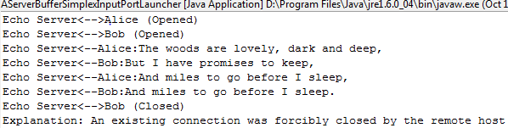
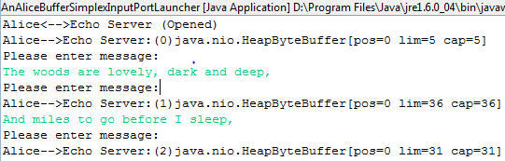
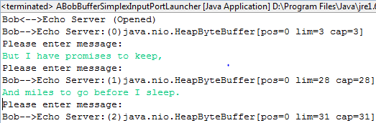
Echo Server
Server
Alice Client
Bob Client

Slide 32
Connection Messages

Slide 33
Tracing Connection Listener
public class ATracingConnectionListener implements ConnectionListener {
InputPort inputPort;
public ATracingConnectionListener(InputPort anInputPort) {
inputPort = anInputPort;
}
public void disconnected(String aRemoteEnd, boolean anExplicitClose,
String aSystemMessage) {
System.out.println(inputPort.getLocalName() + "<-->" +
aRemoteEnd + " (Closed)");
if (anExplicitClose) {
System.out.println("Explanation: Explicit disconnect");
} else {
System.out.println("Explanation: " + aSystemMessage);
}
}
public void connected(String aRemoteEnd) {
System.out.println(inputPort.getLocalName() + "<-->" + aRemoteEnd
+ " (Opened)");
}
public void notConnected(String aRemoteEnd, String aMessage) {
System.out.println (inputPort.getLocalName() + "<-->" + aRemoteEnd +
" (Could not connect)");
}
}

Slide 34
Echo Messages

Slide 35
Echoing Receive Listener
public class AnEchoingReceiveListener
implements ReceiveListener<ByteBuffer> {
InputPort inputPort;
public AnEchoingReceiveListener (InputPort anInputPort) {
inputPort = anInputPort;
}
public void messageReceived(String aRemoteEnd,
ByteBuffer aMessage) {
System.out.println(
inputPort.getLocalName() + "<--" + aRemoteEnd + ":" +
Misc.toString(aMessage));
}
}

Slide 36
Send Tracing Messages
Hand shake message sending client name

Slide 37
Tracing Send Listener
public class ATracingSendListener
implements ByteBufferSendListener {
InputPort inputPort;
public ATracingSendListener(InputPort inputPort) {
inputPort = anInputPort;
}
public void messageSent(String aRemoteEnd,
ByteBuffer aMessage, int aSentId) {
System.out.println(clientInputPort.getLocalName() +
"-->" + aRemoteEnd + ":(" + aSentId + ")" + aMessage);
}
}

Slide 38
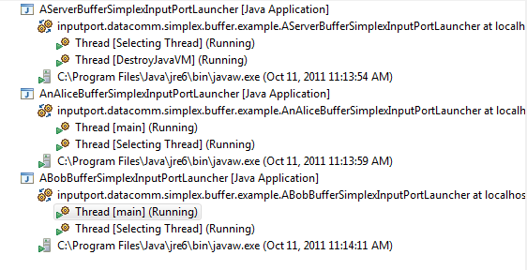
Echo Server

Slide 39
Server
public class AServerBufferSimplexInputPortLauncher extends
ASimplexBufferInputPortLauncher {
public static void main (String[] args) {
setTracing();
SimplexServerInputPort<ByteBuffer> aServerInputPort =
BufferSimplexInputPortSelector.createServerSimplexInputPort(
SERVER_PORT, SERVER_NAME);
addListeners(aServerInputPort);
aServerInputPort.connect();
}
public static void addListeners(
SimplexServerInputPort<ByteBuffer> aServerInputPort) {
aServerInputPort.addConnectionListener(
new ATracingConnectionListener(aServerInputPort));
aServerInputPort.addReceiveListener(
new AnEchoingReceiveListener(aServerInputPort));
}
}
More on tracing later
Why factory choice and constants not in class?

Slide 40
Code Shared with Client
public class ASimplexBufferInputPortLauncher {
final static String SERVER_NAME = "Echo Server";
final static String SERVER_PORT = "9090";
static {
SimplexInputPortFactory<ByteBuffer> factory =
new AnNIOSimplexBufferInputPortFactory();
BufferSimplexInputPortSelector.
setSimplexBufferInputPortFactory(factory);
}
public static void setTracing() {
Tracer.showInfo(false);
}
}
Must ensure server and client agree on server id and name and factory

Slide 41
Alice/Bob Clients
public class AnAliceBufferSimplexInputPortLauncher {
public static String ALICE = "Alice";
public static void main (String[] args) {
AClientSimplexBufferInputPortLuancher.launch(ALICE);
}
}
public class ABobBufferSimplexInputPortLauncher {
public static String BOB = "Bob";
public static void main (String[] args) {
AClientSimplexBufferInputPortLuancher.launch(BOB);
}
}
}

Slide 42
Shared Client Code
public class AClientSimplexBufferInputPortLuancher
extends ASimplexBufferInputPortLauncher{
public static final String SERVER_HOST = "localhost";
public static void launch (String clientName) {
Tracer.showInfo(false);
SimplexClientInputPort<ByteBuffer> clientInputPort =
BufferSimplexInputPortSelector.createClientSimplexInputPort(
SERVER_HOST, SERVER_PORT, SERVER_NAME, clientName);
addListeners(aClientInputPort);
clientInputPort.connect();
processInput(clientInputPort);
}
public static void addListeners(
SimplexClientInputPort<ByteBuffer> aClientInputPort) {
aClientInputPort.addConnectionListener(
new ATracingConnectionListener(aClientInputPort));
aClientInputPort.addSendListener(
new ATracingSendListener(aClientInputPort));
}

Slide 43
Shared Client Code: Process Input
public static void processInput (
SimplexClientInputPort<ByteBuffer> clientInputPort) {
String stringMessage;
ByteBuffer message;
Scanner in = new Scanner(System.in);
while (true) {
System.out.println("Please enter message:");
stringMessage = in.nextLine();
message = ByteBuffer.wrap(stringMessage.getBytes());
clientInputPort.send(message);
}
}
}

Slide 44
GIPC Design Features
Input Port, Byte and Object, Simplex and Duplex, Can be used to simulate multiple duplex ports
Not blocking but delivered and submitted message same
Observer pattern
Factory based configuration of lower level layer

Slide 45
GIPC from Inside and Outside
Application Code
Looked at GIPC from Outside (API)
GIPC Application Interfaces
GIPC Implementation
Inside?

Slide 46
Degree of Examination?
Complete code details probably not interesting and too time consuming
Not all code details well thought out
Aspects relevant to assignments, but perhaps not interesting
Aspects particularly interesting

Slide 47
GIPC from Inside and Outside
Application Code
Decomposition into layers?
GIPC Application Interfaces
GIPC Implementation

Slide 48
Monolithic Channel-Specific Implementation
Application Code
Channel: Mechanism that delivers and receives messages on the network
GIPC Application Interfaces
Socket Implementation (reliable)
NIO Implementation (reliable, blocking)
Others Channel-Specific Implementations
Common code?
Abstract Factory
Observer registration an d notification
Socket
NIO
Other

Slide 49
GIPC from Inside and Outside (Review)
Application Code
Decomposition into layers?
GIPC Application Interfaces
GIPC Implementation

Slide 50
Monolithic Channel-Specific Implementation (Review)
Application Code
Channel: Mechanism that delivers and receives messages on the network
GIPC Application Interfaces
Socket Implementation (reliable)
NIO Implementation (reliable, blocking)
Others Channel-Specific Implementations
Common code?
Abstract Factory
Observer registration an d notification
Socket
NIO
Other

Slide 51
Channel-independent Port Skeletons and Channel-Specific Port Drivers
Application Code
GIPC Interfaces
GIPC Port Skeletons and Helper Classes
Input Port (Server and Client) Reliable Socket Drivers
Input Port (Server and Client) Reliable NIO Driver
Others Channel-Specific Drivers
Socket
NIO
Other

Slide 52
Analogous Device Architecture
Application Code
Device-Independent I/O
Device-Independent Drivers (read() )
GIPC→ Channel (Socket, NIO) ~
Channel → Device
Teletype Driver (ttyRead())
File Driver (fileRead())
Socket Drivers (socketRead())
Socket factories provide different socket implementations
Terminal Interface
Disk Interface
Network Interface
No abstract factory concept

Slide 53
Client Skeleton and Driver
Simplex Client InputPort <ByteBuffer>
SimplexClient InputPortSkeleton <MessageChannelType>
HAS-A
AnNIOSimplex BufferClientInput Driver <SocketChannel>
implements
AGeneric Simplex Buffer ClientInputPort <MessageChannelType>
SimplexBuffer ClientInputPort Driver <MesageChannelType>
HAS-A
implements
Upcalls or callbacks
Connection, send event, which may not occur immediately
Skeleton may store channel (e.g. SocketChannel, Socket) specific data

Slide 54
Server Skeleton and Driver
Simplex ServerInputPort <ByteBuffer>
SimplexServer InputPortSkeleton <OpenChannelType, MessageChannelType>
HAS-A
AnNIOSimplex ServerInput Driver <ServerSocketChannel, SocketChannel>
implements
AGeneric Simplex Buffer ServertInputPort <RequestChannelType, MessageChannelType>
SimplexBuffer ServertInputPort Driver <RequestChannelType, MessageChannelType>
HAS-A
implements
Upcalls or callbacks
Connection, receive event
Request channel (e.g. ServerSocketChannel), Socket and message channel (e.g. SocketChannel, Socket)

Slide 55
Extensibility
What if we want to add delays with messages?
Application Code
Do not want to duplicate code in different drivers
GIPC Interfaces
GIPC Port Skeletons and Helper Classes
Can change or subclass skeletons
Input Port (Server and Client) Reliable Socket Drivers
Input Port (Server and Client) Reliable Socket Driver
Others Channel-Specific Drivers
Need to worry about several unrelated concepts such as connection
Socket
NIO
Other
Sometimes all we want to do is trap receives and sends

Slide 56
Pipe-Based Extensibility
Send
Receive
Application Code
Producer
Consumer
GIPC Interfaces
GIPC Port Skeletons and Helper Classes
Consumer
Consumer
Producer
Producer
Input Port (Server and Client) Reliable Socket Drivers
Input Port (Server and Client) Reliable NIO Driver
Others Channel-Specific Drivers
Consumer
Producer
Producer
Consumer
Socket
NIO
Other
Consumer
Producer
Can add arbitrary long chains of application message trappers between a producer/consumer pair

Slide 57
Communication Flow and Trappers
GIPC Receive Notifier
GIPC Send Caller (Client Skeleton)
notifyPortReceive(String remoteEnd, MessageType message)
External Send Trapper
send(String aRemoteEnd, MessageType aMessage)
External Receive Trapper
External Send Trapper
notifyPortReceive(String remoteEnd, MessageType message)
External Receive Trapper
GIPC Send Destination (Client Driver)
GIPC Receive Listener (Server Skeleton)
send(String aRemoteEnd, MessageType aMessage);

Slide 58
Send Trapper
UniNamingSender <OutMessageType>
send(String aRemoteEnd, MessageType aMessage)
Implementation of SendTrapper <InMessageType, OutMessageType>
has-a
extends
implements
SendTrapper <InMessageType, OutMessageType>
UniNamingSender <OutMessageType> Destination
Property with getter and setter
UniNamingSender <OutMessageType> getDestination()
Void setDestination(UniNamingSender <OutMessageType> d)

Slide 59
Receive Trapper
ReceiveNotifier <InMessageType>
notifyPortReceive(String aRemoteEnd, MessageType aMessage);
Implementation of AReceive Trapper <InMessageType, OutMessageType>
has-a
extends
implements
Receive Trapper <InMessageType, OutMessageType>
ReceiveNotifier <OutMessageType> destination

Slide 60
Attaching Trappers
Receive Trapper <InMessageType, OutMessageType>
ReceiveTrapper
<InMessageType, OutMesageType> receiverTrapper
GIPC Datacomm Port <MessageType>
SendTrapper
<InMessageType, OutMesageType> sendTrapper
Application-defined trappers can be statically/dynamically attached to a data communication port
Send Trapper <InMessageType, OutMessageType>
Factory selector used by port to initialize trapper (chain)
Port provides setters/getters for replacing or changing trapper chain
Predefined trappers for fault tolerance, causality, delays, and (de)serialization

Slide 61
Trapper Factory
ReceiveTrapperFactory <InMessageType, OutMessageType>
ReceiveTrapper<InMessageType, OutMessageType>
createReceiveTrapper(InputPort anInputPort,
ReceiveNotifier<OutMessageType> aDestination) ;
SendTrapperFactory <InMessageType, OutMessageType>
SendTrapper<InMessageType, OutMessageType>
createSendTrapper(InputPort anInputPort,
UniNamingSender<OutMessageType> aDestination) ;
So far, a single selector class with static methods for each factory kind
All ports will not use a single factory and hence selector
Predefined trappers for fault tolerance, causality, delays, and (de)serialization
Buffer data port uses simple forwarder factory and object data port uses forwarder + (de) serializer
These ports must use different selectors each of which chooses, for instance, appropriate (de)serializer
Different implementations of a (factory) interface do not always create alternative implementations

Slide 62
Trapper Selector Interface
TrapperSelector <SendInMessageType, SendOutMessageType>
SendTrapperFactory<SendInMessageType,
SendOutMessageType> sendTrapperFactory();
ReceiveTrapperFactory<SendOutMessageType,
SendInMessageType> receiveTrapperFactory();
How is trapper selector selected?

Slide 63
Global Selectors
GlobalState
static TrapperSelector<ByteBuffer, ByteBuffer>
simplexBufferClientIPTrapperSelector
static TrapperSelector<ByteBuffer, ByteBuffer>
simplexBufferServerIPTrapperSelector
Used by simplex server and client skeletons
Other selectors used by different kinds of ports

Slide 64
Simplex Buffer Ports
Send
Receive
Application Code
Producer
Consumer
GIPC Interfaces
GIPC Port Skeletons and Helper Classes
Consumer
Consumer
Producer
Producer
Input Port (Server and Client) Reliable Socket Drivers
Input Port (Server and Client) Reliable NIO Driver
Others Channel-Specific Drivers
Consumer
Producer
Producer
Consumer
Socket
NIO
Other
Consumer
Producer
Tasks performed by skeletons and helper classes and drivers?

Slide 65
Tasks Types
Independent of Data Comm or RPC
inputport
Data type (buffer, object) independent
inputport.simplex
Buffer dependent but driver independent
inputport.simplex.buffer
Driver dependent
inputport.simplex.buffer.nio

Slide 66
Tasks Types (Review)
Independent of Data Comm or RPC
inputport
Data type (buffer, object) independent
inputport.simplex
Buffer dependent but driver independent
inputport.simplex.buffer
Driver dependent
inputport.simplex.buffer.nio

Slide 67
Registering/Notifying Connection Listeners
AConnectionRegistrar AndNotifier
inputport
addConnectionListener(ConnectionListener l);
removeConnectionListener(ConnectionListener l);
notifyConnect (String remoteEnd)
notifyConnectFailure (String remoteEnd,
String message)
notifyDisconnect (String aRemoteEnd,
boolean anExplcitClose, String aCloseReason
Notification methods call corresponding listener methods

Slide 68
Notification Example
public void notifyConnect (String remoteEnd) {
Tracer.info(this, "Notifying connect to:" + remoteEnd);
for (ConnectionListener
portConnectListener:portConnectListeners)
portConnectListener.connected(remoteEnd);
}
Trace is an executable form of comments

Slide 69
Registering and Notifying Send Listeners
ASendRegistrar AndNotifier
inputport.simplex. buffer
addSendListener(ByteBufferSendListener l);
removeSendListener( ByteBufferSendListener l);
notifyPortSend(String aRemoteEnd,
ByteBuffer message, int sendId)
A single implementation for all dataports
But it understand byte buffers

Slide 70
Registering and Notifying Receive Listeners
AReceiveRegistrar AndNotifier
<MessageType>
inputport.simplex
addReceiveListener(ReceiveListener<MessageType> l)
removeReceiveListener(ReceiveListener<MessageType> l)
notifyPortReceive (String remoteEnd,
MessageType message)
Definition and implementation of methods independent of data type

Slide 71
Type Independent Notification
public void notifyPortReceive (String remoteEnd,
MessageType message) {
Tracer.info(this, "Notifying receive listeners");
for (ReceiveListener<MessageType>
portReceiveListener:portReceiveListeners)
portReceiveListener.messageReceived(remoteEnd, message);
}
A single implementation notifying receive listeners of different types
ByteBuffer listener notified the same way as Object listener

Slide 72
Connection and Communication
Establishing channel connections between client and server
Sending and receiving messages on channels
Sending and receiving full byte buffers
Sending and receiving logical names
Translating between logical remote end and channel?
Detecting channel failures

Slide 73
Client Skeleton and Driver
Simplex Client InputPort <ByteBuffer>
SimplexClient InputPortSkeleton <MessageChannelType>
HAS-A
AnNIOSimplex BufferClientInput Driver <SocketChannel>
implements
AGeneric Simplex Buffer ClientInputPort <MessageChannelType>
SimplexBuffer ClientInputPort Driver <MesageChannelType>
HAS-A
implements
Skeleton has two interfaces: one (port)for the application and one (skeleton) for the driver.

Slide 74
Server Skeleton and Driver
Simplex ServerInputPort <ByteBuffer>
SimplexServer InputPortSkeleton <OpenChannelType, MessageChannelType>
HAS-A
AnNIOSimplex ServerClientInput Driver <ServerSocketChannel, SocketChannel>
implements
AGeneric Simplex Buffer ServertInputPort <RequestChannelType, MessageChannelType>
SimplexBuffer ServertInputPort Driver <RequestChannelType, MessageChannelType>
HAS-A
implements

Slide 75
Client Input Port Connection and Communication: Application API
AGeneric Simplex Buffer ClientInputPort <MessageChannelType>
inputport.simplex.buffer
(dis)connect
send (String destination, ByteBuffer message)
Client name sent for all channels, hence sent by client skeleton on connection and received by server skeleton
Since there is only one channel, no need for translation between logical name and channel

Slide 76
Client Driver
AnNIOSimplexBuffer ClientInputPortDriver <SocketChannel>
inputport.simplex. buffer.nio
setSkeleton(SimplexClientInputPortSkeleton<MessageChannelType> theSkeleton)
(dis)connect();
send(String aRemoteEnd, ByteBuffer aMessage);
(Dis) Connects at channel level
Must send information so the receiver can receive the complete buffer
Must send the complete byte buffer
How this is done may depend on channel
May involve sending multiple channel messages

Slide 77
Client Skeleton (Upcalls)
AGeneric Simplex Buffer ClientInputPort <MessageChannelType>
setDriver(SimplexBufferClientInputPortDriver
<MessageChannelType> d);
connected(String aRemoteEnd);
notConnected(String aRemoteEnd, String anExplanation)
Server is well known name known to driver at creation time
disconnected(String aRemoteEnd, boolean anExplicitClose, String anExplanation);
messageSent(String aRemoteEnd, ByteBuffer aMessage, int aSendId);
Upcalls for operation completion or failure
Skeleton forwards to connect notifier (seen earlier)
Client driver supports (dis)connect and send operation
Skeleton forwards to send notifier (seen earlier)

Slide 78
Server Input Port Connection and Communication: Application API
AGeneric Simplex Buffer ServerInputPort <RequestChannelType, MessageChannelType>
inputport.simplex.buffer
(dis)connect
No calls to receive messages and port is simplex
Connect does not have to send name
Disconnect must remove channel and all message channels
Skeleton keeps track of all message channels

Slide 79
Server Driver
AnNIOSimplexBuffer ServerInputPortDriver <ServerSocketChannel, SocketChannel>
setSkeleton(SimplexServerInputPortSkeleton <RequestChannelType, MessageChannelType> aSkeleton);
(dis)connect()
disconnect(MessageChannelType aChannel);
(Dis)connect (closes) creates request channel and allow it to be connected by clients
Skeleton disconnect closes request channel and all message channels
Disconnect message channel, called by skeleton

Slide 80
Server Skeleton
AGeneric Simplex Buffer ClientInputPort <RequestChannelType, MessageChannelType>
setDriver(SimplexBufferServerInputPortDriver
<RequestChannelType, MessageChannelType> )
connected(String aRemoteEnd);
Client connect notifications
notConnected(String aRemoteEnd, String anExplanation)
disconnected (String aRemoteEnd, boolean anExplicitClose, String anExplanation);
Server skeleton maintains channel to logical name mapping
String getClientName(MessageChannelType channel,)
MessageChannelType getChannel(String clientName,)
messageReceived(MessageChannelType channel,
ByteBuffer message)
messageReceived takes channel as its first call associates received name to channel
Must receive full message from client

Slide 81
Tasks: Selecting and Defining Trappers
GIPC Receive Notifier
GIPC Send Caller (Client Skeleton)
notifyPortReceive(String remoteEnd, MessageType message)
Channels are end nodes so oblivious of trappers
External Send Trapper
send(String aRemoteEnd, MessageType aMessage);
Each port can select initial trappers (changed at runtime by that port or some other object)
External Receive Trapper
Many ports share common trappers
External Send Trapper
notifyPortReceive(String remoteEnd, MessageType message)
External Receive Trapper
Forwarding trappers and associated factories
GIPC Send Destination (Client Driver)
GIPC Receive Listener (Server Skeleton)
send(String aRemoteEnd, MessageType aMessage);

Slide 82
Send Forwarder
public class ASendMessageForwarder<InAndOutMessageType> extends
AnAbstractSendTrapper<InAndOutMessageType, InAndOutMessageType>{
public ASendMessageForwarder(
UniNamingSender<InAndOutMessageType> aDestination) {
super (aDestination);
}
public void send(String remoteName, InAndOutMessageType message) {
Tracer.info(this, "Forwarding sent message " + message);
destination.send(remoteName, message);
}
}
Inputport.datacomm

Slide 83
Send Forwarder factory
public class ASendMessageForwarderFactory<InAndOutMessageType> implements
SendTrapperFactory<InAndOutMessageType, InAndOutMessageType> {
public SendTrapper<InAndOutMessageType, InAndOutMessageType>
createSendTrapper(InputPort anInputPort,
UniNamingSender<InAndOutMessageType> aDestination) {
return new ASendMessageForwarder (aDestination);
}
}
Inputport.datacomm

Slide 84
Receive Forwarder
public class AReceiveMessageForwarder<InAndOutMessageType> extends
AnAbstractReceiveTrapper<InAndOutMessageType, InAndOutMessageType> {
public AReceiveMessageForwarder(InputPort anInputPort,
ReceiveNotifier<InAndOutMessageType> aReceiveNotifier) {
super (aReceiveNotifier);
}
public void notifyPortReceive(String remoteEnd,
InAndOutMessageType message) {
Tracer.info(this, “Forwarding received message " + message);
destination.notifyPortReceive(remoteEnd, message);
}
}
Inputport.datacomm

Slide 85
Send Forwarder factory
public class AReceiveMessageForwarderFactory<InAndOutMessageType> implements ReceiveTrapperFactory<InAndOutMessageType, InAndOutMessageType> {
public ReceiveTrapper<InAndOutMessageType, InAndOutMessageType>
createReceiveTrapper(InputPort anInputPort,
ReceiveNotifier<InAndOutMessageType> aReceiveNotifier) {
return new AReceiveMessageForwarder(anInputPort, aReceiveNotifier);
}
}
Inputport.datacomm

Slide 86
Tasks Types
Independent of Data Comm or RPC
Application connection observers (registry, notification)
Data type (buffer, object) independent
Application send, receive observers (registry, notification), forwarders and factories
Buffer dependent but driver independent
Logical names, and mapping to channels, trapper selection and maybe implementation
Driver dependent
Physical connection and communication, and send/receipt of full messages

Slide 87
Tasks Types
Independent of Data Comm or RPC
inputport
Data type (buffer, object) independent
inputport.simplex
Determine at runtime the division of labor?
Buffer dependent but driver independent
inputport.simplex.buffer
Driver dependent
inputport.simplex.buffer.nio

Slide 88
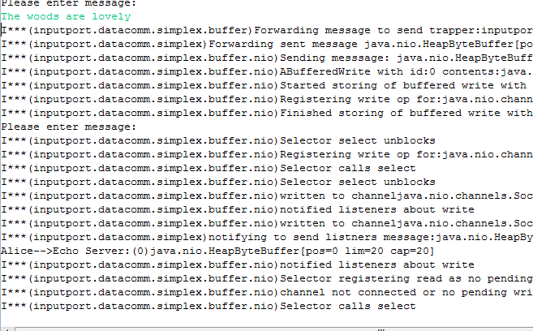
Trace
Tracer.showInfo(true");
May not want to to know about nio
Filtering?

Slide 89
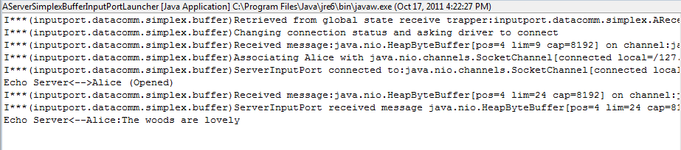
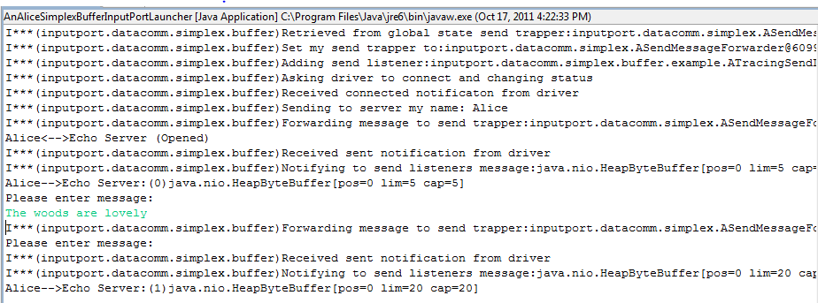
Only InputPort.DataComm.Simplex.Buffer

Slide 90
Explicit Keywords
public static void info(String keyWord, String info);
Tracer.info(“inputport.datacomm.simplex.buffer", "Asking driver to connect and changing status");
public static void setKeyWordStatus(
String keyWord,
Boolean status);
Tracer.setKeyWordStatus(“inputport.datacomm.simplex.buffer", true)
Tracer.setKeyWordStatus(Tracer.ALL_KEYWORDS, false);
Have to specify package name each time
Package name can change

Slide 91
Implicit KeyWords
public static void info(Object object, String info);
Tracer.info(this, "Asking driver to connect and changing status");
public static void setKeyWordStatus(Class c, Boolean status);
Tracer.setKeyWordStatus(
AGenericSimplexBufferClientInputPort.class,
false);

Slide 92
Showing Package Names
Cannot identify classes of the objects printing out messages
Tracer.showInfo(true);
Tracer.setKeyWordStatus(Tracer.ALL_KEYWORDS, false);
Tracer.setKeyWordStatus(
AGenericSimplexBufferClientInputPort.class, true);
Tracer.setMessagePrefixKind(MessagePrefixKind.PACKAGE_NAME);

Slide 93
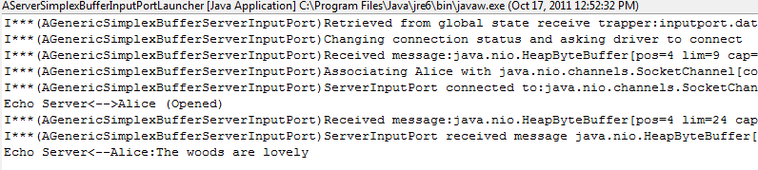
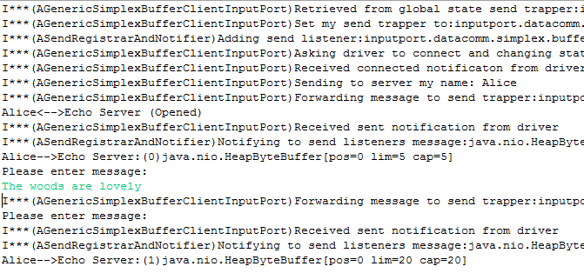
Showing Short Class Names
Tracer.showInfo(true);
Tracer.setKeyWordStatus(Tracer.ALL_KEYWORDS, false);
Tracer.setKeyWordStatus(
AGenericSimplexBufferClientInputPort.class, true);
Tracer.setMessagePrefixKind(MessagePrefixKind.SHORT_CLASS_NAME)

Slide 94
MessagePrefix
public static void setMessagePrefixKind(
MessagePrefixKind newValue)
public enum MessagePrefixKind {
NONE,
OBJECT_TO_STRING,
SHORT_CLASS_NAME,
FULL_CLASS_NAME,
PACKAGE_NAME
}

Slide 95
Displaying All Classes in Package
Tracer.showInfo(true);
Tracer.setKeyWordStatus(Tracer.ALL_KEYWORDS, false);
Tracer.setKeyWordStatus(
AGenericSimplexBufferClientInputPort.class, true);
Tracer.setMessagePrefixKind(MessagePrefixKind.SHORT_CLASS_NAME)
What if we want to focus on one class?

Slide 96

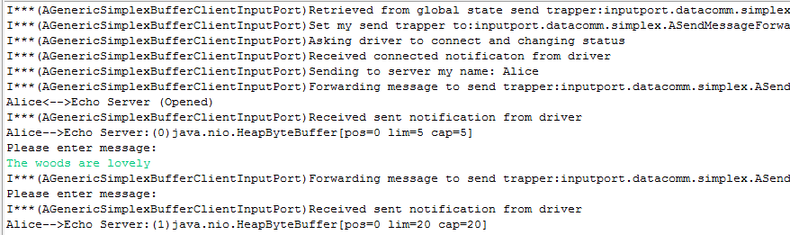
Controlling Implicit Keyword
Tracer.showInfo(true);
Tracer.setKeyWordStatus(Tracer.ALL_KEYWORDS, false);
Tracer.setImplicitKeywordKind(ImplicitKeywordKind.OBJECT_CLASS_NAME);
Tracer.setKeyWordStatus(
AGenericSimplexBufferClientInputPort.class, true);
Tracer.setMessagePrefixKind(MessagePrefixKind.SHORT_CLASS_NAME);

Slide 97
Implicit Keyword
public static void setImplicitKeywordKind(
ImplicitKeywordKind newValue)
public enum ImplicitKeywordKind {
OBJECT_TO_STRING,
OBJECT_CLASS_NAME,
OBJECT_PACKAGE_NAME
}

Slide 98
Simplex Echo Server
Server
Alice Client
Bob Client

Slide 99
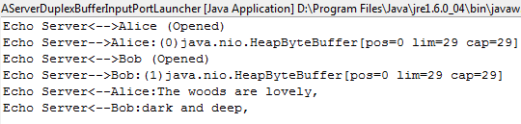
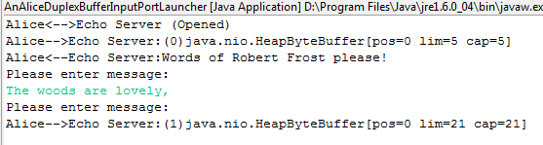
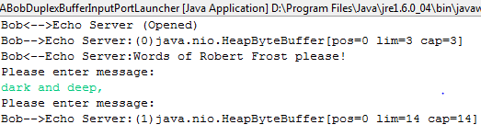
Duplex Echo Server
Server
Alice Client
Bob Client

Slide 100
Sublcassed Server Connection Listener
public class ASendingConnectionListener extends ATracingConnectionListener {
DuplexInputPort<ByteBuffer> duplexInputPort;
public static final String CONNECT_MESSAGE =
"Words of Robert Frost please!";
public ASendingConnectionListener(DuplexInputPort<ByteBuffer> anInputPort) {
super(anInputPort);
duplexInputPort = anInputPort;
}
public void connected(String aRemoteEnd) {
super.connected(aRemoteEnd);
duplexInputPort.send(aRemoteEnd,
ByteBuffer.wrap(CONNECT_MESSAGE.getBytes()));
}
}
Server send must specify client name
Client send can also specify redundant server name to create common send trapper interface

Slide 101
Duplex Server
public class AServerDuplexBufferInputPortLauncher extends ADuplexBufferInputPortLauncher {
public static void main (String[] args) {
setTracing();
DuplexServerInputPort<ByteBuffer> aServerInputPort =
BufferDuplexInputPortSelector.createDuplexServerInputPort(
SERVER_PORT, SERVER_NAME);
addListeners(aServerInputPort);
aServerInputPort.connect();
}
public static void addListeners(
DuplexServerInputPort<ByteBuffer> aServerInputPort) {
aServerInputPort.addConnectionListener(
new ASendingConnectionListener(aServerInputPort));
aServerInputPort.addReceiveListener(
new AnEchoingReceiveListener(aServerInputPort));
aServerInputPort.addSendListener(
new ATracingSendListener(aServerInputPort));
}
}

Slide 102
Code Shared with Client
public class ADuplexBufferInputPortLauncher extends
ASimplexBufferInputPortLauncher {
static {
DuplexInputPortFactory<ByteBuffer> factory =
new AnNIODuplexBufferInputPortFactory();
BufferDuplexInputPortSelector.setDuplexBufferInputPortFactory(
factory);
}
public static void setTracing() {
Tracer.showInfo(false);
}
}

Slide 103
Client Code
public class AClientDuplexBufferInputPortLauncher
extends ADuplexBufferInputPortLauncher{
public static final String SERVER_HOST = "localhost";
public static void launch (String clientName) {
setTracing();
DuplexClientInputPort<ByteBuffer> aClientInputPort =
BufferDuplexInputPortSelector.createDuplexClientInputPort(
SERVER_HOST, SERVER_PORT, SERVER_NAME, clientName);
addListeners(aClientInputPort);
aClientInputPort.connect();
AClientSimplexBufferInputPortLauncher.processInput(
aClientInputPort);
}
public static void addListeners(
DuplexClientInputPort<ByteBuffer> aClientInputPort) {
AClientSimplexBufferInputPortLauncher.addListeners(
aClientInputPort);
aClientInputPort.addReceiveListener(
new AnEchoingReceiveListener(aClientInputPort));
}
}

Slide 104
Duplex Input Port Interfaces
Simplex Client InputPort <MessageType>
Simplex ServerInputPort <MessageType>
send ( MessageType m)
addReceiveListener (ReceiveListener
<MessageType>)
send(String destination, MessageType m )
Same as reply, which is another send operation
extends
Duplex Client InputPort <MessageType>
DuplexServer InputPort <MessageType>
send ( MessageType m)
send (MessageType m)
addReceiveListener (ReceiveListener
<MessageType>)
addReceiveListener (ReceiveListener
<MessageType>)
send(String destination, MessageType m )
send(String destination, MessageType m )

Slide 105
Driver Inheritance
AnNIOSimplex BufferClientInput Driver <SocketChannel>
AnNIOSimplex ServerInput Driver <ServerSocketChannel, SocketChannel>
extends
AnNIODuplex BufferClientInput Driver <SocketChannel>
AnNIODuplex ServerInput Driver <ServerSocketChannel, SocketChannel>
Multiple inheritance missed
InputStream, OutputStrea, InputOutputStream are classical examples
Their work is delegated to helper classes (such as notification registrars) to reduce this problem)

Slide 106
Skeleton Inheritance
AGenericSimplexBuffer ClientInputPort <MessageChannelType>
AGenericSimplex uffer ServertInputPort <RequestChannelType, MessageChannelType>
extends
AGenericDuplex Buffer ClientInputPort <MessageChannelType>
AGenericDuplexBuffer ServertInputPort <RequestChannelType, MessageChannelType>
Multiple inheritance missed

Slide 107
Global Selectors
GlobalState
static TrapperSelector<ByteBuffer, ByteBuffer>
simplexBufferClientIPTrapperSelector
static TrapperSelector<ByteBuffer, ByteBuffer>
duplexBufferServerIPTrapperSelector
static TrapperSelector<ByteBuffer, ByteBuffer>
duplexBufferClientIPTrapperSelector
static TrapperSelector<ByteBuffer, ByteBuffer>
duplexBufferServerIPTrapperSelector
Simplex, Duplex Global Selector?

Slide 108
New Layering
Application Code
GIPC Duplex Interfaces
GIPC Simplex Interfaces
GIPC Duplex Port Skeletons and Helper Classes
GIPC Simplex Port Skeletons and Helper Classes
GIPC Duplex Drivers
GIPC Simplex Drivers

Slide 109
Server Connect
Server Application
addConnectListener()
Connect Registrar and Notifier
addConnectListener()
connect()
Server Port and Skeleton
connect()
Server Driver
Server Channel

Slide 110
Client Connect
Client Application
connected()
addConnectListener()
Connect Registrar and Notifier
addConnectListener(l)
connect()
Client Skeleton
connected()
Send Forwarder
Server Port and Skeleton
messagReceived()
connected()
connect()
Client Driver
Server Driver
Client Channel
Server Channel

Slide 111
Send and Receive Client Name
Server Application
connected()
Connect Registrar and Notifier
notifyConnected()
Client Skeleton
connected()
send()
Send Forwarder
Server Port and Skeleton
messagReceived()
send()
Server Driver
Server Driver
Client Channel
Server Channel

Slide 112
Send and Receive Message
Client Application
Server Application
messageSent()
messageReceved()
addSendListener()
addReceiveListener()
Send Registrar and Notifier
Receive Registrar and Notifier
notifyMessagSend()
notifyMessageReceived()
send()
Client Port and Skeleton
Receive Forwarder
messagSent()
notifyMessageReceived()
send()
Send Forwarder
Server Port and Skeleton
messagReceived*()
send()
Client Driver
Server Driver
Client Channel
Channel

