Slide 1
Comp 110/401 Appendix: Searching for Text in Eclipse
Instructor: Prasun Dewan (FB 150, dewan@unc.edu)

Slide 2
File Search in a Project (useful in Java Teaching and Your projects)
Suppose you want to search the entire project for some string such as some text in a Sakai question: such as “println(c) displays”

Slide 3
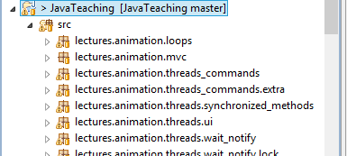
Select Project
Select project (not the src folder)

Slide 4
File→Search

Slide 5
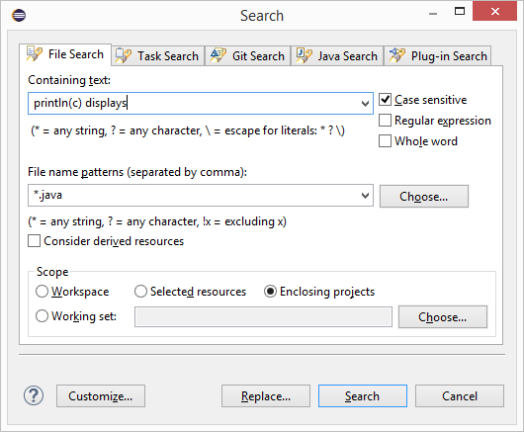
Search Dialog
Search string
Scope of search
Command

Slide 6
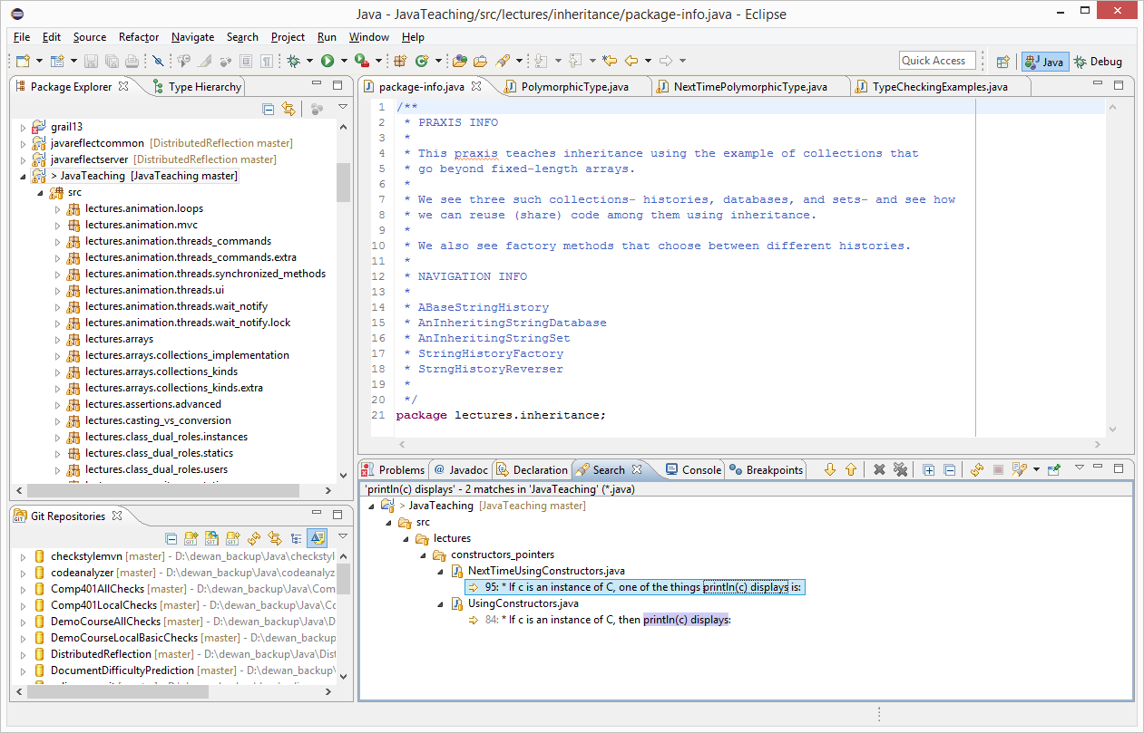
Search Results
Search view shown, console in another tab

Slide 7
Search Results Zoomed
Look at all the tabs availalale here

Slide 8
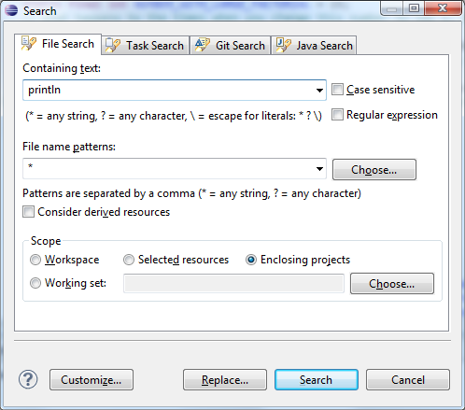
Multi File Text Search for Println

Slide 9
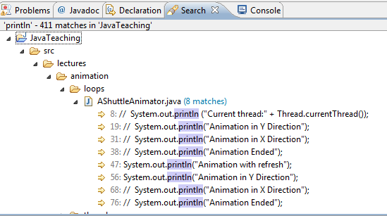
Search Results
Text search, shows uncommented println() also
Use CTR+SHIFT+G (shown earlier) to find active uses of the method

