Slide 1
Installing and running the local check and grader projects in Eclipse

Slide 2
Setup projects

Slide 3
Download projects from Github
Quick overview, in depth follows
File->Import…
Git->Projects from git
Clone URI
https://github.com/pdewan/Comp401LocalChecks.git
https://github.com/pdewan/GraderBasics.git
https://github.com/pdewan/Comp401AllChecks.git
https://github.com/pdewan/Grader.git
Grader branch = integration
Rest = master

Slide 4
Download projects from Github
Import project

Slide 5
Download projects from Github
Select “Projects from Git”

Slide 6
Download projects from Github
Clone URI
Comp401LocalChecks
https://github.com/pdewan/Comp401LocalChecks.git
GraderBasics
https://github.com/pdewan/GraderBasics.git
Comp401AllChecks
https://github.com/pdewan/Comp401AllChecks.git
Grader
https://github.com/pdewan/Grader.git

Slide 7
Download projects from Github
Set the URI for the project from GitHub
Eclipse autocompletes the rest

Slide 8
Download projects from Github
Choose the “master” branch for all but grader
Grader is “integration” branch

Slide 9
Download projects from Github
Choose a directory to save the git project

Slide 10
Download projects from Github
All projects are existing Eclipse projects

Slide 11
Download projects from Github
There may be other projects in the git repository, only import the relevant ones (not Assignments)

Slide 12
Correct dependencies
Projects
DemoCourseLocalBasicsChecks = Comp401LocalChecks
comp110-grader = Grader
Libraries
oeall22.jar from course website

Slide 13
Setup Checkstyle/UNC Checks (Windows)
Open “System” from “System and Security” in the Control Panel
Select “Advanced system settings”

Slide 14
Setup Checkstyle/UNC Checks (Windows)
Select Environment Variables…

Slide 15
Setup Checkstyle/UNC Checks (Windows)
Create a new environment variable called “CLASSPATH” and set it to contain 3 paths separated by semicolons
.
Path to checkstyle-6.5.0-all.jar
Path to UNC_Checks6.5.0.jar
.;C:\Users\Andrew\Documents\GitHub\Grader\checkstyle-classpath\checkstyle-6.5-all.jar;C:\Users\Andrew\Documents\GitHub\Grader\checkstyle-classpath\UNCChecks_6.5.0.jar

Slide 16
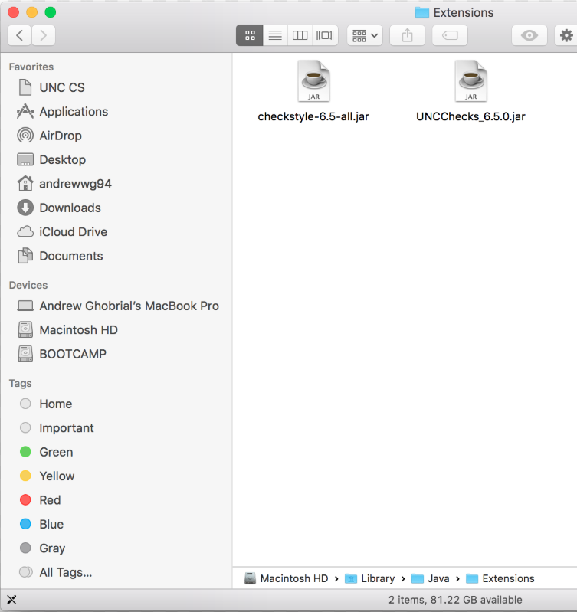
Setup Checkstyle/UNC Checks (Mac)
Add checkstyle files to Library/Java/Extensions
If you add oeall to it also, the UI becomes strange and bad
May need to add localcheckswithoutoe in folder to compile student files

Slide 17
Run local checks
see local checks ppt

Slide 18
Running the grader

Slide 19
What to run
gradingTools.Comp401Grader from Comp401AllChecks

Slide 20
Submissions directory structure
Should use data straight from Sakai
Check Comp401AllChecks\Test Data\Comp401F17\Assignment1 for example

Slide 21
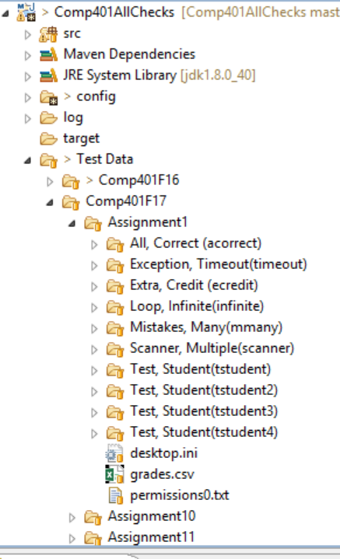
Test Directory Structure in Project
Sakai directory mimicked for different courses

Slide 22
First run
There will be a message about missing download path, this is okay
Grader saves paths, course/assignment choices, and onyens in config files when run

Slide 23
Setting download directory
Press browse next to Download Folder

Slide 24
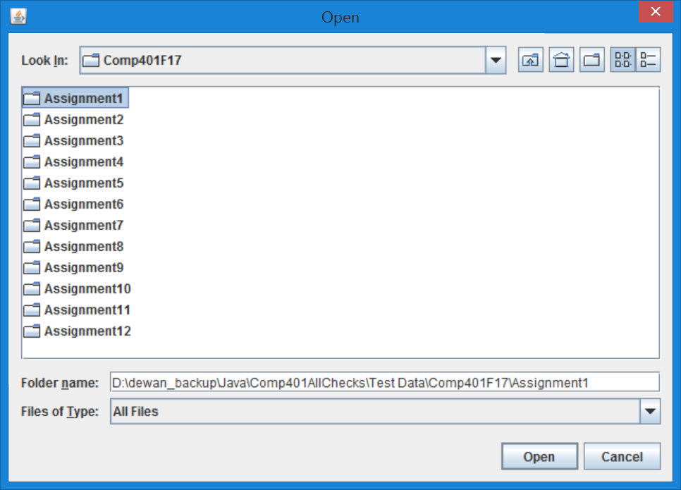
Setting download directory
Press browse next to Download Folder and browse to test data or actual data

Slide 25
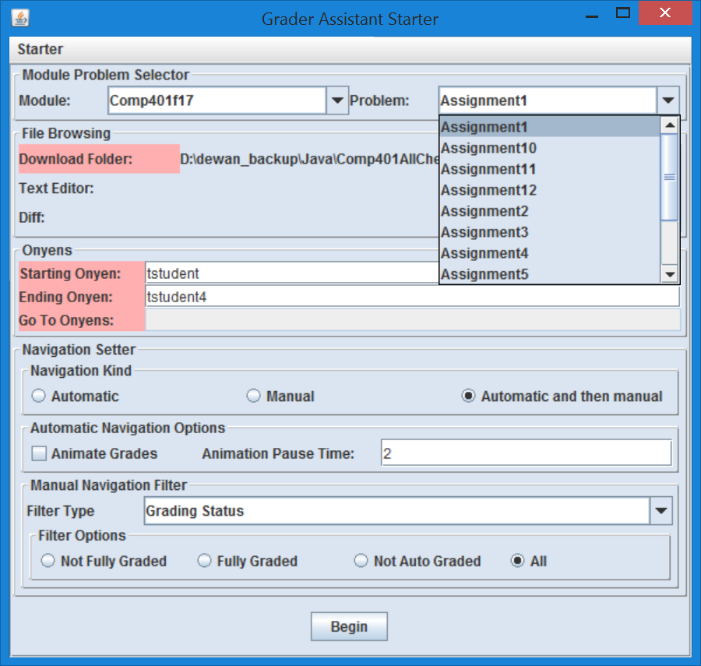
Setting download directory
Grader will know about all assignments in parent directory, so if parent directory is the same for all assignments, this step is not repeated for each course

Slide 26
Setting what to grade
Set Download folder to folder containing assignments
Set Module to correct course
Set Problem to assignment to grade

Slide 27
Setting who to grade
Range of onyens
First/last in starting/ending onyen boxes
List of onyens
Comma separated list I go to box.

Slide 28
Setting how to grade
Navigation Kind
Automatic
Auto grade all students then exits
Manual
No auto grading, just opens grading review view
Automatic and then manual
Runs all auto grading then opens the review view

Slide 29
Setting what to see
Automatic Navigation Options
Animate grades
Shows the review for each student view during auto grading
Animation pause time
Time before displaying next student after finishing previous

Slide 30
Setting what to see cont.
Manual Navigation Filter
Grading Status
How graded is the submission?
Note Status
How much has the grade been explained
Letter Grade
What grade was recieved

Slide 31
Grading
Run gradingTools.Comp401Driver from Comp401AllChecks
Select Relevant course (e.g. Comp401f17) in the “Module” dropdown
Set “Download Folder” to assignment directory
Select the correct assignment in the “Problem” dropdown
Enter first and last onyen to grade
Set “Navigation Kind” to “Automatic and then manual”
Select “Begin”

Slide 32
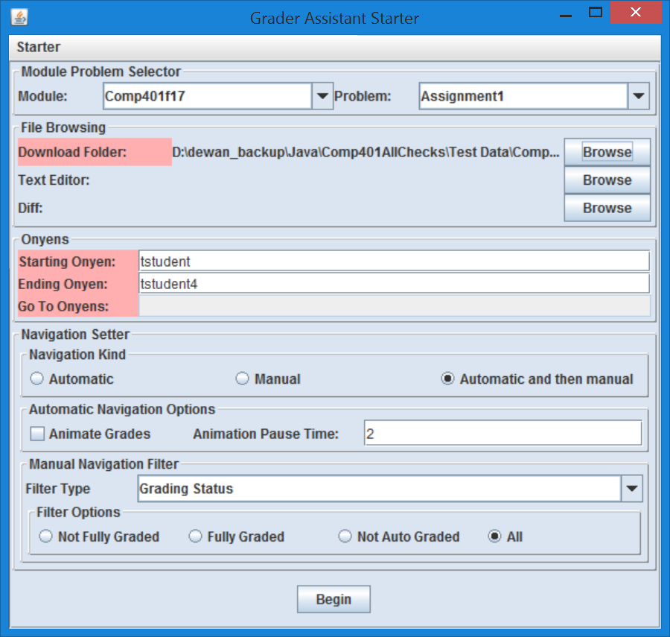
Pressing Begin on Test Data

Slide 33
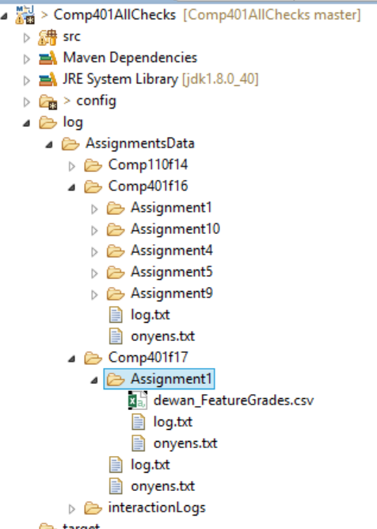
Missing Checkstyle File in Automatically or Manually created directory
ObjectEditor(Version 22, built on Thu Feb 16 12:15:26 EST 2017). Copyright Prasun Dewan, 2012, All rights reserved. US Patent Appl. No.: 12/532,327
W***Could not find checkstyle file:D:\dewan_backup\Java\Comp401AllChecks\.\log\AssignmentsData\Comp401f17\Assignment1/unc_checks_401_f17_a1.xml
W***Using default checkstyle file:config/checks.xml
Searching for onyens between:tstudent->tstudent4
Found start onyen:Test, Student(tstudent)

Slide 34
Download checkstyle file from course page
Scanning | PowerPoint PDF YouTube Mix | Docx PDF Drive | Scanning Visualization | A1. Number Scanner A1. Checks File | lectures.scanning Package Git (Scanning)
Class Dual Role | PowerPoint PDF YouTube Mix | Docx PDF Drive |  | A2. Number And Word Scanner Bean A2. Checks File | lectures.class_dual_roles.statics Package Git (Static) lectures.class_dual_roles.instances Package Git (Instances)

Slide 35
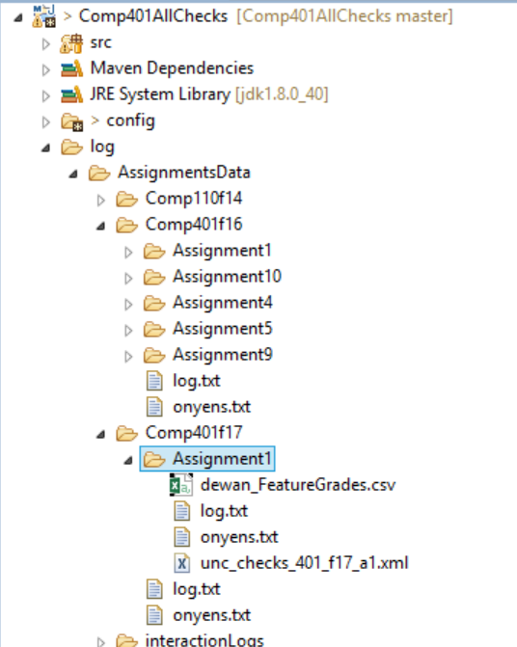
Checks file in log folder

Slide 36
How do you know checkstyle ran
Running command:java com.puppycrawl.tools.checkstyle.Main -c D:\dewan_backup\Java\Comp401AllChecks\.\log\AssignmentsData\Comp401f17\Assignment1/unc_checks_401_f17_a1.xml D:\dewan_backup\Java\Comp401AllChecks\Test Data\Comp401F17\Assignment1\Test, Student(tstudent3)\Submission attachment(s)\Assignment1-Semion\Assignment1\src
Running in folder: D:\dewan_backup\Java\Comp401AllChecks\.
$
Process line:Starting audit...
Starting audit...
Process line:D:\dewan_backup\Java\Comp401AllChecks\Test Data\Comp401F17\Assignment1\Test, Student(tstudent3)\Submission attachment(s)\Assignment1-Semion\Assignment1\src\main\Assignment1.java:0: expectedTypes: Expected type names/tags [main.Assignment1, ScanningIterator//EC]
D:\dewan_backup\Java\Comp401AllChecks\Test Data\Comp401F17\Assignment1\Test, Student(tstudent3)\Submission attachment(s)\Assignment1-Semion\Assignment1\src\main\Assignment1.java:0: expectedTypes: Expected type names/tags [main.Assignment1, ScanningIterator//EC]
Process line:D:\dewan_backup\Java\Comp401AllChecks\Test Data\Comp401F17\Assignment1\Test, Student(tstudent3)\Submission attachment(s)\Assignment1-Semion\Assignment1\src\main\Assignment1.java:1: warning: missingMethodCall: (Assignment1.java:1) has not made expected call (.*)!hasNext:->boolean//EC
D:\dewan_backup\Java\Comp401AllChecks\Test Data\Comp401F17\Assignment1\Test, Student(tstudent3)\Submission attachment(s)\Assignment1-Semion\Assignment1\src\main\Assignment1.java:1: warning: missingMethodCall: (Assignment1.java:1) has not made expected call (.*)!hasNext:->boolean//EC
Process line:D:\dewan_backup\Java\Comp401AllChecks\Test Data\Comp401F17\Assignment1\Test, Student(tstudent3)\Submission attachment(s)\Assignment1-Semion\Assignment1\src\main\Assignment1.java:1: Audit done.
setEarlyLatePoints:Setting Late Penalty:tstudent3 score 1.05

Slide 37
Note: clean slate to regrade onyens
Previously graded assignments will not be auto graded again
Clear old grading with clean slate under “Starter”
Clean Slate(String)
Enter onyen to be cleared
Clean Slate Specified
Clears based on onyen range in UI
Clean Slate All
Clears all students

Slide 38
Result UI Overview

Slide 39
Tabs
Main
Grading results
Source
Submitted source code
Feedback
Textual representation of grading results
Problem History
Grading results of other students
Source Checks
Checkstyle output
Student History
Previous results for current student

Slide 40
Main tab overview

Slide 41
Upper Left—Student Overview
Onyen
Name
Score
Early/late submission score multiplier

Slide 42
Upper Right—Navigation
Next/Previous
Move to next/previous student’s grading
Quit
Close grader (all grading saved)
Open Source/Explore Source
Open submitted source files in text editor
Sync
Save changed to text fields and submitted source files.

Slide 43
Upper Right—Navigation cont.
Next Document
Open next submitted document (pictures, text files, etc.)
First Document
Resets “Next Document” queue to first document
Run
Runs the submitted program allowing interaction
Stop If Not Done
Prevents closing the grader if grading is incomplete on any student
Navigation Distance
Current and total assignments graded

Slide 44
Middle—Grading results
Feature
Name of test
Max/Score
Maximum and actual points awarded
Score can be manually changed
Manual
If must be manually graded
Extra
Is extra credit?
Graded
Has been graded?

Slide 45
Middle—Grading results cont.
Full Credit
Auto graded as full points
Sets feature to full credit
Validate
Marks low scoring feature as being verified as graded properly
Selected
Display output of feature in “Auto Notes”
Auto/Manual Notes
Comments on auto/manual grading
Transcript
Raw output of grading program

Slide 46
Checkstyle tab

Slide 47
Notes for developers

Slide 48
Config files—dynamicmodules.properties
config/dynamicmodules.properties
Automatically generated by grader
List of modules for grader

Slide 49
Config files—dynamicconfig.properties
config/dynamicconfig.properties
Automatically generated by grader
Saves values of fields in UI
Directories
Course
Assignments
Onyens
Etc.

Slide 50
Config files—.gradersettings
.gradersettings
Automatically generated by grader
Small subset of data from dynamicconfig.properties

Slide 51
Config files—config.properties
config/config.properties
In depth grader runtime controls

Slide 52
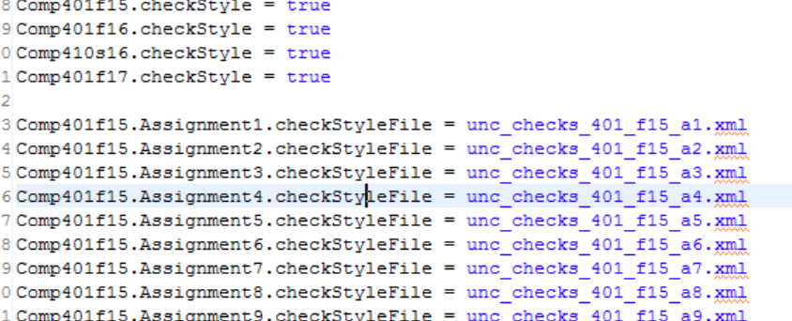
Config files—course.properties
config/course.properties
Course-specific settings
List of courses to display
Checkstyle config file asssociations
Whether checkstyle is used for course

Slide 53
Config files—user-config.properties
config/user-config.properties
When running in headless mode the configuration is changed based on command line arguments, the grader makes a copy of the config.properties file with any relevant changes and saves it as this so the default values aren’t changed in config.properties

