Slide 1
Comp 401-Learning Resources: From Slide PDFs to Praxes
Instructor: Prasun Dewan (FB 150, help401-002-f16@cs.unc.edu)

Slide 2
Text Book
No textbook for this unusual course.
Alternatives?

Slide 3
PDF of Slides

Slide 4
PowerPoint of Slides

Slide 5
Slide Show → Synchronized Recording and Animations
Can escape out into unsynchronized or no audio mode (WPS Office on Android will play synchronized audio)

Slide 6
PowerPoint Slides With Unsynchronized Recordings and Media Control

Slide 7
Recorded YouTube Videos
Play 2X,
rewind, pause, fast-forward to match understanding pace
Youtube video generated from PPT Recordings, does not allow slide-based browsing
PPT modes allow slide-based browsing but requires downloading PPT

Slide 8
Office Mix
Slide markers

Slide 9
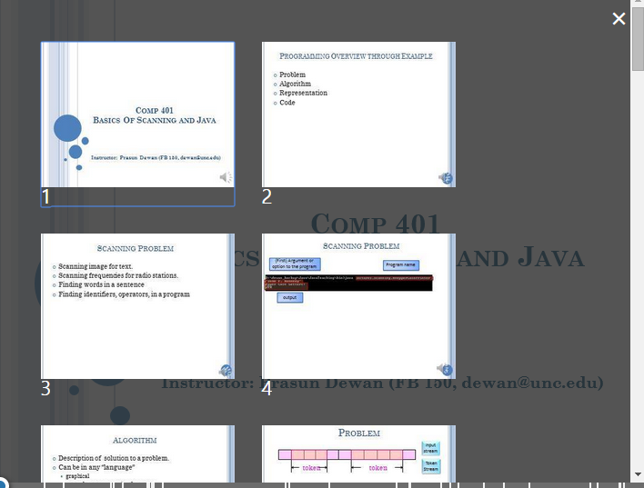
Slide-Based Browsing

Slide 10
Video Nature
Long pauses, you may know the answer
Recordings of live lectures with q/a rather than 15 minute lessons
Cannot hear student answer
Can fast forward
Audio is not the fastest way to get information, specially when studying for an exam
You can get a clue from my answer

Slide 11
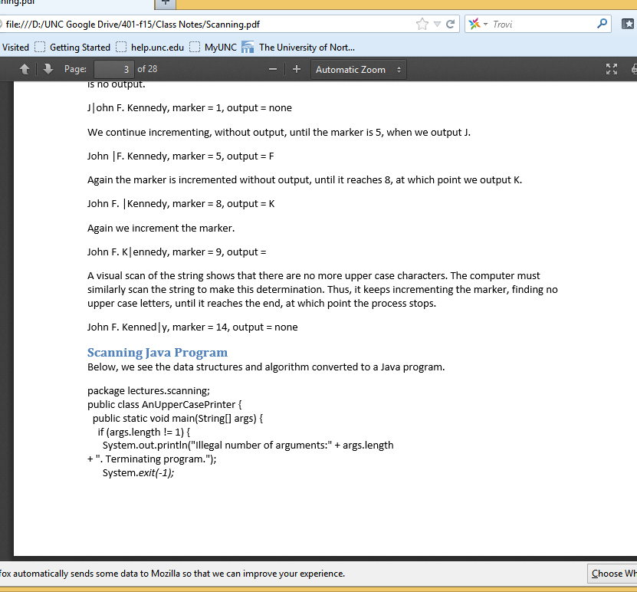
PDF of Word Documents
Little graphics, designed for mobile reading on mobile computers
Lots of (obvious) mistakes

Slide 12
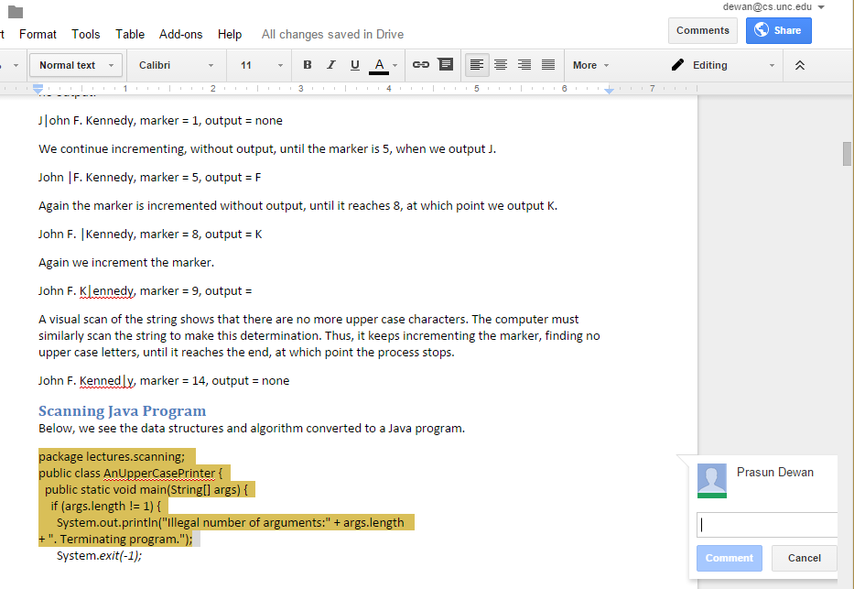
Publicly Commentable Google Docs

Slide 13
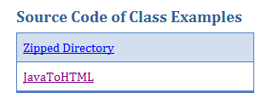
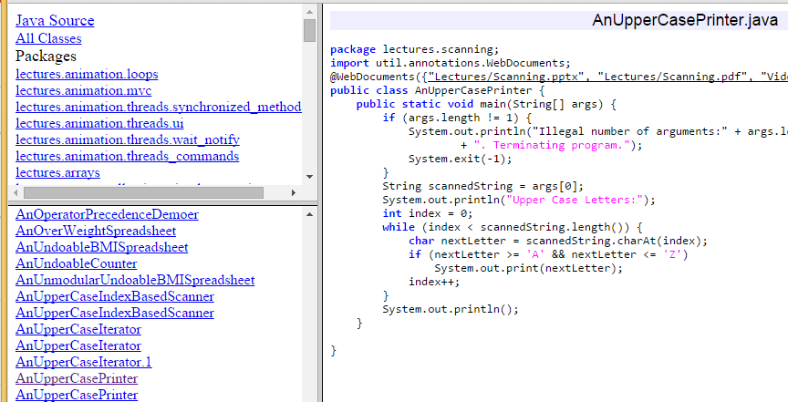
Web-Based Browsable Code
May not be up-to date

Slide 14
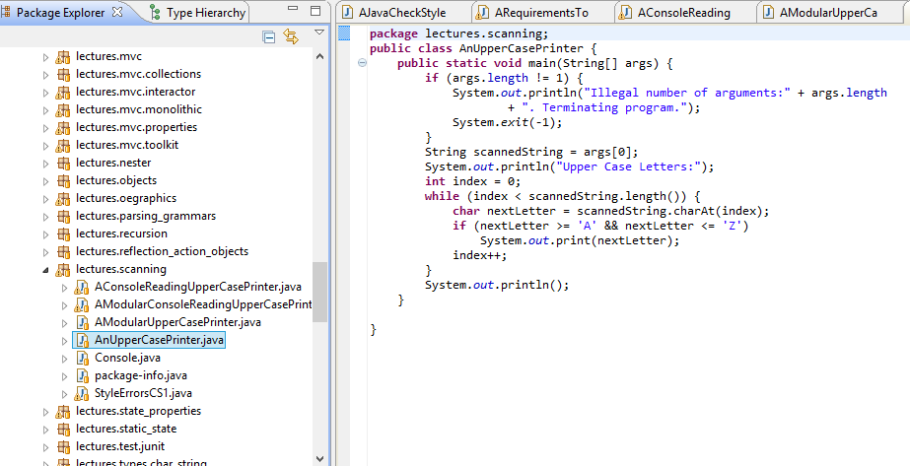
Eclipse Java Project of Lecture Code on GIT

Slide 15
Design Space of Study Modes!
You Tube video
Slides without audio
Slides with unsynchronized audio
Slideshow with synchronized recording
Office Mix
Word PDFs
Shared Google Docs
Eclipse Project
Browsable Project

Slide 16
Web Site Links

Slide 17
Regular and Flipped Class
In regular class
concepts are formally taught by instructor during lecture time.
external learning resources are used to solidify/clarify concepts.
In flipped class:
concepts are learnt by students through external learining (books and online) resources.
lecture time is used for hands-on activities.
A variety of learning resources available!

Slide 18
Usefulness of Live Lecture
Value
Without resources
With resources

Slide 19
What do we do in flipped class?
Problems related to homework?
Works when complexity of work is high
Recitations aim to provide templates for assignment

Slide 20
What do we do in flipped class?
Homework?
Deep thinking done solo?
Limited discussion with classmates?

Slide 21
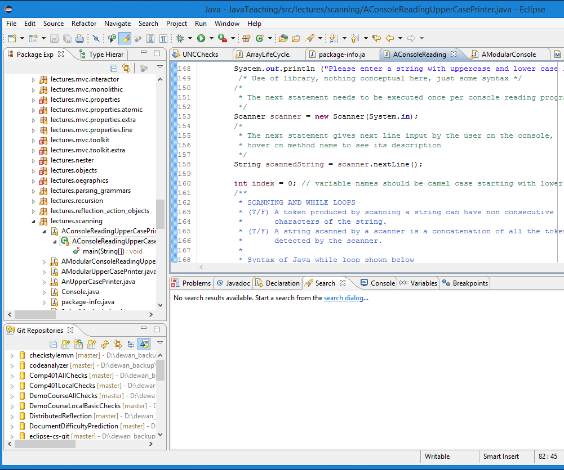
Tradeoffs in Regular Class Styles
Distill concepts in PPT or whiteboard.
Do live programming
Faster paced, concept intensive, use animation and graphics, advanced classes
Slower pace, more laborious, learn programming environment commands, intro classes

Slide 22
Changing Live Programming
I code in class, you watch.
You learn more as a driver than passenger

Slide 23
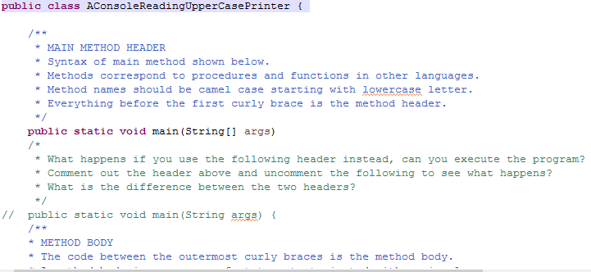
Praxis: Flip Code and Concept Presentation
The script followed by instructor (including questions) whole doing live programming is embedded in the program template
Concept presentation in code rather than code in concept presentation
Sakai quiz to record answers derived in open-book discussion with peers and instructors

