Slide 1
Installing and running the local check projects in Eclipse

Slide 2
Setup projects

Slide 3
Download projects from Github
Quick overview, in depth follows
File->Import…
Git->Projects from git
Clone URI
  https://github.com/pdewan/Comp401LocalChecks.git
  https://github.com/pdewan/GraderBasics.git

Slide 4
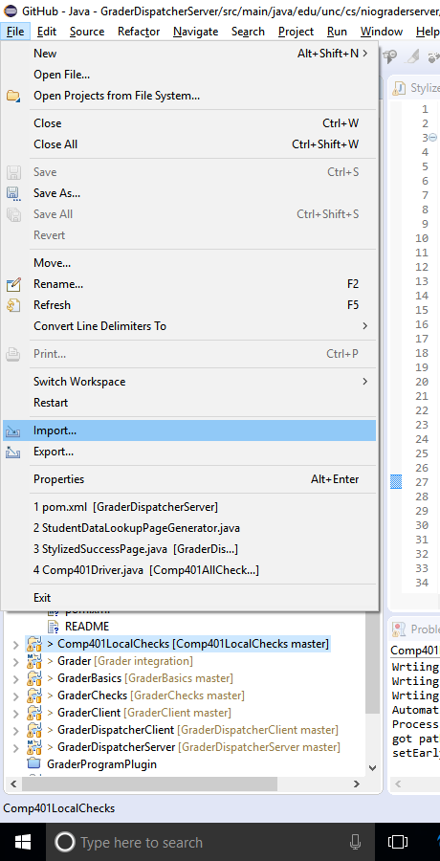
Download projects from Github
Import project

Slide 5
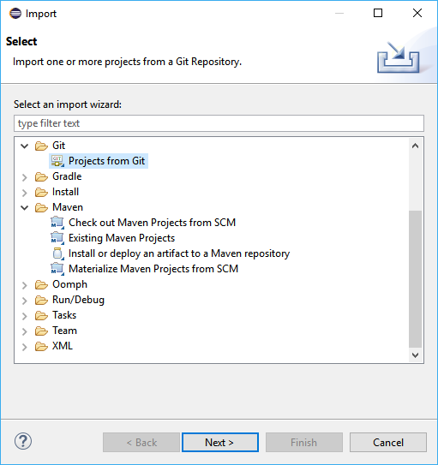
Download projects from Github
Select “Projects from Git”

Slide 6
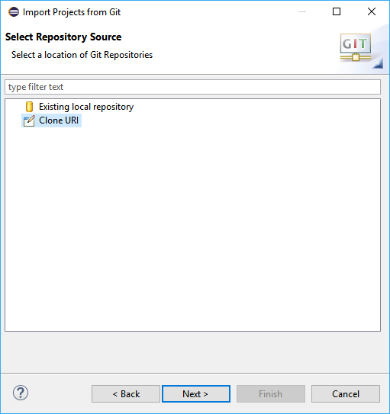
Download projects from Github
Clone URI
Comp401LocalChecks
  https://github.com/pdewan/Comp401LocalChecks.git
GraderBasics
  https://github.com/pdewan/GraderBasics.git

Slide 7
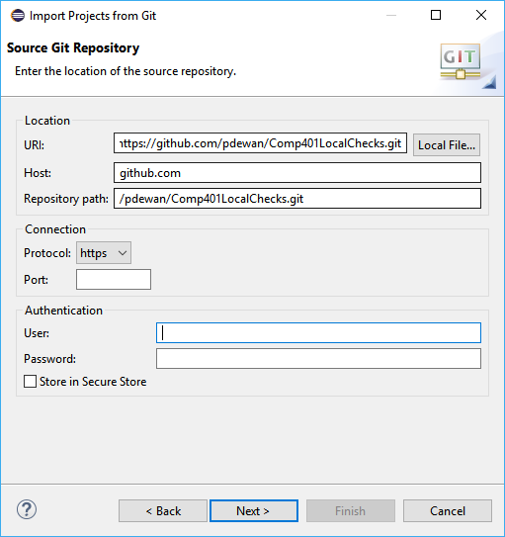
Download projects from Github
Set the URI for the project from GitHub
Eclipse autocompletes the rest

Slide 8
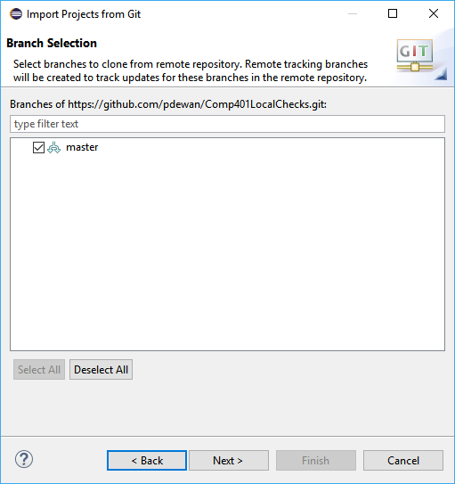
Download projects from Github
Choose the “master” branch

Slide 9
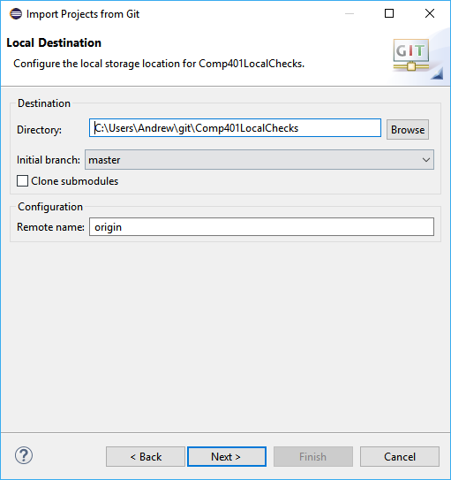
Download projects from Github
Choose a directory to save the git project

Slide 10
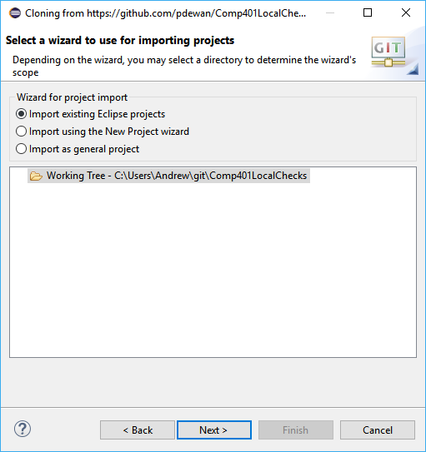
Download projects from Github
All projects are existing Eclipse projects

Slide 11
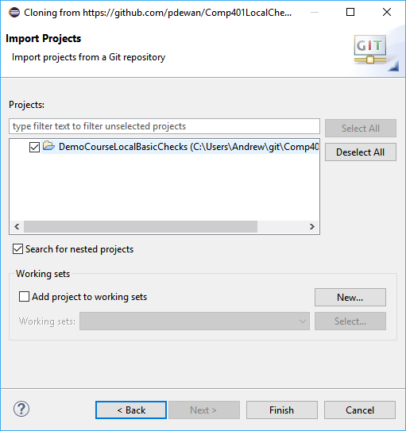
Download projects from Github
There may be other projects in the git repository, only import the relevant ones (not Assignments)

Slide 12
Correct dependencies
Projects
  DemoCourseLocalBasicsChecks = Comp401LocalChecks
Libraries
  oeall22.jar from course website
ObjectEditor Version 22 (latest, use this unless it fails on you) | oeall22

Slide 13

Classpath jars
Need to put these in the system classpath:
  UNChecks_6.5.0.jar is on course page
  Checkstyle-6.5-all.jar is in shared google drive Comp401Instructors
UNCChecks_6.5.0.jar

Slide 14
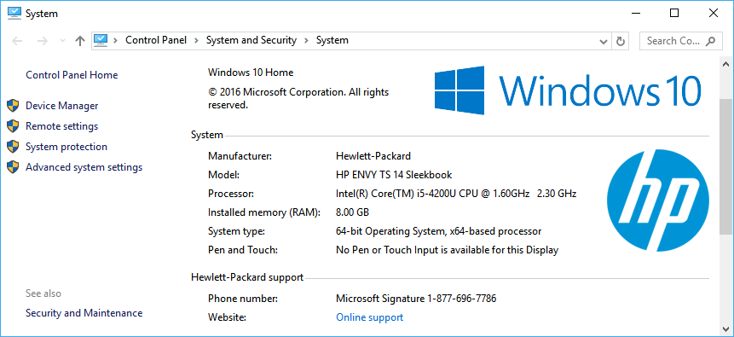
Setup Checkstyle/UNC Checks (Windows)
Open “System” from “System and Security” in the Control Panel
Select “Advanced system settings”

Slide 15
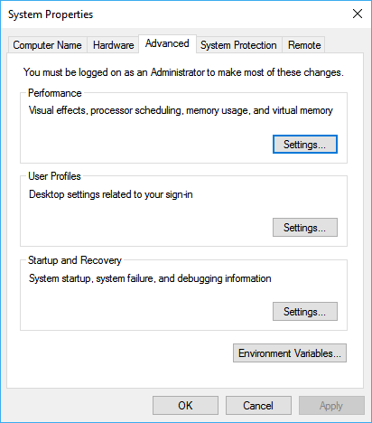
Setup Checkstyle/UNC Checks (Windows)
Select Environment Variables…

Slide 16
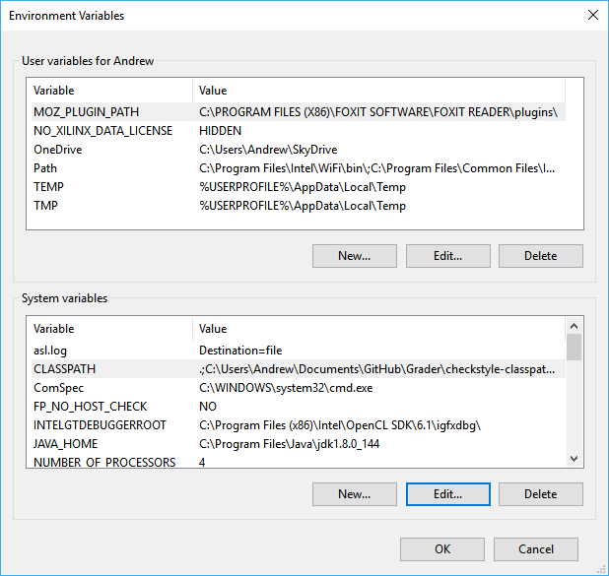
Setup Checkstyle/UNC Checks (Windows)
Create a new environment variable called “CLASSPATH” and set it to contain 3 paths separated by semicolons
  .
  Path to checkstyle-6.5.0-all.jar
  Path to UNC_Checks6.5.0.jar
.;C:\Users\Andrew\Documents\GitHub\Grader\checkstyle-classpath\checkstyle-6.5-all.jar;C:\Users\Andrew\Documents\GitHub\Grader\checkstyle-classpath\UNCChecks_6.5.0.jar

Slide 17
Run local checks

Slide 18
Setup assignment for local checks
Open assignment with eclipse
Add local checks dependencies
  Projects
    Comp401LocalChecks
    GraderBasics
Add new main class to call local check suite

Slide 19
Sample test class
package main;
import gradingTools.comp401f17.assignment1.testcases.Assignment1Suite;
public class A1LocalChecks {
public static void main(String[] args) {
Assignment1Suite.main(args);
}
}

Slide 20
Run local checks
Select test main class
Right click → Debug As → Java Application
AGradeableJUnitTopLevelSuite → Test All

