Slide 1
The Tor Browser
Network Anonymity and its Relation to the Public
By Jackson Wright

Slide 2
The History of Tor
The Tor Browser was first developed and utilized by the United States Navy as an onion-routing tool to protect digital government communications
The inventors were employees of the United States Naval Research Laboratory
Initially designed solely for U.S. government activities, the browser is now widely used by governments around the world as well as journalists, activists, and various others

Slide 3
Positives of the Tor Browser
Encrypts government communications for many smaller nations
Protects users from intrusive government surveillance
Used by many American citizens for simple tasks such as checking bank accounts in order to prevent network logging of information
Provide increased freedom for journalists in oppressed nations
Allows individuals in nations with censorship issues to express their opinions without worry of prosecution
In extreme censorship cases, the Tor Browser simply allows people to access everyday sites such as Facebook, Twitter, and YouTube

Slide 4
GlobaLeaks
“GlobaLeaks is an open source project aimed at creating a worldwide, anonymous, censorship-resistant, distributed whistleblowing platform.”

Slide 5
Worldwide Use of Tor

Slide 6
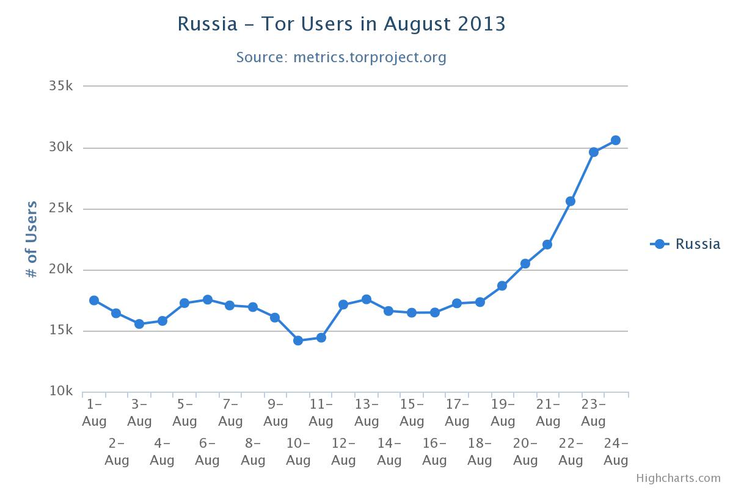

Slide 7
The Use of Tor in West Africa
Nasser Weddady, a Mauritanian who now lives in Boston, implemented a plan to utilize Tor to shed light upon the slavery and tragic conditions of his home nation
Weddady translated the Tor user guide into Arabic and distributed them amongst the owners of the nations cybercafés
Within days, the state government’s censorship plans were in turmoil and the people of Mauritania were able to use Tor to completely bypass their state restrictions and inform the world about the racial and religious slavery still practiced there
“Tor doesn’t say, ‘Just trust us not to give out your information’–it says, ‘We have a design where nobody is in a position to give up your information, because no one person has it”

Slide 8
Other Positive Uses
Many Chinese citizens are able to post on forums and browse websites that we use everyday with the help of Tor to bypass the nations firewall
Facebook, YouTube, Twitter, WordPress, Reddit, etc.
Access to message boards and forums, as well as the ability to be critical of the government without the fear of repercussions
Documented cases show Tor has been used to advocate for gay and transgender rights
Specifically Russia and East African nations where these two groups are heavily persecuted
Activists in the United States run Tor relays and their counterparts overseas encourage the use of Tor among citizens to allow for people to communicate without the fear that they are being watched or that they will be prosecuted for their orientation
http://www.youtube.com/watch?v=iB1bLuvm15Q

Slide 9
Some Cons of the Tor Browser
Network anonymity protects the majority of us, but being anonymous also allows criminals to function under the radar
Distribution of illegal media of all varieties
Authorities often criticize the network because they say it makes it nearly to find the source of a leak
“Crime Syndicates” as the media calls them, such as Silk Road, which is the dark web’s drug marketplace, function with the help of every Tor user because the path that the data takes randomly transfers through any users system and must exit through one users Tor relay
A Tor relay is essentially an exit node for the data

Slide 10
Media Coverage of Silk Road
Businesses on the Tor network run using bitcoins, a cryptographic digital currency that functions on equations rather than human induced inflation
This technology is used worldwide as a form of currency because of its properties of keeping the user anonymous
The Silk Road was compromised just over a month ago when the owner functioning under the alias Dread Pirate Roberts was arrested in New York
FBI seized 28.5 million dollars worth of bitcoins, nearly 2% of the total market
Silk road handled over 1.2 billion dollars in sales during its two and a half years of activity

Slide 11
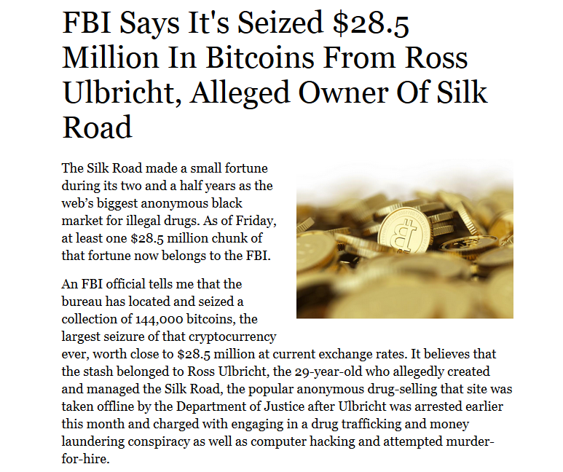

Slide 12
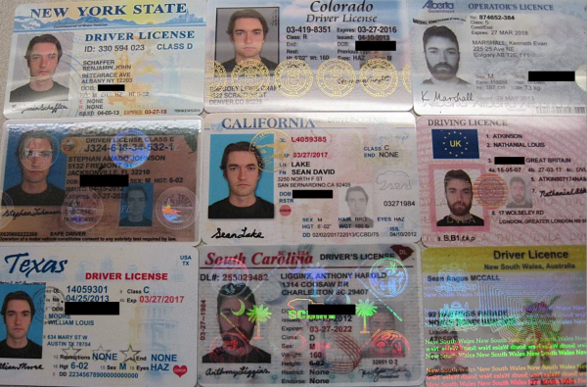
Ross Ulbricht

Slide 13
Last Friday, November 22nd he was seen in court for the first time
This marks the first time a documented user of the Tor browser has been has been prosecuted in the developed world; this brought about many questions of whether the network is still safe as well as whether he would receive more or less punishment for running the business through technology
He was denied bail and his charges were multiplied during the hearing
He was caught because the FBI were able to trace back to a forum post under a familiar alias in 2008 which connected to his Gmail account which was connected to his Google+ profile
The point of this: the Tor network was not at fault for his carelessness, and the fact that the Silk Road 2.0 was up and running again in just two weeks provides evidence that the authorities (NSA, FBI, etc.) who use the browser themselves have not been able to fully crack the system

Slide 14
Significance of Tor
Tor provides a service to our society that is a growing need
We regularly discover that we are under more and more surveillance than we previously knew by the government and this browser has become the most popular in the world at providing anonymity
Allows for an open network; free and anonymous flow of data between people across the world from each other without any authoritative interference
Network anonymity will strengthen with more users because the peer-to-peer network grows stronger with more cooperative entities
Provides a pathway to the “dark web,” which contains over 50% of all webpages but is scarcely used or even seen

