Slide 1
Motion Graphics
By Jin Lin

Slide 2
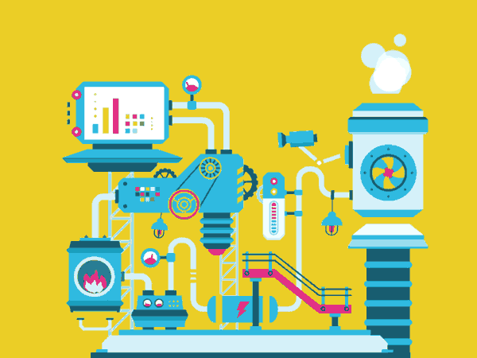
What is motion graphics?
A digital technique that combines the languages of film, animation, and graphic design.
Usually displayed via electronic media technology.

Slide 3
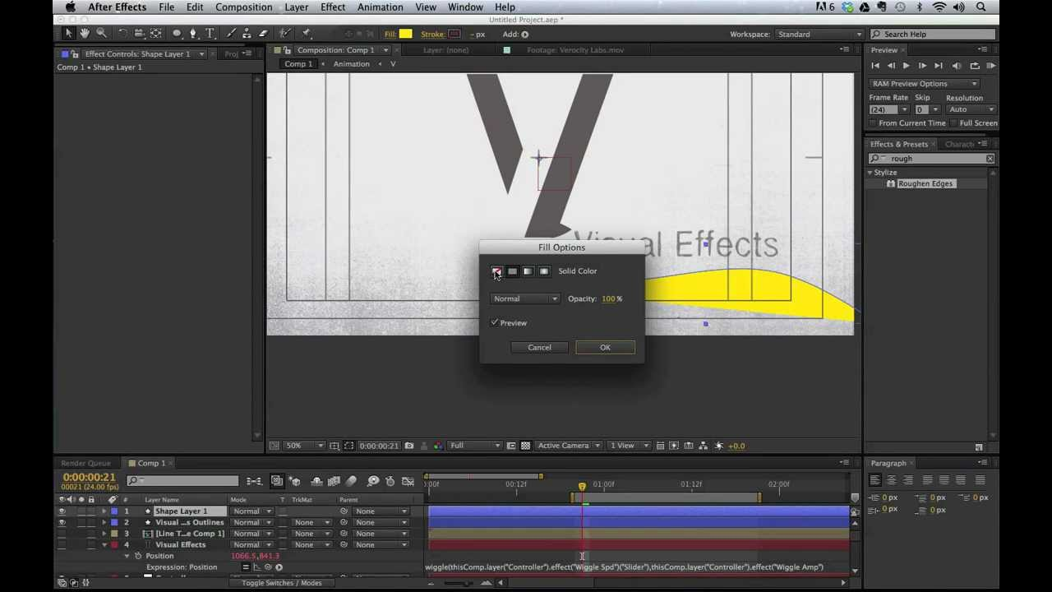
Objectives
Explore the functions of After Effects
Use After Effects to create a short animated video

Slide 4
Purposes/Motivations
A “canvas” to express myself and my ideas
My prolonged interest in animation
Learn the practical usages of motion graphics

Slide 5
Challenges
New materials
Limited time
Finding outside resources

Slide 6
Alternatives
Create 3D drawing using Adobe Photoshop
Photo manipulations with Adobe Photoshop
Make a short video using visual effects

