Slide 1
Public/Private Key Cryptography
Scott Chappell

Slide 2
What is it?
Encrypting data so that only specified people can unlock it
Used to send messages securely across cyberspace
Private vs. Public Key

Slide 3

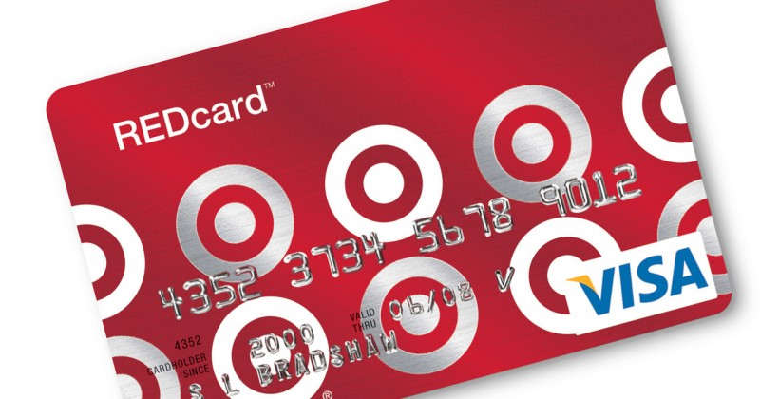
Why is it Important?

Slide 4
How is it Changing?
Hackers getting stronger supercomputers
Companies trying to combat them through stronger encryption

Slide 5
What Will I Research?
Complex ideas behind cryptography
Methods hackers are taking to overcome it
Methods to finding large prime numbers

