Slide 1
Flashcard Quiz Program
By: Kishin Aruwani

Slide 2
Background
This program will be created as a studying tool to give students the ability to create flashcards and be quizzed on them without having to create handwritten flashcards or access the internet to use an online flashcard application.

Slide 3
Process
This program will allow the user to input questions and answers from text files and have them display on flashcards.
Once the user starts the quiz, a timer will start and the first question will be displayed.
As the user advances through each question, the program will notify the user if their answer is correct. If it is incorrect, it will display the correct answer.
When all the flashcards have been answered, the timer will stop and the user’s score will be displayed.

Slide 4
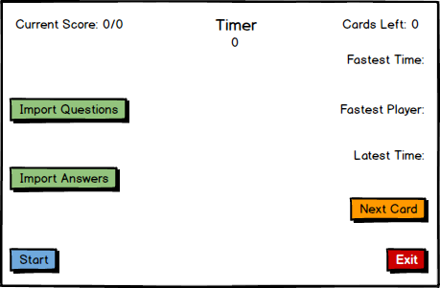
Flashcard Quiz Interface on Startup

Slide 5
Importing Questions and Answers
The user clicks the import questions and import answers buttons to select plain text files to use as questions and answers for the program.
When the questions are imported, a new file will be created if there is not one already, to store the fastest completion times for that question set.
The user can create plain text files by using Notepad or another program that has the ability to save a file as a plain text file, such as Microsoft Word.
The program will store the user’s text files for the questions and answers into arrays and then randomize them the same way.

Slide 6
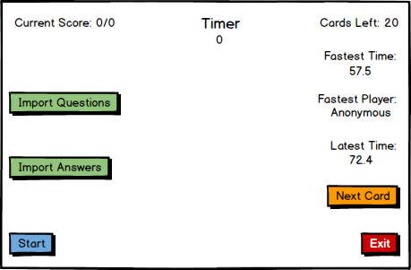
Importing Questions and Answers

Slide 7
User Answer Comparison
The quiz compares the user’s answer in the text box to the answer file that was imported and determines if the user’s answer is correct.
If it is correct, it will increment the number correct answers and potential correct answers by one. If it is incorrect it will only increment the potential correct answers by one.

Slide 8
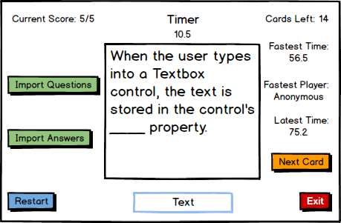
Answering Questions

Slide 9
Timer and Score Calculation
The timer will stop when the user answers all of the questions.
The program calculates the user’s score by dividing the number of correct answers by the total number of questions and multiplying by 100.
If the user clicks the restart button, the their score will be reset and the flashcards will be randomized.

Slide 10
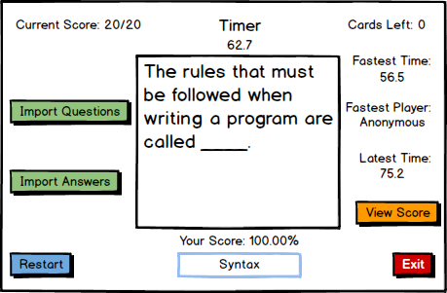
Flashcard Set Completion

