Slide 1
Final Course Project Proposal
Hari Chittilla
Comp 89H
Dr. Ming Lin

Slide 2
My background and motivations
Trimester of Python and Java, respectively
I’m a CS Major looking to learn much more programming but for the time being review my knowledge of Java and build new skills.
Will be enrolled in Comp 401 next semester

Slide 3
Project Idea
Java version MS Notepad (or textEdit if you’re on a Mac)

Slide 4
State-of-art and challenges
Notepad is pretty ubiquitous
It’s a simple program
My purpose: EXPERIENCE.

Slide 5
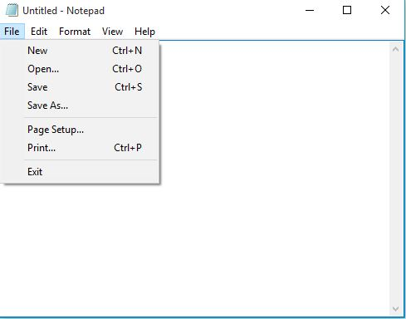
Objectives
To write a new file.
To open and edit an existing file.
To save the file
To Save As…
To Print file.

Slide 6
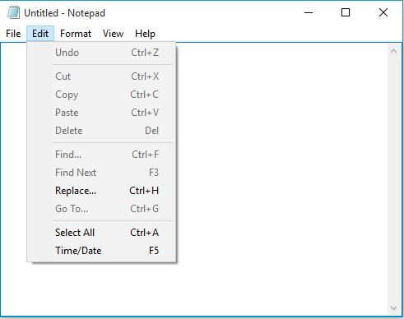
Objectives
Add undo function
Add a redo function
Cut, copy, paste
Find (CTRL+F) function
Select all

Slide 7
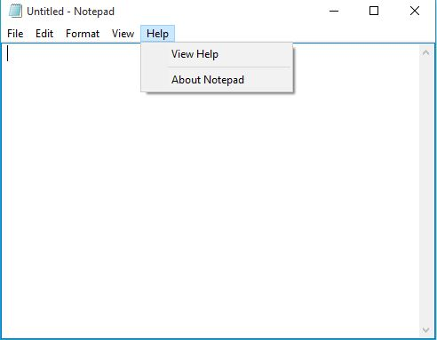
Objectives
Help function
Includes instructions and assistance on how to use my word processor

Slide 8
Tools I plan on utilizing
Writing and running my files in DrJava
FileWriter, GUIS (JFrames, Jmenus, JPanels), ActionListeners,

Slide 9
Resources I plan on using
Java 8 Documentation
Stackexchange
CodeCademy
W3schools
Google (of course)

Slide 10
Ultimate goal
To gain valuable experience based on my prior knowledge of Java.

