Slide 1
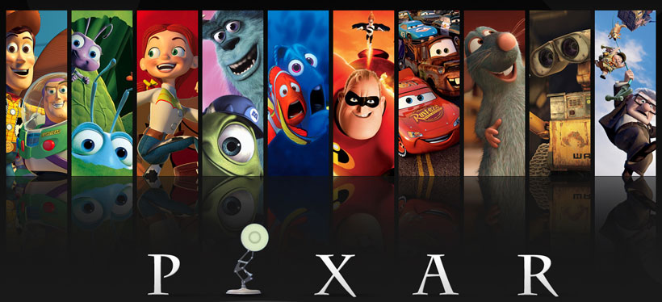
Project Proposal
Megan Cruz

Slide 2
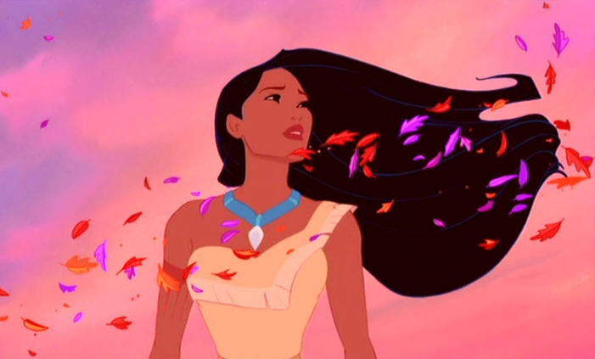
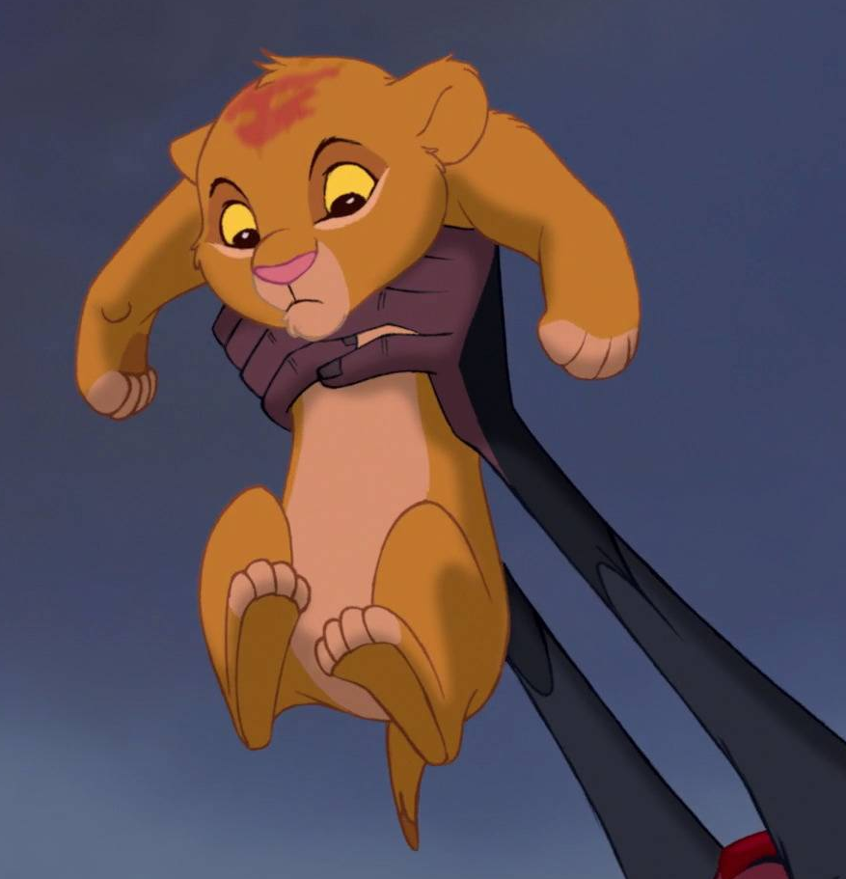
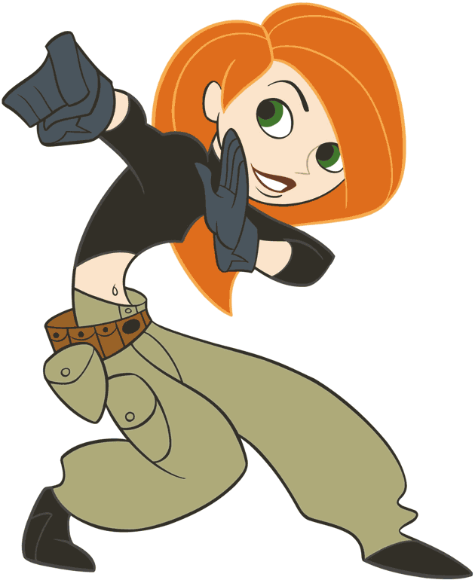
3D Animated Film
Target Audience: Children (12 and under)
Length of Film: 5-10 minutes
3-5 Main Characters

Slide 3
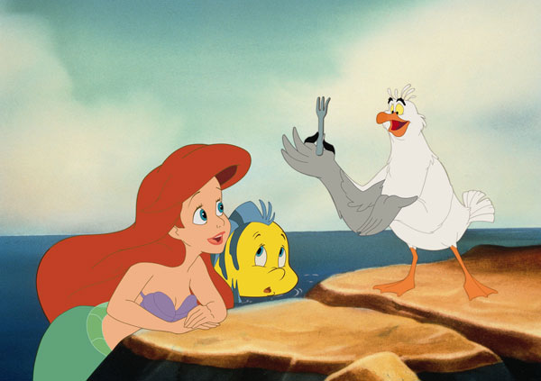
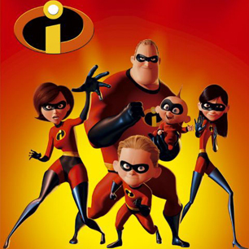
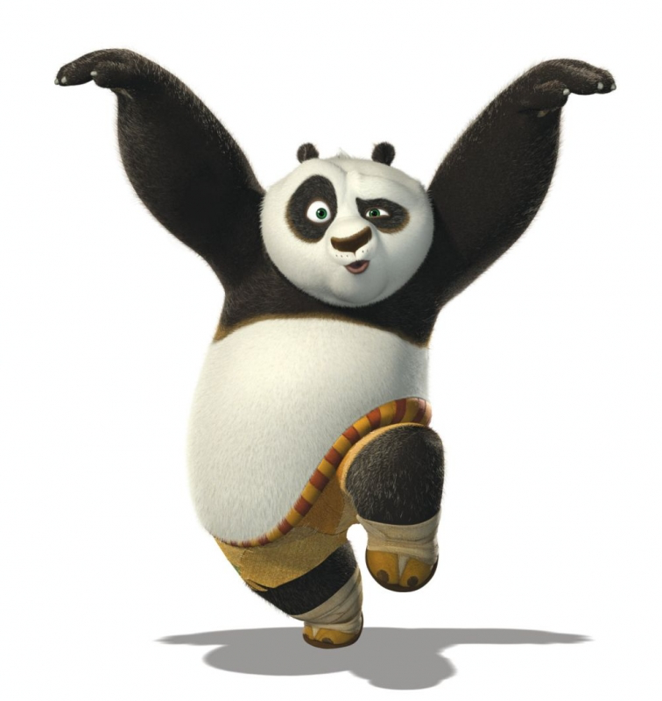
Motivation and Inspiration
Childhood: Disney, Pixar, VHS tapes
Writing children’s stories
Kids are cute ☺
Hope, aspirations, lessons to be learned

Slide 4
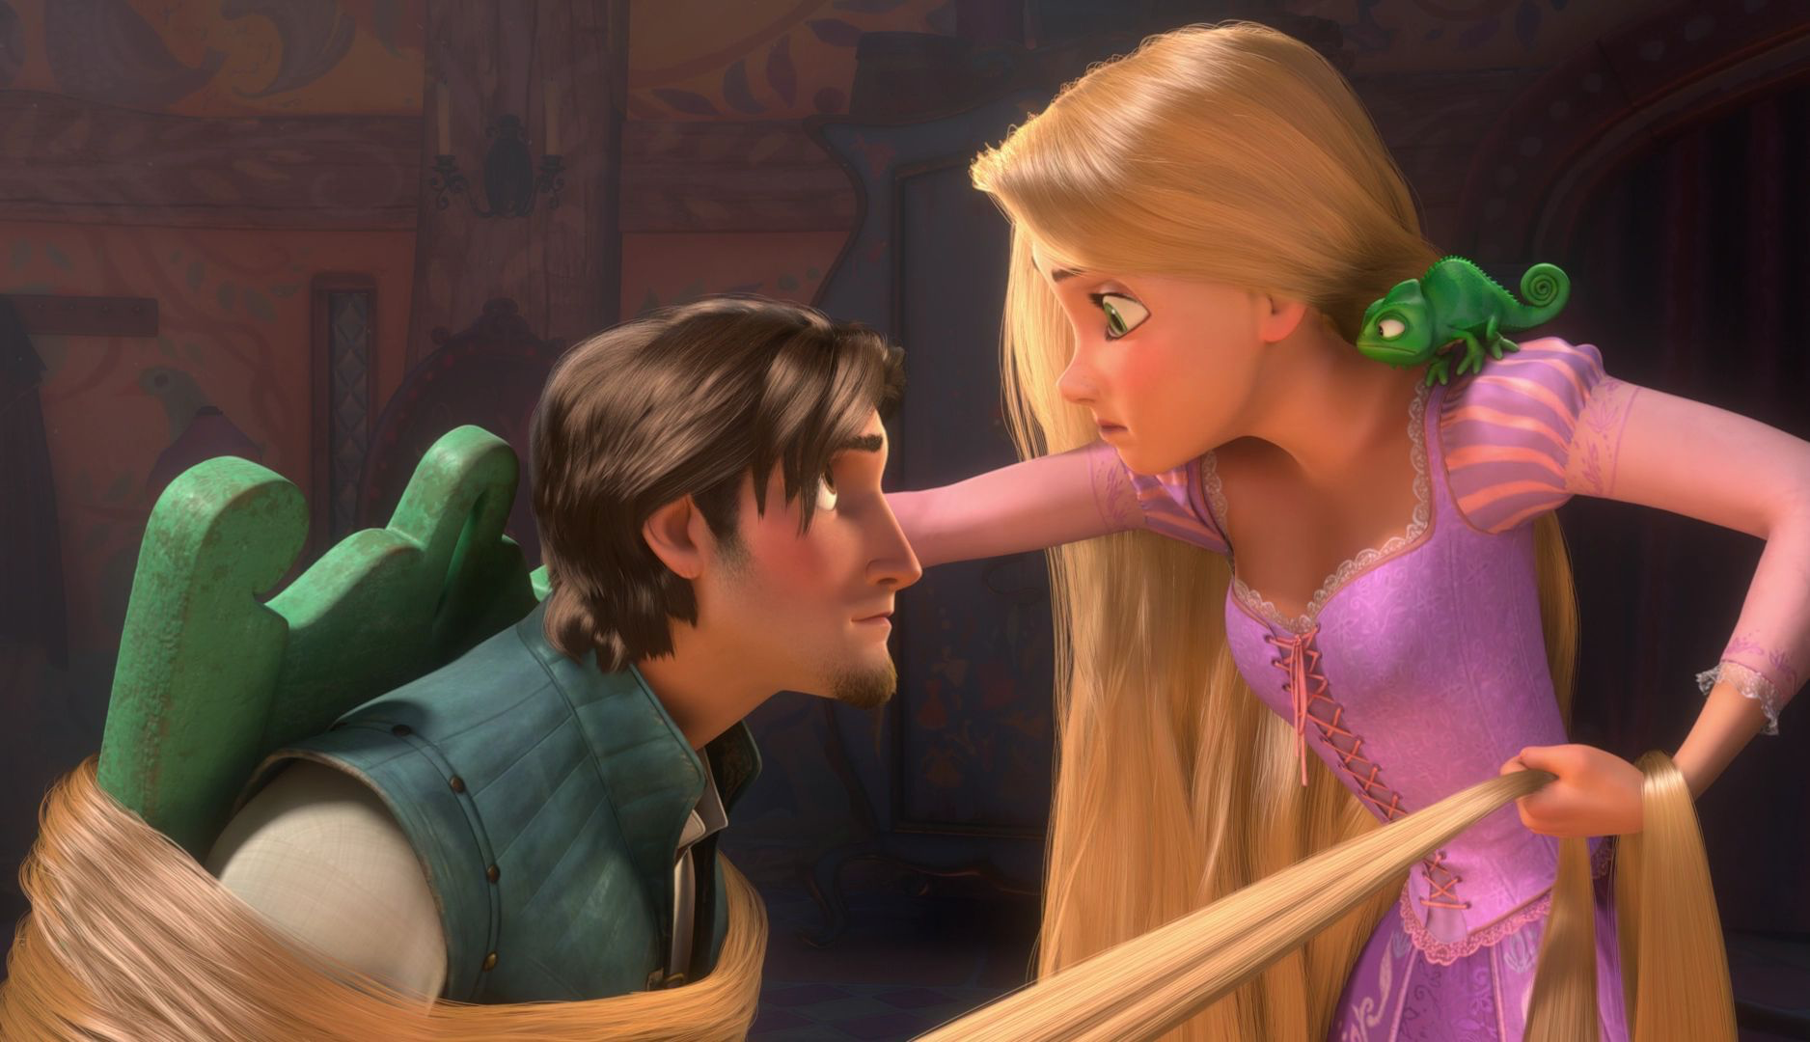
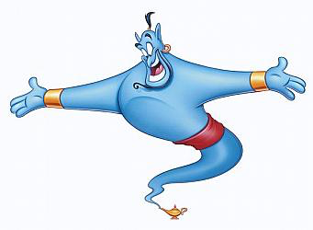
Challenges
Huge process involving many steps, time
Storyline, software, quality, detail (lighting, etc.)
Animation process

Slide 5
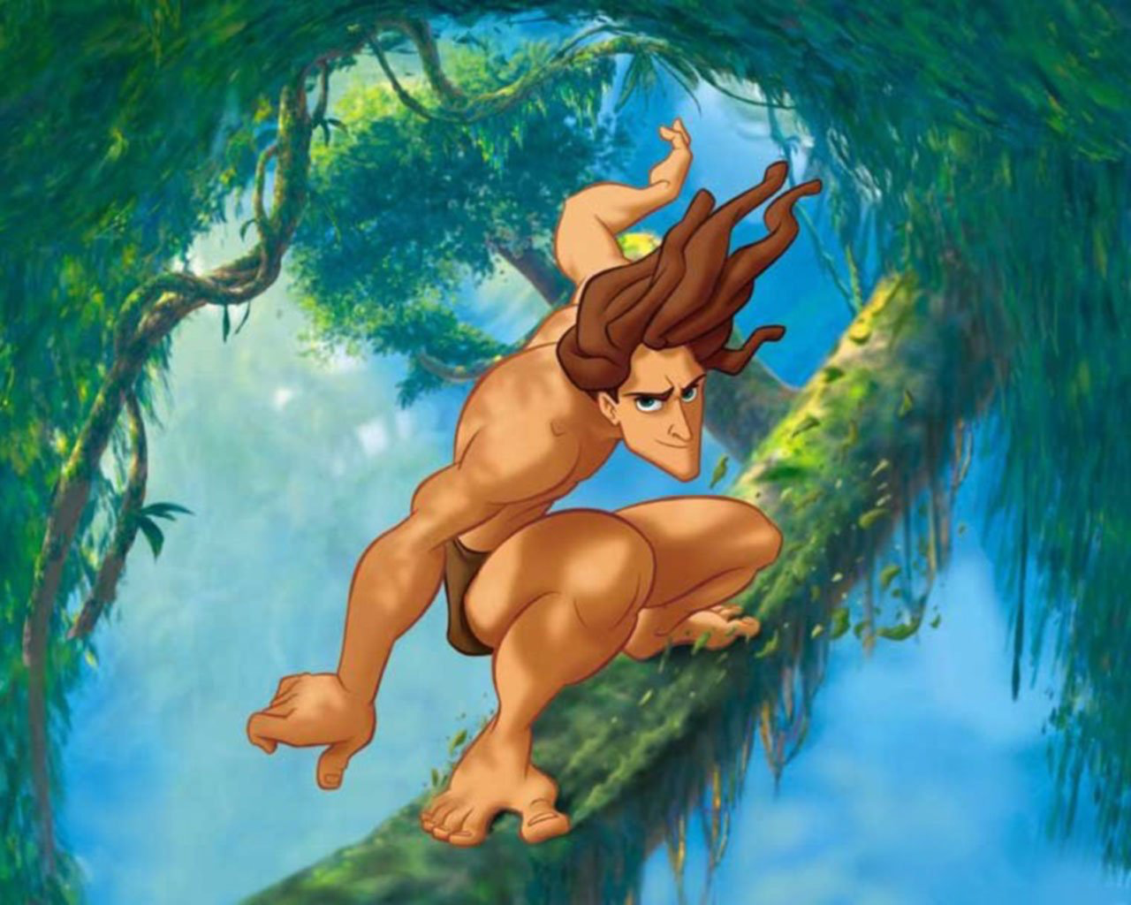
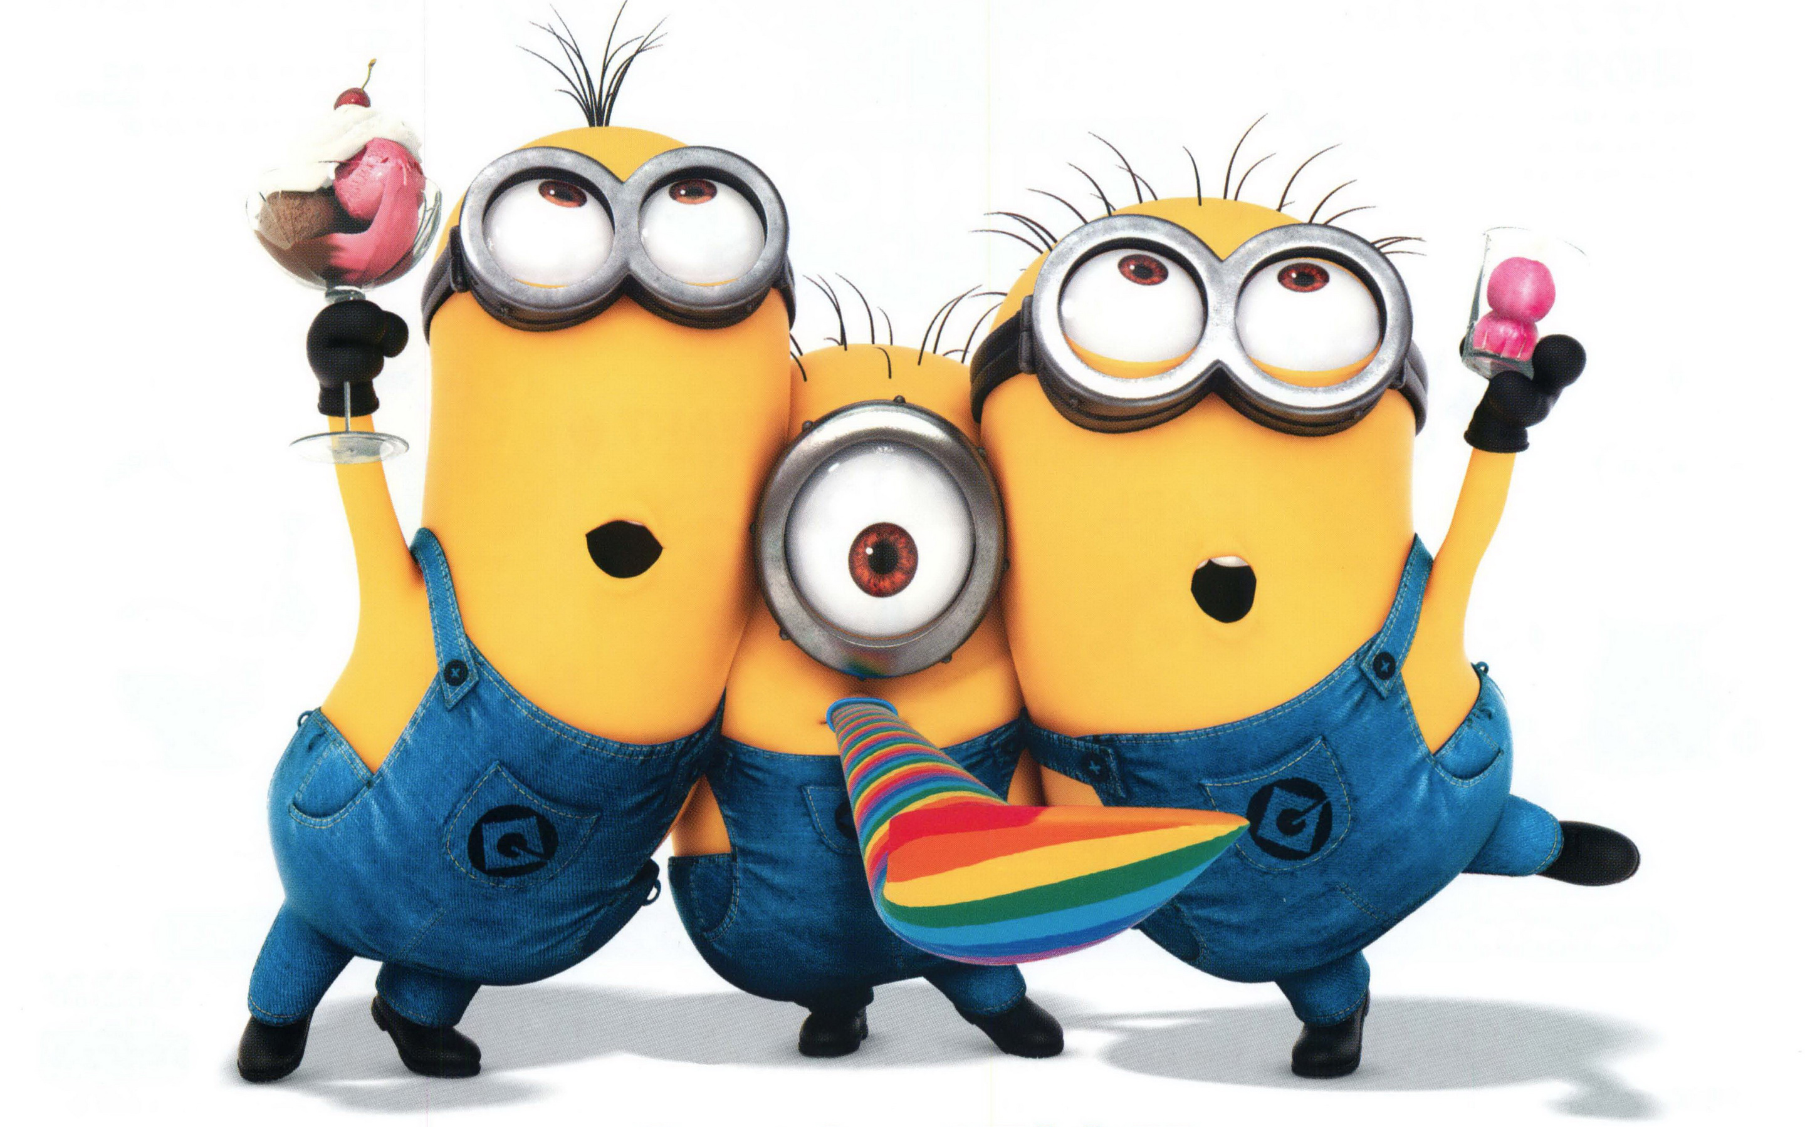
Resources
Many free websites: GoAnimate, Devolver, Animasher
Blender
Alice

Slide 6
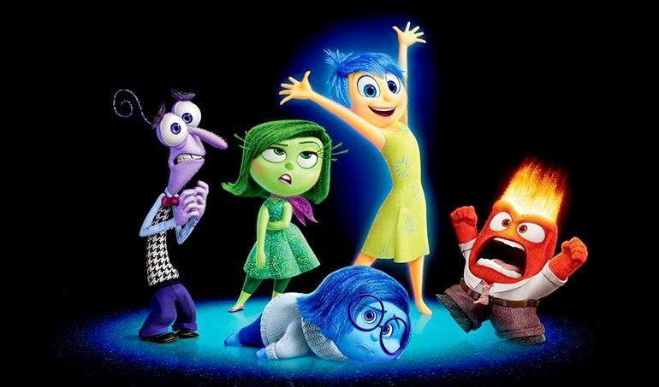
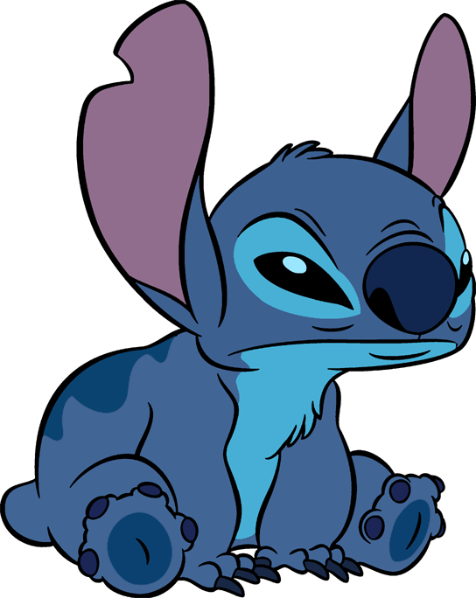
Go Creativity!
Notes:
Photo credits: Walt Disney Studios and Pixar Animation Studios

