Slide 1
COMP541
Combinational Logic - 4
Montek Singh
Sep {24, 26}, 2018

Slide 2
Today’s Topics
Logic Minimization
  Karnaugh Maps
Combinational Building Blocks
  Multiplexers
  Decoders
  Encoders
Delays and Timing

Slide 3
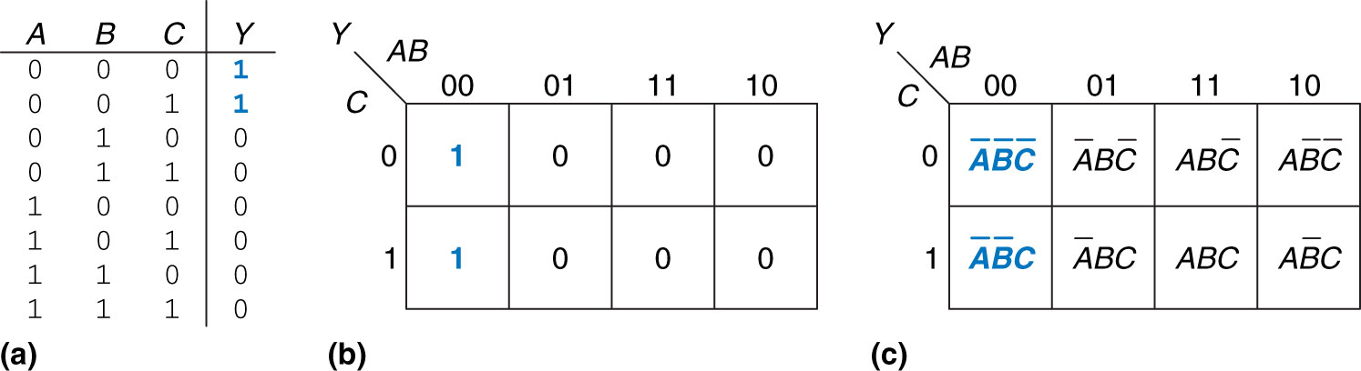
Karnaugh Maps (K-maps)
Graphical method for simplifying Boolean equations
  work well for up to 4 variables
  help quickly combine terms based on visual inspection
Example:
Figure 2.43 Three-input function: (a) truth table, (b) K-map, (c) K-map showing minterms

Slide 4
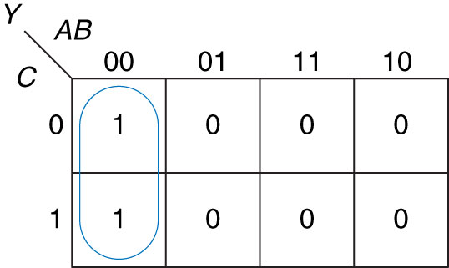
Karnaugh Maps
K-Map structure:
  up to 4 variables
    one or two variables → horizontal dimension
    one or two variables → vertical dimension
  rows/columns arranged so only one variable different among neighbors
    ends “wrap around”
Example:

Slide 5
Logic Minimization using K-Maps
Basic Idea:
  Simply “circle” all “rectangular” regions of 1’s in the K-map
    using the fewest possible number of circles
    each circle should be as large as possible
  Read off the products that were circled
Here are the rules:
  use the fewest circles necessary to cover all the 1’s
  a circle must not contain any 0’s (don’t-cares are okay)
  each circle must span a rectangular block that is a power of 2
    i.e., 1, 2, or 4 squares in each direction
  each circle should be as large as possible
  a circle may wrap around the edges of the K-map
  a 1 in a K-map may be circled multiple times if needed

Slide 6
An aside on notation
In Boolean equations, complementation can be indicated in one of two ways:
  by using an overbar: e.g.
    best for handwriting or math/equation editors
  by using the prime symbol: e.g., X’
    more convenient for basic wordprocessors

Slide 7
K-Map: Example 1
The two 1’s can be covered by a single oval
  the circle spans the region expressed as A’B’
  hence, the minimized sum-of-products expression is:

Slide 8
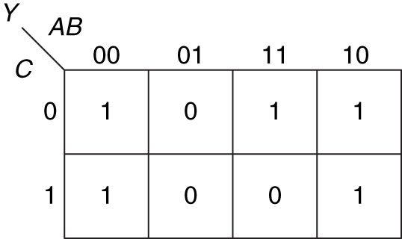
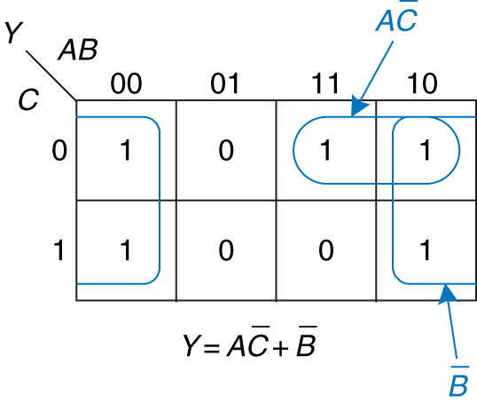
K-Map: Example 2
Need only two products!
  the four 1’s on the corners can be covered by a single circle
    the 1st circle spans the region B’
  the remaining 1 merges with its neighbor to the right
    the 2nd circle spans AC’
  the minimal SOP expression is:
  the unminimized sum-of-minterms would have been:

Slide 9
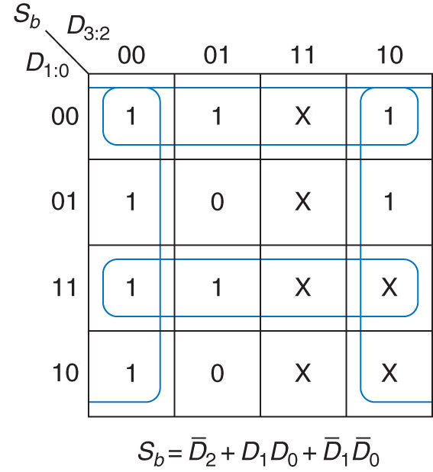
K-Map: Example 3 (with Don’t Cares)
Don’t-Cares can help simplify logic
  a circle may be expanded to include Don’t-Cares
    helps reduce size of product terms
    may help reduce the number of circles
  but Don’t-Cares do not have to be covered
Example:
  if X’s in this K-map were 0’s
    4 products would be needed
    products would be larger

Slide 10
Combinational Building Blocks
Multiplexers
Decoders
Encoders

Slide 11
Multiplexer (Mux)
Selects 1 out of N inputs
  a control input (“select” signal) determines which input is chosen
  # bits in select = ceil(log₂N)
Example: 2:1 Mux
  2 inputs
  1 output
  1-bit select signal

Slide 12
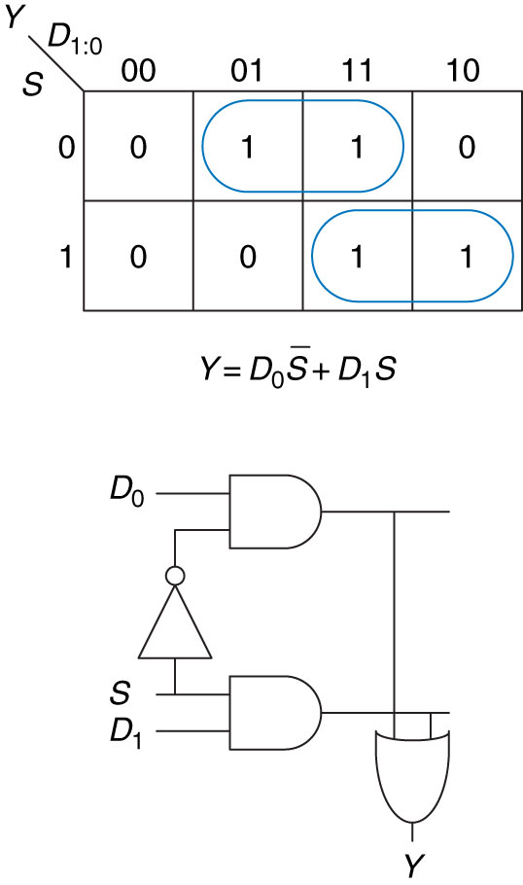
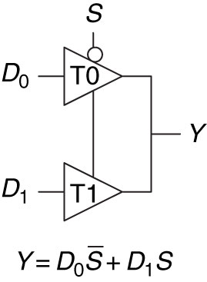
Multiplexer Implementations
Logic gates
  Sum-of-products form
Tristate buffers
  For an N-input mux, use N tristate buffers
  Turn on exactly one buffer to propagate the appropriate input
    all others are in floating (Hi-Z) state

Slide 13
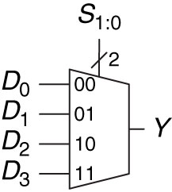
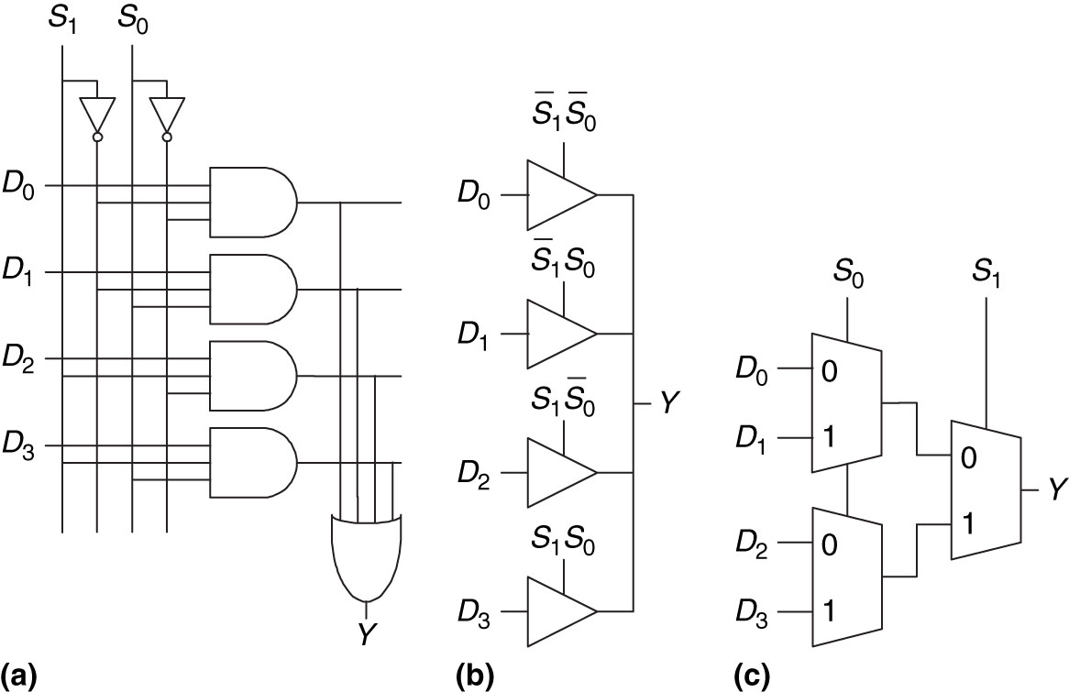
Wider Multiplexers (4:1)
A 4-to-1 mux has 4 inputs and 1 output
  selection signal now is 2 bits
Several ways to implement:
Figure 2.58 4:1 multiplexer implementations: (a) two-level logic, (b) tristates, (c) hierarchical

Slide 14
Combinational Logic using Multiplexers
Implement a truth table using a mux
  use a mux with as many input lines are rows in the table
  Y values are fed into the mux’s data inputs
  AB values become the mux’s select inputs

Slide 15
SystemVerilog for Multiplexer
Just a conditional statement:
  module mux(input wire d0, d1,
  input wire s,
  output wire y);
  assign y = s ? d1 : d0;
  endmodule
Easily extends to multi-bit data inputs:
  module mux4bit(input wire [3:0] d0, d1,
  input wire s,
  output wire [3:0] y);
  assign y = s ? d1 : d0;
  endmodule

Slide 16
SystemVerilog for Multiplexer
Also extends to N-way multiplexers:
  module mux4way4bit(
  input wire [3:0] d0, d1, d2, d3,
  input wire [1:0] s,
  output wire [3:0] y);
  assign y = s[1] ? (s[0]? d3 : d2) : (s[0]? d1 : d0);
  endmodule
Or, in a truth-table style:
  module mux4way4bit(
  input wire [3:0] d0, d1, d2, d3,
  input wire [1:0] s,
  output wire [3:0] y);
  assign y = s == 2’b11 ? d3 :
  s == 2’b10 ? d2 :
  s == 2’b01 ? d1 : d0;
  endmodule

Slide 17
Decoders
N inputs, 2^{N} outputs
“One-hot” outputs
  only one output HIGH at any given time

Slide 18
Decoder Implementation
Each output is a minterm!
  Y_{k} = 1 if the inputs A₁A₀ match corresponding row

Slide 19
Logic using Decoders
Can implement Boolean function using decoders:
  decoder output is all minterms
  OR the ON-set minterms
Example:
For multiple outputs
  only one decoder needed
  one separate OR gate per output

Slide 20
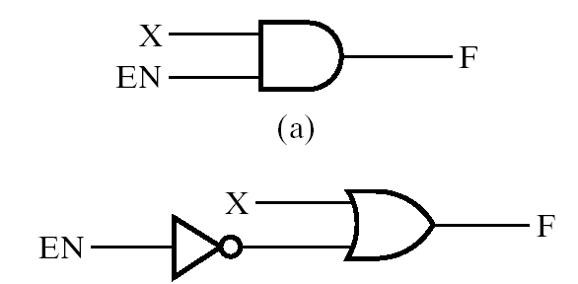
Aside: Enable
Enable is a common input to logic functions
  Typically used in memories and some of today’s logic blocks
Two styles:
  EN is ANDed with function
    turns output to 0 when not enabled
  EN’ is ORed with function
    turns output to 1 when not enabled

Slide 21
Other decoder examples

Slide 22
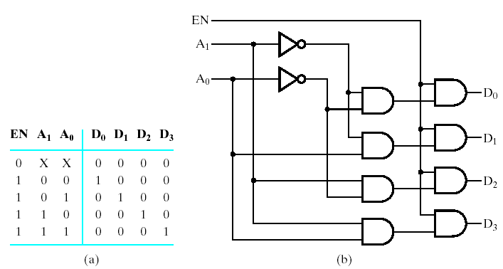
Decoder with Enable
When not enabled, all outputs are 0
  otherwise, 2-to-4 decoder

Slide 23
Decoders
How about a…
  1-to-2 decoder?
  3-to-8 decoder?
  (N)-to-2^{(N)} decoder?
  (N+1)-to-2^{(N+1)} decoder?

Slide 24
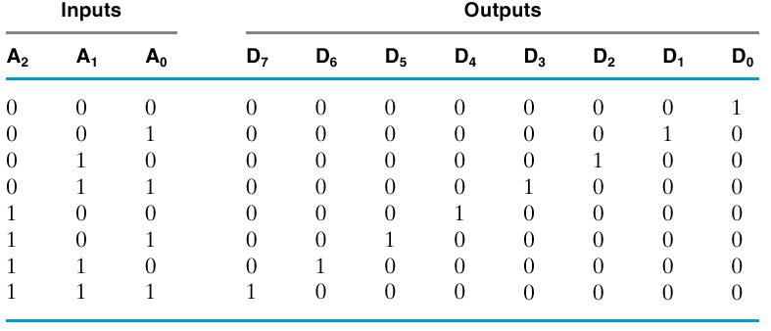
3-to-8 Decoder: Truth Table
Notice they are minterms

Slide 25
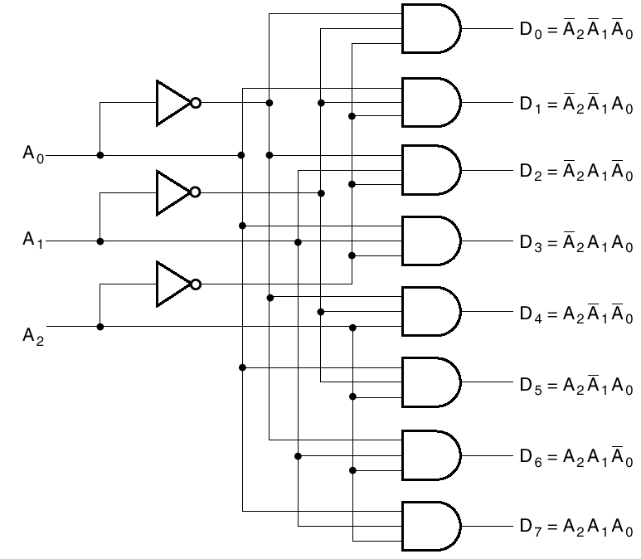
3-to-8 Decoder: Schematic

Slide 26
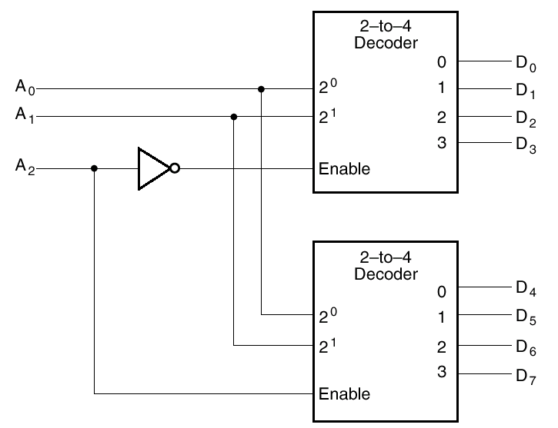
3-to-8 Decoder: “Enable” used for expansion

Slide 27
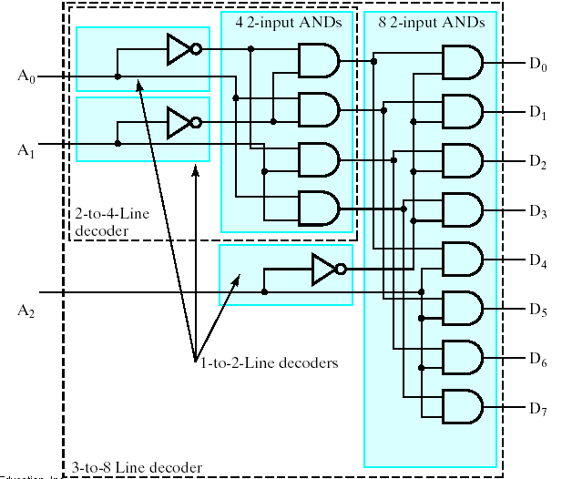
3-to-8 Decoder: Multilevel Circuit

Slide 28
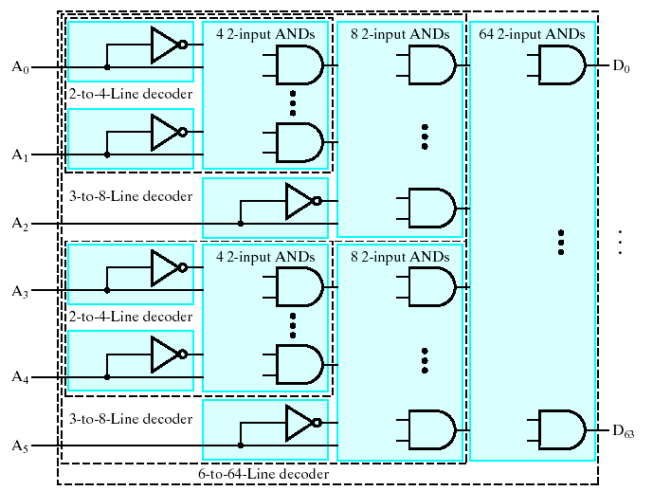
Multi-Level 6-to-64 Decoder
In general: Combine m-to-2^{m} and n-to-2^{n} decoders
  becomes an (m+n)-to-2^{(m+n)} decoder

Slide 29
Uses for Decoders
Binary number might serve to select some operation
  Number might encode a CPU Instruction (op codes)
    Decoder lines might select add, or subtract, or multiply, etc.
  Number might encode a Memory Address
    To read or write a particular location in memory

Slide 30
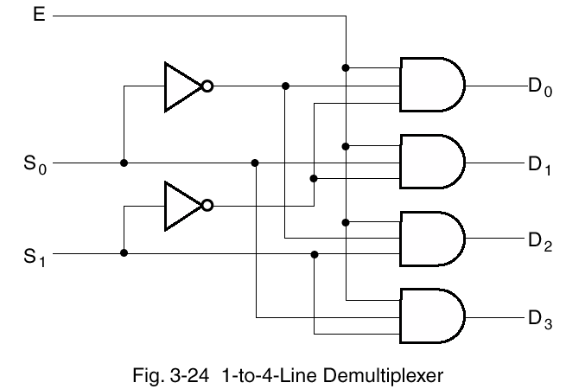
Demultiplexer (demux)
Dual of multiplexer, but a relative of decoder
  One input, multiple outputs (destinations)
  Select signal routes input to one of the outputs
n-bit select implies 2^{n} outputs
  e.g., 4-way demux uses a 2-bit select
  routes input E to one of 4 outputs

Slide 31
Demux vs. Decoder
Similarities
  decoder produces a “1” on one of the 2^{N} outputs
    … “0” elsewhere
  demultiplexer transmits data to one of the 2^{N} outputs
    … “0” elsewhere
Possible to make one from the other
  How?

Slide 32
Encoder
Encoder is the opposite of decoder
  2^{N} inputs (or fewer)
  N outputs

Slide 33
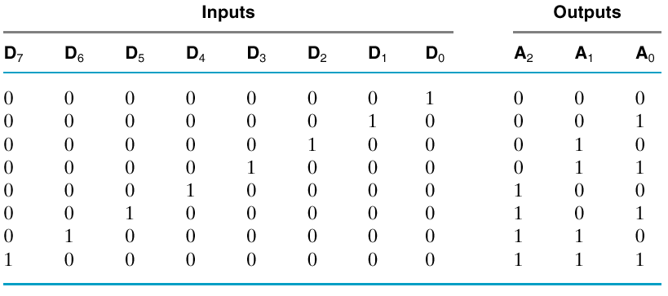
Encoder: Implementation
Inputs are already minterms!
  Simply OR them together appropriately
  e.g.: A₀ = D₁ + D₃ + D₅ + D₇

Slide 34
Encoder Implementation: Problem
Specification assumes:
  Only one of the D inputs can be high
What if, say, D3 and D6 are both high?
  simple OR circuit will set A to 7
  so, must modify the spec to avoid this behavior

Slide 35

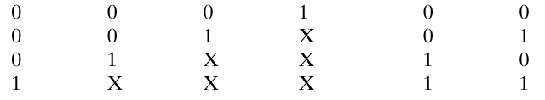
Solution: Priority Encoder
Chooses one with highest priority
  Largest number, usually
Note “don’t cares”

Slide 36
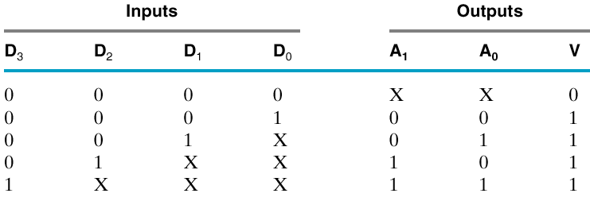
Priority Encoder
What if all inputs are zero?
  Need another output: “Valid”

Slide 37
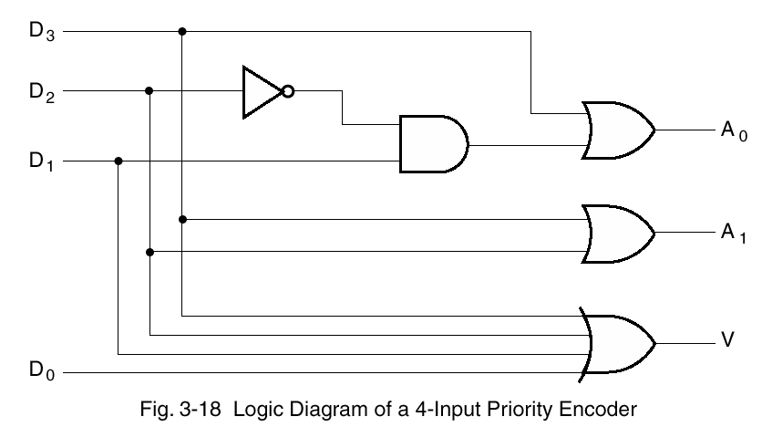
Priority Encoder Implementation
Valid is simply the OR of all the data inputs

Slide 38
Code Converters
General Converters
  convert one code to another
  examples?

Slide 39


Example: Seven-Segment Display
7-segment display
  convert single hex digit …
  … to a display character code)
Used in the first lab using the hardware kit

Slide 40
Delays and Timing

Slide 41
Timing
What is Delay?
  Time from input change to output change
    Transient response
  e.g., rising edge to rising edge
  Usually measured from 50% point

Slide 42
Types of Delays
Transport delay = “pure” delay
  Whatever goes in …
  … comes out after a specified amount of time
Inertial delay
  Inputs have an effect only if they persist for a specified amount of time
    No effect if input changes and changes back in too short a time (can’t overcome inertia)
    can filter out glitches

Slide 43
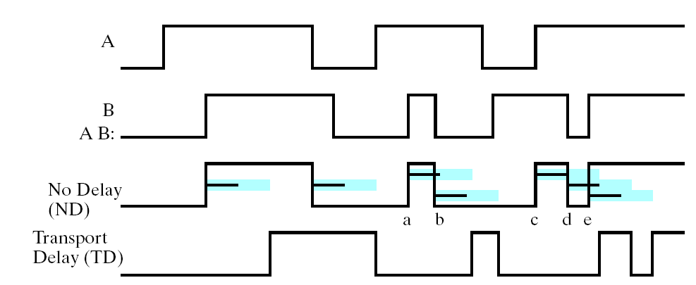
Effect of Transport Delay (blue)
Delay just shifts signal in time
  focus on the blue bars; ignore the black ones
AB

Slide 44
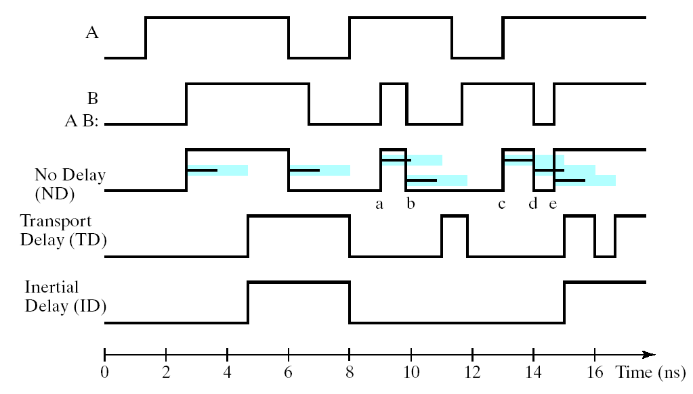
Effect of Inertial Delay
Changes too close to each other cancel out
  focus on the black bars
AB
Blue – Propagation delay time Black – Rejection time (filter out)

Slide 45
Propagation & Contamination Delay
Propagation delay: t_{pd}
  max delay from input to output
Contamination delay: t_{cd}
  min delay from input to output

Slide 46
Propagation & Contamination Delay
Delay is caused by
  Capacitance and resistance in a circuit
    More gates driven, longer delay
    Longer wires at output, longer delay
  Speed of light is the ultimate limitation
Reasons why t_{pd} and t_{cd} may be vary:
  Different rising and falling delays
    What is typically reported? Greater of the two
  Multiple inputs and outputs, some faster than others
  Circuits slow down when hot and speed up when cold
    So, both maximum and typical given
Specs provided in data sheets

Slide 47
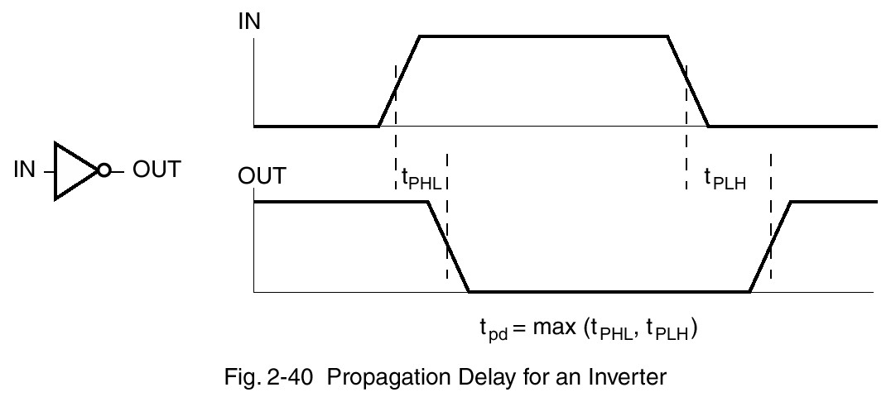
Propagation Delay: Example

Slide 48
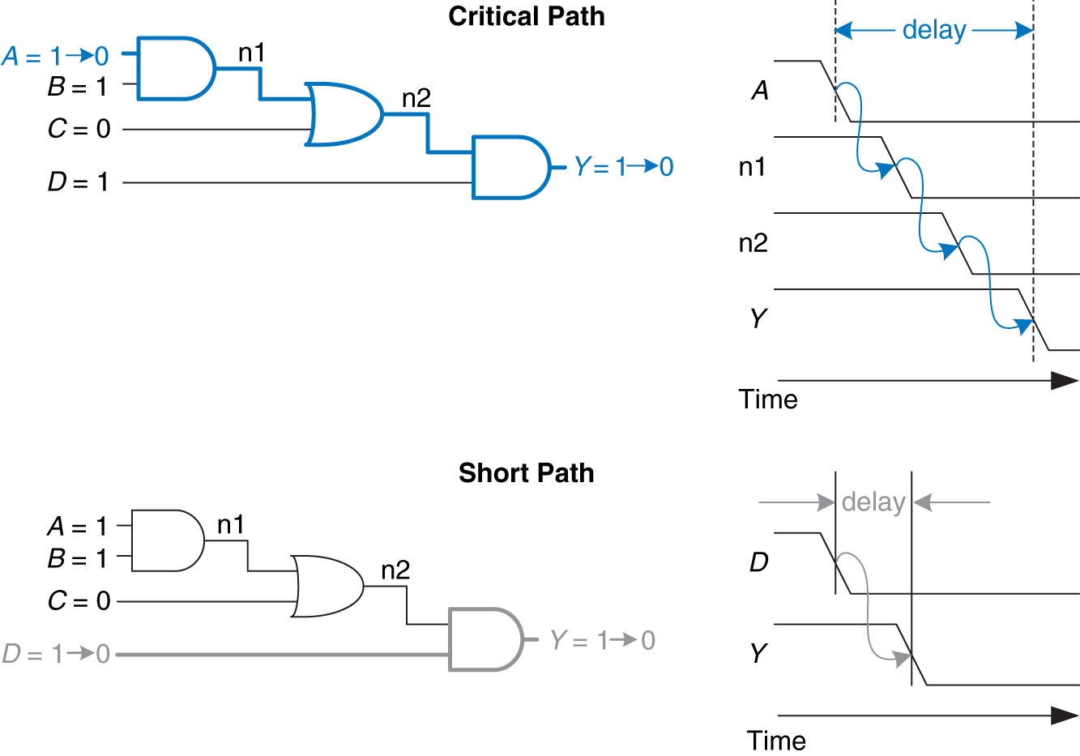
Critical and Short Paths
Critical (Long) Path: t_{pd} = 2t_{pd_AND} + t_{pd_OR}
Short Path: t_{cd} = t_{cd_AND}

Slide 49
Glitches
What is a Glitch?
  a non-monotonic change in a signal
  e.g., a single input change can cause multiple changes on the same output
  a multi-input transition can also cause glitches
Are glitches a problem?
  Not really in synchronous design
    Clock time period must be long enough for all glitches to subside
  Yes, in asynchronous design
    Absence of clock means there should ideally be no spurious signal transitions, esp. in control signals
  It is important to recognize a glitch when you see one in simulations or on an oscilloscope
  Often cannot get rid of all glitches

Slide 50
Glitch Example: Self-Study
What happens when:
  A = 0, C = 1, and
  B goes from 1 to 0?
Logically, nothing
  Because although 2nd term goes to false
  1st term now is true
But, output may glitch
  if one input to OR goes low before the other input goes high

Slide 51
Glitch Example: Self-Study (cont.)

Slide 52
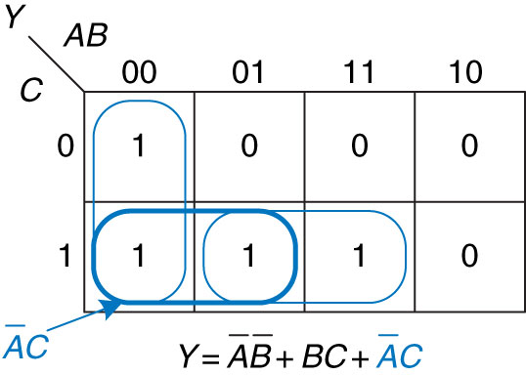
Glitch Example: Self-Study (cont.)
Fixing the glitch: Add redundant logic term
  A’C
    “bridges the two islands”

Slide 53
Next
Sequential Design

