Slide 1
Addressing Modes
Don Porter

Slide 2
Operands and Addressing Modes
Where is the data?
Addresses as data
Names and Values
Indirection

Slide 3
Addressing Modes
What are all of the different ways to specify operands?
  Operands = the variables needed to perform an instruction’s operation
Let us look more generally across various CPUs first, then focus on MIPS

Slide 4
Common “Addressing Modes” in various CPUs
MIPS can do these with appropriate choices for Reg and const
Absolute (Direct): lw $8, 0x1000($0)
  Value = Mem[constant]
  Use: accessing static data
Register-Indirect: lw $8, 0($9)
  Value = Mem[Reg[x]]
  Use: pointer accesses
Displacement: lw $8, 16($9)
  Value = Mem[Reg[x] + constant]
  Use: access to local variables
Indexed:
  Value = Mem[Reg[x] + Reg[y]]
  Use: array accesses (base+index)
Memory indirect:
  Value = Mem[Mem[Reg[x]]]
  Use: access thru pointer in mem
Autoincrement:
  Value = Mem[Reg[x]]; Reg[x]++
  Use: sequential pointer accesses
Autodecrement:
  Value = Reg[X]--; Mem[Reg[x]]
  Use: stack operations
Scaled:
  Value = Mem[Reg[x] + c + d*Reg[y]]
  Use: array accesses (base+index)
Is the complexity worth the cost? Need a cost/benefit analysis!

Slide 5
Revisiting Operands in MIPS
Operands = the variables needed for operation
Three types in the MIPS ISA:
  Register:
    add $2, $3, $4 # operands are the “contents” of a register
  Immediate:
    addi $2,$2,1 # 2nd source operand is part of the instruction
  Displacement:
    lw $2, 12($28) # source operand is in memory
    sw $2, 12($28) # destination operand is memory
  2 special cases of Displacement:
    Absolute (Direct): when rs is $0
    Register-Indirect: when imm is 0
Simple enough, but is it enough?

Slide 6
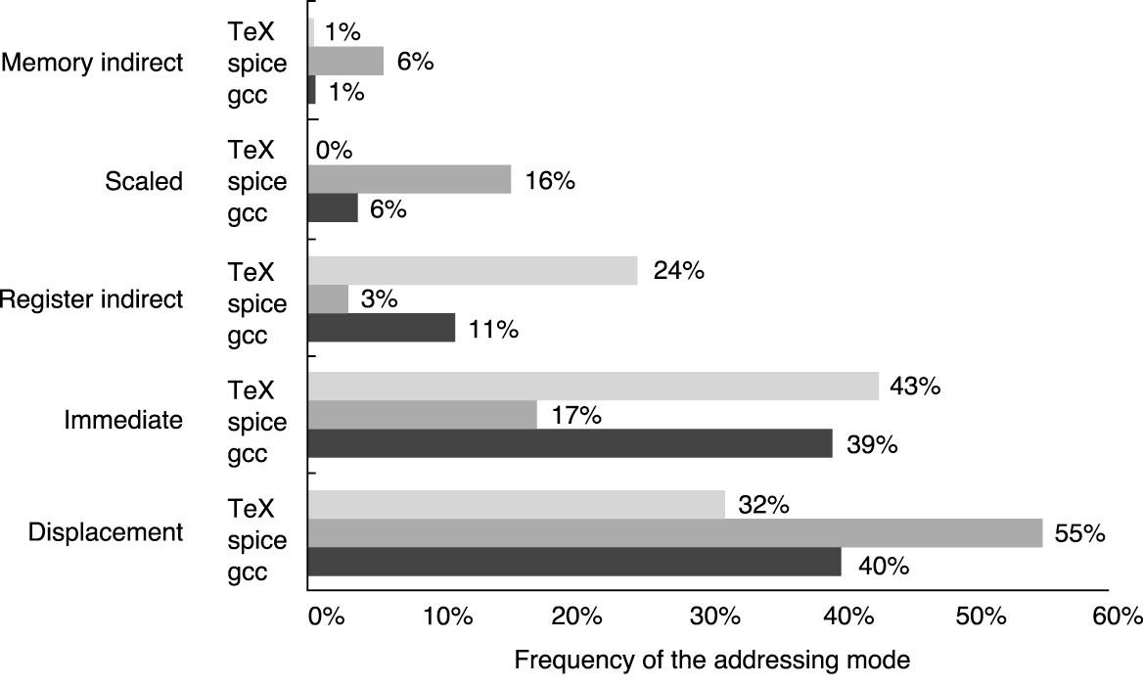
Relative popularity of address modes
Most common ones are
  Displacement/Absolute (combined under “Displacement” in graph)
  Register-Indirect
  Immediate (i.e., constants within instructions)
From Hennessy & Patterson
(graduate architecture book)

Slide 7
Absolute (Direct) Addressing
What we want:
  Contents of a specific memory location, i.e., at a given address
Example:
Caveat:
  Sometimes generates a two instruction sequence
    If the address for x chosen by the programmer/compiler/assembler is too large to fit within the 16-bit immediate field
“MIPS Assembly”
.data
x: .word 10
.text
main:
lw $2,x($0)
addi $2,$2,1
sw $2,x($0)
Allocates space for a single integer (4-bytes) and initializes its value to 10
“C”
int x = 10;
main() {
x = x + 1;
}
‘x’ here means address of x
lui $1,xhighbits
lw $2,xlowbits($1)
e.g., if x is at address 0x12345678
lui $1,0x1234
lw $2,0x5678($1)

Slide 8
Absolute (Direct) Addressing: More detail
“MIPS Assembly”
.data
x: .word 10
.text
main:
lw $2,x($0)
addi $2,$2,1
sw $2,x($0)
“After Compilation”
.data 0x0100
x: .word 10
.text
main:
lw $2,0x100($0)
addi $2,$2,1
sw $2,0x100($0)
“C”
int x = 10;
main() {
x = x + 1;
}
Assembler replaces “x” by its address
  e.g., here the data part of the code (.data) starts at 0x100
  x is the first variable, so starts at 0x100
    this mode works in MIPS only if the address fits in 16 bits

Slide 9
Indirect Addressing
What we want:
  The contents at a memory
  address held in a register
Examples:
Caveats
  You must make sure that the register contains a valid address
  (double, word, or short aligned as required)
“la” is not a real instruction,
It’s a convenient pseudoinstruction that constructs a constant via either a 1 instruction or
2 instruction sequence
“C”
int x = 10;
main() {
int *y = &x;
*y = 2;
}
“MIPS Assembly”
.data
x: .word 10
.text
main:
la $2,x
addi $3,$0,2
sw $3,0($2)
ori $2,$0,x
lui $2,xhighbits
ori $2,$2,xlowbits
$2 performs the role of y, i.e., it is a pointer to x

Slide 10
Note on la pseudoinstruction
la is a pseudoinstruction: la $r, x
  stands for “load the address of” variable x into register r
  not an actual MIPS instruction
  but broken down by the assembler into actual instructions
    if address of x is small (fits within 16 bits), then a single ori
      one could also use a single addiu
    if address of x is larger, use the lui + ori combo
“MIPS Assembly”
.data
x: .word 10
.text
.global main
main:
la $2,x
addi $3,$0,2
sw $3,0($2)
0x0100
0x80000010
ori $2,$0,0x100
lui $2,0x8000
ori $2,$2,0x0010

Slide 11
Displacement Addressing
What we want:
  contents of a memory location at an offset relative to a register
    the address that is the sum of a constant and a register value
Examples:
Remember:
  Must multiply (shift) the “index” to be properly aligned
“MIPS Assembly”
.data 0x0100
a: .space 20
.text
main:
addi $2,$0,3 // i in $2
addi $3,$0,2
sll $1,$2,2 // i*4 in $1
sw $3,a($1)
“C”
int a[5];
main() {
int i = 3;
a[i] = 2;
}
Allocates space for a 5 uninitialized integers (20-bytes)

Slide 12
Displacement Addressing: 2nd example
What we want:
  The contents of a memory location at an offset relative to a register
Examples:
Note:
  offsets to the various fields within a structure are constants known to the assembler/compiler
“MIPS Assembly”
.data
p: .space 8
.text
main:
la $1,p
addi $2,$0,13
sw $2,0($1)
addi $2,$0,12
sw $2,4($1)
“C”
struct p {
int x, y; }
main() {
p.x = 13;
p.y = 12;
}
Allocates space for 2 uninitialized integers (8-bytes)

Slide 13
Assembly Coding Templates
For common C program fragments

Slide 14
Conditionals: if-else
There are little tricks that come into play when compiling conditional code blocks. For instance, the statement:
if (y > 32) {
x = x + 1;
}
compiles to:
lw $24, y($0)
ori $15, $0, 32
slt $1, $15, $24
beq $1, $0, Lendif
lw $24, x($0)
addi $24, $24, 1
sw $24, x($0)
Lendif:
C code:
if (expr) {
STUFF
}
MIPS assembly:
  (compute expr in $rx)
  beq $rx, $0, Lendif
  (compile STUFF)
Lendif:
C code:
if (expr) {
STUFF1
} else {
STUFF2
}
MIPS assembly:
  (compute expr in $rx)
  beq $rx, $0, Lelse
  (compile STUFF1)
  j Lendif
Lelse:
  (compile STUFF2)
Lendif:

Slide 15
Loops: while
C code:
while (expr)
{
STUFF
}
MIPS assembly:
Lwhile:
  (compute expr in $rx)
  beq $rx,$0,Lendw
  (compile STUFF)
  j Lwhile
Lendw:
Alternate MIPS assembly:
j Ltest
Lwhile:
(compile STUFF)
Ltest:
  (compute expr in $rx)
  bne $rx,$0,Lwhile
Lendw:
Compilers spend a lot of time optimizing in and around loops
- moving all possible computations outside of loops
- unrolling loops to reduce branching overhead
- simplifying expressions that depend on “loop variables”

Slide 16
Loops: for
Most high-level languages provide loop constructs that establish and update an iteration variable, which is used to control the loop’s behavior
MIPS assembly:
.data
sum:
.word 0x0
data:
.word 0x1, 0x2, 0x3, 0x4, 0x5
.word 0x6, 0x7, 0x8, 0x9, 0xa
.text
add $30,$0,$0
Lfor:
lw $24,sum($0)
sll $15,$30,2
lw $15,data($15)
add $24,$24,$15
sw $24,sum($0)
addi $30,$30,1
slti $24,$30,10
bne $24,$0,Lfor
Lendfor:
C code:
int sum = 0;
int data[10] =
{1,2,3,4,5,6,7,8,9,10};
int i;
for (i=0; i<10; i++) {
sum += data[i]
}

