Slide 1
Arithmetic and Logic Circuits
Don Porter
Lecture 12

Slide 2
Topics
Arithmetic Circuits
  adder
  subtractor
Logic Circuits
Arithmetic & Logic Unit (ALU)
  … putting it all together

Slide 3
Review: 2’s Complement
N bits
-2^{N-1}
2^{N-2}
…
…
…
2³
2²
2¹
2⁰
Range: – 2^{N-1} to 2^{N-1} – 1
“sign bit”
“binary” point
8-bit 2’s complement example:
  11010110 = – 128 + 64 + 16 + 4 + 2 = – 42
Beauty of 2’s complement representation:
  same binary addition procedure will work for adding both signed and unsigned numbers
    as long as the leftmost carry out is properly handled/ignored
Insert a “binary” point to represent fractions too:
  1101.0110 = – 8 + 4 + 1 + 0.25 + 0.125 = – 2.625

Slide 4
Binary Addition
Example of binary addition “by hand”:
Let’s design a circuit to do it!
  Start by building a block that adds one column:
    called a “full adder” (FA)
  Then cascade them to add two numbers of any size…
Carries from
previous column
1
1
0
1
Adding two N-bit numbers produces an (N+1)-bit result
A: 1101
B:+ 0101
10010
A B
CO CI
S
FA
A3 B3 A2 B2 A1 B1 A0 B0
4-bit adder
A B
CO CI
S
A B
CO CI
S
A B
CO CI
S
A B
CO CI
S
FA
FA
FA
FA
S4 S3 S2 S1 S0

Slide 5
Binary Addition
Extend to arbitrary # of bits
  n bits: cascade n full adders
  Called “Ripple-Carry Adder”
    carries ripple through from right to left
    longest chain of carries has length n
      how long does it take to add the numbers 0 and 1?
      how long does it take to add the numbers -1 and 1?
A_{n-1} B_{n-1} A₂ B₂ A₁ B₁ A₀ B₀
A B
CO CI
S
A B
CO CI
S
A B
CO CI
S
A B
CO CI
S
FA
FA
FA
FA
S_{n} S_{n-1} S₂ S₁ S₀

Slide 6
Designing a Full Adder (1-bit adder)
Follow the step-by-step method
  Start with a truth table:
  Write down eqns for the “1” outputs:
  Simplifying a bit (seems hard, but experienced designers are good at this art!)

Slide 7
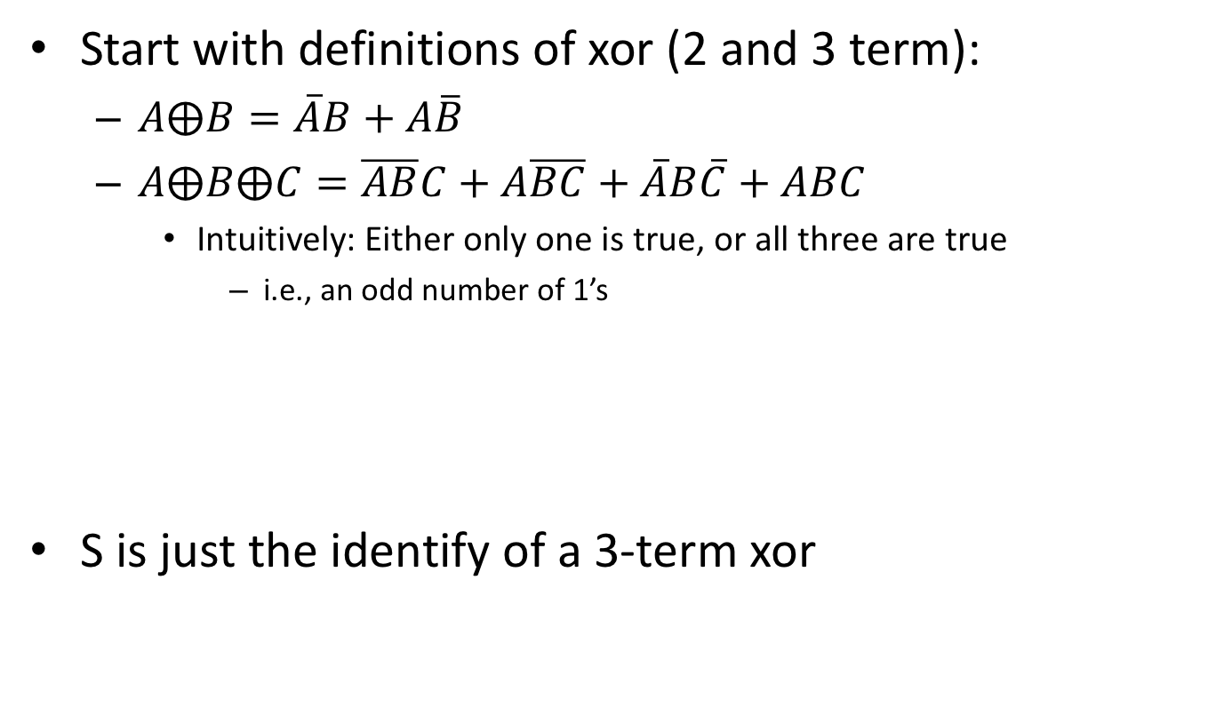
Simplifying the Boolean for Adder
Start with definitions of xor (2 and 3 term):
  $A⨁B=\overline{A}B+A\overline{B}$
  $A⨁B⨁C=\overline{AB}C+A\overline{BC}+\overline{A}B\overline{C}+ABC$
    Intuitively: Either only one is true, or all three are true
      i.e., an odd number of 1’s
S is just the identify of a 3-term xor

Slide 8
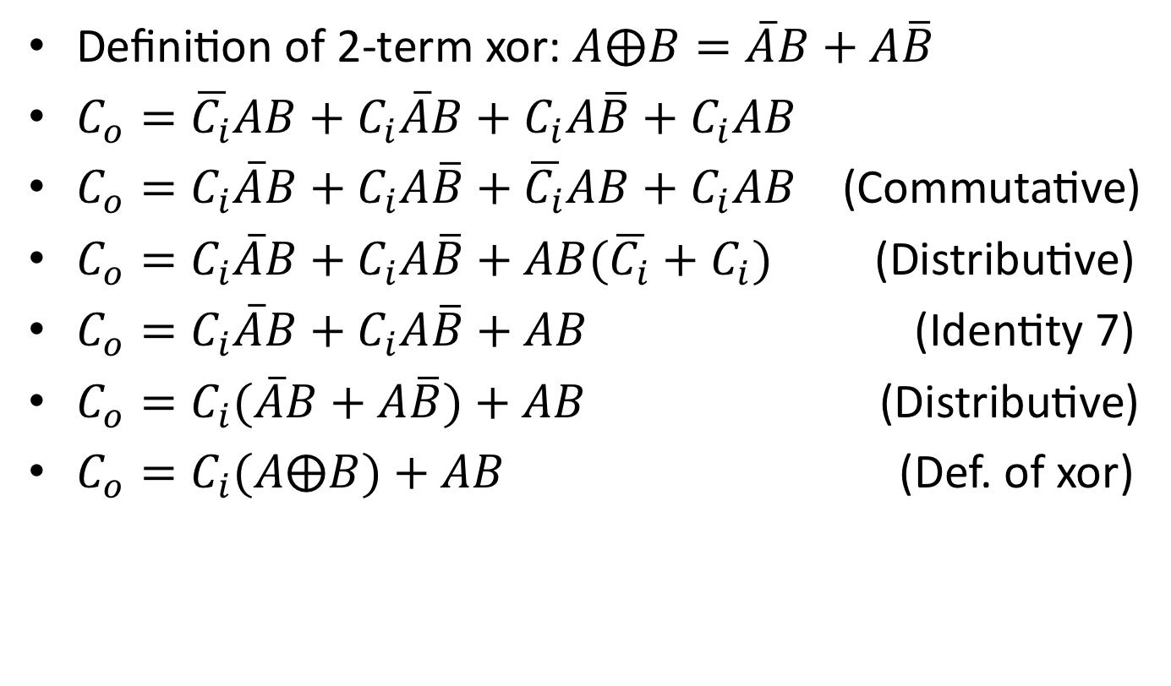
Simplifying the Boolean for Adder
Definition of 2-term xor: $A⨁B=\overline{A}B+A\overline{B}$
$C_{o}=\overline{C_{i}}AB+C_{i}\overline{A}B+C_{i}A\overline{B}+C_{i}AB$
$C_{o}=C_{i}\overline{A}B+C_{i}A\overline{B}+{\overline{C_{i}}AB+C}_{i}AB$ (Commutative)
$C_{o}=C_{i}\overline{A}B+C_{i}A\overline{B}+{AB(\overline{C_{i}}+C}_{i})$ (Distributive)
$C_{o}=C_{i}\overline{A}B+C_{i}A\overline{B}+AB$ (Identity 7)
$C_{o}=C_{i}(\overline{A}B+A\overline{B})+AB$ (Distributive)
$C_{o}=C_{i}(A⨁B)+AB$ (Def. of xor)

Slide 9
For Those Who Prefer Logic Diagrams
A little tricky, but only 5 gates/bit!
A B
“Carry”
Logic
C_{i}
C_{o}
“Sum”
Logic
S

Slide 10
Subtraction: A-B = A + (-B)
Subtract B from A = add 2’s complement of B to A
  In 2’s complement: –B = ~B + 1
  Let’s build an arithmetic unit that does both add and sub
    operation selected by control input:
~ = bit-wise complement
B
0
B
B
1
B
B3 B2 B1 B0
Subtract
A3 A2 A1 A0
But what about the “+1”?
A B
CO CI
S
A B
CO CI
S
A B
CO CI
S
A B
CO CI
S
FA
FA
FA
FA
S4 S3 S0 S1 S0

Slide 11
Condition Codes
One often wants 4 other bits of information from an arith unit:
  Z (zero): result is = 0
    big NOR gate
  N (negative): result is < 0
    S_{n-1}
  C (carry): the most significant position produced a carry, e.g., “1 + (-1)”
    Carry from leftmost column
  V (overflow): indicates answer doesn’t fit
    when:
      both operands are +ve, but sum is -ve
      both operands are -ve, but sum is +ve
    another way to detect:
      carry into leftmost column is different from carry out of leftmost column

Slide 12
Condition Codes
Subtraction is useful also for comparing numbers
To compare A and B:
  First compute A – B
  Then check the flags Z, N, C, V
Examples:
  LTU (less than for unsigned numbers)
    A < B is given by ~C
  LT (less than for signed numbers)
    A < B is given by N⊕V
  Others in table
To compare A and B,
perform A–B and use
condition codes:
Signed comparison:
EQ == Z
NE != ~Z
LT < N⊕V
LE <= Z+(N⊕V)
GE >= ~(N⊕V)
GT > ~(Z+(N⊕V))
Unsigned comparison:
EQ == Z
NE != ~Z
LTU < ~C
LEU <= ~C+Z
GEU >= C
GTU > ~(~C+Z)

Slide 13
How long does addition take? (Latency)
(T_{PD} = max propagation delay or latency of the entire adder)
A_{n-1} B_{n-1} A_{n-2} B_{n-2} A₂ B₂ A₁ B₁ A₀ B₀
C
A B
CO CI
S
A B
CO CI
S
A B
CO CI
S
A B
CO CI
S
A B
CO CI
S
FA
FA
…
FA
FA
FA
S_{n-1} S_{n-2} S₂ S₁ S₀
Worst-case path: carry propagation from LSB to MSB, e.g., when adding 11…111 to 00…001.
Total latency (max delay in producing outputs) is proportional to N:
T_{PD} ≈ O(N)
O(N) is read “order N” and tells us that the latency of our adder grows in proportion to the number of bits in the operands.

Slide 14
Can we add faster?
Yes, there are many sophisticated designs that are faster…
  Carry-Lookahead Adders (CLA)
  Carry-Skip Adders
  Carry-Select Adders
  ➔ See textbook for details

Slide 15
Adder Summary
Adding is not only common, but it is also tends to be one of the most time-critical of operations
  As a result, a wide range of adder architectures have been developed that allow a designer to tradeoff complexity (in terms of the number of gates) for performance.
Smaller / Slower
Bigger / Faster
Ripple
Carry
Carry
Skip
Carry
Select
Carry
Lookahead
A
B
A
B
At this point we’ll define a high-level functional unit for an adder, and specify the details of the implementation as necessary.
Add
sub
Add/Sub
S
S

Slide 16
Shifting and Logical Operations

Slide 17
Shifting Logic
Shifting is useful for logic operations
  applied to groups of bits
  used for alignment
Shifting also used for “short cut” arithmetic operations
  shift left logical (sll)
    X << 1 is the same as 2*X (unless result overflows)
  shift right logical (srl)
    X >> 1 is the same as X/2 for unsigned numbers
  shift right arithmetic (sra)
    like a right shift, but maintains the sign bit
    makes the sign bit “sticky”
    X >>> 1 is the same as X/2 for 2’s-compl. numbers

Slide 18
Shifting Logic
Examples:
  X = 20₁₀ = 00010100₂
  Left Shift: shifts in a 0 from the right end
    (X << 1) = 00101000₂ = 40₁₀
  Right Shift: shifts in a 0 from the left end
    (X >> 1) = 00001010₂ = 10₁₀
  Signed or “Arithmetic” Right Shift: maintains the sign bit
    -X = -20₁₀ = 2’s complement of X = 11101100₂
    (-20₁₀ >>> 1) = (11101100₂ >>> 1) = 11110110₂ = -10₁₀

Slide 19
Shifting Logic: Other shift amounts
Circuit for shifting left by 1
  if SLL1 is true
    shifts the input X: R ← X << 1
  if SLL1 is false
    does not shift X: R ← X
Other shift amounts
  shift left by 2
    rewire the multiplexors so each X_{i} feeds into R_{i+2}
  similarly: shift left by 4, etc.
  also: srl and sra have similar circuitry
    srl: each X_{i} feeds into a lower numbered R_{j}
    sra: sign bit stays the same
X₇
X₆
X₅
X₄
X₃
X₂
X₁
X₀
0
1
R₇
R₆
R₅
R₄
R₃
R₂
R₁
R₀
0
1
0
1
0
1
0
1
0
1
0
1
“0”
0
1
SLL1

Slide 20
Shifting Logic: Other shift amounts
Circuit for shifting left by any amount
  make blocks for SLL1, SLL2, SLL4, SLL8, SLL16
  then, any arbitrary shift amount can be made by combining these shifts
  example: SLL 13 = SLL (8 + 4 + 1)
shift
left
by 16
shift
left
by 8
shift
left
by 4
shift
left
by 2
shift
left
by 1
SLL16
SLL8
SLL4
SLL2
SLL1
0
1
1
0
1
shift amount
13 = 01101 in binary!

Slide 21
Boolean Operations
It will also be useful to perform logical operations on groups of bits. Which ones?
  ANDing is useful for “masking” off groups of bits.
    ex. 10101110 & 00001111 = 00001110 (mask selects last 4 bits)
  ANDing is also useful for “clearing” groups of bits.
    ex. 10101110 & 00001111 = 00001110 (0’s clear first 4 bits)
  ORing is useful for “setting” groups of bits.
    ex. 10101110 | 00001111 = 10101111 (1’s set last 4 bits)
  XORing is useful for “complementing” groups of bits.
    ex. 10101110 ^ 00001111 = 10100001 (1’s invert last 4 bits)
  NORing is useful for.. uhm…
    ex. 10101110 # 00001111 = 01010000 (0’s invert, 1’s clear)

Slide 22
Boolean Unit
It is simple to build up a Boolean unit using primitive gates and a mux to select the function.
  Since there is no interconnection
  between bits, this unit can be simply
  replicated at each position.
  The cost is about 7 gates per bit.
  One for each primitive function,
  and approx 3 for the
  4-input mux.
This is a straightforward design
  several optimizations possible to make it more efficient
A_{i}
B_{i}
This logic block is repeated for each bit (i.e. 32 times)
00 01 10 11
Bool
2
Q_{i}

Slide 23
An ALU, at last (without comparisons)
Combine add/sub, shift and Boolean units
A
B
• 2-bit Bool used for shifter flavor also
• A is shift amount that B is shifted by
Sub
Add/Sub
Bidirectional
Shifter
Boolean
5-bit ALUFN
Sub Bool Shft Math OP
0 XX X 1 A+B
1 XX X 1 A-B
X 00 1 0 B<<A
X 10 1 0 B>>A
X 11 1 0 B>>>A
X 00 0 0 A & B
X 01 0 0 A | B
X 10 0 0 A ^ B
X 11 0 0 A | B
Bool
Shft
1 0
Math
1 0
Flags N,V,C
Result
Z Flag

Slide 24
A Complete ALU
With support for comparisons (LT and LTU)
  LTU = ~C and LT = N⊕V
A
B
Sub
Add/Sub
Bidirectional
Shifter
Boolean
5-bit ALUFN
Sub Bool Shft Math OP
0 XX 0 1 A+B
1 XX 0 1 A-B
1 X0 1 1 A LT B
1 X1 1 1 A LTU B
X 00 1 0 B<<A
X 10 1 0 B>>A
X 11 1 0 B>>>A
X 00 0 0 A & B
X 01 0 0 A | B
X 10 0 0 A ^ B
X 11 0 0 A | B
Bool
<?
Shft
0 1
1 0
Math
1 0
Flags
N,V,C
Bool₀
Result
Z Flag

Slide 25
Next
Circuits for
  Multiplication
  Division
  Floating-Point Operations

