Slide 1
Assembly and Simulation
Don Porter

Slide 2
Today
Assembly programming
  structure of an assembly program
  assembler directives
  data and text segments
  allocating space for data
MIPS assembler: MARS
  development environment
A few coding examples
  self-study

Slide 3
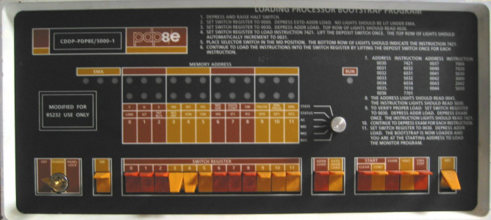
What is an Assembler?
A program for writing programs
Machine Language:
  1’s and 0’s loaded into memory.
  (Did anybody ever really do that?)
Assembly Language:
Front panel of a classic PDP8e. The toggle switches were used to enter machine language.
.globl main
main:
subu $sp, $sp, 24
sw $ra, 16($sp)
li $a0, 18
li $a1, 12
li $a2, 6
jal tak
move $a0, $v0
ASM
01101101
11000110
00101111
10110001
.....
STREAM of
bits to be
loaded into memory
Symbolic
SOURCE
text file
ASSEMBLER
Translator
program
Binary
Machine
Language
  Assembly: A Symbolic LANGUAGE for representing strings of bits
  Assembler: A PROGRAM for translating Assembly Source to binary

Slide 4
Assembly Source Language
An Assembly SOURCE FILE contains, in symbolic text, values of successive bytes to be loaded into memory... e.g.
.data 0x00000000
.byte 1, 2, 3, 4
.byte 5, 6, 7, 8
.word 1, 2, 3, 4
.asciiz "Comp 411"
.align 2
.word 0xfeedbeef
.text 0x00003000
Specifies address for start of data below
Four byte values
Another four byte values
Four word values (each is 4 bytes)
A zero (NULL) terminated ASCII string
Align to next multiple of 2²
A hex-encoded word value
Specifies address for start of program text
Resulting memory dump:
[0x00000000] 0x04030201 0x08070605 0x00000001 0x00000002
[0x00000010] 0x00000003 0x00000004 0x706d6f43 0x31313420
[0x00000020] 0x00000000 0xfeedbeef 0x00000000 0x00000000
Notice the byte ordering. This MIPS is “little-endian” (The least significant byte of a word or half-word has the lowest address)

Slide 5
Assembler Syntax
Assembler DIRECTIVES = Keywords prefixed with ‘.’
  Control the placement and interpretation of bytes in memory
    .data <addr> Subsequent items are considered data
    .text <addr> Subsequent items are considered instructions
    .align N Skip to next address multiple of 2^{N}
  Allocate Storage
    .byte b₁, b₂, …, b_{n} Store a sequence of bytes (8-bits)
    .half h₁, h₂, …, h_{n} Store a sequence of half-words (16-bits)
    .word w₁, w₂, …, w_{n} Store a sequence of words (32-bits)
    .ascii “string” Stores a sequence of ASCII encoded bytes
    .asciiz “string” Stores a zero-terminated string
    .space n Allocates n successive bytes
  Define scope
    .globl sym Declares symbol to be visible to other files
    .extern sym size Sets size of symbol defined in another file
    (Also makes it directly addressable)

Slide 6
More Assembler Syntax
Assembler COMMENTS
  All text following a ‘#’ (sharp) to the end of the line is ignored
Assembler LABELS
  Labels are symbols that represent memory addresses
    labels take on the values of the address where they are declared
    labels can be for data as well as for instructions
  Syntax: <start_of_line><label><colon>
    .data 0x80000000 # specifies where data starts
    item: .word 1 # a data word → “int item=1;”
    .text 0x00010000 # specifies where code text starts
    start: add $3, $4, $2 # an instruction label
    sll $3, $3, 8
    andi $3, $3, 0xff
    beq ..., ..., start

Slide 7
Even More Assembler Syntax
Assembler PREDEFINED SYMBOLS
  Register names and aliases
    $0-$31, $zero, $v0-$v1, $a0-$a3, $t0-$t9, $s0-$s7,
    $at, $k0-$k1, $gp, $sp, $fp, $ra
Assembler MNEMONICS
  Symbolic representations of individual instructions
    add, addu, addi, addiu, sub, subu, and, andi, or, ori, xor, xori, nor, lui, sll, sllv, sra, srav, srl, srlv, div, divu, mult, multu, mfhi, mflo, mthi, mtlo, slt, sltu, slti, sltiu, beq, bgez, bgezal, bgtz, blez, bltzal, bltz, bne, j, jal, jalr, jr, lb, lbu, lh, lhu, lw, lwl, lwr, sb, sh, sw, swl, swr, rfe
    not all implemented in all MIPS versions
  Pseudo-instructions (mnemonics that are not instructions)
    abs, mul, mulo, mulou, neg, negu, not, rem, remu, rol, ror, li, seq, sge, sgeu, sgt, sgtu, sle, sleu, sne, b, beqz, bge, bgeu, bgt, bgtu, ble, bleu, blt, bltu, bnez, la, ld, ulh, ulhu, ulw, sd, ush, usw, move,syscall, break, nop
    not real MIPS instructions; broken down by assembler into real ones

Slide 8
MARS Settings
For some of the examples, following Settings apply:
  (unless specified otherwise)
  “Permit extended (pseudo) instructions and formats”
    is enabled
      allows pseudoinstructions to be used
      allows variable names to be used (instead of just their addresses)
  Memory Configuration is set to
    "Compact, Data at Address 0”
      many of our examples assume that data starts at address 0, and program code starts at address 0x3000

Slide 9
A Simple Programming Task
Add the numbers 0 to 4 …
  0 + 1 + 2 + 3 + 4 ➔ sum is 10
Program in “C”:
Now let’s code it in ASSEMBLY
int i, sum;
main() {
sum = 0;
for (i=0; i<5; i++)
sum = sum + i;
}

Slide 10
Assembly Code: Sum.asm
Simple version: put all variables in registers
Start addr of text
is optional
A convention borrowed from the C language: the entry point of a program is named “main”.
.text 0x3000
main:
add $8,$0,$0 # sum = 0
add $9,$0,$0 # for (i = 0; ...
loop:
add $8,$8,$9 # sum = sum + i;
addi $9,$9,1 # for (...; ...; i++
slti $10,$9,5 # for (...; i<5;
bne $10,$0,loop # is $10 true? ie, != 0
end: ... # need something here to stop!
$8 will have sum
$9 will have i
Bookkeeping:
1) Register $8 is allocated as the “sum” variable
2) Register $9 is allocated as the “i” variable
We will talk about how to exit a program later

Slide 11
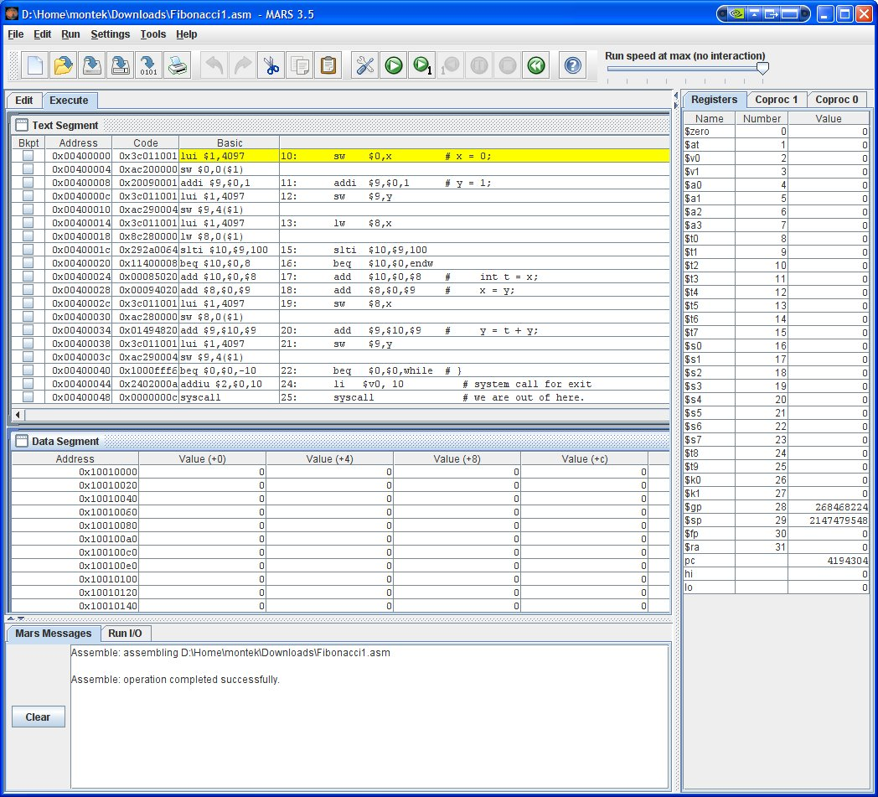
MARS
MIPS Assembler and Runtime Simulator (MARS)
  Java application
  Runs on all platforms
  Links on class website
  Download it now!

Slide 12
A Slightly More Challenging Program
Add 5 numbers from a list …
  sum = n₀ + n₁ + n₂ + n₃ + n₄
In “C”:
Once more… let’s code it in assembly
int sum, i;
int a[5] = {7,8,9,10,8};
main() {
sum = 0;
for (i=0; i<5; i++)
sum = sum + a[i];
}

Slide 13
Variable Allocation
Let’s put variables in memory locations…
  … rather than registers
This time we add the contents of an array
Note: “.word” also works for an array of words
  allows us to initialize a list of sequential words in memory
  label represents the address of the first word in the list, or the name of the array
    does this remind you of how C treats arrays as pointers?!
Note: “.space 4” means 4 bytes uninitialized
  “.word” needs initial value
Start addr of data
is optional
.data 0x0
sum: .space 4
i: .space 4
a: .word 7,8,9,10,8
Arrays have to be in memory. Why?

Slide 14
The New Code: SumArray.asm
Note the small changes:
.text 0x3000
main:
sw $0,sum($0) # sum = 0;
sw $0,i($0) # for (i = 0;
lw $9,i($0) # bring i into $9
lw $8,sum($0) # bring sum into $8
loop:
sll $10,$9,2 # convert "i" to word offset
lw $10,a($10) # load a[i]
add $8,$8,$10 # sum = sum + a[i];
sw $8,sum($0) # update sum in memory
addi $9,$9,1 # for (...; ...; i++
sw $9,i($0) # update i in memory
slti $10,$9,5 # for (...; i<5;
bne $10,$0,loop
end: ... # code for exit here
Assembler replaces sum with 0x0, i with 0x4, and a with 0x8 (see previous slide).

Slide 15
A couple of shortcuts
Can skip the immediate or register field of lw/sw
  assumed to be zero
    lw $8,sum ... is the same as … lw $8,sum($0)
    lw $8,($10) ... is the same as … lw $8,0($10)
  assembler will fill in for you
Also, can optimize code by eliminating intermediate updates in memory
  (next slide)

Slide 16
A couple of shortcuts
Also, can optimize code by eliminating intermediate updates in memory
  a good C compiler will do that automatically for you
main:
add $9,$0,$0 # i in $9 = 0
add $8,$0,$0 # sum in $8 = 0
loop:
sll $10,$9,2 # convert "i" to word offset
lw $10,a($10) # load a[i]
add $8,$8,$10 # sum = sum + a[i];
addi $9,$9,1 # for (...; ...; i++
slti $10,$9,5 # for (...; i<5;
bne $10,$0,loop
sw $8,sum($0) # update final sum in memory
sw $9,i($0) # update final i in memory
end: ... # code for exit here

Slide 17


A Coding Challenge
What is the largest Fibonacci number less than 100?
  Fibonacci numbers:
  F_{i+1} = F_{i} + F_{i-1}
  F₀ = 0
  F₁ = 1
  0, 1, 1, 2, 3, 5, 8, 13, 21, 34, …
In “C”:
int x, y;
main() {
x = 0;
y = 1;
while (y < 100) {
int t = x;
x = y;
y = t + y;
}
}

Slide 18
MIPS Assembly Code: Fibonacci.asm
.data
x: .space 4 # int x, y;
y: .space 4
.text
main:
sw $0,x # x = 0;
addi $9,$0,1 # y = 1;
sw $9,y
lw $8,x
while: # while (y < 100) {
slti $10,$9,100
beq $10,$0,endw
add $10,$0,$8 # int t = x;
add $8,$0,$9 # x = y;
add $9,$10,$9 # y = t + y;
j while # }
endw:
sw $8,x # answer is in x
sw $9,y
... # code for exit here
In assembly
  let’s use these
  registers:
    x → $8
    y → $9
    t → $10

Slide 19
Coming Up…
Parameterized Programs
Procedures
Stacks
MIPS procedure linkage conventions

