Slide 1
Welcome to COMP 411
Don Porter

Slide 2
Welcome!
Today’s goals:
  Give you a flavor of my teaching style with a mini-lecture
  Cover course organization and policies
My high-level goals for the class:
  Demystify how computers work (No magic)
  Learn core principles:
    How programs are translated into the machine language
      And how the hardware executes them
    The hardware/software interface
    What determines program performance
      And how it can be improved
    What a typical computer processor looks like
    How hardware designers improve performance
  Challenging, but supportive, environment

Slide 3
Important Announcements
Labs (on Friday) are mandatory
Note: Room is different (SN 014)

Slide 4
Introductions
Who am I?
Who are you?
  by year
  by major
Why take this course?
  let’s hear from you

Slide 5
Two Goals
Goal 1: Demystify Computers
Goal 2: Learn the Power of Abstraction

Slide 6
Goal 1: Demystify Computers
Analogy to early autos: driver had to be mechanic
  Now: I can’t change my oil
But people in the auto industry should understand mechanics!

Slide 7
Goal 1: Demystify Computers
There is no magic in computers!
By graduation, you should understand what happens inside the computer when write a line of code
Integrate what you learn in other classes into the ”big picture”
  You will write better code

Slide 8
Where do you find computers today?
Besides on your desk, or in your lap, of course!
  Let’s hear from you!
How have computers revolutionized life in the 21st century?
  Automobiles
  Mobile phones, PDAs, games
  Massive distributed projects: e.g., human genome project
  World Wide Web
  Search engines
What has fueled progress in computer technology?
  Moore’s Law

Slide 9
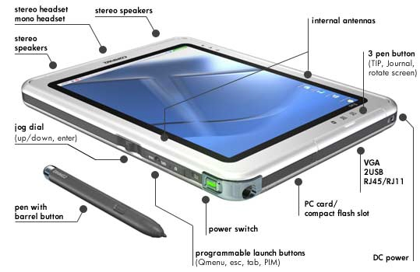
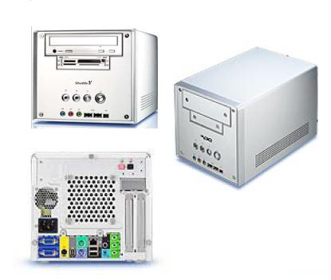
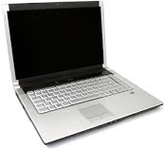
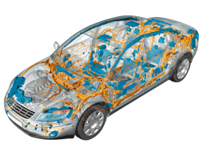
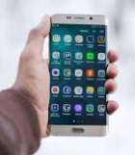
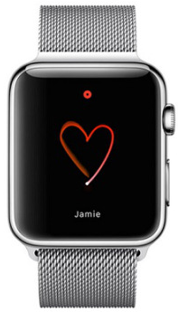
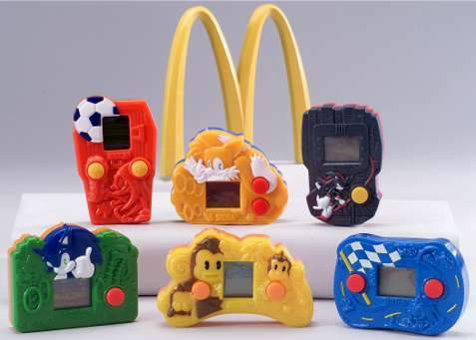
Computers Everywhere
The computers we are used to:
  Desktops
  Laptops
  Servers
    Network-based
    “Cloud computers”
  Embedded processors
    Hidden as components inside: cars, phones, toasters, irons, wristwatches, happy-meal toys

Slide 10
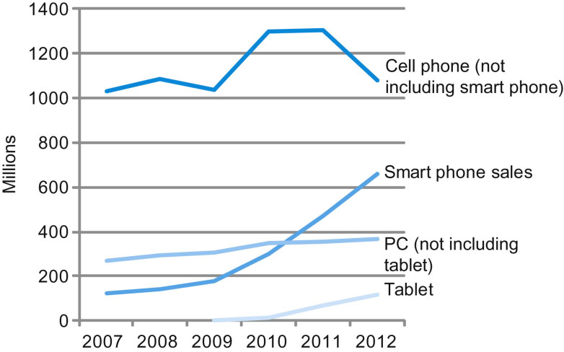
Portable gadgets dominate!
FIGURE 1.2 The number manufactured per year of tablets and smart phones, which reflect the PostPC era, versus personal computers and traditional cell phones. Smart phones represent the recent growth in the cell phone industry, and they passed PCs in 2011. Tablets are the fastest growing category, nearly doubling between 2011 and 2012. Recent PCs and traditional cell phone categories are relatively flat or declining.
  The next billion computers sold won’t be PCs

Slide 11
Goal 2: The Power of Abstraction
What is abstraction?
  Separate what it does from how it does it
Auto Industry Abstractions:
  Operating: Gas pedal: Car goes faster, I don’t care how
  Buying: Metrics like miles per gallon allow comparison
  Servicing: Standard part specifications (e.g., tire sizes) allow same part to be used on different cars, competition, innovation, etc.
Home Example:
  Standard light bulb socket is an abstraction:
    Independent evolution of light fixtures and light bulbs (CFT, LED)
  So what are computer abstractions?

Slide 12
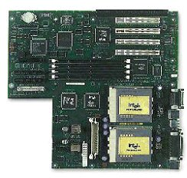
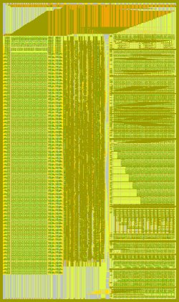
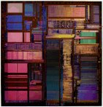
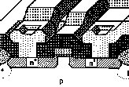

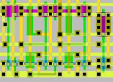

Abstraction: key to building large systems
Personal Computer:
Hardware & Software
Circuit Board:
≈8 / system
1-2G devices
Integrated Circuit:
≈8-16 / PCB
0.25M-16M devices
Module:
≈8-16 / IC
100K devices
MOSFET
="transistor"
="device"
Scheme for
representing
information
Cell:
≈1K-10K / Module
16-64 devices
Gate:
≈2-8 / Cell
8 devices

Slide 13
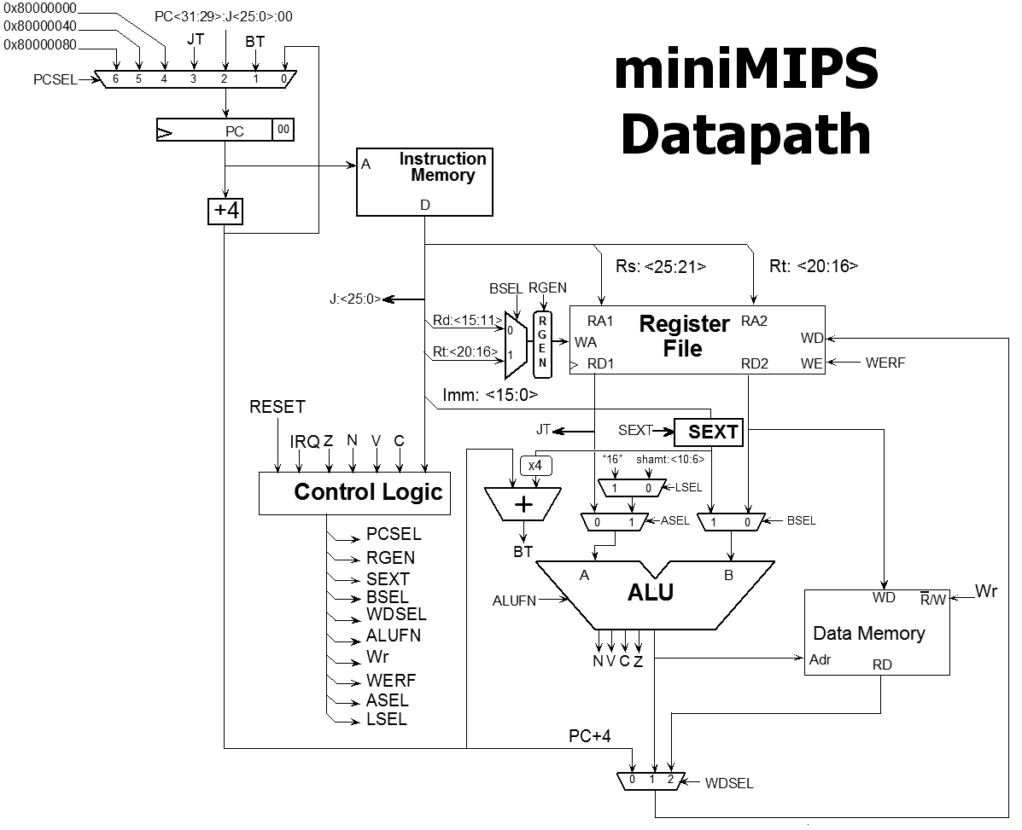
One View of a Computer System
for (i = 0; i < 3; i++)
m += i*i;
Compiler
Assembler and Linker
addi $8, $6, $6
sll $8, $8, 4
CPU
Module
A
ALU
B
A B
CO CI
S
Cells
FA
Gates
Transistors

Slide 14
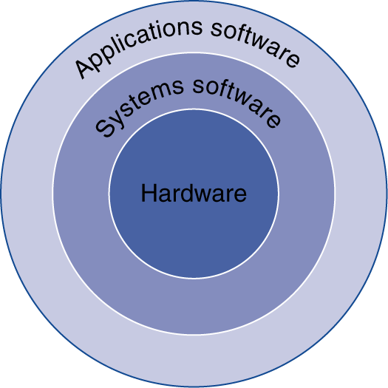
More abstract view!
Application software
  Written in high-level language
System software
  Compiler: translates HLL to machine code
  Operating System: service code
    Handling input/output
    Multiplexes memory and storage
    Scheduling tasks & sharing resources
Hardware
  Processor, memory, I/O controllers

Slide 15
What determines performance?
Algorithm
  Determines number of operations executed
Programming language, compiler, architecture
  Determine number of machine instructions executed per operation
Processor and memory system
  Determine how fast instructions are executed
I/O system (including OS)
  Determines how fast I/O operations are executed

Slide 16
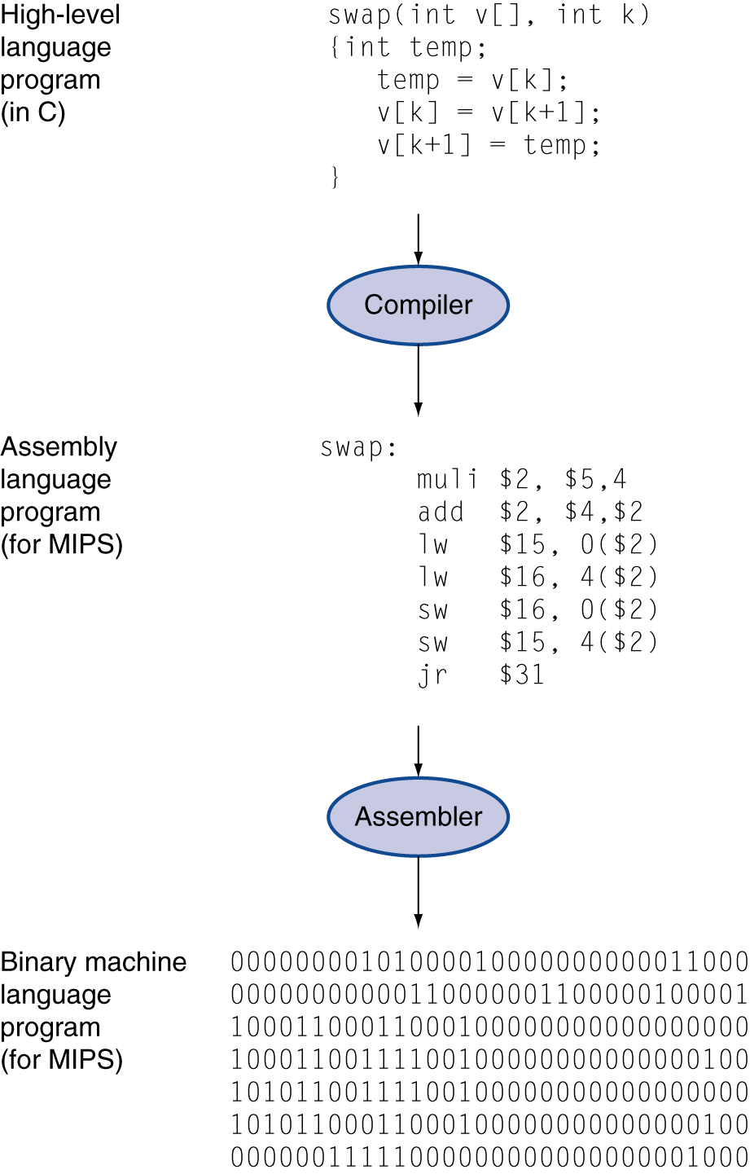
Levels of (Abstraction of) Program Code
High-level language
  Level of abstraction closer to problem domain
  Provides for productivity and portability
Assembly language
  Textual representation of instructions
Hardware representation
  Binary digits (bits)
  Encoded instructions and data

Slide 17
Components of a Computer
Same abstractions apply to all kinds of computers
  Server, personal, phone,
  embedded
Input/output includes
  User-interface devices
    Display, keyboard, mouse
  Storage devices
    Hard disk, CD/DVD, flash
  Network adapters
    For communicating with other computers

Slide 18
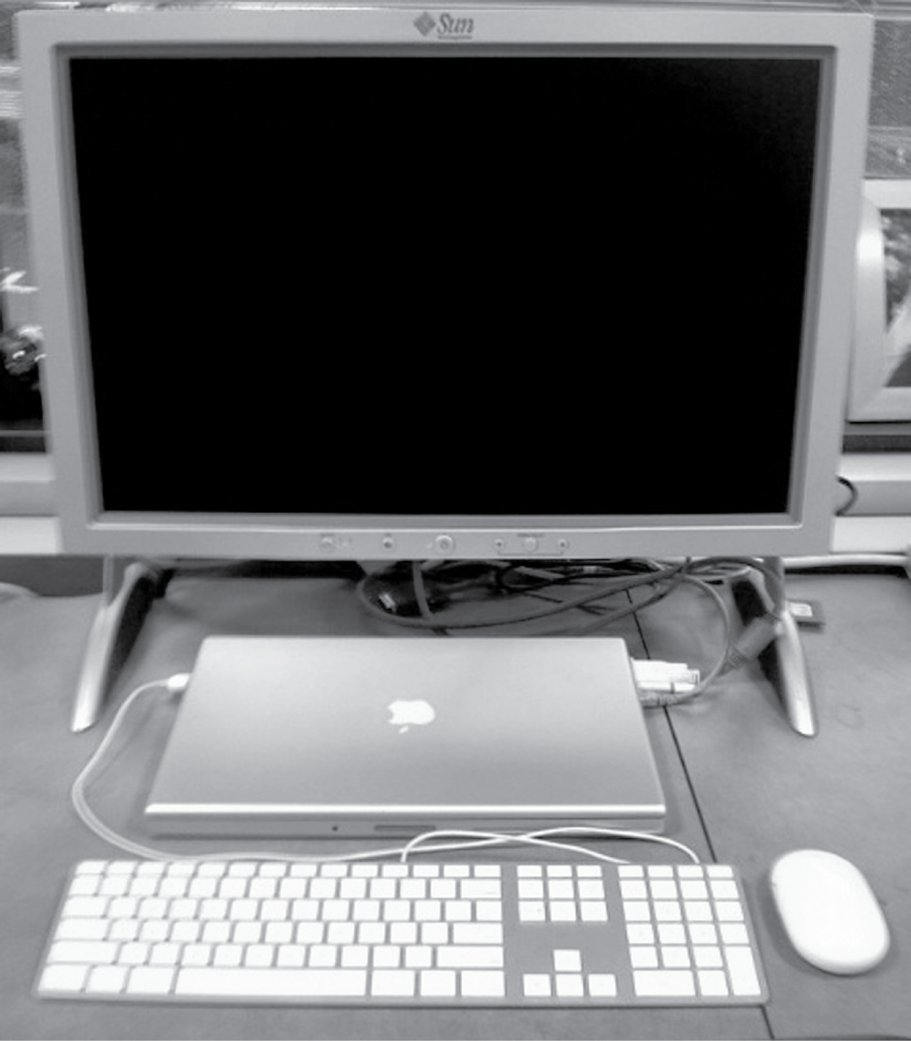
Anatomy of a Computer
Example: Laptop as today’s desktop
Output device
Network cable (I/O)
Input device
Input device
FIGURE 1.5 A desktop computer. The liquid crystal display (LCD) screen is the primary output device, and the keyboard and mouse are the primary input devices. On the right side is an Ethernet cable that connected the laptop to the network and the Web. The lap top contains the processor, memory, and additional I/O devices. This system is a Macbook Pro 15" laptop connected to an external display. Copyright © 2009 Elsevier, Inc. All rights reserved.

Slide 19

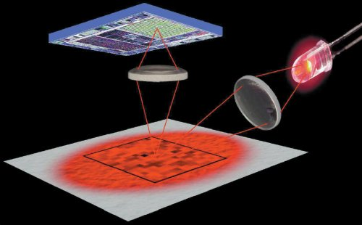
Anatomy of a Mouse
Optical mouse
  LED illuminates desktop
  Small low-res camera
  Basic image processor
    Looks for x, y movement
  Buttons & wheel
Supersedes roller-ball mechanical mouse

Slide 20
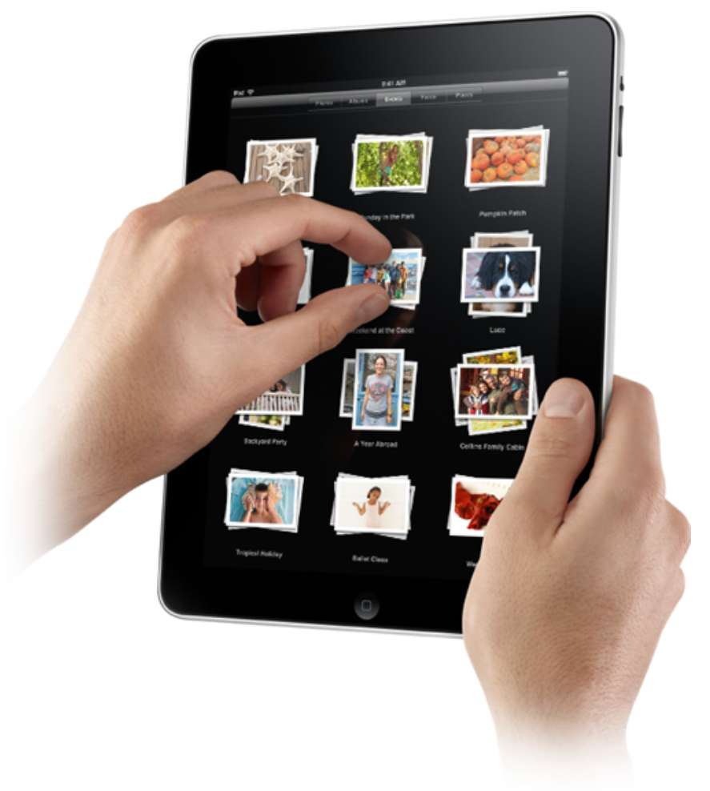
Touchscreen
PostPC device
Supersedes keyboard and mouse
Resistive and Capacitive types
  Most tablets, smart phones use capacitive
  Capacitive allows multiple touches simultaneously

Slide 21
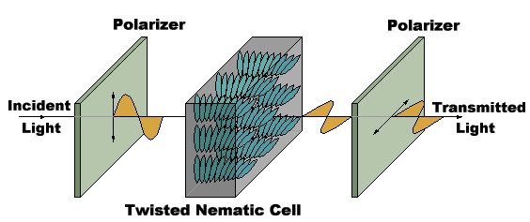
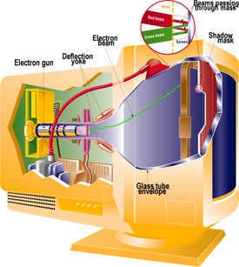
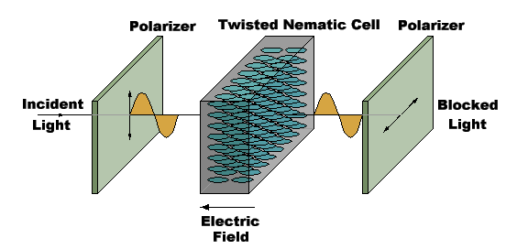
Displays
Cathode Ray Tube (CRT)
  The “last vacuum tube”
  Now nearing extinction
Liquid Crystal Displays (LCDs)

Slide 22
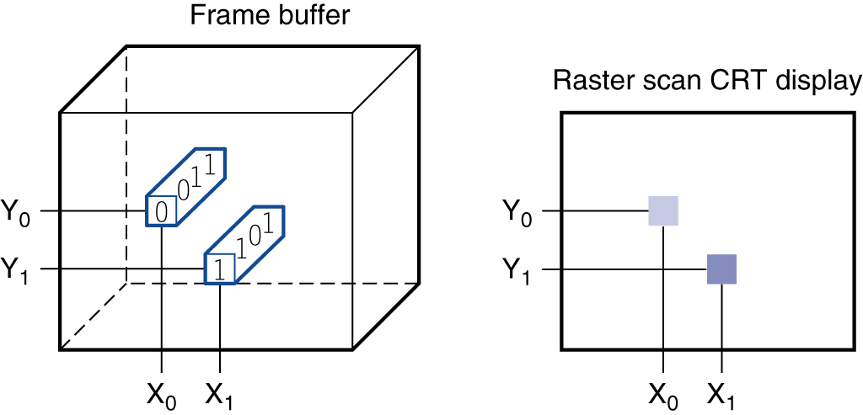
Display Abstraction
Screen: picture elements (pixels)
  Mirrors content of “frame buffer” memory
FIGURE 1.6 Each coordinate in the frame buffer on the left determines the shade of the corresponding coordinate for the raster scan CRT display on the right. Pixel (X₀, Y₀) contains the bit pattern 0011, which is a lighter shade on the screen than the bit pattern 1101 in pixel (X₁, Y₁).

Slide 23
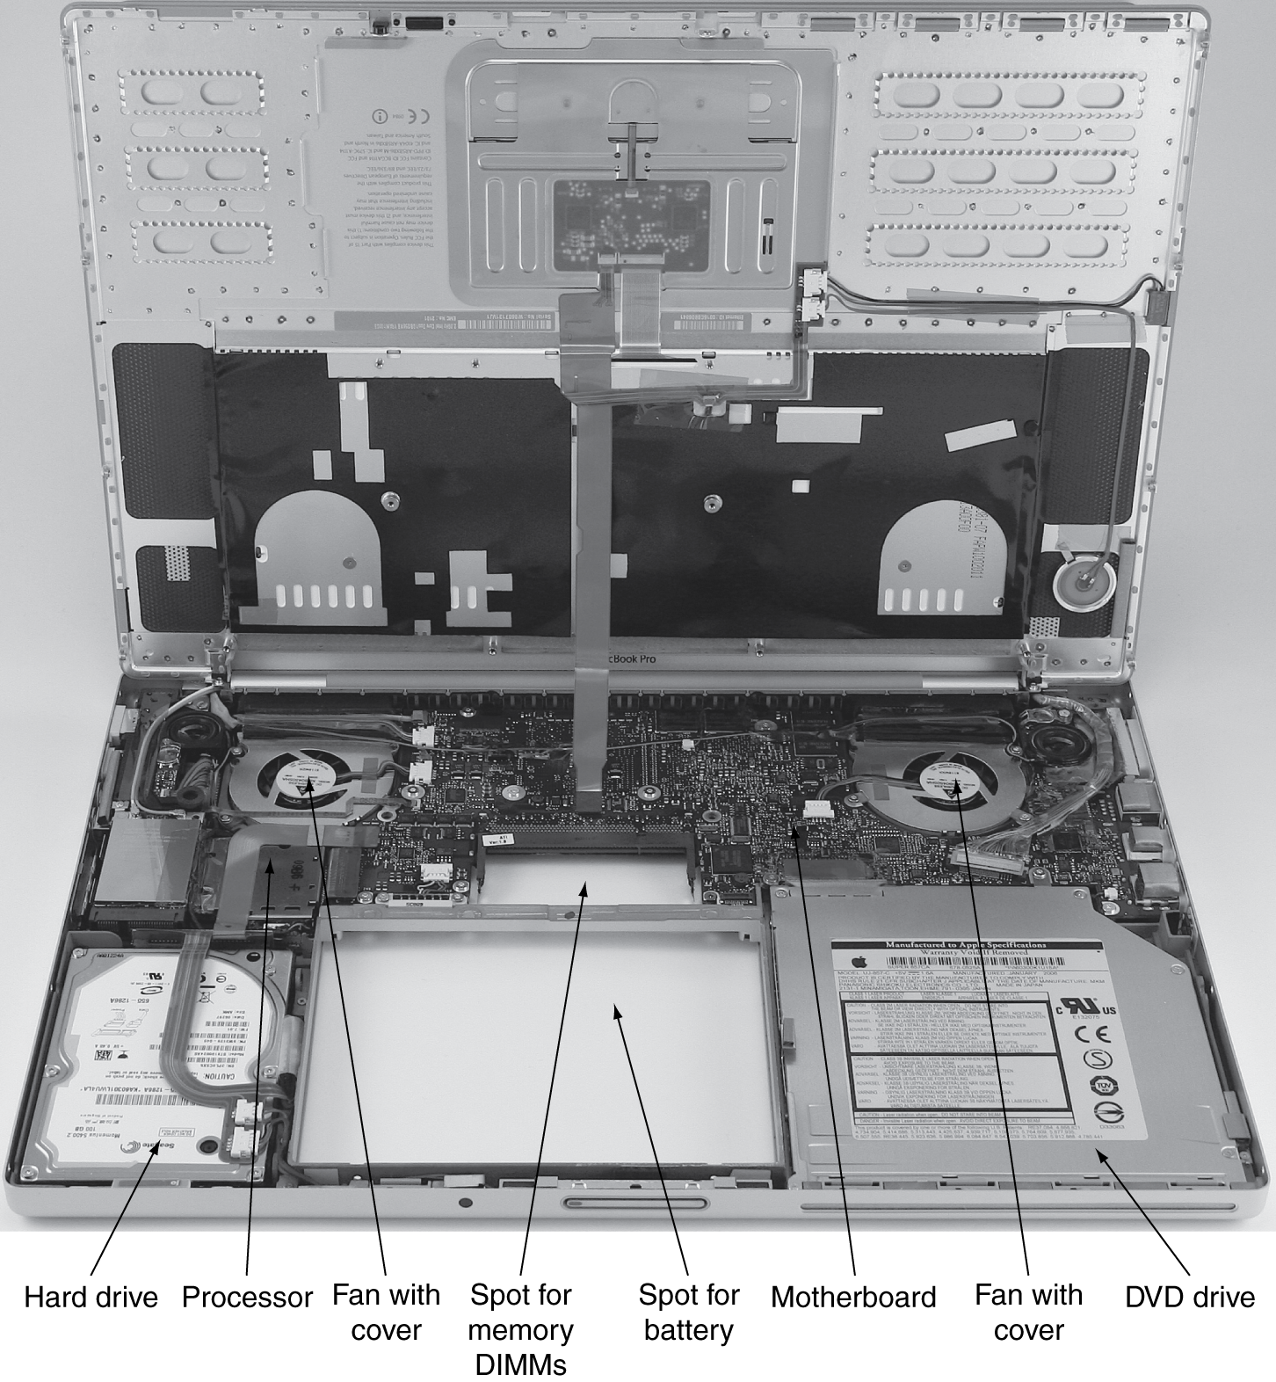
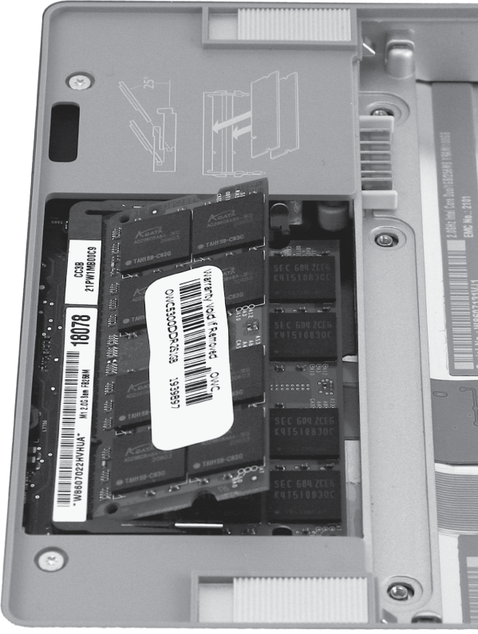
Opening the Box: Laptop

Slide 24
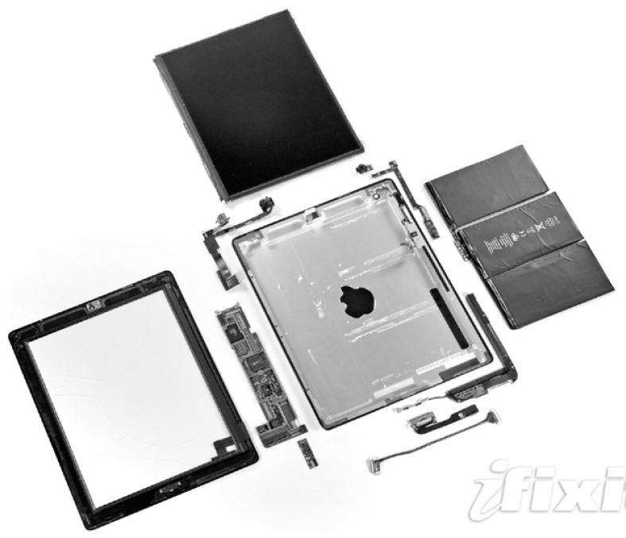
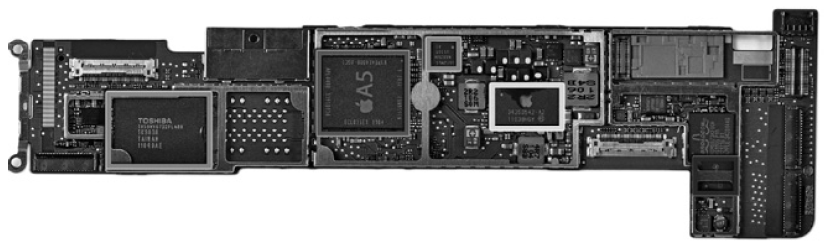
Opening the Box: Tablet
Capacitive multitouch LCD screen
3.8 V, 25 Watt-hour battery
Computer board

Slide 25
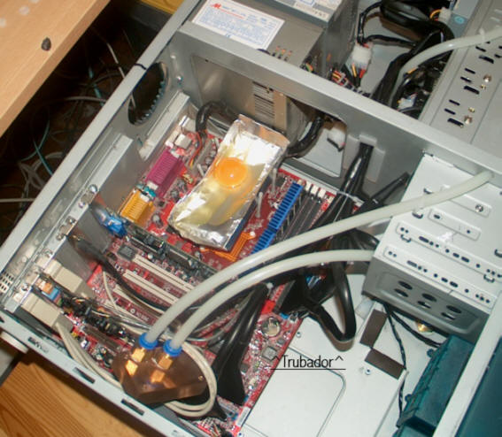
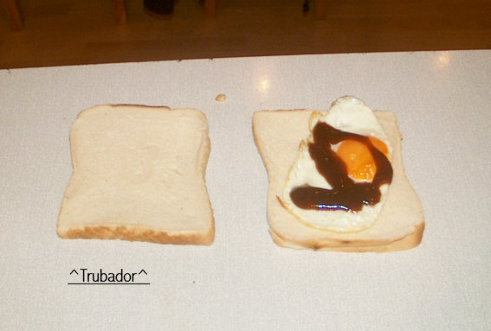
Issues for Modern Computers
  Energy/Power consumption has become a major challenge
    It is now perhaps the limiting factor in most processors
http://www.hotchips.org/
Courtesy Troubador

Slide 26
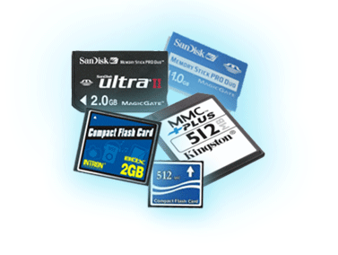
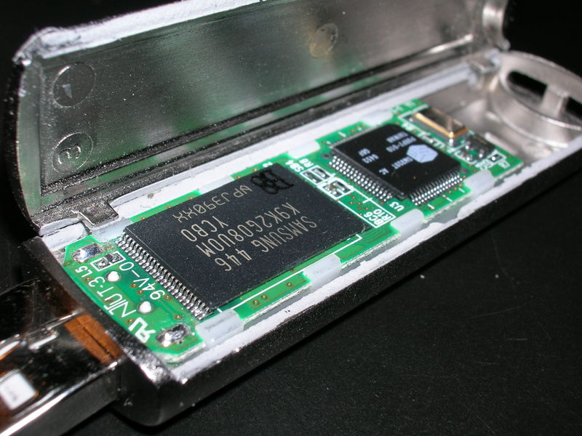
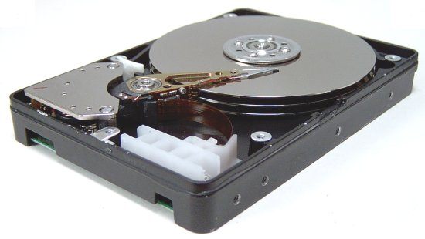
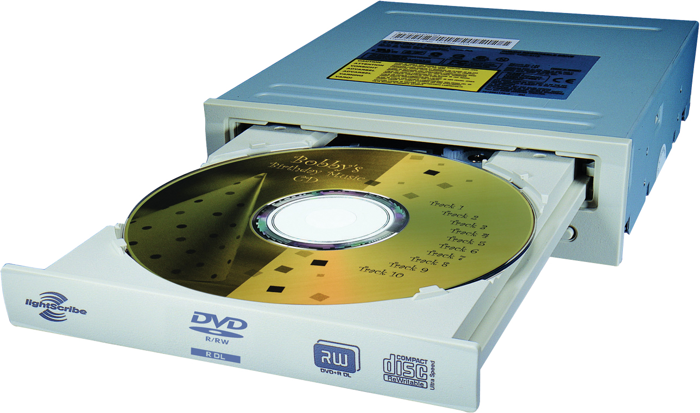
A Safe Place for Data
Volatile main memory
  Loses instructions and data when power off
Non-volatile secondary memory
  Magnetic disk
  Flash memory
  Optical disk (CDROM, DVD)

Slide 27
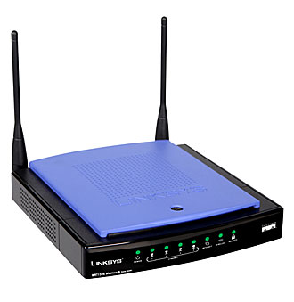
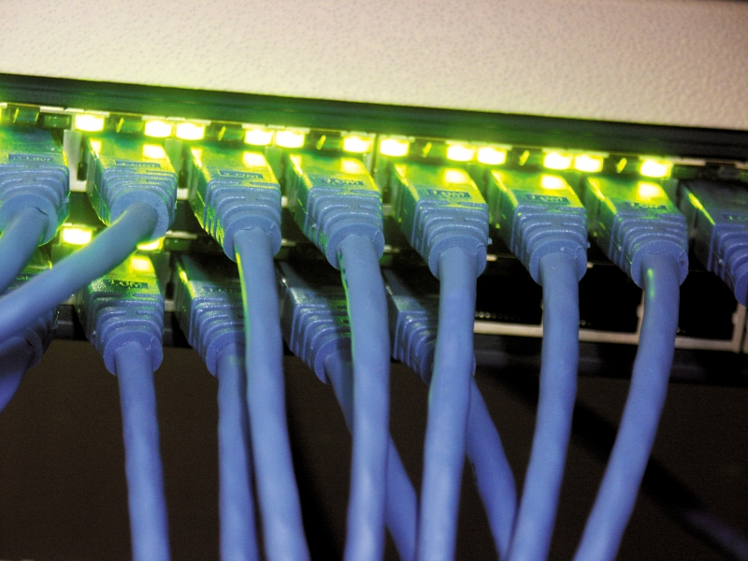
Networks
Communication and resource sharing
Local area network (LAN): Ethernet
  Within a building
Wide area network (WAN): the Internet
Wireless network: WiFi, Bluetooth

Slide 28
Technology Trends
Electronics technology continues to evolve
  Increased capacity and performance
  Reduced cost
Year | Technology | Relative performance/cost
1951 | Vacuum tube | 1
1965 | Transistor | 35
1975 | Integrated circuit (IC) | 900
1995 | Very large scale IC (VLSI) | 2,400,000
2013 | Ultra large scale IC | 250,000,000,000

Slide 29
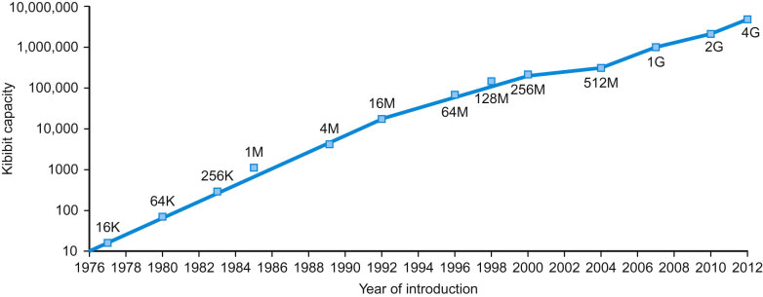
Technology Trends
Memory Capacity:
  Growing exponentially as well
FIGURE 1.11 Growth of capacity per DRAM chip over time. The y-axis is measured in kibibits (2¹⁰ bits). The DRAM industry quadrupled capacity almost every three years, a 60% increase per year, for 20 years. In recent years, the rate has slowed down and is somewhat closer to doubling every two years to three years.
  Caveat: Growth is flattening, but new tech may fix

Slide 30
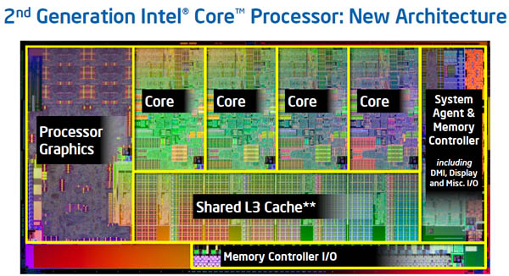
Inside the Processor: Intel Core i7
4 “cores”
  each core is essentially an independent computing engine
  at the top-level, memory and I/O is shared by all cores

Slide 31
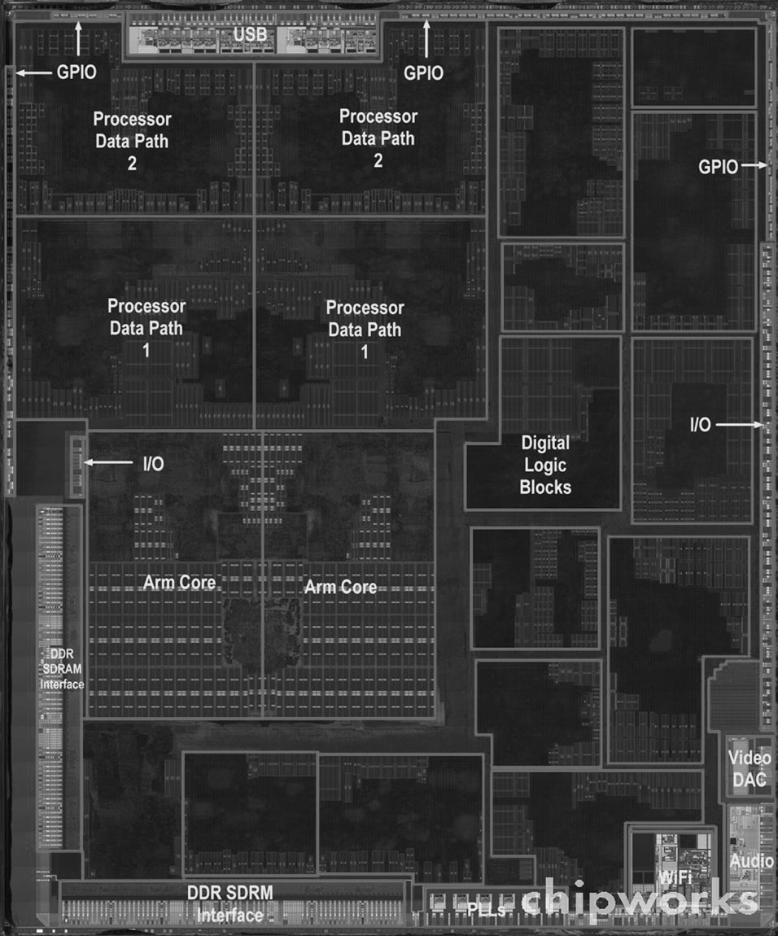
Inside the Processor: Apple
Apple A5
FIGURE 1.9 The processor integrated circuit inside the A5 package. The size of chip is 12.1 by 10.1 mm, and it was manufactured originally in a 45-nm process (see Section 1.5). It has two identical ARM processors or cores in the middle left of the chip and a PowerVR graphical processor unit (GPU) with four datapaths in the upper left quadrant. To the left and bottom side of the ARM cores are interfaces to main memory (DRAM). (Courtesy Chipworks, www.chipworks.com)

Slide 32
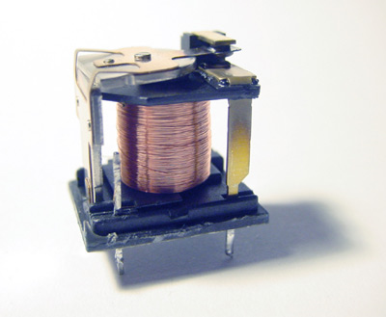
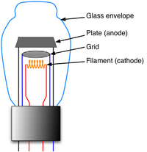
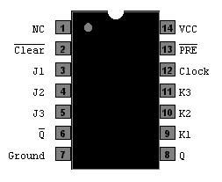
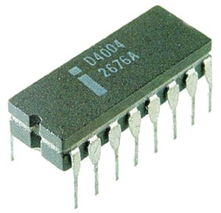
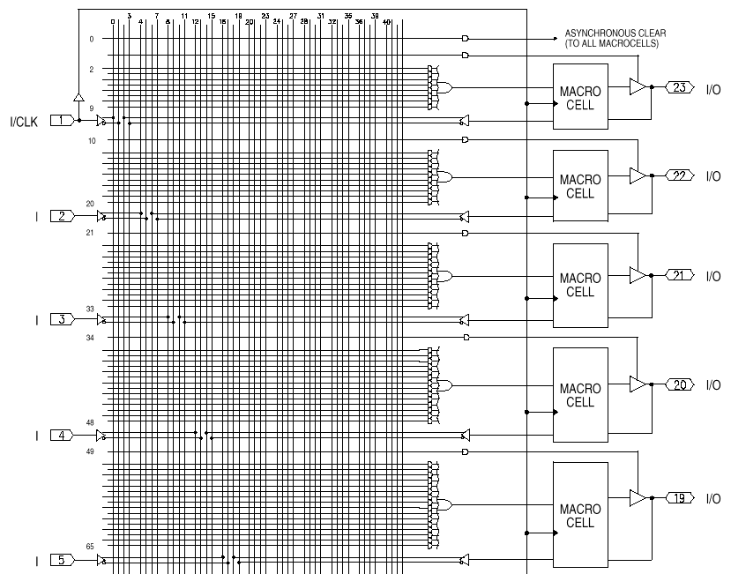
Implementation Technology
Relays
Vacuum Tubes
Transistors
Integrated Circuits
  Gate-level integration
  Medium Scale Integration (PALs)
  Large Scale Integration (Processing unit on a chip)
  Today (Multiple CPUs on a chip)
Nanotubes??
Quantum-Effect Devices??

Slide 33
Implementation Technology
Common Abstraction?
  A controllable switch
Computers are wires and switches
open
open
closed
control

Slide 34
Switches to Functions
Encode logic using a series of switches
  Big part of the course
Need a way to encode information as inputs/outputs
  Garden hose analogy: ”1” if water is on, “0” if off
Digital logic: Compose functions from switches
  Hose + clock -> Morse code
  With enough garden hose switches, one could have 26 outputs, one for each letter of the alphabet

Slide 35
Functions to Circuits and Chips
Compose functions into more complex logic
  Eventually get a CPU
An x86 or ARM CPU is a very, very complex circuit
Fabricated on silicon
One package is called a chip

Slide 36
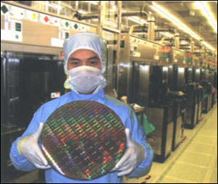
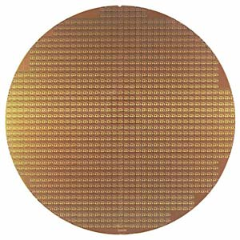
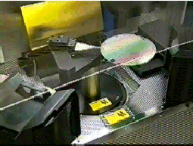
Making a chip
Silicon Wafers
  Chip manufactures build many copies of the same circuit (chip) on a single wafer
    Yield: % of chips that work
  Wafers are processed by automated fabrication lines
    In a meticulously clean environment

Slide 37
Summary
Abstraction: Encapsulate a function
  Separates “what” from “how”
Computers are built by composing functions
  Many, many layers of abstraction
Hardware: I/O, CPU, Memory
  It’s all gates->circuits->chips, just different functions
Digital logic: encoding and manipulating data with switches

Slide 38
Course Policies
Syllabus, schedule, homework, etc. posted on course website
www.cs.unc.edu/~porter/courses/comp411/s18
Please read the syllabus carefully
And sign up for piazza to get announcements

Slide 39
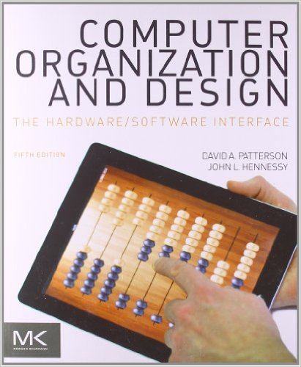
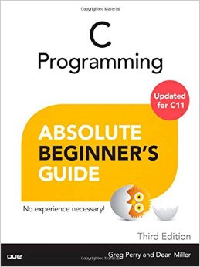
Required Textbooks
Computer Organization and Design:
The Hardware/Software Interface
  Patterson and Hennessy
  5th ed., Oct 2013
  ISBN 9780124077263
C Programming:
Absolute Beginner’s Guide
  Greg Perry and Dean Miller
  3rd ed., Aug 2013
  ISBN 978-0789751980

Slide 40
Credits
Some of the course slides were developed by Montek Singh, Leonard McMillan and Gary Bishop
Some slides and other materials are from the book publisher
This applies to all decks for the course (unless other names are added to specific decks)

Slide 41
Prerequisites
COMP401: Foundations of Programming
  This is a hard prerequisite
  You may be able to substitute another programming course, but please first talk to me!
You need to know at least the following concepts:
  basic data types: integers, characters, Boolean, etc.
  basic arithmetic operators and expressions
  “if-then-else” constructs, and “while”/“for” loops
  function and procedure calls
  basic Boolean operators (AND, OR, XOR, etc.)
If you don’t know many of the above concepts, please talk to me!

Slide 42
Lectures
Discuss and supplement reading material
An important chance to clarify issues
  Questions are encouraged!
I expect you to arrive prepared to answer and ask questions about the reading material
Everything in lectures may appear on the exams, even if not in the book
I need your presence: Digressions are common to fill in “gaps” and to integrate material from other classes
  And as I get familiar with UNC students
  After first two classes, attendance will not be taken
Notes:
START HERE

Slide 43
Recordings
I usually record lectures for students to review later
  I will share on youtube with cs.unc.edu emails; if you don’t have one, please send me your youtube account
  Slides will also be posted online
Recordings are best effort
  Recordings may fail, be unwatchable, or get deleted by accident
  Or be discontinued if too many students stop attending
    I need your facial expressions and questions to know if lectures make sense
Do not use this as a substitute for class attendance

Slide 44
Readings
My lectures aren’t perfect; some concepts are subtle
  Reading other words can be helpful for reinforcement and clarification
You will learn more in class if you read before class
  Can’t ask the textbook questions

Slide 45
Grading
  Homework: 25%
  Lab Assignments: 20%
  Lab Mini-Project: 5%
  Quizzes: 15%
  Midterm: 15%
  Final Exam: 20%
Lowest scores dropped:
  1 lowest lab score dropped
    Excluding scores for “lab mini-project” not dropped
  1 lowest homework score dropped
  2 lowest quiz scores dropped
50%
50%

Slide 46
Assignments
  Problem Sets:
    Will be distributed on the web. You will typically have 1 week to do them, but sometimes more or less time.
  Quizzes:
    There will be a quiz on Sakai most Fridays.
  Labs:
    Labs on Fridays are compulsory. It is a combined review-quiz-lab session.
  Honor Code:
    You will work these alone
    The honor code is in effect for all homework, labs, exams etc. Please review the policy on the course website.

Slide 47
Exams and Quizzes
Open book
Open notes
Usually completed on sakai
Not open internet - i.e., googling not allowed
  Probably won’t help you anyway

Slide 48
Absences
classes: while attendance is not required, there is no substitute to coming to class if you want a good grade
labs: skipping a lab (even if you have a good excuse) will make it very hard to complete the lab
quizzes: since the dates are announced, please see me well in advance if you have a compelling reason for absence
exams: bring any conflicts to my attention in the first two weeks of class (or ASAP)

Slide 49
Lateness
Each student gets 72 late hours for programming hw
  List how many you use in slack.txt
  Each day after these are gone costs a full letter grade on the assignment
  Worst grade for lateness is a D, up until LDOC
It is your responsibility to use these to manage:
  Holidays, weddings, research deadlines, job interviews, Buffy marathons, release of the next Zelda game, etc.
3 Exceptions: illness (need doctor’s note), death in immediate family, accommodation for disability
Notes:
If it isn’t on this list, I don’t want to hear about it.

Slide 50
Course email list
We will use Piazza this semester. Link on course website
Will help scale up to a large class
This is the primary announcement medium
And for discussions about course work
  Do not post code here or other solutions
  Goal: Everyone can learn from general questions
Material discussed on the mailing list can be an exam question

Slide 51
Labs and Homework: Learn by doing
This course is time intensive
  Labs and homework will take a lot of time
But, we hope you learn proportionally to the effort you put in
Notes:
Not all material will be presented in lecture

Slide 52
Productive Frustration
One of the “meta skills” that distinguishes an excellent programmer is the ability to get un-stuck
  Fixing a “heisenbug” has this property
How do you learn this skill?
  Get stuck on a hard, but solvable problem
  Learn which strategies will get you moving again
If you take a quick cheat, you won’t learn the skills to solve truly hard problems

Slide 53
Academic Integrity
I take cheating very seriously. It can end your career.
In a gray area, it is your job to stay on right side of line
Never show your solutions (code or written) to anyone except course staff
Never look at anyone else’s solutions (incl. other universities or past semesters)
Do not discuss code; do not debug each other’s code
Acknowledge students that give you good ideas

Slide 54
Why do we care?
Analogy: This is the programming dojo
  If you don’t do your exercises, you will be unprepared for battle
  You’ve wasted your money and both of our time
  It brings dishonor on the dojo when you lose every battle
Similarly, a lot of what I have to teach (and what will make you a valuable employee when you graduate) has no short cut
  How do you learn to punch through a board?
  You punch a board over and over until your fist goes through it

Slide 55
Integrity Homework
Exercises applying course policies and ethics to several situations
Due in class Thurs. 1/18, or by email

Slide 56
Other administrative notes
Read syllabus completely
Subscribe to the class piazza forum
3 exams cover: lectures, labs, mailing list
All staff email goes to comp411ta-s18@cs.unc.edu
  Except private issues for instructor only

Slide 57
Special Offer!
You can write your own exam questions
  Send them to me in advance of the test, if I like them, I will use them
  Do NOT share with anyone else

Slide 58
How NOT to do well in this course
BIG mistakes
  Skipping lectures
  Not obtaining the TWO textbooks
  Not reading the books (only reviewing lecture slides)
  Not spending enough time to do homework
    Start early. Many problem sets are too hard to attempt the night before.
  Not asking questions in class
  Not discussing concepts with other students
    But all work handed in must be your own (see Honor Code)
  Looking up solutions from earlier semesters = cheating. Not worth it.

Slide 59
Getting help
TA’s will keep office hours
Instructor keeps office hours
  Note that “by appointment” means more time available on demand

Slide 60
Questions?
Remember:
  Do academic honesty homework
  Labs Friday in SN 014

