Slide 1
Memories and State Machines
Don Porter
Lecture 13

Slide 2
Topics
Memory Arrays
Transparent Latches
Edge-Triggered Registers
Finite State Machines

Slide 3
Read-Only Memory = a Lookup Table
A
B
Read-Only Memory (ROM)
MUX
Logic
Fn(A,B)
A multiplexer can implement a lookup table:
  for an N-input function we need a 2^{N} input multiplexer
  simply select one row out of 2^{N}
  2^{N} values go into the mux, only one comes out
  N-bit select input is now the “address” of data being accessed
Limitations:
  mux can get really big: 10-bit address → 1024 rows!
  read-only; we also would like to write!
Notes:
For N-input function, need
N select inputs to MUX
2**N data inputs to MUX (LOTSA pins!)
Practical TABLE LOOKUP needs more efficient
use of space...
2^{n}
1024-input MUX???

Slide 4
A Mux’s Guts: Decoder + Selector
Decoder
Selector
I
Multiplexers
can be partitioned
into two sections.
A DECODER that
identifies the
desired input,and
a SELECTOR that enables that input
onto the output.
0
0
A
0
B
I
0
A decoder
generates
all possible
product
terms for
a set of
inputs
1
A
1
B
Y
I
1
0
A
2
B
I
1
1
A
3
B
Hmmm, by sharing the decoder part of the logic MUXs could be adapted to make lookup tables with any number of outputs
Notes:
... THIS one AIN’T!

Slide 5
Decoder
D₁
DECODER:
  k SELECT inputs,
  N = 2^{k} DATA OUTPUTs.
Selected D_{j} HIGH;
all others LOW.
D₂
D_{N}
k
NOW, we are well on our way to building a general purpose table-lookup device.
We can build a 2-dimensional ARRAY of decoders and selectors as follows ...
Notes:
DECODER -- sorta inverse MUX.
BINARY number as input
UNARY (decoded) output.

Slide 6
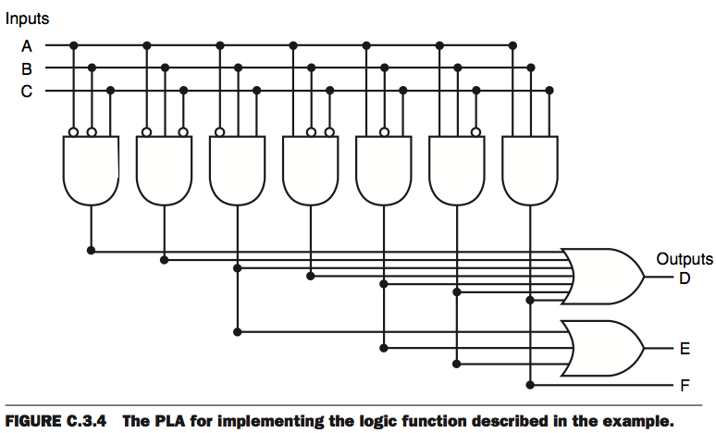
Shared Decoding Logic
We can build a general purpose “table-lookup” device called a Read-Only Memory (ROM), from which we can implement any truth table and, thus, any combinational device

Slide 7
Logic According to ROMs
Different ROM implementation technologies
  Mask (old) → ROM
    read-only memory
  Fuses (old) → PROM
    programmable read-only memory
  Erasable → EPROM
    erasable programmable read-only memory
  Electrically erasable → EEPROM
    electrically-erasable programmable read-only memory
    today called FLASH! Used everywhere!
Model: LOOK UP value of function in truth table...
  Inputs: “ADDRESS” of a truth table entry
  ROM SIZE = # truth table entries...
    ... for an N-input boolean function, size = ____________
2^{N} x #outputs
Notes:
2-D: 2x/dimension
NOT OPTIMAL -- Optimized for WORST case
(NO structure in TT entries!)
ADVANTAGE: Flexibility.
CHANGE function with little change in HW.

Slide 8
Read-Write Memories (RAM)
Read-Write often called random-access memories (RAM)
Dynamic RAM uses analog storage:
  encode information using voltages
  from physics: we can “store” a
  voltage as “charge” on a capacitor
word
line
N-transistor
serves
as an
access
switch
bit line
  Pros:
    compact!
  Cons:
    it leaks! -> refresh
    complex interface
    reading a bit, destroys it
      (you have to rewrite the value after each read)
    it’s NOT a digital circuit
V_{REF}
To write:
Drive bit line, turn on access transistor,
force storage cap to new voltage
To read:
precharge bit line, turn on access trans.,
detect (small) change in bit line voltage
  This storage circuit is the basis for commodity DRAMs

Slide 9
Static RAM: A “Digital” Storage Element
It’s also easy to build a DIGITAL storage element (called a latch) using a MUX and FEEDBACK:
Here’s a feedback path,
so it’s no longer a
combinational circuit.
“state” signal
appears as both
input and output
A
G
0
0
1
1
D
--
--
0
1
Q_{IN}
0
1
--
--
Q_{OUT}
0
1
0
1
0
Q
Y
D
Q stable
B
1
Q follows D
G
S

Slide 10
Static D Latch
D
Q
D
Q
G
G
Positive latch
Negative latch
Q follows D
D
1
G
D
Q
0
Q
G
Q stable
“static” means latch will hold data (i.e., value of Q) while G is inactive, however long that may be.

Slide 11
Latch Timing
Circuits with memory must follow some rules
  Guarantee that inputs to sequential devices are valid and stable during periods when they may influence state changes
    This is assured with additional timing specifications
>t_{PULSE}
G
D
>t_{SETUP}
>t_{HOLD}
t_{PULSE} (minimum pulse width): guarantee G is active for long enough for latch to capture data
t_{SETUP} (setup time): guarantee that D value has propagated through feedback path before latch becomes opaque
t_{HOLD} (hold time): guarantee latch is opaque and Q is stable before allowing D to change again

Slide 12
Effects of transparency
Toll Booth Analogy

Slide 13
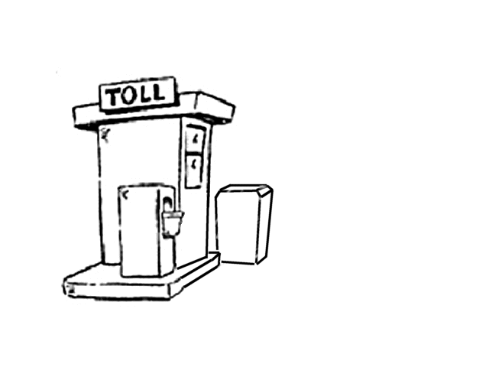




Flakey Control Systems
Here’s a strategy for saving 2 bucks the next time you find yourself at a toll booth!

Slide 14

Flakey Control Systems
Here’s a strategy for saving 2 bucks the next time you find yourself at a toll booth!

Slide 15
Flakey Control Systems
Here’s a strategy for saving 2 bucks the next time you find yourself at a toll booth!
WARNING:
DON’T try this
At home!

Slide 16
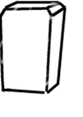
Escapement Strategy
The Solution:
Add two gates
and only open
one at a time.

Slide 17
Escapement Strategy
The Solution:
Add two gates
and only open
one at a time.

Slide 18
Escapement Strategy
The Solution:
Add two gates
and only open
one at a time.

Slide 19
Escapement Strategy
The Solution:
Add two gates
and only open
one at a time.

Slide 20
Escapement Strategy
The Solution:
Add two gates
and only open
one at a time.

Slide 21
Escapement Strategy
The Solution:
Add two gates
and only open
one at a time.

Slide 22
Escapement Strategy
The Solution:
Add two gates
and only open
one at a time.

Slide 23
Escapement Strategy
The Solution:
Add two gates
and only open
one at a time.

Slide 24
Escapement Strategy
The Solution:
Add two gates
and only open
one at a time.

Slide 25
Escapement Strategy
The Solution:
Add two gates
and only open
one at a time.

Slide 26
Escapement Strategy
The Solution:
Add two gates
and only open
one at a time.

Slide 27
Escapement Strategy
The Solution:
Add two gates
and only open
one at a time.

Slide 28
Escapement Strategy
The Solution:
Add two gates
and only open
one at a time.

Slide 29
Escapement Strategy
The Solution:
Add two gates
and only open
one at a time.

Slide 30
Escapement Strategy
The Solution:
Add two gates
and only open
one at a time.

Slide 31
Escapement Strategy
The Solution:
Add two gates
and only open
one at a time.
Key Idea: At no time is there an open path through both gates…

Slide 32
D Flip-Flop (Edge-Triggered Flip-Flop)
D
D
Q
D
Q
Q
D
D
Q
Q
L1
L2
G
G
CLK
CLK
Logical “escapement”:
  Double-gated toll booth built using logic gates
Observations:
  only one latch “transparent” at any time:
    L1 opaque when L2 is transparent (CLK is high)
    L2 opaque when L1 is transparent (CLK is low)
    no combinational path all the way through flip flop
  Q only changes shortly after 0 →1 transition of CLK, so flip flop appears to be “triggered” by rising edge of CLK
Transitions mark instants, not intervals

Slide 33
D Flip-Flop: Operation
D
D
Q
D
Q
Q
D
D
Q
Q
L1
L2
G
G
CLK
CLK
Edge-triggered
  when CLK goes from 0 to 1
    output Q is updated once to the input D value
  all other times, output is held
Why?
  L1 is transparent when CLK=0
    the last value of D that goes through to N1 is when CLK goes to 1
  L2 is transparent when CLK=1
    the value that goes through is N1
    i.e., last value of D just before CLK goes to 1

Slide 34
Flip Flop Waveforms
D
D
Q
D
Q
Q
D
D
Q
Q
L1
L2
G
G
CLK
CLK
D
CLK
Q
L1 closed
L2 open
L2 closed
L1 open

Slide 35
Flip Flop Timing
<t_{PD}
D
D
Q
Q
Q
CLK
CLK
D
t_{PD}: maximum propagation delay, CLK →Q
>t_{SETUP}
>t_{HOLD}
t_{SETUP}: setup time
  guarantee that D has propagated through feedback path before L1 closes
t_{HOLD}: hold time
  guarantee L1 is closed and data is stable before allowing D to change

Slide 36
Synchronous Systems
Designing digital systems using a clock

Slide 37
Synchronous Systems
data
Flipflop
Combinational
logic
Flipflop
trailing
edge
Clock
leading
edge
On the leading edge of the clock, the input of a flipflop is transferred to the output and held.
We must be sure the output of the combinational logic has settled before the next leading clock edge.
Clock period must be “long enough”
Clock Period >= t_{FF} + t_{logic} + t_{setup}

Slide 38
Finite State Machines
What is a State Machine?
  Remember automata?
  It is defined by the following:
    Set of STATES
    Set of INPUTS
    Set of OUTPUTS
    A mapping from (STATES, INPUTS) to …
    … the next STATE and an OUTPUT
  STATE represents memory!

Slide 39
Implementing an FSM
Use flipflops to represent state (i.e., memory)
Use combinational logic to compute:
  output as a function of inputs + state
  next state as a function of inputs + state
Inputs
Function
(comb. logic)
Outputs
State
(flipflops)
Clock

Slide 40
Example: Traffic Light Controller
4 states
  each corresponding to a circle
  represent states using 2 bits
    00, 01, 10, 11
4 bits of output
  2 bits for east/west light
  2 bits for north/south light
    Red (00)
    Yellow (01)
    Green (10)
G E/W
R N/S
Y E/W
R N/S
R E/W
G N/S
R E/W
Y N/S

Slide 41
Example: Traffic Light Controller
4 states
    00, 01, 10, 11
    need 2 flipflops to represent state
4 bits of output
    R (00), Y (01), G (10)
Truth table:
    this defines the combinational logic part of the FSM
G E/W
R N/S
Y E/W
R N/S
R E/W
G N/S
Input (State) | Output | Next State
00 | 10 00 | 01
01 | 01 00 | 10
10 | 00 10 | 11
11 | 00 01 | 00
R E/W
Y N/S

Slide 42
Summary
Regular Arrays can be used to implement arbitrary logic functions
Memories
  ROMs are HARDWIRED memories
  RAMs include storage elements that are read-write
    dynamic memory: compact, only reliable short-term
    static memory: controlled use of positive feedback
For static storage:
  Level-sensitive D-latches; edge-triggered flipflops
  Timing issues: setup and hold times
Finite State Machines:
  Implement using flipflops for memory, and combinational logic to compute output, next state

