Slide 1
More Arithmetic:
Multiplication, Division, and Floating-Point
Don Porter
Lecture 13

Slide 2
Topics
Brief overview of:
  integer multiplication
  integer division
  floating-point numbers and operations
Reading: Study Chapter 3.3-3.5

Slide 3
Binary Multipliers
The key trick of multiplication is memorizing a digit-to-digit table… Everything else is just adding
× | 0 | 1
0 | 0 | 0
1 | 0 | 1
× | 0 | 1 | 2 | 3 | 4 | 5 | 6 | 7 | 8 | 9
0 | 0 | 0 | 0 | 0 | 0 | 0 | 0 | 0 | 0 | 0
1 | 0 | 1 | 2 | 3 | 4 | 5 | 6 | 7 | 8 | 9
2 | 0 | 2 | 4 | 6 | 8 | 10 | 12 | 14 | 16 | 18
3 | 0 | 3 | 6 | 9 | 12 | 15 | 18 | 21 | 24 | 27
4 | 0 | 4 | 8 | 12 | 16 | 20 | 24 | 28 | 32 | 36
5 | 0 | 5 | 10 | 15 | 20 | 25 | 30 | 35 | 40 | 45
6 | 0 | 6 | 12 | 18 | 24 | 30 | 36 | 42 | 48 | 54
7 | 0 | 7 | 14 | 21 | 28 | 35 | 42 | 49 | 56 | 63
8 | 0 | 8 | 16 | 24 | 32 | 40 | 48 | 56 | 64 | 72
9 | 0 | 9 | 18 | 27 | 36 | 45 | 54 | 63 | 72 | 81
You’ve got to be kidding… It can’t be that easy!

Slide 4
Binary Multiplication
The “Binary” Multiplication Table
Binary multiplication is implemented using the same basic longhand algorithm that you learned in grade school.
X
0
1
Hey, that looks like an AND gate
0
0
0
A₃
A₂
A₁
A₀
1
0
1
x
B₃
B₂
B₁
B₀
A_{j}B_{i} is a “partial product”
A₃B₀
A₂B₀
A₁B₀
A₀B₀
A₃B₁
A₂B₁
A₁B₁
A₀B₁
A₃B₂
A₂B₂
A₁B₂
A₀B₂
+
A₃B₃
A₂B₃
A₁B₃
A₀B₃
Multiplying N-digit number by M-digit number gives (N+M)-digit result
Easy part: forming partial products (just an AND gate since B_{I} is either 0 or 1)
Hard part: adding M, N-bit partial products

Slide 5
Multiplication: Implementation
S
t
a
r
t
M
u
l
t
i
p
l
i
e
r
0
=
1
M
u
l
t
i
p
l
i
e
r
1
0
=
0
.
T
e
s
M
u
t
l
t
i
p
l
i
e
r
0
1
a
.
A
d
d
m
u
l
t
i
p
l
i
c
a
n
d
t
o
p
r
o
d
u
c
p
t
a
n
d
l
a
c
e
t
h
e
r
e
s
u
l
t
i
n
P
r
o
d
u
c
t
r
e
g
i
s
t
e
r
2
.
S
h
i
f
t
t
h
e
M
u
l
t
i
p
l
i
c
a
n
d
r
e
g
i
s
t
e
r
l
e
f
t
1
b
i
t
3
t
.
S
h
i
f
t
t
h
e
M
u
l
t
i
p
l
i
e
r
r
e
g
i
s
t
e
r
r
i
g
h
t
1
b
i
Hardware
Implementation
N
o
:
<
3
2
r
e
p
e
t
i
t
i
3
2
n
d
r
o
n
s
e
p
e
t
i
t
i
o
n
?
Flow Chart
Y
e
s
:
3
2
r
e
p
e
t
i
t
i
o
n
s
D
o
n
e

Slide 6
Second Version
S
t
a
r
t
M
u
l
t
i
p
l
i
c
a
n
d
3
2
b
i
t
s
M
u
l
t
i
p
l
i
e
r
0
=
1
M
u
l
t
i
p
l
i
e
r
1
0
=
0
.
T
e
s
t
M
u
l
t
i
p
l
i
e
r
M
u
0
l
t
i
p
l
i
e
3
2
r
-
b
i
t
A
L
U
S
h
i
f
t
r
i
g
h
t
3
2
b
i
t
s
S
h
i
f
t
r
i
g
h
t
1
a
.
A
d
d
m
u
l
t
i
p
l
i
c
a
n
d
t
o
t
h
e
l
e
f
t
h
a
l
f
o
P
f
r
o
d
u
c
t
C
o
n
t
r
o
l
t
e
s
W
t
r
i
t
e
t
h
e
p
r
o
d
u
c
t
a
n
d
p
l
a
c
e
t
h
e
r
e
s
u
l
t
i
n
t
h
e
l
e
f
t
h
a
l
f
o
f
t
h
e
P
r
o
d
u
c
t
r
e
g
i
s
t
e
6
4
b
r
i
t
s
2
.
S
h
i
f
t
t
h
e
P
r
o
d
u
c
t
r
e
g
i
s
t
e
r
r
i
g
h
t
1
b
i
t
3
.
S
h
i
f
t
t
h
e
M
u
l
t
i
p
l
i
e
r
r
e
g
i
s
t
e
r
r
i
g
h
t
1
b
i
t
More Efficient Hardware
Implementation
N
o
:
<
3
2
r
e
p
e
t
i
t
i
3
2
n
d
r
o
n
s
e
p
e
t
i
t
i
o
n
?
Flow Chart
Y
e
s
:
3
2
r
e
p
e
t
i
t
i
o
n
s
D
o
n
e

Slide 7
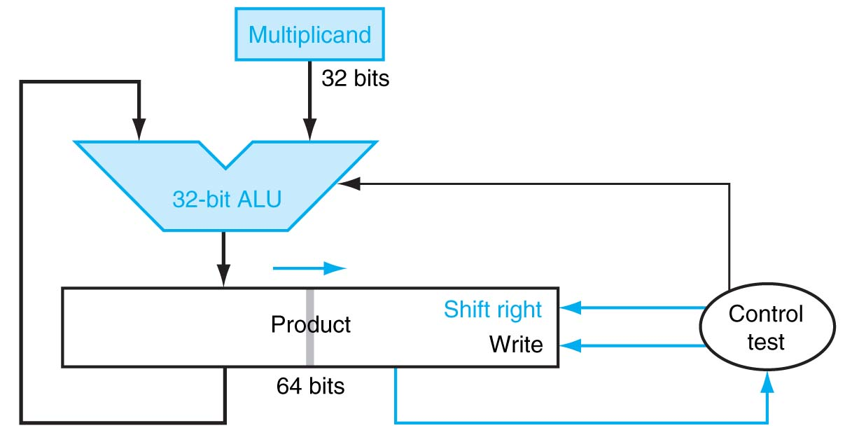
Final Version
S
t
a
r
t
P
r
o
d
u
c
t
0
=
1
P
r
o
d
u
c
t
1
0
=
0
.
T
e
s
t
P
r
o
d
u
c
t
0
1
a
.
A
d
d
m
u
l
t
i
p
l
i
c
a
n
d
t
o
t
h
e
l
e
f
t
h
a
l
f
o
f
t
h
e
p
r
o
d
u
c
t
a
n
d
p
l
a
c
e
t
h
e
r
e
s
u
l
t
i
n
t
h
e
l
e
f
t
h
a
l
f
o
f
t
h
e
P
r
o
d
u
c
t
r
e
g
i
s
t
e
r
2
.
S
h
i
f
t
t
h
e
P
r
o
d
u
c
t
r
e
g
i
s
t
e
r
r
i
g
h
t
1
b
i
t
Even More Efficient
Hardware Implementation!
N
o
:
<
3
2
r
e
p
e
t
i
t
i
3
2
n
d
r
o
n
s
e
p
e
t
i
t
i
o
n
?
The trick is to use the lower half of the product to hold the multiplier during the operation.
Y
e
s
:
3
2
r
e
p
e
t
i
t
i
o
n
s
D
o
n
e

Slide 8
Example for second version
Iteration
Step
Multiplier
Multiplicand
Product
0
Initial
1011
0010
0000 0000
1
Test true
shift right
1011
0101
0010
0010 0000
0001 0000
2
Test true
shift right
0101
0010
0010
0011 0000
0001 1000
3
Test false
shift right
0010
0001
0010
0001 1000
0000 1100
4
Test true
shift right
0001
0000
0010
0010 1100
0001 0110

Slide 9
What about the sign?
Positive numbers are easy
How about negative numbers?
  Please read signed multiplication in textbook (Ch 3.3)

Slide 10
Can do we faster?
Instead of iterating in time…
How about iterating in space…?
  repeat circuits in space
    consume more area
    but faster computation

Slide 11
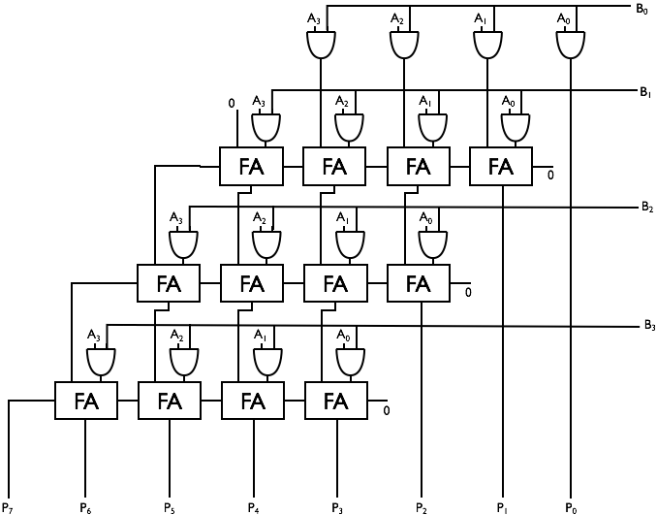
Simple Combinational Multiplier
“Array Multiplier”
  repetition in space, instead of time
  Components used:
    N*(N-1) full adders
    N² AND gates

Slide 12
Simple Combinational Multiplier
Propagation delay
  Proportional to N
    N is #bits in each operand
  ~ 3N*t_{pd,FA}

Slide 13
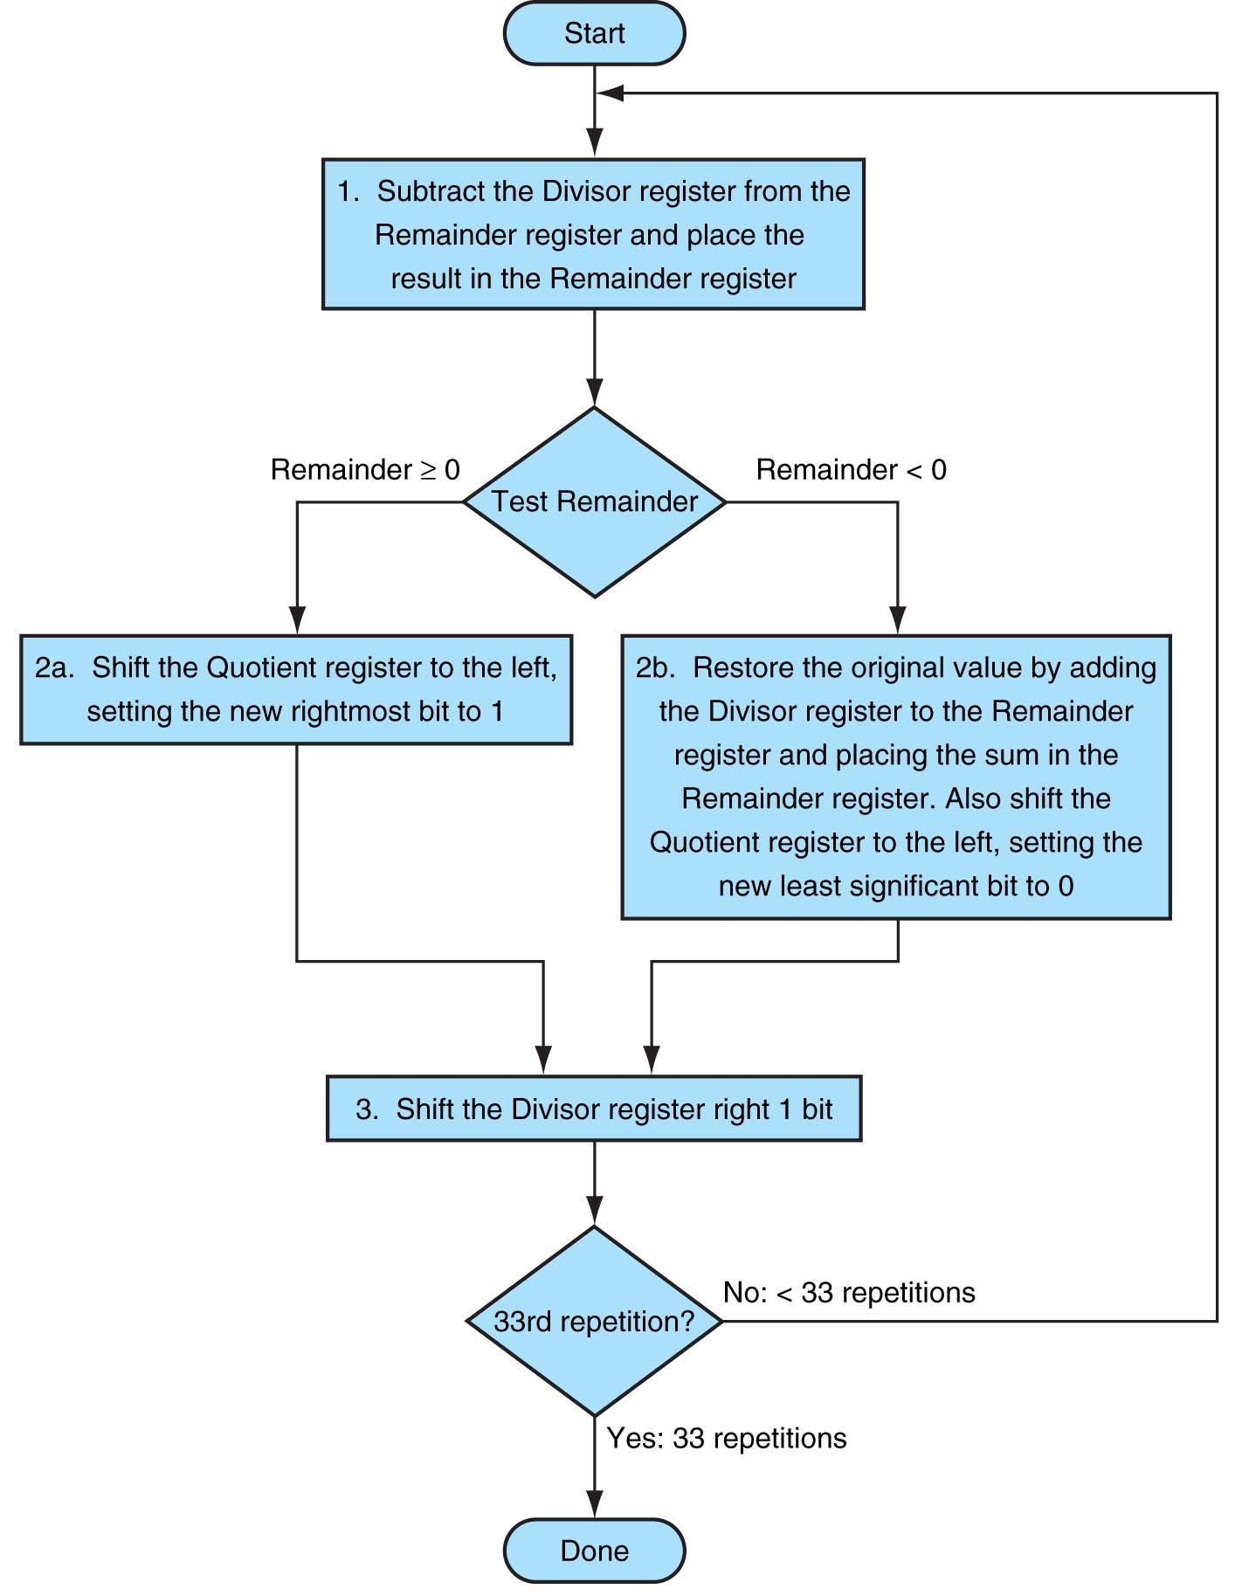
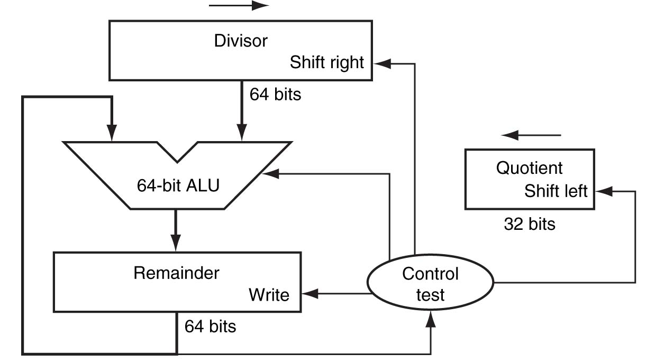
Division
Hardware
Implementation
See example in textbook (Fig 3.10)
Flow Chart

Slide 14
Floating-Point Numbers & Arithmetic
Reading: Study Chapter 3.5

Slide 15
Why do we need floating point?
Several reasons:
  Many numeric applications need numbers over a huge range
    e.g., nanoseconds to centuries
  Most scientific applications require real numbers (e.g. π)
But so far we only have integers. What do we do?
  We could implement the fractions explicitly
    e.g.: ½, 1023/102934
  We could use bigger integers
    e.g.: 64-bit integers
  Floating-point representation is often better
    has some drawbacks too!

Slide 16
Recall Scientific Notation
Recall scientific notation from high school
  Numbers represented in parts:
    42 = 4.200 x 10¹
    1024 = 1.024 x 10³
    -0.0625 = -6.250 x 10⁻²
Arithmetic is done in pieces
  1024 1.024 x 10³
  - 42 -0.042 x 10³
  = 982 0.982 x 10³
  = 9.820 x 10²
Significant Digits
Exponent
Before adding, we must match the exponents, effectively “denormalizing” the smaller magnitude number
We then “normalize” the final result so there is one digit to the left of the decimal point and adjust the exponent accordingly.

Slide 17
Multiplication in Scientific Notation
Is straightforward:
  Multiply together the significant parts
  Add the exponents
  Normalize if required
Examples:
  1024 1.024 x 10³
  x 0.0625 6.250 x 10⁻²
  = 64 6.400 x 10¹
  42 4.200 x 10¹
  x 0.0625 6.250 x 10⁻²
  = 2.625 26.250 x 10⁻¹
  = 2.625 x 10⁰ (Normalized)
In multiplication, how far is the most you will ever normalize?
In addition?

Slide 18
Binary Floating-Point Notation
IEEE single precision floating-point format
  Example: (0x42280000 in hexadecimal)
Three fields:
  Sign bit (S)
  Exponent (E): Unsigned “Bias 127” 8-bit integer
    E = Exponent + 127
    Exponent = 10000100 (132) – 127 = 5
  Significand (F): Unsigned fixed-point with “hidden 1”
    Significand = “1”+ 0.01010000000000000000000 = 1.3125
  Final value: N = -1^{S} (1+F) x 2^{E-127} = -1⁰(1.3125) x 2⁵ = 42
0
1 | 0 | 0 | 0 | 0 | 1 | 0 | 0
0 | 1 | 0 | 1 | 0 | 0 | 0 | 0 | 0 | 0 | 0 | 0 | 0 | 0 | 0 | 0 | 0 | 0 | 0 | 0 | 0 | 0 | 0
“S”
Sign
Bit
“E”
Exponent + 127
“F”
Significand (Mantissa) - 1

Slide 19
Example Numbers
One
  Sign = +, Exponent = 0, Significand = 1.0
    1 = -1⁰ (1.0) x 2⁰
    S = 0, E = 0 + 127, F = 1.0 – ‘1’
    0 01111111 00000000000000000000000 = 0x3f800000
One-half
  Sign = +, Exponent = -1, Significand = 1.0
    ½ = -1⁰ (1.0) x 2⁻¹
    S = 0, E = -1 + 127, F = 1.0 – ‘1’
    0 01111110 00000000000000000000000 = 0x3f000000
Minus Two
  Sign = -, Exponent = 1, Significand = 1.0
    -2 = -1¹ (1.0) x 2¹
    1 10000000 00000000000000000000000 = 0xc0000000

Slide 20
Zeros
How do you represent 0?
  Sign = ?, Exponent = ?, Significand = ?
    Here’s where the hidden “1” comes back to bite you
    Hint: Zero is small. What’s the smallest number you can generate?
      Exponent = -127, Signficand = 1.0
      -1⁰ (1.0) x 2⁻¹²⁷ = 5.87747 x 10⁻³⁹
IEEE Convention
  When E = 0, we’ll interpret numbers differently…
    0 00000000 00000000000000000000000 = exactly 0 (not 1x2⁻¹²⁷)
    1 00000000 00000000000000000000000 = exactly -0 (not -1x2⁻¹²⁷)
Yes, there are “2” zeros. Setting E=0 is also used to represent a few other small numbers besides 0 (“denormalized numbers”, see later).

Slide 21
Infinities
IEEE floating point also reserves the largest possible exponent to represent “unrepresentable” large numbers
  Positive Infinity: S = 0, E = 255, F = 0
    0 11111111 00000000000000000000000 = +∞
    0x7f800000
  Negative Infinity: S = 1, E = 255, F = 0
    1 11111111 00000000000000000000000 = -∞
    0xff800000
  Other numbers with E = 255 (F ≠ 0) are used to represent exceptions or Not-A-Number (NAN)
    √-1, -∞ x 42, 0/0, ∞/∞, log(-5)
  It does, however, attempt to handle a few special cases:
    1/0 = + ∞, -1/0 = - ∞, log(0) = - ∞

Slide 22
Low-End of the IEEE Spectrum
denorm
gap
2⁻¹²⁷
2⁻¹²⁶
2⁻¹²⁵
0
normal numbers with hidden bit
“Denormalized Gap”
  Because of the hidden 1, there’s a relatively large gap between 0 and the smallest +ve “normalized” number:
    0.0000 0000 0000 0000 0000 000
    1.0000 0000 0000 0000 0000 000 x 2⁻¹²⁷
    1.0000 0000 0000 0000 0000 001 x 2⁻¹²⁷
  The gap can be filled with “denormalized” numbers:
    0.0000 0000 0000 0000 0000 000
    0.0000 0000 0000 0000 0000 001 x 2⁻¹²⁶ ➔ 1 x 2⁻¹⁴⁹ (tiniest!)
    0.0000 0000 0000 0000 0000 010 x 2⁻¹²⁶
    0.0000 0000 0000 0000 0000 011 x 2⁻¹²⁶

Slide 23
Low-End of the IEEE Spectrum
denorm
gap
2⁻¹²⁷
2⁻¹²⁶
2⁻¹²⁵
0
normal numbers with hidden bit
Denormalized Numbers
  those without the hidden 1
  if the E field is 0
    there is no hidden 1 → the number is no longer in normal form
    the exponent value is assumed to be -126
    X = -1^{S} 2⁻¹²⁶ (0.F)

Slide 24
Floating point AIN’T NATURAL
It is CRUCIAL for computer scientists to know that Floating Point arithmetic is NOT the arithmetic you learned since childhood
1.0 is NOT EQUAL to 10*0.1 (Why?)
  1.0 * 10.0 == 10.0
  0.1 * 10.0 != 1.0
  0.1 decimal == 1/16 + 1/32 + 1/256 + 1/512 + 1/4096 + … ==
    0.0 0011 0011 0011 0011 0011 …
  In decimal 1/3 is a repeating fraction 0.333333…
  If you quit at some fixed number of digits, then 3 * 1/3 != 1
Floating Point arithmetic IS NOT associative
  x + (y + z) is not necessarily equal to (x + y) + z
Addition may not even result in a change
  (x + 1) MAY == x

Slide 25
Floating Point Disasters
Scud Missiles get through, 28 die
  In 1991, during the 1st Gulf War, a Patriot missile defense system let a Scud get through, hit a barracks, and kill 28 people. The problem was due to a floating-point error when taking the difference of a converted & scaled integer. (Source: Robert Skeel, "Round-off error cripples Patriot Missile", SIAM News, July 1992.)
$7B Rocket crashes (Ariane 5)
  When the first ESA Ariane 5 was launched on June 4, 1996, it lasted only 39 seconds, then the rocket veered off course and self-destructed. An inertial system, produced a floating-point exception while trying to convert a 64-bit floating-point number to an integer. Ironically, the same code was used in the Ariane 4, but the larger values were never generated (http://www.around.com/ariane.html).
Intel Ships and Denies Bugs
  In 1994, Intel shipped its first Pentium processors with a floating-point divide bug. The bug was due to bad look-up tables used to speed up quotient calculations. After months of denials, Intel adopted a no-questions replacement policy, costing $300M. (http://www.intel.com/support/processors/pentium/fdiv/)

Slide 26
Optional material
(for self-study only; won’t be tested on)

Slide 27
Floating-Point Multiplication
Step 1:
Multiply significands
Add exponents
E_{R} = E₁ + E₂ -127
(do not need twice
the bias)
Step 2:
Normalize result
(Result of
[1,2) *[1.2) = [1,4)
at most we shift
right one bit, and
fix exponent
S
E
F
S
E
F
×
24 by 24
Small
ADDER
Subtract 127
Control
round
Add 1
Mux
(Shift Right by 1)
S
E
F

Slide 28
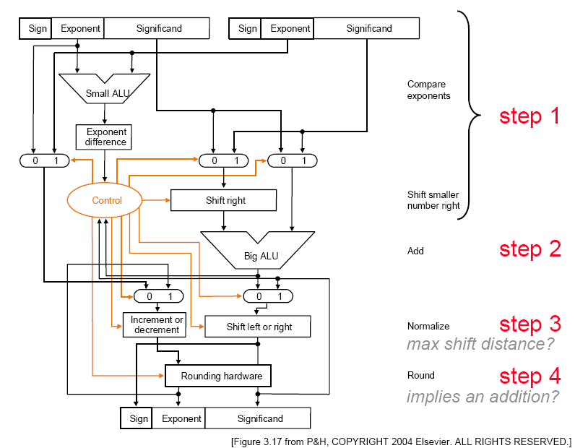
Floating-Point Addition

Slide 29
MIPS Floating Point
Floating point “Co-processor”
  Separate co-processor for supporting floating-point
    Separate circuitry for arithmetic, logic operations
Registers
  F0…F31: each 32 bits
    Good for single-precision (floats)
  Or, pair them up: F0|F1 pair, F2|F3 pair … F30|F31 pair
    Simply refer to them as F0, F2, F4, etc. Pairing implicit from instruction used
    Good for 64-bit double-precision (doubles)

Slide 30
MIPS Floating Point
Instructions determine single/double precision
  add.s $F2, $F4, $F6 // F2=F4+F6 single-precision add
  add.d $F2, $F4, $F6 // F2=F4+F6 double-precision add
    Really using F2|F3 pair, F4|F5 pair, F6|F7 pair
Instructions available:
  add.d fd, fs, ft # fd = fs + ft in double precision
  add.s fd, fs, ft # fd = fs + ft in single precision
  sub.d, sub.s, mul.d, mul.s, div.d, div.s, abs.d, abs.s
  l.d fd, address # load a double from address
  l.s, s.d, s.s
  Conversion instructions: cvt.w.s, cvt.s.d, …
  Compare instructions: c.lt.s, c.lt.d, …
  Branch (bc1t, bc1f): branch on comparison true/false

Slide 31
End of optional material

Slide 32
Next
Sequential circuits
  Those with memory
  Useful for registers, state machines
Let’s put it all together
  … and build a CPU

