Slide 1
Performance
Don Porter

Slide 2
Topics
Defining “Performance”
Performance Measures
How to improve performance
Performance pitfalls
Examples

Slide 3
Why Study Performance?
Helps us make intelligent design choices
  See through the marketing hype
Key to understanding underlying computer organization
  Why is some hardware faster than others for different programs?
  What factors of system performance are hardware related?
    e.g., Do we need a new machine …
    … or a new operating system?
  How does a machine’s instruction set affect its performance?

Slide 4
What is Performance?
Loosely:
  How fast can a computer complete a task
Examples of “tasks”:
  Short tasks:
    Crunch a bunch of numbers (say calculate mean)
    Display a PDF document
    Respond to a game console button press
  Longer ones:
    Search for a document on hard drive
    Rip a DVD into an mpg file
    Apply a Photoshop filter

Slide 5
Performance Metrics
Latency: Time from input to corresponding output
  How long does it take for my program to run?
  How long must I wait after typing return for the result?
  Other examples?
Throughput: Results produced per unit time
  How many results can be processed per second?
  What is the average execution rate of my program?
  How much work is getting done each second?
  Other examples?

Slide 6
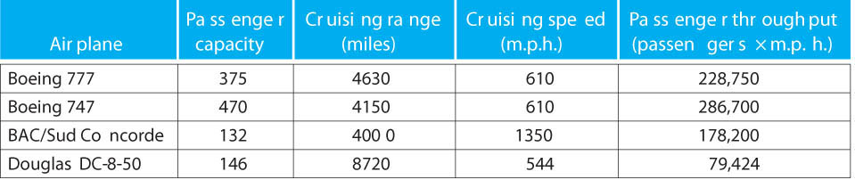
Which airplane is “best”?
Airplane
Passenger capacity
Cruising range (miles)
Cruising speed (mph)
Passenger throughput (passengers x mph)
How to Define “Best”?:
  Fastest?
  Farthest range?
  Most passenger capacity?
  Passenger-miles per hour?

Slide 7
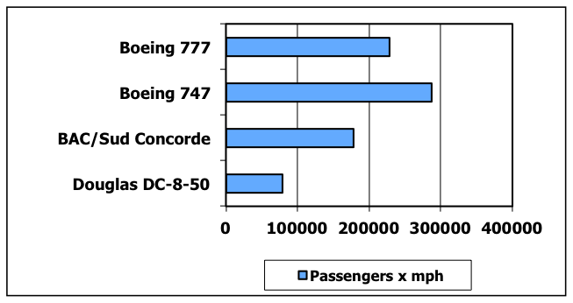
Which airplane is “best”?
Airplane
Passenger capacity
Cruising range (miles)
Cruising speed (mph)
Passenger throughput (passengers x mph)

Slide 8
Which airplane is “best”?
Airplane
Passenger capacity
Cruising range (miles)
Cruising speed (mph)
Passenger throughput (passengers x mph)
How much faster is the Concorde than the 747?
  1350 mph / 610 mph = 2.2 X (“X” means “factor of”)
How much larger is the 747’s capacity than the Concorde?
  470 passengers / 132 passengers = 3.6 X
  Note: X is a ratio – no units

Slide 9
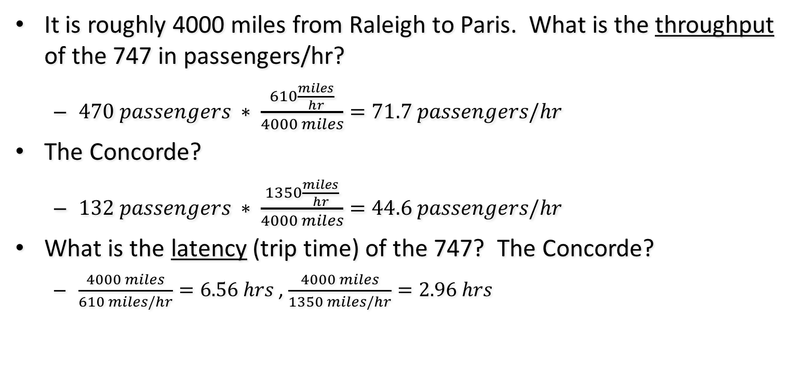
Which airplane is “best”?
Airplane
Passenger capacity
Cruising range (miles)
Cruising speed (mph)
Passenger throughput (passengers x mph)
It is roughly 4000 miles from Raleigh to Paris. What is the throughput of the 747 in passengers/hr?
  $470 passengers ∗ \frac{610\frac{miles}{hr}}{4000 miles}=71.7 passengers/hr$
The Concorde?
  $132 passengers ∗ \frac{1350\frac{miles}{hr}}{4000 miles}=44.6 passengers/hr$
What is the latency (trip time) of the 747? The Concorde?
  $\frac{4000 miles}{610 miles/hr}=6.56 hrs$ , $\frac{4000 miles}{1350 miles/hr}=2.96 hrs$
  Note: Dimensional analysis is your friend

Slide 10
Performance Metrics
Latency: Time from input to corresponding output
  Flight time from Raleigh to Paris
  How long does it take for my program to run?
  How long must I wait after typing return for the result?
  Other examples?
Throughput: Results produced per unit time
  Passengers/hour
  How many results can be processed per second?
  What is the average execution rate of my program?
  How much work is getting done each second?
  Other examples?

Slide 11
Execution Time
Elapsed Time/Wall Clock Time
  counts everything (disk and memory accesses, I/O, etc.)
  includes the impact of other programs
  a useful number, but often not good for comparison purposes
CPU time
  does not include I/O or time spent running other programs
  can be broken up into system time, and user time
Our focus: user CPU time
  time spent executing actual instructions of “our” program

Slide 12
Performance
For some program running on machine X,
  Performance_{X} = Program Executions / Time_{X} (executions/sec)
  = 1 / Execution Time_{X}
Relative Performance
  "X is n times faster than Y”
  Performance_{X} / Performance_{Y} = n

Slide 13
Performance
Performance_{X} = 1 / Execution Time_{X}
Relative Performance (“X is n times faster than Y”)
  n = Performance_{X} / Performance_{Y}
Example:
  Machine A runs a program in 20 seconds
  Machine B runs the same program in 25 seconds
    By how much is A faster than B?
Performance_{A} = 1/20
Performance_{B} = 1/25
Machine A is (1/20)/(1/25) = 1.25 times faster than Machine B

Slide 14
Performance: Pitfalls of using %
Same Example:
  Machine A runs a program in 20 sec; B takes 25 sec
  By how much is A faster than B?
    Is it (25-20)/25 = 20% faster?
    Is it (25-20)/20 = 25% faster?
    Correct answer is: A is (Perf_{A}-Perf_{B})/Per_{B} faster
      (0.05 - 0.04) / (0.04) = 25% faster
  By how much is B slower than A?
    Correct answer is: B is (Perf_{B}-Perf_{A})/Per_{A} faster/slower
      (0.04 - 0.05) / (0.05) = -20% faster = 20% slower
  Confusing: A is 25% faster than B; B is 20% slower
  Better: A is 1.25 times faster than B; B is 1/1.25 as fast
Also: percentages are only good up to 100%
  Never say A is 13000% faster than B
  Neither immediately intuitive; voice of experience

Slide 15
CPU Clocking
Operation of digital hardware governed by a constant-rate clock
Clock period
Clock (cycles)
Data transfer
and computation
Update state
Clock period: duration of a clock cycle
  e.g., 250ps = 0.25ns = 250×10^{–12}s
Clock frequency (rate): cycles per second
  e.g., 1/(0.25ns) = 4GHz = 4000MHz = 4.0×10⁹Hz
  Water hose analogy

Slide 16
Program Clock Cycles
Execution time often reported in cycle counts
  History: A newer generation of the same processor…
    Used to have the same cycle counts for the same program
    But a faster clock speed (ex, 1 GHz changes to 1.5 GHz)
    Not really true anymore, but does focus on CPU performance
Clock “ticks” indicate when machine state changes
  Abstraction: model time as discrete instead of continuous
Simple relation:
time

Slide 17
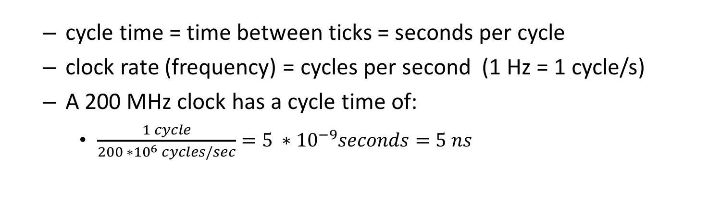
From Cycles to *seconds
Relation:
  or:
  cycle time = time between ticks = seconds per cycle
  clock rate (frequency) = cycles per second (1 Hz = 1 cycle/s)
  A 200 MHz clock has a cycle time of:
    $\frac{1 cycle}{200 ∗{10}^{6} cycles/sec}=5 ∗{10}^{−9}seconds=5 ns$

Slide 18
How Many Cycles in a Program?
For some processors (e.g., MIPS processor)
  # of cycles == # of instructions
1st instruction
2nd instruction
3rd instruction
4th
5th
6th
...
time
This assumption can be incorrect,
Different instructions take different amounts of time on different machines.
Memory accesses might require more cycles than other instructions.
Floating-Point instructions might require multiple clock cycles to execute.
Branches might stall execution rate

Slide 19
Instruction Count and CPI
Instruction Count for a program
  Determined by
    program
    Instruction set architecture (ISA)
    compiler
Average cycles per instruction (“CPI”)
  Determined by CPU hardware
  If different instructions have different CPI
    Average CPI affected by instruction mix

Slide 20
Now that we understand cycles
A given program will require
  some number of instructions (machine instructions)
  some number of cycles
  some number of seconds
We have a vocabulary that relates these quantities:
  cycle time (seconds per cycle)
  clock rate (cycles per second)
  CPI (average cycles per instruction)
    a floating point intensive application might have a higher CPI
  MIPS (millions of instructions per second)
    this would be higher for a program using simple instructions

Slide 21
Computer Performance Measure
Millions of Instructions per Second
Frequency in MHz
Unfortunate coincidence:
This “MIPS” has nothing to do with the name of the MIPS processor we will be studying!
CPI (Average Cycles Per Instruction)
Historically:
PDP-11, VAX, Intel 8086: CPI > 1
  Load/Store RISC machines
  MIPS, SPARC, PowerPC, miniMIPS: CPI = 1
  Modern CPUs, Pentium, Athlon : CPI < 1

Slide 22
How to Improve Performance?
Many ways to write the same equations:
So, to improve performance (everything else being equal) you can either
  ________ the # of required cycles for a program;
  ________ the clock cycle time or, said another way,
  ________ the clock rate;
  ________ the CPI (average clocks per instruction).
MIPS Pitfall
  Cannot compare MIPS of two different processors if they run different sets of instructions!
  ARM CPU clock rate not directly comparable to Intel – ISA is different
  ➔ Meaningless Indicator of Processor Speed!
Decrease
Decrease
Increase
Decrease

Slide 23
Example
Our favorite program runs in 10 seconds on computer A, which has a 2 GHz clock. We are trying to help a computer designer build a new machine B, to run this program in 6 seconds. The designer can use new (or perhaps more expensive) technology to substantially increase the clock rate, but has informed us that this increase will affect the rest of the CPU design, causing machine B to require 1.2 times as many clock cycles as machine A for the same program. What clock rate should we tell the designer to target?

Slide 24
Performance Traps
Performance: What matters is the execution time of a program that you care about.
Do any of the other variables (alone) equal performance?
  # of cycles to execute program?
  # of instructions in program?
  # of cycles per second?
  average # of cycles per instruction?
  average # of instructions per second?
Common pitfall:
  Putting the blinders on, and focusing exclusively on one variable

Slide 25
CPI Example
Suppose we have two implementations of the same instruction set architecture (ISA)
  If same ISA which quantity (clock rate, CPI) is the same?
  For some program:
    Computer A has a clock cycle time of 250 ps and a CPI of 2.0
    Computer B has a clock cycle time of 500 ps and a CPI of 1.2
  What machine is faster for this program, and by how much?
Neither!
  A is faster by 1.2X

Slide 26
CPI in More Detail
If different instruction classes take different numbers of cycles
  Weighted average CPI:
Relative frequency
  On most CPUs, CPI is a weighted average

Slide 27
Example: Compiler’s Impact
Two different compilers are being tested for a 500 MHz machine with three different classes of instructions: Class A, Class B, and Class C, which require one, two, and three cycles (respectively). Both compilers are used to produce code for a large piece of software. The first compiler's code uses 5 million Class A instructions, 1 million Class B instructions, and 2 million Class C instructions. The second compiler's code uses 7 million Class A instructions, 1 million Class B instructions, and 1 million Class C instructions.
Which program uses fewer instructions?
  Instructions₁ = (5+1+2) x 10⁶ = 8 x 10⁶
  Instructions₂ = (7+1+1) x 10⁶ = 9 x 10⁶
Which sequence uses fewer clock cycles?
  Cycles₁ = (5(1)+1(2)+2(3)) x 10⁶ = 13 x 10⁶
  Cycles₂ = (7(1)+1(2)+1(3)) x 10⁶ = 12 x 10⁶
CPI₁ = ?
13/8 = 1.625
CPI₂ = ?
12/9 = 1.33

Slide 28
Another CPI Example
Alternative compiled code versions using instructions in classes A, B, C
Class | A | B | C
CPI for class | 1 | 2 | 3
IC for version 1 | 2 | 1 | 2
IC for version 2 | 4 | 1 | 1
Version 1: IC = 5
  Clock Cycles
  = 2×1 + 1×2 + 2×3
  = 10
  Avg. CPI = 10/5 = 2.0
Version 2: IC = 6
  Clock Cycles
  = 4×1 + 1×2 + 1×3
  = 9
  Avg. CPI = 9/6 = 1.5

Slide 29
Performance Summary
Performance depends on
  Algorithm: affects IC, possibly CPI
  Programming language: affects IC, CPI
  Compiler: affects IC, CPI
  Instruction set architecture: affects IC, CPI, Cycle Time

Slide 30
Comparing Computers
So, if IPC, clock, etc. aren’t good measures, what is?
Execution time of the program you care about!
  But this is in the eye of the beholder
Idea: Let’s get a set of representative applications
  May not be perfect, or exactly what I care about
  But covers common use cases
What might be good smartphone apps?

Slide 31
Benchmarks
A set of applications for comparing execution time
  Use programs typical of expected workload
  Or, typical of expected class of applications
    e.g., compilers/editors, scientific applications, graphics, etc.
Small benchmarks
  nice for architects and designers
  easy to standardize
  can be abused
SPEC (System Performance Evaluation Cooperative)
  companies have agreed on a set of real program and inputs
  can still be abused
  valuable indicator of performance (and compiler technology)

Slide 32
SPEC ’95
Periodically updated with newer benchmarks:

Slide 33
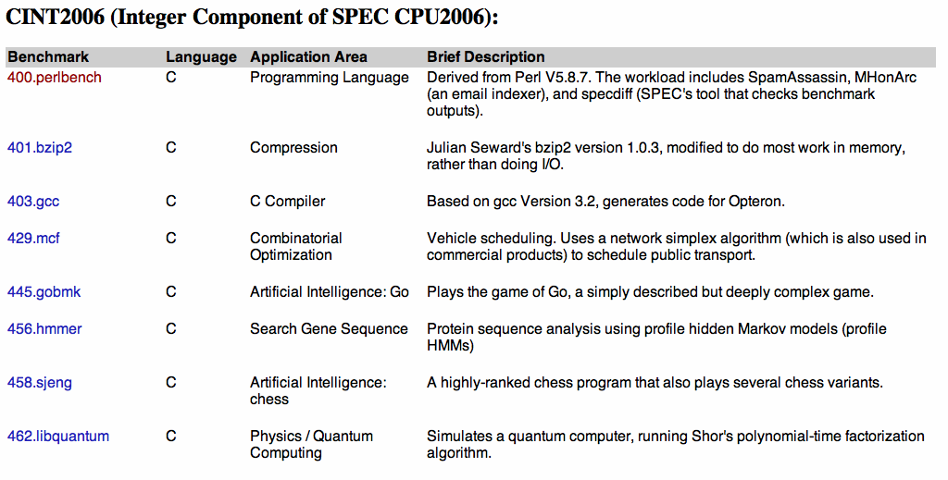
SPEC 2006
Interesting to see how the mix of applications has changed over the years…
  See http://www.spec.org/cpu2006/{CINT2006, CFP2006}

Slide 34
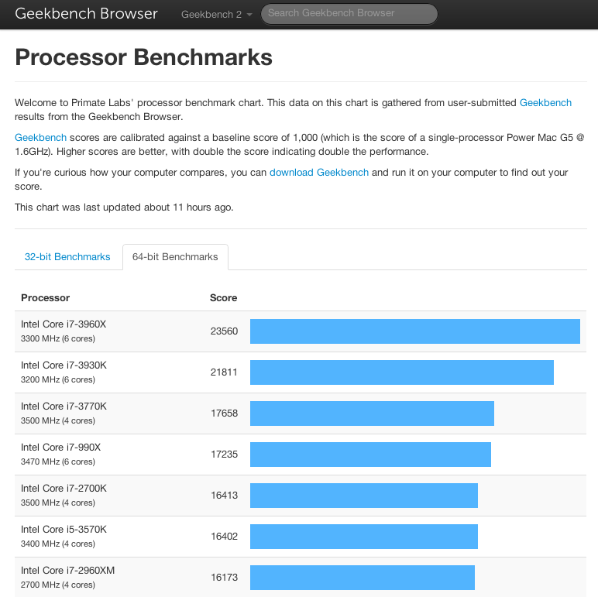
Other Popular Benchmarks
Desktop: Phoronix
File System: Filebench
Java VM: DaCapo
Cloud: Cloudbench
  Same goal: Standardize & compare end-user perf.

Slide 35
Amdahl’s Law
Possibly the most important law on performance:
Informally: The law of diminishing returns
  Eventually, performance gains will be limited by what cannot be improved
  Paris flight example: I spend 1 hour in take-off/taxi/landing, and 6 in the air. If I improve take-off time, what is the fastest I will get to Paris?
    6 hours if I could instantly jump into the air from parked
  Implication: Make the common case fast

Slide 36
Amdahl’s Law: Example
Example: "Suppose a program runs in 100 seconds on a machine, where multiplies are executed 80% of the time. How much do we need to improve the speed of multiplication if we want the program to run 4 times faster?"
How about making it 5 times faster?
25 = 80/r + 20 r = 16x
20 = 80/r + 20 r = ?

Slide 37
Example
Suppose we enhance a machine making all floating-point instructions run FIVE times faster. If the execution time of some benchmark before the floating-point enhancement is 10 seconds, what will the speedup be if only half of the 10 seconds is spent executing floating-point instructions?
5/5 + 5 = 6 Relative Perf = 10/6 = 1.67 x

Slide 38
Example
We are looking for a benchmark to show off the new floating-point unit described above, and want the overall benchmark to show at least a speedup of 3. What percentage of the execution time would floating-point instructions have to account for in this program in order to yield our desired speedup on this benchmark?
  Recall: we make floating point 5x faster
100/3 = f/5 + (100 – f) = 100 – 4f/5 f = 83.33

Slide 39
Design Tradeoffs
Performance is rarely the sole factor
  Cost is important too
  Energy/power consumption is often critical
Frequently used compound metrics
  Performance/Cost (throughput/$)
  Performance/Power (throughput/watt)
  Work/Energy (total work done per joule)
    for battery-powered devices

Slide 40
Power Consumption
Power = Energy consumed per unit time
Two contributors to power consumption
  Dynamic power
    power consumed when doing actual work
    called dynamic because components and wires are switching between ‘0’ and ‘1’
  Static or ‘leakage’ power
    power consumed even when everything is idle or ‘static’
    due to some small amount of ‘leakage’ current that still flows

Slide 41
Dynamic Power Consumption
Energy consumed due to switching activity:
  Remember the model of gates as on/off switches? This burns energy
  All wires and transistor gates have capacitance, or the ability to store electric charge
  Energy required to charge a capacitance, C, to V_{DD} is CV_{DD}²
    Energy = CV_{DD}²
C is the total capacitance of circuit (“capacitive load”)
V_{DD} is the supply voltage
f is the switching frequency

Slide 42
Dynamic Power Consumption
Energy consumed due to switching activity:
  Energy = CV_{DD}²
  Circuit running at frequency f: transistors switch (from 1 to 0 or vice versa) at that frequency
  Capacitor is charged f/2 times per second
    assume 50% chance switching from 0 to 1
      additional energy drawn from battery → CV_{DD}²
    assume 50% chance switching from 1 to 0
      no additional energy taken from battery → stored energy is discharged
P_{dynamic} = CV_{DD}^{2 *}f/2 = ½CV_{DD}²f
C is the total capacitance of circuit (“capacitive load”)
V_{DD} is the supply voltage
f is the switching frequency

Slide 43
Static Power Consumption
Power consumed when no gates are switching
  Caused by the quiescent supply current, I_{DD} (also called the leakage current)
P_{static} or P_{leakage} = I_{DD}V_{DD}
V_{DD} is the supply voltage
I_{DD} is the leakage current

Slide 44
Combining Dynamic + Static
P = ½CV_{DD}²f + I_{DD}V_{DD}
C is the total capacitance of circuit (“capacitive load”)
V_{DD} is the supply voltage
I_{DD} is the leakage current
f is the switching frequency

Slide 45
Power Consumption Example
Estimate the power consumption of a wireless handheld computer
  V_{DD} = 1.2 V
  C = 20 nF
  f = 1 GHz
  I_{DD} = 20 mA
P = ½CV_{DD}²f + I_{DD}V_{DD}
= ½(20 nF)(1.2 V)²(1 GHz) + (20 mA)(1.2 V)
= 14.4 W + 24 mW
= 14.424 W
C is the total capacitance of circuit (“capacitive load”)
V_{DD} is the supply voltage
I_{DD} is the leakage current
f is the switching frequency
1 F = 1 (W *s) / Volt²
1 W = 1 V * 1 A
1 Hz = 1 second ⁻¹

Slide 46
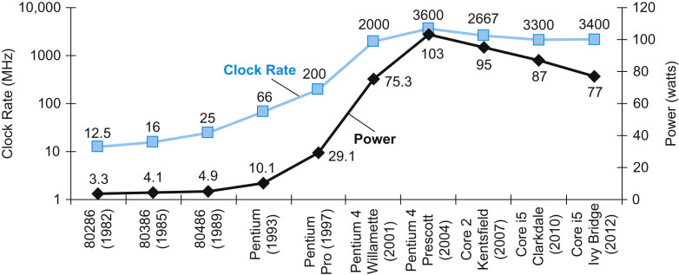
Power Trends
In CMOS IC technology
×30
5V → 1V
×1000
Note: “Frequency” may also be called “clock rate/frequency” or “frequency switched”

Slide 47
Reducing Dynamic Power
Suppose a new CPU has
  85% of capacitive load of old CPU
  15% voltage and 15% frequency reduction
About a 50% reduction in power

Slide 48
The Power Wall
Hard physical realities:
  It is hard to reduce voltage below a certain point
    Leakage starts to dominate results
      Garden hose analogy: hard to differentiate water left in hose from real output
    Circuit outputs become unstable
  We can only dissipate so much heat from a cm² of surface area
    Fancier cooling possible: liquids, larger heat sinks
    But not in my phone!

Slide 49
Fallacy: Low Power at Idle
AMD X4 power benchmark:
  At 100% load: 295W (max power)
  At 50% load: 246W (83% max power)
  At 10% load: 180W (still consumes 61% of max power)
Google data center
  Mostly operates at 10% - 50% load
  At 100% load less than 1% of the time
Open Problem: Design processors to make power proportional to load

Slide 50
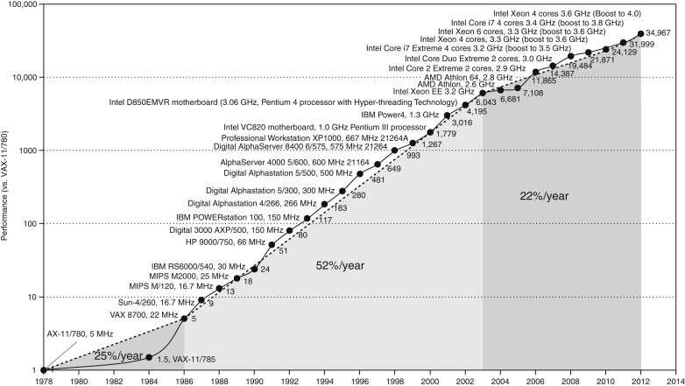
Moore’s Law: Uniprocessor Perf.
Constrained by power, instruction-level parallelism, memory latency

Slide 51
Multiprocessors
“Multicore” microprocessors
  More than one processor core per chip
Requires explicitly parallel programming
  Hardware executes multiple instructions at once
    Ideally, hidden from the programmer
  Hard to do
    Programming for performance
    Load balancing
    Optimizing communication and synchronization
    But, newer OSes and libraries have been designed for this

Slide 52
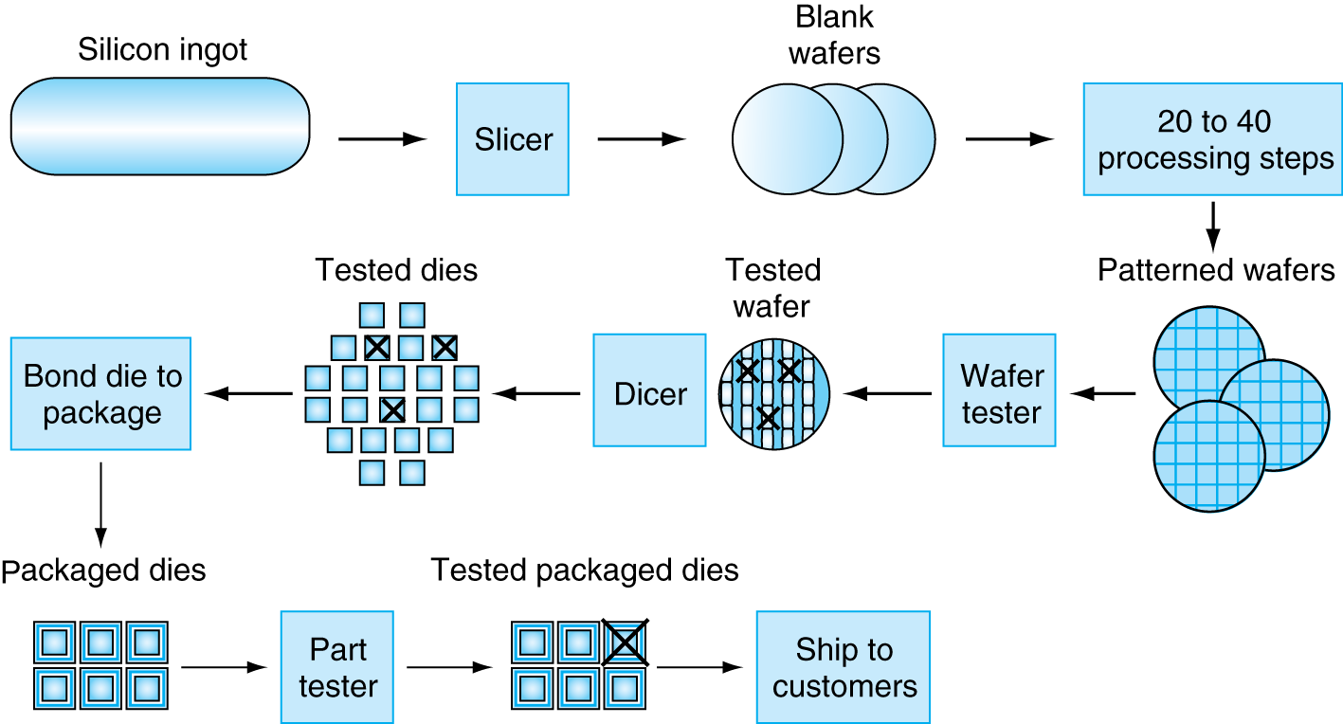
Manufacturing ICs
IC = Integrated Circuit (“chip”)
Yield: proportion of working dies per wafer

Slide 53
Integrated Circuit Cost
Nonlinear relation to area and defect rate
  Wafer cost and area are fixed
  Defect rate determined by manufacturing process
  Die area determined by architecture and circuit design

Slide 54
Remember
Performance is specific to a particular program
  Total execution time is a consistent summary of performance
For a given architecture, performance comes from:
  increases in clock rate (without adverse CPI affects)
  improvements in processor organization that lower CPI
  compiler enhancements that lower CPI and/or instruction count
Pitfall: Expecting improvements in one aspect of a machine’s performance to affect the total performance
You should not always believe everything you read!
  Read carefully! Especially what the business guys say!

Slide 55
Concluding Remarks
Cost/performance is improving
  Due to underlying technology development
Hierarchical layers of abstraction
  In both hardware and software
Instruction set architecture
  The hardware/software interface
Execution time: the best performance measure
Power is a limiting factor
  Use parallelism to improve performance

