Slide 1
Representing Information
Don Porter

Slide 2
Representing Operands
Characters
Integers
  Positive numbers
  Negative numbers
Non-Integers
  Fixed-Point Numbers
  Floating-Point Numbers
Reading:
  Chapter 2.3-2.4
  Chapter 3.5 (only through pg. 202)

Slide 3
Motivation
Computer use binary representation internally
  a wire is “hot” or “cold”
  a switch is “on” or “off”
How do we use bits to represent information?
We need standards representations for
  Letters
  Numbers
  Colors/pixels
  Music
  Video
  …

Slide 4
Information Encoding
Encoding = assign representation to information
Examples:
  suppose you have two “things” (symbols) to encode
    one is  and other 
    what would you do?
  now suppose you have 4 symbols to encode
    h, d, b and z
    what would you do?
  now suppose you have the following numbers to encode
    1, 3, 5 and 7
    what would you do?

Slide 5
Encoding is an art
Choosing an appropriate and efficient encoding is a real engineering challenge (and an art)
Impacts design at many levels
  Complexity (how hard to encode/decode)
  Efficiency (#bits used, transmit energy)
  Reliability (what happens with noise?)
  Security (encryption)

Slide 6
Fixed-Length Encodings
What is fixed-length encoding?
  all symbols are encoded using the same number of bits
When to use it?
  if all symbols are equally likely (or we have no reason to expect otherwise)
When not to use it?
  when some symbols are more likely, while some are rare
  what to use then: variable-length encoding
  example:
    suppose X is twice as likely as Y or Z
    how would we encode them?

Slide 7
Fixed-Length Encodings
Length of a fixed-length code
  use as many bits as needed to unambiguously represent all symbols
    1 bit suffices for 2 symbols
    2 bits suffice for …?
    n bits suffice for …?
    how many bits needed for M symbols?
  ex. Decimal digits 10 = {0,1,2,3,4,5,6,7,8,9}
    4-bit binary code: 0000 to 1001
  ex. ~84 English characters = {A-Z (26), a-z (26), 0-9 (10), punctuation (8), math (9), financial (5)}
    7-bit ASCII (American Standard Code for Information Interchange)

Slide 8
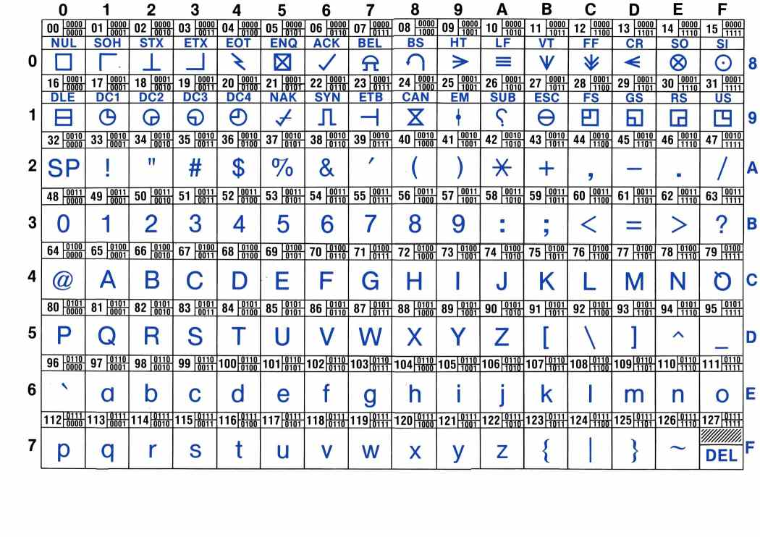
Encoding Characters
ASCII Code: use 7 bits to encode 128 characters

Slide 9
Encoding More Characters
ASCII is biased towards western languages, esp. English
In fact, many more than 256 chars in common use:
â, m, ö, ñ, è, ¥, 揗, 敇, 횝, カ, ℵ, ℷ, ж, ค
Unicode is a worldwide standard that supports all languages, special characters, classic, and arcane
  Several encoding variants, e.g. 16-bit (UTF-8)
ASCII equiv range:
0
x
x
x
x
x
x
x
16-bit Unicode
1
1
0
y
y
y
y
x
1
0
x
x
x
x
x
x
24-bit Unicode
1
1
1
0
z
z
z
z
1
0
z
y
y
y
y
x
1
0
x
x
x
x
x
x
1
1
1
1
0
w
w
w
1
0
w
w
z
z
z
z
1
0
z
y
y
y
y
x
1
0
x
x
x
x
x
x
32-bit Unicode

Slide 10
Encoding Positive Integers
How to encode positive numbers in binary?
  Each number is a sequence of 0s and 1s
  Each bit is assigned a weight
  Weights are increasing powers of 2, right to left
  The value of an n-bit number is
2¹¹
2¹⁰
2⁹
2⁸
2⁷
2⁶
2⁵
2⁴
2³
2²
2¹
2⁰
0
1
1
1
1
1
0
1
0
0
0
0
2⁴ = 16
+ 2⁶ = 64
+ 2⁷ = 128
+ 2⁸ = 256
+ 2⁹ = 512
+ 2¹⁰ = 1024
2000_{ten}

Slide 11
Some Bit Tricks
Get used to working in binary
  Specifically for Comp 411, but it will be helpful throughout your career as a computer scientist
Here are some helpful guides
Memorize the first 10 powers of 2
  2⁰ = 1 2⁵ = 32
  2¹ = 2 2⁶ = 64
  2² = 4 2⁷ = 128
  2³ = 8 2⁸ = 256
  2⁴ = 16 2⁹ = 512

Slide 12
More Tricks with Bits
Get used to working in binary
Here are some helpful guides
2. Memorize the prefixes for powers of 2 that are
multiples of 10
  2¹⁰ = Kilo (1024)
  2²⁰ = Mega (1024*1024)
  2³⁰ = Giga (1024*1024*1024)
  2⁴⁰ = Tera (1024*1024*1024*1024)
  2⁵⁰ = Peta (1024*1024*1024*1024*1024)
  2⁶⁰ = Exa (1024*1024*1024*1024*1024*1024)
For fun: http://highscalability.com/blog/2012/9/11/how-big-is-a-petabyte-exabyte-zettabyte-or-a-yottabyte.html

Slide 13
Even More Tricks with Bits
Get used to working in binary
Here are some helpful guides
01
0000000011
0000001100
0000101000
When you convert a binary number to decimal, first break it down into clusters of 10 bits.
Then compute the value of the leftmost remaining bits (1) find the appropriate prefix (GIGA) (Often this is sufficient)
Compute the value of and add in each remaining 10-bit cluster

Slide 14
Other Helpful Clusterings
Sometimes convenient to use other number “bases”
  often bases are powers of 2: e.g., 8, 16
    allows bits to be clustered into groups
  base 8 is called octal ➔ groups of 3 bits
    Convention: lead the number with a 0
03720
Octal - base 8
000 - 0
001 - 1
010 - 2
011 - 3
100 - 4
101 - 5
110 - 6
111 - 7
2¹¹
2¹⁰
2⁹
2⁸
2⁷
2⁶
2⁵
2⁴
2³
2²
2¹
2⁰
0
1
1
1
1
1
0
1
0
0
0
0
= 2000₁₀
3
7
2
0
0*8⁰ = 0
+ 2*8¹ = 16
+ 7*8² = 448
+ 3*8³ = 1536
2000₁₀

Slide 15
One Last Clustering
Base 16 is most common!
  called hexadecimal or hex ➔ groups of 4 bits
  hex ‘digits’ (“hexits”): 0-9, and A-F
  each hexit position represents a power of 16
    Convention: lead with 0x
2¹¹
2¹⁰
2⁹
2⁸
2⁷
2⁶
2⁵
2⁴
2³
2²
2¹
2⁰
0x7d0
Hexadecimal - base 16
0000 - 0 1000 - 8
0001 - 1 1001 - 9
0010 - 2 1010 - a
0011 - 3 1011 - b
0100 - 4 1100 - c
0101 - 5 1101 - d
0110 - 6 1110 - e
0111 - 7 1111 - f
0
1
1
1
1
1
0
1
0
0
0
0
= 2000₁₀
7
d
0
0*16⁰ = 0
+ 13*16¹ = 208
+ 7*16² = 1792
2000₁₀

Slide 16
Signed-Number Representations
What about signed numbers?
  one obvious idea: use an extra bit to encode the sign
    convention: the most significant bit (leftmost) is used for the sign
    called the SIGNED MAGNITUDE representation
S
2¹⁰
2⁹
2⁸
2⁷
2⁶
2⁵
2⁴
2³
2²
2¹
2⁰
1
0
1
1
1
1
1
0
1
0
0
0
0
2000
-2000

Slide 17
Signed-Number Representations
The Good: Easy to negate, find absolute value
The Bad:
  add/subtract is complicated
    depends on the signs
    4 different cases!
  two different ways of representing a 0
  it is not used that frequently in practice
    except in floating-point numbers

Slide 18
Alternative: 2’s Complement Rep.
N bits
-2^{N-1}
2^{N-2}
…
…
…
2³
2²
2¹
2⁰
Range: – 2^{N-1} to 2^{N-1} – 1
sign bit
The 2’s complement representation for signed integers is the most commonly used signed-integer representation. It is a simple modification of unsigned integers where the most significant bit is considered negative.
8-bit 2’s complement example:
11010110 = –2⁷ + 2⁶ + 2⁴ + 2² + 2¹
= – 128 + 64 + 16 + 4 + 2 = – 42
chute
ladders

Slide 19
Why 2’s Complement?
Benefit: the same binary addition (mod 2^{n}) procedure will work for adding positive and negative numbers
  Don’t need separate subtraction rules!
  The same procedure will also handle unsigned numbers!
  NOTE: We typically ignore the leftmost carry
When using signed magnitude representations, adding a negative value really means to subtract a positive value. However, in 2’s complement, adding is adding regardless of sign. In fact, you NEVER need to subtract when you use a 2’s complement representation.
Example: 55₁₀ = 00110111₂
+ 10₁₀ = 00001010₂
65₁₀ = 01000001₂
55₁₀ = 00110111₂
+ -10₁₀ = 11110110₂
45₁₀ = 100101101₂

Slide 20
2’s Complement
How to negate a number?
  First complement every bit (i.e. 1 → 0, 0 → 1), then add 1
    4-bit example
      +5 = 0101 ➔ -5 = 1010 + 1 = 1011 = 1+2-8
      -5 = 1011 ➔ +5 = 0100 + 1 = 0101 = 1+4
    8-bit example
      +20 = 00010100 ➔ -20 = 11101011 + 1 = 11101100
      -20 = 11101100 ➔ +20 = 00010011 + 1 = 00010100
  Why does this work?
    Proof on board. Hint:
Notes:
High bit is -2^n. All but high bit set is (2^n)-1; if you complement everything, you get -2^n, so you need to add 1

Slide 21
2’s Complement
How to negate a number?
  Method:
    Complement every bit
    Add 1 to LSB
  Shortcut
    Keep the rightmost “1” and any following “0”s as they are
    Complement all remaining bits
    Example: 1001000 ➔ 0111000

Slide 22
2’s Complement
Sign-Extension
  suppose you have an 8-bit number that needs to be “extended” to 16 bits
    Why? Maybe because we are adding it to a 16-bit number…
  Examples
    16-bit version of 42 = 0000 0000 0010 1010
    8-bit version of -2 = 1111 1110
  Why does this work?
    Same hint:
    Proof on board
1111 1111

Slide 23
Tutorial on Base Conversion (+ve ints)
Binary to Decimal
  multiply each bit by its positional power of 2
  add them together
Decimal to Binary
  Problem: given v, find b_{i} (inverse problem)
  Hint: expand series
    observe: every term is even except first
      this determines b₀
      divide both sides by 2

Slide 24
Tutorial on Base Conversion (+ve ints)
Decimal to Binary
  Problem: given v, find b_{i} (inverse problem)
  Algorithm:
    Repeat
      divide v by 2
      remainder becomes the next bit, b_{i}
      quotient becomes the next v
    Until v equals 0
Note: Same algorithm applies to other number bases
  just replace divide-by-2 by divide-by-n for base n

Slide 25
Non-Integral Numbers
How about non-integers?
  examples
    1.234
    -567.34
    0.00001
    0.0000000000000012
  fixed-point representation
  floating-point representation

Slide 26
Fixed-Point Representation
Set a definite position for the “binary” point
  everything to its left is the integral part of the number
  everything to its right is the fractional part of the number
  1101.0110 = 2³ + 2² + 2⁰ + 2⁻² + 2⁻³
  = 8 + 4 + 1 + 0.25 + 0.125
  = 13.375
2³
2²
2¹
2⁰
2⁻¹
2⁻²
2⁻³
2⁻⁴
Treat like an integer, but divide by maximum ”left” size
Or
1101.0110 = (2⁷ + 2⁶ + 2⁴ + 2² + 2¹) * 2⁻⁴
= 214 * 2⁻⁴ = 214/16 = 13.375

Slide 27
Fixed-Point Base Conversion
Binary to Decimal
  multiply each bit by its positional power of 2
  just that the powers of 2 are now negative
  for m fractional bits
Examples
  0.1₂ = ½ = 0.5_{ten}
  0.0011₂ = 1/8 + 1/16 = 0.1875_{ten}
  0.001100110011₂= 1/8+1/16+1/128+1/256+1/2048+1/4096 = 0.19995117187_{ten} (getting close to 0.2)
  0.0011₂ (repeats) = 0.2_{ten}

Slide 28
Fixed-Point Base Conversion
Decimal to Binary
  Problem: given v, find b_{i} (inverse problem)
  Hint: this time, try multiplying by 2
    whole number part is b₋₁
    remaining fractional part is the rest
  Algorithm:
    Repeat
      multiply v by 2
      whole part becomes the next bit, b_{i}
      remaining fractional part becomes the next v
    Until (v equals 0) or (desired accuracy is achieved)

Slide 29
Repeated Binary Fractions
Not all fractions have a finite representation
  e.g., in decimal, 1/3 = 0.3333333… (unending)
In binary, many of the fractions you are used to have an infinite representation!
  Examples
    1/10 = 0.1₁₀ = 0.000110011…₂=0.00011₂
    1/5 = 0.2₁₀ = 0.0011₂ = 0.333…₁₆
Question
  In Decimal: When do fractions repeat?
    when the denominator is mutually prime w.r.t. 5 and 2
  In Binary: When do fractions repeat?
    when the denominator is mutually prime w.r.t. 2
    i.e., when denominator is anything other than a power of 2

Slide 30
Signed fixed-point numbers
How do you incorporate a sign?
  use sign magnitude representation
    an extra bit (leftmost) stores the sign
    just as in negative integers
  2’s complement
    leftmost bit has a negative coefficient
    1101.0110 = -2³ + 2² + 2⁰ + 2⁻² + 2⁻³
    = -8 + 4 + 1 + 0.25 + 0.125 = -2.625
    OR:
      first ignore the binary point, use 2’s complement, put the point back
    1101.0110 = (-128 + 64 + 16 + 4 + 2)* 2⁻⁴
    = -42/16 = -2.625
-2³
2²
2¹
2⁰
2⁻¹
2⁻²
2⁻³
2⁻⁴

Slide 31
Signed fixed-point numbers
How to negate in 2’s complement representation
  Same idea: flip all the bits, and add “1” to the rightmost bit
    not the bit to the left of the binary point
  Example
    1101.0110 = -2³ + 2² + 2⁰ + 2⁻² + 2⁻³
    = -8 + 4 + 1 + 0.25 + 0.125 = -2.625
    1101.0110 ➔ 0010.1001 + 0.0001 = 0010.1010
    0010.1010 = 2¹ + 2⁻¹ + 2⁻³
    = 2 + 0.5 + 0.125 = 2.625

Slide 32
Bias Notation
Idea: add a large number to everything, to make everything look positive!
  must subtract this “bias” from every representation
  This representation is called “Bias Notation”.
2⁷
2⁶
2⁵
2⁴
2³
2²
2¹
2⁰
1
1
0
1
0
1
1
0
6 * 1 = 6
Ex: (Bias = 127)
13 * 16 = 208
Why? Monotonicity
- 127
87

Slide 33
Floating-Point Representation
Another way to represent numbers is to use a notation similar to Scientific Notation.
  This format can be used to represent numbers with fractions (3.90 x 10⁻⁴), very small numbers (1.60 x 10⁻¹⁹), and large numbers (6.02 x 10²³).
  This notation uses two fields to represent each number. The first part represents a normalized fraction (called the significand), and the second part represents the exponent (i.e. the position of the “floating” binary point).
Exponent
Normalized Fraction
“dynamic range”
“bits of accuracy”

Slide 34
IEEE 754 Floating-Point Formats
The 1 is hidden because it provides no information after the number is “normalized”
This is effectively a signed magnitude fixed-point number with a “hidden” 1.
Single-precision format
S
Exponent
Significand
1
8
23
The exponent is represented in bias 127 notation. Why?
Double-precision format
S
Exponent
Significand
1
11
52

Slide 35
In Closing
Selecting encoding scheme has imp. implications
  how this information can be processed
  how much space it requires.
Computer arithmetic is constrained by finite encoding
  Advantage: it allows for complement arithmetic
  Disadvantage: it allows for overflows, numbers too big or small to be represented
Bit patterns can be interpreted in an endless number of ways, however important standards do exist
  Two’s complement
  IEEE 754 floating point

