Slide 1
Transistors and Logic, Part 1
Don Porter

Slide 2
Today’s Topics
Where are we in this course?
Today’s topics
  Why go digital?
  Encoding bits using voltages
  Digital design primitives
    transistors and gates

Slide 3
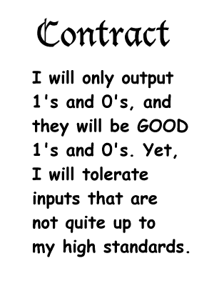
Let’s go digital!
Why DIGITAL?
  … because it helps guarantee a reliable system
The price we pay for this robustness?
  All the information that we transfer between
  components is only 1 crummy bit!
  But, in exchange, we get a guarantee of a reliable system.
0 or 1

Slide 4
The Digital Abstraction
“Ideal”
Abstract World
Real World
Manufacturing
Variations
0/1
Noise
Bits
Volts or
Electrons or
Ergs or Gallons
Keep in mind, the world is not digital, we engineer it to behave so.
We must use real physical phenomena to implement digital designs!

Slide 5
Types of Digital Components
Two categories of components
  those whose output only depends on their current inputs
    called COMBINATIONAL
    they are “memory-less”, don’t remember the past
  those who output depends also on their past state
    called SEQUENTIAL
    they are “state-holding”, remember their past
    key to building memories

Slide 6
Terminology
Circuit
  a small (often leaf-level) component consisting of a network of gates
Component/Element
  an individual part of a bigger system
  clearly-defined function and interface
  implement it and put a black-box around it
  larger components created using smaller components
System
  a reasonably large assembly of components
  division of a system into components is typically arbitrary but almost always hierarchical

Slide 7
Combinational Components
A circuit is combinational if-and-only-if it has:
  one or more digital inputs
  one or more digital outputs
  a functional specification that details the value of each output for every possible combination of valid input values
    output depends only on the latest inputs
  a timing specification consisting (at minimum) of an upper bound t_{pd} on the time this circuit will take to produce the output value once stable valid input values are applied
t_{pd} =
“propagation delay”
Output a “1” if at
least 2 out of 3 of
my inputs are a “1”.
Otherwise, output “0”.
input A
input B
output Y
input C
I will generate a valid
output in no more than
2 minutes after
seeing valid inputs

Slide 8
A Combinational Digital System
Theorem: A system of interconnected elements is combinational if-and-only-if:
  each primitive circuit element is combinational
  every input is connected to exactly one output or directly to a source of 0’s or 1’s
  the circuit contains no directed cycles
    no feedback (yet!)
Proof: By induction
  Start with the rightmost level of elements
    their output only depends on their inputs, which in turn are outputs of the level of element just to their left
    and so on… until you arrive at the leftmost inputs
But, in order to realize digital processing
elements we have one more requirement!

Slide 9
Noise Margins
Key idea: Keep “0”s distinct from the “1”s
  say, “0” is represented by min voltage (e.g., 0 volts)
  … “1” is represented by high voltage (e.g., 1.8 volts)
  use the same voltage representation throughout the entire system!
For reliability, outlaw “close calls”
  forbid a range of voltages between “0” and “1”
Invalid
Valid
“0”
Valid
“1”
Forbidden Zone
Min Voltage
volts
Max Voltage
CONSEQUENCE: Notion of “VALID” and “INVALID” logic levels

Slide 10
Digital Processing Elements
Some digital processing elements occur so frequently that we give them special names and symbols
I will copy and
restore my input
to my output
I will output the
complement of
my input
A
Y
A
Y
buffer
inverter
A
A
I will output a
‘1’ if any of my
inputs are ‘1’
I will only output
a ‘1’ if all my
inputs are ‘1’
Y
Y
AND
OR
B
B
A
I will only output a
‘1’ if an odd number
of my inputs are ‘1’
XOR
Y
B

Slide 11
Digital Processing Elements
Some digital processing elements occur so frequently that we give them special names and symbols
A
Y
A
Y
buffer
inverter
A
A
Y
OR
Y
AND
B
B
A
XOR
Y
B

Slide 12
Most common technology today
… is called CMOS
  everything built using transistors
  a transistor is just a switch
2 types of transistors
  n-type
    called “NFET”, or “nMOS” or “n channel transistor” or “n transistor”
    switch is on (i.e., conducts) when its control input is ‘1’
  p-type
    called “PFET”, or “pMOS”, or “p channel transistor” or “p transistor”
    switch is on (i.e., conducts) when its control input is ‘0’
  need both types to build useful gates

Slide 13
Transistors as switches
At an abstract level, transistors are merely switches
  3-ported voltage-controlled switch
    n-type: conduct when control input is 1
    p-type: conduct when control input is 0

Slide 14
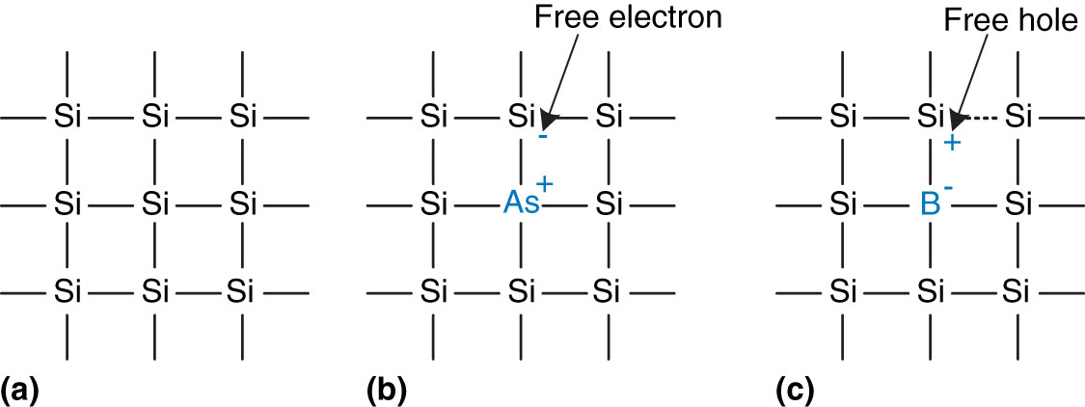
Silicon as a semiconductor
Transistors are built from silicon
Pure Si itself does not conduct well
Impurities are added to make it conducting
  Arsenic (As) provides free electrons → n-type
  Boron (B) provides free “holes” → p-type
Silicon lattice and dopant atoms (from Harris and Harris)

Slide 15
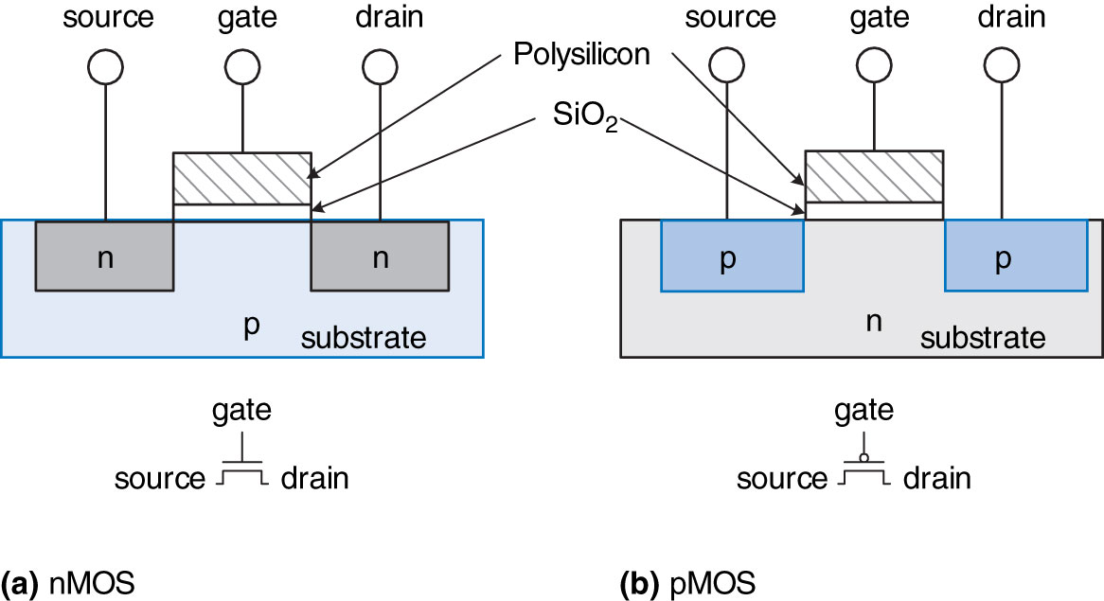
MOS Transistors
MOS = Metal-oxide semiconductor
3 terminals
  gate: the voltage here controls whether current flows
  source and drain: are what the current flows between
    structurally, source and drain are the same
nMOS and pMOS transistors (from Harris and Harris)

Slide 16
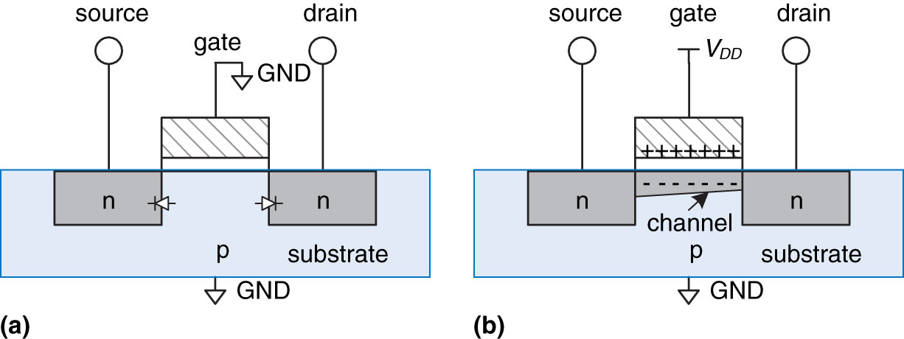
nMOS Transistors
Gate = 0
  OFF = disconnect
    no current flows between source & drain
Gate = 1
  ON= connect
    current can flow between source & drain
    positive gate voltage draws in electrons to form a channel
nMOS transistor operation (from Harris and Harris)

Slide 17
pMOS Transistors
Just the opposite
  Gate = 1 → disconnect
  Gate = 0 → connect

Slide 18
Summary: nMOS and pMOS Transistors
Summary:

Slide 19
CMOS Topologies
There is actually more to it than connect/disconnect
  nMOS: pass good 0’s, but bad 1’s
    so connect source to GND
  pMOS: pass good 1’s, but bad 0’s
    so connect source to V_{DD}
Typically use them in
complementary fashion:
  nMOS network at bottom
    pulls output value down to 0
  pMOS network at top
    pulls output value up to 1
  only one of the two networks must conduct at a time!
    or output is undefined (or smoke may be produced!)
  if neither network conducts → output will be floating

Slide 20
CMOS Gate Recipe
Use complementary networks of p- and n-transistors
  called CMOS (“complementary metal-oxide semiconductor”)
  at any time: either “pullup” active, or “pulldown” active
    never both!
V_{DD}
Use p-type here
pullup: make this connection
when some combination of inputs
is near 0 so that output = V_{DD}
pulldown: make this connection
when some combination of inputs
is near V_{DD} so that output = 0 (Gnd)
Use n-type
here
Gnd

Slide 21
CMOS Inverter
“0”
“1”
V_{out}
Valid “1”
V_{in}
V_{out}
Invalid
“1”
“0”
Valid “0”
V_{in}
Only a narrow range of input voltages result in “invalid” output values. (This diagram is greatly exaggerated)
A
Y
inverter

Slide 22
CMOS Complements
A
A
conducts when A is high
conducts when A is low
A
Series N connections:
A
B
B
Parallel P connections:
conducts when A is high
and B is high: A.B
conducts when A is low
or B is low: A+B = A.B
A
A
B
Parallel N connections:
B
Series P connections:
conducts when A is high
or B is high: A+B
conducts when A is low
and B is low: A.B = A+B

Slide 23
Boolean Logic/Nomenclature Review
Or: A + B
And: A * B
Not: A

Slide 24
Simplest CMOS gate: Inverter
A | P1 | N1 | Y
0 | ON | OFF | 1
1 | OFF | ON | 0

Slide 25
A Two Input Logic Gate
What function does
this gate compute?
A B Y
0 0
0 1
1 0
1 1
The “dot” at an intersection
means the wires connect
(see next slide)

Slide 26
NAND
A | B | P1 | P2 | N1 | N2 | Y
0 | 0 | ON | ON | OFF | OFF | 1
0 | 1 | ON | OFF | OFF | ON | 1
1 | 0 | OFF | ON | ON | OFF | 1
1 | 1 | OFF | OFF | ON | ON | 0

Slide 27
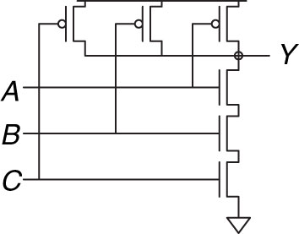
3-Input NAND

Slide 28
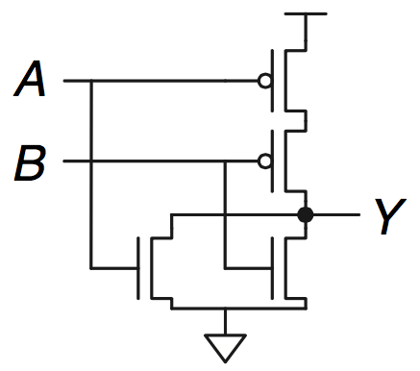
Here’s Another…
What function does
this gate compute?
A B Y
0 0
0 1
1 0
1 1
1
0
0
0
2-input NOR gate

Slide 29
3-input NOR Gate?

Slide 30
2-input AND Gate?
NAND
NOT
Why can’t we make an AND gate directly, using a single CMOS gate?

Slide 31
CMOS Gates Like to Invert
Observation: CMOS gates tend to be inverting!
  One or more “0” inputs are necessary to generate a “1” output
  One or more “1” inputs are necessary to generate a “0” output
  Why?

Slide 32
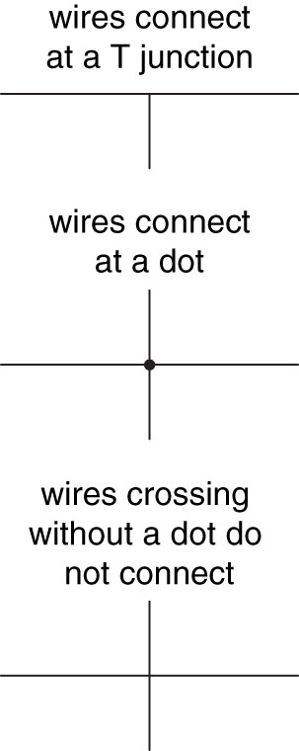
Drawing Style
Indicate inputs and outputs using arrows
  or: inputs at left/top, outputs at right/bottom
If possible, gates should flow from left to right
  or: top to bottom
Straight wires best
  or: keep bends at a minimum (preferably 90 deg)
Connections:
  wires always connect at a “T” junction
  a dot at a wire crossing indicates connection
  wire crossing without a dot means no connection

Slide 33
Drawing Style (contd.)
Wire connections
  A dot where wires cross indicates a connection
  Wires crossing without a dot make no connection
  Wires always connect at a T junction

Slide 34
A More Complex CMOS Gate
Design a single gate that computes
  Step 1. Determine pull-down network that sets output to ‘0’
    (A OR B) AND C ➔ Y=0
  Step 2. Determine pull-up network by walking through pulldown hierarchy, and
    replacing n-transistors with p-transistors
    replacing series composition with parallel composition
    replacing parallel composition with series composition
  Step 3. Combine the pull-up and pull-down networks together
C
A
B
C
A
B
C
A
B
Y
C
A
B

Slide 35
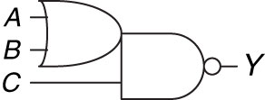
A More Complex CMOS Gate (contd.)
Single gate that computes
  called “complex gate” because it is not one of the basic gates (NAND, NOR, NOT, etc.)
  this one is actually called
  OR-AND-INVERT (OAI)
  symbol:
A
C
B
Y
C
A
B

Slide 36
One More Exercise
Lets construct a gate to compute:
  F = A+BC = NOT(OR(A,AND(B,C)))
  Step 1: Draw the pull-down network
  Step 2: The complementary pull-up network
  this one is called AND-OR-INVERT (AOI)
V_{dd}
A
B
C
F
A
B
C

Slide 37
One More Exercise
Lets construct a gate to compute:
  F = A+BC = NOT(OR(A,AND(B,C)))
  Step 1: Draw the pull-down network
  Step 2: The complementary pull-up network
  Step 3: Combine and Verify
V_{dd}
A
B
C
F
A
B
A | B | C | F
0 | 0 | 0
0 | 0 | 1
0 | 1 | 0
0 | 1 | 1
1 | 0 | 0
1 | 0 | 1
1 | 1 | 0
1 | 1 | 1
1
1
1
0
0
0
0
0
C

Slide 38
Next
This lecture
  basics of transistors
  CMOS gates
Next lecture
  Boolean algebra
  gate-level design

