Slide 1
Transistors and Logic,
Part Deux
Don Porter
Lecture 11

Slide 2
Today’s Topics
Basic gates
Boolean algebra
Synthesis using standard gates
  Truth tables
  Universal gates: NAND and NOR
  Gates with more than 2 inputs
  Sum-of-Products
  DeMorgan’s Law

Slide 3
Single-Input Logic Gates

Slide 4
Two-Input Logic Gates

Slide 5
More Two-Input Logic Gates

Slide 6
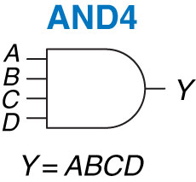
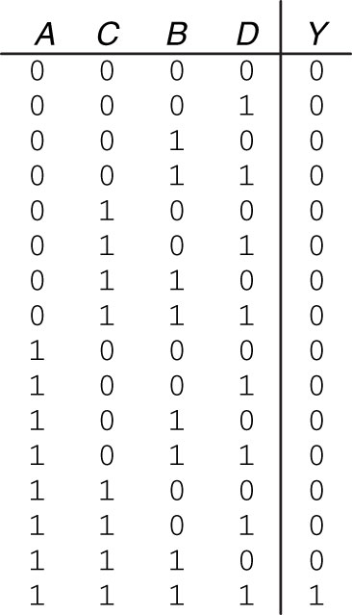
Multiple-Input Logic Gates

Slide 7
Multiple-Input Logic Gates

Slide 8
Basic gates vs. single CMOS gates
Not all basic gates can be implemented using a single CMOS gate
Some can be
  inverter, NAND, NOR
    we have covered their CMOS implementation
Others need multiple CMOS gates connected together
  AND: implemented as NAND + inverter
  OR: implemented as NOR + inverter
  buffer: implemented as inverter + inverter
  XOR / XNOR: will see shortly

Slide 9
Boolean Algebra
Algebra of 1s and 0s

Slide 10
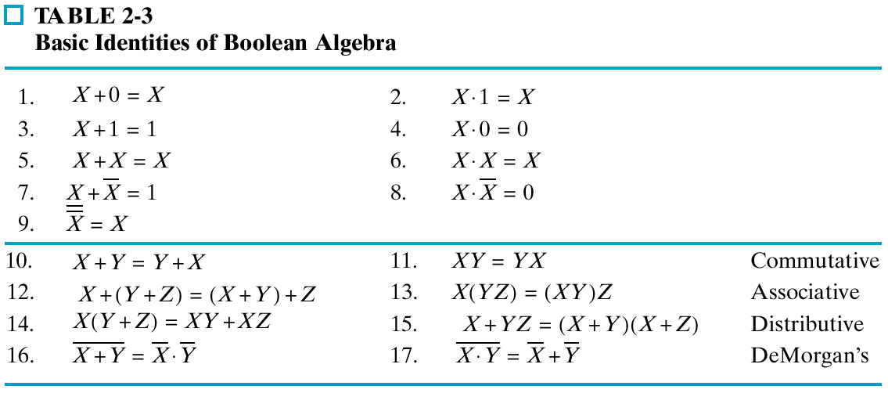
Table of Identities

Slide 11
Duals
Left and right columns are duals
Replace ANDs and ORs, 0s and 1s

Slide 12
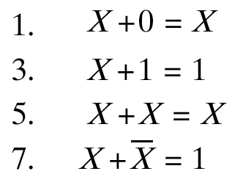
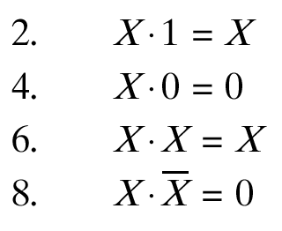

Single Variable Identities

Slide 13


Commutativity
Operation is independent of order of variables

Slide 14

Associativity
Independent of order in which we group
So can also be simply written as:
  X+Y+Z, and
  XYZ

Slide 15
Distributivity

Slide 16
Substitution
Can substitute arbitrarily large algebraic expressions for the variables
  Distribute an operation over the entire expression
  Example:
  X + YZ = (X+Y)(X+Z)
  Substitute ABC for X
  ABC + YZ = (ABC + Y)(ABC + Z)

Slide 17


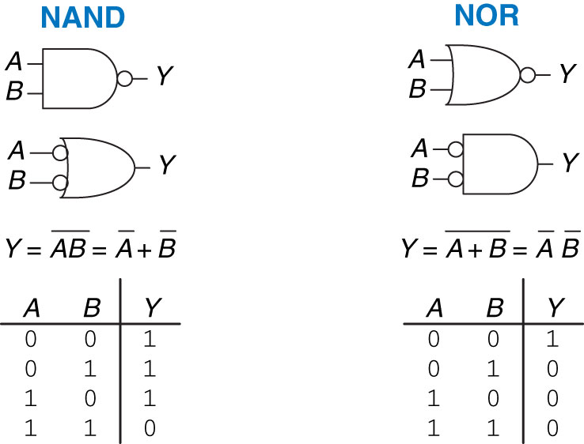
DeMorgan’s Theorem
Used a lot
  NOR ➔ invert, then AND
  NAND ➔ invert, then OR

Slide 18
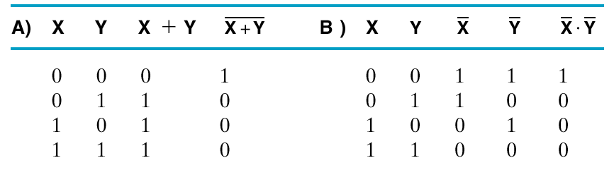
Truth Tables for DeMorgan’s

Slide 19
DeMorgan’s Thm.: “Bubble Pushing”
Bubble pushing:
  imagine the bubble at the output is being pushed towards the inputs
    it becomes a bubble at every input, and
    the shape of the gate changes from AND to OR, and vice versa

Slide 20
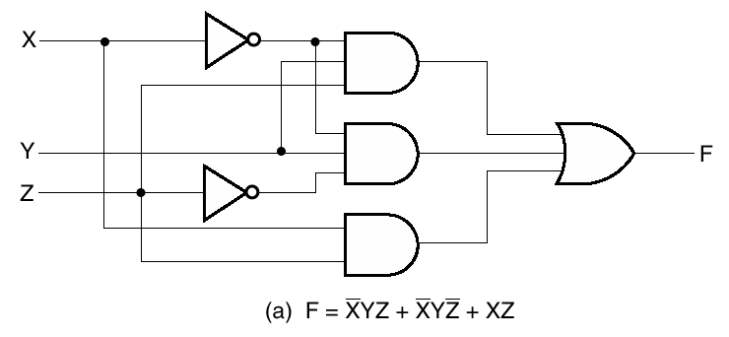
Algebraic/Boolean Manipulation
Apply algebraic and Boolean identities to simplify expression
  Example:

Slide 21


Simplification Example
Apply
Apply
Apply

Slide 22
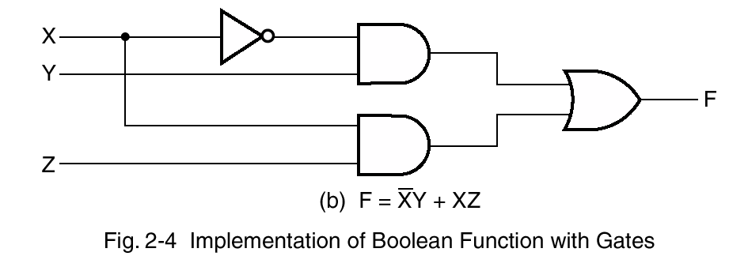
Fewer Gates

Slide 23
From Truth Table to Gate-Level Circuit

Slide 24
Start with Functional Spec
We need to start somewhere
  usually it’s the functional specification
A
If C is 1 then
copy B to Y,
otherwise copy
A to Y
Truth Table
Y
B
C
First step is to translate a verbal description into a tabular form. Any combinational function can be represented as a “truth table.”
A truth table lists the output(s) for each combination of inputs.

Slide 25
We Can Make Most Gates Out of Others
Example 1: B > A
  Output Y is 1 if and only if B is 1 AND A is 0
  ➔ Y = B AND (NOT(A))
B>A
A
y
B

Slide 26
We Can Make Most Gates Out of Others
Example 2: A XOR B
  Output Y is 1 if and only if …
    B is 1 AND A is 0 --OR—
    B is 0 AND A is 1
  ➔ Y = B AND (NOT(A)) OR
  A AND (NOT(B))
XOR
A
B
Y
A
Y
B
Symbol for XOR

Slide 27
How many gates do we really need?

Slide 28
One Will Do!
NANDs and NORs are universal
  one can make any circuit out of just NANDs,
  or out of just NORs!
=
=
=
=
=
=

Slide 29
Gates with more than two inputs
Sometimes can be directly created in CMOS
  e.g., 3-input NOR, 4-input NAND etc.
Often constructed using smaller gates:
  e.g., N-input AND gate using several 2-input AND gates
  AND(A₀, A₁, A₂ … A_{N-1})
  = AND … (AND(AND(A₀, A₁), A₂) … A_{N-1})
  Delay in computing final output is linear in # of gates: O(N)
    can we do it faster?
A₂
A₃
A_{N-1}
A₁
A₀
Notes:
DIFFERENT prop delays from each INPUT...
... but we’re taking MAX (worst case).

Slide 30
Gate trees are faster
More parallelism: combine two at a time in parallel
  Like a tournament bracket!
A₀
A₁
A₂
A₃
A_{N-4}
A_{N-3}
A_{N-2}
A_{N-1}
  Delay is now logarithmic: O(log₂ (N))

Slide 31
Systematic Approach
Given truth table:
Develop Boolean equation

Slide 32
Design Approach: Sum-of-Products
Truth Table
Three steps:
  Write functional spec as a truth table
  Write down a Boolean expression for
  every row with ‘1’ in the output
    an input that is ‘0’ becomes inverted
    AND all the inputs in each term
  Wire up the gates!
This approach give us expressions of the type:
  SUM-OF-PRODUCTS (“SOP”)
    Boolean “SUM” actually means OR
    Boolean “PRODUCT” actually means AND

Slide 33
Gate-level circuit
We can implement SUM-OF-PRODUCTS…
  …with just three levels of logic:
    INVERTERS/AND/OR
A
B
C
A
B
C
Y
A
B
C
A
B
C

Slide 34
Notations
Symbols and Boolean operators:

Slide 35
An Interesting 3-Input Gate: Multiplexer
Based on C, select the A or B input to be copied to the output Y.
Truth Table
A
If C is 1 then
copy B to Y,
otherwise copy
A to Y
Y
B
C
2-input Multiplexer (“mux”)
A
0
B
1
Gate
symbol
C

Slide 36
Multiplexer (MUX) Shortcuts
A 4-bit wide 2-input Mux
A 4-input Mux
(implemented as a tree)
A₀
B₀
A₁
B₁
0
1
Y₀
0
1_{S}
I₀
I₁
I₂
I₃
0
1
0
1
0
1_{S}
0
1_{S}
Y₁
0
1
A
B
C
D
S
0
1_{S}
Y
0
1
2
3
A₀₋₃
B₀₋₃
S
Y
A₂
B₂
A₃
B₃
Y₀₋₃
0
1
0
1
0
1_{S}
0
1_{S}
Y₂
0
1
0
1_{S}
Y₃
S₀ S₁
S

Slide 37
Next Class
Arithmetic circuits

