Slide 1
C for Java Programmers & Lab 0
Don Porter
Portions courtesy Kevin Jeffay
Notes:
Pictures for C memory placement (heap v stack); fix kevin’s slides for % and *, lab 0

Slide 2
Same Basic Syntax
Data Types: int, char, [float]
void - (untyped pointer)
Can create other data types using typedef
No Strings - only char arrays
Last character needs to be a 0
Not ‘0’, but ‘\0’

Slide 3
struct – C’s object
typedef struct foo {
int a;
void *b;
void (*op)(int c); // function pointer
} foo_t; // <------type declaration
Actual contiguous memory
Includes data and function pointers

Slide 4
Pointers
Memory placement explicit (heap vs. stack)
Two syntaxes (dot, arrow)
int main {
struct foo f;
struct foo *fp = &f;
f.a = 32; // dot: access object directly
fp->a = 33; // arrow: follow a pointer
fp = malloc(sizeof(struct foo));
fp->a = 34;
…
}
Stack
Heap
main:
f:
a = 33;
b = NULL;
op = NULL;
f:
a = 32;
b = NULL;
op = NULL;
struct foo:
a = 34;
b = NULL;
op = NULL;
f:
a = 0;
b = NULL;
op = NULL;
struct foo:
a = 0;
b = NULL;
op = NULL;
Ampersand:
Address of f
PC
fp:
struct foo {
int a;
void *b;
void (*op)(int c);
}
Notes:
START HERE 2020 – briefly recap and move to next slide

Slide 5
Function pointer example
fp->op = operator;
fp->op(32); // Same as calling
// operator(32);
Stack
Heap
main:
f:
a = 33;
b = NULL;
op = NULL;
f:
a = 32;
b = NULL;
op = NULL;
f:
a = 0;
b = NULL;
op = NULL;
struct foo:
a = 34;
b = NULL;
op = NULL;
struct foo:
a = 34;
b = NULL;
op =
fp:
Code in memory:
Main
…
Operator:
...
struct foo {
int a;
void *b;
void (*op)(int c);
}

Slide 6
More on Function Pointers
C allows function pointers to be used as members of a struct or passed as arguments to a function
Continuing the previous example:
void myOp(int c){ /*…*/ }
/*…*/
foo_t *myFoo = malloc(sizeof(foo_t));
myFoo->op = myOp; // set pointer
/*…*/
myFoo->op(5); // Actually calls myop

Slide 7
No Constructors or Destructors
Must manually allocate and free memory - No Garbage Collection!
void *x = malloc(sizeof(foo_t));
sizeof gives you the number of bytes in a foo_t - DO NOT COUNT THEM YOURSELF!
free(x);
Memory allocator remembers the size of malloc’ed memory
Must also manually initialize data
Custom function
memset(x, 0, sizeof(*x)) will zero it

Slide 8
Memory References
‘.’ - access a member of a struct
myFoo.a = 5;
‘&’ - get a pointer to a variable
foo_t * fPointer = &myFoo;
‘->’ - access a member of a struct, via a pointer to the struct
fPointer->a = 6;
‘*’ - dereference a pointer
if(5 == *intPointer){…}
Without the *, you would be comparing 5 to the address of the int, not its value.
Notes:
START HERE (18)

Slide 9
Int example
Stack
PC
int x = 5; // x is on the stack
int *xp = &x;
*xp = 6;
printf(“%d\n”, x); // prints 6
xp = (int *) 0;
*xp = 7; // segmentation fault
main:
x: 6
x: 5
xp:
xp: NULL

Slide 10
Memory References, cont.
‘[]’ - refer to a member of an array
char *str = malloc(5 * sizeof(char));
str[0] = ‘a’;
Note: *str = ‘a’ is equivalent
str++; increments the pointer such that *str == str[1]
str
str+1
str+2
str+3
str+4
str[0]
str[1]
str[2]
str[3]
str[4]
Notes:
START HERE

Slide 11
The Chicken or The Egg?
Many C functions (printf, malloc, etc) are implemented in libraries
These libraries use system calls
System calls provided by kernel
Thus, kernel has to “reimplement” basic C libraries
In some cases, such as malloc, can’t use these language features until memory management is implemented

Slide 12
For more help
man pages are your friend!
(not a dating service)!
Ex: ‘man malloc’, or ‘man 3 printf’
Section 3 is usually where libraries live - there is a command-line utility printf as well
Use ‘apropos term’ to search for man entries about term
The C Programming Language by Brian Kernighan and Dennis Ritchie is a great reference.

Slide 13
Lab 0 Overview
C programming on Linux refresher
Parser for your shell (Lab 1)

Slide 14
Shells
Shell: aka the command prompt
At a high level:
while (more input) {
read a line of input
parse the line into a command
if valid command: execute it
}
We will give you this
Lab 0
Lab 1

Slide 15
Detour: Environment Variables
Nearly all shell commands are actually binary files
Very few commands actually implemented in the shell
A few built-ins that change the shell itself (exit, cd)
Example: ls is actually in /bin/ls
For fun, play with which, as in which ls
So where to look for a given command?
Note that we want some flexibility system-to-system
Idea: dynamically set a variable that controls which directories to search

Slide 16
Environment Variables
A set of key-value pairs
Passed to main() as a third argument
Often ignored by programmers
Serves many different purposes
For Lab 0, we need to look at PATH
By convention, a single, colon-delimited set of prefixes
Example:
/usr/local/sbin:/usr/local/bin:/usr/sbin:/usr/bin:/sbin:/bin

Slide 17
PATH in a shell
If my PATH is
/usr/local/sbin:/usr/local/bin:/usr/sbin:/usr/bin:/sbin:/bin
Then, for a given command (ls), the shell will check, in order, until found:
/usr/local/sbin/ls
/usr/local/bin/ls
/usr/sbin/ls
/usr/bin/ls
/sbin/ls
/bin/ls

Slide 18
Lab 0, Exercise 1
Your first job will be to write parsing code that takes in a colon-delimited set of prefixes, and to create a table of prefixes to try in future commands
See path_table in jobs.c
We wrote a test harness test_env.c
$ PATH=/foo:/bar ./test_env
===== Begin Path Table =====
Prefix 0: [/foo]
Prefix 1: [/bar]
===== End Path Table =====

Slide 19
Ex 2: Parsing commands
A typical shell command includes a main binary (e.g., ‘ls’)
and 0+ whitespace-separated arguments (e.g., ‘-l’)
and possibly extra whitespace
You will get this as a single character array
Your job is to break this up into individual ‘tokens’
l
s
-
l
\0
l
s
\0
\0
Input
-
l
\0
commands
\0

Slide 20
Pipelines
A shell can compose multiple commands using pipelines
Key idea: standard output of one command becomes standard input of next
Example: ls | wc -l
List a directory (ls) – send listing output to a wordcount utility (wc) to count how many entries in directory
The vertical bar (|) is a special character
May not appear in any other valid commands
Does not need whitespace: ls|wc –l is valid

Slide 21
parse.c:parse_line()
The workhorse for lab 0 (and 1)
Takes in a line of input, outputs a 2-D array
First dimension: one entry per pipeline stage
Simple commands just have one entry
Second dimension: one entry per command token

Slide 22
How to parse a pipeline?
l
s
|
w
c
-
l
\0
Input
l
s
\0
\0
commands
(parsed)
w
c
\0
\0
-
l
\0
\0

Slide 23
Other special cases
Comments – anything past a ‘#’ character
File redirection - sets standard input/output to a file
Example: ls > mydir.txt
Saves the output of ls into a file
Example: wc –l < mydir.txt
Sends the contents of mydir.txt into wc as standard input
Built-in commands (see builtin.c)
For now, you just need to recognize them and call the appropriate handler function

Slide 24
Working on Homework Assignments
You should all have accounts on comp530fa20.cs.unc.edu
Use your ONYEN to log in
You are welcome to use your own laptop, but code must work on comp530fa20 !

Slide 25
Checking out the starter code
Once you have a github account registered
Make sure you accept the invite:
Click https://github.com/comp530-f20
Click the link in the homework to create a private repo
Then, on your machine or classroom (substituting your team for ‘team-don’ – see the green clone button):
git clone git@github.com:comp530-f20/thsh-team-don.git

Slide 26
Submitting homework
We will be using gradescope to submit and autograde the homework
Challenge problems and late hours done manually
Submit challenges separately
Ideally, use github connection to directly submit
Upload ok
Feel free to try early to catch issues with grading

Slide 27
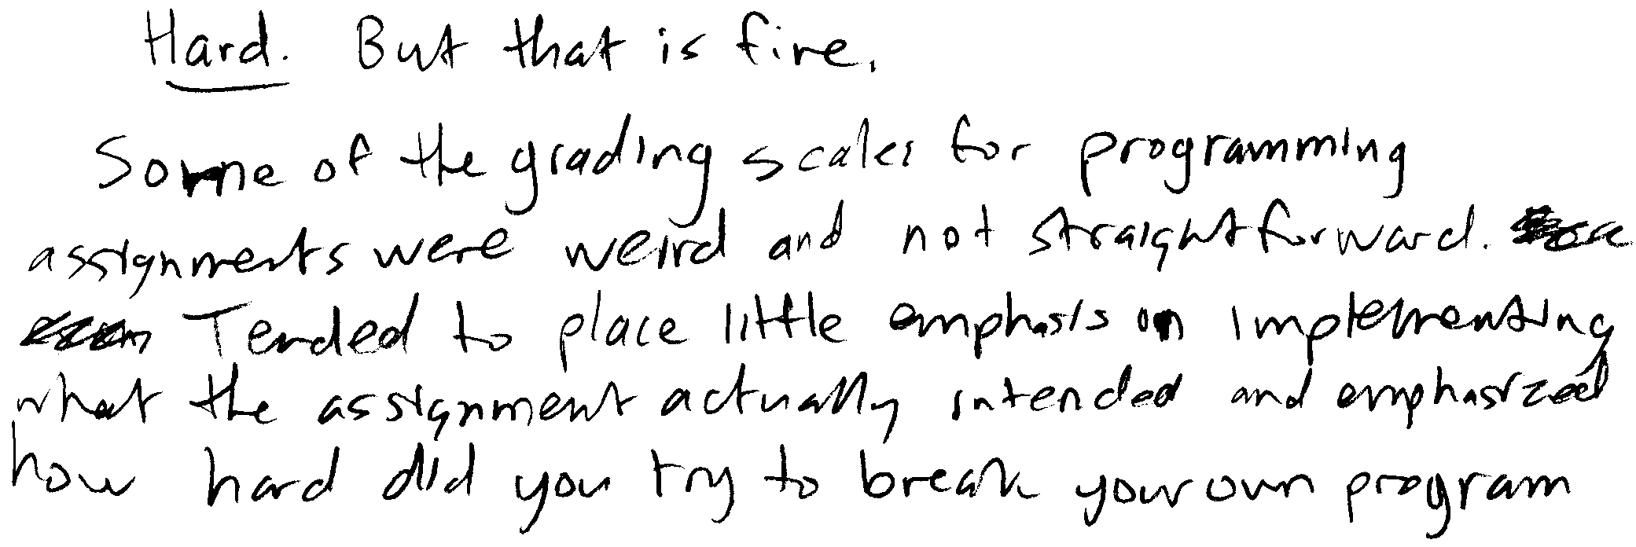
Dr. Jeffay’s Experience
(“Hard But that is fine. Some of the grading scales for programming assignments were weird and not straightforward. Tended to place little emphasis on implementing what the assignment actually intended and emphasized how hard did you try to break your own program”)
Programs that “mostly work” don’t cut it in a senior-level course!
Notes:
Documentation: More is NOT necessarily better!
Make sure you put your name on your program!

Slide 28
Honor Code: Acceptable and Unacceptable Collaboration
Working in teams on programming assignments is OK
But you can only collaborate with other students in the course
Every line of code handed in must be written exclusively by team members themselves, and
All collaborators must be acknowledged in writing (and part of the team)
Use of the Internet
Using code from the Internet in any form is not allowed
Websites may be consulted for reference (e.g., to learn how a system call works)
But all such websites used or relied on must be listed as a reference in a header comment in your program
Warning: Sample code found on the Internet rarely helps the student

