Slide 1
Concurrent Programming with Threads: Why you should care deeply
Don Porter
Portions courtesy Emmett Witchel

Slide 2
Uniprocessor Performance Not Scaling
Graph by Dave Patterson

Slide 3
Power and Heat Lay Waste to CPU Makers
Intel P4 (2000-2007)
1.3GHz to 3.8GHz, 31 stage pipeline
“Prescott” in 02/04 was too hot. Needed 5.2GHz to beat 2.6GHz Athalon
Intel Pentium Core, (2006-)
1.06GHz to 3GHz, 14 stage pipeline
Based on mobile (Pentium M) micro-architecture
Power efficient
2% of electricity in the U.S. feeds computers
Doubled in last 5 years

Slide 4
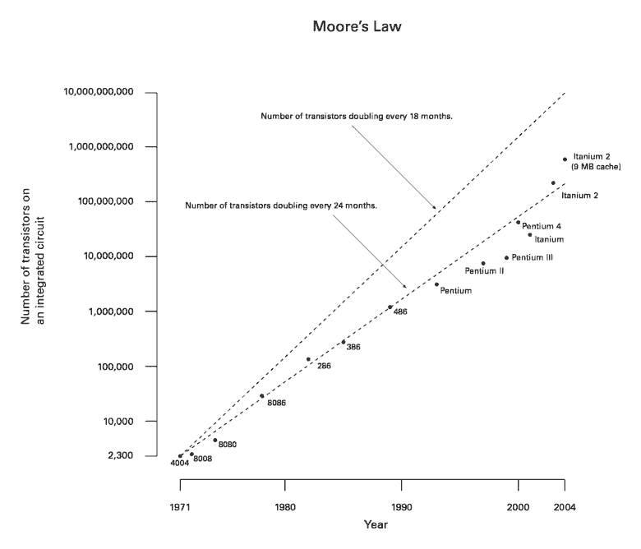
What about Moore’s law?
Number of transistors double every 24 months
Not performance!

Slide 5
Transistor Budget
We have an increasing glut of transistors
(at least for a few more years)
But we can’t use them to make things faster
Techniques that worked in the 90s blew up heat faster than we can dissipate it
What to do?
Use the increasing transistor budget to make more cores!

Slide 6
Multi-Core is Here: Plain and Simple
Raise your hand if your laptop is single core?
Your phone?
That’s what I thought

Slide 7
Multi-Core Programming == Essential Skill
Hardware manufacturers betting big on multicore
Software developers are needed
Writing concurrent programs is not easy
You will learn how to do it in this class
Still treated like a bonus: Don’t graduate without it!

Slide 8
Threads: OS Abstraction for Concurrency
Process abstraction combines two concepts
Concurrency
Each process is a sequential execution stream of instructions
Protection
Each process defines an address space
Address space identifies all addresses that can be touched by the program
Threads
Key idea: separate the concepts of concurrency from protection
A thread is a sequential execution stream of instructions
A process defines the address space that may be shared by multiple threads
Threads can execute on different cores on a multicore CPU (parallelism for performance) and can communicate with other threads by updating memory

Slide 9
Practical Difference
With processes, you coordinate through nice abstractions (relatively speaking – e.g., lab 1)
Pipes, signals, etc.
With threads, you communicate through data structures in your process virtual address space
Just read/write variables and pointers

Slide 10
Programmer’s View
void fn1(int arg0, int arg1, …) {…}
main() {
…
tid = CreateThread(fn1, arg0, arg1, …);
…
}
At the point CreateThread is called, execution continues in parent thread in main function, and execution starts at fn1 in the child thread, both in parallel (concurrently)

Slide 11
Implementing Threads: Example Redux
Virtual Address Space
hello
heap
stk1
stk2
libc.so
Linux
0
0xffffffff
2 threads requires 2 stacks in the process
No problem!
Kernel can schedule each thread separately
Possibly on 2 CPUs
Requires some extra bookkeeping

Slide 12
How can it help?
How can this code take advantage of 2 threads?
for(k = 0; k < n; k++)
a[k] = b[k] * c[k] + d[k] * e[k];
Rewrite this code fragment as:
do_mult(l, m) {
for(k = l; k < m; k++)
a[k] = b[k] * c[k] + d[k] * e[k];
}
main() {
CreateThread(do_mult, 0, n/2);
CreateThread(do_mult, n/2, n);
What did we gain?

Slide 13
How Can Threads Help?
Consider a Web server
Create a number of threads, and for each thread do
get network message from client
get URL data from disk
send data over network
What did we gain?
Notes:
START HERE

Slide 14
Overlapping I/O and Computation
Request 1
Thread 1
Request 2
Thread 2
get network message (URL) from client
get URL data from disk
send data over network
get network message (URL) from client
get URL data from disk
send data over network
(disk access latency)
(disk access latency)
Total time is less than request 1 + request 2
Time

Slide 15
Why threads? (summary)
Computation that can be divided into concurrent chunks
Execute on multiple cores: reduce wall-clock exec. time
Harder to identify parallelism in more complex cases
Overlapping blocking I/O with computation
If my web server blocks on I/O for one client, why not work on another client’s request in a separate thread?
Other abstractions we won’t cover (e.g., events)

Slide 16
Threads vs. Processes
Threads
A thread has no data segment or heap
A thread cannot live on its own, it must live within a process
There can be more than one thread in a process, the first thread calls main & has the process’s stack
If a thread dies, its stack is reclaimed
Inter-thread communication via memory.
Each thread can run on a different physical processor
Inexpensive creation and context switch
Processes
A process has code/data/heap & other segments
There must be at least one thread in a process
Threads within a process share code/data/heap, share I/O, but each has its own stack & registers
If a process dies, its resources are reclaimed & all threads die
Inter-process communication via OS and data copying.
Each process can run on a different physical processor
Expensive creation and context switch

Slide 17
Implementing Threads
Process’s
address space
Processes define an address space; threads share the address space
Process Control Block (PCB) contains process-specific information
Owner, PID, heap pointer, priority, active thread, and pointers to thread information
Thread Control Block (TCB) contains thread-specific information
Stack pointer, PC, thread state (running, …), register values, a pointer to PCB, …
TCB for
Thread1
mapped segments
PC
SP
State
Registers
…
DLL’s
Heap
TCB for
Thread2
Stack – thread2
PC
SP
State
Registers
…
Stack – thread1
Initialized data
Code

Slide 18
Thread Life Cycle
Threads (just like processes) go through a sequence of start, ready, running, waiting, and done states
Start
Done
Ready
Running
Waiting
Notes:
Besides memory state and processor state, there’s also execution state.
In this class we’ll use a simple 3-state model of process execution.
— At all times a process is always in one of these three states.
— We assume a single processor so there’s only ever one process in the running state.
There are queues associated w/ the waiting and ready states.
— More later.
Do an example of a process making state transitions upon performing I/O.
— Note that the READ operation causes two process transitions: one from the running to the waiting state, and one from the ready to the running state.

Slide 19
Threads have their own…?
65
47
of
65
CPU
Address space
PCB
Stack
Register State
0

Slide 20
Threads have the same scheduling states as processes
True
False
In fact, OSes generally schedule threads to CPUs, not processes
Yes, yes, another white lie in this course

Slide 21
Lecture Outline
What are threads?
Small digression: Performance Analysis
There will be a few more of these in upcoming lectures
Why are threads hard?

Slide 22
Performance: Latency vs. Throughput
Latency: time to complete an operation
Throughput: work completed per unit time
Multiplying vector example: reduced latency
Web server example: increased throughput
Consider plumbing
Low latency: turn on faucet and water comes out
High bandwidth: lots of water (e.g., to fill a pool)
What is “High speed Internet?”
Low latency: needed to interactive gaming
High bandwidth: needed for downloading large files
Marketing departments like to conflate latency and bandwidth…

Slide 23
Latency and Throughput
Latency and bandwidth only loosely coupled
Henry Ford: assembly lines increase bandwidth without reducing latency
My factory takes 1 day to make a Model-T ford.
But I can start building a new car every 10 minutes
At 24 hrs/day, I can make 24 * 6 = 144 cars per day
A special order for 1 green car, still takes 1 day
Throughput is increased, but latency is not.
Latency reduction is difficult
Often, one can buy bandwidth
E.g., more memory chips, more disks, more computers
Big server farms (e.g., google) are high bandwidth

Slide 24
Latency, Throughput, and Threads
Can threads improve throughput?
Yes, as long as there are parallel tasks and CPUs available
Can threads improve latency?
Yes, especially when one task might block on another task’s IO
Can threads harm throughput?
Yes, each thread gets a time slice.
If # threads >> # CPUs, the %of CPU time each thread gets approaches 0
Can threads harm latency?
Yes, especially when requests are short and there is little I/O
Threads can help or hurt: Understand when they help!

Slide 25
So Why are Threads Hard?
Order of thread execution is non-deterministic
Multiprocessing
A system may contain multiple processors ➔ cooperating threads/processes can execute simultaneously
Multi-programming
Thread/process execution can be interleaved because of time-slicing
Operations often consist of multiple, visible steps
Example: x = x + 1 is not a single operation
read x from memory into a register
increment register
store register back to memory
Goal:
Ensure that your concurrent program works under ALL possible interleavings
Thread 2
read
increment
store
Notes:
START HERE

Slide 26
Questions
Do the following either completely succeed or completely fail?
Writing an 8-bit byte to memory
A. Yes B. No
Creating a file
A. Yes B. No
Writing a 512-byte disk sector
A. Yes B. No
Notes:
START HERE 18

Slide 27
Sharing Amongst Threads Increases Performance
int a = 0, b = 2;
main() {
CreateThread(fn1, 4);
CreateThread(fn2, 5);
}
fn1(int arg1) {
if(a) b++;
}
fn2(int arg1) {
a = arg1;
}
What are the values of a & b
at the end of execution?
But can lead to problems…

Slide 28
Some More Examples
What are the possible values of x in these cases?
Thread1: x = 1; Thread2: x = 2;
Initially y = 10;
Thread1: x = y + 1; Thread2: y = y * 2;
Initially x = 0;
Thread1: x = x + 1; Thread2: x = x + 2;

Slide 29
The Need for Mutual Exclusion
Running multiple processes/threads in parallel increases performance
Some computer resources cannot be accessed by multiple threads at the same time
E.g., a printer can’t print two documents at once
Mutual exclusion is the term to indicate that some resource can only be used by one thread at a time
Active thread excludes its peers
For shared memory architectures, data structures are often mutually exclusive
Two threads adding to a linked list can corrupt the list
Notes:
START HERE 2020

Slide 30
Real Life Example
Imagine multiple chefs in the same kitchen
Each chef follows a different recipe
Chef 1
Grab butter, grab salt, do other stuff
Chef 2
Grab salt, grab butter, do other stuff
What if Chef 1 grabs the butter and Chef 2 grabs the salt?
Yell at each other (not a computer science solution)
Chef 1 grabs salt from Chef 2 (preempt resource)
Chefs all grab ingredients in the same order
Current best solution, but difficult as recipes get complex
Ingredient like cheese might be sans refrigeration for a while

Slide 31
Critical Sections
Key abstraction: A group of instructions that cannot be interleaved
Generally, critical sections execute under mutual exclusion
E.g., a critical section is the part of the recipe involving butter and salt – you know, the important part
One critical section may wait for another
Key to good multi-core performance is minimizing the time in critical sections
While still rendering correct code!

Slide 32
The Need to Wait
Very often, synchronization consists of one thread waiting for another to make a condition true
Master tells worker a request has arrived
Cleaning thread waits until all lanes are colored
Until condition is true, thread can sleep
Ties synchronization to scheduling
Mutual exclusion for data structure
Code can wait (wait)
Another thread signals (notify)

Slide 33
Example 2: Traverse a singly-linked list
Suppose we want to find an element in a singly linked list, and move it to the head
Visual intuition:
lhead
lprev
lptr

Slide 34
Example 2: Traverse a singly-linked list
Suppose we want to find an element in a singly linked list, and move it to the head
Visual intuition:
lhead
lprev
lptr

Slide 35
Even more real life, linked lists
lprev = NULL;
for(lptr = lhead; lptr; lptr = lptr->next) {
if(lptr->val == target){
// Already head?, break
if(lprev == NULL) break;
// Move cell to head
lprev->next = lptr->next;
lptr->next = lhead;
lhead = lptr;
break;
}
lprev = lptr;
}
Where is the critical section?

Slide 36
Even more real life, linked lists
Thread 1
Thread 2
// Move cell to head
lprev->next = lptr->next;
lptr->next = lhead
lhead = lptr;
lprev->next = lptr->next;
lptr->next = lhead;
lhead = lptr;
lhead
elt
lptr
lprev
lhead
elt
lptr
lprev
A critical section often needs to be larger than it first appears
The 3 key lines are not enough of a critical section

Slide 37
Even more real life, linked lists
Thread 1
Thread 2
if(lptr->val == target){
elt = lptr;
// Already head?, break
if(lprev == NULL) break;
// Move cell to head
lprev->next = lptr->next;
// lptr no longer in list
for(lptr = lhead; lptr;
lptr = lptr->next) {
if(lptr->val == target){
Putting entire search in a critical section reduces concurrency, but it is safe.

Slide 38
Safety and Liveness
Safety property : “nothing bad happens”
holds in every finite execution prefix
Windows™ never crashes
a program never terminates with a wrong answer
Liveness property: “something good eventually happens”
no partial execution is irremediable
Windows™ always reboots
a program eventually terminates
Every property is a combination of a safety property and a liveness property - (Alpern and Schneider)
Notes:
START HERE

Slide 39
Safety and liveness for critical sections
At most k threads are concurrently in the critical section
A. Safety
B. Liveness
C. Both
A thread that wants to enter the critical section will eventually succeed
A. Safety
B. Liveness
C. Both
Bounded waiting: If a thread i is in entry section, then there is a bound on the number of times that other threads are allowed to enter the critical section (only 1 thread is alowed in at a time) before thread i’s request is granted.
A. Safety B. Liveness C. Both

Slide 40
Lecture Summary
Understand the distinction between process & thread
Understand motivation for threads
Concepts of Throughput vs. Latency
Intuition of why coordinating threads is hard
Idea of mutual exclusion and critical sections
Much more on last two points to come

