Slide 1
C for Java Programmers
& Lab 0
Don Porter
Portions courtesy Kevin Jeffay
Notes:
Pictures for C memory placement (heap v stack); fix kevin’s slides for % and *, lab 0

Slide 2
Same Basic Syntax
Data Types: int, char, [float]
  void - (untyped pointer)
  Can create other data types using typedef
No Strings - only char arrays
  Last character needs to be a 0
    Not ‘0’, but ‘\0’

Slide 3
struct – C’s object
typedef struct foo {
int a;
void *b;
void (*op)(int c); // function pointer
} foo_t; // <------type declaration
Actual contiguous memory
Includes data and function pointers

Slide 4
Pointers
Memory placement explicit (heap vs. stack)
Two syntaxes (dot, arrow)
int main {
struct foo f;
struct foo *fp = &f;
f.a = 32; // dot: access object directly
fp->a = 33; // arrow: follow a pointer
fp = malloc(sizeof(struct foo));
fp->a = 34;
…
}
Stack
Heap
main:
f:
a = 33;
b = NULL;
op = NULL;
f:
a = 32;
b = NULL;
op = NULL;
struct foo:
a = 34;
b = NULL;
op = NULL;
f:
a = 0;
b = NULL;
op = NULL;
struct foo:
a = 0;
b = NULL;
op = NULL;
Ampersand:
Address of f
PC
fp:
struct foo {
int a;
void *b;
void (*op)(int c);
}
Notes:
START HERE 2020 – briefly recap and move to next slide

Slide 5
Function pointer example
fp->op = operator;
fp->op(32); // Same as calling
// operator(32);
Stack
Heap
main:
f:
a = 33;
b = NULL;
op = NULL;
f:
a = 32;
b = NULL;
op = NULL;
f:
a = 0;
b = NULL;
op = NULL;
struct foo:
a = 34;
b = NULL;
op = NULL;
struct foo:
a = 34;
b = NULL;
op =
fp:
Code in memory:
Main
…
Operator:
...
struct foo {
int a;
void *b;
void (*op)(int c);
}

Slide 6
More on Function Pointers
C allows function pointers to be used as members of a struct or passed as arguments to a function
Continuing the previous example:
void myOp(int c){ /*…*/ }
/*…*/
foo_t *myFoo = malloc(sizeof(foo_t));
myFoo->op = myOp; // set pointer
/*…*/
myFoo->op(5); // Actually calls myop

Slide 7
No Constructors or Destructors
Must manually allocate and free memory - No Garbage Collection!
  void *x = malloc(sizeof(foo_t));
    sizeof gives you the number of bytes in a foo_t - DO NOT COUNT THEM YOURSELF!
  free(x);
    Memory allocator remembers the size of malloc’ed memory
Must also manually initialize data
  Custom function
  memset(x, 0, sizeof(*x)) will zero it

Slide 8
Memory References
‘.’ - access a member of a struct
  myFoo.a = 5;
‘&’ - get a pointer to a variable
  foo_t * fPointer = &myFoo;
‘->’ - access a member of a struct, via a pointer to the struct
  fPointer->a = 6;
‘*’ - dereference a pointer
  if(5 == *intPointer){…}
    Without the *, you would be comparing 5 to the address of the int, not its value.
Notes:
START HERE (18)

Slide 9
Int example
Stack
PC
int x = 5; // x is on the stack
int *xp = &x;
*xp = 6;
printf(“%d\n”, x); // prints 6
xp = (int *) 0;
*xp = 7; // segmentation fault
main:
x: 6
x: 5
xp:
xp: NULL

Slide 10
Memory References, cont.
‘[]’ - refer to a member of an array
  char *str = malloc(5 * sizeof(char));
  str[0] = ‘a’;
  Note: *str = ‘a’ is equivalent
  str++; increments the pointer such that *str == str[1]
str
str+1
str+2
str+3
str+4
str[0]
str[1]
str[2]
str[3]
str[4]
Notes:
START HERE

Slide 11
The Chicken or The Egg?
Many C functions (printf, malloc, etc) are implemented in libraries
These libraries use system calls
System calls provided by kernel
Thus, kernel has to “reimplement” basic C libraries
  In some cases, such as malloc, can’t use these language features until memory management is implemented

Slide 12
For more help
man pages are your friend!
  (not a dating service)!
  Ex: ‘man malloc’, or ‘man 3 printf’
    Section 3 is usually where libraries live - there is a command-line utility printf as well
Use ‘apropos term’ to search for man entries about term
The C Programming Language by Brian Kernighan and Dennis Ritchie is a great reference.

Slide 13
Lab 0 Overview
C programming warm-up
“Hello world” program
  Plus get your current process ID and working directory

Slide 14
Working on Homework Assignments
This semester we will use Docker
  If you did learncli in comp211, similar infrastructure
    New image for 530
You are welcome to use your own laptop, but code must work in the COMP 530 docker environment
  Will be the same in autograder

Slide 15
Checking out the starter code
Once you have a github account registered
  Make sure you accept the invite:
    Click https://github.com/comp530-f22
Click the link in the homework to create a private repo
Then, on your machine or classroom (substituting your team for ‘team-don’ – see the green clone button):
  git clone git@github.com:comp530-f22/lab0-team-don.git

Slide 16
Submitting homework
We will be using gradescope to submit and autograde the homework
  Challenge problems and late hours done manually
  Submit challenges separately
Ideally, use github connection to directly submit
  Upload ok
Feel free to try early to catch issues with grading

Slide 17
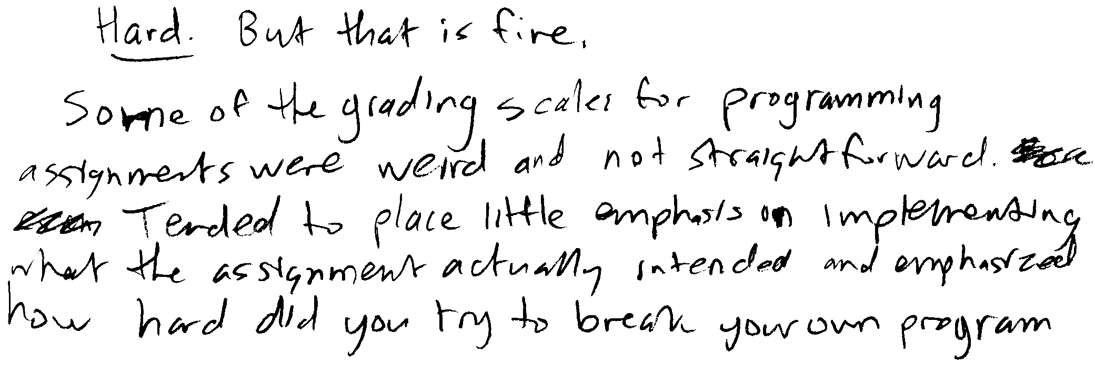
Dr. Jeffay’s Experience
(“Hard But that is fine.
Some of the grading scales for programming
assignments were weird and not straightforward.
Tended to place little emphasis on implementing
what the assignment actually intended and emphasized
how hard did you try to break your own program”)
Programs that “mostly work” don’t cut it in a senior-level course!
Notes:
Documentation: More is NOT necessarily better!
Make sure you put your name on your program!

Slide 18
Honor Code: Acceptable and Unacceptable Collaboration
Working in teams on programming assignments is OK
  But you can only collaborate with other students in the course
  Every line of code handed in must be written exclusively by team members themselves, and
  All collaborators must be acknowledged in writing (and part of the team)
Use of the Internet
  Using code from the Internet in any form is not allowed
  Websites may be consulted for reference (e.g., to learn how a system call works)
  But all such websites used or relied on must be listed as a reference in a header comment in your program
  Warning: Sample code found on the Internet rarely helps the student

