Slide 1
Data Storage and
I/O Scheduling
Don Porter
Portions courtesy Emmett Witchel and Montek Singh

Slide 2
Today’s Lecture
How do computers store and access bits?
Review current and emerging storage technologies
  Hard Disk Drives (HDDs)
  Solid State Drives (SSDs, aka flash)
Reasoning about volatility vs. persistence
Key trade-offs
How to optimize I/O performance
Practical miscellany
Emerging media

Slide 3
OS’s view of a storage device
Simple array of sectors
  Sectors are usually 512 or 4k bytes
  Also called Logical Block Addresses (LBAs)
    Captures virtual address space that device exports to OS
OS can issue reads/writes to disk as small as one sector/LBA
Depending on how data is placed on device, can also aggregate into larger requests
  One contiguous LBA range and operation (read/write) per IO request

Slide 4
Storing Bits in a Computer
We are used to the idea of just defining variables, reading, writing, etc.
But internally, how does one actually store data?
  How is data stored in real life, before computers?

Slide 5

Discretizing Physical Phenomena
Key idea: Measure and manipulate some property of a physical medium
Silly example: I can store a bit in a bucket of water
  Empty == 0
  Full == 1
  Read: measure water with sensor
  Write: dump or refill with actuator(s)
Any concerns?
  What if the bucket has a few drops?
  What if the bucket has a slow leak?
“Discretize” == round measurement of a continuous quantity (volume) to a discrete value (bit)
https://openclipart.org/detail/325616/bucket

Slide 6
Lessons from the bit bucket
Rarely perfectly full or empty
  Rather, need to tolerate some imprecision
  Better bit bucket encoder:
    <1/4 full == 0
    >3/4 full == 1
    1/4---3/4 == error
Damage to the media can flip bits
  A leaky bucket can shift its value over time
  Or just evaporation over long enough…

Slide 7
What if I want to store more bits?
Could use more buckets
  Need more space (or smaller buckets)
    Impact of smaller size on precision? Cost?
Could take finer measurements
    <1/4 full == 00
    1/4---1/2 == 01
    1/2---3/4 == 10
    >3/4 full == 11
  Impact on cost? Risk of error?
  Key strategies: Replicate or Increase Precision

Slide 8
What about write speed?
What can I do to make writes faster? Downsides?
  Smaller buckets -> more precise reads
  More hoses/valves can fill more buckets -> more cost
Splitting the difference:
  Expensive filling mechanism attached to a drone that relocates over correct bucket:
    Save money, increase latency

Slide 9
Key design questions:
What is the physical phenomenon?
How robust is the physical phenomenon to environmental damage, or passage of time?
How to scale capacity, vs cost?
Other engineering constraints or performance anomalies?

Slide 10
Key design questions: Bit bucket
What is the physical phenomenon?
  Water volume
How robust is the physical phenomenon to environmental damage, or passage of time?
  Not terribly robust to physical shock (not good for an apple watch), water evaporates over enough time (prob months)
How to scale capacity, vs cost?
  More buckets or finer measurements
Other engineering constraints or performance anomalies?
  “Drone solution” introduces delays, but cheaper than per-bucket instrumentation

Slide 11
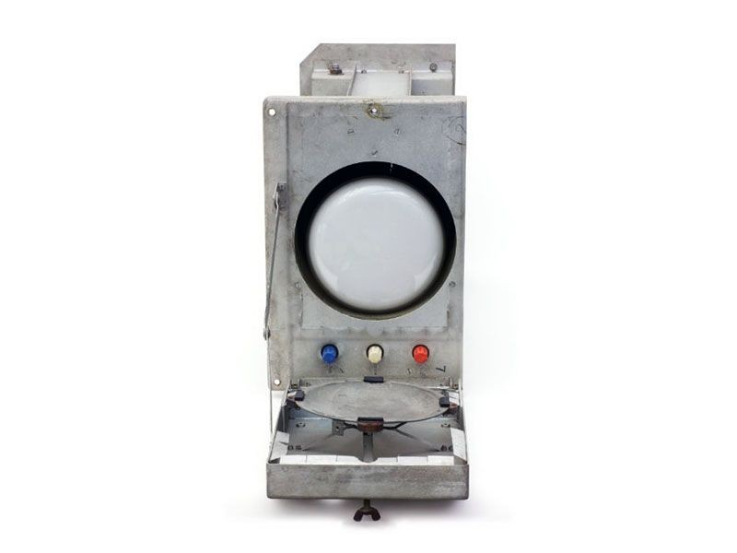
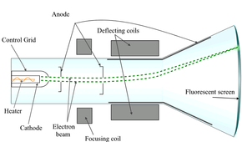
1947: First Fully Electronic Memory
Williams-Kilburn Tube
Media: a Cathode Ray Tube (CRT)
  Same as old TVs
CRTs work by shooting electron
beam at phosphorescent screen
  Pixel “glows” for a fraction of
  second
  Encode one bit per pixel on/off
Computer “read” charge level on
screen with metal pickup plate
  Rewrites signal periodically,
  Called refresh
Top: Computer
History Museum
Bottom: Wikipedia
  Many media require periodic data refresh

Slide 12
Williams-Kilburn Tube Lessons
Write speed limited by how fast glow fades
Precision: Glow has imperfect fading rate
  Mitigated by writing to nearby, unmeasured space on screen to pull charge out of an “off” pixel
  Trades capacity for lower latency
Physical resilience: sensitive to other magnetic fields
  Required constant recalibration in practice
Refreshing values uses power, increases cost
  But again, a common strategy
    Non-thrifty fix for leaky bucket: periodically measure and top off

Slide 13
Key design questions: Williams-Kilburn
What is the physical phenomenon?
  Phosphoresence in a cathode-ray tube
How robust is the physical phenomenon to environmental damage, or passage of time?
  Sensitive to other magnetic fields
  Holds data for fraction of second before refresh
How to scale capacity, vs cost?
  Bigger screen or more screens; limited by speed of electron beam
Other engineering constraints or performance anomalies?
  Can trade some space for higher write speed

Slide 14
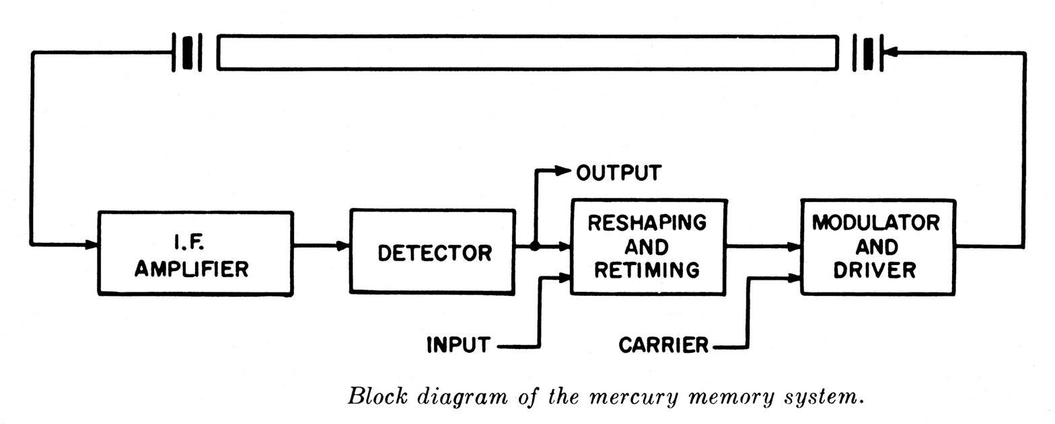
1949: Delay-line memory
Encode data in a looped waveform/signal
  Media varies: sound through a mercury tube used first
    High speed of sound in mercury, plus similar acoustic impedance to quartz crystals
    Audible “hum” from some devices
Image Source: wikipedia

Slide 15
Delay-line memory
Bits encoded using waveform + time
  Sequential access (not random)
    Must wait for wave to circle around to desired bit
  Capacity determined by number of tubes x length of tube
    Longer tubes increase access time (and, to a lesser degree, cost)
    More tubes increase cost
Volatile memory: Bits lost once powered off
Lots of engineering effort to deal with environmental variation (e.g., temperature, clock variations)
  Mercury later replaced with magnetism, quartz, and electric delay lines for faster, lower variance
  Not used today; I believe largely because of clock variance

Slide 16
Historical Shout-Out
Delay-lines were originally used in radar applications
  Delay-line memory invented by Presper Eckert, who worked first in radar, then computers
  Patented in 1947 by Eckert and John Mauchly
  Used in 2nd real computer: EDSAC
    16 delay lines, 560 bits each
Today, ACM/IEEE award for major contributions to the field of computer architecture is named for them: the Eckert-Mauchly award
  Given in 1983 to Kilburn
  And in 2004 to our own Fred Brooks

Slide 17
Key design questions: Delay-line memory
What is the physical phenomenon?
  Sound wave in mercury
How robust is the physical phenomenon to environmental damage, or passage of time?
  Susceptible to acoustic interference, requires constant refreshing
How to scale capacity, vs cost?
  More tubes or longer tubes
Other engineering constraints or performance anomalies?
  Clock variance is a bummer, sequential access within a tube

Slide 18
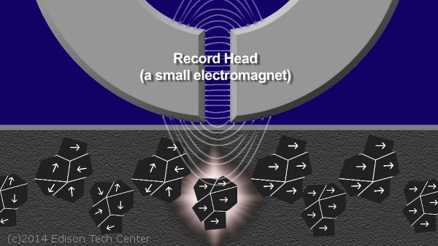
Next Big Idea: Magnetic Recording
A powerful electromagnet can change the polarity of some materials, such as iron oxide
Media can hold polarity arrangement for decades
    All materials eventually succumb to entropy
    Refresh data every 50 years, rather than every .5 seconds!!

Slide 19
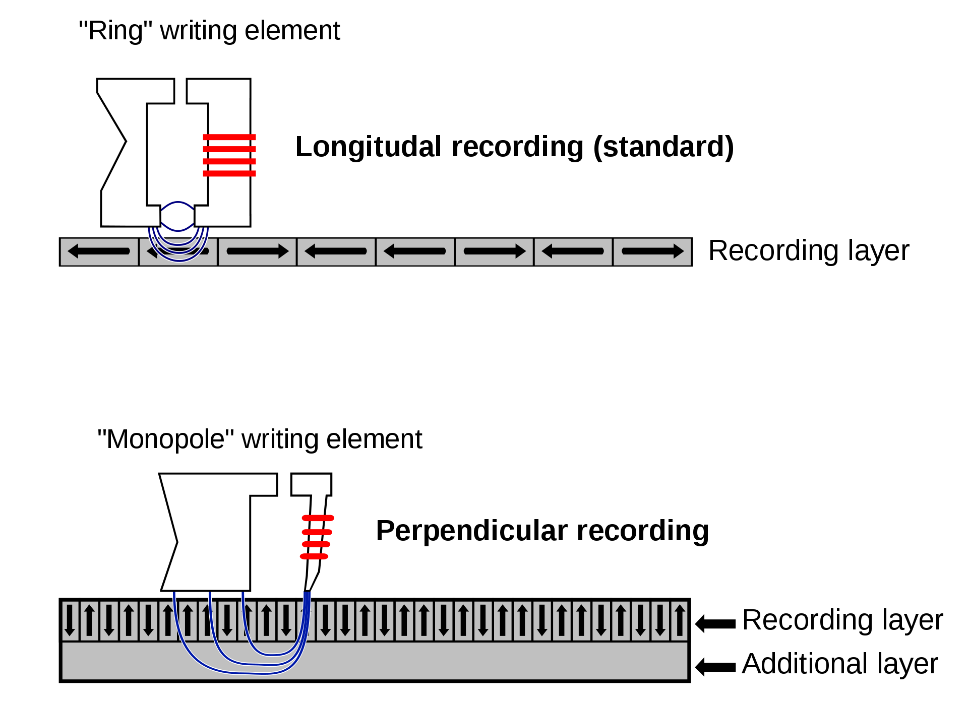
Another illustration, from wikipedia

Slide 20
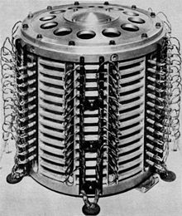
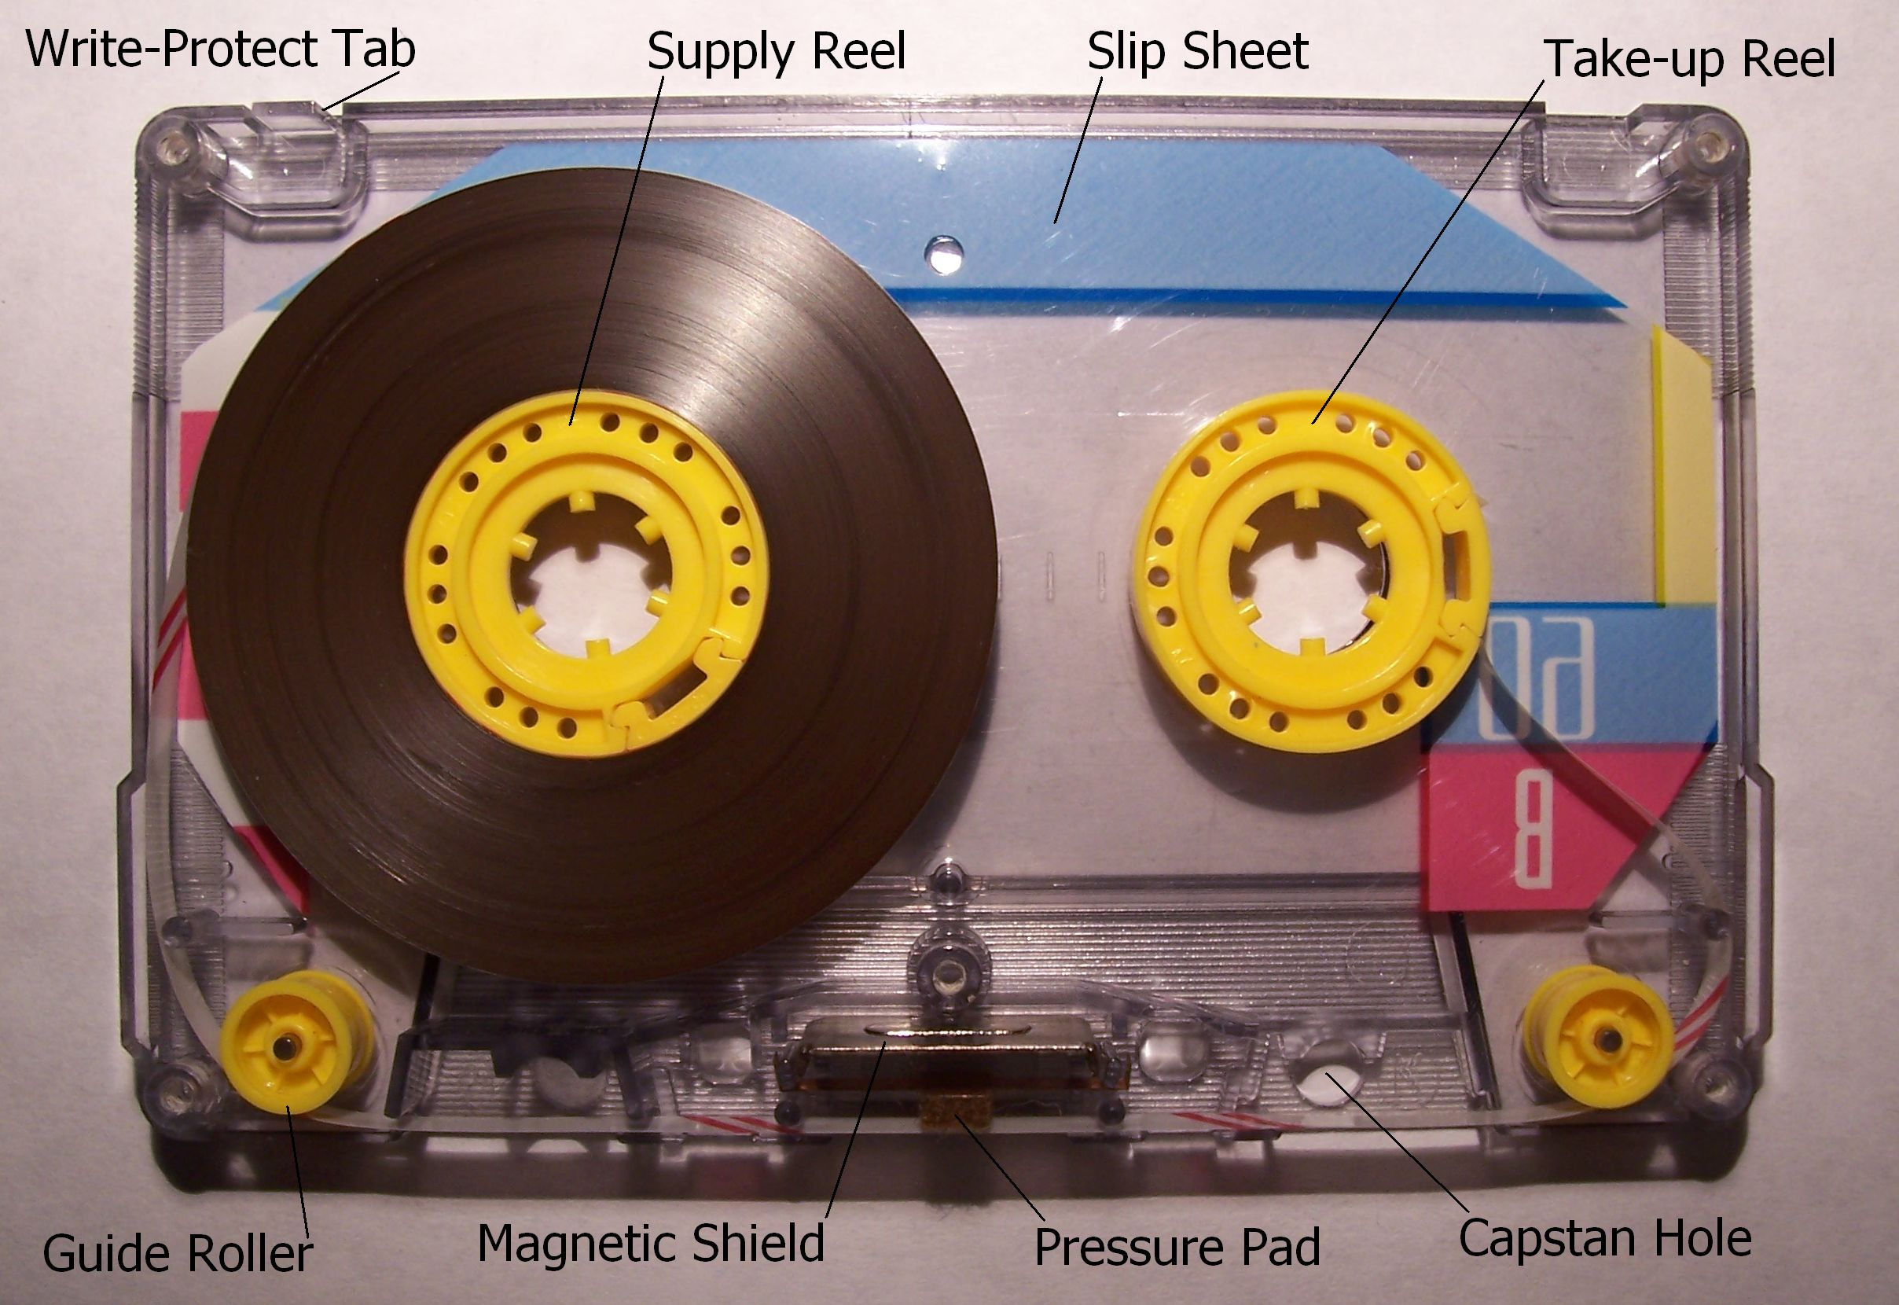
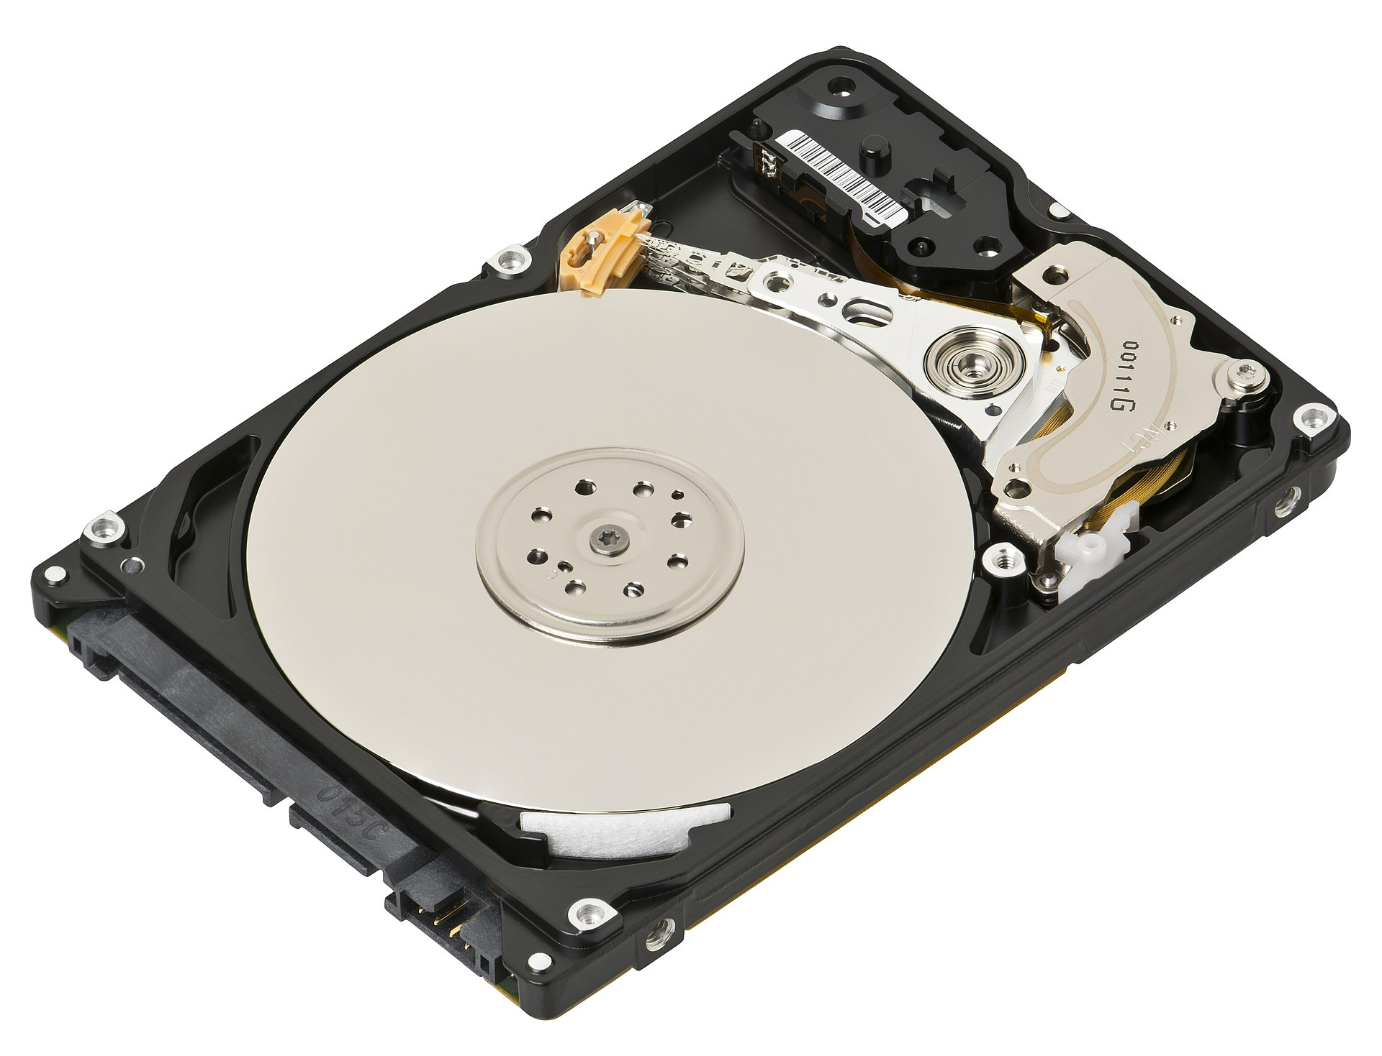
Magnetic Recording over time
Cassette tape
From wikipedia
Drum memory, 1932-60s
From wikipedia
Hard disk
From wikipedia
  Many, many variants over time

Slide 21
More on magnetic recording
A ton of engineering to increase precision (and capacity)
  Major cost in the encoding head that does encoding/decoding
  Most designs have a small number of heads and move media under the head (e.g., spooling tape under the head)
Magnetic recording is susceptible to being “erased” by adjacent magnetic fields
  Engineered to resist weaker magnetic fields
  Magnetic data loss typically requires a powerful magnet

Slide 22
A simple disk model
Disks are slow. Why?
  Moving parts << circuits
Programming interface: simple array of sectors Physical layout:
  Concentric circular “tracks” of sectors on a platter
  E.g., sectors 0-9 on innermost track, 10-19 on next track, etc.
  Disk arm moves between tracks
  Platter rotates under disk head to align w/ requested sector

Slide 23
Disk Model
Disk
Head
1
0
2
7
Disk spins at a constant speed.
Sectors rotate underneath head.
3
6
4
5
Disk Head reads at granularity of entire sector

Slide 24
Disk Model
Concentric tracks
9
8
21
Disk
Head
10
1
0
20
11
2
7
19
12
3
6
18
13
4
5
17
14
15
16
Disk head seeks to different tracks
Gap between 7 and 8 accounts for seek time

Slide 25
Many Tracks
Disk
Head

Slide 26
Several (~4) Platters
Platters spin together at same speed
Each platter has a head; All heads seek together

Slide 27
Implications of multiple platters
Blocks actually striped across platters
Also, both sides of a platter can store data
  Called a surface
  Need a head on top and bottom
Example:
  Sector 0 on platter 0 (top)
  Sector 1 on platter 0 (bottom, same position)
  Sector 2 on platter 1 at same position, top,
  Sector 3 on platter 1, at same position, bottom
  Etc.
  8 heads can read all 8 sectors simultaneously

Slide 28
Real Example
Seagate 73.4 GB Fibre Channel Ultra 160 SCSI disk
Specs:
  12 Platters
  24 Heads
  Variable # of sectors/track
  10,000 RPM
    Average latency: 2.99 ms
  Seek times
    Track-to-track: 0.6/0.9 ms
    Average: 5.6/6.2 ms
    Includes acceleration and settle time.
  160-200 MB/s peak
  transfer rate
    1-8K cache
  12 Arms
  14,100 Tracks
  512 bytes/sector
Notes:
Example: Seagate 73.4 GB Fibre Channel Ultra 160 SCSI disk.
Approximately 53 MB/dollar, or $0.019/MB ($1,389 total).
Size: 1.6×4×5.75 inches.
— 24 heads (in 1.5 inches!). Two heads per arm, with one arm on the top and bottom of the stack.
— 14,100 tracks/cylinders — in less than 2 inches!
— 5.6 ms average seek time for a read, 6.2 ms for a write.
— Variable number of sectors/track (required to keep distance/bit constant). There are an average of (in the middle of the disk):
— 424 sectors/track, 217K bytes/track.
— 10,168 sectors/cylinder, 5.2 MB/cylinder.
— 143,374,739 sectors total on disk.
— 10,000 RPM, average rotational latency of 2.99 ms.
166.67 revolutions/s, 1 revolution every 6 ms.
— 160-200 MB/s peak transfer rate.

Slide 29
Disks: Technology Trends
Disks are getting denser
  More bits/square inch → small disks with large capacities
Disks are getting cheaper
  Well, in $/byte – a single disk has cost at least $50-100 for 20 years
  2x/year since 1991
Disks are getting faster
  Seek time, rotation latency: 5-10%/year (2-3x per decade)
  Bandwidth: 20-30%/year (~10x per decade)
  This trend is really flattening out on commodity devices; more apparent on high-end
Increasingly esoteric constraints to increase density
  Shingled Magnetic Recording, Interlaced Magnetic Recording, Heat-Assisted Magnetic Recording, etc.
  Overall: Capacity improving much faster than perf.
Notes:
START HERE 22

Slide 30
Key design questions: Magnetic Hard Disks
What is the physical phenomenon?
  Magnetic polarity
How robust is the physical phenomenon to environmental damage, or passage of time?
  Susceptible to strong magnetic interference
  Sensitive to physical disturbance (e.g., dropping or shaking it)
  Data lasts for decades without a refresh
How to scale capacity, vs cost?
  More surfaces
  More precision encoding (smaller surface area)
    Heads not independent (too costly)
Other engineering constraints or performance anomalies?
  Latency for head movement

Slide 31
Dynamic RAM (DRAM)
Encode data as charge in capacitors
  “high charge” == 1, “low charge” == 0
Reading the charge also discharges it, requiring a read to re-write the data
  Charge leaks out after 1-10 seconds – not persistent
  Thus, requires periodic refresh
Circuits relatively cheap to replicate at scale
  Relatively uniform access times across cells (no “drone”)
  Power seems to be bottleneck to capacity

Slide 32
Attacks on DRAM (1)
Cold boot attack: Dump a computer’s RAM contents
  Without administrator account on OS
  Requires physical possession of the computer
Recall: Data retention a function of temperature
  Longer when colder
Literally put a laptop in the freezer
  Leverage seconds of retention while unplugged to quickly take out DRAM and plug into another computer

Slide 33
Attacks on DRAM (2)
Rowhammering: Flip bits in memory you don’t have access to
  E.g., in the kernel or another process’s address space
Observation: Frequent charge/discharge cycles can cause disturb charge in adjacent cells
Idea: Repeatedly read your own memory
  Flip bits in adjacent cells
Leverage this to gain privilege

Slide 34
Key design questions: DRAM
What is the physical phenomenon?
  Charge in a capacitor
How robust is the physical phenomenon to environmental damage, or passage of time?
  Susceptible to electrical disturbance
  Data lasts for a few seconds
How to scale capacity, vs cost?
  Replicate circuits
Other engineering constraints or performance anomalies?
  Some performance variance from multiplexing

Slide 35
Flash Memory (aka EEPROM)
A capacitor that holds its charge longer than DRAM
  ~10 yrs fully unplugged
Low-level physics is complex, based on quantum effects, I’ll give intuition

Slide 36
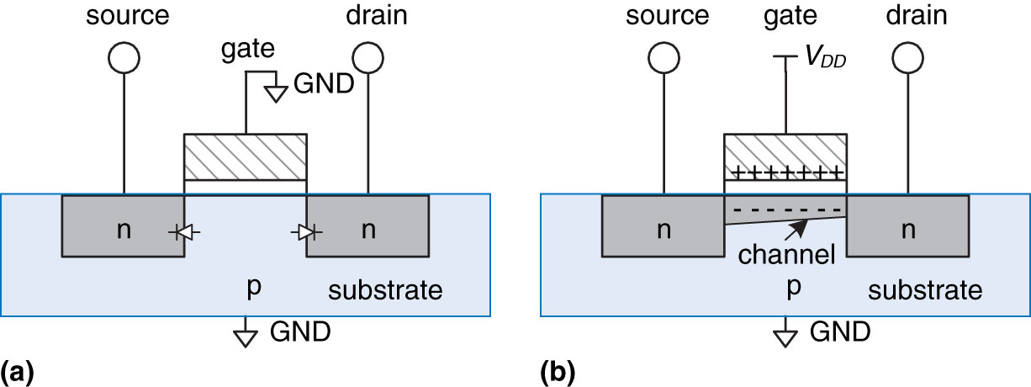
nMOS Transistors (stolen from COMP 411)
Gate = 0
  OFF = disconnect
    no current flows between source & drain
Gate = 1
  ON= connect
    current can flow between source & drain
    positive gate voltage draws in electrons to form a channel
nMOS transistor operation (from Harris and Harris)

Slide 37
nMOS Transistor -> Flash
Surrounded by insulator, holds charge longer
Disconnected “bonus” gate
Source
Control
Gate
Drain
Floating
Gate
Insulator

Slide 38
Manipulating Flash
Moving electrons in/out of floating gate
Causes quantum tunneling across insulator
Source
Control
Gate
Drain
Floating
Gate
Insulator
Channel
Current differential here

Slide 39
Reading Flash
Charge here
Source
Control
Gate
Drain
Floating
Gate
Insulator
Affects current here

Slide 40
Flash details
Like DRAM, cheap enough to replicate (nearly) everything – no expensive sensor to move around
Program/erase via high current on control gate
  No charge == 1
  Program (add electrons to floating gate) to convert to a 0
  Erase (remove electrons from flt gate) to pull back to a 1
Sense charge level via current measurement of control gate

Slide 41
Flash Performance Caveat
Erasing 7x slower than programming
Trick: Hide erase cost by adding more cells than advertised
  E.g., an 800 GB SSD may actually have 1 TB of cells
For engineering reasons, write in KB blocks,
  Erase in MB erase blocks
Add a ”page table” to redirect writes for a logical block address (LBA) to a new location on each write
  Called a Flash Translation Layer (FTL)

Slide 42
The FTL and SSD firmware
The FTL is firmware (really software) that runs inside an SSD
An SSD is really a small embedded computer
  Often with a few ARM cores and 100s MB of DRAM
  Runs software to implement the translation table
  And manage actual reads/writes of flash cells
In the background, FTL erases blocks
  Try to go for mostly stale contents, then recycle space
  If some live data in erase block, must first copy elsewhere
  No longer a simple machine to reason about…

Slide 43
The TRIM command
Indicates to the device a logical block (sector) is free
  So FTL can avoid copying junk contents when erasing block
  Abstraction introduced for flash (useful elsewhere)
As opposed to leaving junk in place until overwrite
  Harmless on disks, adds overhead on flash
TRIM issued by file system to device (more soon…)

Slide 44
Scaling Flash
Replication is one common strategy
  New technology: 3D stacked flash
Another is increasing precision
  Rather than just measuring charged, not charged, measure charge more finely
  And charge more carefully
  This is Single Level Cell (1 bit/cell)
    vs. Multi-Level Cell (2 bits) vs TLC (3 bits/cell) vs QLC (4 bits/cell) vs PLC (5 bits/cell)
  Trade write speed (and endurance) for capacity
Same capacity in SLC will be faster, last longer, (and cost more) than in MLC…PLC

Slide 45
Flash Endurance Caveats
Over time, a cell wears out
  Sending electrons across the insulator damages the insulator
  Around 10,000 program/erase cycles, but varies
    Reduced by higher precision encoding
    Repeatedly adding electrons hastens wear
Over time, electrons get stuck in the floating gate
  Becomes more difficult to erase
  And causes skew (bit flips) in higher precision encodings

Slide 46
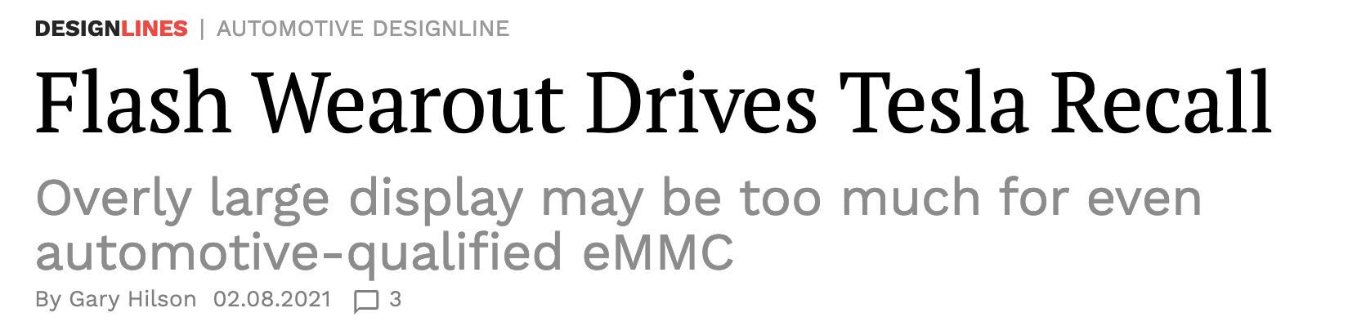
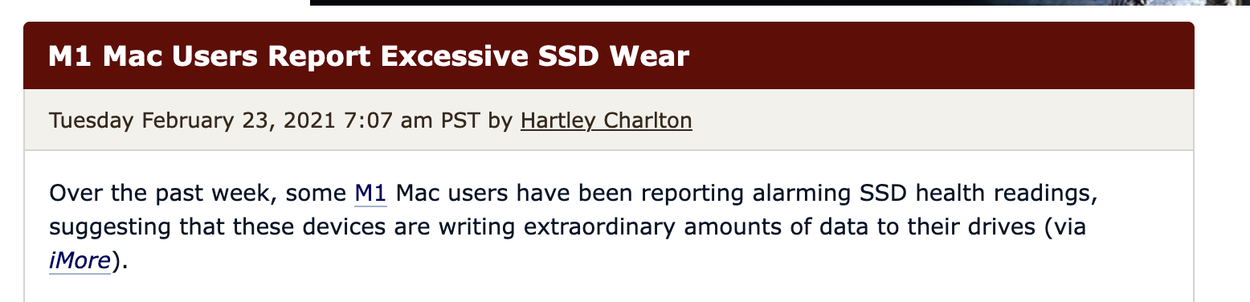
Flash Wearout: A Real Thing

Slide 47
Key design questions: Flash
What is the physical phenomenon?
  Charge in a floating gate
How robust is the physical phenomenon to environmental damage, or passage of time?
  Limited writes, but high tolerance for physical damage
  Data lasts for about 10 years
How to scale capacity, vs cost?
  Replicate circuits and increase precision
Other engineering constraints or performance anomalies?
  Large erase blocks -> Copying/erasing in FTL

Slide 48
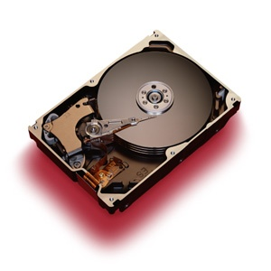

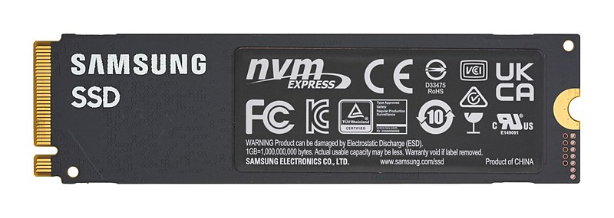
Big picture: Cost/Speed vs Size
In 2023:
  Cost: Max Capacity Sold in one dev
  DRAM: $1.94 / GB 32 GB
  SSD: $0.03/GB 16 TB
  HDD: $0.02/GB 22 TB
Note: Cost picked based on first non-sponsored hit on newegg.com (i.e., random sample), capacity based on maximum available

Slide 49
Today’s Lecture
How do computers store and access bits?
Review current and emerging storage technologies
  Hard Disk Drives (HDDs)
  Solid State Drives (SSDs, aka flash)
Reasoning about volatility vs. persistence
Key trade-offs
How to optimize I/O performance
Practical miscellany
Emerging media

Slide 50
How to Optimize Storage Performance?
Two key techniques:
  Large IOs and locality on device
  I/O scheduling

Slide 51
OS’s view of a storage device
Simple array of sectors
  Sectors are usually 512 or 4k bytes
  Also called Logical Block Addresses (LBAs)
    Captures virtual address space that device exports to OS
OS can issue reads/writes to disk as small as one sector
Depending on how data is placed on device, can also aggregate into larger requests
  One contiguous LBA range and operation (read/write) per IO request

Slide 52
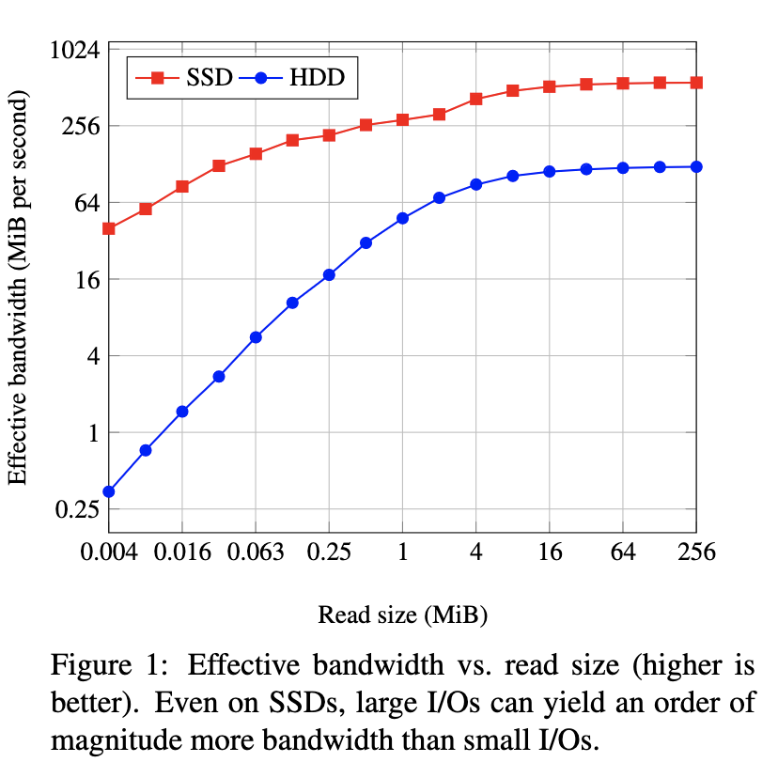
The Case for Larger I/Os
From Conway et al, “Filesystems Fated for Senescence?…”FAST ‘17

Slide 53
Large IOs
Regardless of device or internals,
  Fewer, big IO requests >> more small ones
How to ensure large requests?
  Heavily affected by placement on device by file system
    (a topic for next lecture)
  Or hold requests in memory for a bit, to see if they can be combined
    Very common optimization to delay writes for a few seconds

Slide 54
The Disk Scheduling Problem: Background
Goals: Maximize disk throughput
  Bound latency
Between file system and disk, you have a queue of pending requests:
  Read or write a contiguous logical block address (LBA) range
You can reorder these as you like to improve throughput
What reordering heuristic to use? If any?
Heuristic is called the IO Scheduler
  Or “Disk Scheduler” or “Disk Head Scheduler”

Slide 55
Let’s Start with Hard Disks
Latency of a given operation is a function of current disk arm and platter position
Each request changes these values
Idea: build a model of the disk
  Maybe use delay values from measurement or manuals
  Use simple math to evaluate latency of each pending request
  Greedy algorithm: always select lowest latency

Slide 56
3 Key HDD Latencies
I/O delay: time it takes to read/write a sector
Rotational delay: time the disk head waits for the platter to rotate desired sector under it
  Note: disk rotates continuously at constant speed
Seek delay: time the disk arm takes to move to a different track
Notes:
START HERE 2020

Slide 57
Example formula
s = seek latency, in time/track
r = rotational latency, in time/sector
i = I/O latency, in seconds
Time = (Δtracks * s) + (Δsectors * r) + I
Note: Δsectors must factor in position after seek is finished. Why?
Example read time:
seek time + latency + transfer time
(5.6 ms + 2.99 ms + 0.014 ms)
  Evaluation: how many tracks head moves across

Slide 58
Practical Simplification
Most hard disks don’t export low-level geometry
  But LBA layout (mostly) sequential on disk
In practice, use LBA distance as proxy for track distance
  I.e., we may not know exactly how many tracks an IO request crosses in practice, but we can assume bigger gaps in LBA space correspond to more tracks to cross

Slide 59
I/O Scheduling Algorithm 1: FCFS
Assume a queue of requests exists to read/write tracks:
  and the head is on track 65
83
72
14
147
16
150
… Incoming reqs
Next req
0
25
50
65
75
100
125
150
  FCFS: Moves head 550 tracks
Notes:
Explain what the figure is attempting to represent!
— A slice of the disk from the spindle to the outer edge.
How to schedule the requests?
— Start with something simple: No scheduling (i.e., FCFS).
FCFS results in the head moving 550 tracks.
— Can we do better?
Clearly some sort of greedy algorithm would/should do better...

Slide 60
I/O Scheduling Algorithm 2: SSTF
Greedy scheduling: shortest seek time first
  Rearrange queue from:
  To:
83
72
14
147
16
150
14
16
150
147
82
72
0
25
50
75
100
125
150
SSTF scheduling results in the head moving 221 tracks
  Can we do better?
  SSTF: 221 tracks (vs 550 for FCFS)
Notes:
What’s the algorithm here?
— The idea is not that we arrange the queue per se, but rather that as new requests arrive they are inserted into the queue in SSTF order.
— So while the request for track 65 is being serviced, the 6 requests arrive. The order in which they arrive does not matter. The queue is the same.
— Note that when the head is at track 82, track 147 is 65 tracks away while track 16 is 66 tracks away.
SSTF results in the head moving 221 tracks.
— Can we do better?

Slide 61
Other problems with greedy?
“Far” requests will starve
  Assuming you reorder every time a new request arrives
Disk head may just hover around the “middle” tracks

Slide 62
I/O Scheduling Algorithm 3: SCAN
Move the head in one direction until all requests have been serviced, and then reverse.
Also called Elevator Scheduling
Rearrange queue from:
To:
83
72
14
147
16
150
72
150
147
83
14
16
150
147
72
14
16
83
0
25
50
75
100
125
150
  SCAN: 187 tracks (vs. 221 for SSTF)
Notes:
SCAN results in the head moving 187 tracks.
It is important to note that there is no practical algorithm for this problem.
— SCAN is optimal for these requests but it is not an optimal algorithm.
We can certainly find the optimal solution given any queue of requests by simulating the effect of all possible orderings of the queue and then choosing that which results in the least head movement.
— However, for a queue with n entries this will require n! work.
This problem is an NP-complete problem. It reduces to the travelling salesman problem. From a practical standpoint, NP-complete here means that we can’t do any better (in finding an optimal scheduling algorithm) than the brute force search outlined above.
— Thus in practice, disk head scheduling algorithms rely on hueristics that have been shown to work well in practice.

Slide 63
I/O Scheduling Algorithm 4: C-SCAN
Circular SCAN: Move the head in one direction until an edge of the disk is reached, and then reset to the opposite edge
0
25
50
75
100
125
150
Marginally better fairness than SCAN
  C-SCAN: 265 tracks (vs. 221 for SSTF, 187 for SCAN)
Notes:
In C-SCAN blocks are only ever read while the head moves in 1 direction. (Either the left or the right, but only one of these.)
C-SCAN performance:
— 65 + 150 + (150 – 72) = 293 tracks are traversed if the head was originally moving left, or
— (150 – 65) + (150 – 14) = 221 tracks (same as SSTF) if the head was moving right.
LOOK performance:
— If the head moving left: 293 – 14 = 279 tracks.
— Same as SCAN if the head is moving right and track 150 is the outermost track (so that C-SCAN stops at track 150).
These algorithms perform poorly for this queue of requests but:
1. These requests are only in the middle of some larger stream.
2. In reality, a seek all the way across the disk is cheaper than our measuring scheme here indicates. (I.e., measuring performance by total number of tracks traversed is not perfect.)

Slide 64
Scheduling Checkpoint
SCAN seems most efficient for these examples
  C-SCAN offers better fairness at marginal cost
  Your mileage may vary (i.e., workload dependent)
File systems would be wise to place related data ”near” each other
  Files in the same directory
  Blocks of the same file
You will explore the practical implications of this model in Lab 5!

Slide 65
So what about IO scheduling for SSDs?
Elevator scheduler is pointless on an SSD
  LBA locality across requests irrelevant
  Larger requests do help
SSDs often use a no-op scheduler in practice
  Or simply delay IO requests to combine
Possible room for improvement in future
  Devices themselves still evolving rapidly

Slide 66
Today’s Lecture
How do computers store and access bits?
Review current and emerging storage technologies
  Hard Disk Drives (HDDs)
  Solid State Drives (SSDs, aka flash)
Reasoning about volatility vs. persistence
Key trade-offs
How to optimize I/O performance
Practical miscellany
Emerging media

Slide 67
Disk Partitioning
Multiple file systems can share a disk: Partition space
Disks are typically partitioned to minimize the maximum seek time
  A partition is a collection of cylinders
  Each partition is a logically separate disk
Partition A
Partition B
Notes:
START HERE 18
If seek distances can be minimized then overall performance will improve and the importance of the disk-head scheduling algorithm will be lessened.
— The shorter the average seek distance then the more each disk head scheduling algorithm approximates each other (and FCFS).
Other factors arguing for disk partitions are the fact that frequently OS software components (like backup utilities) do not keep pace with improvements in storage densities.
These utilities often assume a maximum disk size that is smaller than current disk sizes.
— Thus disks need to appear smaller than they really are.
The number of disk partitions per disk is usually small (1-3).

Slide 68
Parallel performance with disks
Idea: Use more of them working together
  Just like with multiple cores
Redundant Array of Inexpensive Disks (RAID)
  Intuition: Spread logical blocks across multiple devices
  Ex: Read 4 LBAs from 4 different disks in parallel
Does this help throughput or latency?
  Definitely throughput, can construct scenarios where one request waits on fewer other requests (latency)
It can also protect data from a disk failure
  Transparently write one logical block to 1+ devices

Slide 69
Disk Striping: RAID-0
Blocks broken into sub-blocks that are stored on separate disks
  similar to memory interleaving
Provides for higher disk bandwidth through a larger effective block size
1
2
3
OS disk
block
8 9 10 11
12 13 14 15
0 1 2 3
8 9 10 11
12 13 14 15
0 1 2 3
Physical disk blocks
Notes:
Throughput is increased through a larger effective block size and through the ability to perform parallel I/O.
— The larger block size will have the same transfer time as the smaller block size.
— Rotational latency will be determined by the disk with the largest latency (a random variable).
This example shows the contents of a disk block as viewed by the OS and as laid out on the disks.
— The OS views this as one disk block when it reality it is three blocks spread out over three disks.
— The three disk blocks have the same address on each disk.
If the rotation of the disks can be synchronized so that all have the same rotational latency for any read/write operation then we have what is known as RAID.
— The fastest form of disk striping.

Slide 70
RAID 1: Mirroring
To increase the reliability of the disk, redundancy must be introduced
  Simple scheme: disk mirroring (RAID-1)
  Write to both disks, read from either.
x
x
0 1 1 0 0
1 1 1 0 1
0 1 0 1 1
Primary
disk
0 1 1 0 0
1 1 1 0 1
0 1 0 1 1
Mirror
disk
  Can lose one disk without losing data
Notes:
Having spare sectors on a disk means that you can “fill in a hole” on the disk when a block goes bad.
— However, the data stored in the bad block is still lost.
To improve reliability of disk sub-system, redundancy is introduced.
— This is a fundamental result. There is no other way to do this.
Simple scheme: mirroring or keeping a copy of the data.
— Each block on the mirror disk is a “mirror image” of the corresponding block on the original disk.
— Works well but is expensive (100% overhead).
— Some performance gains as well. Reads are sped up by a factor of 2 since block requests can be interleaved between the two disks.
(No speedup for writes.)

Slide 71
RAID 5: Performance and Redundancy
Idea: Sacrifice one disk to store the parity bits of other disks (e.g., xor-ed together)
Still get parallelism
Can recover from failure of any one disk
Cost: Extra writes to update parity
Disk 1
Disk 2
Disk 3
Disk 4
Disk 5
x
x
x
x
x
1 1 1 1
1 1 1 1
0 0 0 0
0 0 0 0
1 1 1 1
0 0 0 0
0 0 1 1
0 0 1 1
0 0 1 1
0 1 0 1
0 1 0 1
0 1 0 1
1 0 0 1
0 1 1 0
0 1 1 0
Block
x
8
9
10
11
12
13
14
15
0
1
2
3
Block
x
Parity
Notes:
Now we explain the concept of interleaved parity striping.
— Using block striping as in RAID-5 as an example.
Parity is still computed on a bit-by-bit basis as before.
— However the contents of data blocks changes. Each disk block is a coherent data block in RAID-5.
Overhead (in terms of storage space) is more tunable than in RAID-3.
— We can chose the number of blocks to protect with parity. (The effective block size can be arbitrary.)

Slide 72
RAID 5: Interleaved Parity
Disk 1
Disk 2
Disk 3
Disk 4
Disk 5
x
x
x
x
x
1 1 1 1
1 1 1 1
0 0 0 0
0 0 0 0
1 1 1 1
0 0 0 0
0 0 1 1
0 0 1 1
0 0 1 1
0 1 0 1
0 1 0 1
0 1 0 1
1 0 0 1
0 1 1 0
0 1 1 0
Block
x
8
9
10
11
12
13
14
15
0
1
2
3
Block
x
Parity
1 1 1 1
1 1 1 1
0 0 0 0
0 0 0 0
1 1 1 1
0 0 0 0
0 0 1 1
0 0 1 1
0 0 1 1
0 1 0 1
0 1 0 1
0 1 0 1
1 0 0 1
0 1 1 0
0 1 1 0
Block
x+1
Block
x+1
Parity
a
b
c
d
e
f
g
h
i
j
k
l
1 1 1 1
1 1 1 1
0 0 0 0
0 0 0 0
1 1 1 1
0 0 0 0
0 0 1 1
0 0 1 1
0 0 1 1
0 1 0 1
0 1 0 1
0 1 0 1
1 0 0 1
0 1 1 0
0 1 1 0
Block
x+2
m
n
o
Block
x+2
Parity
p
q
r
s
t
u
v
w
x
1 1 1 1
1 1 1 1
0 0 0 0
0 0 0 0
1 1 1 1
0 0 0 0
0 0 1 1
0 0 1 1
0 0 1 1
0 1 0 1
0 1 0 1
0 1 0 1
1 0 0 1
0 1 1 0
0 1 1 0
Block
x+3
y
z
aa
bb
cc
dd
Block
x+3
Parity
ee
ff
gg
hh
ii
jj
Notes:
In RAID-5 parity blocks are interleaved across disks to avoid having the parity disk become the bottleneck in the case of multiple simultaneous reads/writes.
— In this example, every 5th block on each disk is a parity block.
Bit-wise striping of the disks (RAID-3):
— When you write you have to read 8+1 blocks and then write 8+1 blocks. (Parity disk not the bottleneck.)
Block-wise striping of the disks (RAID-5):
— When you write, you write the destination block, read the parity block to re-compute/update the parity block, and then write the parity block.
— These are sequential steps, (sub-block write, parity block read, parity block write) hence the parity disk can become the bottleneck.

Slide 73
Other RAID variations
Variations on encoding schemes, different trades for failures and performance
  See wikipedia
  But 0, 1, 5 are the most popular by far
More general area of erasure coding:
  Store k logical blocks (message) in n physical blocks (k < n)
  In an optimal erasure code, recover from any k/n blocks
  Xor parity is a (k, k+1) erasure code
  Gaining popularity at data center granularity

Slide 74
Where is RAID implemented?
Hardware (i.e., a chip that looks to OS like 1 disk)
  +Tend to be reliable (hardware implementers test)
  +Offload parity computation from CPU
    Hardware is a bit faster for rewrite intensive workloads
  -Dependent on card for recovery (replacements?)
  -Must buy card (for the PCI bus)
  -Serial reconstruction of lost disk
Software (i.e., a “fake” disk driver)
  -Software has bugs
  -Ties up CPU to compute parity
  +Other OS instances might be able to recover
  +No additional cost
  +Parallel reconstruction of lost disk
  Most PCs have “fake” HW RAID: All work in driver
Notes:
Having spare sectors on a disk means that you can “fill in a hole” on the disk when a block goes bad.
— However, the data stored in the bad block is still lost.
To improve reliability of disk sub-system, redundancy is introduced.
— This is a fundamental result. There is no other way to do this.
Simple scheme: mirroring or keeping a copy of the data.
— Each block on the mirror disk is a “mirror image” of the corresponding block on the original disk.
— Works well but is expensive (100% overhead).
— Some performance gains as well. Reads are sped up by a factor of 2 since block requests can be interleaved between the two disks.
(No speedup for writes.)

Slide 75
Word to the wise
RAID is a good idea for protecting data
  Can safely lose 1+ disks (depending on configuration)
But there is another weak link: The power supply
  I have personally had a power supply go bad and fry 2/4 disks in a RAID5 array, effectively losing all of the data
  RAID is no substitute for backup to another machine

Slide 76
Today’s Lecture
How do computers store and access bits?
Review current and emerging storage technologies
  Hard Disk Drives (HDDs)
  Solid State Drives (SSDs, aka flash)
Reasoning about volatility vs. persistence
Key trade-offs
How to optimize I/O performance
Practical miscellany
Emerging media

Slide 77
A Few Emerging Media
Byte-addressable, non-volatile RAM
  Resistive media: Memristor
    Phase-Change Memory
Capacity-optimized storage
  Glass

Slide 78
Example: Phase-Change Memory (PCM)
Chalcogenide glass: 2 chemical states as solid
  Crystalline or amorphous solid
  Depends on how fast it cools
  Each state has different electrical resistivity and different optical refraction
Optical refraction is how CDs, DVDs, Blu-Ray encode bits
PCM uses resistivity
Slower to write (must melt and cool cell)
  Than to read (just measure current)
  Overall performance <10x slower than DRAM, uses less power
Retention projected at 300 years; no refresh needed
Heating element does wear out (100m writes)
  Bytes still readable

Slide 79
Key design questions: PCM
What is the physical phenomenon?
  Electrical resistivity of chalcogenide glass
How robust is the physical phenomenon to environmental damage, or passage of time?
  Limited writes, but high tolerance for physical damage
  Data estimated to last 300 years (but limited experience)
How to scale capacity, vs cost?
  Replicate circuits; not clear if precision can be raised
Other engineering constraints or performance anomalies?
  Limited write endurance, but last value retained
  Writes slower than reads

Slide 80
Memristors
Several different materials under study manipulate resistivity
  Generically called Memristor
    ReRAM
    Spin-Transfer Torque memory
Active area of development, moving quickly
  Motivated in part by difficulty scaling refresh of DRAM
    Current prototypes slower than DRAM, within an order of magnitude
  Will probably change during your career!

Slide 81
Microsoft’s Project Silica
Focus on very, very long-term storage
  Example: Archiving UNC student data for >5 yrs ago
    Don’t need immediately, but occasional requests for a transcript
Encode data with laser-etched, quartz glass
  Write once, read many times
  Very high endurance, retention
  Cheap material
    Some cost to move material to sensor (robot)
  No cost to retain other than space
  Too slow to try to compete with RAM

Slide 82

Silica Video

Slide 83
Editorial: Where is all this going?
My personal guess: Market will segment
  Really fast storage (compete with DRAM on speed)
  Cheap, bulk storage (compete on total $/GB)
    HDDs mostly moving in this direction
    Some flash companies trying to compete here too
    Costs likely to include operating $$ and carbon
HDD and SSD internals will also get esoteric
  Conventional scaling techniques have plateaued
  Interesting experiments with new encoding techniques
  And new constraints on updates in place (vs copying)
Hybrid devices increasingly common

Slide 84
Summary
Know the 4 key questions to ask about any key storage technology
  Familiarity with HDD and Flash in particular
Understand how to get good performance from storage
  Large IOs (always), LBA locality (HDDs)
Understand I/O scheduling algorithms
Understand RAID, partitioning, TRIM

