Slide 1
Basic OS Programming Abstractions
(and Lab 1 Overview)
Don Porter
Portions courtesy Kevin Jeffay

Slide 2
Recap
We’ve introduced the idea of a process as a container for a running program
This lecture: Introduce key OS APIs for a process
  Some may be familiar from lab 0
  Some will help with lab 2

Slide 3
Lab 1: A (Not So) Simple Shell
Lab 1: Parsing for a shell
  You will extend in lab 2
I’m giving you some boilerplate code that does basics
My goal: Get some experience using process APIs
  Most of what you will need discussed in this lecture
You will incrementally improve the shell

Slide 4
Tasks
Turn input into commands; execute those commands
  Support PATH variables
Be able to change directories
Print the working directory at the command line
Add debugging support
Add scripting support
Pipe indirection: <, >, and |
goheels – draw an ASCII art Tar Heel
  Significant work – start early!

Slide 5
Process Creation: fork/join in Linux
The execution context for the child process is a copy of the parent’s context at the time of the call
main {
int childPID;
S₁;
childPID = fork();
if(childPID == 0)
<code for child process>
else {
<code for parent process>
wait();
}
S₂;
}
fork()
Code
childPID
= 0
Code
Data
Data
Stack
childPID
= xxx
Stack
Parent
Child
Notes:
UNIX supports the fork/join model of processes.
— Except in UNIX the join is called wait.
Explain the concept of a PID.
— In the parent process the childID variable is the PID of the child.
Because context is copied, both parent and child have the same processor state.
— Both processes have the same program counter and hence both “continue” execution at the same point (they both execute the if-statement).
Explain what the wait() does and how it is optional.
Thus one program serves two roles: it is simultaneously the parent and the child program, however, each process (in theory) executes only 1/2 of the code.
Why do this? Example: better response time and fault tolerance in a web server that forks off a new process to handle each request.

Slide 6
Process Creation: exec in Linux
exec allows a process to replace itself with another program
  (The contents of another binary file)
foo:
main {
S’
}
exec()
a.out:
main {
S₀
exec(foo)
S₁
S₂
}
Code
Data
Stack
Memory
Context

Slide 7
Process Creation: Abstract fork in Linux
Common case: fork() followed by an exec()
main {
int childPID;
S₁;
childPID = fork();
if(childPID == 0)
exec(filename)
else {
<code for parent process>
wait();
}
S₂;
}
fork()
exec()
Code
Code
main {
S’
}
Data
Data
Stack
Stack
. /foo
Parent
Child

Slide 8
Outline
Files and File Handles
Inheritance
Pipes & Sockets
Signals
Synthesis Example: The Shell

Slide 9
2 Ways to Refer to a File
Path, or hierarchical name, of the file
  Absolute: “/home/porter/foo.txt”
    Starts at system root
  Relative: “foo.txt”, “../porter/foo.txt”
    Assumes file is in the program’s current working directory (CWD)
A handle to an open file
  A handle keeps track of process access to the file:
    an offset for read/write operations
    file status, and flags
    file reference count
    access permission

Slide 10
Path-based calls
Functions that operate on the directory tree
  rename, unlink (delete), chmod (change permissions), etc.
Open – creates a handle to a file
  int open (char *path, int flags, mode_t mode);
    Flags include O_RDONLY, O_RDWR, O_WRONLY
    Permissions are generally checked only at open
  opendir() – variant for a directory

Slide 11
Handle-based calls
ssize_t read(int fd, void *buf, size_t count)
  Fd is the handle
  Buf is a user-provided buffer to receive count bytes of the file
  Returns how many bytes read
ssize_t write(int fd, void *buf, size_t count)
  Same idea, other direction
int close(int fd)
  Close an open file
int lseek(int fd, size_t offset, int flags)
  Change the cursor position
Notes:
STOPPED HERE

Slide 12
Example
PC
char buf[9];
int fd = open (“foo.txt”, O_RDWR);
ssize_t bytes = read(fd, buf, 8);
if (bytes != 8) // handle the error
lseek(fd,0,SEEK_SET); // set cursor
memcpy(buf, “Awesome”, 7);
buf[7] = ‘\0’;
bytes = write(fd, buf, 8);
if (bytes != 8) // error
close(fd);
Awesome\0
Awesome\0
buf
fd: 3
bytes: 8
User-level stack
Handle 3
Kernel
Contents
Awesome
Contents\0
foo.txt

Slide 13
Why handles?
Handles in Unix/Linux serve three purposes:
Track the offset of last read/write
  Alternative: Application explicitly passes offset
Cache the access check from open()
Hold a reference to a file
  Unix idiom: Once a file is open, you can access the contents as long as there is an open handle --- even if the file is deleted from the directory

Slide 14
But what is a handle?
A reference to an open file or other OS object
  For files, this includes a cursor into the file
In the application, a handle is just an integer
  This is an offset into an OS-managed table

Slide 15
Logical View
Handles can be shared
Hello!
Foo.txt
inode
50
Handle Table
Process A PCB
Handle indices are process-specific
20
Process B PCB
Disk
Handle
Table
Process C PCB

Slide 16
Handle Recap
Every process has a table of pointers to kernel handle objects
  E.g., a file handle includes the offset into the file and a pointer to the kernel-internal file representation (inode)
Applications can’t directly read these pointers
  Kernel memory is protected
  Instead, make system calls with the indices into this table
  Index is commonly called a handle

Slide 17
Rearranging the table
The OS picks which index to use for a new handle
An application explicitly copy an entry to a specific index with dup2(old, new)
  Be careful if new is already in use…

Slide 18
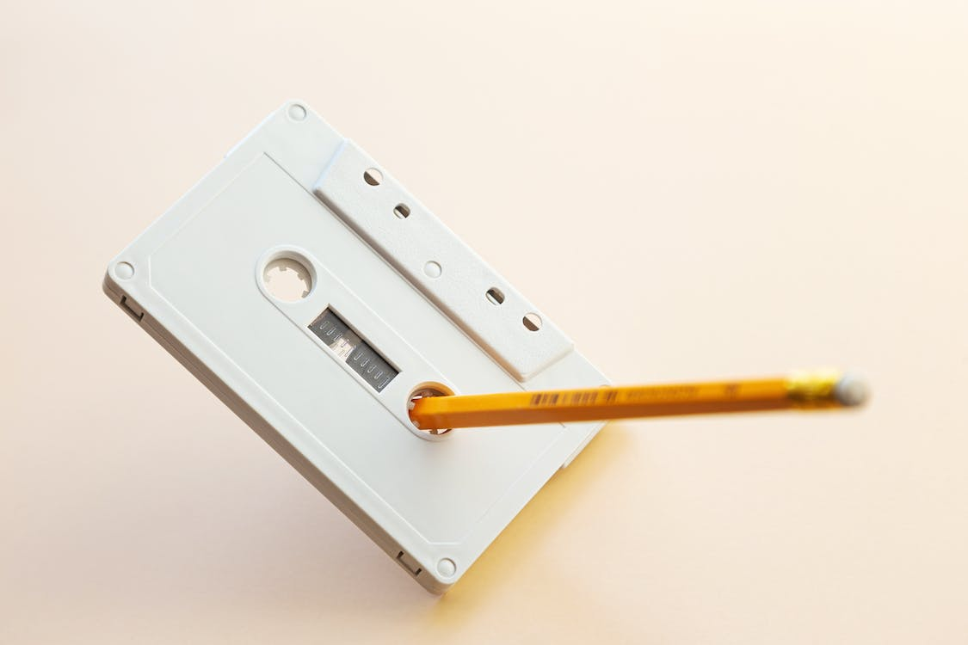
Other useful handle APIs
mmap() – can map part or all of a file into memory
seek() – adjust the cursor position of a file
  Like rewinding a cassette tape
https://www.pexels.com/photo/yellow-pencil-on-white-cassette-tape-8040775/

Slide 19
Outline
Files and File Handles
Inheritance
Pipes & Sockets
Signals
Synthesis Example: The Shell

Slide 20
Inheritance
By default, a child process gets a reference to every handle the parent has open
  Very convenient
  Also a security issue: may accidentally pass something the program shouldn’t
Between fork() and exec(), the parent has a chance to clean up handles it doesn’t want to pass
  See also FD_CLOEXEC flag, used as follows with fcntl():
  fcntl(fd, F_SETFD, fcntl(fd, F_GETFD) | FD_CLOEXEC);

Slide 21
Standard in, out, error
Handles 0, 1, and 2 are special by convention
  0: standard input (STDIN_FILENO in <stdio.h>)
  1: standard output (STDOUT_FILENO)
  2: standard error output (STDERR_FILENO)
Command-line programs use this convention
  Parent program (shell) is responsible to use open/close/dup2 to set these handles appropriately between fork() and exec()

Slide 22
Example
int pid = fork();
if (pid == 0) {
// Opens "in.txt" for reading.
int fd = open (“in.txt”, O_RDONLY);
// Redirects standard input to come from "in.txt" by duplicating the file descriptor.
dup2(fd, 0);
// Executes the grep command, which will search for the string "quack" in the file "in.txt".
exec(“grep”, “quack”);
}

Slide 23
Outline
Files and File Handles
Inheritance
Pipes & Sockets
Signals
Synthesis Example: The Shell
Notes:
START HERE

Slide 24
Pipes
FIFO stream of bytes between two processes
Read and write like a file handle
  But not anywhere in the hierarchical file system
  And not persistent
  And no cursor or seek()-ing
  Actually, 2 handles: a read handle and a write handle
Primarily used for parent/child communication
  Parent creates a pipe, child inherits it

Slide 25
Example
PC
int pipe_fd[2];
int rv = pipe(pipe_fd);
int pid = fork();
if (pid == 0) {
close(pipe_fd[1]);
dup2(pipe_fd[0], 0);
close(pipe_fd[0]);
exec(“grep”, “quack”);
} else {
close (pipe_fd[0]);
...
W
PCB
PC
Handle Table
Parent
R
Child
execlp("grep", "grep", "quack", NULL);
  Goal: Create a pipe; parent writes, child reads

Slide 26
Sockets
Similar to pipes, except for network connections
Setup and connection management is a bit trickier
  A topic for another day (or class)

Slide 27
Select
What if I want to block until one of several handles has data ready to read?
Read will block on one handle, but perhaps miss data on a second…
Select will block a process until a handle has data available
  Useful for applications that use pipes, sockets, etc.

Slide 28
Outline
Files and File Handles
Inheritance
Pipes & Sockets
Signals
Synthesis Example: The Shell

Slide 29
Signals
Similar concept to an application-level interrupt
  Unix-specific (more on Windows later)
Each signal has a number assigned by convention
  Just like interrupts
Application specifies a handler for each signal
  OS provides default

Slide 30
Signals, cont.
Can occur for:
  Exceptions: divide by zero, null pointer, etc.
  IPC: Application-defined signals (USR1, USR2)
  Control process execution (KILL, TERM, STOP, CONT)
Send a signal using kill(pid, signo)
  Killing an errant program is common, but you can also send a non-lethal signal using kill()
Use signal() or sigaction() to set the handler for a signal

Slide 31
How signals work
If process survives, control is returned to the application
Although signals appear to be delivered immediately…
  They are actually delivered lazily…
  Whenever the OS happens to be returning to the process from an interrupt, system call, etc.
If I signal another process, the other process may not receive it until it is scheduled again
Does this matter?
Notes:
START HERE 2022 – quick wrap up

Slide 32
More details
When a process receives a signal, it is added to a pending mask of pending signals
  Stored in PCB
Just before scheduling a process, the kernel checks if there are any pending signals
  If so, return to the appropriate handler
  Save the original register state for later
  When handler is done, call sigreturn() system call
    Then resume execution

Slide 33
Meta-lesson
Laziness rules!
  Not on homework
  But in system design
Procrastinating on work in the system often reduces overall effort
  Signals: Why context switch immediately when it will happen soon enough?

Slide 34
Language Exceptions
Signals are the underlying mechanism for Exceptions and catch blocks
JVM or other runtime system sets signal handlers
  Signal handler causes execution to jump to the catch block
Notes:
STOPPED HERE

Slide 35
Windows comparison
Exceptions have specific upcalls from the kernel to ntdll
IPC is done using Events
  Shared between processes
  Handle in table
  No data, only 2 states: set and clear
  Several variants: e.g., auto-clear after checking the state

Slide 36
Outline
Files and File Handles
Inheritance
Pipes & Sockets
Signals
Synthesis Example: The Shell

Slide 37
Shell Recap
Almost all ‘commands’ are really binaries
  /bin/ls
Key abstraction: Redirection over pipes
  ‘>’, ‘<‘, and ‘|’implemented by the shell itself

Slide 38
Shell Example
Ex: ls | grep foo
Shell pseudocode:
while(EOF != read_input) {
  parse_input();
  // Sets up chain of pipes
  // Forks and exec’s ‘ls’ and ‘grep’ separately
  // Wait on output from ‘grep’, print to console
// print console prompt
}
thsh
fork()
csh
thsh
ls
exec(ls)

Slide 39
Lab 1 Overview
C programming on Linux refresher
Parser for your shell (Lab 1)

Slide 40
Shells
Shell: aka the command prompt
At a high level:
while (more input) {
read a line of input
parse the line into a command
if valid command: execute it
}
We will give you this
Lab 1
Lab 2

Slide 41
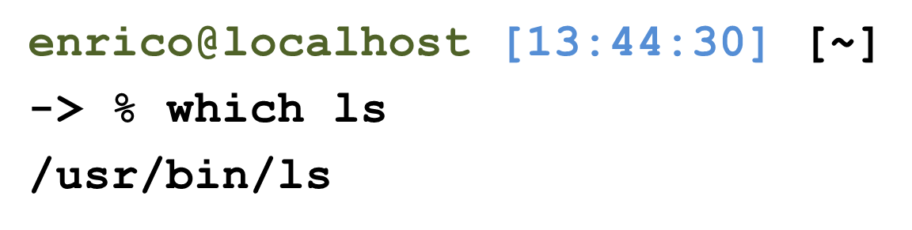
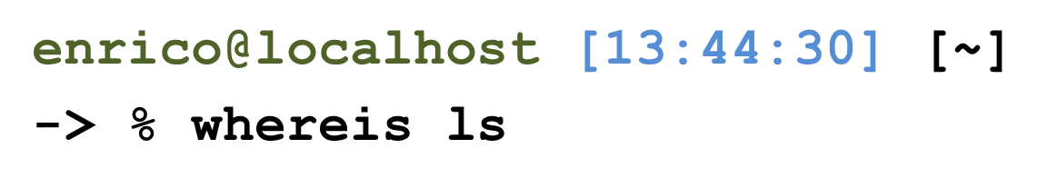
Detour: Environment Variables
Nearly all shell commands are actually binary files
  Very few commands actually implemented in the shell
  A few built-ins that change the shell itself (exit, cd)
Example: ls is actually in /bin/ls
  For fun, play with which, as in which ls
So where to look for a given command?
  Note that we want some flexibility system-to-system
  Idea: dynamically set a variable that controls which directories to search

Slide 42
Environment Variables
A set of key-value pairs
  Passed to main() as a third argument
  Often ignored by programmers
Serves many different purposes
For Lab 1, we need to look at PATH
  By convention, a single, colon-delimited set of prefixes
Example:
/usr/local/sbin:/usr/local/bin:/usr/sbin:/usr/bin:/sbin:/bin

Slide 43
PATH in a shell
If my PATH is
/usr/local/sbin:/usr/local/bin:/usr/sbin:/usr/bin:/sbin:/bin
Then, for a given command (ls), the shell will check, in order, until found:
/usr/local/sbin/ls
/usr/local/bin/ls
/usr/sbin/ls
/usr/bin/ls
/sbin/ls
/bin/ls

Slide 44
Lab 1, Exercise 1
Your first job will be to write parsing code that takes in a colon-delimited set of prefixes, and to create a table of prefixes to try in future commands
  See path_table in jobs.c
  We wrote a test harness test_env.c
$ PATH=/foo:/bar ./test_env
===== Begin Path Table =====
Prefix 0: [/foo]
Prefix 1: [/bar]
===== End Path Table =====

Slide 45
Exercise 2: Parsing commands
A typical shell command includes a main binary (e.g., ‘ls’)
  and 0+ whitespace-separated arguments (e.g., ‘-l’)
  and possibly extra whitespace
You will get this as a single character array
Your job is to break this up into individual ‘tokens’
l
s
-
l
\0
l
s
\0
\0
Input
-
l
\0
commands
\0

Slide 46
Pipelines
A shell can compose multiple commands using pipelines
  Key idea: standard output of one command becomes standard input of next
Example: ls | wc -l
  List a directory (ls) – send listing output to a wordcount utility (wc) to count how many entries in directory
The vertical bar (|) is a special character
  May not appear in any other valid commands
  Does not need whitespace: ls|wc –l is valid

Slide 47
parse.c:parse_line()
The workhorse for lab 1 (and 2)
Takes in a line of input, outputs a 2-D array
First dimension : one entry per pipeline stage
  Simple commands just have one entry
Second dimension : one entry per command token

Slide 48
How to parse a pipeline?
l
s
|
w
c
-
l
\0
Input
l
s
\0
\0
commands
(parsed)
w
c
\0
\0
-
l
\0
\0

Slide 49
Other special cases
Comments – anything past a ‘#’ character
File redirection - sets standard input/output to a file
  Example: ls > mydir.txt
    Saves the output of ls into a file
  Example: wc –l < mydir.txt
    Sends the contents of mydir.txt into wc as standard input
Built-in commands (see builtin.c)
  For now, you just need to recognize them and call the appropriate handler function

Slide 50
Working on Homework Assignments
Use the same learncli211 container as lab 0

Slide 51
Checking out the starter code
Once you have a github account registered
  Make sure you accept the invite:
    Click https://github.com/comp530-f23
Click the link in the homework to create a private repo
Then, on your machine or classroom (substituting your team for ‘team-don’ – see the green clone button):
  git clone git@github.com:comp530-f23/thsh-team-don.git

Slide 52
Submitting homework
We will be using gradescope to submit and autograde the homework
  Challenge problems and late hours done manually
  Submit challenges separately
Ideally, use github connection to directly submit
Feel free to try early to catch issues with grading

Slide 53



A note on Lab 2
thsh
wait()
fork()
csh
thsh
ls
exec(ls)
You’re going to be creating lots of processes in this assignment
If you fork a process and it never terminates…
You’ve just created a Z O M B I E P R O C E S S!!
  Zombies will fill up the process table in the Linux kernel
  Nobody can create a new process
  This means no one can launch a shell to kill the zombies!

Slide 54
A note on Lab 1
thsh
wait()
fork()
csh
thsh
ls
exec(ls)
Be safe! Limit the number of processes you can create
  add the command “limit maxproc 10” to the file ~/.cshrc
  (remember to delete this line at the end of the course!)
Periodically check for and KILL! zombie processes
  ps -ef | egrep -e PID -e YOUR-LOGIN-NAME
  kill pid-number
Read the HW handout carefully for zombie-hunting details!

Slide 55
What about Ctrl-Z?
Shell really uses select() to listen for new keystrokes
  (while also listening for output from subprocess)
Special keystrokes are intercepted, generate signals
  Shell needs to keep its own “scheduler” for background processes
  Assigned simple numbers like 1, 2, 3
‘fg 3’ causes shell to send a SIGCONT to suspended child
Ctrl+C implemented using SIGKILL

Slide 56
Other hints
Splice(), tee(), and similar calls are useful for connecting pipes together
  Avoids copying data into and out-of application

Slide 57
Collaboration Policy Reminder
You can work alone or as part of a team
  Must be the same as lab 1; may change starting in lab 2
  Every line of code handed in must be written by one of the pair (or the boilerplate)
    No sharing code with other groups
    No code from Internet
  Any other collaboration must be acknowledged in writing
  High-level discussion is ok (no code)
See written assignment and syllabus for more details
  Not following these rules is an Honor Code violation

Slide 58
Summary
Understand how handle tables work
  Survey basic APIs
Understand signaling abstraction
  Intuition of how signals are delivered
Be prepared to start writing your shell in lab 2!

Slide 59
Extra slides

Slide 60
enrico@localhost [13:44:30] [~]
-> % whereis ls
/usr/bin/ls

