Slide 1
Scheduling Processes
Don Porter
Portions courtesy Emmett Witchel

Slide 2
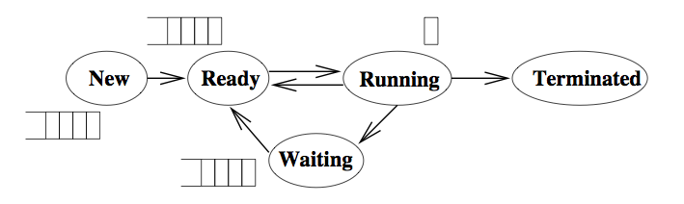
Processes (refresher)
Each process has state, that includes its text and data, procedure call stack, etc. This state resides in memory.
The OS also stores process metadata for each process. This state is called the Process Control Block (PCB), and it includes the PC, SP, register states, execution state, etc.
All of the processes that the OS is currently managing reside in one and only one of these states.

Slide 3
Scheduling Processes
The OS has to decide:
  When to take a Running process back to Ready
  Which process to select from the Ready queue to run next
Ready Queue: Policy can be something other than First-in, First-out!

Slide 4
Scheduler
The kernel runs the scheduler at least when
  a process switches from running to waiting (blocks)
  a process is created or terminated.
  an interrupt occurs (e.g., timer chip)
Non-preemptive system
  Scheduler runs when process blocks or is created, not on hardware interrupts
Preemptive system
  OS makes scheduling decisions during interrupts, mostly timer, but also system calls and other hardware device interrupts

Slide 5
Evaluation Criteria and Policy Goals?
CPU Utilization: The percentage of time that the CPU is busy.
Throughput: The number of processes completing in a unit of time.
Turnaround time: The length of time it takes to run a process from initialization to termination, including all the waiting time.
Waiting time: The total amount of time that a process is in the ready queue.
Response time: The time between when a process is ready to run and its next I/O request.
Fairness: ??
Notes:
START HERE

Slide 6
Scheduling Policies
Ideal CPU scheduler
  Maximizes CPU utilization and throughput
  Minimizes turnaround time, waiting time, and response time
Real CPU schedulers implement particular policy
  Minimize response time - provide output to the user as quickly as possible and process their input as soon as it is received.
  Minimize variance of average response time - in an interactive system, predictability may be more important than a low average with a high variance.
  Maximize throughput - two components
    1. minimize overhead (OS overhead, context switching)
    2. efficient use of system resources (CPU, I/O devices)
  Minimize waiting time - be fair by ensuring each process waits the same amount of time. This goal often increases average response time.
Will a fair scheduling algorithm maximize throughput? A) Yes B) No

Slide 7
Different Process Activity Patterns
CPU bound
  mp3 encoding
  Scientific applications (matrix multiplication)
  Compile a program or document
I/O bound
  Index a file system
  Browse small web pages
Balanced
  Playing video
  Moving windows around/fast window updates
Scheduling algorithms reward I/O bound and penalize CPU bound
  Why?
Notes:
START HERE 2022

Slide 8
Scheduling Policies
Simplifying Assumptions
  One process per user
  One thread per process (more on this topic next week)
  Processes are independent
Researchers developed these algorithms in the 70’s when these assumptions were more realistic, and it is still an open problem how to relax these assumptions.
Scheduling Algorithms to Evaluate Today:
  FCFS: First Come, First Served
  Round Robin: Use a time slice and preemption to alternate jobs.
  SJF: Shortest Job First
  Multilevel Feedback Queues: Round robin on priority queue.
  Lottery Scheduling: Jobs get tickets and scheduler randomly picks winning ticket.

Slide 9
Policy 1: FCFS (First Come, First Served)
The scheduler executes jobs to completion in arrival order.
In early FCFS schedulers, the job did not relinquish the CPU even when it was doing I/O.
We will assume a FCFS scheduler that runs when processes are blocked on I/O, but that is non-preemptive, i.e., the job keeps the CPU until it blocks (say on an I/O device).

Slide 10
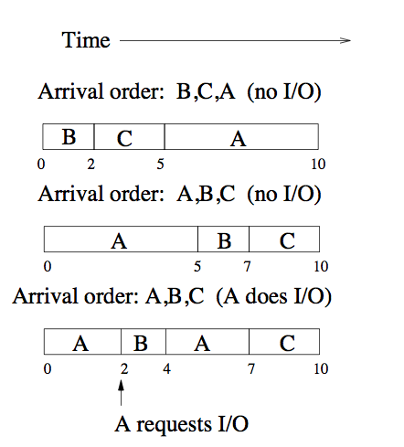
FCFS Example and Analysis
In a non-preemptive system, the scheduler must wait for one of these events, but in a preemptive system the scheduler can interrupt a running process.
If the processes arrive one time unit apart, what is the average wait time in these three cases?
Advantages:
Disadvantages

Slide 11
Policy 2: Round Robin
Run each process for its time slice (scheduling quantum)
After each time slice, move the running thread to the back of the queue.
Selecting a time slice:
  Too large - waiting time suffers, degenerates to FCFS if processes are never preempted.
  Too small - throughput suffers because too much time is spent context switching.
  Balance the two by selecting a time slice where context switching is roughly 1% of the time slice.
A typical time slice today is between 10-100 milliseconds, with a context switch time of 0.1 to 1 millisecond.
  Max Linux time slice is 3,200ms, Why?
Is round robin more fair than FCFS? A)Yes B)No

Slide 12
Round Robin Example (1)
5 jobs, 100 seconds each, time slice 1 second, context switch time of 0, jobs arrive at time 0,1,2,3,4
 |  | Completion Time (Wall clock time) |  | Wait Time = (Compl. – Arrival – exec time)
Job | Length | FCFS | Round Robin | FCFS | Round Robin
1 | 100
2 | 100
3 | 100
4 | 100
5 | 100
Average

Slide 13
Round Robin Example (1)
5 jobs, 100 seconds each, time slice 1 second, context switch time of 0, jobs arrive at time 0,1,2,3,4
 |  | Completion Time (Wall clock time) |  | Wait Time = (Compl. – Arrival – exec time)
Job | Length | FCFS | Round Robin | FCFS | Round Robin
1 | 100 | 100 |  | 0
2 | 100 | 200 |  | 99
3 | 100 | 300 |  | 198
4 | 100 | 400 |  | 297
5 | 100 | 500 |  | 396
Average |  | 300 |  | 198

Slide 14
Round Robin Example (1)
5 jobs, 100 seconds each, time slice 1 second, context switch time of 0, jobs arrive at time 0,1,2,3,4
 |  | Completion Time (Wall clock time) |  | Wait Time = (Compl. – Arrival – exec time)
Job | Length | FCFS | Round Robin | FCFS | Round Robin
1 | 100 | 100 | 496 | 0 | 396
2 | 100 | 200 | 497 | 99 | 396
3 | 100 | 300 | 498 | 198 | 396
4 | 100 | 400 | 499 | 297 | 396
5 | 100 | 500 | 500 | 396 | 396
Average |  | 300 | 498 | 198 | 396
Why is this better?

Slide 15
Round Robin Example (2)
5 jobs, of length 50, 40, 30, 20, and 10 seconds each, time slice 1 second, context switch time of 0 seconds, all arrive at time 0
 |  | Completion Time (Wall clock time) |  | Wait Time = (Compl. – Arrival – exec time)
Job | Length | FCFS | Round Robin | FCFS | Round Robin
1 | 50
2 | 40
3 | 30
4 | 20
5 | 10
Average
Notes:
START HERE 2020

Slide 16
Round Robin Example (2)
5 jobs, of length 50, 40, 30, 20, and 10 seconds each, time slice 1 second, context switch time of 0 seconds, all arrive at time 0
 |  | Completion Time (Wall clock time) |  | Wait Time = (Compl. – Arrival – exec time)
Job | Length | FCFS | Round Robin | FCFS | Round Robin
1 | 50 | 50 |  | 0
2 | 40 | 90 |  | 50
3 | 30 | 120 |  | 90
4 | 20 | 140 |  | 120
5 | 10 | 150 |  | 140
Average |  | 110 |  | 80

Slide 17
Round Robin Example (2)
5 jobs, of length 50, 40, 30, 20, and 10 seconds each, time slice 1 second, context switch time of 0 seconds, all arrive at time 0
 |  | Completion Time (Wall clock time) |  | Wait Time = (Compl. – Arrival – exec time)
Job | Length | FCFS | Round Robin | FCFS | Round Robin
1 | 50 | 50 | 150 | 0 | 100
2 | 40 | 90 | 140 | 50 | 100
3 | 30 | 120 | 120 | 90 | 90
4 | 20 | 140 | 90 | 120 | 70
5 | 10 | 150 | 50 | 140 | 40
Average |  | 110 | 110 | 80 | 80
Seriously, aren’t these the same?

Slide 18
Fairness
Was the average wait time or completion time really the right metric?
  No!
What should we consider for the example with equal job lengths?
  Variance!
What should we consider for the example with varying job lengths?
  Is completion time proportional to required CPU cycles?

Slide 19
Policy 3: Shortest Job First (SJF)
Schedule the job that has the least (expected) amount of work (CPU time) to do until its next I/O request or termination.
  I/O bound jobs get priority over CPU bound jobs.

Slide 20
Shortest Job First (SJF) Example
Example: 5 jobs, of length 50, 40, 30, 20, and 10 seconds each, time slice 1 second, context switch time of 0 seconds, all arrive at time 0
 |  | Completion Time (Wall Clock Time) |  |  | Wait Time (Compl. – Exec – Arrival)
Job | Length | FCFS | RR | SJF | FCFS | RR | SJF
1 | 50
2 | 40
3 | 30
4 | 20
5 | 10
Average

Slide 21
Shortest Job First (SJF) Example
Example: 5 jobs, of length 50, 40, 30, 20, and 10 seconds each, time slice 1 second, context switch time of 0 seconds, all arrivae at time 0
 |  | Completion Time |  |  | Wait Time
Job | Length | FCFS | RR | SJF | FCFS | RR | SJF
1 | 50 | 50 | 150 | 150 | 0 | 100 | 100
2 | 40 | 90 | 140 | 100 | 50 | 100 | 60
3 | 30 | 120 | 120 | 60 | 90 | 90 | 30
4 | 20 | 140 | 90 | 30 | 120 | 70 | 10
5 | 10 | 150 | 50 | 10 | 140 | 40 | 0
Average |  | 110 | 110 | 70 | 80 | 80 | 40
Now that’s what I’m talking about!

Slide 22
Shortest Job First
Works for preemptive and non-preemptive schedulers.
Preemptive SJF is called SRTF - shortest remaining time ﬁrst.
Advantages?
  Free up system resources more quickly
Disadvantages?
  How do you know how long something will run?
  “Academic” scheduler: Useful to decide if a good idea

Slide 23
Idea: Use the Past to Predict the Future
Intuition: Assign a dynamic priority to each task
  Higher priority processes more likely to be scheduled
    (if ready)
Assign dynamic priority based on behavior during last few quanta
  Raise dynamic priority frequently process blocks on I/O
    Probably latency-sensitive (e.g., word processer, web server)
    When runnable, will probably do a little work and block again on more I/O
  Lower dynamic priority of processes that use all of their quantum
    Probably CPU-bound
Adaptive: priorities change when process changes behavior (e.g., switching from I/O to CPU-intensive)
Notes:
START HERE 24 – recap and move on

Slide 24
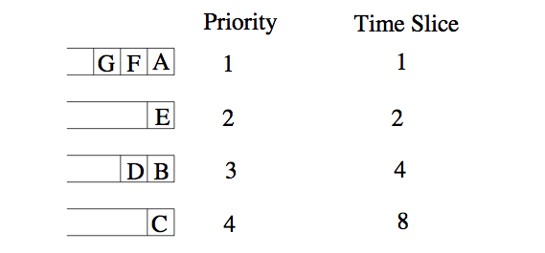
Policy 4: Multi-Level Feedback Queues
Approximate SJF: multiple queues with different priorities.
OS uses Round Robin scheduling at each priority level, running the jobs in the highest priority queue first.
Once those finish, OS runs jobs out of the next highest priority queue, etc. (Can lead to starvation.)
Round robin time slice increases exponentially at lower priorities.
  Good for CPU-bound jobs to be lower priority (if they don’t starve)

Slide 25
Policy 4: Multi-Level Feedback Queues
Adjust priorities as follows (details can vary):
Proc starts in the highest priority queue
If proc’s time slice expires, drop its priority one level.
If proc’s blocked with remaining time slice, increase its priority one level, up to the top priority level.
==> In practice, CPU bound procs drop like a rock in priority and I/O bound procs stay at high priority

Slide 26
Fairness
SJF is optimal, but unfair
Improving fairness means giving long jobs a fraction of the CPU when shorter jobs are available
  Will degrade average waiting time.
Possible solutions:
  Give each level queue a fraction of the CPU time. This solution is only fair if there is an even distribution of jobs among queues.
  Adjust the priority of jobs as they do not get serviced (Unix originally did this.)
    Avoids starvation
    Average waiting time suffers when the system is overloaded because all the jobs end up with a high priority.

Slide 27
Policy 5: Lottery Scheduling
Give every job some number of lottery tickets.
On each time slice, randomly pick a winning ticket.
On average, CPU time is proportional to the number of tickets given to each job.
Assign tickets by giving the most to short running jobs, and fewer to long running jobs (approximating SJF). To avoid starvation, every job gets at least one ticket.
Degrades gracefully as load changes. Adding or deleting a job affects all jobs proportionately, independent of the number of tickets a job has.
Notes:
START HERE

Slide 28
Lottery Scheduling Example
Example: Short jobs get 9 tickets, long jobs get 1 tickets each.
# short jobs / # long jobs | % of CPU each short job gets | % of CPU each long job gets
1/1 | 90% | 10%
0/2
2/0
10/1
1/10

Slide 29
Lottery Scheduling Example
Example: Short jobs get 9 tickets, long jobs get 1 tickets each.
# short jobs / # long jobs | % of CPU each short job gets | % of CPU each long job gets
1/1 | 90% | 10%
0/2 | 0% | 50%
2/0
10/1
1/10

Slide 30
Lottery Scheduling Example
Example: Short jobs get 9 tickets, long jobs get 1 tickets each.
# short jobs / # long jobs | % of CPU each short job gets | % of CPU each long job gets
1/1 | 90% | 10%
0/2 | 0% | 50%
2/0 | 50% | 0%
10/1
1/10

Slide 31
Lottery Scheduling Example
Example: Short jobs get 9 tickets, long jobs get 1 tickets each.
# short jobs / # long jobs | % of CPU each short job gets | % of CPU each long job gets
1/1 | 90% | 10%
0/2 | 0% | 50%
2/0 | 50% | 0%
10/1 | 9/91=~9.8% | 1/91=~1%
1/10

Slide 32
Lottery Scheduling Example
Example: Short jobs get 9 tickets, long jobs get 1 tickets each.
# short jobs / # long jobs | % of CPU each short job gets | % of CPU each long job gets
1/1 | 90% | 10%
0/2 | 0% | 50%
2/0 | 50% | 0%
10/1 | 9/91=~9.8% | 1/91=~1%
1/10 | 9/19=~47% | 1/19=~5.3%

Slide 33
Summary of Scheduling Algorithms
FCFS: Not fair, and average waiting time is poor.
Round Robin: Fair, but average waiting time is poor.
SJF: Not fair, but average waiting time is minimized assuming we can accurately predict the length of the next CPU burst. Starvation is possible.
Multilevel Queuing: An implementation (approximation) of SJF.
Lottery Scheduling: Fairer with a low average waiting time, but less predictable.
⇒ Our modeling assumed that context switches took no time, which is unrealistic.

