Slide 1
COMP 550 Algorithm and Analysis Introduction

Slide 2
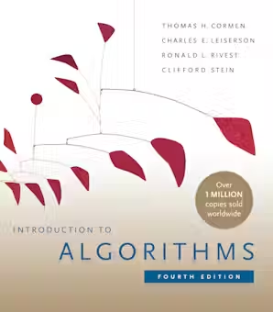
Logistics
We meet in-person MW 4:00pm-5:15pm at Davie112
Class webpage: www.cs.unc.edu/~shareef/teaching/comp550
Email: shareef@cs.unc.edu (Please include [comp550] prefix)
Canvas: https://uncch.instructure.com/courses/34716
Textbook:
Introduction to Algorithms, Fourth Edition.
T. H. Cormen, C. E. Leiserson, R. L. Rivest and C. Stein.
MIT Press.

Slide 3
Logistics
Other very good textbooks:
Algorithm Design
J. Kleignberg and E. Tardos.
Algorithms
S. Dasgupta, C. H. Papadimitriou, and U. V. Vazirani
The Algorithm Design Manual
S. Skienna
Algorithms
Jeff Erickson

Slide 4
Who Am I?
Fifth year Ph.D. student
Real-time systems group led by Prof. Jim Anderson
Work on real-time scheduling theory (scheduling programs by an OS scheduler so that certain timing properties can be met)
Tentative dissertation title:
“Efficient scheduling and analysis of complex real-time systems”

Slide 5
Who Am I?
From Bangladesh
Population $≈$ 1/2 of USA population
Area: slightly larger than NC
Native language: Bengali
Sorry for my poor English

Slide 6
Who Am I?
I live an hour away from Chapel Hill
I have a 3 month only baby daughter!

Slide 7
About Yourself
Menti.com
Code: 5957 4641

Slide 8
What Are Your Expectations?
https://forms.gle/cNNo6NGxzCfzQWaE6
You can submit this later today

Slide 9
Learning Objectives
Develop skills to devise algorithms using appropriate data structures and common algorithmic paradigms for real-life problems.
Develop skills to prove correctness and analyze time and space complexity of an algorithm.
Develop the ability to compare different algorithmic solutions of a problem and determine their trade-offs.
Develop the ability to anticipate and determine tractability of a problem.
Develop skills to deal with intractability using common techniques.

Slide 10
What in This Course?
This course is about problem solving, NOT about programming
When you solve a computational problem, you need to convince people that your solution is correct
Proof of correctness
You also need to determine whether your solution is efficient
Inefficient solutions are not useful

Slide 11
How To Be a Good Problem Solver
Practice!
Challenge yourself
Always try to solve a problem on your own first
Implement and proof
Many good resources nowadays
Book exercise
Online platforms (leetcode, hackerrank, codeforces, etc.)

Slide 12
Logistics Again
Course schedule online and in syllabus
Subject to change (current one is somewhat optimistic)
Grading
Quizzes: 5%
Assignments: 30%
Midterms: 15% + 15%
Final: 35%

Slide 13
Logistics Again
Any Questions or Concerns?
(Email me if needed)
If you want to be anonymous, you can use the earlier google form

Slide 14
What Is An Algorithm?
An algorithm is a computational procedure for solving a computational problem.
A computational problem is a mathematical problem, specified by an input/output relation.
A computational procedure is a sequence of computation steps or instructions

Slide 15
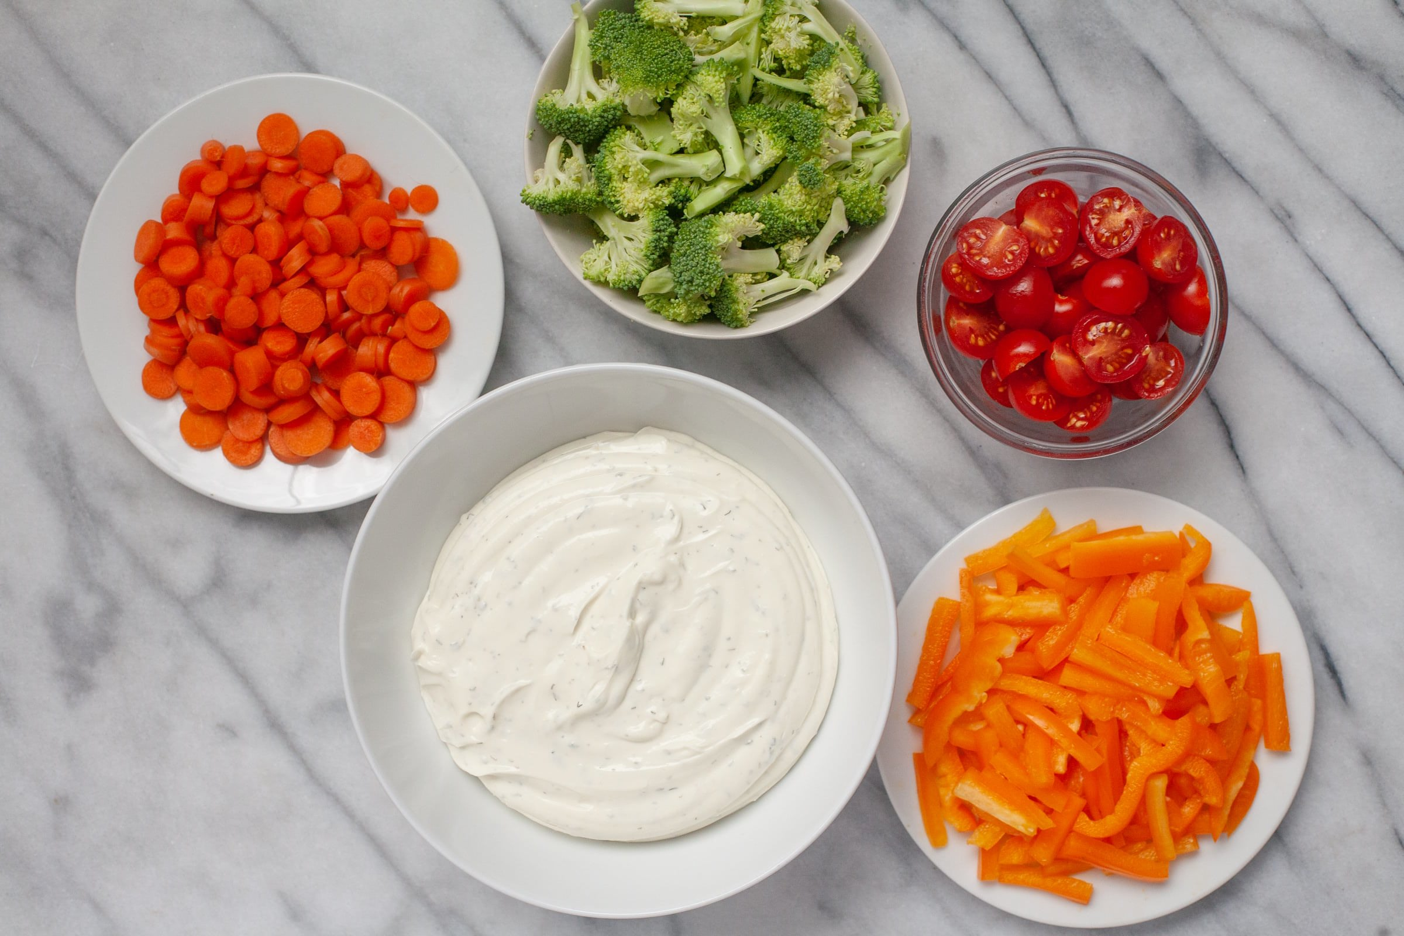
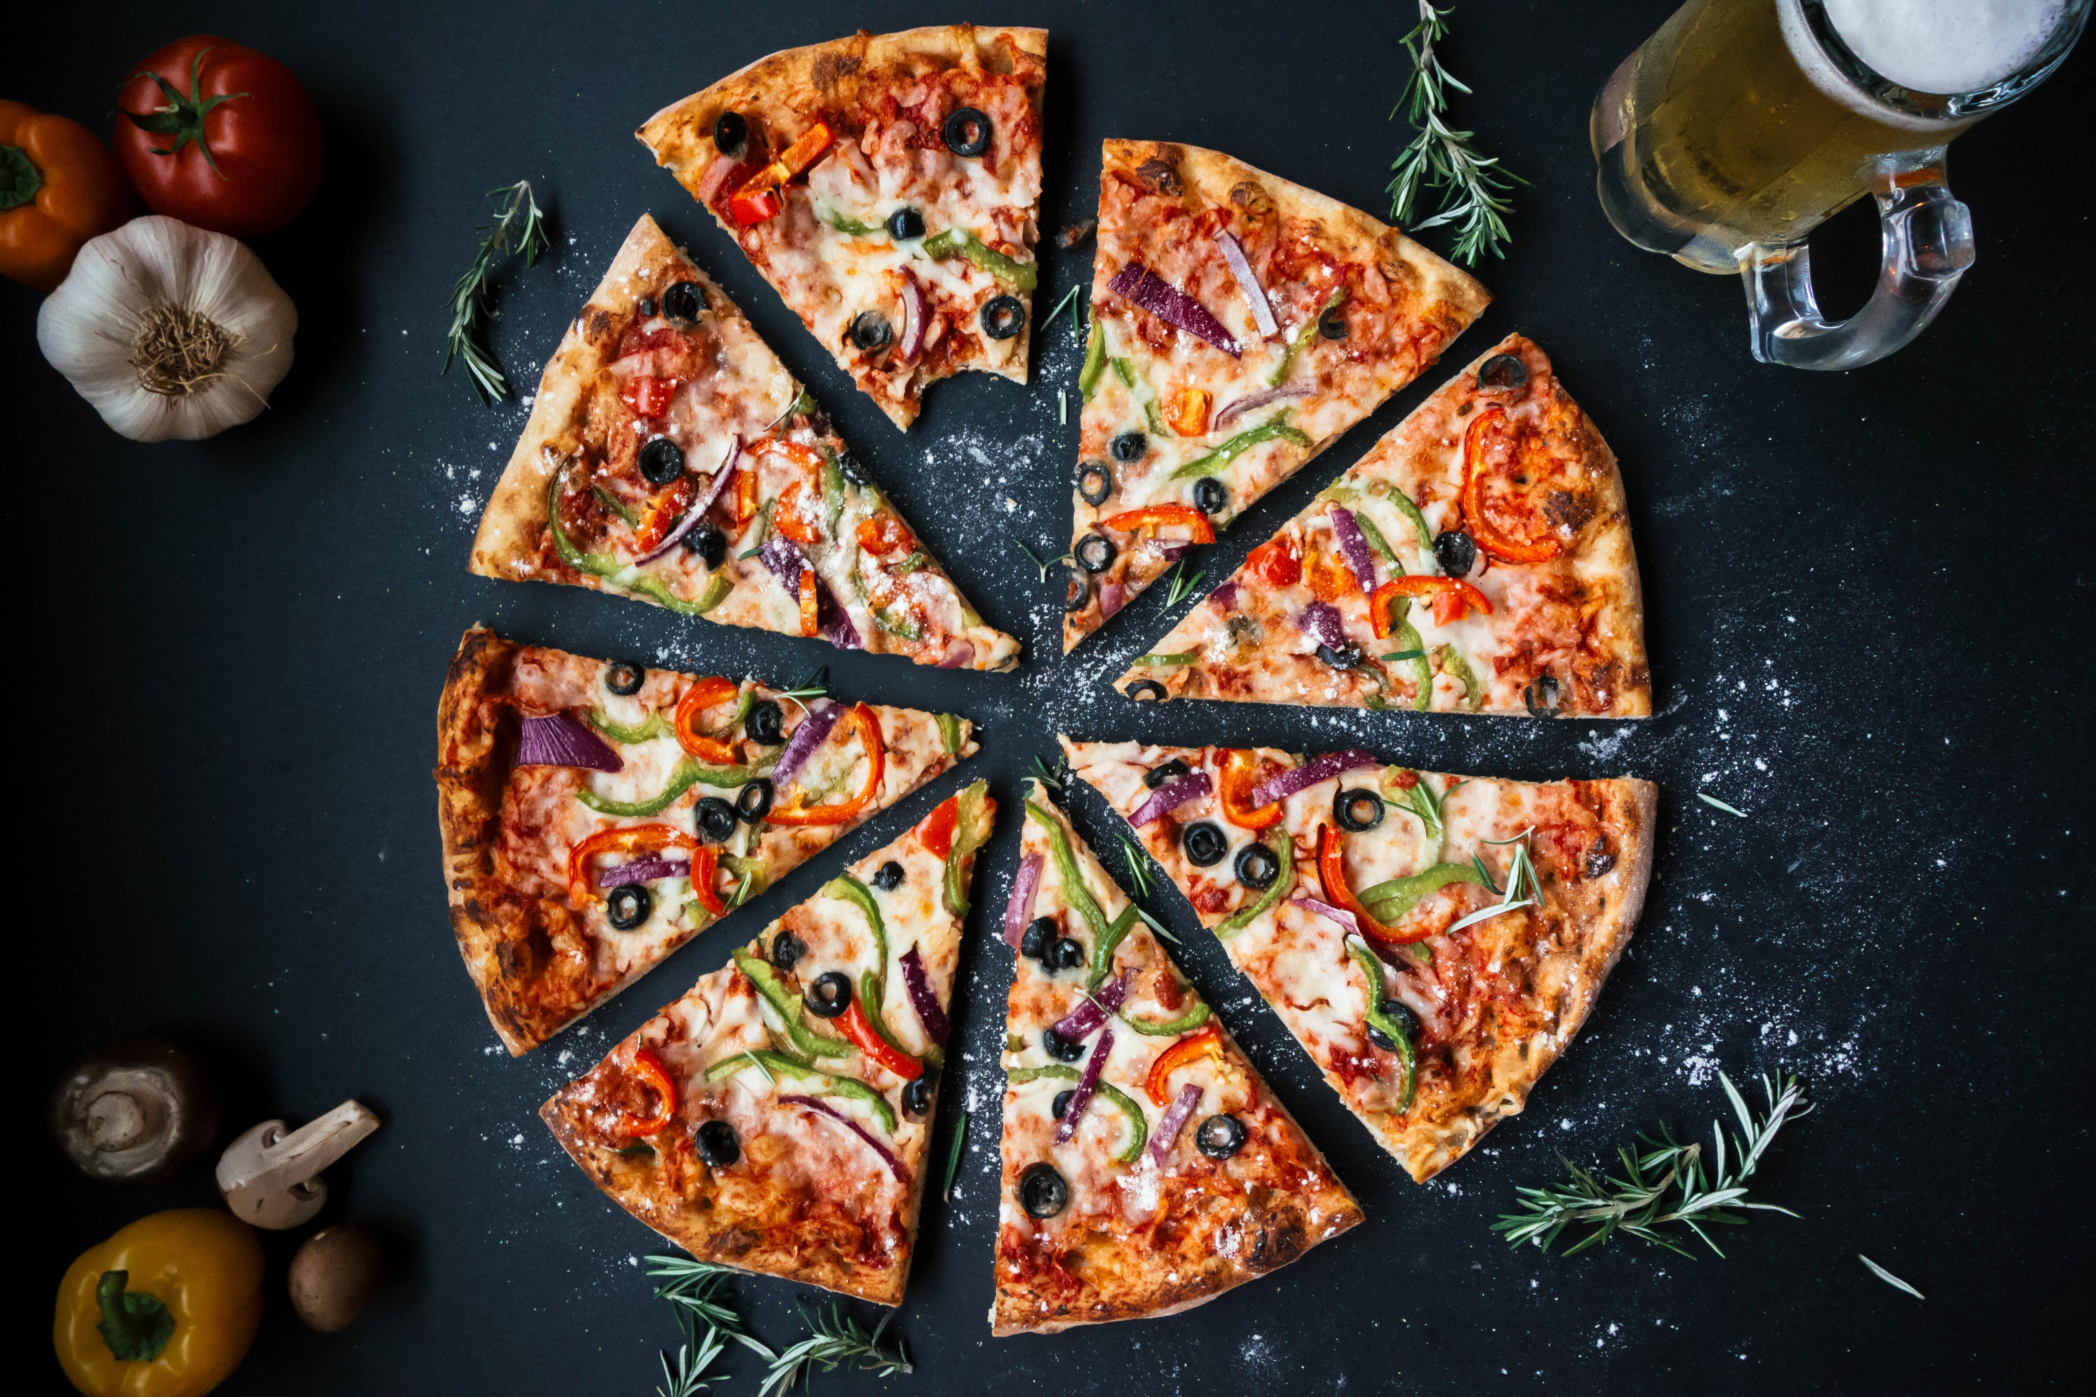
What Is An Algorithm?
Algorithm
Input
Output
157, 283
157+283
Musa al-Khwarizmi $⇒$ Algorithm

Slide 16
What Is An Algorithm?
Algorithm
Input
Output
We are interested in algorithms to solve computational problems
Carried out by a computer

Slide 17
Data Structures and Algorithms
Data Structure:
A way of organizing, storing, accessing, and updating data
Examples: Arrays, Linked Lists, Stacks, Queues, Trees
COMP 210
Program:
A program is the expression of an algorithm in a programming language
Program = Data Structure + Algorithms

Slide 18
Algorithms and Programs
Algorithms are the ideas behind computer programs
An algorithm is the thing that stays the same whether the program is in C running on a Windows or is in JAVA running on a Linux!

Slide 19
Algorithm: Example
Find the maximum element of a sequence of numbers
Input: A sequence of $n$ numbers $\left\langle a_{1},a_{2},…,a_{n}\right\rangle$
Output: The number $a_{k}$ ($k∈\{1..n\}$) such that ${i ∈ \left\{1..n\right\} : a}_{k}≥ a_{i}$
Example:
Input: 31, 41, 59, 26, 41, 58
Output: 59
Formally, input is called an instance of the problem

Slide 20
Algorithm: Example
Sort a sequence of numbers
Input: A sequence of $n$ numbers $\left\langle a_{1},a_{2},…,a_{n}\right\rangle$
Output: A permutation (reordering) of the input sequence such that $a_{1} ≤ a_{2} ≤ … ≤ a_{n}$
Example:
Input: 31, 41, 59, 26, 41, 58
Output: 26, 31, 41, 41, 58, 59

Slide 21
Algorithm: Example
Can we use the algorithm to solve the sorting problem to solve the “FindMax” problem (and vice versa)?
Some computation
Some computation
Instance of
FindMax
The Maximum
Algorithm for Sorting

Slide 22
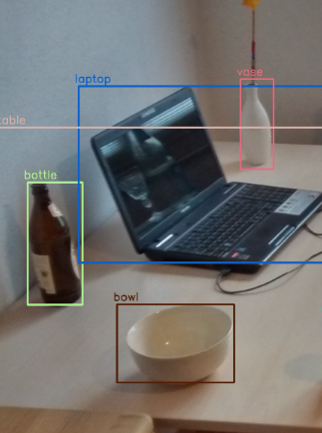
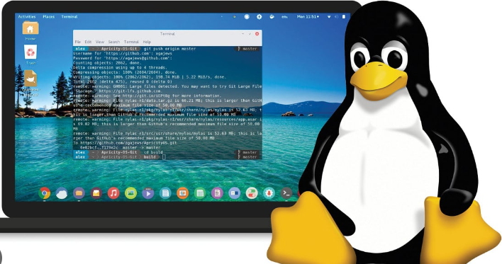
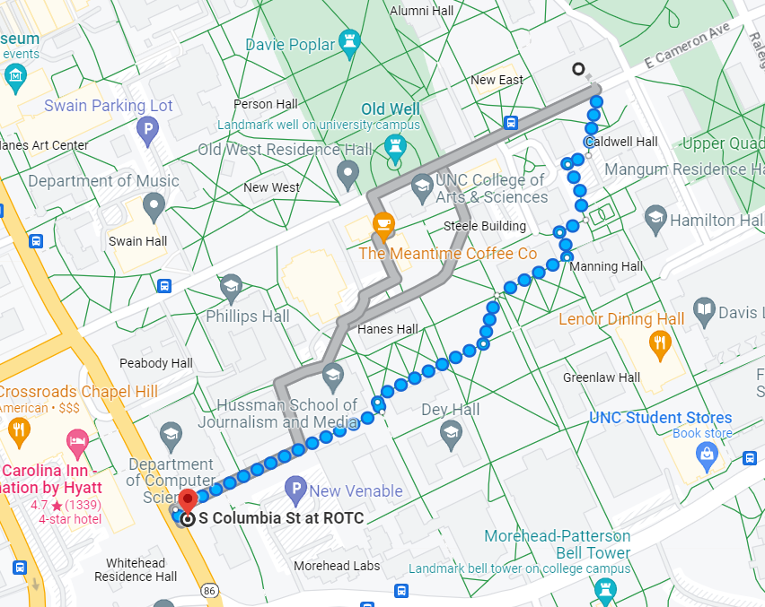
Why Study Algorithms?
Computer science is basically the study of algorithms
Algorithms change the way of life

Slide 23
Why Study Algorithms?
Algorithms enable discovery of life and universe
CHIRP (Continuous High-resolution Image Reconstruction using Patch priors) combined data from eight radio telescopes
“Computer models mirroring real life have become crucial for most advances made in chemistry today…. Today the computer is just as important a tool for chemists as the test tube.” — Royal Swedish Academy of Sciences (Nobel Prize in Chemistry 2013)

Slide 24
Why Study Algorithms?
Become a proficient programmer (and get top tech jobs)
“Programming is the art of algorithm design and the craft for debugging errant code” — Ellen Ullman
“I will, in fact, claim that the difference between a bad programmer and a good one is whether he considers his code or his data structures more important. Bad programmers worry about the code. Good programmers worry about data structures and their relationships.” — Linus Torvalds (Linux creator)

Slide 25
Designing Algorithms
How to design an algorithm to solve a problem?
How to determine whether my algorithm is correct?
How to measure efficiency of my algorithm?
“An algorithm without a proof is a conjecture, it's not a theorem. And if you're proving things, well, that means mathematics.” — Leslie Lamport (ACM Turing Prize Winner)

Slide 26
How to express an algorithm
Natural Language (English)
Pseudocode
Programming Language
Ease of expression
Precision

Slide 27
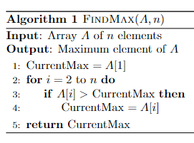
Pseudocode
High level description of an algorithm
More structured than English prose
Less detailed than a program (code)
Hides programming language specific details and design issues.

Slide 28
Pseudocode
Pseudocode conventions: CLRS Chapter 2.1
These are not universal
You are not required to strictly follow them, but should maintain usual standard practices

Slide 29
Pseudocode
Indentation indicates block
Loop counter is retained after loop (unless explicitly modified)
Local variables (unless explicitly stated)
Indexing starts from 1
A[1]: first element of array A
A[1:j]: Subarray of A from index 1 to j
A[1..j] in 3rd edition

Slide 30
Pseudocode
Compound data stored as objects
point.x, point.y
Array or object variables are pointers or references
Parameter pass by value

Slide 31
Correctness
Correct Algorithm
For every input instance, it halts with the correct output
Since there are usually infinitely many inputs, it is not trivial
Incorrect Algorithm
Might not halt at all on some input instances
Might halt with other than the desired answer

Slide 32
Correctness
Prove that the algorithm produces correct output when it terminates.
Called Partial Correctness
Prove that the algorithm is partially correct and will necessarily terminate
Called Total Correctness

Slide 33
Efficiency
To sort $n$ numbers:
Enumerate all permutations of these numbers and test which permutation has the correct order
Use FindMax $n$ times
To find the maximum
Sort the sequence and return the last number
How good are these algorithms?
How to measure how good they are?

Slide 34
Efficiency
Insertion sort vs Merge sort
Here, $c_{1},c_{2}$ are positive constant, $n$is the sequence length
Typically, $c_{1}<c_{2}$
Assume $c_{1}=2$(well-crafted code) and $c_{2}=50$ (avg code)
Insertion sort on a computer with 10 billion instructions/second
Merge sort on a computer with 10 million instructions/second
Insertion sort | Merge sort
$c_{1}×n^{2}$ instructions | $c_{2}×n\log_{2}{n}$ instructions

Slide 35
Efficiency
Insertion sort vs Merge sort
Insertion sort | Merge sort
$c_{1}×n^{2}$ instructions | $c_{2}×n\log_{2}{n}$ instructions
$$c_{1}=2$$ | $$c_{2}=50$$
Speed = ${10}^{10}$ inst./sec | Speed = ${10}^{7}$ inst./sec
Time for $n=10$
$$n=10,000$$
$$n=1,000,000$$

Slide 36
Efficiency
Insertion sort vs Merge sort
Insertion sort | Merge sort
$c_{1}×n^{2}$ instructions | $c_{2}×n\log_{2}{n}$ instructions
$$c_{1}=2$$ | $$c_{2}=50$$
Speed = ${10}^{10}$ inst./sec | Speed = ${10}^{7}$ inst./sec
0.00000002 sec | 0.0001660964047 sec
0.02 sec | 0.664385619 sec
200 sec | 99.65784285 sec
Time for $n=10$
$$n=10,000$$
$$n=1,000,000$$

Slide 37
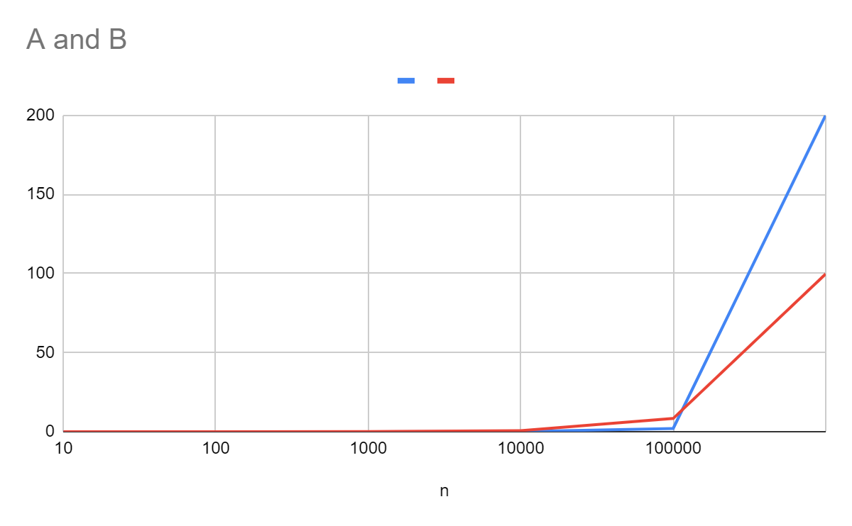
Efficiency
Insertion sort vs Merge sort
Time
(sec)
n

Slide 38
Thank You!

