Slide 1
COMP 550 Algorithm and Analysis Asymptotic Complexity Based on CLRS Sec 3
Some slides are adapted from ones by prior instructors Prof. Plaisted and Prof. Osborne

Slide 2
Asymptotic Complexity
Order of growth: how an algorithm’s running time increases w.r.t input size
Asymptotic behavior (Asymptotic complexity) of the algorithm
Running time increase as input size increases without bound
Expressed using Asymptotic Notations
Example: $O$ (Big-Oh), $Ω$ (Big-Omega), $Θ$ (Big-Theta)

Slide 3
$O$-Notation (Big-Oh)
$O$-notation characterizes an upper bound on the asymptotic behavior of a function
A function grows no faster than a certain rate (based on higher order terms)
A function is $O(g\left(n\right))$ if it grows no faster than $c⋅g\left(n\right)$ for constant $c$

Slide 4
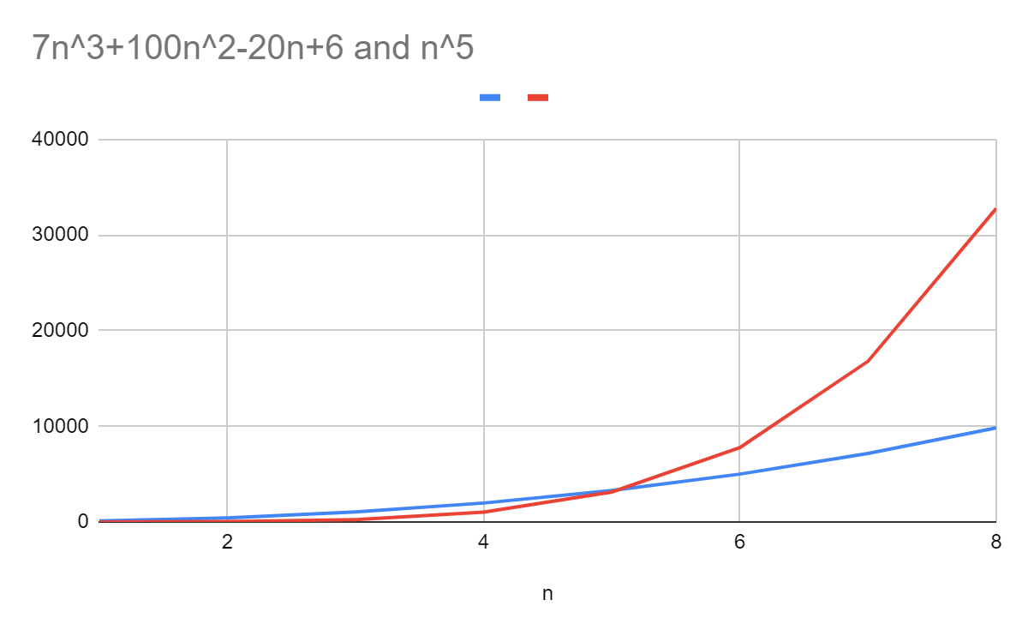
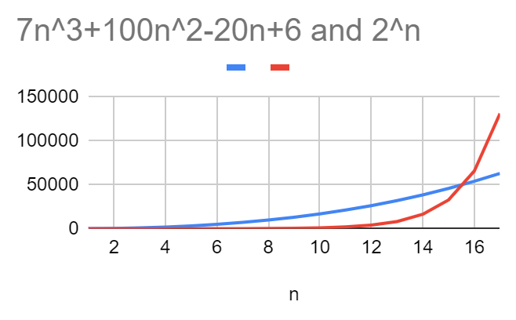
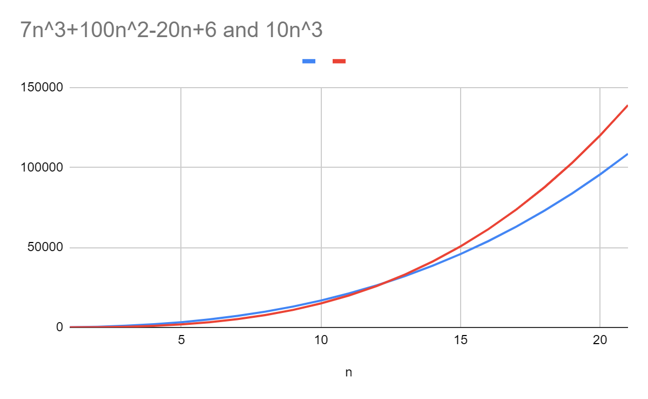
$O$-Notation (Big-Oh)
A function is $O(g\left(n\right))$ if it grows no faster than $c⋅g\left(n\right)$ for constant $c$
Example: $f(n)=7n3+100n2−20n+6$
$f\left(n\right)$is $O(n3)$
$f(n)$ is also $O(n5)$, $O(2^{n})$, and $O\left(n!\right)$. Why?

Slide 5
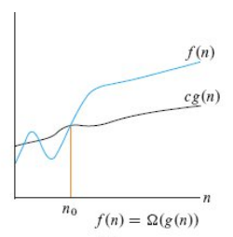
$Ω$-Notation (Big-Omega)
$Ω$-notation characterizes a lower bound on the asymptotic behavior of a function
A function grows no slower than a certain rate (based on higher order terms)
A function is $Ω(g\left(n\right))$ if it grows no slower than $c⋅g\left(n\right)$ for constant $c$

Slide 6
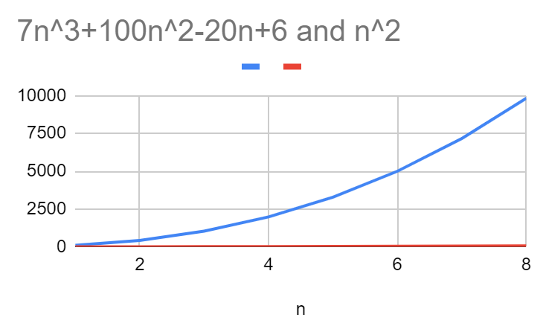
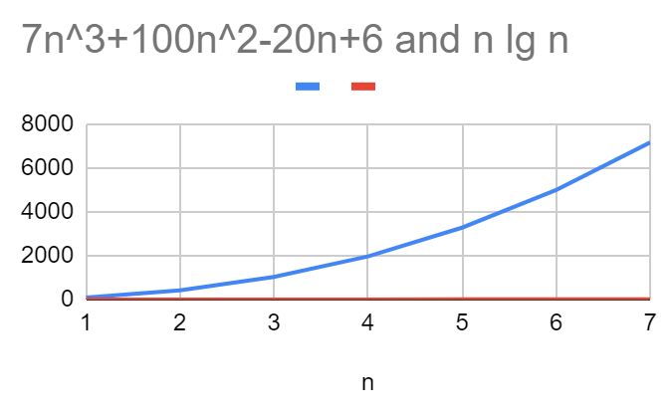
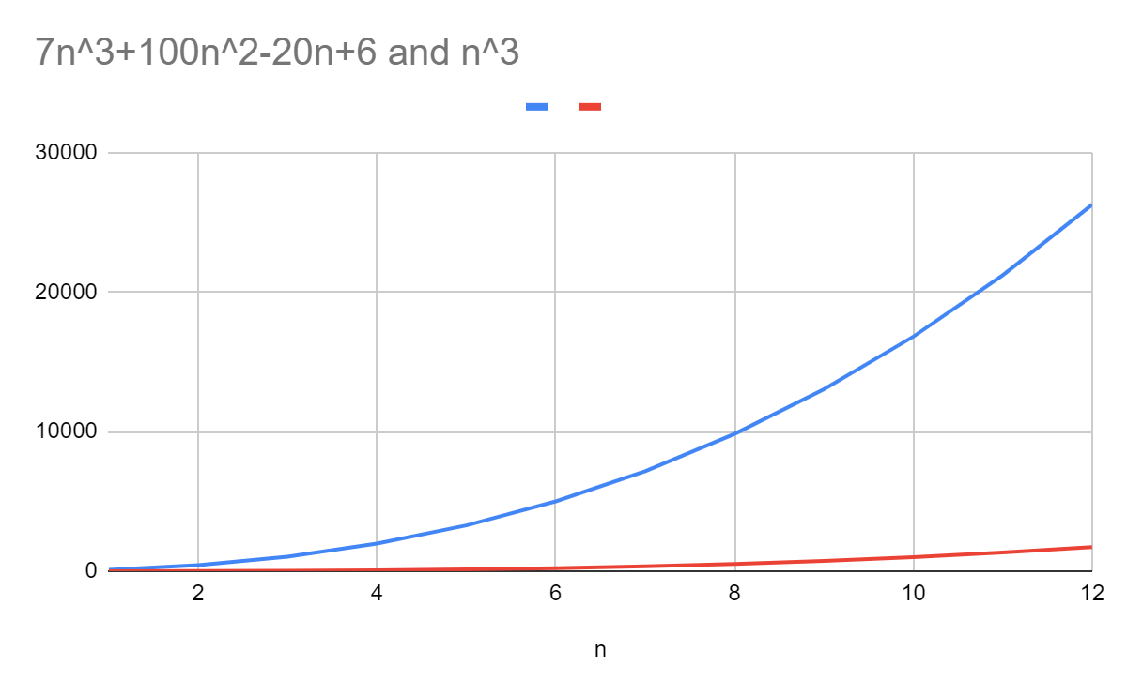
$Ω$-Notation (Big-Omega)
A function is $Ω(g\left(n\right))$ if it grows no slower than $c⋅g\left(n\right)$ for constant $c$
Example: $f(n)=7n3+100n2−20n+6$
$f\left(n\right)$is $Ω(n3)$
$f(n)$ is also $Ω(n^{2})$,$Ω(n)$, and$Ω\left(log n\right)$. Why?

Slide 7
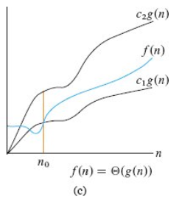
$Θ$-Notation (Big-Theta)
$Θ$-notation characterizes a tight bound on the asymptotic behavior of a function
A function grows precisely a certain rate (based on higher order terms)
A function is $Θ(g\left(n\right))$ if it is both $O(g\left(n\right))$ and $Ω(g\left(n\right))$
Example: $f(n)=7n3+100n2−20n+6$
$f\left(n\right)$is $Θ(n3)$
$f(n)$ is NOT $Θ(n^{2})$,$Θ(n^{4})$, and$Θ\left(log n\right)$. Why?

Slide 8
Why Functions?
Recall that our derived running times for FindMax, Linear Search, and Insertion Sort are functions of input size $n$
We will represent these running times in asymptotic notations
Simplicity
Enable comparison

Slide 9
Insertion Sort Asymptotic Complexity
Worst-case running time, $T\left(n\right)=$ Longest running time for any input of size $n$.
Worst-case running time of Insertion Sort is $Θ(n^{2})$. How?

Slide 10
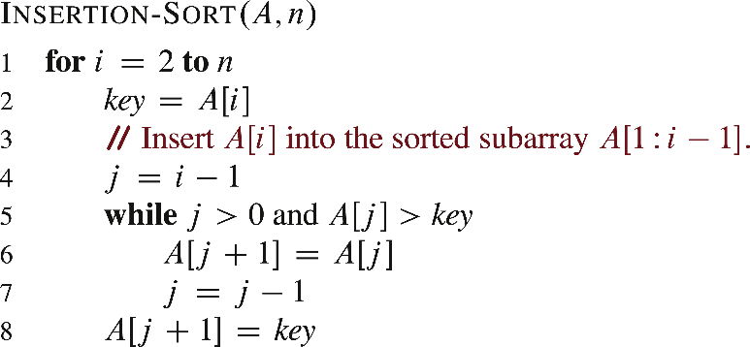
Insertion Sort Asymptotic Complexity
Can we determine this asymptotic complexity w/o evaluating sums?
Show that the worst-case running time is both $O\left(n^{2}\right)$ and $Ω\left(n^{2}\right).$
Worst-case running time of Insertion Sort is $O(n^{2})$.
Outer loop runs $n−1$ times
For each iteration of outer loop
Inner loop runs at most $i−1$ times
$i≤n ⟹i−1≤n−1$
Total inner loop iteration $≤(n−1)(n−1)$
Each line takes constant time
Worst-case running time $=O(n^{2})$

Slide 11
Insertion Sort Asymptotic Complexity
Worst-case running time of Insertion Sort is $Ω(n^{2})$,
For every $n,$ there exists an input that takes at least $c⋅n^{2}$ time for some constant $c$
For a reverse-sorted array,
A[1] moves through at least $n−1$ positions
A[2] moves through at least $n−2$ positions
…
Total steps $≥\left(n−1\right)+\left(n−2\right)+…+0=\sum_{i=1}^{n−1}{i} = \frac{\left(n−1\right)n}{2}$
Worst-case running time is at least $\frac{\left(n−1\right)n}{2}$, meaning $Ω(n^{2})$
* The textbook has a different example

Slide 12
Insertion Sort Asymptotic Complexity
The worst-case running time of Insertion Sort is $Θ\left(n^{2}\right)$
Can we say that running time of Insertion Sort is $Θ\left(n^{2}\right)$?
No. Why?
No “worst-case” in the statement $⟹Θ(n^{2})$ for all cases!
Running time is $an+b$ for some input (best-case running time)
Running time of Insertion Sort is $O(n^{2})$ and $Ω(n)$

Slide 13
Insertion Sort Asymptotic Complexity
Worst-case running time is both $O(n^{2})$ and $Ω\left(n^{2}\right)$
$$⇒Θ(n^{2})$$
Best-case running time is both $O(n)$ and $Ω(n)$
$$⇒Θ\left(n\right)$$
Running time is $O(n^{2})$ and $Ω(n)$

Slide 14
Insertion Sort Asymptotic Complexity
Running time is $O(g(n))$ $⇒$ Worst-case running time is $O(g(n))$
$O(g(n))$bound on the worst-case running time $⇒$ $O(g(n))$bound on the running time of every input.
$Θ(g(n))$bound on the worst-case running time $⇏$ $Θ(g(n))$bound on the running time of every input.
Running time is $Ω(g(n))$ $⇒$ Best case is $Ω(g(n))$
Can still say “Worst-case running time is $Ω(g(n))$”
The worst-case running time is given by some unspecified function $f\left(n\right)∈Ω\left(g\left(n\right)\right).$

Slide 15
Insertion Sort Asymptotic Complexity
Insertion sort takes Θ(n²) in the worst case, so sorting (as a problem) is O(n²). Why?
Any sorting algorithm must look at each item, so sorting is Ω(n).

Slide 16
$O$-Notation Definition
For a given function $g\left(n\right), O(g\left(n\right))$ is the set of functions
Pronounced as big-oh of g of n
$O\left(g\left(n\right)\right)$is the set of all functions whose rate of growth is the same as or lower than that of g(n).
$O\left(g\left(n\right)\right)=\{f\left(n\right) :∃$ positive constants $c,n_{0}$ such that $0≤f\left(n\right)≤cg(n)$ holds for all $n≥n_{0}\}$

Slide 17
$O$-Notation Definition
For a given function $g\left(n\right), O(g\left(n\right))$ is the set of functions
We should write $f\left(n\right)∈O(g\left(n\right))$
Common notational abuse, $f\left(n\right)=O(g\left(n\right))$
$O\left(g\left(n\right)\right)=\{f\left(n\right) :∃$ positive constants $c,n_{0}$ such that $0≤f\left(n\right)≤cg(n)$ holds for all $n≥n_{0}\}$

Slide 18
$O$-Notation Definition
$O\left(g\left(n\right)\right)=\{f\left(n\right) :∃$ positive constants $c,n_{0}$ such that $0≤f\left(n\right)≤cg(n)$ holds for all $n≥n_{0}\}$
Show that $4n^{2}+100n+500∈O(n^{2})$
Need to find appropriate $c$and $n_{0}$ such that
$$4n^{2}+100n+500≤cn^{2}$$
So, $c≥4+\frac{100}{n}+\frac{500}{n^{2}}$
One choice $n_{0}=1$ and any $c≥604$

Slide 19
$O$-Notation Definition
$O\left(g\left(n\right)\right)=\{f\left(n\right) :∃$ positive constants $c,n_{0}$ such that $0≤f\left(n\right)≤cg(n)$ holds for all $n≥n_{0}\}$
Show that $n^{3}−100n^{2}∉O(n^{2})$
Assume that
$$n^{3}−100n^{2}≤cn^{2}$$
So, $c≥n−100$, which is impossible

Slide 20
$O$-Notation Definition
$O\left(g\left(n\right)\right)=\{f\left(n\right) :∃$ positive constants $c,n_{0}$ such that $0≤f\left(n\right)≤cg(n)$ holds for all $n≥n_{0}\}$
Note that this definition requires $f\left(n\right)$ and $g(n)$ to be asymptotically non-negative
$f\left(n\right)≥0$, as $n→∞$

Slide 21
$Ω$-Notation Definition
For a given function $g\left(n\right), Ω(g\left(n\right))$ is the set of functions
Pronounced as big-omega of g of n
$Ω\left(g\left(n\right)\right)$is the set of all functions whose rate of growth is the same as or higher than that of $g(n)$.
$Ω\left(g\left(n\right)\right)=\{f\left(n\right) :∃$ positive constants $c,n_{0}$ such that $0≤cg\left(n\right)≤f(n)$ holds for all $n≥n_{0}\}$

Slide 22
$Ω$-Notation Definition
$Ω\left(g\left(n\right)\right)=\{f\left(n\right) :∃$ positive constants $c,n_{0}$ such that $0≤cg\left(n\right)≤f(n)$ holds for all $n≥n_{0}\}$
Show that $4n^{2}+100n+500∈Ω(n^{2})$
Need to find appropriate $c$and $n_{0}$ such that
$$4n^{2}+100n+500≥cn^{2}$$
So, $c≤4+\frac{100}{n}+\frac{500}{n^{2}}$
One choice $n_{0}=1$ and any $c≤604$

Slide 23
$Θ$-Notation Definition
For a given function $g\left(n\right), Θ(g\left(n\right))$ is the set of functions
Pronounced as big-theta of g of n
$Θ\left(g\left(n\right)\right)$is the set of all functions whose rate of growth is the same as $g(n)$.
$Θ\left(g\left(n\right)\right)=\{f\left(n\right) :∃$ positive constants $c_{1},c_{2},n_{0}$ such that $0≤c_{1}g\left(n\right)≤f\left(n\right)≤c_{2}g(n)$ holds for all $n≥n_{0}\}$

Slide 24
$Θ$-Notation Definition
Thm. 3.1. $f\left(n\right)=Θ\left(g(n)\right)$ if and only if $f\left(n\right)=O\left(g(n)\right)$ and $f\left(n\right)=Ω\left(g(n)\right)$
Question: How to prove statement “P if and only if Q”?
If P, then Q (Q is a necessary condition for P)
If Q, then P (Q is a sufficient condition for P)
Proof Obligation:
If $f\left(n\right)=Θ\left(g(n)\right),$then $f\left(n\right)=O\left(g(n)\right)$ and $f\left(n\right)=Ω\left(g(n)\right)$
If $f\left(n\right)=O\left(g(n)\right)$ and $f\left(n\right)=Ω\left(g(n)\right)$, then$f\left(n\right)=Θ\left(g(n)\right)$

Slide 25
$Θ$-Notation Definition
Thm. 3.1. $f\left(n\right)=Θ\left(g(n)\right)$ if and only if $f\left(n\right)=O\left(g(n)\right)$ and $f\left(n\right)=Ω\left(g(n)\right)$
If $f\left(n\right)=Θ\left(g(n)\right),$then $f\left(n\right)=O\left(g(n)\right)$ and $f\left(n\right)=Ω\left(g(n)\right):$
$$f\left(n\right)=Θ\left(g(n)\right)⟹∃c_{1},c_{2},n_{0}>0 :∀n≥n_{o}, 0≤c_{1}g\left(n\right)≤f\left(n\right)≤c_{2}g(n)$$
So, $∃c_{1}, n_{0}>0 :∀n≥n_{o}, 0≤c_{1}g\left(n\right)≤f\left(n\right)$
$$⇒f\left(n\right)=Ω(g\left(n\right))$$
Also, $∃c_{2}, n_{0}>0 :∀n≥n_{o}, 0≤{f\left(n\right)≤c}_{2}g\left(n\right)$
$$⇒f\left(n\right)=O(g\left(n\right))$$

Slide 26
$Θ$-Notation Definition
Thm. 3.1. $f\left(n\right)=Θ\left(g(n)\right)$ if and only if $f\left(n\right)=O\left(g(n)\right)$ and $f\left(n\right)=Ω\left(g(n)\right)$
If$f\left(n\right)=O\left(g(n)\right) \text{and} f\left(n\right)=Ω\left(g(n)\right),$then $f\left(n\right)=Θ\left(g(n)\right)$:
$$f\left(n\right)=Ω\left(g(n)\right)⟹∃c_{1},n_{0}^{′}>0 :∀n≥n_{0}^{′}, 0≤c_{1}g\left(n\right)≤f\left(n\right)$$
$$f\left(n\right)=O\left(g(n)\right)⟹∃c_{2},n_{0}^{′′}>0 :∀n≥n_{0}^{′′}, 0≤f\left(n\right)≤c_{2}g(n)$$
Let $n_{0}=max \{n_{0}^{′}$, $n_{0}^{′′}\}$
So, $∃{c_{1},c}_{2}, n_{0}>0 :∀n≥n_{o}, 0≤c_{1}g\left(n\right)≤{f\left(n\right)≤c}_{2}g\left(n\right)$
$$⇒f\left(n\right)=Θ(g\left(n\right))$$

Slide 27
Asymptotic Notations
Be as precise as possible
If $f\left(n\right)=Θ\left(n\right),$ then try to write so (not $f\left(n\right)=O(n))$
Algorithm A runs in $3n^{2}+20n$ time in all cases
Running time (or Time Complexity) is $Θ(n^{2})$
Running time is $O\left(n^{3}\right)$, this is imprecise
Running time is $Θ\left({3n}^{2}+20n\right),$ this has unnecessary details

Slide 28
Asymptotic Notations
Common mistakes (but kind of accepted)
An $O(n log n)$ time algorithm is faster than $O(n^{2})$ time algorithm
$O$-notation is the earliest (Bachman 1892)
$Θ$- and $Ω$-notations were advocated by Knuth

Slide 29
Asymptotic Notations in Expressions
$2n^{2}+3n+1=Θ\left(n^{2}\right)$
Equality means set membership
${2n}^{2}+Θ(n)$
$Θ\left(n\right)$is standing for an anonymous function $f\left(n\right)∈Θ(n)$
$2n^{2}+Θ\left(n\right)=Θ(n^{2})$
No matter what anonymous function $Θ\left(n\right)$ represents, there is always a way to choose an anonymous function for $Θ\left(n^{2}\right)$ so that the equation is valid.

Slide 30
Asymptotic Notations in Expressions
O(g(n)) means order of growth as $n$ goes to $∞$
What about $O\left(1\right)?$
Infer from context
If $f\left(n\right)=O(1)$, $n$goes to $∞$
$T\left(n\right)=O\left(1\right)$ for $n<3$
$∃c>0 : T\left(n\right)≤c$ for $n<3$

Slide 31
$o$-Notation
Non-tight upper bound
Compare the definition with $O$-notation
$2n^{2}+n$ is $O(n^{2})$, but not $o(n^{2})$
$2n^{2−ε}+n$ for any $ε>0$ is $o(n^{2})$
$o\left(g\left(n\right)\right)=\{f\left(n\right) :∀$ positive constants $c, ∃n_{0}>0$ such that $0≤f\left(n\right)<cg(n)$ holds for all $n≥n_{0}\}$

Slide 32
$o$-Notation
Non-tight upper bound
Intuitively, $f\left(n\right)$becomes insignificant w.r.t $g(n)$ as $n→∞$
$$\lim_{n→∞}{\frac{f(n)}{g(n)}}=0$$
$o\left(g\left(n\right)\right)=\{f\left(n\right) :∀$ positive constants $c, ∃n_{0}>0$ such that $0≤f\left(n\right)<cg(n)$ holds for all $n≥n_{0}\}$

Slide 33
$ω$-Notation
Non-tight upper bound
Compare the definition with $Ω$-notation
$2n^{2}+n$ is $Ω(n^{2})$, but not $ω(n^{2})$
$2n^{2+ε}+n$ for any $ε>0$ is $ω(n^{2})$
$ω\left(g\left(n\right)\right)=\{f\left(n\right) :∀$ positive constants $c, ∃n_{0}>0$ such that $0≤cg\left(n\right)<f(n)$ holds for all $n≥n_{0}\}$

Slide 34
$ω$-Notation
Non-tight upper bound
Intuitively, $f\left(n\right)$becomes arbitrarily large w.r.t $g(n)$ as $n→∞$
$$\lim_{n→∞}{\frac{f(n)}{g(n)}}=∞$$
$ω\left(g\left(n\right)\right)=\{f\left(n\right) :∀$ positive constants $c, ∃n_{0}>0$ such that $0≤cg\left(n\right)<f(n)$ holds for all $n≥n_{0}\}$

Slide 35
Asymptotic Notations: Properties
Transitivity:
$f\left(n\right)=X\left(g\left(n\right)\right)∧g\left(n\right)=X\left(h\left(n\right)\right) ⇒f\left(n\right)=X\left(h\left(n\right)\right)$
$X$can be any one of $O,Ω, Θ, o, ω$
Reflexivity:
$f\left(n\right)=X(f\left(n\right))$, where $X$ is one of $O,Ω, Θ$
Why not applicable to $o$ and $ω?$

Slide 36
Asymptotic Notations: Properties
Symmetry:
$f\left(n\right)=Θ\left(g\left(n\right)\right) ⇔g\left(n\right)=Θ\left(f\left(n\right)\right)$
Transpose symmetry:
$f\left(n\right)=O\left(g\left(n\right)\right)⇔g\left(n\right)=Ω\left(f\left(n\right)\right)$
$f\left(n\right)=o\left(g\left(n\right)\right)⇔g\left(n\right)=ω\left(f\left(n\right)\right)$

Slide 37
Asymptotic Notations: Properties
Prove that$o\left(g\left(n\right)\right)∩ω\left(g\left(n\right)\right)=∅.$
Assume that $f\left(n\right)∈o\left(g\left(n\right)\right)∩ω\left(g\left(n\right)\right)$
From $f\left(n\right)∈o\left(g\left(n\right)\right),$ $∀c>0, ∃n_{0}^{′}>0:∀n≥n_{0}^{′}, 0≤f\left(n\right)<cg\left(n\right)$
From $f\left(n\right)∈ω\left(g\left(n\right)\right),$ $∀c>0, ∃n_{0}^{′′}>0:∀n≥n_{0}^{′′}, 0≤cg\left(n\right)<f\left(n\right)$
Let $n_{0}=\max{\{n_{0}^{′}, n_{0}^{′′}\}}$
Then, $∀n≥n_{0}:f\left(n\right)<cg\left(n\right)∧cg\left(n\right)<f\left(n\right)$
This is impossible, a contradiction

Slide 38
Asymptotic Notations: Properties
$$O(g\left(n\right))$$
$$Ω(g\left(n\right))$$
$$o(g\left(n\right))$$
$$Θ(g\left(n\right))$$
$$ω(g\left(n\right))$$

Slide 39
Useful but Incorrect Analogies
Asymptotic Notation | Is Like
$$f\left(n\right)=O(g\left(n\right))$$ | $$f\left(n\right)≤g(n)$$
$$f\left(n\right)=Θ(g\left(n\right))$$ | $$f\left(n\right)=g\left(n\right)$$
$$f\left(n\right)=Ω(g\left(n\right))$$ | $$f\left(n\right)≥g\left(n\right)$$
$$f\left(n\right)=o(g\left(n\right))$$ | $$f\left(n\right)<g(n)$$
$$f\left(n\right)=ω(g\left(n\right))$$ | $$f\left(n\right)>g(n)$$
Warning: DO NOT formally use them in HWs/Exams/Interviews

Slide 40
Exercise
Express functions in A in asymptotic notation using functions in B.
A B
5n² + 100n 3n² + 2
A ∈ Θ(B)
A ∈ Θ(n²), n² ∈ Θ(B) ⇒ A ∈ Θ(B)
log₃(n²) log₂(n³)
A ∈ Θ(B)
log_{b}a = log_{c}a / log_{c}b; A = 2lgn / lg3, B = 3lgn, A/B =2/(3lg3)
lg²n n^{1/2}
A ∈ ο (B)
lim ( lgª n / n^{b} ) = 0 (here a = 2 and b = 1/2) ⇒ A ∈ ο (B)
^{n→∞}

Slide 41
Common Functions

Slide 42
Motonocity
A function $f(n)$ is
Monotonically increasing if $m≤n ⟹f\left(m\right)≤f(n)$
Monotonically decreasing if $m≤n ⟹f\left(m\right)≥f(n)$
Strictly increasing if $m<n ⟹f\left(m\right)<f\left(n\right)$
Strictly decreasing if $m<n ⟹f\left(m\right)>f(n)$
Question: Which of the above is true for $f\left(n\right)=n^{2}$ where $n≥0?$

Slide 43
Polynomials
$p\left(n\right)$ is a polynomial in $n$ of degree $d$ if
$p\left(n\right)=a_{d}p^{d}+a_{d−1}p^{d−1}+…+a_{0}$ AND $a_{d}≠0$ ($d≥0$ is an integer constant)
$a_{d}, a_{d−1,}…$are co-efficients
$p\left(n\right)=Θ(n^{d})$
A function $f\left(n\right)=O(n^{k})$ for a constant $k$ is called polynomially bounded
Common polynomials:
$O(n)$: Linear running time, $O(n^{2})$: Quadratic running time, $O(n^{3})$: Cubic running time

Slide 44
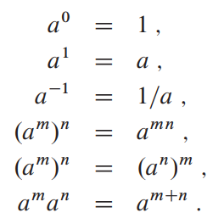
Exponentials
Functions that have $a^{n}$ terms ($a$ is a constant)
Polynomials: variable base, constant exponent
Exponentials: constant base, variable exponent
For any real constants $a, b$ with $a>1$
$n^{b}=o(a^{b})$, because $\lim_{n⟶∞}{\frac{n^{b}}{a^{b}}=0}$
See book for some (in)equalities regarding $e^{x}$
Identities

Slide 45
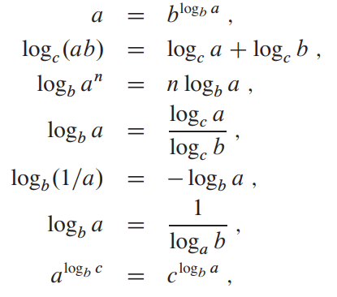
Logarithms
$x = logba ⟺$ $a = b^{x}$
Identities
CLRS Notations

Slide 46
Logarithms
Log bases do not matter in asymptotic notations
$\log_{a}{n=Θ(\log_{b}{n)}}$. Why?
A function $f\left(n\right)=O(\lg^{k}n)$ for a constant $k$ is called polylogarithmically bounded
$\lg^{b}{n=o(n^{a})}$ for any $a>0$
Identities

Slide 47
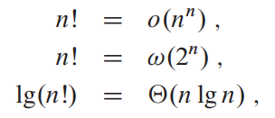
Factorials
How many ways can you arrange $n$ items?
Stirling’s approximation
Using the above:

Slide 48
Growth Rates
$$n$$ | $$lg⁡n$$ | $$\lg^{2}{n}$$ | $$\sqrt{n}$$ | $$n lg⁡n$$ | $$n^{2}$$ | $$n^{3}$$ | $$2^{n}$$
4 | 2 | 4 | 2 | 8 | 16 | 64 | 16
16 | 4 | 16 | 4 | 64 | 256 | 4096 | 65536
64 | 6 | 36 | 8 | 384 | 4096 | 2.62E+05 | 1.84E+19
256 | 8 | 64 | 16 | 2048 | 65536 | 1.68E+07 | 1.16E+77
1024 | 10 | 100 | 32 | 10240 | 1.05E+06 | 1.07E+09 | 1.79E+308
4096 | 12 | 144 | 64 | 4.92E+04 | 1.68E+07 | 6.87E+10 | E+1233
16384 | 14 | 196 | 128 | 2.29E+05 | 2.68E+08 | 4.40E+12 | E+4932
65536 | 16 | 256 | 256 | 1.05E+06 | 4.29E+09 | 2.81E+14 | E+19728
262144 | 18 | 324 | 512 | 4.72E+06 | 6.87E+10 | 1.80E+16 | E+78913

Slide 49
Growth Rates
Running times on a million instruction/sec machine
$$n$$ | $$lg⁡n$$ | $$\lg^{2}{n}$$ | $$\sqrt{n}$$ | $$n lg⁡n$$ | $$n^{2}$$ | $$n^{3}$$ | $$2^{n}$$
4 | <1 sec | <1 sec | <1 sec | < 1 sec | <1 sec | <1 sec | <1 sec
16 | <1 sec | <1 sec | <1 sec | < 1 sec | <1 sec | <1 sec | <1 sec
64 | <1 sec | <1 sec | <1 sec | < 1 sec | <1 sec | <1 sec | 2*10^8 years
256 | <1 sec | <1 sec | <1 sec | < 1 sec | <1 sec | 16 sec | very long
1024 | <1 sec | <1 sec | <1 sec | < 1 sec | 1 sec | 18 min | very long
4096 | <1 sec | <1 sec | <1 sec | < 1 sec | 16 sec | 19 hours | very long
16384 | <1 sec | <1 sec | <1 sec | < 1 sec | 5 min | 51 years | very long
65536 | <1 sec | <1 sec | <1 sec | 1 sec | 1 hour | 3257 years | very long
262144 | <1 sec | <1 sec | <1 sec | 5 sec | 19 hours | 2*10^5 years | very long

Slide 50
Growth Rate | Name | Examples and Notes
$$Θ(1)$$ | Constant | Add to linked list (unsorted) Assign value to variable
$$Θ(\lg{n})$$ | Logarithmic | Binary Search
$$Θ(\sqrt{n})$$ | Square Root | Primality Testing;
$$Θ(n)$$ | Linear | Find item in unsorted lists, String comparison, Special-purpose sorts
$$Θ(n lg n)$$ | Log-Linear | Good sorting algorithms (merge sort, heapsort)
$$Θ(n^{2})$$ | Quadratic | Naive sorting algorithms (Bubble, Insertion, Selection)
$$Θ(n^{3})$$ | Cubic | Naive Matrix Multiplication Floyd-Warshall (All-pairs shortest paths)
$$Θ\left(n^{p}\right), p>3$$ | High-Order Polynomial | Perfect graph recognition, O($n^{9}$). https://cstheory.stackexchange.com/questions/6660/polynomial-time-algorithms-with-huge-exponent-constant/
$$Θ\left(c^{n}\right), c>1$$ | Exponential | Find all subsets. Algorithm is inefficient, if can’t do better, then the problem is hard.
$$Θ(n!)$$ | Factorial | Find all permutations.

Slide 51
Thank You!

