Slide 1
COMP 550 Algorithm and Analysis Divide & Conquer Based on CLRS Sec 3
Some slides are adapted from ones by prior instructors Prof. Plaisted and Prof. Osborne

Slide 2
Divide & Conquer
Recursive in structure
Divide the problem into sub-problems that are similar to the original but smaller in size
Conquer the sub-problems by solving them recursively. If they are small enough, just solve them in a straightforward manner.
Combine the solutions to create a solution to the original problem

Slide 3
Divide & Conquer
Divide-and-Conquer(A)
if size of A is small
calculate and return result
Partition A into A₁, A₂, …, A_{k}
R₁ = Divide-and-Conquer(A₁)
R₂ = Divide-and-Conquer(A₂)
…
R₃ = Divide-and-Conquer(A₃)
R = Calculate result from R₁, R₂, …, R_{k}
return R

Slide 4
Merge Sort
Sorting Problem: Sort a sequence of n elements into non-decreasing order.
Divide: Divide the n-element sequence to be sorted into two subsequences of n/2 elements each
Conquer: Sort the two subsequences recursively using merge sort.
Combine: Merge the two sorted subsequences to produce the sorted answer.
18
26
32
6
43
15
9
1
1
6
9
15
18
26
32
43
43
15
15
9
1
6
18
26
32
1
43
18
26
32
6
9

Slide 5
Merge Sort
Original Sequence
Sorted Sequence
18
26
32
6
43
15
9
1
1
6
9
15
18
26
32
43
18
26
32
6
43
15
9
1
6
18
26
32
1
9
15
43
18
26
32
6
43
15
9
1
18
26
6
32
15
43
1
9
18
26
32
6
43
15
9
1
18
26
32
6
43
15
9
1
18
26
32
6
43
15
9
1

Slide 6
Merge Sort

Slide 7
Merge Procedure
Merge($A, p, q, r$)
n_{L} = q – p + 1
n_{R} = r – q
Let L[1:n_{L}] and R[1:n_{R}] be new arrays
for i = 1 to n_{L}
L[i] = A[p + i – 1]
for j = 1 to n_{R}
R[j] = A[q + j]
L[n_{L}+1] = R[n_{R}+1] = $$
i = j = 1
for k = p to r
if L[i] ≤ R[j]
A[k] = L[i]
i = i + 1
else
A[k] = R[j]
j = j + 1
From CLSR 3rd edition
Input: Array $A$ with sorted subarrays $A[p:q]$ and $A\left[q+1,r\right]$
Output: Array A with sorted subarray $A[p:r]$
Sentinels: Simplification by avoiding having to check if either subarray is fully copied at each step.

Slide 8
Merge Procedure
Merge($A, p, q, r$)
n_{L} = q – p + 1
n_{R} = r – q
Let L[1:n_{L}] and R[1:n_{R}] be new arrays
for i = 1 to n_{L}
L[i] = A[p + i – 1]
for j = 1 to n_{R}
R[j] = A[q + j]
L[n_{L}+1] = R[n_{R}+1] = ∞
i = j = 1
for k = p to r
if L[i] ≤ R[j]
A[k] = L[i]
i = i + 1
else
A[k] = R[j]
j = j + 1
A
…
6
8
26
32
1
9
42
43
…
1
6
8
9
26
32
42
43
k
k
k
k
k
k
k
k
k
L
6
8
26
32
∞
R
6
8
26
32
1
9
42
43
∞
1
9
42
43
i
i
i
i
i
j
j
j
j
j

Slide 9
Merge Procedure
Merge($A, p, q, r$)
n_{L} = q – p + 1
n_{R} = r – q
Let L[1:n_{L}] and R[1:n_{R}] be new arrays
for i = 1 to n_{L}
L[i] = A[p + i – 1]
for j = 1 to n_{R}
R[j] = A[q + j]
L[n_{L}+1] = R[n_{R}+1] = $$
i = j = 1
for k = p to r
if L[i] ≤ R[j]
A[k] = L[i]
i = i + 1
else
A[k] = R[j]
j = j + 1
Correctness:
We need to show that-
Given sorted subarrays $A[p:q]$ and $A\left[q+1:r\right],$ the Merge procedure constructs a sorted subarray $A[p:r]$ that consists of all elements in $A[p:q]$ and $A\left[q+1:r\right]$

Slide 10
Merge Procedure
Merge($A, p, q, r$)
n_{L} = q – p + 1
n_{R} = r – q
Let L[1:n_{L}] and R[1:n_{R}] be new arrays
for i = 1 to n_{L}
L[i] = A[p + i – 1]
for j = 1 to n_{R}
R[j] = A[q + j]
L[n_{L}+1] = R[n_{R}+1] = $$
i = j = 1
for k = p to r
if L[i] ≤ R[j]
A[k] = L[i]
i = i + 1
else
A[k] = R[j]
j = j + 1
Loop Invariant for the for loop
At the start of each iteration of the for loop of lines 10-16, subarray A[p:k – 1] consists of the k – p smallest elements of L and R in sorted order. L[i] and R[j] are the smallest elements of L and R that have not been copied back into A.
Initialization: Trivial

Slide 11
Merge Procedure
Merge($A, p, q, r$)
n_{L} = q – p + 1
n_{R} = r – q
Let L[1:n_{L}] and R[1:n_{R}] be new arrays
for i = 1 to n_{L}
L[i] = A[p + i – 1]
for j = 1 to n_{R}
R[j] = A[q + j]
L[n_{L}+1] = R[n_{R}+1] = $$
i = j = 1
for k = p to r
if L[i] ≤ R[j]
A[k] = L[i]
i = i + 1
else
A[k] = R[j]
j = j + 1
Maintenance:
Case 1: $L[i]  R[j]$
LI holds at the start of k-th iteration
By LI, A contains $k – p$smallest elements of L and R in sorted order.
By LI, L[i] and R[j] are the smallest elements of L and R not yet copied into A.
Line 12 results in A containing $k –p + 1$smallest elements (again in sorted order).
Incrementing i and k establishes the LI for the next iteration.
Similarly, for $L[i] > R[j].$

Slide 12
Merge Procedure
Merge($A, p, q, r$)
n_{L} = q – p + 1
n_{R} = r – q
Let L[1:n_{L}] and R[1:n_{R}] be new arrays
for i = 1 to n_{L}
L[i] = A[p + i – 1]
for j = 1 to n_{R}
R[j] = A[q + j]
L[n_{L}+1] = R[n_{R}+1] = $$
i = j = 1
for k = p to r
if L[i] ≤ R[j]
A[k] = L[i]
i = i + 1
else
A[k] = R[j]
j = j + 1
Termination:
On termination, $k = r + 1$.
By LI, A contains $r – p + 1$smallest
elements of L and R in sorted order.
L and R together contain $r – p + 3$elements.
All but the two sentinels have been copied back into A.

Slide 13
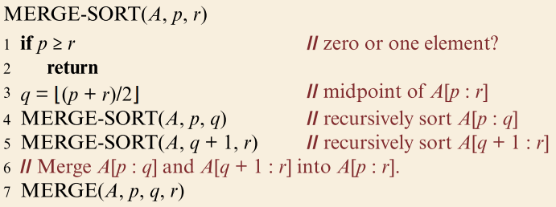
Merge Sort
Correctness of Merge Sort:
We need to prove that-
Given a (sub)array $A\left[p:r\right],$ merge sort correctly sort $A\left[p:r\right].$

Slide 14
Merge Sort
Use Strong Induction
Base case: Array size $=1$ (In other words, $p=r)$
Merge-Sort is correct due to lines 1-2
Inductive Hypothesis (IH): Merge sort correctly sorts any array of size $<n$(In other words, $r−p<n)$
Inductive Step: By IH, after lines 4 and 5, $A\left[p:q\right]$and $A[q+1:r]$ are sorted
By the Loop invariant we’ve proved, line 7 correctly constructs sorted $A\left[p:r\right]$
So, Merge Sort is correct.

Slide 15
Merge Procedure: Time Complexity
Merge($A, p, q, r$)
n_{L} = q – p + 1
n_{R} = r – q
Let L[1:n_{L}] and R[1:n_{R}] be new arrays
for i = 1 to n_{L}
L[i] = A[p + i – 1]
for j = 1 to n_{R}
R[j] = A[q + j]
L[n_{L}+1] = R[n_{R}+1] = $$
i = j = 1
for k = p to r
if L[i] ≤ R[j]
A[k] = L[i]
i = i + 1
else
A[k] = R[j]
j = j + 1
Lines 1-3: $Θ\left(1\right)$time
Lines 4-7: $Θ\left(n_{L}+n_{R}\right)=Θ(n)$ time
$n=n_{L}+n_{R}=r−p+1$
Lines 8-9: $Θ(1)$ time
Lines 10-16: $Θ\left(r−p+1\right)=Θ(n)$ time
Total running time: $Θ(n)$

Slide 16
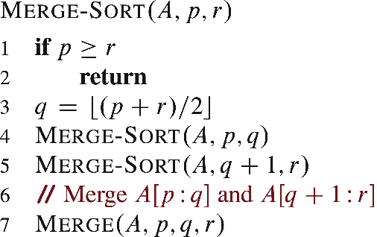
Merge Sort: Time Complexity
Determine running time $T\left(n\right)$ to sort $n$ elements
Time
$$Θ(1)$$
$$Θ(1)$$
$$Θ(1)$$
$$T\left(\frac{n}{2}\right)$$
$$Θ(n)$$
$$T(n) =2×T\left(\frac{n}{2}\right)+Θ(n)$$

Slide 17
Merge Sort: Time Complexity
$$T\left(n\right)=2T\left(\frac{n}{2}\right)+Θ(n)$$
Running time for input size $n$
Non-recursive parts
Number of recursive calls
Input size of recursive call
Actual Merge Sort recurrence: $T\left(n\right)=T\left(\left\lfloor \frac{n}{2}\right\rfloor \right)+T\left(\left\lceil \frac{n}{2}\right\rceil \right)+Θ(n)$
Safe to ignore floors and ceilings in asymptotic analysis

Slide 18
Merge Sort: Time Complexity
Considering the base case
$$T\left(n\right)=\left\{\begin{aligned}Θ\left(1\right) \\ 2T\left(\frac{n}{2}\right)+Θ(n)\end{aligned}\right.$$
We can rewrite the above as
$$T\left(n\right)=\left\{\begin{aligned}c_{1} \\ 2T\left(\frac{n}{2}\right)+c_{2}n\end{aligned}\right.$$
Can we replace $c_{1}$ and $c_{2}$ by a single constant $c?$
if $n=1$
if $n>1$
if $n=1$
if $n>1$

Slide 19
Recurrence Relations

Slide 20
Solving Recurrence: Recursion Trees
$$c_{2}n$$
$$T\left(n\right)=2T\left(\frac{n}{2}\right)+c_{2}n$$
$$+$$
$$T\left(\frac{n}{2}\right)$$
$$+$$
$$T\left(\frac{n}{2}\right)$$

Slide 21
Recursion Tree Expansion
$$T\left(n\right) =c_{2}n+ T\left(\frac{n}{2}\right)+T\left(\frac{n}{2}\right)$$
$$T\left(\frac{n}{2}\right)=c_{2}\left(\frac{n}{2}\right)+ T\left(\frac{n}{4}\right)+T\left(\frac{n}{4}\right)$$

Slide 22
Recursion Tree Expansion

Slide 23
Recursion Tree Expansion
Each time we go down one level, the number of subproblems doubles, but the cost per subproblem halves
Cost per level remains the same ($c_{2}n)$ until $n=1$
How many levels?
When will input size go from $n$ to 1 by repetitive division by 2?
Alternative: When will input size go from 1 to n by repetitive multiplication by 2?

Slide 24
Recursion Tree Expansion
Assume that $n$ is an exact power of $2$
$$2×2×2×…=n$$
$$⟹2^{y}=n$$
$$⟹y=lg n$$
$y=lg n$ steps from $2$to $n$
$y+1=lg n+1$ steps from $1$to $n$

Slide 25
Recursion Tree Expansion
Cost at each level except the base case (leaves) is $c_{2}n$
Number of such levels$,y=lg n$
Cost for base case $=c_{1}n$
Total cost $= lg n⋅c_{2}n+c_{1}n=Θ(n lg n)$

Slide 26
Ignoring Floors And Ceilings
Actual merge sort recurrence,
$$T\left(n\right)=T\left(\left\lfloor \frac{n}{2}\right\rfloor \right)+T\left(\left\lceil \frac{n}{2}\right\rceil \right)+Θ\left(n\right)$$
$$≤2T\left(\frac{n}{2}+1\right)+Θ(n)$$
Define a new recurrence $S\left(n\right)=T(n+c)$, $c$is a constant
Applying def of $T$and $S$, $S\left(n\right)≤2S\left(\frac{n}{2}−\frac{c}{2}+1\right)+n+c$
c=2 implies $S\left(n\right)≤2S\left(\frac{n}{2}\right)+n+2$
Solution of $S\left(n\right)=O(n\lg{n)}$, asymptotically remains same for $T(n)$

Slide 27
Closest Pair of Points
Input: A set $P=\left\{p_{1},p_{2}, …, p_{n}\right\}$ of $n$ points on a plane. Each $p_{i}=(x_{i},y_{i})$
Output: A pair of points that are closest together
$y$
$$(12,3)$$
$$(3,0)$$
$$(0,0)$$
$$(10,0)$$
$x$

Slide 28
Closest Pair of Points: Naïve Solution
ClosestPointNaive($P,n$)
Minimum = $∞$
Closest = NIL
for i = 1 to n
for j = i + 1 to n
if Dist(p_{i} , p_{j}) < Minimum
Minimum = Dist(p_{i} , p_{j})
Closest = (p_{i} , p_{j})
return Closest
dist($p_{i }, p_{j}$)
// sqrt is not needed for this purpose
return (p_{i}.x - p_{j}.x) * (p_{i}.x - p_{j}.x)
+ (p_{i}.y - p_{j}.y) * (p_{i}.y - p_{j}.y)
What it this algorithm’s running time?
$Θ(n^{2})$

Slide 29
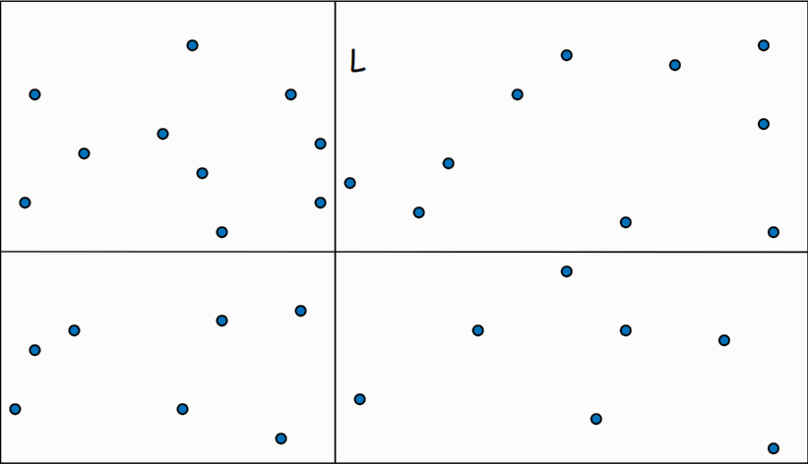
Divide and Conquer Solution
Any better solution must run faster than $Θ\left(n^{2}\right)$
Typical runtime to consider: $O\left(n\right), O\left(n lg n\right), O\left(n \lg^{2} n\right), …$
Divide and conquer approach similar to merge sort: first attempt

Slide 30
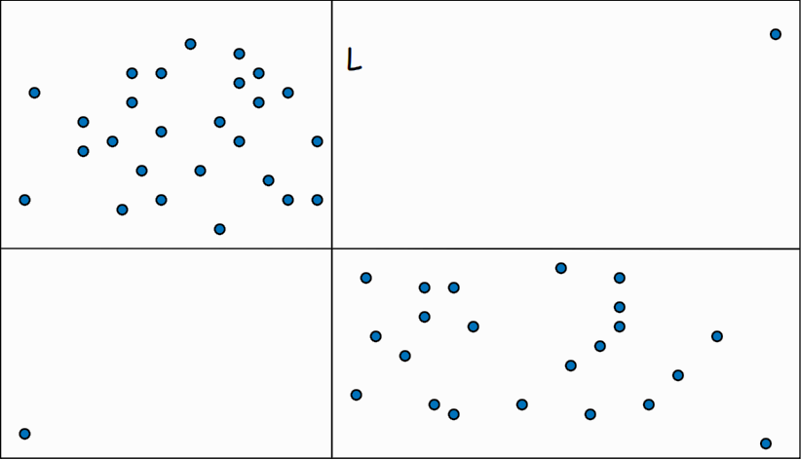
Divide and Conquer Solution
Problem: Subdividing the entire region in 4 quadrants each with $\frac{n}{4}$ points is impossible.

Slide 31
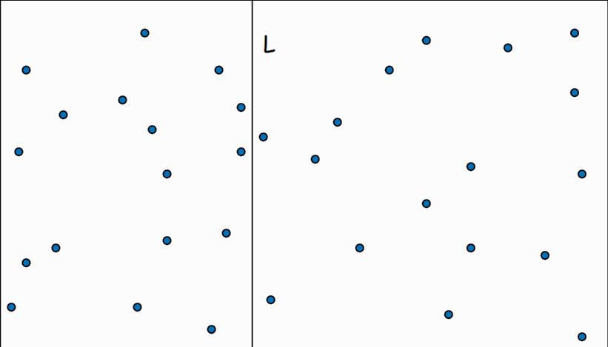
Divide and Conquer Solution
Divide: $n$ points into $≈\frac{n}{2}$ points in left and right by a vertical line $L$
Need to sort all points according to $x$-coordinate

Slide 32
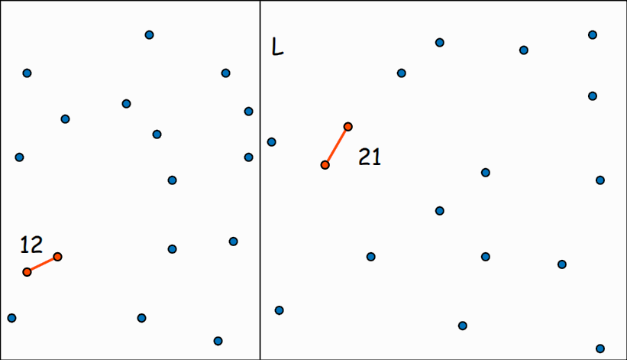
Divide and Conquer Solution
Divide: $n$ points into $≈\frac{n}{2}$ points in left and right by a vertical line $L$
Conquer: Find closest pair of points in each side recursively

Slide 33
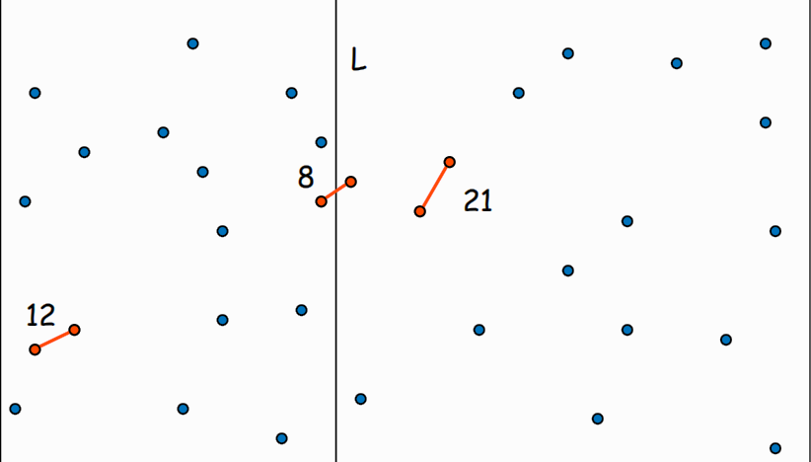
Divide and Conquer Solution
Divide: $n$ points into $≈\frac{n}{2}$ points in left and right by a vertical line $L$
Conquer: Find closest pair of points in each side recursively
Combine: Find closest pair with one point in each side and return the closest among the three

Slide 34
Combine
Let $δ_{1}, δ_{2}$ be the distance between closest pair in each side.
Let $δ=min \left\{δ_{1}, δ_{2}\right\}$
Observation: Only points within $δ$ within $L$ can be closer than the current closest pair
$$δ$$
$$δ=min\left\{12,21\right\}$$
$=12$

Slide 35
Combine
Observation: Only points within $δ$ within $L$ are needed to be checked
Does calculating all pair distance between two shaded region help?
$$δ$$
$$δ=min\left\{12,21\right\}$$
$=12$

Slide 36
Combine
Observation: Only points within $δ$ within $L$ are needed to be checked
Does calculating all pair distance between two shaded region help?
$$δ$$
$$δ=min\left\{12,21\right\}$$
$=12$

Slide 37
Combine
Observation: Only points within $δ$ within $L$ are needed to be checked
Sort points in 2$δ$-strip by their $y$-coordinates
For each point, only check distances of those within 11 positions in sorted list!
$$δ$$
7
6
5
4
$$δ=min\left\{12,21\right\}$$
$=12$
3
2
1

Slide 38
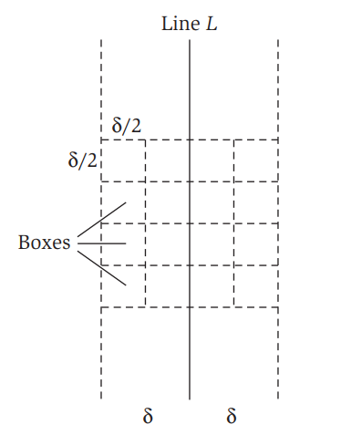
Combine
Let $S_{y}$ be the sorted points within the 2$δ$-strip
Proof: Assume that $p_{i},p_{j}$ are at least 12 points of each other.
Subdivide the 2$δ$-strip into $\frac{δ}{2}×\frac{δ}{2}$ boxes.
Each box contains at most one point. Why?
So, there must be two rows of boxes between $p_{i}, p_{j}.$ Why?
Then, $dist\left(p_{i},p_{j}\right)≥2⋅\frac{δ}{2}= δ,$ contradiction.
Lemma. If $p_{i}, p_{j}$ lie in different side of $L$ and $dist\left(p_{i},p_{j}\right)<δ$ holds, then $p_{i}$ and $p_{j}$ are within 11 points of each other in $S_{y}$

Slide 39
The Algorithm
ClosestPoint ($P,n$)
if n $≤$ 3
Calculate all distances and return min
Sort P by x-coordinates
mid = $\left\lfloor \frac{n}{2}\right\rfloor$
L = vertical line according to p_{mid}
${(sL, sR, δ}_{1})$ = ClosestPoint({p₁, p₂,…, p_{mid})
${(tL, tR, δ}_{2})$ = ClosestPoint({p_{mid+1}, p_{mid+2},…, p_{n})
$δ$ = min($δ_{1}, δ_{2})$
m₁, m₂ = Points corresponding to $δ$
S_{y} = All points within 2$δ$-strip from L
Sort S_{y} by y-coordinates
n_{y} = |S_{y}|
for i = 1 to n_{y}-1
for j = i + 1 to min(i + 11, n_{y})
if dist(p_{i}, p_{j}) < $δ$
(m₁,m₂,$δ)$ = (p_{i},p_{j},dist(p_{i}, p_{j}))
return (m₁,m₂,$δ)$
Lines 1-2, $Θ\left(1\right)$ time
Line 3, $Θ\left(n lg n\right)$ time
Lines 4-5, $Θ\left(1\right)$ time
Lines 6-7, $2T\left(\frac{n}{2}\right)$ time
Lines 8-9, $Θ\left(1\right)$ time
Line 10, $Θ\left(n\right)$ time
Line 11, $Θ(n lg n)$ time
Line 12, $Θ(1)$ time
Lines 13-16, $Θ\left(n\right)$ time
Line 17, $Θ\left(1\right)$ time

Slide 40
Recurrence
$$T\left(n\right)=\left\{\begin{aligned}Θ(1) \\ 2T\left(\frac{n}{2}\right)+Θ(n lg n)\end{aligned}\right.$$
Solving the recurrence,
$$T\left(n\right)=Θ(n \lg^{2}n)$$
How?
if $n≤3$
if $n>3$

Slide 41
Running Time
$$c_{2} n lg n$$
$$c_{2} n lg n$$
$$c_{2}\frac{n}{2} lg\frac{n}{2}$$
$$c_{2}\frac{n}{2} lg\frac{n}{2}$$
$$c_{2} n lg\frac{n}{2}$$
$lg n$ $+ 1$
$$c_{2}\frac{n}{4} lg\frac{n}{4}$$
$$c_{2}\frac{n}{4} lg\frac{n}{4}$$
$$c_{2}\frac{n}{4} lg\frac{n}{4}$$
$$c_{2}\frac{n}{4} lg\frac{n}{4}$$
$$c_{2} n lg\frac{n}{4}$$
$$c_{1} n$$
$$c_{1}$$
$$c_{1}$$
$$c_{1}$$
$$c_{1}$$
$$c_{1}$$
$$c_{1}$$
$$c_{1}$$
$$c_{1}$$
$$c_{1}$$
$$c_{1}$$

Slide 42
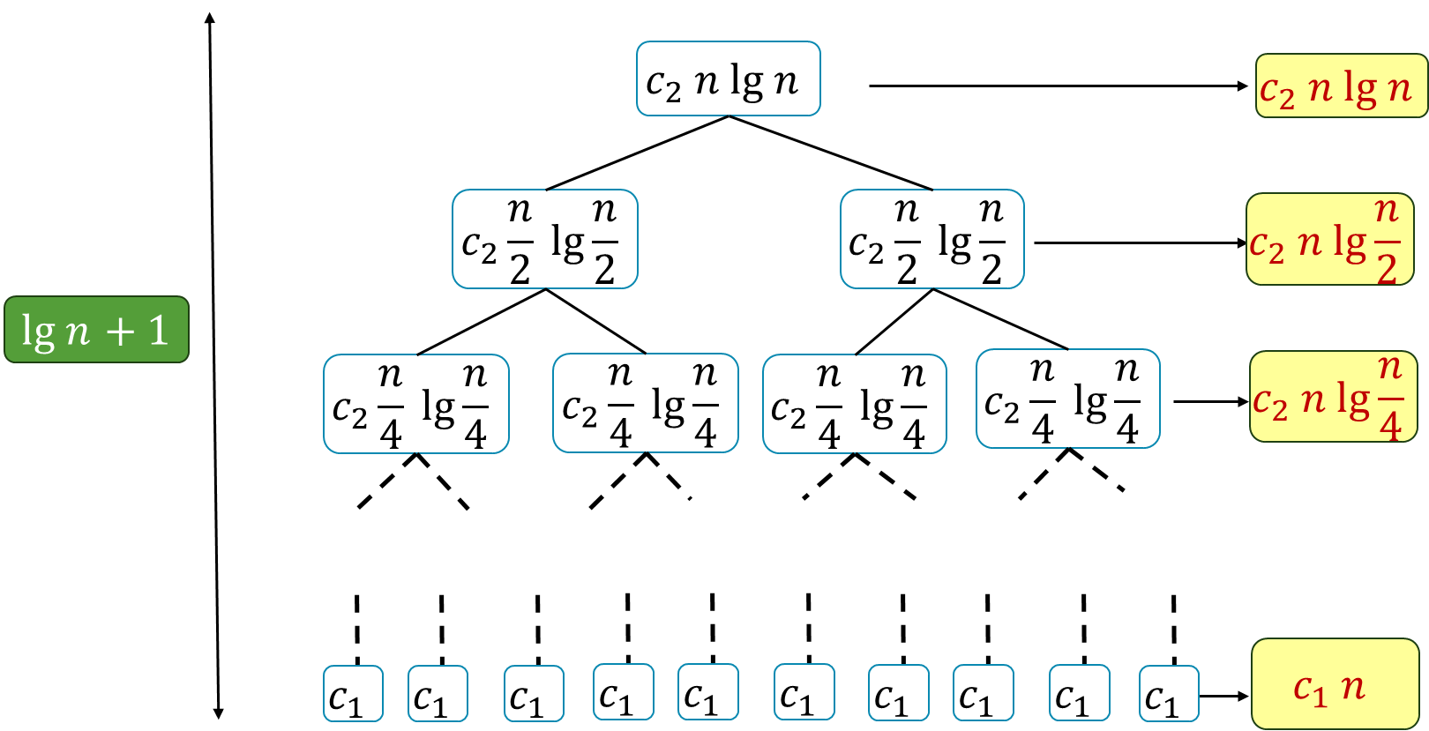
Running Time
Assume $n=2^{y}$
$T\left(n\right)= c_{2}n⋅\left(lg n+lg\frac{n}{2}+…+lg 2\right)+c_{1}n$
$=c_{2}n⋅((lg n+\lg{n+…+\lg{n) −\left(1+2+…+2^{y−1}\right))+c_{1}n}}$
$=c_{2}n\lg^{2}{n − }c_{2}n\frac{2^{y}−1}{2−1}+c_{1}n$
$=c_{2}n\lg^{2}{n−c_{2}n(\lg{n−1)+c_{1}n}}$
$=Θ(n\lg^{2}{n)}$

Slide 43
Running Time
Conclusion: Closest pair of points can be computed in $Θ(n\lg^{2}{n) }$time
It is possible to improve the running time to $Θ(n\lg{n)}$

Slide 44
Thank You!

