Slide 1
COMP 550 Algorithm and Analysis Recurrence Relations Based on CLRS Sec 4
Some slides are adapted from ones by prior instructors Prof. Plaisted and Prof. Osborne

Slide 2
Recurrence Relations
An equation or inequality that describes a function over the integers or reals using the function itself
$T\left(n\right)=\left\{\begin{aligned}Θ\left(1\right) \\ 2T\left(\frac{n}{2}\right)+Θ(n)\end{aligned}\right.$
Zero, one, or many functions may satisfy a recurrence
Well-defined if at least one satisfies, ill-defined otherwise
if $n=1$ (base case)
if $n>1$ (recursive case)

Slide 3
Algorithmic Recurrences
$T(n)$ is an algorithmic recurrence if for every sufficiently large threshold constant $n_{0}>0$
For all $n<n_{0}, T\left(n\right)=Θ(1)$
For all $n≥n_{0},$ every path of recursion tree terminates on a defined base case within finite recursive invocations
(1) implies for $n<n_{0}$, $0≤c_{1}≤T\left(n\right)≤c_{2}$
Not (2) implies the algorithm is incorrect!

Slide 4
Algorithmic Recurrences
Divide-and-conquer and recurrences
$$T\left(n\right)=T\left(\frac{n}{3}\right)+T\left(\frac{2n}{3}\right)+Θ(n)$$
Subproblems are not always of constant fraction of original problem
$$T\left(n\right)=T\left(n−1\right)+Θ(1)$$
FindMax ($A,n$)
if n $≤$ 1
return A[1]
return max(A[n], FindMax(A,n-1))

Slide 5
Solving A Recurrence
Substitution method
Recursion-tree method
Master method
Akra-Bazzi method

Slide 6
Substitution Method
Two step process
Guess the solution
Use mathematical induction to show that the guessed solution works
Works well when you can guess the solution
Guessing may not be always easy

Slide 7
Substitution Method
Determine an asymptotic upper bound on $T\left(n\right)=2T\left(\left\lfloor n/2\right\rfloor \right)+Θ\left(n\right)$.
Guess: $T(n)=O(n lg n)$
It’s better not to try prove $Θ$-bound directly. Why?
Can prove separate $O$- and $Ω$-bound instead.
Note that $T(n)=O(n lg n)$ means $T\left(n\right)≤cn\lg{n}$ holds for $n≥n_{0}$
We don’t need to prove anything for $n<n_{0}$
$n_{0}$ should be reasonably small so that $T\left(n\right)=Θ(1)$

Slide 8
Substitution Method
$$T\left(n\right)=2T\left(\left\lfloor n/2\right\rfloor \right)+Θ\left(n\right)$$
Assume that $T\left(m\right)≤c∙m\log{m}$ holds for all $n_{0}≤m<n$ ($n_{0}$ to be defined later)
First consider, $n≥2n_{0}$
$\log_{c}{(a⋅b)=}\log_{c}{a}+\log_{c}{b}$ (3.18 in book)
$\log_{c}\left(\frac{a}{b}\right)=\log_{c}{a}−\log_{c}{b}$(not in book)
Need $cn$ to dominate $Θ\left(n\right).$
$$≤$$
From CLRS

Slide 9
Substitution Method
$$T\left(n\right)=2T\left(\left\lfloor n/2\right\rfloor \right)+Θ\left(n\right)$$
Assume that $T\left(m\right)≤c∙m\log{m}$ holds for all $n_{0}≤m<n$ ($n_{0}$ to be defined later)
Now consider, $n_{0}≤n<2n_{0}$ (Induction base case). Looks different from recursive base case?
Pick $n_{0}:$Can we take $n_{0}=1?$Then, $T\left(1\right)≤c⋅1⋅\lg{1}=0$. Possible?
Can we take $n_{0}=2?$Then, $T\left(2\right)≤2c\lg{2}$
For $n_{0}=2,$base case includes $2≤n<2⋅2=4$. So, $n∈\left\{2,3\right\}$. $T\left(3\right)≤3c\lg{3}$
Take $c=\max{(T\left(2\right),T\left(3\right))}.$ Then, $T\left(n\right)≤cn\lg{n},$ for any $n≥n_{0}=2$

Slide 10
Substitution Method
Base case handling is often ignored
Pretty much the same way to deal with
Take a $n_{0},$ then determine a large constant $c$ so that $n_{0}≤n<n_{0}′$ admits the inductive hypothesis ($n_{0}′$ is $2n_{0}$ in prior example).

Slide 11
Substitution Method
Steps:
Guess the solution
Prove the solution for large $n≥n_{0}′$
Prove the solution for small $n, n_{0}≤n<n_{0}^{′}$. (Usually done by taking $T\left(n\right)=Θ(1))$
Determine $c$ (can be done by previous step)
Omitting the last two steps are often fine!

Slide 12
Guessing Solution
Try the solution to a similar-looking problem you’ve already solved
$T\left(n\right)=2T\left(\frac{n}{2}+17\right)+Θ\left(n\right)$ looks like $T\left(n\right)=2T\left(\left\lfloor n/2\right\rfloor \right)+Θ(n)$, so try $T\left(n\right)≤c⋅n \log{n}$
Try a looser solution and then narrow the bound from both ends
Prove the recurrence is $O\left(n^{2}\right)$ and $Ω\left(n\right).$ Work from both directions to narrow the gap between upper and lower bounds
Draw a recursion tree

Slide 13
Correct Guess But Math Fails
Try this: subtract a lower-order term.
New Guess: $T\left(n\right)≤cn−d$
$T\left(n\right)≤2(c\left(\frac{n}{2}\right)−d)+Θ\left(1\right)$
$=cn−2d+Θ(1)$
$≤cn−d−\left(d−Θ\left(1\right)\right)$
$≤cn−d$
Be careful about choice of $c, d$, and base cases
$T\left(n\right)=2T\left(\frac{n}{2}\right)+Θ\left(1\right)$
Guess $T\left(n\right)=O(n)$, so $T\left(n\right)≤cn$
$T\left(n\right)≤2c\left(\frac{n}{2}\right)+Θ\left(1\right)=cn+Θ\left(1\right)$
The above does NOT imply $T\left(n\right)≤cn$

Slide 14
Pitfalls
Do NOT use asymptotic notation in the inductive hypothesis.
$T\left(n\right)=2T\left(\left\lfloor \frac{n}{2}\right\rfloor \right)+Θ(n)$
Assume $T\left(n\right)=O(n)$
$T\left(n\right)$ $≤2⋅O\left(\left\lfloor \frac{n}{2}\right\rfloor \right)+Θ(n)$
$=2⋅O\left(n\right)+Θ(n)$
$=O\left(n\right)$
To avoid pitfall,
Assume $T\left(n\right)≤cn$
$T\left(n\right)$ $≤2⋅c\left(\left\lfloor \frac{n}{2}\right\rfloor \right)+Θ(n)$
$≤cn+ Θ(n)$
$≰cn$
The constant hidden by $O()$ may change.

Slide 15
Recursion-Tree Method
Making a good guess is sometimes difficult with the substitution method.
Use recursion trees to devise good guesses.
Better not to use it as direct proof (would need to be meticulous about expanding tree and summing costs)
For generating guess, some ‘sloppiness’ is tolerable

Slide 16
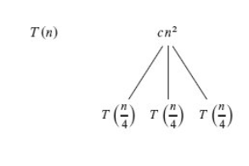
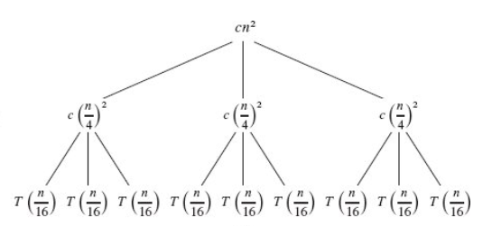
Recursion Tree
Example: $T\left(n\right)=3T\left(\frac{n}{4}\right)+Θ\left(n^{2}\right)$
From CLRS

Slide 17
Recursion Tree
Number of levels
Cost per level
Number of leaves
From CLRS

Slide 18
Recursion Tree
$T\left(n\right)=cn^{2}+\frac{3}{16}cn^{2}+{\left(\frac{3}{16}\right)}^{2}cn^{2}+…+{\left(\frac{3}{16}\right)}^{\log_{4}{n}−1}cn^{2}+Θ(n^{\log_{4}{3}})$
$=\sum_{i=0}^{\log_{4}{n−1}}{{\left(\frac{3}{16}\right)}^{i}cn^{2}}+Θ(n^{\log_{4}{3}})$
$≤\sum_{i=0}^{∞}{{\left(\frac{3}{16}\right)}^{i}cn^{2}}+Θ(n^{\log_{4}{3}})$

Slide 19
Recursion Tree
Goal: evaluate $\sum_{i=0}^{∞}{{\left(\frac{3}{16}\right)}^{i}}$
$$\sum_{i=0}^{∞}{{\left(\frac{3}{16}\right)}^{i}}=\frac{1}{1−\frac{3}{16}}=\frac{16}{13}$$
The summation
$$\sum_{k=0}^{∞}{x^{k}}=1+x+x^{2}+…+∞$$
is a geometric series. If $\left|x\right|<1,$ then
$$\sum_{k=1}^{n}{x^{k}}=\frac{1}{1−x}$$
Evaluating the sums
Appendix A: Summations

Slide 20
Recursion Tree
$T\left(n\right)=cn^{2}+\frac{3}{16}cn^{2}+{\left(\frac{3}{16}\right)}^{2}cn^{2}+…+{\left(\frac{3}{16}\right)}^{\log_{4}{n}−1}cn^{2}+Θ(n^{\log_{4}{3}})$
$=\sum_{i=0}^{\log_{4}{n−1}}{{\left(\frac{3}{16}\right)}^{i}cn^{2}}+Θ(n^{\log_{4}{3}})$
$≤\sum_{i=0}^{∞}{{\left(\frac{3}{16}\right)}^{i}cn^{2}}+Θ(n^{\log_{4}{3}})$
$=\frac{16}{13}cn^{2}+Θ(n^{\log_{4}{3}})$
$=O(n^{2})$

Slide 21
Recursion Tree: Verify with Substitution
Use substitution method to prove $T\left(n\right)=3T\left(\frac{n}{4}\right)+Θ({n^{2})}^{}$ is $O\left(n^{2}\right)$
Assume the constant in $Θ\left(n^{2}\right)$ is $c$, i.e., $Θ\left(n^{2}\right)=cn^{2}$
Assume, $T\left(m\right)≤dm^{2}$ for all $n_{0}≤m<n$.
We need to prove $T\left(n\right)≤dn^{2}$
Now consider $n,$
$$T\left(n\right)=3T\left(\frac{n}{4}\right)+cn^{2}≤3d{\left(\frac{n}{4}\right)}^{2}+cn^{2}=\left(\frac{3d}{16}+c\right)n^{2}$$
Can we pick value of $d$so that $\frac{3d}{16}+c≤d?$
This calculation works for $n≥4n_{0}.$ Why?
Show for $n_{0}≤n<4n_{0}$ (Recurrence base case)

Slide 22
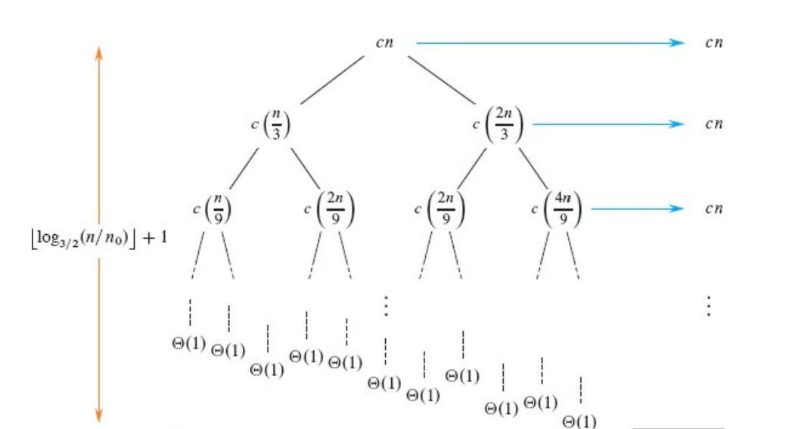
Recursion Tree
An irregular example: $T\left(n\right)=T\left(\frac{n}{3}\right)+T\left(\frac{2n}{3}\right)+Θ(n)$
From CLRS

Slide 23
Recursion Tree
An irregular example: $T\left(n\right)=T\left(\frac{n}{3}\right)+T\left(\frac{2n}{3}\right)+Θ(n)$
From CLRS

Slide 24
Recursion Tree
Height of the tree = $Θ(\lg{n)}$
Cost per level = $O(n)$
Guess, $T\left(n\right)=O(n\lg{n)}$
Try this by substitution method
How many leaves in total?
Assuming complete binary tree, # of leaves $=2^{\left\lfloor \log_{3/2}{n}\right\rfloor +1}+1≤2n^{\lg_{\frac{3}{2}}{2}}=O\left(n^{1.71}\right)$
This is larger than tight running time $O(n\lg{n)}$
Takeaway: Over-approximating #of leaves may cause running time to be dominated by the costs of leaves leading to a loose running time bound.

Slide 25
Master Method
A master recurrence is in form $T\left(n\right)=aT\left(\frac{n}{b}\right)+f\left(n\right),$where $a>0$ and b$>1$ are constants
Divides a problem of size $n$ into a subproblems, each of size $\frac{n}{b}$
$aT\left(\frac{n}{b}\right)$ actually means $a^{′}T\left(\left\lfloor \frac{n}{b}\right\rfloor \right)+a^{′′}T\left(\left\lceil \frac{n}{b}\right\rceil \right)$ for $a^{′},a^{′′}≥0$and $a^{′}+a^{′′}=a$
$f\left(n\right)=$ cost of dividing and combining.
$f(n)$ is referred to as the driving function.

Slide 26
Master Method
Theorem 4.1 (Master Theorem):
Solves master recurrences, $T\left(n\right)=aT\left(\frac{n}{b}\right)+f\left(n\right)$
3 cases based on comparing $f(n)$ with $n^{\log_{b}{a}}$
$n^{\log_{b}{a}}$is called the watershed function

Slide 27
Master Method
$$T\left(n\right)=aT\left(\frac{n}{b}\right)+f\left(n\right)$$
 | Condition | Solution
Case 1 | There exists constant $ε>0$such that $$f\left(n\right)=O(n^{\log_{b}{a−ε}})$$ | $$T\left(n\right)=Θ(n^{\log_{b}{a}})$$
Case 2 | There exists constant $k≥0$such that $$f\left(n\right)=Θ(n^{\log_{b}{a}}\lg^{k}{n})$$ | $$T\left(n\right)=Θ(n^{\log_{b}{a}}\lg^{k+1}{n})$$
Case 3 | There exists constant $ε>0$such that $$f\left(n\right)=Ω(n^{\log_{b}{a+ε}})$$ and $af\left(\frac{n}{b}\right)≤cf\left(n\right)$ for constant $c<1,$ | $$T\left(n\right)=Θ(f(n))$$

Slide 28
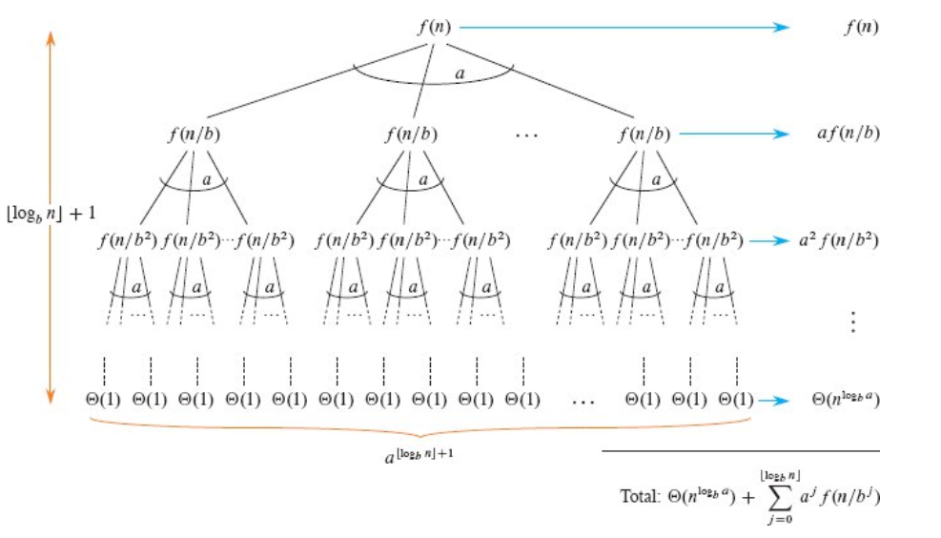
Master Method
$$T\left(n\right)=aT\left(\frac{n}{b}\right)+f\left(n\right)$$

Slide 29
Master Method
$$T\left(n\right)=aT\left(\frac{n}{b}\right)+f\left(n\right)$$

Slide 30
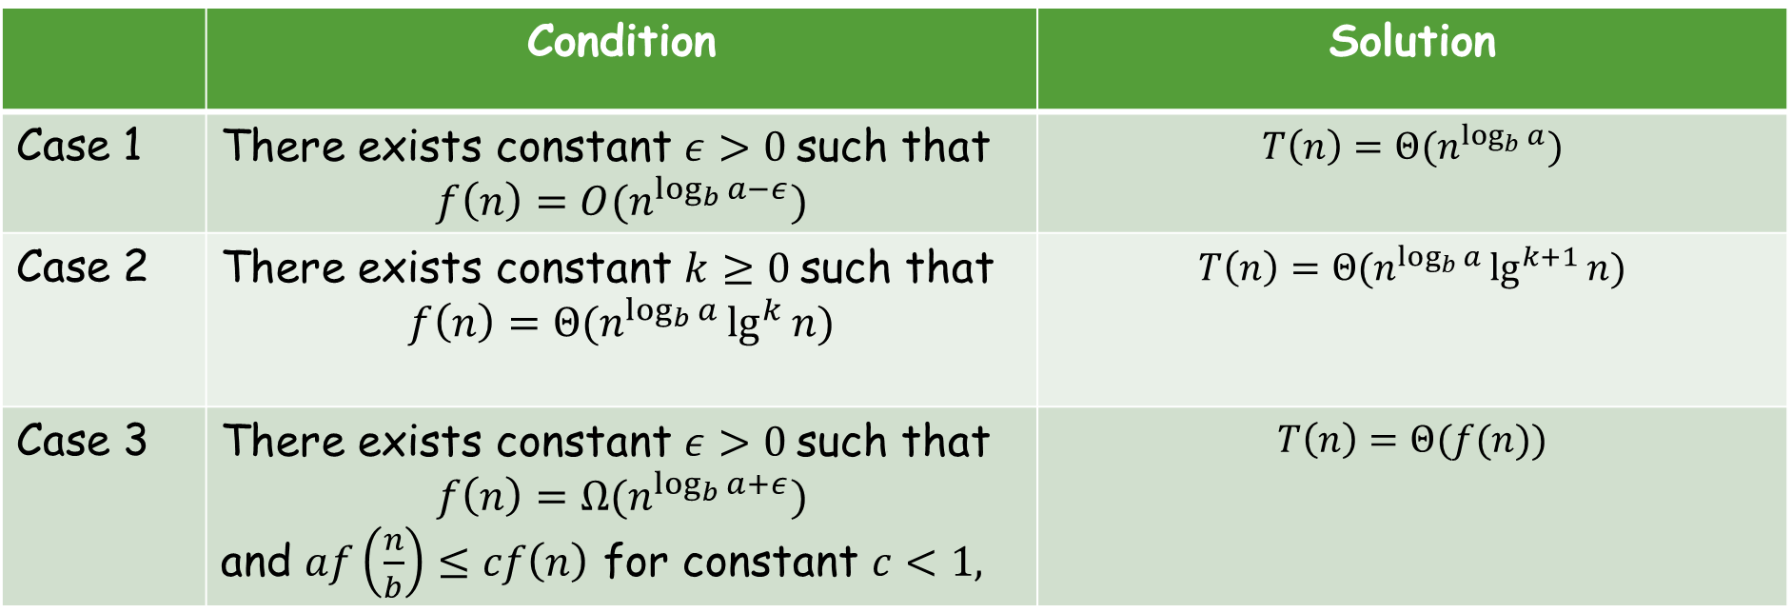
Master Method
Any idea what’ happening in each case?
(Hint: look at the solution and the cost of the levels in recursion tree)

Slide 31
Master Method
Case 1: Running time is dominated by leaves. When this happens?
Case 3: Running time is dominated by the root. When this happens?

Slide 32
Master Method
Case 2: Each level (with internal nodes) has asymptotically same cost
(Just like merge sort and closest pair of points)
Total running time = cost per level * number of levels

Slide 33
Master Method
Case 1: There exists constant $ε>0$such that $f\left(n\right)=O(n^{\log_{b}{a−ε}})$
$$T\left(n\right)=Θ(n^{\log_{b}{a}})$$
$f\left(n\right)$is polynomially smaller than $n^{\log_{b}{a}}$
$f\left(n\right)$is asymptotically smaller than $n^{\log_{b}{a}}$ by a factor of $O\left(n^{ε}\right)$ for $ε>0$

Slide 34
Master Method
Case 1: There exists constant $ε>0$such that $f\left(n\right)=O(n^{\log_{b}{a−ε}})$
$$T\left(n\right)=Θ(n^{\log_{b}{a}})$$
Per-level cost increases as we go down the recursion tree
Cost of leaves dominates costs of internal nodes
Cost of leaves $=Θ\left(n^{\log_{b}{a}}\right)$
Cost of internal nodes = $O\left(n^{\log_{b}{a}}\right)$
Total cost =$Θ\left(n^{\log_{b}{a}}\right)$

Slide 35
Master Method
Case 1: There exists constant $ε>0$such that $f\left(n\right)=O(n^{\log_{b}{a−ε}})$
$$T\left(n\right)=Θ(n^{\log_{b}{a}})$$
Example: $9T\left(\frac{n}{3}\right)+n$
Dissect the Recurrence
$f\left(n\right)=n$; $a=9, b=3:$ $n^{\log_{b}{a}}=n^{\log_{3}{9}}=n^{2}$
Check case requirement
$f\left(n\right)=n=O\left(n^{2−1}\right)$
Give the solution
$T\left(n\right)=Θ(n^{2})$

Slide 36
Master Method
Case 2: There exists constant $k≥0$such that $f\left(n\right)=Θ(n^{\log_{b}{a}}\lg^{k}{n})$
$$T\left(n\right)=Θ(n^{\log_{b}{a}}\lg^{k+1}{n})$$
$f(n)$ is within a polylog factor of${ n}^{\log_{b}{a}}$
Cost at each level with internal nodes $=f\left(n\right)= Θ\left(n^{\log_{b}{a}}\lg^{k}{n}\right)$
Cost of all internal nodes =$Θ\left(n^{\log_{b}{a}}\lg^{k+1}{n}\right)$

Slide 37
Master Method
Case 2: There exists constant $k≥0$such that $f\left(n\right)=Θ(n^{\log_{b}{a}}\lg^{k}{n})$
$$T\left(n\right)=Θ(n^{\log_{b}{a}}\lg^{k+1}{n})$$
Example:$T\left(n\right)=27T\left(\frac{n}{3}\right)+n^{3}\log_{2}{n}$
Dissect the Recurrence
$f\left(n\right)=n^{3}\lg{n}$; $a=27, b=3:$ $n^{\log_{b}{a}}=n^{\log_{3}{27}}=n^{3}$
Check case requirement
$f\left(n\right)=n^{3}\lg{n}=Θ\left(n^{3}\lg{n}\right)$
Give the solution
$T\left(n\right)=Θ(n^{3}\lg^{2}{n})$

Slide 38
Master Method
Case 3: There exists constant $ε>0$such that $f\left(n\right)=Ω(n^{\log_{b}{a+ε}})$ and $af\left(\frac{n}{b}\right)≤cf\left(n\right)$ for constant $c<1,$
$$T\left(n\right)=Θ(f(n))$$
Mirrors Case 1, $f(n)$ is polynomially greater than $n^{\log_{b}{a}}$
$af\left(n/b\right)≤cf\left(n\right):$ Regularity condition
Per-level cost decreases as we go down the recursion tree
Root’s cost = $Θ\left(f(n) \right),$ Other’s cost = $O(f(n))$
Total cost = $Θ(f\left(n\right))$

Slide 39
Master Method
Case 3: There exists constant $ε>0$such that $f\left(n\right)=Ω(n^{\log_{b}{a+ε}})$ and $af\left(\frac{n}{b}\right)≤cf\left(n\right)$ for constant $c<1,$
$$T\left(n\right)=Θ(f(n))$$
Example:$T\left(n\right)=5T\left(\frac{n}{2}\right)+n^{3}$
Dissect the Recurrence
$f\left(n\right)=n^{3};$ $a=5, b=2:$ $n^{\log_{b}{a}}=n^{\log_{2}{5}}=n^{3}$
Check case requirement
$f\left(n\right)=n^{3}=Ω(n^{\log_{2}{5}})$ and $5f\left(\frac{n}{2}\right)=5{\left(\frac{n}{2}\right)}^{3}≤\frac{5}{8}n^{3}$
Give the solution
$T\left(n\right)=Θ(n^{3})$

Slide 40
Master Method: Not Applicable Case
Example: $T\left(n\right)=2T\left(\frac{n}{2}\right)+\frac{n}{\lg{n}}$
Dissect the Recurrence
$f\left(n\right)=n/\lg{n};$ $a=2, b=2:$ $n^{\log_{b}{a}}=n^{\log_{2}{2}}=n$
Check case requirement
$f\left(n\right)=\frac{n}{\lg{n}}≠O\left(n^{1−ε}\right),$i.e., $\frac{n}{\lg{n}}$is not polynomially smaller than $n$
Case 1 not applicable
$f\left(n\right)=n\lg^{−1}{n}, k<0$ required to match Case 2.
Case 2 not applicable
$f\left(n\right)=n/\lg{n≠Ω(n^{1+ε})}$
Case 3 not applicable

Slide 41
Master Method: Not Applicable Case
Another Example: $T\left(n\right)=2T\left(√n\right)+Θ(lg n)$
Solution strategy: Change of variables and try to fit to the Master Theorem
Let $n=2^{m},$ implying $m= lg n$
We can rewrite the recurrence as
$T\left(2^{m}\right)=2T\left(2^{m/2}\right)+Θ\left(lg 2^{m}\right)=2T\left(2^{m/2}\right)+Θ\left(m lg 2\right)=2T\left(2^{m/2}\right)+Θ\left(m\right)$

Slide 42
Thank You!

