Slide 1

COMP 550
Algorithm and Analysis
Sorting Algorithms
Based on CLRS Secs. 6-8
Some slides are adapted from ones by prior instructors Prof. Plaisted and Prof. Osborne

Slide 2
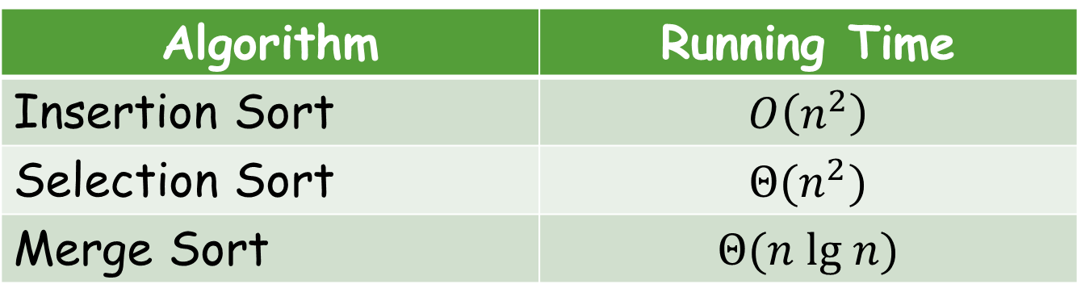
Sorting Algorithms
We’ve already studied
Algorithm | Running Time
Insertion Sort | $$O\left(n^{2}\right)$$
Selection Sort | $$Θ(n^{2})$$
Merge Sort | $$Θ(n lg n)$$

Slide 3
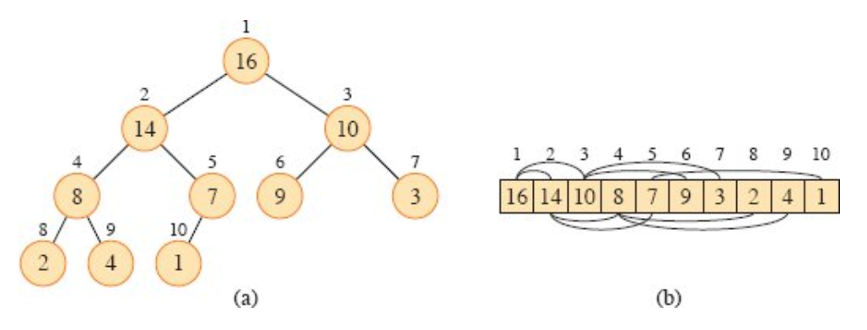
Heap Sort
Binary Heap: Can either be MAX-heap or MIN-heap
  Complete binary tree (all levels except the last one are full)
  Each node has a key
  Satisfies heap property:
    A node’s key is larger than its children’s key (MAX-heap)
From CLRS

Slide 4
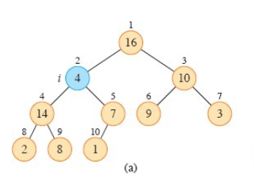
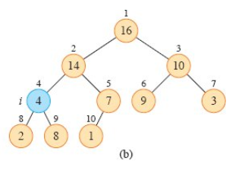
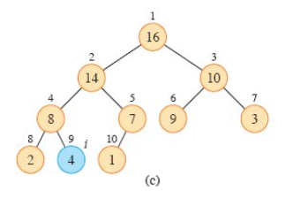
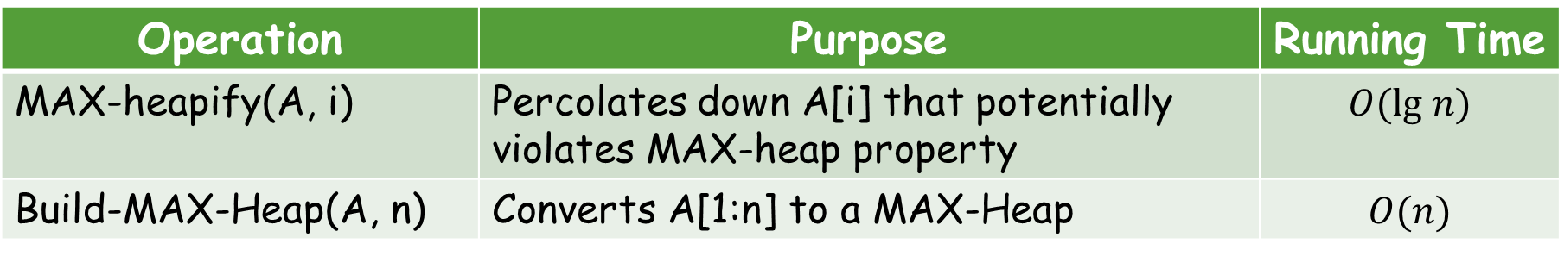
Heap Sort
MAX-Heap Operations:
Operation | Purpose | Running Time
MAX-heapify(A, i) | Percolates down A[i] that potentially violates MAX-heap property | $$O(lg n)$$
Build-MAX-Heap(A, n) | Converts A[1:n] to a MAX-Heap | $$O(n)$$
Illustration of MAX-heapify(A, 2) from CLRS

Slide 5
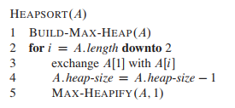
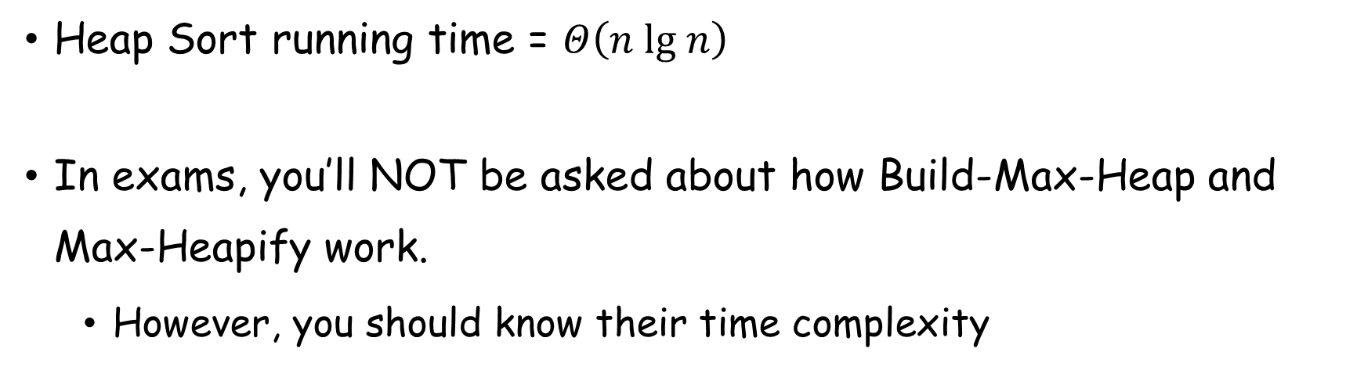
Heap Sort
Heap Sort running time = $Θ\left(n lg n\right)$
In exams, you’ll NOT be asked about how Build-Max-Heap and Max-Heapify work.
  However, you should know their time complexity

Slide 6
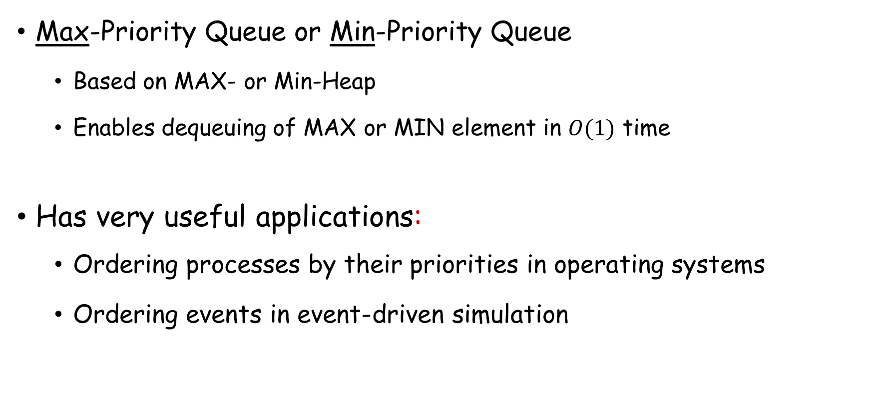
Priority Queue
Max-Priority Queue or Min-Priority Queue
  Based on MAX- or Min-Heap
  Enables dequeuing of MAX or MIN element in $O(1)$ time
Has very useful applications:
  Ordering processes by their priorities in operating systems
  Ordering events in event-driven simulation

Slide 7
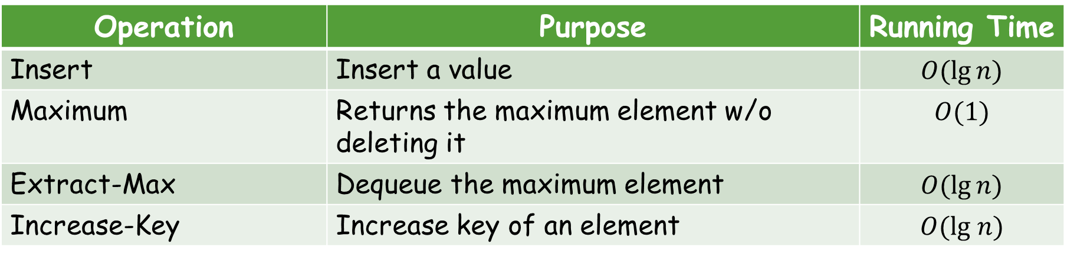
Priority Queue
MAX-Priority queue operations:
Operation | Purpose | Running Time
Insert | Insert a value | $$O(\lg{n})$$
Maximum | Returns the maximum element w/o deleting it | $$O(1)$$
Extract-Max | Dequeue the maximum element | $$O(\lg{n})$$
Increase-Key | Increase key of an element | $$O(lg n)$$
We’ll be needing priority queues when solving problems of future topics
You need to know what operations are supported and what are their running times
For exams, you don’t need to know how these operations actually work.

Slide 8
Quick Sort
A very well-known sorting algorithm
We’ll not cover it in detail now (will do later if we get time)
Basic idea: Divide & Conquer

Slide 9


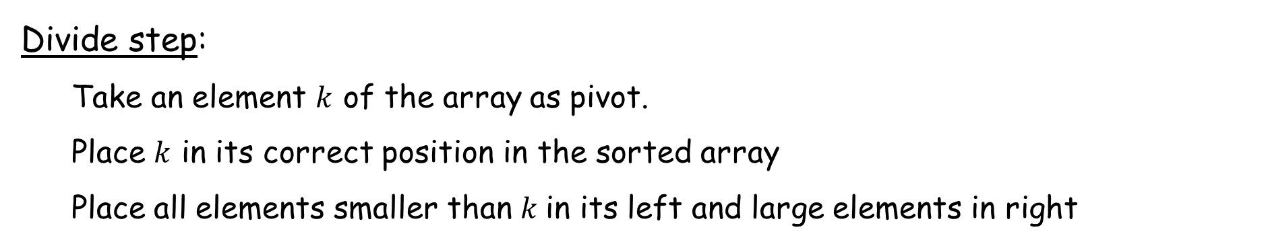
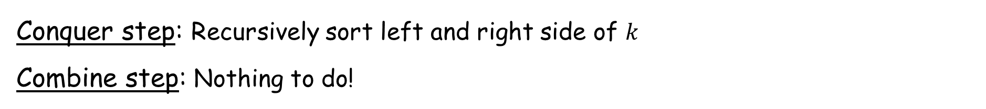
Quick Sort
Divide step:
  Take an element $k$ of the array as pivot.
  Place $k$ in its correct position in the sorted array
  Place all elements smaller than $k$in its left and large elements in right
Conquer step: Recursively sort left and right side of $k$
Combine step: Nothing to do!

Slide 10
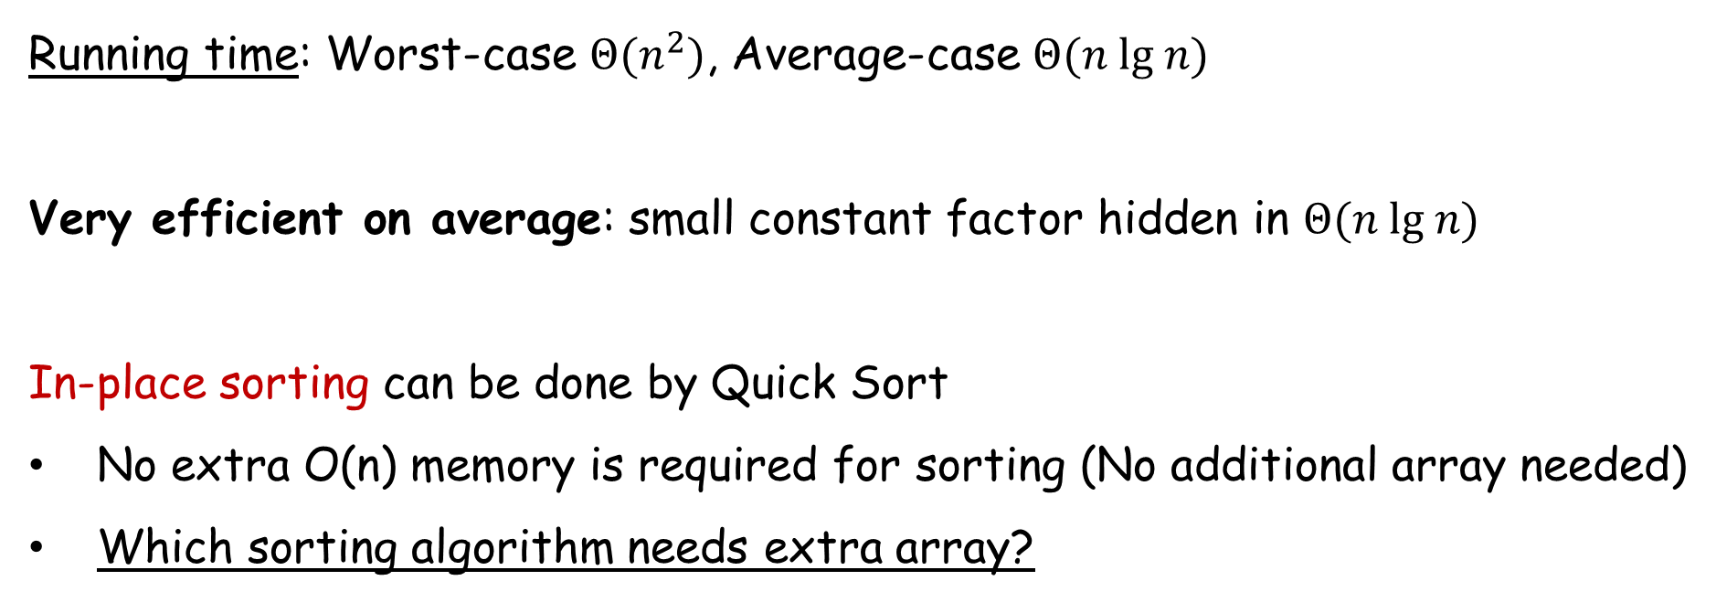
Quick Sort
Running time: Worst-case $Θ(n^{2})$, Average-case $Θ(n lg n)$
Very efficient on average: small constant factor hidden in $Θ(n lg n)$
In-place sorting can be done by Quick Sort
No extra O(n) memory is required for sorting (No additional array needed)
Which sorting algorithm needs extra array?

Slide 11
Announcement
Midterm 2: November 13, 2023 (in class)
Final Exam: Dec. 14th, Thursday, 4:00 PM
  We have three options for final exam
    Dec. 14th, Thursday, 4:00 PM (M/W/F 3:35 PM)
    Dec. 15th, Friday, 8:00 AM (M/W/F 3:35 PM)
    Dec. 14th, Friday, 4:00 PM (Classes not otherwise…)

Slide 12
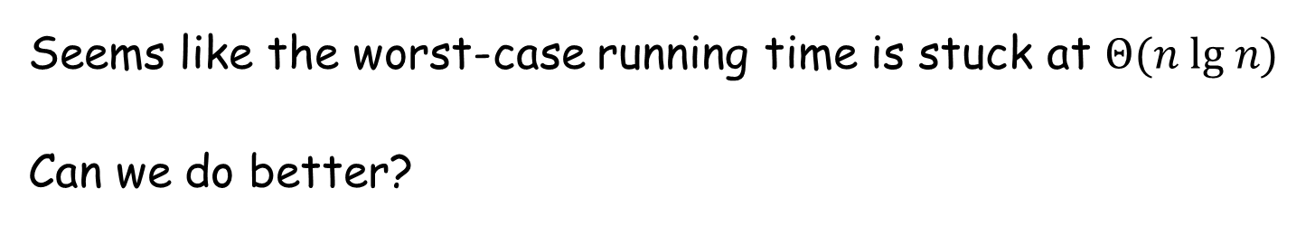
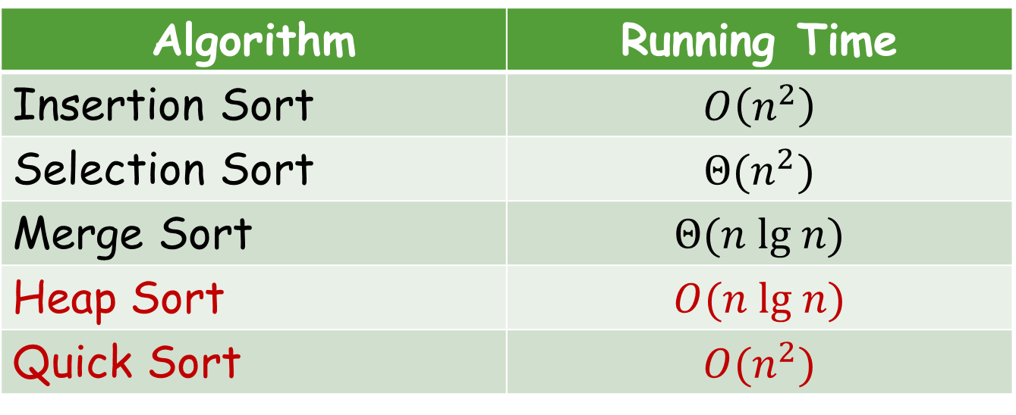
Sorting Algorithms
Algorithm | Running Time
Insertion Sort | $$O\left(n^{2}\right)$$
Selection Sort | $$Θ(n^{2})$$
Merge Sort | $$Θ(n lg n)$$
Heap Sort | $$O(n lg n)$$
Quick Sort | $$O(n^{2})$$
Seems like the worst-case running time is stuck at $Θ(n lg n)$
Can we do better?

Slide 13

Sorting Algorithms: Lower Bound
Comparison sorts cannot run faster than $Θ\left(n\lg{n}\right)$
  In other words, comparison sorts require $Ω(n\lg{n)}$ time
Comparison sort: a sort that orders elements based on comparing elements.
We can say A is greater than B only if
  We’ve compared A to B or
  We’ve compared A to something known to be greater than B.

Slide 14
Decision Trees
Numbers are indices not elements.
Leaves indicate the sorted order of the original elements.
Go left iff the first (left) element is smaller.
Path length indicates the number of comparisons needed to reach a solution.
  Tree height = worst-case running time
1:2
≤
>
2:3
1:3
≤
≤
>
⟨1,2,3⟩
1:3
⟨2,1,3⟩
2:3
≤
>
≤
>
⟨1,3,2⟩
⟨3,1,2⟩
⟨2,3,1⟩
⟨3,2,1⟩
Decision Tree for sorting a 3-item array

Slide 15

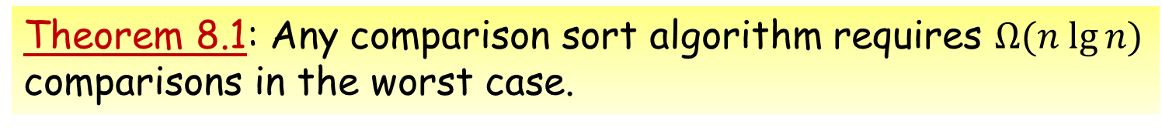
Decision Trees
Theorem 8.1: Any comparison sort algorithm requires $Ω(n lg⁡n)$ comparisons in the worst case.
Proof:
Goal: Lower bound the tree height
Decision tree must have at least $n!$ leaves
A binary tree of height $h$ has at most $2^{h}$ leaves.
Let $l$ be the number of leaves.
$$n!≤l≤2^{h}$$
1:2
≤
>
2:3
1:3
≤
≤
>
⟨1,2,3⟩
1:3
⟨2,1,3⟩
2:3
≤
>
≤
>
⟨1,3,2⟩
⟨3,1,2⟩
⟨2,3,1⟩
⟨3,2,1⟩
Decision Tree for sorting a 3-item array

Slide 16

Decision Trees
Theorem 8.1: Any comparison sort algorithm requires $Ω(n lg⁡n)$ comparisons in the worst case.
Proof
$$n!≤l≤2^{h}$$
$⟹$ {Transitive Property}
$$n!≤2^{h}$$
$⟹$ {Take log in each side}
$$log\left(n!\right)≤h$$
$⟹$ $\{$Eq. 3.28, Sec. 3.3$\}$
$$Ω(n\log{n)≤h}$$
There exists a permutation that requires at least $Ω(n\log{n)}$ to reach.
1:2
≤
>
2:3
1:3
≤
≤
>
⟨1,2,3⟩
1:3
⟨2,1,3⟩
2:3
≤
>
≤
>
⟨1,3,2⟩
⟨3,1,2⟩
⟨2,3,1⟩
⟨3,2,1⟩
Decision Tree for sorting a 3-item array

Slide 17

Non-comparison Sorts
We’ve seen that, for any comparison sort
  Worst-case running time $≥cn\lg{n}$ (for some $c$ and all $n≥n_{0})$
Can we sort without making comparisons?
  If so, can they have better worst-case running time?
Answer of both is yes
  But we need to make assumption about input
  Example: Counting Sort, Radix Sort, Bucket Sort

Slide 18

Counting Sort
Key assumption: numbers to be sorted are integers in $\{0, 1, 2, …, k\}$.
Input: $A[1:n]$, where $A\left[j\right]∈\{0, 1, 2, …, k\}$ for $j = 1, 2, …, n$. Array $A$ and values $n$ and $k$ are given as parameters.
Output: $B[1:n]$sorted.
Auxiliary Storage: $C[0..k]$
Runs in linear time if $k = O(n)$.

Slide 19
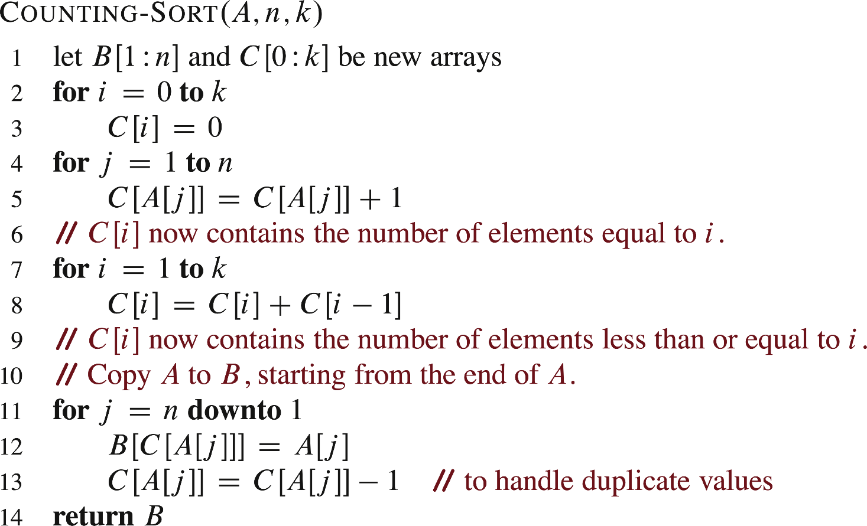
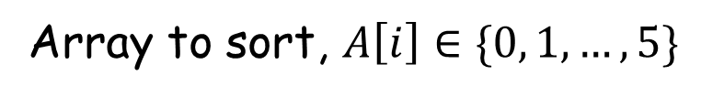
Counting Sort
1 | 2 | 3 | 4 | 5 | 6 | 7 | 8
A
2 | 5 | 3 | 0 | 2 | 3 | 0 | 3
Array to sort, $A\left[i\right]∈\{0, 1,…,5\}$
0 | 1 | 2 | 3 | 4 | 5
C
2 | 0 | 2 | 3 | 0 | 1
Array C after line 5
0 | 1 | 2 | 3 | 4 | 5
C
2 | 2 | 4 | 7 | 7 | 8
Array C after line 8

Slide 20
Counting Sort
1 | 2 | 3 | 4 | 5 | 6 | 7 | 8
A
2 | 5 | 3 | 0 | 2 | 3 | 0 | 3
1 | 2 | 3 | 4 | 5 | 6 | 7 | 8
B
0 | 1 | 2 | 3 | 4 | 5
C
2 | 2 | 4 | 7 | 7 | 8
Before 1st iteration of for loop in lines 11-13
After 1st iteration of for loop in lines 11-13
1 | 2 | 3 | 4 | 5 | 6 | 7 | 8
A
2 | 5 | 3 | 0 | 2 | 3 | 0 | 3
1 | 2 | 3 | 4 | 5 | 6 | 7 | 8
B
 |  |  |  |  |  | 3
0 | 1 | 2 | 3 | 4 | 5
C
2 | 2 | 4 | 6 | 7 | 8

Slide 21
Counting Sort
1 | 2 | 3 | 4 | 5 | 6 | 7 | 8
A
2 | 5 | 3 | 0 | 2 | 3 | 0 | 3
1 | 2 | 3 | 4 | 5 | 6 | 7 | 8
B
 |  |  |  |  |  | 3
0 | 1 | 2 | 3 | 4 | 5
C
2 | 2 | 4 | 6 | 7 | 8
Before 2nd iteration of for loop in lines 11-13
After 2nd iteration of for loop in lines 11-13
1 | 2 | 3 | 4 | 5 | 6 | 7 | 8
A
2 | 5 | 3 | 0 | 2 | 3 | 0 | 3
1 | 2 | 3 | 4 | 5 | 6 | 7 | 8
B
 | 0 |  |  |  |  | 3
0 | 1 | 2 | 3 | 4 | 5
C
1 | 2 | 4 | 6 | 7 | 8

Slide 22
Counting Sort
1 | 2 | 3 | 4 | 5 | 6 | 7 | 8
A
2 | 5 | 3 | 0 | 2 | 3 | 0 | 3
1 | 2 | 3 | 4 | 5 | 6 | 7 | 8
B
 | 0 |  |  |  |  | 3
0 | 1 | 2 | 3 | 4 | 5
C
1 | 2 | 4 | 6 | 7 | 8
Before 3rd iteration of for loop in lines 11-13
After 3rd iteration of for loop in lines 11-13
1 | 2 | 3 | 4 | 5 | 6 | 7 | 8
A
2 | 5 | 3 | 0 | 2 | 3 | 0 | 3
1 | 2 | 3 | 4 | 5 | 6 | 7 | 8
B
 | 0 |  |  |  | 3 | 3
0 | 1 | 2 | 3 | 4 | 5
C
1 | 2 | 4 | 5 | 7 | 8

Slide 23
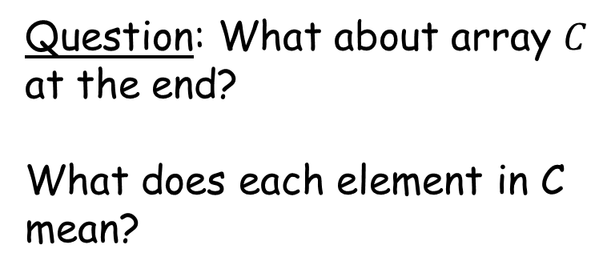
Counting Sort
After all iterations
1 | 2 | 3 | 4 | 5 | 6 | 7 | 8
A
2 | 5 | 3 | 0 | 2 | 3 | 0 | 3
1 | 2 | 3 | 4 | 5 | 6 | 7 | 8
B
0 | 0 | 2 | 2 | 3 | 3 | 3 | 5
Question: What about array $C$ at the end?
What does each element in C mean?

Slide 24
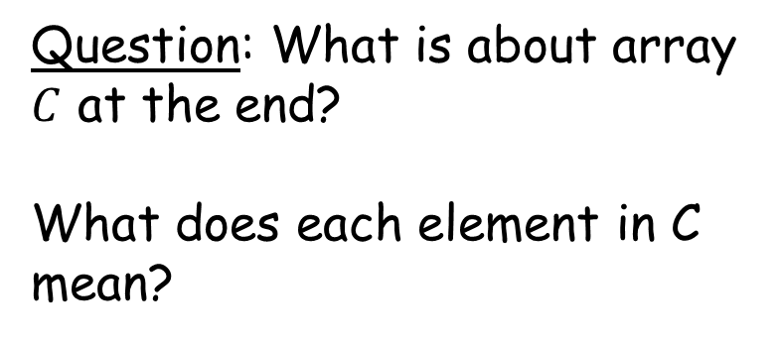
Counting Sort
After all iterations
1 | 2 | 3 | 4 | 5 | 6 | 7 | 8
A
2 | 5 | 3 | 0 | 2 | 3 | 0 | 3
1 | 2 | 3 | 4 | 5 | 6 | 7 | 8
B
0 | 0 | 2 | 2 | 3 | 3 | 3 | 5
Question: What is about array $C$ at the end?
What does each element in C mean?

Slide 25
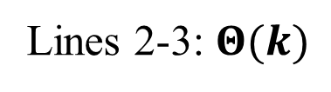
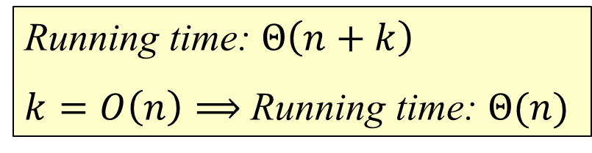
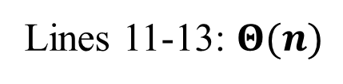
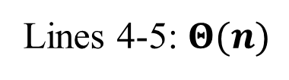
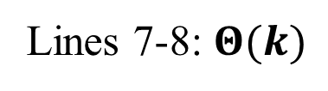
Counting Sort: Time Complexity
Lines 2-3: $Θ(k)$
Lines 4-5: $Θ(n)$
Lines 7-8: $Θ(k)$
Lines 11-13: $Θ(n)$
Running time: $Θ\left(n+k\right)$
$k=O\left(n\right)⟹$Running time: $Θ(n)$

Slide 26
Counting Sort
Counting Sort is stable
  Same value elements appear in the same order in the output array as in the input array
1 | 2 | 3 | 4 | 5 | 6 | 7 | 8
A
2 | 5 | 3 | 0 | 2 | 3 | 0 | 3
1 | 2 | 3 | 4 | 5 | 6 | 7 | 8
B
0 | 0 | 2 | 2 | 2 | 3 | 3 | 5

Slide 27
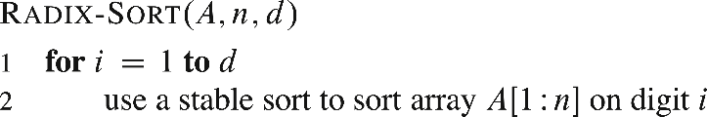
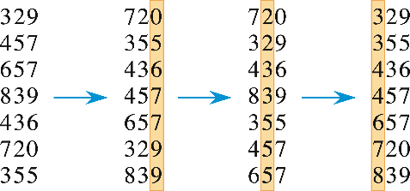
Radix Sort
Key idea: sort on the “least significant digit” first and on the remaining digits in sequential order. The sorting method used to sort each digit must be “stable”. Why?
Start by sorting the least significant digit.

Slide 28
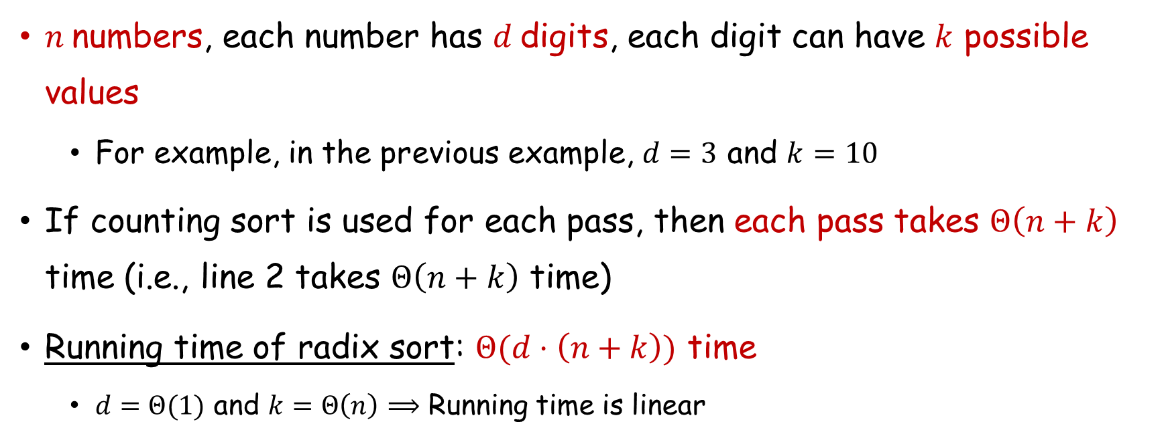
Radix Sort: Time Complexity
Start by sorting the least significant digit.
$n$numbers, each number has $d$digits, each digit can have $k$ possible values
  For example, in the previous example, $d=3$ and $k=10$
If counting sort is used for each pass, then each pass takes $Θ\left(n+k\right)$ time (i.e., line 2 takes $Θ\left(n+k\right)$ time)
Running time of radix sort: $Θ(d⋅\left(n+k\right))$ time
  $d=Θ(1)$ and $k=Θ\left(n\right)$ $⟹$ Running time is linear

Slide 29
Bucket Sort
Assumes input is generated by a random process that distributes the elements uniformly over [0, 1).
Idea:
  Divide [0, 1) into n equal-sized buckets.
  Distribute the n input values into the buckets.
  Sort each bucket.
  Then go through the buckets in order, listing elements in each one.

Slide 30
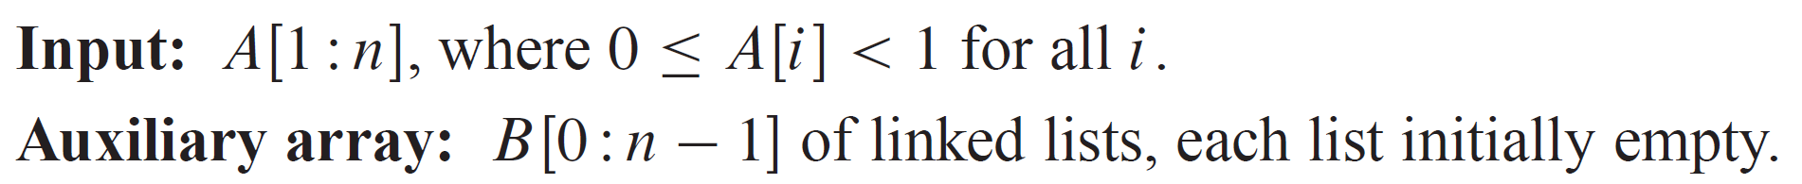
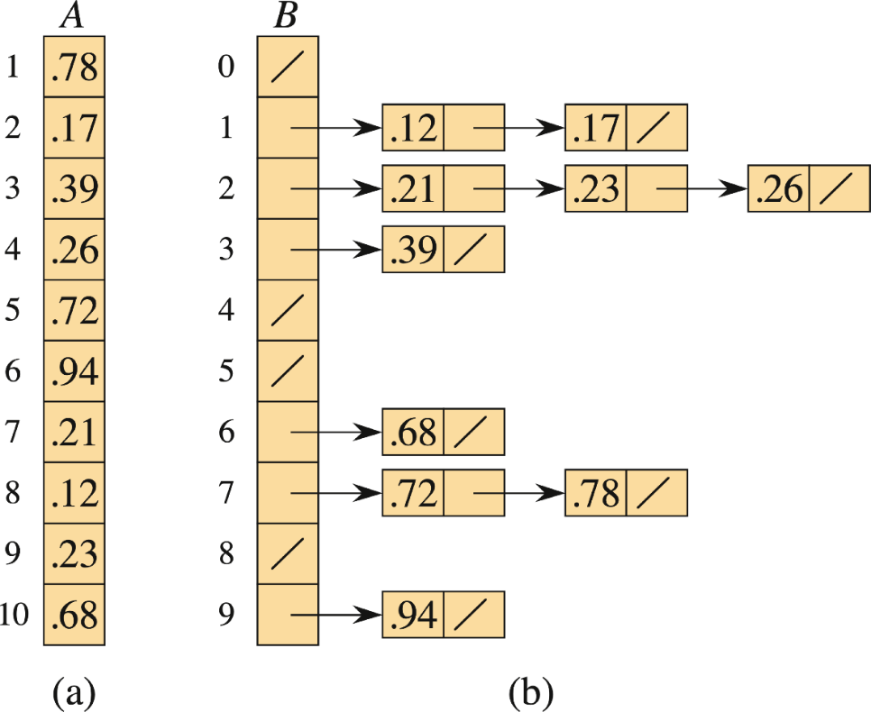
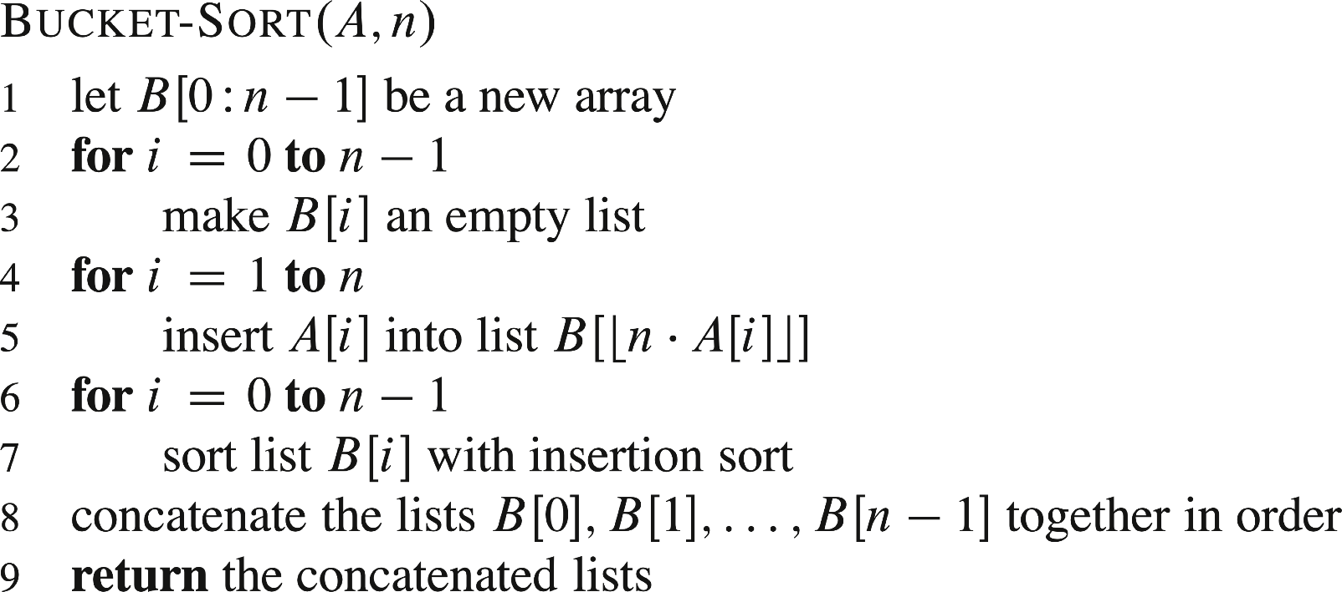
Bucket Sort

Slide 31
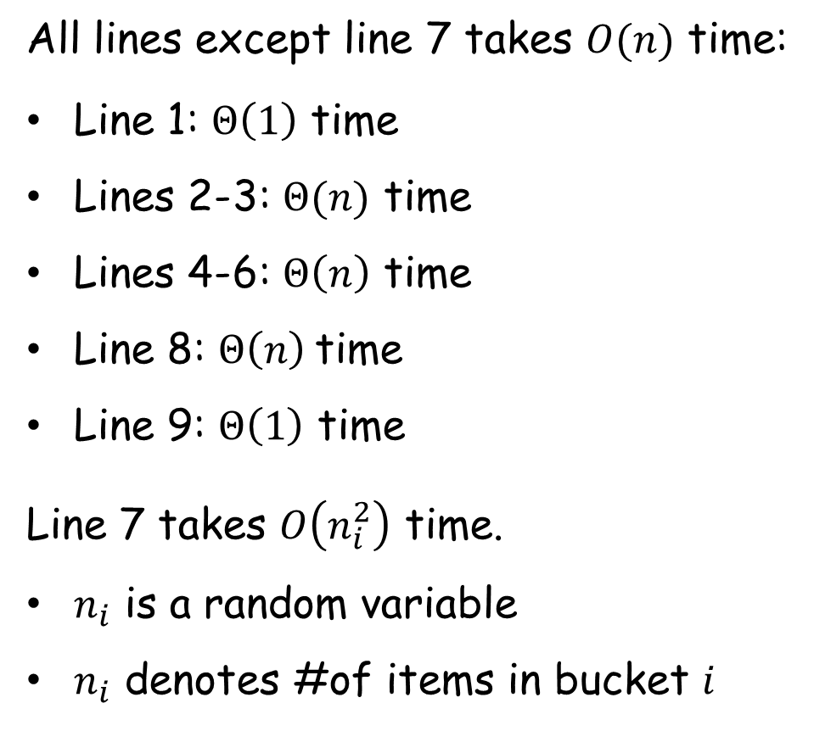
Bucket Sort: Time Complexity
All lines except line 7 takes $O(n)$ time:
Line 1: $Θ\left(1\right)$ time
Lines 2-3: $Θ(n)$ time
Lines 4-6: $Θ\left(n\right)$ time
Line 8: $Θ\left(n\right)$time
Line 9: $Θ\left(1\right)$ time
Line 7 takes $O\left(n_{i}^{2}\right)$ time.
$n_{i}$ is a random variable
$n_{i}$ denotes #of items in bucket $i$

Slide 32
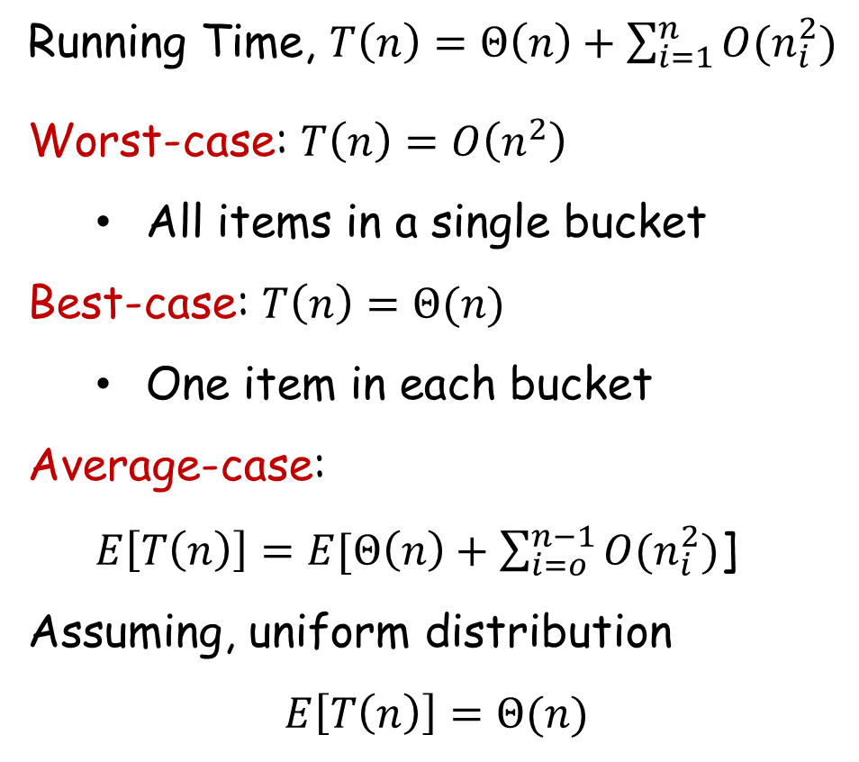
Bucket Sort: Time Complexity
Running Time, $T\left(n\right)=Θ\left(n\right)+\sum_{i=1}^{n}{{O(n}_{i}^{2})}$
Worst-case: $T\left(n\right)=O\left(n^{2}\right)$
  All items in a single bucket
Best-case: $T\left(n\right)=Θ(n)$
  One item in each bucket
Average-case:
$E\left[T\left(n\right)\right]=E[Θ\left(n\right)+\sum_{i=o}^{n−1}{{O(n}_{i}^{2})}$]
Assuming, uniform distribution
$$E\left[T\left(n\right)\right]=Θ(n)$$

Slide 33
Thank You!

