Slide 1
COMP 550 Algorithm and Analysis Greedy Algorithms (Huffman Encoding) Based on CLRS Sec. 15.3
Some slides are adapted from ones by prior instructors Prof. Plaisted and Prof. Osborne

Slide 2
Data Compression
Lossy
Big file $→$Small file $→$ Imperfect copy
Example: JPEG, MP3
Idea: Targeted data deletion.
Delete parts of data that people won’t notice.
Lossless
Big file $→$Small file $→$ Perfect copy
Example: ZIP, PNG, JBIG.
How to do this?
Original
Original
Restored
Restored
Compressed
Compressed

Slide 3
Fixed-Length Encoding
Let’s consider compression of text files
How is text commonly represented?
Fixed length encoding (e.g., ASCII, Unicode)
8 bits in ASCII
Assuming ASCII, how many bits represent this text (ignore whitespace)?
Number of characters: 30
Bits required: $30×8=240$
she sells seashells by the seashore

Slide 4
Fixed-Length Encoding
Assuming ASCII, how many bits represent this text (ignore whitespace)?
Number of characters: 30
Bits required: $30×8=240$
There are 10 different characters in this text
At least 4 bits per character are required under fixed-length encoding scheme
Bits required: $30×4=120$
she sells seashells by the seashore

Slide 5
Variable-Length Encoding
Drawbacks of fixed-length codes
Wasted space
Same number of bits used to represent all characters
Potential solution: use variable-length codes
Variable number of bits when frequency of occurrence is known
Short codes for characters that occur frequently
English letter frequencies (Wikipedia)
Letter | %
e | 13
t | 9.1
a | 8.2
o | 7.5
i | 7
n | 6.7
all others

Slide 6
Variable-Length Encoding
she sells seashells by the seashore
Letter | %
e | 13
t | 9.1
a | 8.2
o | 7.5
i | 7
n | 6.7
all others
Low
High
Letter | Freq | Bit code | Bit count | Bits required
E | 7 | 10 | 2 | 7x2=14
T | 1 | 00 | 2 | 1x2=2
A | 2 | 011 | 3 | 2x3=6
O | 1 | 110 | 3 | 1x3=3
S | 8 | 0101 | 4 | 8x4=32
H | 4 | 0100 | 4 | 4x4=16
L | 4 | 11100 | 5 | 4x5=20
Y | 1 | 11101 | 5 | 1x5=5
B | 1 | 11110 | 5 | 1x5=5
R | 1 | 11111 | 5 | 1x5=5
Bit Code Length
Average Frequency across
all text
High
Low
Number of bits = 108

Slide 7
Variable-Length Encoding
she sells seashells by the seashore
Low
High
Letter | Freq | Bit code | Bit count | Bits required
S | 8 | 10 | 2 | 8x2=16
E | 7 | 00 | 2 | 7x2=14
H | 4 | 011 | 3 | 4x3=12
L | 4 | 110 | 3 | 4x3=12
A | 2 | 0101 | 4 | 2x4=8
R | 1 | 0100 | 4 | 1x4=4
B | 1 | 11100 | 5 | 1x5=5
Y | 1 | 11101 | 5 | 1x5=5
T | 1 | 11110 | 5 | 1x5=5
O | 1 | 11111 | 5 | 1x5=5
Bit Code Length
Frequency in the given text
High
Low
Number of bits = 86

Slide 8
Variable-Length Encoding
One issue: Where a character ends and another begins?
Not a problem under fixed-length encoding
011100100011101010011…
Fixed length
Variable length

Slide 9
Prefix-Free Codes
No codeword is a prefix of another codeword
Letter | Freq | Bit code | Bit count | Bits required
S | 8 | 10 | 2 | 8x2=16
E | 7 | 00 | 2 | 7x2=14
H | 4 | 011 | 3 | 4x3=12
L | 4 | 110 | 3 | 4x3=12
A | 2 | 0101 | 4 | 2x4=8
R | 1 | 0100 | 4 | 1x4=4
B | 1 | 11100 | 5 | 1x5=5
Y | 1 | 11101 | 5 | 1x5=5
T | 1 | 11110 | 5 | 1x5=5
O | 1 | 11111 | 5 | 1x5=5
No other codeword starts with 10
Code: 0110011011011111
HELLO

Slide 10
Prefix-Free Codes
The following codes do not satisfy prefix-free property
Decode the code 1010
Can be anyone among “ESES, LL, LES, ESL”
Letter | Bit code
S | 0
E | 1
H | 01
L | 10

Slide 11
Prefix-Free Codes
Prefix-free codes form a binary tree
0
1
Letter | Freq | Bit code
S | 8 | 10
E | 7 | 00
H | 4 | 011
L | 4 | 110
A | 2 | 0101
R | 1 | 0100
B | 1 | 11100
Y | 1 | 11101
T | 1 | 11110
O | 1 | 11111
0
1
0
1
E
S
0
1
0
1
H
L
1
1
0
0
R
A
0
1
0
1
B
Y
T
O

Slide 12
Optimal Encoding
Problem: Determine optimal prefix-free codes for a given text
Optimal = Minimize the number of bits to store the text
Minimize: $\sum{frequecy of a char×Number of bits for the char}$
Key property:
Less frequent characters are further down the tree

Slide 13
Huffman Encoding
1. Tabulate character frequencies
2. Each char:frequency tuple forms a single-node tree
S:8
E:7
H:4
L:4
A:2
R:1
B:1
Y:1
T:1
O:1
3. Merge the two trees with the smallest roots. The new root is the sum of the two frequencies below it. Repeat until there’s one tree.
2
S:8
E:7
H:4
L:4
A:2
R:1
B:1
Y:1
T:1
O:1

Slide 14
Huffman Encoding
3. Merge the two trees with the smallest roots. The new root is the sum of the two frequencies below it. Repeat until there’s one tree.
2
2
S:8
E:7
H:4
L:4
A:2
R:1
B:1
Y:1
T:1
O:1

Slide 15
Huffman Encoding
3. Merge the two trees with the smallest roots. The new root is the sum of the two frequencies below it. Repeat until there’s one tree.
3
2
2
S:8
E:7
H:4
L:4
A:2
R:1
B:1
Y:1
T:1
O:1

Slide 16
Huffman Encoding
3. Merge the two trees with the smallest roots. The new root is the sum of the two frequencies below it. Repeat until there’s one tree.
4
3
2
2
S:8
E:7
H:4
L:4
A:2
R:1
B:1
Y:1
T:1
O:1

Slide 17
Huffman Encoding
3. Merge the two trees with the smallest roots. The new root is the sum of the two frequencies below it. Repeat until there’s one tree.
7
4
3
2
2
S:8
E:7
H:4
L:4
A:2
R:1
B:1
Y:1
T:1
O:1

Slide 18
Huffman Encoding
3. Merge the two trees with the smallest roots. The new root is the sum of the two frequencies below it. Repeat until there’s one tree.
7
4
8
3
2
2
S:8
E:7
H:4
L:4
A:2
R:1
B:1
Y:1
T:1
O:1

Slide 19
Huffman Encoding
3. Merge the two trees with the smallest roots. The new root is the sum of the two frequencies below it. Repeat until there’s one tree.
14
7
4
8
3
2
2
S:8
E:7
H:4
L:4
A:2
R:1
B:1
Y:1
T:1
O:1

Slide 20
Huffman Encoding
3. Merge the two trees with the smallest roots. The new root is the sum of the two frequencies below it. Repeat until there’s one tree.
14
16
7
4
8
3
2
2
S:8
H:4
L:4
E:7
A:2
R:1
B:1
Y:1
T:1
O:1

Slide 21
Huffman Encoding
3. Merge the two trees with the smallest roots. The new root is the sum of the two frequencies below it. Repeat until there’s one tree.
30
14
16
7
4
8
3
2
2
S:8
H:4
L:4
E:7
A:2
R:1
B:1
Y:1
T:1
O:1

Slide 22
Huffman Encoding
3. Merge the two trees with the smallest roots. The new root is the sum of the two frequencies below it. Repeat until there’s one tree.
30
14
16
7
4
8
3
2
2
S:8
H:4
L:4
E:7
A:2
R:1
B:1
Y:1
T:1
O:1

Slide 23
Huffman Encoding
4. Label left edges “0” and right edges “1”
30
1
0
14
1
16
7
1
1
0
4
0
1
0
0
8
3
2
2
0
1
0
1
0
1
0
1
S:8
H:4
L:4
E:7
A:2
R:1
B:1
Y:1
T:1
O:1

Slide 24
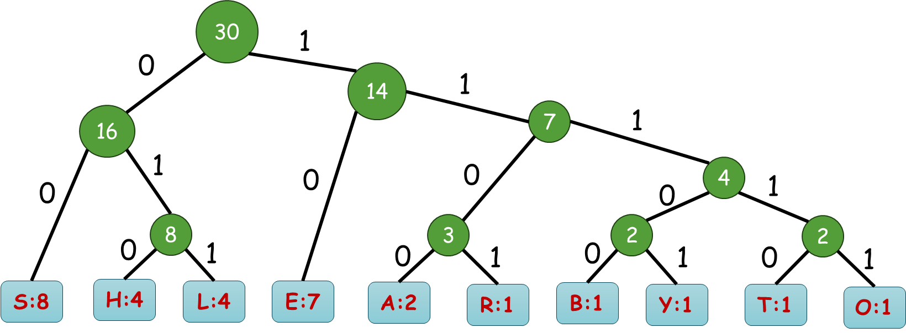
Huffman Encoding
Codes are given by the path from root to leaf
Letter | Bit code
S | 00
E | 10
H | 010
L | 011
A | 1100
R | 1101
B | 11100
Y | 11101
T | 11110
O | 11111

Slide 25
Huffman Encoding
Input: A set $C$ of $n$ characters each with an attribute $freq$
Output: A tree corresponding to optimal code
$O(\lg{n)}$when we use MIN-Priority Queue
Running time $O(n\lg{n)}$

Slide 26
Correctness
To show that Huffman encoding builds an optimal prefix-free code:
The greedy choice of merging two trees with the smallest root satisfies the greedy-choice property
Constructing optimal prefix-free codes has the optimal substructure property

Slide 27
Greedy-Choice Property
There is an optimal solution containing the greedy choice (lowest frequency characters are siblings at the maximum depth)
Proof (sketch) by exchange argument:
Take a tree $T$representing an arbitrary optimal prefix-free code
Transform the tree $T$ to a tree $T′$ that has the greedy choice made by Huffman algorithm
Show that $T′$ is no worse than $T$
Lowest frequency characters
Same for $y$and $b$
Show that exchanging x and a does not cause more bits to encode

Slide 28
Optimal Substructure Property
Making the least frequency characters siblings and solving the new subproblem results in an optimal prefix-free code.
Goal: Replace the least frequency character $x$and $y$ and a new node $z$ with
$z.freq=x.freq+y.freq$
Optimal solution of problem = optimal solution of subproblem + ($x$ and $y$ as children of $z$)
Proof sketch: Assume that
Optimal solution of problem $≠$ optimal solution of subproblem + ($x$ and $y$ as children of $z$)
By the greedy-choice property, we know there is an optimal solution $OPT$ where $x$and $y$ are siblings.
Removing x and y from $OPT$ and replacing their parents in $OPT$ by $z$ results in a better solution for the subproblem, contradiction

Slide 29
Encoding & Decoding
Encoding:
Create a hashmap or dictionary or array (indexed by characters) to store bit code of each character
Scan each character in the text, look for its code, and concatenate
Decoding:
Go left/right the tree representing prefix-free code according to the current bit
If leaf is reached, concatenate that character to current text

Slide 30
Thank You!

