Slide 1
COMP 550 Algorithm and Analysis Minimum Spanning Tree Based on CLRS Sec. 21
Some slides are adapted from ones by Prof. Jim Anderson

Slide 2
Minimum-Cost Communication Network
We want to set up a communication network on $n$locations so that each pair of locations are connected
The cost of a direct link is proportional to their distance
Construct the network as cheaply as possible
b
c
a
d
e
f

Slide 3
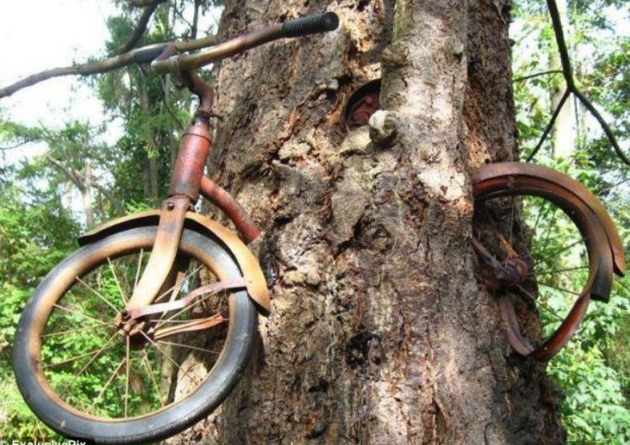
Minimum-Cost Communication Network
The number of direct link should be as small as possible
Property 1: Acyclic. (The cheapest network is a tree)
A tree has no cycle (unlike this)
Source: https://www.dailymail.co.uk/news/article-2255706/Amazing-images-bikes-left-long-trees-them.html

Slide 4
Minimum-Cost Communication Network
The number of direct link should be as small as possible
Property 2: Barely connected (formally, minimally connected). Removal of any link disconnects some location from the network
Property 2: Maximally acyclic. Addition of any link creates a cycle
b
c
a
d
e
f

Slide 5
Spanning Tree
$T=(V_{T},E_{T})$ is a spanning tree of a connected graph $G=\left(V,E\right)$ if $T$ connects (‘’spans’’) all vertices in $G$
$G$is an undirected graph
8
7
8
7
b
c
d
b
c
d
4
9
2
11
4
11
a
i
14
e
a
i
e
7
6
6
8
10
8
10
h
g
f
h
g
f
1
2
1
2
A graph $G$
A spanning tree of $G$
Weight/Cost of a spanning tree $=\sum{weight of each tree edge}$

Slide 6
Minimum Spanning Tree (MST)
A graph $G$can have many spanning trees
Minimum Spanning Tree (MST): spanning tree with minimum weight/cost
8
7
b
c
d
4
9
2
11
4
14
a
i
e
7
6
8
10
h
g
f
1
2
Tree Weight = 37
Tree Weight = 53
8
7
8
7
b
c
d
b
c
d
4
9
2
11
4
a
i
e
a
i
e
6
8
10
h
g
f
h
g
f
1
2
1
2

Slide 7
The MST Problem
Input: An undirected weighted graph $G=(V,E)$ with weight function $w:E→R$
Output: An MST of $G$
Question: What about MST of an undirected unweighted graph?

Slide 8
Optimal Substructure
Does MST have optimal substructure property?
Does MST of a graph $G$contain MST of $G$’s subgraph?
Yes!
Lemma. Let $T_{1}$ and $T_{2}$ be two trees after removing an edge $(u,v)$ from an MST $T$ of graph $G$. Then, $T_{1}$ and $T_{2}$ are MSTs of the subgraphs induced by nodes of $T_{1}$and $T_{2}$, respectively.
8
7
7
b
c
d
Subgraph induced by
vertices $\{c,d,e,f,g\}$
c
d
4
9
9
2
11
4
14
4
a
i
e
14
e
7
6
8
10
10
h
g
f
g
f
1
2
2

Slide 9
Optimal Substructure
Lemma. Let $T_{1}$ and $T_{2}$ be two trees after removing an edge $(u,v)$ from an MST $T$ of graph $G$. Then, $T_{1}$ and $T_{2}$ are MSTs of the subgraphs induced by nodes of $T_{1}$and $T_{2}$, respectively.
8
7
8
b
c
d
Remove $\left(c,d\right)$ from $T$
b
c
d
4
9
4
9
2
2
11
4
14
11
4
a
i
e
a
i
14
e
7
6
7
6
8
10
8
10
h
g
f
h
g
f
1
2
1
2
Proof: W.l.o.g., assume that $T_{1}$ is not an MST of the subgraph induced by $T_{1}$.
Assume $T_{1}^{′}$ is an MST of that subgraph.
Then, we can create an MST $T^{′}$ of $G$by connecting $T_{1}^{′}$and $T_{2}$ by $(u,v)$. $T′$ has smaller weight than $T,$contradiction.

Slide 10
Cut
8
7
b
c
d
A cut $\left(S,V−S\right)$ of an undirected graph is a partition of $V$
An edge crosses cut $\left(S,V−S\right)$ if its one endpoint is in $S$ and the other in $V−S$
An edge is a light edge crossing a cut is its weight is the minimum crossing that cut
4
9
2
11
4
14
a
i
e
6
8
7
10
h
g
f
1
2
Example: $S=\{a,b,d,e\}$ and $V−S=\left\{c,f,g,h,i\right\}$
Edges $\left(a,h\right), \left(b,h\right), \left(b,c\right),\left(c,d\right), (d,f)$ cross the cut.
$(c,d)$ is the light edge for this cut

Slide 11
Cut Property
Lemma. Let $\left(S,V−S\right)$ be a cut of a graph $G$ and $(u,v)$ be a light edge crossing the cut. Then, there is an MST that has $(u,v)$ as one of its edge.
8
7
b
c
d
4
9
2
11
4
14
a
i
e
6
8
7
10
h
g
f
1
2
There is an MST that has the edge $(c,d)$ as one of its edge
This property is basically a greedy-choice property

Slide 12
Cut Property
Lemma. Let $\left(S,V−S\right)$ be a cut of a graph $G$ and $(u,v)$ be a light edge crossing the cut. Then, there is an MST that has $(u,v)$ as one of its edge.
Proof: Let $T′$ be an MST the does not have $\left(u,v\right)$ as one of its edge.
W.l.o.g., assume that $u∈S$ and $v∈V−S$
There is a path $P$ from $u$to $v$in $T^{′}$
Let $q$ be the first node in $V−S$in the $P$
Let $p$be the node just before $q$ in $P$ (so, $p∈S)$
Thus, edge $\left(p,q\right)$crosses the cut $(S,V−S)$
Since $(u,v)$ is a light edge of this cut, $w\left(p,q\right)≥w(u,v)$
We can create a spanning tree by exchanging $\left(p,q\right)$ with $\left(u,v\right)$
The new tree’s cost is no more than $T^{′}.$The new tree is also an MST
$$p$$
$$q$$
$$u$$
$$v$$
$$S$$
$$V−S$$

Slide 13
MST Algorithms
We will see two algorithms based on the cut property
Prim’s algorithm
Kruskal’s algorithm

Slide 14
Prim’s Algorithm
Start with a node $s$and greedily grow a tree outward
Always maintain a partially-constructed tree
At each step, extend the partial tree by adding a node by the cheapest possible edge
Example:
8
7
b
c
d
4
9
2
11
4
a
i
14
e
7
6
8
10
h
g
f
1
2

Slide 15
Prim’s Algorithm
Start with a node $s$and greedily grow a tree outward
Always maintain a partially-constructed tree
At each step, extend the partial tree by adding the cheapest possible edge that does not form a cycle
Example:
8
7
b
c
d
4
9
2
11
4
a
i
14
e
7
6
8
10
h
g
f
1
2

Slide 16
Prim’s Algorithm
Start with a node $s$and greedily grow a tree outward
Always maintain a partially-constructed tree
At each step, extend the partial tree by adding the cheapest possible edge that does not form a cycle
Example:
8
7
b
c
d
4
9
2
11
4
a
i
14
e
7
6
8
10
h
g
f
1
2

Slide 17
Prim’s Algorithm
Start with a node $s$and greedily grow a tree outward
Always maintain a partially-constructed tree
At each step, extend the partial tree by adding the cheapest possible edge that does not form a cycle
Example:
8
7
b
c
d
4
9
2
11
4
a
i
14
e
7
6
8
10
h
g
f
1
2

Slide 18
Prim’s Algorithm
Start with a node $s$and greedily grow a tree outward
Always maintain a partially-constructed tree
At each step, extend the partial tree by adding the cheapest possible edge that does not form a cycle
Example:
8
7
b
c
d
4
9
2
11
4
a
i
14
e
7
6
8
10
h
g
f
1
2

Slide 19
Prim’s Algorithm
Start with a node $s$and greedily grow a tree outward
Always maintain a partially-constructed tree
At each step, extend the partial tree by adding the cheapest possible edge that does not form a cycle
Example:
8
7
b
c
d
4
9
2
11
4
a
i
14
e
7
6
8
10
h
g
f
1
2

Slide 20
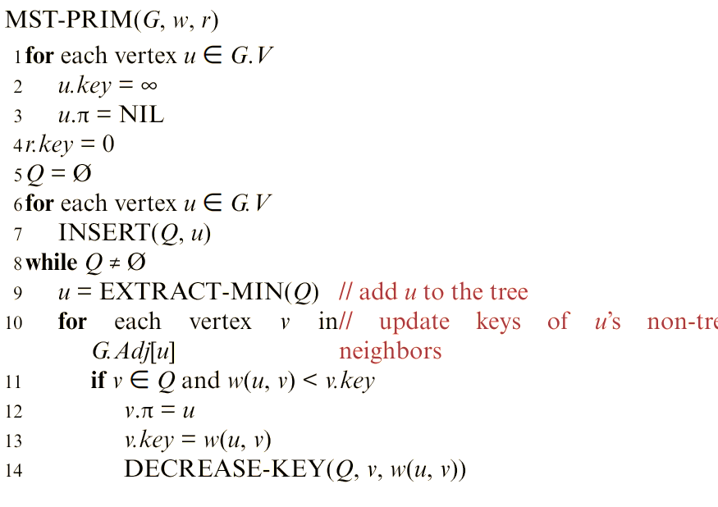
Prim’s Algorithm
Similar to Dijkstra’s shortest-path algorithm
$Q$: Min Priority Queue, orders elements based on $v.key$
Greedily take a node that can be added using cheapest-possible edge from the partial tree
Update newly discovered cheaper edge to reach $v$ from the partial tree
Correctness is due to the cut property

Slide 21
Time Complexity
Like Dijkstra’s algorithm, running time depends on priority queue implementation
Assume that we use Binary Heap
Line 6-7 can be done in $O(V)$ time by Build-Min-Heap procedure
Actually, Build-Min-Heap() isn’t needed. Why?
Line 9 takes $O(V\lg{V})$ time
Total $V$ calls to Extract-Min
Extract-Min takes $O(\lg{V)}$ time per call
Line 14 takes $O(E\lg{V)}$time
The inner loop executes $O\left(E\right)$ times in total (exactly $2|E|$ times)
Each call of Decrease-Key take $O(\lg{V)}$time
Running time:$O\left(\left(V+E\right)\lg{V}\right)$ using Binary Heap
This is $O(E\lg{V)}$if $\left|E\right|=Ω(V)$

Slide 22
Kruskal’s Algorithm
Instead of maintaining a partial tree, maintain a forest that eventually becomes MST
Start with a forest of all $|V|$ nodes and no edges
Consider edges in increasing order of weights and add an edge if it does not create a cycle
All blue colored nodes are single-node trees
Example:
8
7
b
c
d
4
9
2
11
4
a
i
14
e
7
6
8
10
h
g
f
1
2

Slide 23
Kruskal’s Algorithm
Instead of maintaining a partial tree, maintain a forest that eventually becomes MST
Start with a forest of all $|V|$ nodes and no edges
Consider edges in increasing order of weights and add an edge if it does not create a cycle
All blue colored nodes are single-node trees
Example:
8
7
b
c
d
4
9
(h,g) forms a yellow-colored tree
2
11
4
a
i
14
e
7
6
8
10
h
g
f
1
2

Slide 24
Kruskal’s Algorithm
Instead of maintaining a partial tree, maintain a forest that eventually becomes MST
Start with a forest of all $|V|$ nodes and no edges
Consider edges in increasing order of weights and add an edge if it does not create a cycle
All blue colored nodes are single-node trees
Example:
8
7
b
c
d
4
9
(c,i) forms a green-colored tree
2
11
4
a
i
14
e
7
6
8
10
h
g
f
1
2

Slide 25
Kruskal’s Algorithm
Instead of maintaining a partial tree, maintain a forest that eventually becomes MST
Start with a forest of all $|V|$ nodes and no edges
Consider edges in increasing order of weights and add an edge if it does not create a cycle
All blue colored nodes are single-node trees
Example:
8
7
b
c
d
4
9
(g,f) extends the yellow tree
2
11
4
a
i
14
e
7
6
8
10
h
g
f
1
2

Slide 26
Kruskal’s Algorithm
Instead of maintaining a partial tree, maintain a forest that eventually becomes MST
Start with a forest of all $|V|$ nodes and no edges
Consider edges in increasing order of weights and add an edge if it does not create a cycle
All blue colored nodes are single-node trees
Example:
8
7
b
c
d
4
9
2
Edge (c,f) combines yellow and green trees into a single tree (colored yellow, assume that majority color is retained)
11
4
a
i
14
e
7
6
8
10
h
g
f
1
2

Slide 27
Kruskal’s Algorithm
Instead of maintaining a partial tree, maintain a forest that eventually becomes MST
Start with a forest of all $|V|$ nodes and no edges
Consider edges in increasing order of weights and add an edge if it does not create a cycle
All blue colored nodes are single-node trees
Example:
8
7
b
c
d
4
9
(a,b) forms a green-colored tree
2
11
4
a
i
14
e
7
6
8
10
h
g
f
1
2

Slide 28
Kruskal’s Algorithm
Instead of maintaining a partial tree, maintain a forest that eventually becomes MST
Start with a forest of all $|V|$ nodes and no edges
Consider edges in increasing order of weights and add an edge if it does not create a cycle
All blue colored nodes are single-node trees
Example:
8
7
b
c
d
4
9
Assuming (a,h) wins tie-breaker, (a,h) combines yellow and green trees into a single yellow tree
2
11
4
a
i
14
e
7
6
8
10
h
g
f
1
2

Slide 29
Kruskal’s Algorithm
Instead of maintaining a partial tree, maintain a forest that eventually becomes MST
Start with a forest of all $|V|$ nodes and no edges
Consider edges in increasing order of weights and add an edge if it does not create a cycle
All blue colored nodes are single-node trees
Example:
8
7
b
c
d
4
9
Cannot add this edge
2
11
4
a
i
14
e
7
6
8
10
h
g
f
1
2

Slide 30
Kruskal’s Algorithm
Instead of maintaining a partial tree, maintain a forest that eventually becomes MST
Start with a forest of all $|V|$ nodes and no edges
Consider edges in increasing order of weights and add an edge if it does not create a cycle
All blue colored nodes are single-node trees
Example:
8
7
b
c
d
4
9
(c,d) extends the yellow tree
2
11
4
a
i
14
e
7
6
8
10
h
g
f
1
2

Slide 31
Kruskal’s Algorithm
Instead of maintaining a partial tree, maintain a forest that eventually becomes MST
Start with a forest of all $|V|$ nodes and no edges
Consider edges in increasing order of weights and add an edge if it does not create a cycle
All blue colored nodes are single-node trees
Example:
8
7
b
c
d
4
9
(d,e) extends the yellow tree
2
11
4
a
i
14
e
7
6
8
10
h
g
f
1
2

Slide 32
Kruskal’s Algorithm
Instead of maintaining a partial tree, maintain a forest that eventually becomes MST
Start with a forest of all $|V|$ nodes and no edges
Consider edges in increasing order of weights and add an edge if it does not create a cycle
All blue colored nodes are single-node trees
Example:
8
7
b
c
d
4
9
(d,e) extends the yellow tree
2
11
4
a
i
14
e
7
6
8
10
h
g
f
1
2

Slide 33
Kruskal’s Algorithm
Instead of maintaining a partial tree, maintain a forest that eventually becomes MST
Start with a forest of all $|V|$ nodes and no edges
Consider edges in increasing order of weights and add an edge if it does not create a cycle
All blue colored nodes are single-node trees
Example:
8
7
b
c
d
4
9
(d,e) extends the yellow tree
2
11
4
a
i
14
e
7
6
8
10
h
g
f
1
2

Slide 34
Kruskal’s Algorithm Implementation
Need to maintain a set of trees
Example: $\left\{a\right\}, \left\{b\right\}, \left\{c,i\right\}, \left\{f,g,h\right\}, \left\{d\right\}, \{e\}$ in the state of Kruskal’s execution in the right
After picking an edge, need to determine which set the endpoints belong to
Example: $(c,f)$ is picked by the Kruskal’s algorithm. We need to determine that they belong to sets $\{c,f\}$ and $\{f,g,h\}$, respectively
Need to union to sets into one set
Example: After adding edge $(c,f)$, the new combined set is $\{c,f,g,h,i\}$
8
7
b
c
d
4
9
2
11
4
a
i
14
e
7
6
8
10
h
g
f
1
2
Three operations:
Make-Set(v): make a set of node $v$
Find-Set(v): find the set of node $v$
Union(u,v): Combine the sets of $u$ and $v$

Slide 35
Kruskal’s Algorithm Implementation
$"A"$ contains edges of the MST
Does not create cycle if $u$and $v$ are in different set.

Slide 36
Time Complexity
Running time depends on running time of Make-Set(v), Find-Set(v), Union(u,v), and Sorting of edges
Sorting takes $O(E\lg{E)=O(E\lg{V)} }$time (since $\left|E\right|=O({\left|V\right|}^{2})$
 | Make-Set(v) |  |  | Find-Set(v) |  |  | Union(u,v) |  |  | Sorting
 | # calls | Running time per call | Total running time | # calls | Running time per call | Total running time | # calls | Running time per call | Total running time
Trivial (linked-list) | $$O(V)$$ | $$O(1)$$ | $$O(V)$$ | $$O(E)$$ | $$O(V)$$ | $$O(VE)$$ | $$O(E)$$ | $$O(V)$$ | $$O(VE)$$ | $$O(E\lg{V)}$$
Total running time with trivial implementation = $O(VE)$

Slide 37
Time Complexity
Running time can be improved if we use Disjoint-Set data structures (CLRS Sec. 19)
With Disjoint-Set, a sequence of $k$ Make-Set, Union, and Find-Set takes $O\left(k⋅α\left(n\right)\right)$, here $n=$ the number of items
Here, $α(n)$ is a very slow growing function
For simplicity, we use $O(k\lg{n)}$instead
 | Make-Set(v) + Union(v) + Find-Set(V) |  | Sorting
 | #calls | Total running time
Disjoint-Set | $$O(V+E)$$ | $$O\left(\left(V+E\right)\lg{V}\right)$$ (which is $O(E\lg{V) }$if $E=Ω(V))$ | $$O(E\lg{V)}$$
Total running time with Disjoint-Set = $O(E\lg{V})$

Slide 38
Disjoint-Set
Each set is represented as a rooted tree
The root node is the representative of the set
Find-Set() returns the representative
Make-Set(): Create a single-node tree
Find-Set(): Traverse by parent pointer until root is reached.
Then, the root is returned
a
representative
b
d
parent pointer
c
y
x
y
Union
x
Can speed up sequence of the operations by means of two heuristics
Slide Courtesy: Prof. Anderson

Slide 39
Disjoint-Set
1) Union by Rank
Store rank of tree in rep.
Rank ≈ tree size.
Make root with smaller rank point to root with larger rank.
2) Path Compression
During Find-Set, “flatten” tree.
d
d
c
Find-set(a)
b
a
b
c
a
Slide Courtesy: Prof. Anderson

Slide 40
Conclusion
MST can be computed in $O(E\lg{V)}$time by Prim’s and Kruskal’s algorithm
Both are greedy algorithms
Karger, Klein, and Tarjan gave an algorithm that runs in $O(E\lg{V)}$ at worst case, but $O(V+E)$ in average case
https://cs.brown.edu/research/pubs/pdfs/1995/Karger-1995-RLT.pdf
Bernard Chazelle gave an $O(E α(\left|E\right|,\left|V\right|)$-time algorithm (known best so far!)
$α(⋅,⋅)$ is the slow growing function mentioned in disjoint set data structure
It is still open whether MST can be solved in $O(V+E)$ worst-case running time.

Slide 41
Thank You!

