Slide 1
On Beyond Objects Programming in the 21th century COMP 590-059 Fall 2021
David Stotts
Computer Science Dept
UNC Chapel Hill

Slide 2
Concurrency
Concurrency is when two or more different calculations are underway in overlapping time periods
These different activities
might not interact ( independent, not interesting )
might cooperate to accomplish a task together
might interfere to cause problems or errors
Concurrent activities might be
chunky, large, coarse-grained, few in number
fine-grained, large in number, small actions
in-between

Slide 3
Concurrency vs. Parallelism
Parallelism is a form of very fine-grained concurrency that is usually executed on a “parallel architectures”
Super computers, graphics cards, machines with very large numbers of smaller CPU or cores
Often applied semi-automatically to highly regular numerical applications (matrix algebra, e.g.) in domains like graphics, image analysis
Parallelizing compilers can break up loops into coordinated overlapping concurrent executions of the body

Slide 4
Concurrent Programming
Languages for expressing concurrent computations
Multi-threaded: Java, Go, Rust, Clojure, Go, C#
Coordination language: Linda, CnC
Functional: Clojure, Erlang, Elixir, Haskell
Message passing: Smalltalk, Rust
Distributed computing: Julia, Oz, Hermes (IBM), Limbo (Bell)
Logic: Parlog (Prolog), Mercury
Monitor-based: Concurrent Pascal, Concurrent Euclid, Emerald
CSP-based: Occam, Limbo, Go, Crystal (2014)
Dataflow

Slide 5
Models: Shared Data State
Shared read/write variables or data blocks
Scope allows data visibility to different code blocks
Code blocks then “execute” concurrently and all read/write the shared data
Even on single CPU system, “virtual” concurrent execution is a good way to think of the computation as progressing
Concurrent tasks might be larger (processes) or medium (threads)
Not usually used for fine-grained parallelism

Slide 6
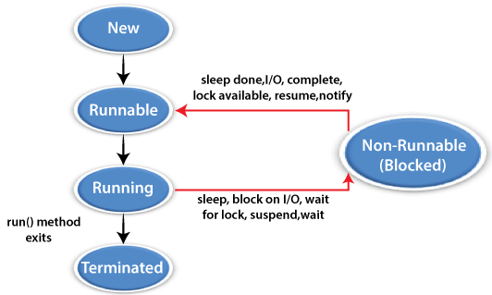
Threads examples
Threads in Java
Java threads are lightweight sub-processes that can share memory
Every Java program has at least one thread… main
Main thread can cause new threads to come into existence and run
A thread exists in one of these states

Slide 7
Concurrency via Threads
public class FooStuff extends Thread {
public void run( ) {
System.out.println(“doing foo stuff”);
}
public static void main (String[] args) {
FooStuff thExt = new FooStuff();
thExt.start();
}
}
Making a new Thread
Two ways in Java:
Extend the Thread class
Implement the Runnable interface
Extend the Thread class
Create a thread-intended class that extends Thread
Override the run( ) method
Instantiate an object of your thread-intended class
Have that object invoke its start( ) method
start( ) internally executes the run( ) method you overrode

Slide 8
Concurrency via Threads
public class FooStuff implements Runnable {
public void run( ) {
System.out.println(“doing foo stuff”);
}
public static void main (String[] args) {
Thread thRnb = new Thread(new FooStuff());
thRnb.start();
}
}
Making a new Thread
We would use this approach for a class that already extends some parent class, but needs thread capability
Java wont allow multiple inheritance (extends)
Implement the Runnable interface
Create a thread-intended class that implements Runnable
Code up the run( ) method
Instantiate an object of Thread class, pass a new thread-intended class object to the Thread constructor
Have that object invoke its start( ) method
start( ) internally executes the run( ) method you overrode

Slide 9
Counting
public class Counting { public static void main(String[] args) throws InterruptedException { class Counter { int counter = 0; public void increment() { counter++; } public int get() { return counter; } } final Counter counter = new Counter(); class CountingThread extends Thread { public void run() { for (int x = 0; x < 500000; x++) { counter.increment(); } } } CountingThread t1 = new CountingThread(); CountingThread t2 = new CountingThread(); t1.start(); t2.start(); t1.join(); t2.join(); System.out.println(counter.get()); } }
Java threads
codes from
Marko Dvečko

Slide 10
CountingBetter
import java.util.concurrent.atomic.AtomicInteger; class CountingBetter { public static void main(String[] args) throws InterruptedException { final AtomicInteger counter = new AtomicInteger(0); class CountingThread extends Thread { public void run() { for (int i = 0; i < 500000; i++) { counter.incrementAndGet(); } } } CountingThread thread1 = new CountingThread(); CountingThread thread2 = new CountingThread(); thread1.start(); thread2.start(); thread1.join(); thread2.join(); System.out.println(counter.get()); } }

Slide 11
Deadlock
public class Deadlock {
public static void main(String[] args) throws InterruptedException {
class Account {
int balance = 100;
public Account(int balance) { this.balance = balance; }
public synchronized void deposit(int amount) { balance += amount; }
public synchronized boolean withdraw(int amount) {
if (balance >= amount) { balance -= amount; return true; }
return false;
}
public synchronized boolean transfer(Account destination, int amount) {
if (balance >= amount) {
balance -= amount;
synchronized(destination) { destination.balance += amount; };
return true;
}
return false;
}
public int getBalance() { return balance; }
}

Slide 12
Deadlock (cont.)
final Account bob = new Account(200000);
final Account joe = new Account(300000);
class FirstTransfer extends Thread {
public void run() {
for (int i = 0; i < 100000; i++) {
bob.transfer(joe, 2);
} } }
class SecondTransfer extends Thread {
public void run() {
for (int i = 0; i < 100000; i++) {
joe.transfer(bob, 1);
} } }
FirstTransfer thread1 = new FirstTransfer();
SecondTransfer thread2 = new SecondTransfer();
thread1.start(); thread2.start();
thread1.join(); thread2.join();
System.out.println("Bob's balance: " + bob.getBalance());
System.out.println("Joe's balance: " + joe.getBalance());
}
}

Slide 13
Monitor
Concurrency control mechanism
Per Brinch Hansen, C.A.R. Hoare (c. 1973)
Class-like structure wrapping a shared resource, allowing locking and mutual exclusion (mutex)
Also gives threads the ability to wait (block) for a certain condition to become false.
A monitor consists of a mutex (lock) object and condition variables.
A condition variable essentially is a container of threads that are waiting for a certain condition.
Monitors provide a mechanism for threads to temporarily give up exclusive access in order to wait for some condition to be met, before regaining exclusive access and resuming their task.
( wiki )

Slide 14
Monitor
Overall Pattern
monitor class Account {
private int balance := 0 invariant balance >= 0
public method boolean withdraw(int amount)
precondition amount>=0 {
if balance < amount { return false }
else {
balance := balance - amount
return true
}
}
public method deposit(int amount)
precondition amount >= 0 {
balance := balance + amount
}
}

Slide 15
Monitor
Internal effect is this
class Account {
private lock myLock
private int balance := 0 invariant balance >= 0
public method boolean withdraw(int amount) precondition amount >= 0 {
myLock.acquire()
try {
if balance < amount { return false }
else {
balance := balance - amount
return true
}
} finally { myLock.release() }
}
public method deposit(int amount) precondition amount >= 0 {
myLock.acquire()
try { balance := balance + amount }
finally { myLock.release() }
}
}

Slide 16
Mutex not enough
Threads can deadlock
In general, threads attempting some op in a monitor may need to wait until some condition P holds on the state of the monitor’s shared data
A busy waiting loop wont work here
while not( P ) do skip
Why not?
A thread doing this is in the monitor, and has the mutex lock
Thus, no other thread can enter the monitor to change the data state and make P true
Need a way to pause the thread, and then signal it back to running when the condition P is true (or could be true).
condition variables

Slide 17
Example Issues
Busy Waiting
global RingBuffer queue; // A thread-unsafe ring-buffer of tasks
// Method representing each producer thread's behavior
public method producer() {
while (true) {
task myTask = ...; // Produce some new task to be added
while (queue.isFull()) {} // Busy-wait until the queue is non-full
queue.enqueue(myTask); // Add the task to the queue
}
}
// Method representing each consumer thread's behavior
public method consumer() {
while (true) {
while (queue.isEmpty()) {} // Busy-wait until the queue is non-empty
myTask = queue.dequeue(); // Take a task off of the queue
doStuff(myTask); // Go off and do something with task
}
}
race conditions, mess up queue state

Slide 18
Example Issues
Spin Waiting (spin lock)
a mutex is used to protect the critical sections of code
busy-waiting is still used
the lock is acquired and released in between each busy-wait check
global RingBuffer queue; // A thread-unsafe ring-buffer of tasks
global Lock queueLock; // A mutex for the ring-buffer of tasks
// Method representing each producer thread's behavior
public method producer() {
while (true) {
task myTask = ...; // Producer makes some new task to be added
queueLock.acquire(); // Acquire lock for initial busy-wait check
while (queue.isFull()) { // Busy-wait until the queue is non-full
queueLock.release();
// Drop the lock temporarily to allow a chance for other threads
// needing queueLock to run so that a consumer might take a task
queueLock.acquire(); // Re-acquire lock for the next call to "queue.isFull()"
}
queue.enqueue(myTask); // Add the task to the queue
queueLock.release(); // Drop queue lock until we need it again to add the next task
}
}

Slide 19
Example Issues
Spin Waiting
// Method representing each consumer thread's behavior
public method consumer() {
while (true) {
queueLock.acquire(); // Acquire lock for initial busy-wait check
while (queue.isEmpty()) { // Busy-wait until the queue is non-empty
queueLock.release();
// Drop the lock temporarily to allow a chance for other threads
// needing queueLock to run so that a producer might add a task
queueLock.acquire(); // Re-acquire the lock for the next
// call to "queue.isEmpty()"
}
myTask = queue.dequeue(); // Take a task off of the queue
queueLock.release(); // Drop queue lock until need it
// again to take off the next task
doStuff(myTask); // Go off and do something with the task
}
}

Slide 20
Example Issues
Spin Waiting
Well, it’s a solution: assures inconsistent shared state does not occur
But it’s not an efficient solution
wastes CPU resources due to so much busy-waiting
even if the queue is empty and producer threads have nothing to add for a long time, consumer threads are always busy-waiting (for nothing)
likewise, if consumers are blocked for a long time on current tasks and the queue is full, producers are busy-waiting, consuming CPU cycles
need a way to make producer threads block until the queue is non-full, and a way to make consumer threads block until the queue is non-empty.

Slide 21
Monitor condition variables
These are pools (queues) of threads
Conceptually a condition variable is a queue of threads, associated with a mutex, on which a thread may wait for some condition to become true
Each condition variable c is associated with an assertion Pc
While a thread is waiting on some c , that thread is not considered to occupy the monitor . . . so other threads may enter the monitor to change the monitor's state
In most types of monitors, these other threads may signal the condition variable c to indicate that assertion Pc is true in the current monitor data state.

Slide 22
signal c, also known as notify c
Monitor condition variables
Three main operations on condition variables
wait c, m
where c is a condition var and m is a mutex (lock) of the monitor
signal c ( also known as notify c )
called by a thread to indicate that the assertion Pc is true
broadcast c ( also known as notifyAll c )
similar op to signal, but wakes up all threads in c's wait-queue

Slide 23
NonDeterminism
public class NonDeterminism { public static void main(String[] args) throws InterruptedException { class Container { public String value = "Empty"; } final Container container = new Container(); class FastThread extends Thread { public void run() { container.value = "Fast"; } } class SlowThread extends Thread { public void run() { try { Thread.sleep(50); } catch(Exception e) {} container.value = "Slow"; } } FastThread fast = new FastThread(); SlowThread slow = new SlowThread(); fast.start(); slow.start(); fast.join(); slow.join(); System.out.println(container.value); } }

Slide 24
These methods are from Thread class
* public static void sleep(long millis) throws InterruptedException * public static void yield() * public final void join() throws InterruptedException * public final void setPriority(int newPriority)
Methods from Object class.
* public final void wait() throws InterruptedException * public final void notify() * public final void notifyAll()
These methods are from Thread class
* public static void sleep(long millis) throws InterruptedException * public static void yield() * public final void join() throws InterruptedException * public final void setPriority(int newPriority)
Methods from Object class.
* public final void wait() throws InterruptedException * public final void notify() * public final void notifyAll()
Thread Control
Methods to control thread execution and state
These methods are from Thread class
public static void sleep( long millis ) throws InterruptedException
public static void yield( )
public final void join( ) throws InterruptedException
public final void setPriority( int newPriority )
Methods from Object class
public final void wait( ) throws InterruptedException
public final void notify( )
public final void notifyAll( )

Slide 25
Thread Control
Methods to control thread execution and state
Thread tt = new Thread( ); // th state new
tt.start( ); // th state runnable and running
tt.join( ); // current thread (like main) waits for tt run to end
tt.yield( );
tt.sleep(1000); // in millisecs
tt.sleep(0,200); // in nanosecs

Slide 26
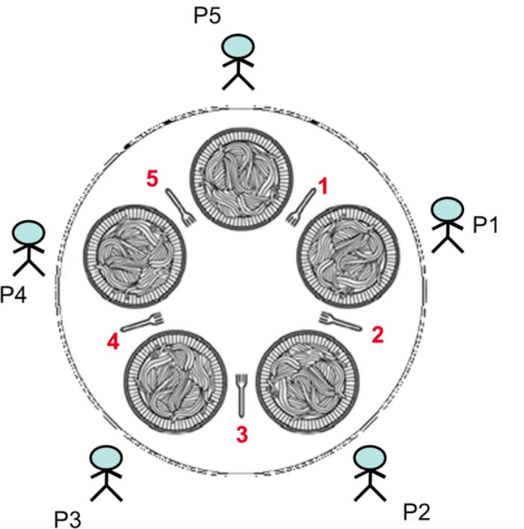
Dining Philosophers
Classic concurrency problem
5 philosophers around a table …
5 plates of food, 5 forks as shown
They think … and they must also eat
Starving to death ends thinking.
Now, to eat a philosopher must take a fork in each hand, eat a while, then put down the forks and go back to thinking
Note that when (say) P3 takes forks 3 & 4, P4 and P2 cannot eat.
The goal is to program this activity so that no philosopher starves ( i.e., never is able to pick up the needed 2 forks )

Slide 27
Dining Philosophers
Classic concurrency problem
Note that no more than 2 philos can be eating at any time (as that uses 4 forks in hand, leaving only 1 fork on the table)
All 5 can be thinking at any one instant, but if they all stay that way (never eat) they all starve.
So we assume a philos has a natural cycle of thinking, trying to eat, eating, and back to thinking.
If Pi is trying to eat, and never gets 2 forks, we say Pi starves
If all 5 manage to each get one fork, then none will ever get another; this is a deadlock… and all starve

Slide 28
Dining Philosophers
Can one Pi starve and the others not?
while ( true ) {
// Initially, thinking about life, universe, and everything
think( ); // lasts a while
// Take a break from thinking, hungry now
pick_up_left_fork( );
pick_up_right_fork( );
eat( ); // lasts a while
put_down_right_fork();
put_down_left_fork();
// Not hungry anymore. Back to thinking!
}

Slide 29
Dining Philosophers
Each Pi is a thread
5 threads trying to pick up 5 (shared) forks
// possible order of events
P1 thinking
P2 thinking
P3 thinking
P4 thinking
P5 thinking
P1 picks up left fork
P2 picks up left fork
P3 picks up left fork
P4 picks up left fork
P5 picks up left fork
// … crickets…
deadlocked
What else might we do?

Slide 30
Dining Philosophers
What about this?
while ( true ) {
// Initially, thinking about life, universe, and everything
think( ); // lasts a while
// Take a break from thinking, hungry now
pick_up_left_fork( );
pick_up_right_fork( );
eat( ); // lasts a while
put_down_right_fork();
put_down_left_fork();
// Not hungry anymore. Back to thinking!
}
simultaneously
simultaneously

Slide 31
Dining Philosophers
Other issues
We must take care to not serialize it totally
Synchronize away all concurrency
What about some starve, others do not?

Slide 32
Cigarette Smokers Problem
Another Classic concurrency problem
Three smokers are sitting at a table.
One of them has tobacco, another has cigarette papers, and the third one has matches – each one has a different ingredient required to make and smoke a cigarette
Each may not give any ingredient to another.
On the table in front of them, two of the three ingredients will be placed (from an infinite supply of all)
The smoker who has the necessary third ingredient should pick up the ingredients from the table, make the cigarette and smoke it.

Slide 33
Cigarette Smokers Problem
Another Classic concurrency problem
A new 2-set of ingredients will not be placed on the table until this action is completed
The other smokers who cannot make and smoke a cigarette with the ingredients on the table will wait, and must not interfere with the one who can.
As with Dining Philosophers, the goal is a “solution”, meaning a program that causes this cycle to operate endlessly without race conditions (corruption of the data state) and without deadlocks or starvations.

Slide 34
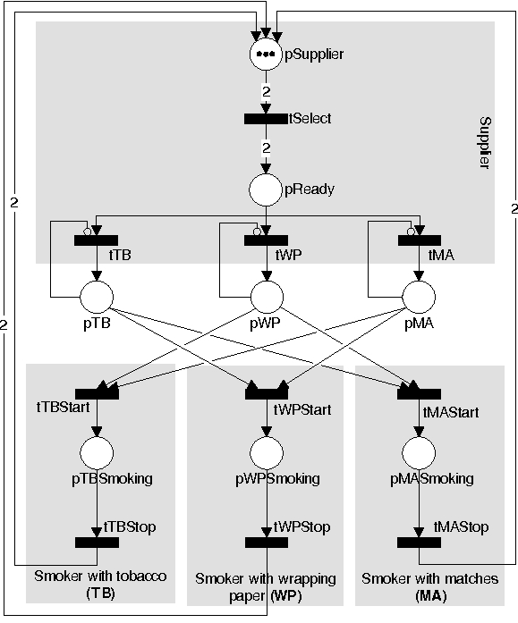
Petri Net Solution
Nets with inhibitor arcs

Slide 35
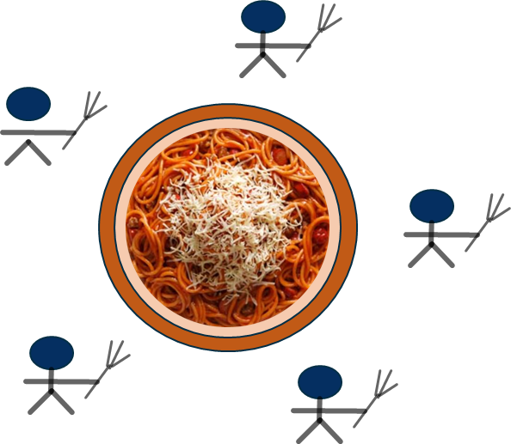
Dining Siblings
Yet another classic
5 siblings around a table … they share a meal from a communal pot
The pot contains M servings of sibling fodder.
Each sib has a fork (and we assume, a bowl plate), which is all one needs to eat.
Each sibling goes to the pot, takes a serving of fodder (if the pot is not empty) and eats
When hungry again, each sibling goes back to the pot to take another potion and eats again.
“Mom” (the cook) keeps the pot filled. Mom fills the pot only when the pot becomes empty, and once cooking, cooks enough to fill the pot full.

Slide 36
Dining Siblings
Yet another classic
As with the others, a solution is a program simulating the actors and actions in this scenario, using concurrent programming and avoiding the issues in concurrency (deadlock, race conditions, starvation)

Slide 37
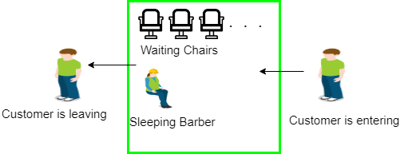
Sleeping Barber Problem
Yet another classic
Summary: We must keep a barber working when there are customers, resting when there are none, and doing so in an orderly manner
A barber has a shop with one chair for service.
The shop has several wait chairs customers can wait in
When there are no customers, the barber sleeps (in his own chair)
When a customer arrives, they find one of 3 things:
Barber is busy cutting hair, and a wait chair is open… so they sit and wait
Barber is sleeping… so they wake the barber for a cut
Barber is busy and all wait chairs are full… so they leave

Slide 38
Readers-Writers
Yet another classic

Slide 39
Producers-Consumers
Yet another classic

Slide 40
Assignment
Due (see assignments page)
Write a Java threads program to implement a solution to the Dining Philosophers problem.
Test it for concurrency issues, and write an explanation (text document) explaining how your approach works… can it deadlock? Does it show race conditions? Explain any strange or interesting behavior you notice
You may work in groups of up to 3
Write your own code… do not look up a web solution and copy it… learning comes from thinking it through
When done submit in Sakai as we have done other programs

Slide 41
END

Slide 42
Sample APL Program (source)
Conway’s Game of Life
Alan Kay on APL
APL Has been called a “write-only language”
And so you know…

Slide 43
