Slide 1
On Beyond Objects Programming in the 21th century COMP 590-059 Fall 2021
David Stotts
Computer Science Dept
UNC Chapel Hill

Slide 2
Erlang Processes Patterns

Slide 3
A process is created and terminated extremelly fast, that's why you can actually have thousands of them.
A process executes some piece of code, then it terminates. It can also run forever.
Course Recap
Progress this Semester
We have studied these topics up to now
Object models… Java compared to others
Aspect Oriented Programming
SML, functional programming
Type inference (in SML)
ADT axiomatic specs (Guttag)
Expressing and testing ADT specs in SML
Lambda calculus
Concurrency… monitors, P/V, history
Java Threads
Issues: Race conditions, deadlock, starvation
Classic problems… Dining Philosophers, Smokers, Sleeping Barber, etc.
Erlang… history, sequential functional subset
Erlang processes, process patterns
We are headed here
Actor concurrency model
Linda tuplespace concurrency model
Temporal logic and Model checking

Slide 4
A process is created and terminated extremelly fast, that's why you can actually have thousands of them.
A process executes some piece of code, then it terminates. It can also run forever.
Processes: Problems
Race Conditions, Deadlock, Starvation
All concurrent notations have these issues
Careful programming can help keep them from happening but not eliminate them
We will see that formal methods like model checking can detect them
Race condition: two processes (or more) proceed at different rates, interact unpredictably on a shared recourse
Deadlock: two processes block, each waiting for the other to do some needed act produce some needed resource
Starvation: a process needs a resource, but waits endlessly to get it due to activity of other processes also competing for the resource
We saw starvation as a potential problem in Dining Philosophers… one philosopher wants to eat, trys to get forks, but neighbors keep getting forks first
We saw deadlock in Dining Philosophers too, in that if all philosophers want to eat and each picks up one fork, then all are unable to proceed… none will get another fork

Slide 5
A process is created and terminated extremelly fast, that's why you can actually have thousands of them.
A process executes some piece of code, then it terminates. It can also run forever.
Processes: Problems
register/2 and whereis/2
register(Name, Pid)
Associates the name Name (an atom) with the process Pid.
registered()
Returns a list of names that have been registered using register/2.
whereis(Name)
Returns the pid registered under Name, or undefined if the name is not registered.
-module(reg).
-export([start/0, call/2]).
call(Arg1, Arg2) ->
io:fwrite("~p~n",[Arg1]).
start() ->
Pid = spawn(?MODULE, call, ["hello", "process"]),
register(myprocess, Pid),
io:fwrite("~p~n",[whereis(myprocess)]).

Slide 6
A process is created and terminated extremelly fast, that's why you can actually have thousands of them.
A process executes some piece of code, then it terminates. It can also run forever.
Processes: Problems
(in shell) register/2 and whereis/2
12> c(reg).
{ok,reg}
13> reg:start().
<0.104.0>
"hello"
ok
14> whereis(foo).
undefined
15> whereis(myprocess).
undefined
16> registered().
[standard_error,erl_prim_loader, . . .
. . .kernel_sup,code_server]
17>
17> whereis(code_server).
<0.50.0>
18>

Slide 7
A process is created and terminated extremelly fast, that's why you can actually have thousands of them.
A process executes some piece of code, then it terminates. It can also run forever.
Processes: Scheduling
General Overview
A scheduler carries out the decision making and effectuation of matching work (processes) to workers (processors)
The goal in general is to maximize throughput, maximize fairness while minimizing response time and latency.
Scheduling is a major portion of the work in programs like OS and Virtual Machines; there are two prevalent types: preemptive, and cooperative.
Preemptive: A preemptive scheduler does context switching among running tasks and has the power to preempt (interrupt) tasks and resume them at a later time without the cooperation of the preempted tasks. This is done based on some factors like their priority, time slice or reductions.
Cooperative: A Cooperative scheduler needs tasks’ agreement for context switching; the scheduler simply lets running tasks voluntarily release control periodically or when idle, then starts a new task and again waits for it to return control back voluntarily.

Slide 8
A process is created and terminated extremelly fast, that's why you can actually have thousands of them.
A process executes some piece of code, then it terminates. It can also run forever.
Processes: Scheduling
How ERTS schedules processes
Erlang as a real-time platform for multitasking uses Preemptive Scheduling.
The responsibility of an Erlang scheduler is selecting a next Process to run, and then executing the code.
It also does Garbage Collection and Memory Management process by process.
The deciding factor when selecting processes for execution is based on their priority level, which is configurable per process
Within each priority level, processes are scheduled in a round robin fashion.

Slide 9
A process is created and terminated extremelly fast, that's why you can actually have thousands of them.
A process executes some piece of code, then it terminates. It can also run forever.
Processes: Scheduling
Number of “Reductions”
On the other hand, the scheduler also has to decide when to preempt or suspend the currently running process
The factor guiding the decision to preempt is based on a certain number of “reductions” since the last time it was selected for execution, regardless of its priority level.
The reductions is a counter per process that is normally incremented by one for each function call.
A process is preempted and context switched when its reductions counter reaches the set maximum.
In Erlang/OTP R12B this maximum number was 2000 reductions, for example.
This information is accurate as of 2016.

Slide 10
A process is created and terminated extremelly fast, that's why you can actually have thousands of them.
A process executes some piece of code, then it terminates. It can also run forever.
Processes: Race Condition
Example code
start () ->
case whereis(db_server) of
undefined ->
Pid = spawn(db_server, init, []),
Register(db_server, Pid),
{ok, Pid};
Pid when ispid(Pid) ->
{error, already_started}
end.
Consider two of these spawned as processes
Pid1 = spawn(?MODULE, start, [ ]).
Pid2 = spawn(?MODULE, start, [ ]).
Assume the db server has NOT been started, and both processes eval the whereis(db_server) guard on the case.
Pid1 is first (let’s say), gets “undefined” as a result, and begins the matching clause… but does not get to the register before it is pre-empted ( ERTS scheduler, time slice )

Slide 11
A process is created and terminated extremelly fast, that's why you can actually have thousands of them.
A process executes some piece of code, then it terminates. It can also run forever.
Processes: Race Condition
Example code
start () ->
case whereis(db_server) of
undefined ->
Pid = spawn(db_server, init, []),
Register(db_server, Pid),
{ok, Pid};
Pid when ispid(Pid) ->
{error, already_started}
end.
Then Pid2 gets to execute and it also gets undefined from whereis(db_server)
It creates the server and begins to use it… at least registers it with the name db_server
Then Pid2 is pre-empted, and Pid1 continues, creates another db server (with a different PID)… this is one problem
Then when it tried to register the name db_server, the process fails with a runtime error since the name is already in use… contrary to what the case statement was told

Slide 12
A process is created and terminated extremelly fast, that's why you can actually have thousands of them.
A process executes some piece of code, then it terminates. It can also run forever.
Processes: Deadlock
Rare in Erlang
Message passing is asynchronous, non-blocking by default.
Sending a message always succeeds
You can make a synchronous communication (send a message and block/wait for a reply)
But to do so is to risk deadlock
If process A sends a message to B… and waits for B to reply …
And if B does the same to A
Then the messages might cross in the (unpredictable) flow of execution and now both A and B are blocked and waiting for the other to reply
So don’t write processes that do that

Slide 13
A process is created and terminated extremelly fast, that's why you can actually have thousands of them.
A process executes some piece of code, then it terminates. It can also run forever.
Processes: Patterns
Common Forms for Networks of Processes
Client-Server
Basic and heavily used
-module(server).
-export([start/2, rpc/2]).
start(Name, Mod) ->
register(Name, spawn(fun() -> loop(Name, Mod, Mod:init()) end)).
rpc(Name, Request) ->
Name ! {self(), Request},
receive
{Name, Response} -> Response
end.
loop(Name, Mod, State) ->
receive
{From, Request} ->
{Response, State1} = Mod:handle(Request, State),
From ! {Name, Response},
loop(Name, Mod, State1)
end.

Slide 14
A process is created and terminated extremelly fast, that's why you can actually have thousands of them.
A process executes some piece of code, then it terminates. It can also run forever.
Processes: Patterns
-module(name_server).
-export([init/0, add/2, whereis/1, handle/2]).
-import(server1, [rpc/2]).
init() ->
dict:new().
add(Name, Place) ->
rpc(name_server, {add, Name, Place}).
whereis(Name) ->
rpc(name_server, {whereis, Name}).
handle({add, Name, Place}, Dict) ->
{ok, dict:store(Name, Place, Dict)};
handle({whereis, Name}, Dict) ->
{dict:find(Name, Dict), Dict}.

Slide 15
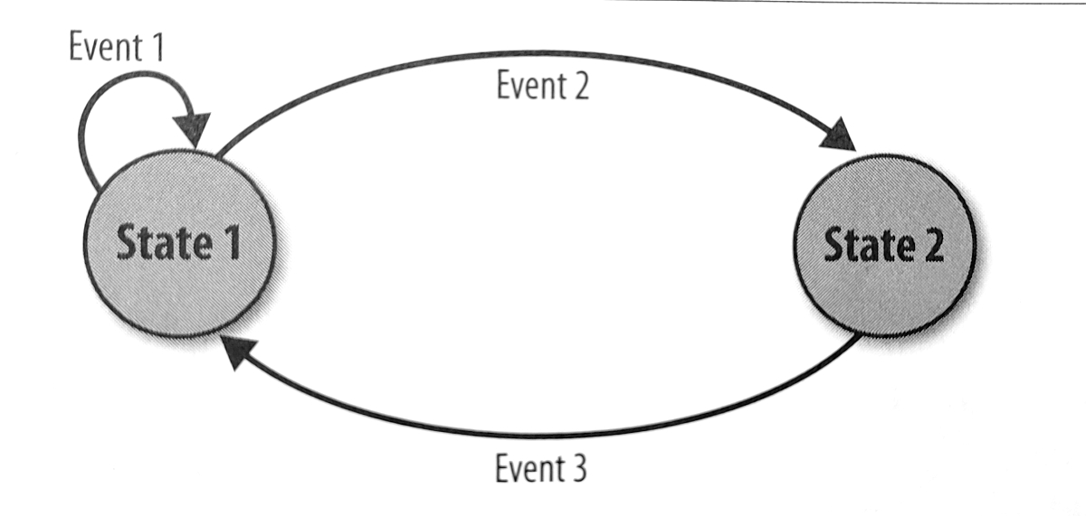
A process is created and terminated extremelly fast, that's why you can actually have thousands of them.
A process executes some piece of code, then it terminates. It can also run forever.
Processes: FSM Pattern
Common Forms for Networks of Processes
Finite State Machine
Erlang was, after all, created for telephony equipment and apps
We model the FSM with a tail recursive function for each state
Means a process for each state
Actions implemented as function calls
Events/transitions implemented as messages state-to-state
Note … only one process active at a time… not super concurrent

Slide 16
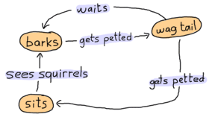
A process is created and terminated extremelly fast, that's why you can actually have thousands of them.
A process executes some piece of code, then it terminates. It can also run forever.
Processes: FSM
Common Forms for Networks of Processes
Here is an FSM modeling a pet dog

Slide 17
A process is created and terminated extremelly fast, that's why you can actually have thousands of them.
A process executes some piece of code, then it terminates. It can also run forever.
Processes: Patterns
-module(dog_fsm).
-export([start/0, squirrel/1, pet/1]).
start() -> spawn(fun() -> bark() end).
squirrel(Pid) -> Pid ! squirrel. % message the fsm, change state
pet(Pid) -> Pid ! pet. % message the fsm
bark() -> io:format("Dog says: BARK! BARK!~n"),
receive
pet -> wag_tail();
_ -> io:format("Dog is confused~n"),
bark()
after 2000 ->
bark()
end.

Slide 18
A process is created and terminated extremelly fast, that's why you can actually have thousands of them.
A process executes some piece of code, then it terminates. It can also run forever.
Processes: Patterns
wag_tail() -> io:format("Dog wags its tail~n"),
receive
pet -> sit();
_ -> io:format("Dog is confused~n"),
wag_tail()
after 10000 ->
bark()
end.
sit() -> io:format("Dog is sitting. Gooooood boy!~n"),
receive
squirrel -> bark();
_ -> io:format("Dog is confused~n"),
sit()
end.

Slide 19
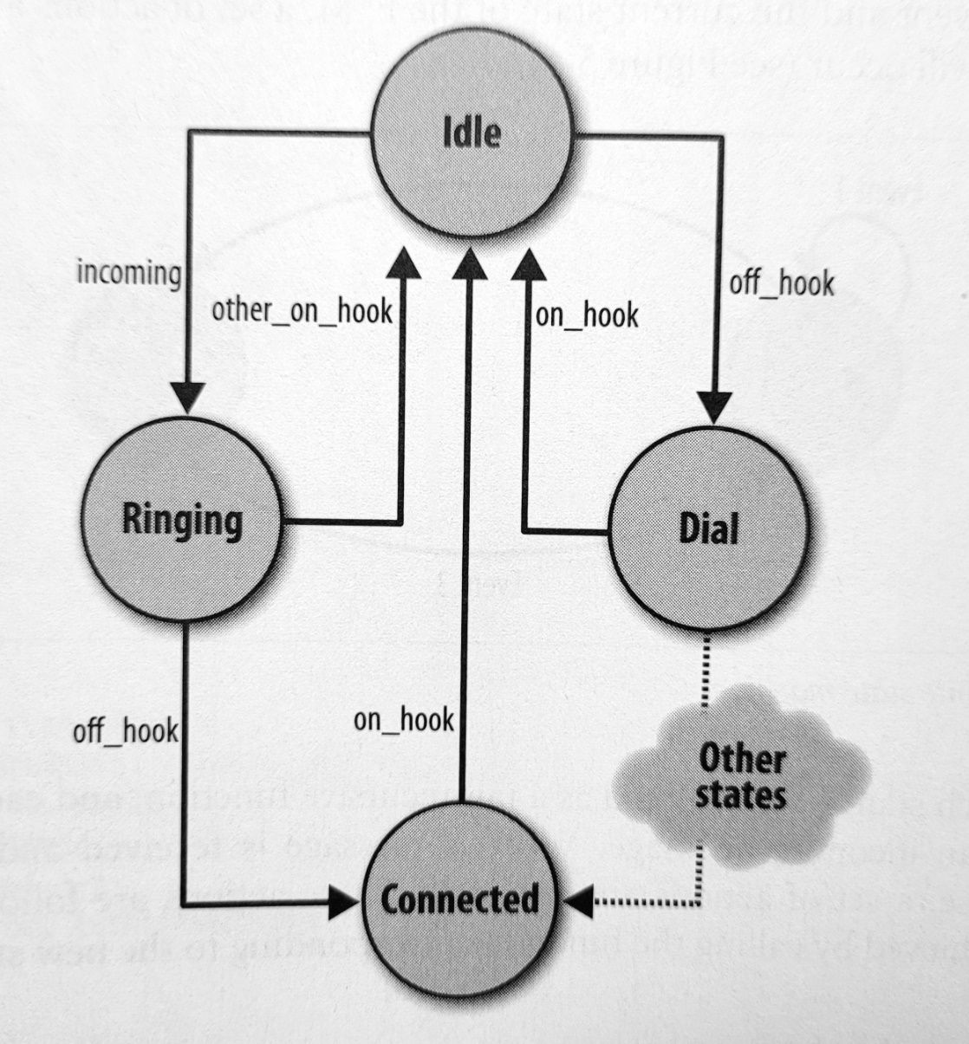
A process is created and terminated extremelly fast, that's why you can actually have thousands of them.
A process executes some piece of code, then it terminates. It can also run forever.
Processes: Patterns
Common Forms for Networks of Processes
Basic Phone FSM
Erlang was, after all, created for telephony equipment and apps
This basic model was used by the engineers at Ericsson when they were designing Erlang
Tried each new idea on many basic codes and this was one

Slide 20
A process is created and terminated extremelly fast, that's why you can actually have thousands of them.
A process executes some piece of code, then it terminates. It can also run forever.
Processes: Patterns
idle() ->
receive
{Number, incoming} ->
start_ringing(),
ringing(Number);
off_hook ->
start_tone(),
dial() % indirect tail recursion
end.
ringing(Number) ->
receive
{Number, other_on_hook} ->
stop_ringing(),
idle()
{Number, off_hook} ->
stop_ringing(),
connected(Number)
end.
connected() -> ...
dial() -> ...
start_ringing() -> ...
start_tone() -> ...
stop_ringing() -> ...

Slide 21
Pause…

Slide 22
Erlang Big Example
Dining Philosophers
-module(dphilos).
-compile([export_all]).
-define(EAT,1000).
-define(THINK,1000).
college() ->
R = spawn_link(?MODULE, report,[]),
F1 = spawn_link(?MODULE, fork,["fork1",R]),
F2 = spawn_link(?MODULE, fork,["fork2",R]),
F3 = spawn_link(?MODULE, fork,["fork3",R]),
F4 = spawn_link(?MODULE, fork,["fork4",R]),
F5 = spawn_link(?MODULE, fork,["fork5",R]),
spawn_link(?MODULE, philosopher,["Socrates", R, F1,F2]),
spawn_link(?MODULE, philosopher,["Confucius", R, F2,F3]),
spawn_link(?MODULE, philosopher,["Aristole", R, F3,F4]),
spawn_link(?MODULE, philosopher,["Homer", R, F4,F5]),
spawn_link(?MODULE, sphilosopher,["Plato", R, F1,F5]).

Slide 23
Dining Philosophers
%% create philosophers randomly
philosopher(Name, Report, LeftF, RightF) ->
random:seed(
erlang:phash2([node()]),
erlang:monotonic_time(),
erlang:unique_integer()
),
create_phils( Name, Report, LeftF, RightF ) .
%% create special philosopher
sphilosopher(Name, Report, RightF, LeftF) ->
random:seed(
erlang:phash2([node()]),
erlang:monotonic_time(),
erlang:unique_integer()
),
create_special_phil( Name, Report, RightF, LeftF ) .

Slide 24
Dining Philosophers
%% creates random 4 philos who get the Left fork first then the right
create_phils(Name,Report,LeftF,RightF) ->
%% thinking state
reporting(Name,Report,thinking),
timer:sleep(random:uniform(?THINK)),
%% hungry state
reporting(Name,Report,hungry),
LeftF ! RightF ! {pick,self()},
receive
{picked, LeftF} -> reporting(Name, Report, left);
{picked, RightF} -> reporting(Name, Report, right)
end,
receive
{picked, LeftF} -> reporting(Name, Report, left);
{picked, RightF} -> reporting(Name, Report, right)
end,
%% eating state
reporting(Name,Report,eating),
timer:sleep(random:uniform(?EAT)),
LeftF ! RightF ! {let_go,self()},
create_phils(Name,Report,LeftF,RightF).

Slide 25
Dining Philosophers
%% create special philosopher who attempts to communicate first with the
%% right fork proccess instead of the left fork
create_special_phil(Name,Report,RightF,LeftF) ->
%% thinking state
reporting(Name,Report,thinking),
timer:sleep(random:uniform(?THINK)),
%% hungry state
reporting(Name,Report,hungry),
RightF ! LeftF ! {pick,self()},
receive
{picked, RightF} -> reporting(Name, Report, right);
{picked, LeftF} -> reporting(Name, Report, left)
end,
receive
{picked, RightF} -> reporting(Name, Report, right);
{picked, LeftF} -> reporting(Name, Report, left)
end,
%% eating state
reporting(Name,Report,eating),
timer:sleep(random:uniform(?EAT)),
RightF ! LeftF ! {let_go,self()},
create_special_phil(Name,Report,RightF,LeftF).

Slide 26
Dining Philosophers
%%prepares what the Report proccess will print
reporting(Name,Report,Status) ->
Report ! {Name,Status,self()},
receive
{Report,ack} -> ok
end.
%%Report proccess, receives and prints
report() ->
receive
{Name,Status,Pid} ->
io:format("~s : ~s ~n",[Name,status(Status)]),
Pid ! {self(),ack},
report()
end.

Slide 27
Dining Philosophers
%% function to pass the appropriate status in string for io:format
status(Status) ->
case Status of
thinking -> "is thinking";
hungry -> "is hungry";
eating -> "is eating";
right -> "got right fork";
left -> "got left fork";
on_table -> "on table";
in_use ->"in use";
Status -> atom_to_list(Status)
end.
fork(Name,Report) ->
receive
{pick,Pid} ->
reporting(Name,Report,in_use),
Pid ! {picked,self()},
receive
{let_go,Pid} -> reporting(Name,Report,on_table)
end,
fork(Name,Report)
end.

Slide 29
END

Slide 31
Assignment
Due ???
1) Write some Java Threads progs

Slide 32
A process is created and terminated extremelly fast, that's why you can actually have thousands of them.
A process executes some piece of code, then it terminates. It can also run forever.
Processes: Race Conditions
Example code
-module(rac).
-export([start/0, call/2]).
call(Arg1, Arg2) ->
io:fwrite("~p~n",[Arg1]).
start() ->
Pid = spawn(?MODULE, call, ["hello", "process"]),
register(myprocess, Pid),
io:fwrite("~p~n",[whereis(myprocess)]).
start () ->
case whereis(db_server) of
undefined ->
Pid = spawn(db_server, init, []),
Register(db_server, Pid),
{ok, Pid};
Pid when ispid(Pid) ->
{error, already_started}
end.

