Slide 1
On Beyond Objects Programming in the 21th century COMP 590-059 Fall 2021
David Stotts
Computer Science Dept
UNC Chapel Hill

Slide 2
Futures and Promises
References used for this presentation:
Wikipedia,
See class website readings for links

Slide 3
Futures and Promises
Yet another concurrency mechanism
Futures and promises are mechanisms for managing the execution of concurrent elements in asynchronous programming
An object that acts as a proxy for a result that is initially unknown, usually because the computation of its value is not yet complete.
They appear in (either built-in, or by packages)
Java, JavaScript, C++, Clojure, Rust, Scala, VB, Python, Ruby, R, Swift, others
Basic ideas developed by multiple people about the same time
The term promise comes from Dan Friedman and David Wise (1976)
The term eventual comes from Peter Hibbard (1976)
The term future comes from Carl Hewitt (1977)
The concepts of future and promise are slightly different, but the terms are often used interchangeably

Slide 4
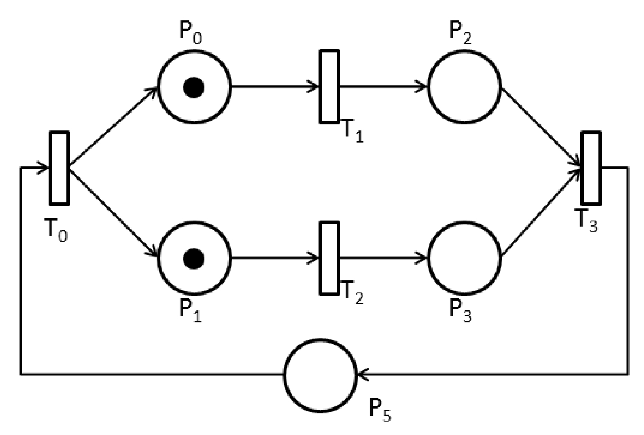
promise.then(function(message){ console.log(message); },function(err){ console.log(err) });
promise.then(function(message){ console.log(message); },function(err){ console.log(err) });
Debit Nets
But First, Review a Formal Model of Concepts
We have seen that PT Nets are used to model (in state machine form) creation and synchronization of concurrent tasks (synchronous tasks)
In this example, event T0 “spawns” two tasks (P0 and P1) and they can proceed concurrently
Event T3 synchronizes these tasks… P5 cannot execute until both (P1;P2) and (P1;P3) have completed… which sequence is slower waits for the other sequence to “catch up”
These structures mirror the “synchronized” capabilities in Java threads, and also provide the same capabilities we get from the traditional P/V (signal/wait) synchronizing actions and locks in monitors, CSP, Erland message processing, etc.

Slide 5
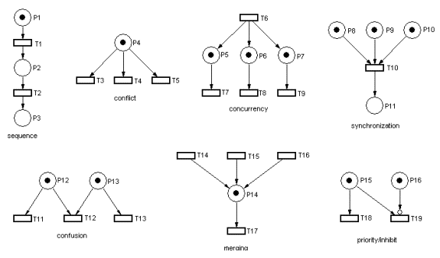
promise.then(function(message){ console.log(message); },function(err){ console.log(err) });
promise.then(function(message){ console.log(message); },function(err){ console.log(err) });
PT Nets Structures
Different programming actions supported
conflict
concurrency
concurrency
synchronization
sequence
confusion
priority/inhibit
merging

Slide 6
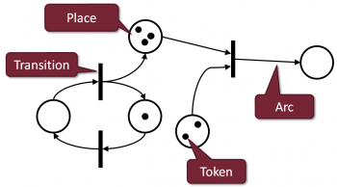
promise.then(function(message){ console.log(message); },function(err){ console.log(err) });
promise.then(function(message){ console.log(message); },function(err){ console.log(err) });
PT Nets
PT Nets are “infinite” state automata
Here, the top place “p3” will accumulate tokens unlimitedly as transition “t2” fires
The state of a PT net is a tuple of token counts, the count for each place
state here is <0,1,3,2,0>
Consider this firing sequence
t1: <1,0,3,2,0>
t2: <0,1,4,2,0>
t1: <1,0,4,2,0>
t2: <0,1,5,2,0>
t1: <1,0,5,2,0>
t2: <0,1,6,2,0>
. . .
p3
t3
p5
t2
p2
p1
p4
t1

Slide 7
promise.then(function(message){ console.log(message); },function(err){ console.log(err) });
promise.then(function(message){ console.log(message); },function(err){ console.log(err) });
How Powerful Are They?
PT Nets vs. Chomsky Hierarchy
PNET
enhanced
PNET
FSM
regular
PDA
context free
TM
all progs
LBA
context sensitive

Slide 8
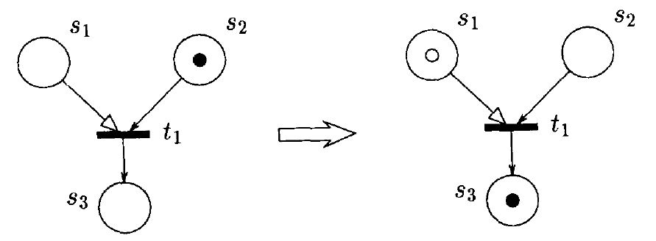
promise.then(function(message){ console.log(message); },function(err){ console.log(err) });
promise.then(function(message){ console.log(message); },function(err){ console.log(err) });
Now, Debit Nets
Or … Predicate/Transition Nets with Debit Arcs
In normal rules, t1 is not enabled and cannot fire
s1 has no token
t1 fires and token in s2 moves to s3
But we record a “debt” with this clear token in s1
This is a debit arc
which means we can fire t1 with no token in s1
The computation “owes us one”, a token to be produced later to pay off the debt

Slide 9
More Debit Arc Behavior
A debit arc can also function like a normal arc, allowing normal enabling and transition firing in the presence of solid tokens
Now what about this? Debt and token in same place… we next look at that
So both these state changes are valid.. Bottom one creates debt, top one does not

Slide 10
promise.then(function(message){ console.log(message); },function(err){ console.log(err) });
promise.then(function(message){ console.log(message); },function(err){ console.log(err) });
Now, Debit Nets
How do we pay off debts?
s5
s5
normal arc
t2 fires, we get a solid token in s1 with the clear “debt” token
t2
t2
s1
s2
s1
s2
t3
t1
t3
t1
s4
s3
s4
s3

Slide 11
promise.then(function(message){ console.log(message); },function(err){ console.log(err) });
promise.then(function(message){ console.log(message); },function(err){ console.log(err) });
Now, Debit Nets
Token and Debt together in one place… now what?
s5
s5
One idea is they
annihilate instantly … a
token and an “anti-token”
cannot co-exist in a place
t2
t2
s1
s2
s1
s2
This happens automatically, no choices made,
You cannot prevent it. No transitions fired
t3
t1
t3
t1
s4
s4
s3
s3

Slide 12
promise.then(function(message){ console.log(message); },function(err){ console.log(err) });
promise.then(function(message){ console.log(message); },function(err){ console.log(err) });
Now, Debit Nets
Token and Debt together in one place… now what?
s5
The debt remains unpaid
s5
Another idea is they
co-exist … and annihilation
is a specific execution choice,
a step made when wanted,
IF wanted
t2
t2
s1
s2
s1
s2
Here t3 fires and moves a solid token from s1 to s4, and the choice made to not annihilate the pair at this point
t3
t1
t3
t1
s4
s3
s3
s4

Slide 13
promise.then(function(message){ console.log(message); },function(err){ console.log(err) });
promise.then(function(message){ console.log(message); },function(err){ console.log(err) });
Now, Debit Nets
Keep going, and now maybe choose to annihilate
s5
We could then fire t2 again (since it is enabled), moving a solid token from s5 to s1
s5
t2
t2
s1
s2
s1
s2
Now we choose to annihilate the pair
Choose to pay off the debt
t3
t1
t3
t1
s4
s3
s3
s4

Slide 14
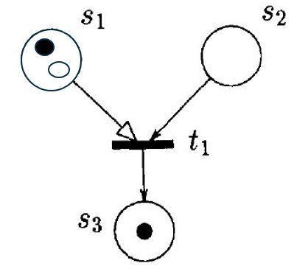
promise.then(function(message){ console.log(message); },function(err){ console.log(err) });
promise.then(function(message){ console.log(message); },function(err){ console.log(err) });
Debit Nets Annihilation Policy
Forced Annihilation? Or delay by choice?
We showed (in 1992) that the annihilation policy used causes two different classes of recognition power.
If we choose delayed annihilation (deliberate choice) then Debit Nets have the power of normal PT nets … they are just a notational convenience
If we choose forced annihilation then we get additional computational “power” and Debit nets become equivalent to Turing machines.
The extra power seems to be in line with other common PT net extensions, like inhibitor arcs or timed events.
If you constrain the free-choice somehow in making net execution decisions, you seem to add power

Slide 15
promise.then(function(message){ console.log(message); },function(err){ console.log(err) });
promise.then(function(message){ console.log(message); },function(err){ console.log(err) });
How Powerful Are They?
PT Nets vs. Chomsky Hierarchy
Debit Nets
Forced annihilation
Debit Nets
delayed annihilaton
FSM
regular
PNET
PDA
context free
TM
all progs
LBA
context sensitive

Slide 16
promise.then(function(message){ console.log(message); },function(err){ console.log(err) });
promise.then(function(message){ console.log(message); },function(err){ console.log(err) });
OK, So Where Are We?
Notion of debt and “owing” a result or event
So we have models of the idea of work that is yet to be done, and is “owed” before the results are completed
How does this translate into practice? Into programming and language features?
Future, promise, etc. appear in several well-used languages
Java and JavaScript are two heavily use examples
We will concentrate on Java here
First some terms definition and history

Slide 17
Futures and Promises
General Terms and Usage
The terms future, promise, delay, and deferred are often interchanged
Usually, a future is a read-only placeholder view of a variable
A promise is a writable, single assignment container which sets the value of the future
A future can be defined without specifying which promise will set its value
Different possible promises may set the value of a given future (though this can be done only once for a given future)
In some implementations, a future and a promise are created together and associated with each other
the future is the value
the promise is the function that sets the value – essentially the return value (future) of an asynchronous function (promise)
Setting the value of a future is also called resolving, fulfilling, or binding it.

Slide 18
Early Development
Appeared First in Functional Programming
Friedman was a LISP fan… his work on Promises was in LISP
Also developed early on in the logic programming (Prolog) community
Goal was to decouple a value (a future) from how it was computed (a promise)
This allowed the computation to be done more flexibly in parallel
Later, it found use in distributed computing, in reducing the latency from communication round trips (compute several results in one remote-trip)
Later still, it gained more use by allowing writing asynchronous programs in direct style, rather than in continuation-passing style

Slide 19
Implicit vs. Explicit
Two programming styles
Implicit use: any use of the future automatically obtains its value, as if it were an ordinary reference
Explicit use: the user must call a function to obtain the value, such as the get method of Java
Obtaining the value of an explicit future can be called stinging or forcing
Explicit futures can be implemented as a library
Implicit futures are usually implemented as built-in language features
The first Baker and Hewitt paper described implicit futures in the actor model of computation (and also used in pure object-oriented programming languages like Smalltalk)
Friedman and Wise (’77) described only explicit futures in their LISP work

Slide 20
Implicit vs. Explicit
Two programming styles
Friedman and Wise probably had explicit use due to the difficulty of efficiently implementing implicit futures on stock hardware.
The difficulty is that stock hardware does not deal with futures for primitive data types like integers.
For example, an add instruction does not know how to deal with 3 + future factorial(100000).
In pure actor or object languages this problem can be solved by sending future factorial(100000) the message +[3], asking the future (actor) to add 3 to itself and return the result.
Note that the message passing approach works regardless of when factorial(100000) finishes computation and that no stinging/forcing is needed.

Slide 21
More History
The New Millennium
Futures and promises were researched in the late 80’s and 90’s in small contexts… languages made to evaluate specific concepts, work on parallelism and pipelining… etc.
After 2000, a major revival of interest in futures and promises occurred
This was driven by web browsers becoming an increasingly general UI technology
Futures/promises helped improve responsiveness of user interfaces in web development, due to the request–response model of message-passin
Several mainstream languages now have language support for futures and promises, most notably popularized by FutureTask in Java 5 (announced 2004),
Also due to the async/await constructions in .NET 4.5 (2012) and largely inspired by the asynchronous workflows of F# (from 2007)
This has subsequently been adopted by other languages, notably Dart (2014), Python (2015), ECMAScript 7 (JavaScript), Scala, and C++

Slide 22
Java Threads before Future
Threads for Concurrency
Java threads (Runnable) allows a form of concurrency, in that we can create “processes” that run as separate computations
Two threads communicate via altering data/variables that are visible to each (shared memory).
This requires synchronization to prevent simultaneous access that can make incorrect results… sync limits concurrency by causing waiting/blocking
Callable is a Java interface that allows a thread to return a result when done… another way that threads can communicate, and this does not force sync to do the communication (other than to get the result)
Callable creates a form of Remote Procedure Call (RPC) for Java, and also more closely mimics message passing a la Erlang/Actors
Future goes beyond and builds on Callable

Slide 23
Future in Java
Class Future was introduced in Java 5 (2005)
Future represents the result of an asynchronous computation. Methods are provided to check if the computation is complete, to wait for its completion, and to retrieve the result of the computation. In simple terms, a future is promise to hold the result of some operation once that operation completes.
The value is retrieved from a future with get, which blocks until the value is ready.
FutureTask class is an implementation of Future that implements Runnable, and so may be executed by an Executor.
Futures have several shortcomings. For instance, they cannot be manually completed and they do not notify when they are completed. Futures cannot be chained and combined. In addition, there is no exception handling.
To address this issue, Java 8 (2014) introduced CompletableFuture

Slide 24
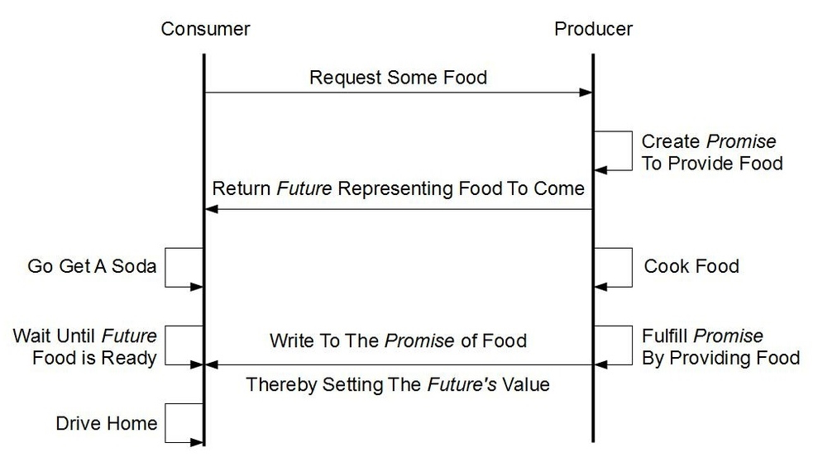
Future Diagram
Future with Promise

Slide 25
Simple Example in Java
import java.util.concurrent.*;
public class FutureAndCallableExample {
public static void main(String[] args)
throws InterruptedException, ExecutionException { // task T1
ExecutorService executorService = Executors.newSingleThreadExecutor();
Callable<String> T2 = () -> { // Perform some needed indep computation
System.out.println("T2: Entered Callable");
Thread.sleep(3000); // vary for length of T2
System.out.println("T2: Callable is done... about to return");
return "Made in and returned from T2";
};
System.out.println("Submitting Callable");
Future<String> futT2 = executorService.submit(T2); // returns a future
// This line executes immediately
System.out.println("T1: Do something else while T2 is getting executed");
Thread.sleep(10000); // vary for length of T1
System.out.println("T1: something else done, now lets check in on our T2");
System.out.println("T1: Retrieve the result of the future");
// Future.get() blocks until the result is available
String result = futT2.get();
System.out.println(result);
executorService.shutdown();
} }

Slide 26
Similar Java Example
import java.util.concurrent.*;
public class FutureIsDoneExample {
public static void main(String[] args)
throws InterruptedException, ExecutionException {
ExecutorService executorService = Executors.newSingleThreadExecutor();
Future<String> T2fut = executorService.submit(() -> {
System.out.println("T2: starting...");
Thread.sleep(2000);
System.out.println("T2: done!");
return "Produced by and sent from T2";
});
while(!T2fut.isDone()) {
System.out.println(“T1: T2 task is still not done...");
Thread.sleep(200);
}
System.out.println(“T1: T2 task completed! Retrieving the result");
String result = T2fut.get();
System.out.println(result);
executorService.shutdown();
} }

Slide 27
Another Example in Java
import java.math.BigInteger;
import java.util.concurrent.Callable;
import java.util.concurrent.TimeUnit;
public class FactorialCalculator implements Callable<BigInteger> {
private int value;
public FactorialCalculator(int value) { this.value = value; }
@Override
public BigInteger call() throws Exception {
var result = BigInteger.valueOf(1);
if (value==0 || value==1) { result = BigInteger.valueOf(1); }
else {
for (int i = 2; i <= value; i++) {
result = result.multiply(BigInteger.valueOf(i));
}
}
TimeUnit.MILLISECONDS.sleep(500);
return result;
}
}

Slide 28
Another Example in Java (pt. 2)
import java.math.BigInteger; import java.util.* // ArrayList,HashMap,Map,List,Random
import java.util.concurrent.ExecutionException; import java.util.concurrent.Executors;
import java.util.concurrent.Future; import java.util.concurrent.ThreadPoolExecutor;
public class JavaFutureEx {
public static void main(String[] args) throws ExecutionException,InterruptedException {
var executor = (ThreadPoolExecutor) Executors.newFixedThreadPool(2);
List<Map<Integer, Future<BigInteger>>> resultList = new ArrayList<>();
var random = new Random();
for (int i = 0; i < 6; i++) {
int number = random.nextInt(100) + 10;
var factorialCalculator = new FactorialCalculator(number);
Map<Integer, Future<BigInteger>> result = new HashMap<>();
result.put(number, executor.submit(factorialCalculator));
resultList.add(result);
}
for (Map<Integer, Future<BigInteger>> pair : resultList) {
var optional = pair.keySet().stream().findFirst();
if (!optional.isPresent()) { return; }
var key = optional.get();
System.out.printf("Value is: %d%n", key);
var future = pair.get(key);
var result = future.get();
var isDone = future.isDone();
System.out.printf("Result is %d%n", result);
System.out.printf("Task done: %b%n", isDone);
System.out.println("--------------------");
}
executor.shutdown();
} }

Slide 29
END

