Slide 1
On Beyond Objects Programming in the 21th century COMP 590-059 Fall 2021
David Stotts
Computer Science Dept
UNC Chapel Hill

Slide 2
Model checking

Slide 3
A process is created and terminated extremelly fast, that's why you can actually have thousands of them.
A process executes some piece of code, then it terminates. It can also run forever.
Model Checking
A form of Formal Verification
Some background
In software, we have the eternal problem of deciding if the code does what it is supposed to do
Major approaches to a solution are
Testing
Verification
Validation
Testing is running the code and seeing if the output (for some input) matches an “oracle”… the oracle somehow tells the “truth” about what the code should compute
Testing everything is impossible, as most code computes an infinite function… unbounded number of possible <input,output> pairs
Testing gives increased confidence in correctness, but cannot prove correctness
Model checking falls in the verification approach
It gives an alternative to (and a complement to) testing
Validation is important but not really the issue we want to discuss… validation is what the customer does to decide if the code you deliver (as a developer) is computing the functions that the customer asked for… matching deliverable to requirements

Slide 4
A process is created and terminated extremelly fast, that's why you can actually have thousands of them.
A process executes some piece of code, then it terminates. It can also run forever.
Verification, Hoare-style
Formal Methods
What means “formal” ?
Formal method is an analysis technique or programming process based on a “formalism”
Verification is the demonstration (somehow) that the code is correct in all instances
Likened to proving something mathematical … you can show the truth of some proposition P on specific values by substitution (testing), but to demonstrate for ALL values you need a proof
So early verification was referred to as “program proving”
Methods: Hoare verification, Mills denotational, Guttag ADT, etc.
Example Hoare verification

Slide 5
A process is created and terminated extremelly fast, that's why you can actually have thousands of them.
A process executes some piece of code, then it terminates. It can also run forever.
Formal Verification: Pro and Con
Hoare-Style formal Verification
There are limitations to Hoare-style “proving”
Pro: it works on the code directly… so conclusions apply to the program that is being proven
Con: Not automatable… can’t generate loop invariants automatically
Con: If the code is NOT correct, a “proof” is impossible and the proving method will not terminate… it will just cause you to keep trying to do the impossible… it will never stop and declare “NOT correct”
Con: very complex and detailed, requires tool support
So what’s to be done?
Model checking: fully automatable
However… it works not on code directly, but on a “model”… a structure derived from the code

Slide 6
A process is created and terminated extremelly fast, that's why you can actually have thousands of them.
A process executes some piece of code, then it terminates. It can also run forever.
Model Checking
The Basics
This work was done originally by Clarke and Emerson. They won a Turing Award for it (2007)
We need a formal notation to express “specs” … properties/conditions/facts that the system should exhibit
We need a “model” that captures the essence of the code
We need an algorithm or procedure (that is efficient) to determine if the model exhibits the specs
Let’s start with the formal notation
Temporal Logic … predicate calculus with addition of the ability to reason about execution traces
Using temporal logic we will write assertions about what can -- and cannot – happen as the code executes

Slide 7
A process is created and terminated extremelly fast, that's why you can actually have thousands of them.
A process executes some piece of code, then it terminates. It can also run forever.
Temporal Logic
Linear and Branching Time Temporal Logic
Trace t = s0, s1, s2, s3, ... , sn, … is a sequence of program states
Program state si is simply a collection of <name,value> bindings (variables and values)
We want to express properties like this about an execution trace:
“ eventually, a state si is reached where P holds ”
“ if Q holds in some state sj , then R holds in all states after “
Deadlock: if a philosopher gets one fork, it will eventually get the other fork
Starvation: there is no execution trace where one philosopher is trying to eat and never gets to do so
We start with Predicate Calculus so we can make basic assertions about program states like
X > 100
Y + Z = K/2
For all i: Arr[i] is prime, etc.
We will use general symbols like to P, Q, R, etc. to denote a statement in predicate calculus

Slide 8
A process is created and terminated extremelly fast, that's why you can actually have thousands of them.
A process executes some piece of code, then it terminates. It can also run forever.
Temporal Logic
Linear Time Temporal Logic
We then arrive at a notation called CTL (Computation Tree Logic) by adding operators to predicate calculus.
CTL is a temporal logic (there are many such notations), meaning you can reason about “time”. By time, we mean execution sequences… state changes… so we will use CTL to make assertions about how the program behaves over its run-time
We get a notation that is Linear Time (about a single trace) with these operators:
G always… globally G(P)
F eventually … future F(P)
X next time … in the next state X(P)
U until P U Q binary operator
Examples:
F(PvQ) eventually we get to a state where PvQ is true (P or Q)
X( P ^ ( W v G( R ) )) in the next state it is true that P holds and (W or G(R)) holds also
G( P v Q → X( R )) it is true in every state that if that state makes (PvQ) true, then in the
following state R holds
P U Q says that in this state P is true, and P is true in every following state as well until
we get to a state where Q holds.. AND we will get to a state where Q holds.
Math: PUQ iff starting in s0… exists i [ i>=0 and si |= Q and for all k [0<=k<i → sk |= P ]

Slide 9
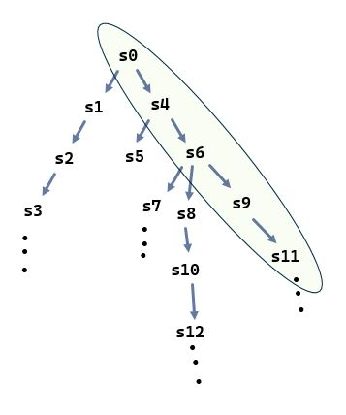
A process is created and terminated extremelly fast, that's why you can actually have thousands of them.
A process executes some piece of code, then it terminates. It can also run forever.
Temporal Logic
Path Quantification gives Branching Time Temporal Logic
Previous assertions apply to a single trace, like the one in green to the right
We assume (unless written otherwise) that the prior assertion types are said to hold for a trace starting in state s0
When a program executes once, it produces a single trace… start in some initial state and then state-change, state-change, … etc., until execution terminates.
Again, like the trace shown in green at right.
However, with many different executions, a program potentially produces many different traces
This means a program’s total behavior can be thought of as a computation state tree starting at the initial state

Slide 10
A process is created and terminated extremelly fast, that's why you can actually have thousands of them.
A process executes some piece of code, then it terminates. It can also run forever.
Temporal Logic
Path Quantification gives Branching Time Temporal Logic
We need a notation to make assertions on all possible program behaviors (all traces) and not simply one trace
So, we add path quantifiers to CTL :
A for all paths AG(PvQ) AX(R) AF(Q ^ S)
E for some path EF(W -> Z) E(P U Q) EG( Z ^ ~D )
And now we see why “Computation Tree Logic” is the name
Clarke adds more restrictions… in CTL you can’t combine the operators in just any combinations. This would lead to excessive time complexity in the model checking algorithm
Rather these combinations are allowed… path quantifiers combined with temporal
AF, EF, AX, EX, AU, EU, AG, EG
These combinations allow efficient checking
No need to implement them all directly, as several are expressible in terms of the others

Slide 11
A process is created and terminated extremelly fast, that's why you can actually have thousands of them.
A process executes some piece of code, then it terminates. It can also run forever.
Temporal Logic
Path Quantification gives Branching Time Temporal Logic
Shorthand in CTL :
AF(p) is same as A[true U p] p is inevitable
EF(p) is same as E[true U p] p is potential
EG(p) is same as ~AF(~p)
AG(p) is same as ~EF(~p) p holds globally
So to implement a checker, you only have to code up AX, EX, AU, EU, ^ and ~
Ok, so final summary of CTL
There is a set of atomic propositions AP
Every p that is in AP is a valid CTL formula.
If p1 and p2 are valid CTL formulae, then so are
~p1
p1 ^ p2
AX(p2)
EX(p1)
A[p1 U p2]
E[p1 U p2]

Slide 12
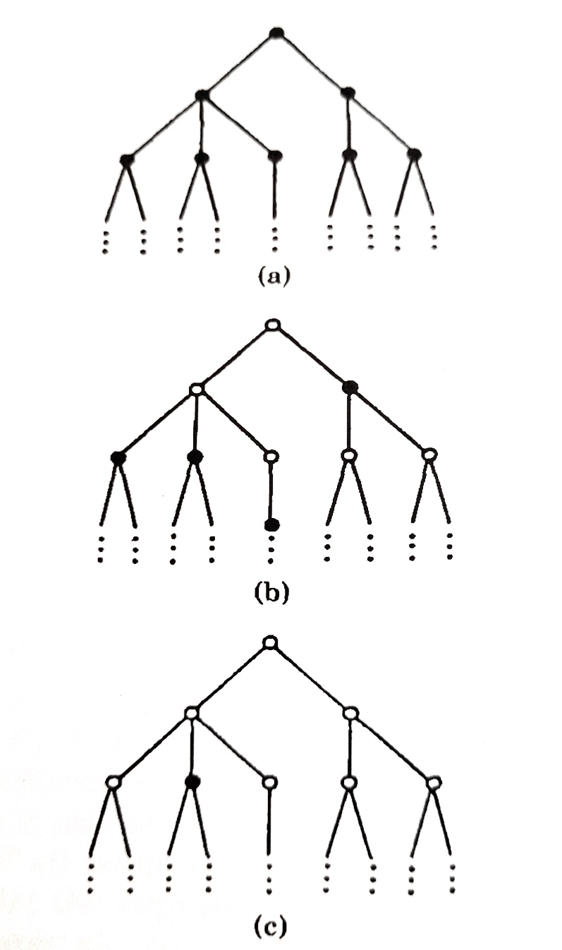
A process is created and terminated extremelly fast, that's why you can actually have thousands of them.
A process executes some piece of code, then it terminates. It can also run forever.
Temporal Logic
Branching Time Temporal Logic
A solid dot indicates a program state where P holds
(a) This shows a computation tree in which AG( P ) holds at the root ( P is invariant )
(b) This shows a computation tree in which AF( P ) holds at the root ( P is inevitable )
(c) This shows a computation tree in which EF( P ) holds at the root ( P is possible )

Slide 13
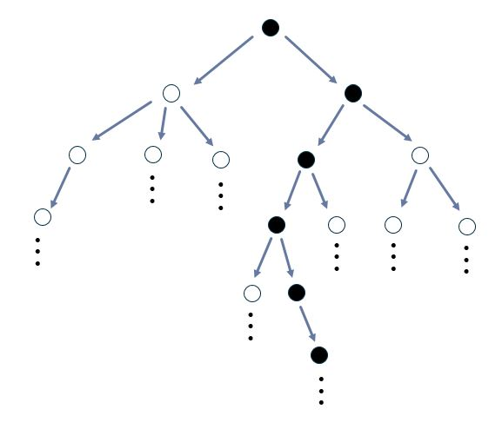
A process is created and terminated extremelly fast, that's why you can actually have thousands of them.
A process executes some piece of code, then it terminates. It can also run forever.
Temporal Logic
Branching Time Temporal Logic
A solid dot indicates a program state where P holds
(d) This shows a computation tree in which EG( P ) holds at the root ( P is possibly invariant )

Slide 14
A process is created and terminated extremelly fast, that's why you can actually have thousands of them.
A process executes some piece of code, then it terminates. It can also run forever.
Model Checking: The Model
Annotated FSM
Ok, so we have the formal notation CTL
Now we need something to measure that relates to the code we wish to analyze
A model is a Finite State Machine with annotations on the states
Given AP, a CTL model is formally a triple M = (S, R, P) where
S is a finite set of states.
R is a binary relation on S (R is subset of S x S) which gives the possible transitions between states; R must be total; that is, for all x in S: exists y is S [ (x, y) in R ]
P : S → subset(AP) assigns to each state the set of atomic propositions true in that
S and R together provide the structure of an FSM
P is a mapping that pairs each state with a subset of the atomic proposition
We interpret the model in the following way
the FSM expresses some of the state changes from the program we wish to analyze (not all of a program must be modeled)
The elements of AP state truths about the variable values of the program in each state, and/or truths about any other aspects of the code we wish to study

Slide 15
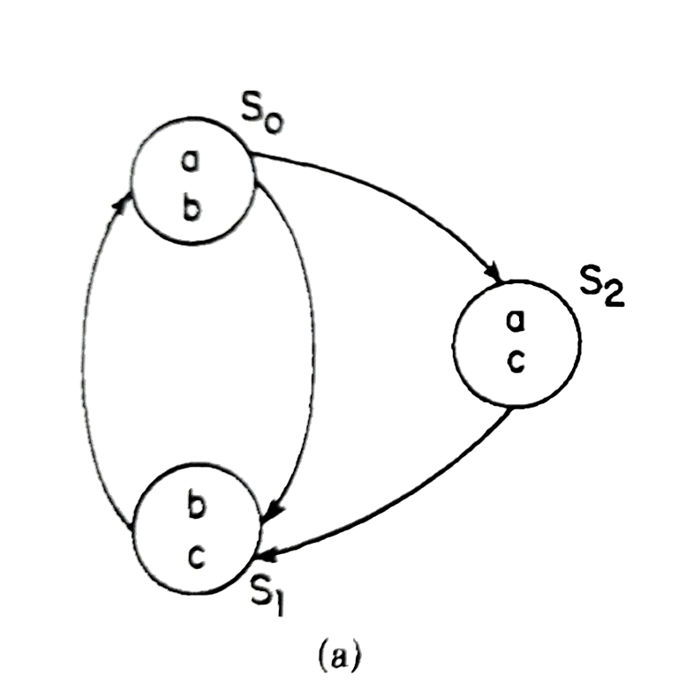
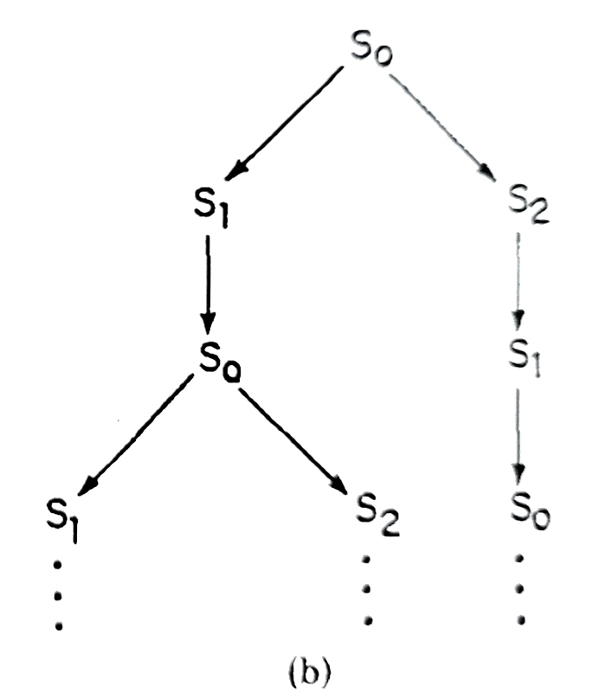
A process is created and terminated extremelly fast, that's why you can actually have thousands of them.
A process executes some piece of code, then it terminates. It can also run forever.
Model Example
Simple Annotated FSM
Computation tree for FSM

Slide 16
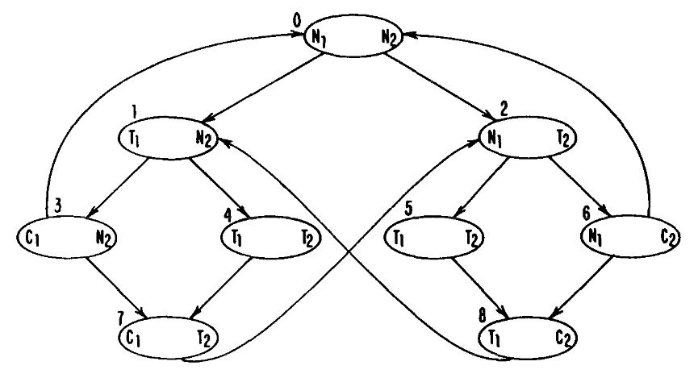
A process is created and terminated extremelly fast, that's why you can actually have thousands of them.
A process executes some piece of code, then it terminates. It can also run forever.
Model Example
Example Model
This small FSM represents two processes interacting on a shared resource
Each process is always in 1 of 3 states, defining these atomic propositions:
Ti means process i is trying for the resource
Ci means process i is in the critical region, using the resource
Ni means process i is otherwise occupied without the resource
This means each FSM state is marked with 2 atomic propositions
For example, state s7 says that proc1 is using the resource, and proc2 is trying to get it

Slide 17
A process is created and terminated extremelly fast, that's why you can actually have thousands of them.
A process executes some piece of code, then it terminates. It can also run forever.
Model Example
Example Model
So we note this is not code
It is built by considering the code, its blocks and components, and reasoning about what is going on in each area in terms of the issue you wish to analyze
Here we analyze issues related to concurrency… starvation, deadlock, etc. and this determines the atomic propositions
AF(C1) holds in s1
EF(C1 ^ C2) is false in s0
[ AF(C1) ^ AF(C2) ] in s0 ?
AG [ (T1 ^ T2) → [ AF(C1) ^ AF(C2) ] ] is this valid CTL ?
A → B is same as ~A or B
A or B is same as ~( ~A ^ ~B)

Slide 18
A process is created and terminated extremelly fast, that's why you can actually have thousands of them.
A process executes some piece of code, then it terminates. It can also run forever.
The Checker
Wander around in the Annotated FSM
Let’s consider the 2-process FSM
T1 → AF(C1) (absence of starvation)
Is this true starting is s0 ?
Break it up into sub-formulae
~T1 v AF(C1)
~T1
T1
AF(C1)
C1
By length of sub-formulae (shortest first), check each state for truth of each sub-formula
Mark each state with the sub-formula as you find one true there
Work from smallest up to the full formula

Slide 19
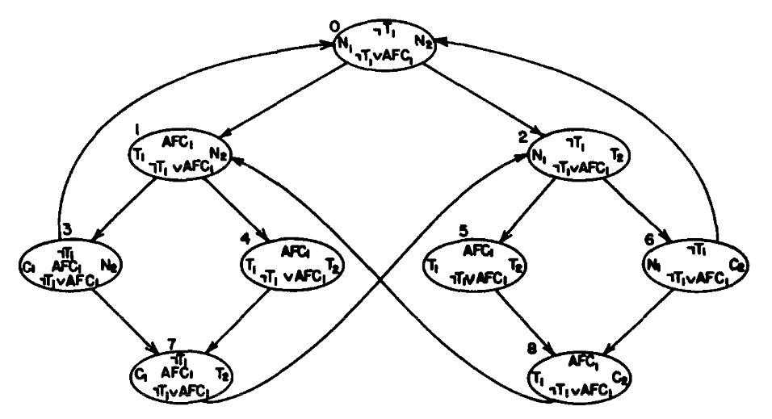
Traverse the graph, mark each state with C1, T1, ~T1, etc. where each is true
Then check each state for AF(C1)
Then check each state for ~T1 v AF(C1)
The checking algorithm form a formula F and a FSM with V nodes and E edges…
is O( len(F) * ( |V|+|E| ) )

Slide 20
A process is created and terminated extremelly fast, that's why you can actually have thousands of them.
A process executes some piece of code, then it terminates. It can also run forever.
The Checker
Important PRO about it
A con about Hoare-style proving was
… that if the code is wrong, it’s impossible to prove it correct… so the proof procedure never ends and announces “wrong!”… it just keeps on going frustrating you that you just “can’t manage to get it”
Model checker does terminate ! It always ends and says either TRUE or FALSE about the property you are checking

Slide 21
A process is created and terminated extremelly fast, that's why you can actually have thousands of them.
A process executes some piece of code, then it terminates. It can also run forever.
MCB: Clarke’s Original
Practical Application
Try basic model checking
On classroom.cs.unc.edu
directory ~stotts/public_html/590/mcheck
remote login, must use this host, it is a linux box with general public access
You can go to that directory using a remote shell
cd ~stotts/public_html/590/mcheck
You can also access the files there with a browser
https://www.cs.unc.edu/~stotts/590/mcheck
Model checker program is mcb
Files with “.net” suffix are petri net models
cannot be model checked directly
Must be converted to FSM form
Files with “.fsm” suffix are in mcb state machine format and can be checked with mcb

Slide 22
A process is created and terminated extremelly fast, that's why you can actually have thousands of them.
A process executes some piece of code, then it terminates. It can also run forever.
MCB: FSM Model Format
NAME = paper ;
INPUTS = ;
STATES = 9 ;
CUBES = 100 ;
MOORE-OUTPUTS =
N1.H, N2.H, T1.H, T2.H, C1.H, C2.H ;
#0 110000
1
2
#1 011000
3
4
#2 100100
5
6
#3 010010
7
0
#4 001100
7
#5 001100
8
#6 100001
8
0
#7 000110
2
#8 001001
1
#END
How the data file looks
Format is text, so you can read it and edit it
Atomic propositions,
Symbolic names
A state (numbered)
#3 is state 3
This is a bit string showing which atomic props hold in this state
Here, N2.H and C1.H both hold
Next states
State #3 has an edge to state #7, and an edge to state #0

Slide 23
A process is created and terminated extremelly fast, that's why you can actually have thousands of them.
A process executes some piece of code, then it terminates. It can also run forever.
MCB: FSM Model Format
NAME = paper ;
INPUTS = ;
STATES = 9 ;
CUBES = 100 ;
MOORE-OUTPUTS =
N1.H, N2.H, T1.H, T2.H, C1.H, C2.H ;
#0 110000
1
2
#1 011000
3
4
#2 100100
5
6
#3 010010
7
0
#4 001100
7
#5 001100
8
#6 100001
8
0
#7 000110
2
#8 001001
1
#END
How the data file looks
Format is text, so you can read it and edit it
Atomic propositions,
Symbolic names
A state (numbered)
#3 is state 3
This is a bit string showing which atomic props hold in this state
Here, N2.H and C1.H both hold
Next states
State #3 has an edge to state #7, and an edge to state #0

Slide 24
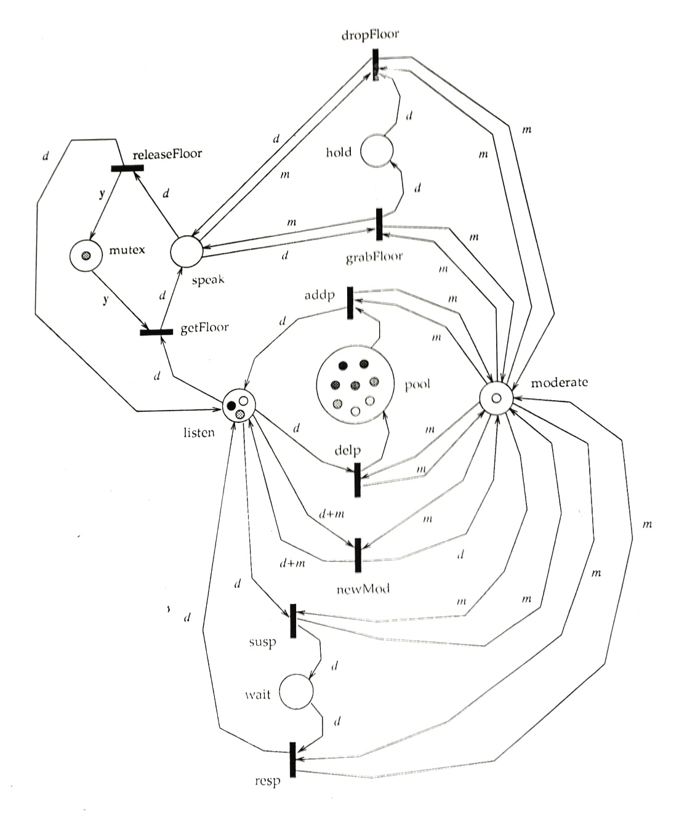
A process is created and terminated extremelly fast, that's why you can actually have thousands of them.
A process executes some piece of code, then it terminates. It can also run forever.
Example
Collaboration Protocol
Floor control protocol (simplified) for something like a chat room, or zoom room
This one has a moderator, and participants
To speak a participant requests the floor and is granted it by the Mod, if the floor is not occupied already
Mod has power to remove speaker from floor and give floor to another, then return original speaker to floor
Mod may add or remove participants (control the number of participants)
Mod may suspend a participant for a time, then put the person back in
Mod may give up the gavel to a participant… swap Mods

Slide 25
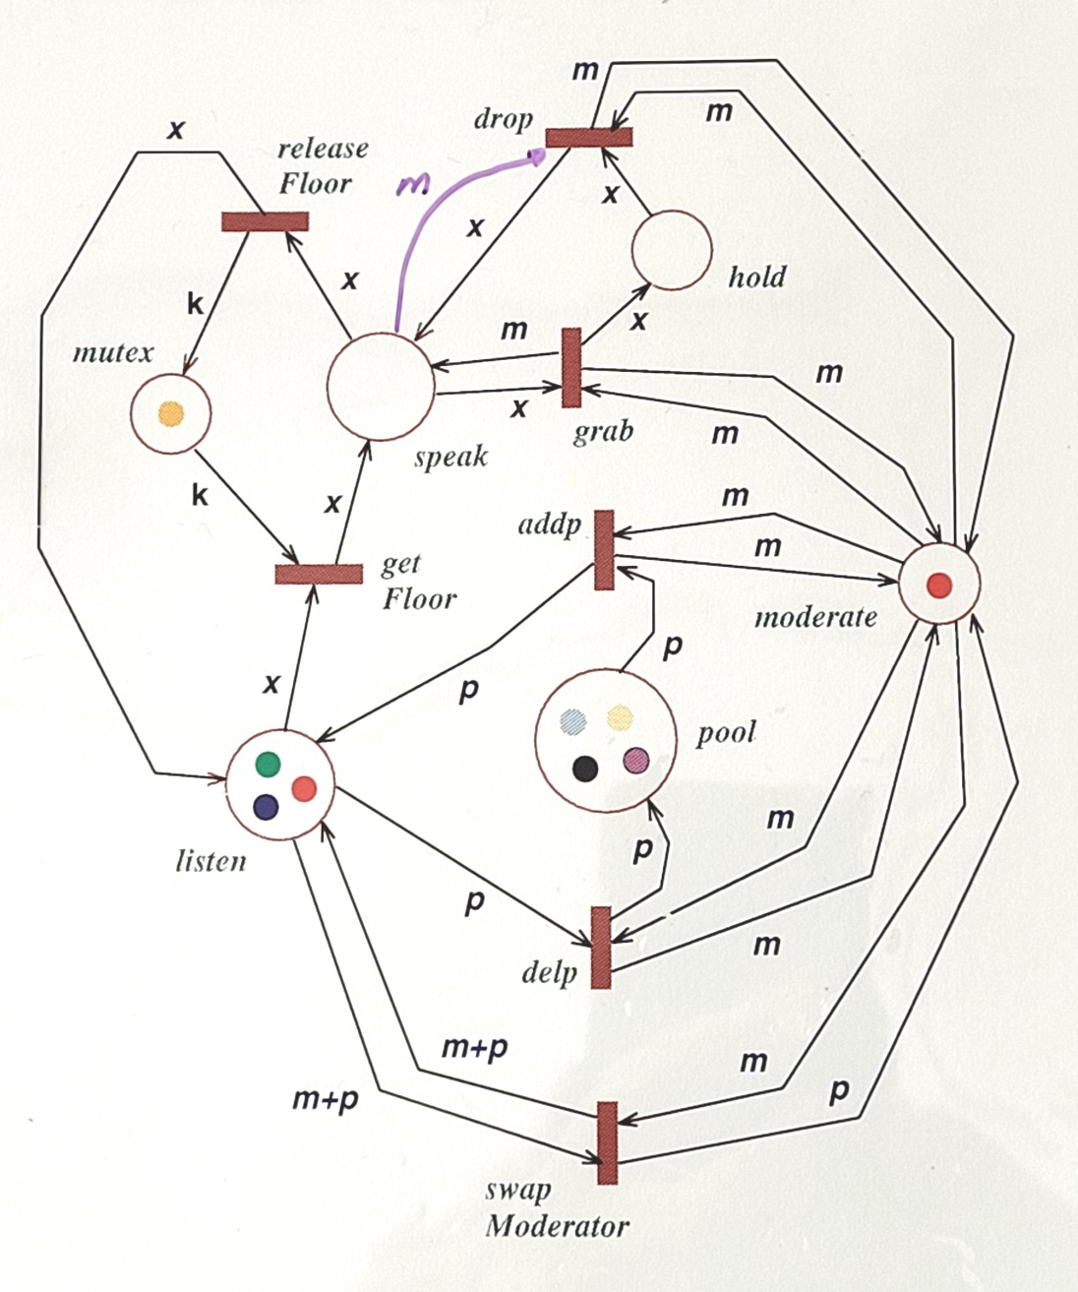
A process is created and terminated extremelly fast, that's why you can actually have thousands of them.
A process executes some piece of code, then it terminates. It can also run forever.
Example
Collaboration Protocol (alt)
Floor control protocol (simplified) for something like a chat room, or zoom room
This one has a moderator, and participants
To speak a participant requests the floor and is granted it by the Mod, if the floor is not occupied already
Mod has power to remove speaker from floor and give floor to another, then return original speaker to floor
Mod may add or remove participants
Mod may give up the gavel to a participant… swap Mods

Slide 26
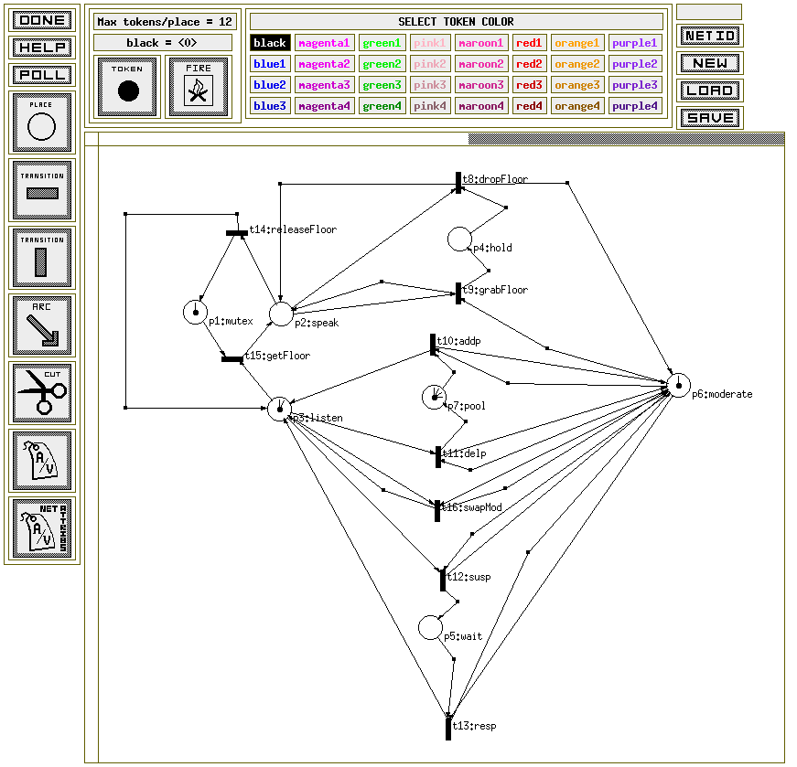
A process is created and terminated extremelly fast, that's why you can actually have thousands of them.
A process executes some piece of code, then it terminates. It can also run forever.
Example
Collaboration Protocol (alt2)
Floor control protocol (simplified) for perhaps a chat room, or zoom room
This is has no colors on tokens, so it is simplified over the others
It still generates a FSM with 91 states
FSM for this is here

Slide 27
A process is created and terminated extremelly fast, that's why you can actually have thousands of them.
A process executes some piece of code, then it terminates. It can also run forever.
Modern Tools
Java Pathfinder
Produced at NASA Ames
Java Pathfinder (JPF) is a system to verify executable Java bytecode programs.
Open sourced in 2005
Works on “souce code” meaning it derives the FSM model from the program you write
Actually works on compiled source code (.class byte code files)
Its primary application has been model checking of concurrent programs, to find defects such as data races and deadlocks.

Slide 28
A process is created and terminated extremelly fast, that's why you can actually have thousands of them.
A process executes some piece of code, then it terminates. It can also run forever.
Modern Tools
Java Pathfinder Example
public class Racer implements Runnable {
int d = 42;
public void run () {
doSomething(1001);
d = 0; // (1)
}
public static void main (String[] args){
Racer racer = new Racer();
Thread t = new Thread(racer);
t.start();
doSomething(1000);
int c = 420 / racer.d; // (2)
System.out.println(c);
}
static void doSomething (int n) {
try { Thread.sleep(n); } catch (InterruptedException ix) { }
}
}

Slide 29
JavaPathfinder v6.0 - (C) RIACS/NASA Ames Research Center
====================================================== system under test
application: Racer.java
...
====================================================== error #1
gov.nasa.jpf.listener.PreciseRaceDetector
race for field Racer@13d.d
main at Racer.main(Racer.java:16)
"int c = 420 / racer.d; " : getfield
Thread-0 at Racer.run(Racer.java:7)
"d = 0; " : putfield
====================================================== trace #1
---- transition #0 thread: 0
...
---- transition #3 thread: 1
gov.nasa.jpf.jvm.choice.ThreadChoiceFromSet[id="sleep",isCascaded:false,{main,>Thread-0}]
[3 insn w/o sources]
Racer.java:22 : try { Thread.sleep(n); } catch (InterruptedException ix) {}
Racer.java:23 : }
Racer.java:7 : d = 0;
...
---- transition #5 thread: 0
gov.nasa.jpf.jvm.choice.ThreadChoiceFromSet[id="sharedField",isCascaded:false,{>main,Thread-0}]
Racer.java:16 : int c = 420 / racer.d;
Output from running Pathfinder on the code

Slide 30
A process is created and terminated extremelly fast, that's why you can actually have thousands of them.
A process executes some piece of code, then it terminates. It can also run forever.
Problems
Theoretically important, practically limited
The checker is already O( F * (|V|+|E|) )
Linear in length of the formula
Linear in size of the FSM
Multiplied, so short formulae and larger FSM means a smaller multiple of linear in FSM
Requires explicit creation of full state space (the FSM)
Can be very large… prohibitively large
If you have a notation like Petri Nets for expressing the “code” then creating a FSM from it will be O(2^N)… or worse (where N is the size of the Pnet)
Not only will it take O(2^N) time to generate the FSM, it will required O(2^N) space to store it all.
Solution:
Symbolic Model Checking
Does not explicitly enumerate a state space

Slide 31
END

Slide 32
.
.
.
.
.
.
.
.
.
.
.
.
.
.
.
.
.
.
.
.
.
.
.
.

Slide 33
s0
s1
s4
s2
s5
s6
.
s9
s3
s7
.
.
s8
.
.
.
.
s11
s10
.
.
.
s12
.
.

Slide 34
A process is created and terminated extremelly fast, that's why you can actually have thousands of them.
A process executes some piece of code, then it terminates. It can also run forever.
Processes: Race Conditions
Example code
-module(rac).
-export([start/0, call/2]).
call(Arg1, Arg2) ->
io:fwrite("~p~n",[Arg1]).
start() ->
Pid = spawn(?MODULE, call, ["hello", "process"]),
register(myprocess, Pid),
io:fwrite("~p~n",[whereis(myprocess)]).
start () ->
case whereis(db_server) of
undefined ->
Pid = spawn(db_server, init, []),
Register(db_server, Pid),
{ok, Pid};
Pid when ispid(Pid) ->
{error, already_started}
end.

