Slide 1
On Beyond Objects Programming in the 21th century COMP 590-059 Fall 2021
David Stotts
Computer Science Dept
UNC Chapel Hill

Slide 2
Erlang Processes and concurrency

Slide 3
A process is created and terminated extremelly fast, that's why you can actually have thousands of them.
A process executes some piece of code, then it terminates. It can also run forever.
Concurrency: Processes
Spawn a simple process
Erlang was designed for massive concurrency
A process is created and terminated very rapidly, so you can easily have thousands of them
A process executes some piece of code, then it terminates.
It can also run forever.
Each Erlang process has a small memory footprint, which can grow/shrink dynamically
Use the built-in `spawn` function to create a process.
Once created, a process can access its own process id, by calling the `self` function.
-module(procs).
-compile([export_all]).
proc() -> io:format("I'm a process with id ~p~n", [self()]).
loop() -> loop().
run() ->
spawn(fun() -> proc() end),
spawn(procs, proc, []),
spawn(?MODULE, proc, []),
okay.

Slide 4
A process is created and terminated extremelly fast, that's why you can actually have thousands of them.
A process executes some piece of code, then it terminates. It can also run forever.
Concurrency: Processes
make_request(ServerId, Msg) ->
ServerId ! Msg.
run() ->
Pid = spawn(?MODULE, serve, []),
make_request(Pid, request1),
make_request(Pid, request2),
timer:sleep(10),
Pid2 = spawn(?MODULE, math, []),
Pid2 ! {add, 1, 2},
Pid2 ! {sub, 3, 2},
okay.
Process communication
Processes in Erlang share no memory, hence they communicate via message passing.
Each process has a mailbox.
The `receive` block allows a process to do something with the messages in its mailbox.
A process can receive different kinds of messages, then act on them.
To send a message to a process, use the `!` operator, after the process id of the receiver process
-module(send_recv).
-compile([export_all]).
serve() -> receive
Request ->
io:format("Handling: ~s~n", [Request]),
serve()
end.
math() -> receive
{add, X, Y} ->
io:format("~p + ~p = ~p~n", [X,Y,X+Y]),
math();
{sub, X, Y} ->
io:format("~p - ~p = ~p~n", [X,Y,X-Y]),
math()
end.

Slide 5
A process is created and terminated extremelly fast, that's why you can actually have thousands of them.
A process executes some piece of code, then it terminates. It can also run forever.
Processes: You’ve Got Mail
Message Handling
Every process has a mailbox
Mailbox is a queue of messages… when a process receives a new message it is enqueued (at the back)
The receive block will try each message in the queue (from front, oldest first) against the patterns in the receive block (in order), until one of the messages matches (or all are checked )
When a match happens, the message is removed from the mailbox queue, and the logic corresponding to the matched pattern will get executed.

Slide 6
A process is created and terminated extremelly fast, that's why you can actually have thousands of them.
A process executes some piece of code, then it terminates. It can also run forever.
Processes: Mailbox
oldest
Message Handling
math() -> receive
{add, X, Y} ->
io:format("~p + ~p = ~p~n", [X,Y,X+Y]),
math();
{sub, X, Y} ->
io:format("~p - ~p = ~p~n", [X,Y,X-Y]),
math()
end.
sub, 13, 5
add, 4, 7
mult, 9, 17
If no match is found, then that message stays in the mailbox, and the next message is tried for a match against the receive block’s patterns.
newest
If no message in the box matches any receive block pattern, the process will get suspended until a new message arrives
When a new message arrives (and is put at the back of the queue), the process wakes, and the message processing logic starts all over, beginning with the first message in the mailbox (front of the queue).

Slide 7
A process is created and terminated extremelly fast, that's why you can actually have thousands of them.
A process executes some piece of code, then it terminates. It can also run forever.
To link a process to the current one, spawn a new process then use the `link` function to create a link.
Processes: Linking
Links are Bi-directional
Two processes can be linked to each other
To link a process to the current one, spawn it, then use the `link` function to create a link.
You can spawn and link a process atomically using the ‘spawn_link‘ function.
-module(links).
-compile([export_all]).
child() ->
io:format("I(child) have pid: ~p~n", [self()]),
receive
after 2000 ->
io:format("I(child ~p) will die now!~n", [self()])
end.

Slide 8
A process is created and terminated extremelly fast, that's why you can actually have thousands of them.
A process executes some piece of code, then it terminates. It can also run forever.
To link a process to the current one, spawn a new process then use the `link` function to create a link.
Example Code: Linking
When a process terminates, it will terminate with an exit reason.
This exit reason is emitted in an exit signal to all linked processes.
The default behavior when a process receives an exit signal with an exit reason (other than `normal`), is to terminate
The terminating process will in turn emit exit signals with the same exit reason to its linked processes.
An exit signal with reason `normal` is ignored.
A process can be set to trap exit signals by setting the `trap_exit` process flag to `true`.

Slide 9
A process is created and terminated extremelly fast, that's why you can actually have thousands of them.
A process executes some piece of code, then it terminates. It can also run forever.
To link a process to the current one, spawn a new process then use the `link` function to create a link.
Example Code: Linking
parent() ->
Pid = spawn(links, child, []),
link(Pid),
io:format("I (parent) have pid ~p~n", [self()]),
io:format("I (parent) have a linked child: ~p~n", [Pid]),
lists:foreach(
fun(_) -> P = spawn_link(links, child, []),
io:format("I(parent) have another linked child: ~p~n", [P])
end,
lists:seq(1,4)
),
process_flag(trap_exit, true),
receive
{'EXIT', Pid, Reason} -> timer:sleep(10),
io:format("I(parent) have dying child(~p). Reason: ~p~n", [Pid,Reason]),
io:format("I(parent) will die too ...~n")
end.

Slide 10
A process is created and terminated extremelly fast, that's why you can actually have thousands of them.
A process executes some piece of code, then it terminates. It can also run forever.
To link a process to the current one, spawn a new process then use the `link` function to create a link.
Example Code: Linking
grandparent() ->
Pid = spawn_link(links, parent, []),
io:format("I (grandparent) have pid ~p~n", [self()]),
io:format("I (grandparent) have a linked child: ~p~n", [Pid]),
process_flag(trap_exit, true),
receive
{'EXIT', Pid, Reason} ->
timer:sleep(10),
io:format("I(gparent) have dead child(~p). Reason:~p~n", Pid,Reason]),
io:format("I(gparent) will die too ...~n")
end.
run() ->
spawn(links, grandparent, []),
timer:sleep(1500),
ok.

Slide 11
A process is created and terminated extremelly fast, that's why you can actually have thousands of them.
A process executes some piece of code, then it terminates. It can also run forever.
To link a process to the current one, spawn a new process then use the `link` function to create a link.
Processes: Monitoring
Monitors are alternative to Links
Monitors are unidirectional
This worker will wait for ?TIMEOUT ms, and if it does not receive any work it will die
a `{'DOWN', Ref, process, PidOfTerminatedProc, Reason}` message will be send to its monitors.
-module(monitors).
-compile([export_all]).
-define (TIMEOUT, 3000).
worker() ->
receive
do_work ->
io:format("I (worker ~p) will work now~n", [self()]),
worker()
after ?TIMEOUT ->
io:format("I (worker ~p) have no work to do~n", [self()]),
io:format("I (worker ~p) will die now ...~n", [self()]),
exit(no_activity)
end.

Slide 12
A process is created and terminated extremelly fast, that's why you can actually have thousands of them.
A process executes some piece of code, then it terminates. It can also run forever.
To link a process to the current one, spawn a new process then use the `link` function to create a link.
Example Code: Monitoring
To monitor a process, use the function `erlang:monitor` then listen for `DOWN` messages in the `receive` block.
Repeated calls to `erlang:monitor` will create several, independent monitors.
register/2 is a BIF to associate a name (an atom) with a PID… making sort of an alias
A process is automatically un-registered when it terminates
parent() ->
Pid = spawn(monitors, worker, []),
register(worker, Pid),
Ref = erlang:monitor(process, Pid),
io:format("I (parent) have a new worker~p~n", [Pid]),
?MODULE ! {new_worker, Pid},
receive
{'DOWN', Ref, process, Pid, Reason} ->
io:format("I(parent) My worker ~p died (~p)~n",[Pid,Reason]),
parent()
end.

Slide 13
A process is created and terminated extremelly fast, that's why you can actually have thousands of them.
A process executes some piece of code, then it terminates. It can also run forever.
To link a process to the current one, spawn a new process then use the `link` function to create a link.
Example Code: Monitoring
loop() -> receive
{new_worker, WorkerPid} -> timer:sleep(?TIMEOUT-2000),
WorkerPid ! do_work,
loop()
end.
start() -> Pid = spawn(monitors, loop, []),
register(?MODULE, Pid),
ParentPid = spawn(monitors, parent, []),
register(parent, ParentPid),
Ref = erlang:monitor(process, Pid),
erlang:demonitor(Ref), % removes the monitor from process Ref
timer:sleep(round(?TIMEOUT*1.5)),
exit(whereis(worker), finished),
exit(whereis(parent), finished),
exit(whereis(?MODULE), finished),
ok.

Slide 14
A process is created and terminated extremelly fast, that's why you can actually have thousands of them.
A process executes some piece of code, then it terminates. It can also run forever.
Processes: Miscellaneous
Collection of Facts About Erlang and Processes
OTP is a collection of libraries and design principles that comes with the Erlang language distribution and makes building larger systems easier
OTP is a bit like Java collections, but the abstrations it supports tend to be towards processes and concurrency… like a generic server
Erlang debugger (in OTP) can be used from the shell with debugger:start( ).
Debugger documentation here: https://erlang.org/doc/apps/debugger/debugger_chapter.html
wxErlang is an Erlang binding for the wxWidgets package (written in C++) for making GUIs for Erlang programs

Slide 15
A process is created and terminated extremelly fast, that's why you can actually have thousands of them.
A process executes some piece of code, then it terminates. It can also run forever.
Processes: Miscellaneous
Collection of Facts About Erlang and Processes
ERTS (Erlang Run Time System) is the virtual machine and run time system that makes Erlang able to support thousands of processes efficiently
ERTS is like Java JRT, BEAM (VM) is like JVM
ERTS does its own process threads, does not use the OS to create threads (for speed)
Each process has its own stack and garbage collection… so not large pauses in the VM for garbage collection… it is done continually in small pieces as processes execute
Once spawned, a process will continue and remain alive until termination
Normal termination occurs when a process has no more code to execute
An explicit terminate action, or some error, causes termination with non-normal reason, which can be signaled to related processes
spawn/3 never fails, even if func does not exist… PID is returned and the new process terminates with a runtime error

Slide 16
A process is created and terminated extremelly fast, that's why you can actually have thousands of them.
A process executes some piece of code, then it terminates. It can also run forever.
Processes: The Shell
Process handling in Erlang shell
The shell gives you abilities to see and manage the processes running in the ERTS
processes( ). will list the PIDs of all processes in the system… but careful, some industrial apps can have a million processes
i( ). will give a readable table of what each process is doing
The shell is a process like the ones we spawn
Means we can send messages to the shell
flush( ). Will clear out a mailbox
4> PD = self().
<0.79.0>
5> PD.
<0.79.0>
6>
6>
6> PD ! go_heels.
go_heels
7> PD!win_game, PD!coding_rules, PD!lastOne.
lastOne
9> flush().
Shell got go_heels
Shell got win_game
Shell got lastOne
ok
10> flush().
ok
11>

Slide 17
A process is created and terminated extremelly fast, that's why you can actually have thousands of them.
A process executes some piece of code, then it terminates. It can also run forever.
Processes: Shell as a Process
Message Send always succeeds
Even if the receiving process is terminated
If send a message to a non-existent process, it is discarded without causing an error
Message sender is not suspended after sending, it just executes on to its next clause
Since the shell is a process, you can send it messages… we saw this…
Now lets test the message to dead process behavior using the shell
12> PD = self().
<0.79.0>
13> 1/0.
** exception error: an error occurred when evaluating an arithmetic expression
in operator '/'/2
called as 1 / 0
14> self().
<0.95.0>
15> pid(0,79,0) ! hello.
hello
16> flush().
ok

Slide 18
A process is created and terminated extremelly fast, that's why you can actually have thousands of them.
A process executes some piece of code, then it terminates. It can also run forever.
Processes: Hot Swapping Code
Process can have new code subbed in while executing
Simple compared to other languages/systems
-module(hot).
-compile([export_all]).
go() ->
Pid = spawn(hot,server,[]),
register(hs,Pid).
% hot swap version… runs newest beam file for the code
server() -> receive
Msg ->
io:fwrite("Msg: ~s~n", [Msg]),
hot:server() % module_name : function
end.
% static version… runs the beam version that existed when first executed
cerver() -> receive
Msg ->
io:fwrite("Msg: ~s~n", [Msg]),
cerver() % no module name
end.

Slide 19
A process is created and terminated extremelly fast, that's why you can actually have thousands of them.
A process executes some piece of code, then it terminates. It can also run forever.
Processes: Linking Idioms
3 Basic Linking Idioms with Erlang processes
I don't care if my child process dies:
spawn(...)
I want to crash if my child process crashes:
spawn_link(...)
I want to receive a message if my child process terminates (normally or not):
process_flag(trap_exit, true),
spawn_link(...)

Slide 20
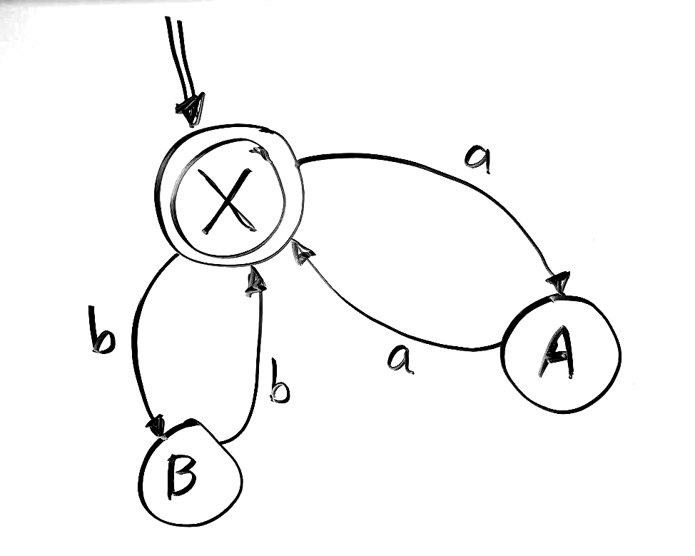
A process is created and terminated extremelly fast, that's why you can actually have thousands of them.
A process executes some piece of code, then it terminates. It can also run forever.
Processes: FSM example
Let’s make an FSM simulation
First try will be make each state a separate process
We will have input be a list of atoms, something like this: [a,b,c,b,c,b,a,a]
Valid inputs:
[a,a,b,b]
[ ]
[a,a]
[b,b,a,a,b,b,b,b]
etc.
Invalid inputs:
[a,b]
[a]
[a,b,b,a]
[a,b,a,b,a,b]
etc.
Consider this FSM

Slide 21
A process is created and terminated extremelly fast, that's why you can actually have thousands of them.
A process executes some piece of code, then it terminates. It can also run forever.
FSM (one way)
-module(fsm1).
-compile([export_all]).
go() ->
{ok, W} = io:read("type input as atoms in a list: "),
io:fwrite("Input word: ~p ~n",[W]),
% start up the state processes
register(sa, spawn(?MODULE,stateA,[])),
register(sb, spawn(?MODULE,stateB,[])),
register(sx, spawn(?MODULE,stateX,[])),
Start = sx, % start state is X
Final = sx, % accepting state is X
Curr = sx, % current state
fire(Start,W).
clean() -> unregister(sa) ,unregister(sb) ,unregister(sx) .
fire(_, []) -> clean(), accept;
fire(CS,[H|RestOfInput]) ->
%io:fwrite("char: ~p ~n",[H]),
CS ! {self(),H},
timer:sleep(1000),
receive
{NextState} -> fire(NextState,RestOfInput); % keep going
M -> io:fwrite("Error: Bad Input ~p~n",[M]) % halt
end.

Slide 22
A process is created and terminated extremelly fast, that's why you can actually have thousands of them.
FSM (one way)
stateX() ->
receive
{Pid, a} ->
io:fwrite("in X, ~p~n",[a]),
Pid ! {sa},
stateX();
{Pid, b} ->
io:fwrite("in X, ~p~n",[b]),
Pid ! {sb},
stateX();
M ->
io:fwrite("in X, ~p~n",[M]),
exit(BadInput)
end.
stateA() ->
receive
{Pid, a} ->
io:fwrite("in A, ~p~n",[a]),
Pid ! {sx},
stateA();
M ->
%exit(BadInput)
io:fwrite("in A, ~p~n",[M]),
stateA()
end.
stateB() ->
receive
{Pid, b} ->
io:fwrite("in B, ~p~n",[b]),
Pid ! {sx},
stateB();
M ->
%exit(BadInput)
io:fwrite("in B, ~p~n",[M]),
stateB()
end.

Slide 23
A process is created and terminated extremelly fast, that's why you can actually have thousands of them.
A process executes some piece of code, then it terminates. It can also run forever.
FSM (another way)
-module(fsm2).
-compile([export_all]).
go() ->
{ok, W} = io:read("type input as atoms in a list: "),
register(sa, spawn(?MODULE,stateA,[])),
register(sb, spawn(?MODULE,stateB,[])),
register(sx, spawn(?MODULE,stateX,[])),
Start = sx, % start state is X
Final = sx, % accepting state is X
sx!W. % send the input to the start state
stateX() ->
receive
[] ->
io:fwrite("in X, end of input, so accept~n"),
clean(), accept;
[a|Rest] ->
io:fwrite("in X, ~p~n",[a]),
timer:sleep(1000),
sa! Rest,
stateX();
[b|Rest] ->
io:fwrite("in X, ~p~n",[b]),
timer:sleep(1000),
sb ! Rest,
stateX();
M ->
io:fwrite("in X, ~p, fail~n",[M]),
clean(),
exit(self(),bad_input)
end.

Slide 24
A process is created and terminated extremelly fast, that's why you can actually have thousands of them.
A process executes some piece of code, then it terminates. It can also run forever.
FSM (another way)
stateA() ->
receive
[a|Rest] ->
io:fwrite("in A, ~p~n",[a]),
timer:sleep(1000),
sx ! Rest,
stateA();
M ->
io:fwrite("in A, ~p, fail~n",[M]),
clean(),
exit(self(),bad_input)
end.
stateB() ->
receive
[b|Rest] ->
io:fwrite("in B, ~p~n",[b]),
timer:sleep(1000),
sx ! Rest,
stateB();
M ->
io:fwrite("in B, ~p, fail~n",[M]),
clean(),
exit(self(),bad_input)
end.
clean() -> unregister(sa) ,unregister(sb) ,unregister(sx) .

Slide 25
END

