Slide 1

On Beyond Objects
Programming in the 21th century
COMP 590-059
Fall 2023
David Stotts
Computer Science Dept
UNC Chapel Hill

Slide 2
The Go Language
David Stotts
Computer Science Dept
UNC Chapel Hill

Slide 3


History (reference)
Go Lang
Go is designed at Google by Robert Griesemer, Rob Pike, Ken Thompson (Unix and B fame)
Started in 2007, first appears for use in Nov. 2009
Version 1.0 released March 2012
Intended for an era of multicore hardware (concurrency), networked platforms, large codebases for new projects
Wanted to keep static typing, run-time efficiency (like C)
Wanted readability and usability (like Python)
High-performance on networks and multiprocessors
Developers did have a dislike of C++ in common

Slide 4
History
Go Lang
New style of “OO” programming
From the 2010 Bossie Award citation (13 years ago):
Google’s Go language tries to restore simplicity to programming.
It does away with numerous constructs that have crept into all OO languages by re-imagining how to simplify and improve the conversation between a developer and the code.
Go provides garbage collection, type safety, memory safety, and built-in support for concurrency and for Unicode characters.
In addition, it compiles (fast!) to binaries for multiple platforms.
Go is still in development (new features are being added) and it has limitations, notably poor support for Windows.
But it shows a new, exciting direction in programming languages.

Slide 5
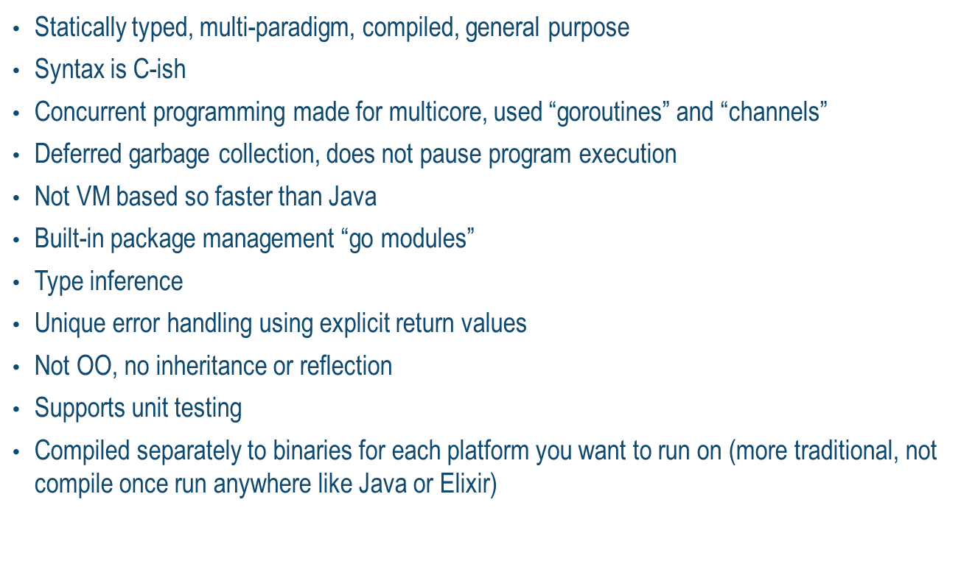
Go Features
Go Lang
The language has …

Slide 6
Basic Go Components
Go Lang
basic data int, float, complex, boolean, string, byte, rune (32-bit Unicode)
data structures struct, array, slice, map
scope global, or function-level
export visibility outside files defining names
types programmer defined
pointers ( but no pointer arithmetic )
function can return multiple results
method a function attached to a struct
goroutine concurrency and synchronization
functions as values, closures
interface
goto, and label on statements

Slide 7
First Go Program
Go Lang
package main
import "fmt“
func main() {
fmt.Print("Hello ")
x := sub_sq(15)
fmt.Println(x)
}
func sub_sq ( x int) int {
return x*x
}
Lets try this example in the Windows shell
Put the code anywhere (for now). Lets make a file on my desktop

Slide 8
Packages
Go Lang
packages are grouping units for code, helps you to organize your project
a package groups one or more source files
to use code in a package, you import the package
any code written in Go belongs to a package
a Go program is composed of a single (or many) packages
a package is like a name space…
code in a package can use all functions and data defined in that package
a package specified what functions and data are exported
only exported names are visible to code not in the package
Upper case first char is exported
lower case first char is not exported (visible in files that package only)
Go Standard Library is a package, can be viewed here , compact for now

Slide 9
Package Example
Go Lang
Physically, a package is just a directory.
Directory name and the package name should be the same … a convention
Go tools and programmers use this convention, so good idea to follow it
Functions, types, variables, and constants defined in one source file are visible to all other source files within the same package
example…
package main
import "fmt"
func main() {
fmt.Print("Hello ")
x := sub_sq(15)
fmt.Println(x)
}
func sub_sq (x int) int { return x*x }
Package does not have to have a main function
But, executable program has one “main” package
That package must have a main function
Function main is the first to execute

Slide 10
Modules
Go Lang
system component, use built-in module handler go mod
hierarchies of modules create code inclusion structure

Slide 11
Global, Local Scopes
Go Lang
Local scope is anything declared inside a function definition
Global scope is anything outside all functions
package main
import "fmt"
/* global variable declaration */
var g int
func main() {
/* local variable declaration */
var a, b int
/* actual initialization */
a = 10
b = 20
g = a + b
fmt.Printf("value of a = %d, b = %d and g = %d\n", a, b, g)
}

Slide 12
Array
Go Lang
an array is a numbered sequence of elements of a specific length
Homogenous… the type of an array element is statically declared
The length is fixed, cannot be lengthened, index starts at 0
b := [5]int{1, 2, 3, 4, 5}
fmt.Println("dcl:", b)
var twoD [2][3]int
for i := 0; i < 2; i++ {
for j := 0; j < 3; j++ {
twoD[i][j] = i + j
}
}
fmt.Println("2d: ", twoD)
}
package main
import "fmt"
func main() {
var a [5]int
fmt.Println("emp:", a)
a[4] = 100
fmt.Println("set:", a)
fmt.Println("get:", a[4])
fmt.Println("len:", len(a))

Slide 13
Array
Go Lang
fruit := [3]string{“peach", “apple“, “grape”}
fruit := [...]string{“peach", “apple“, “grape”}
fruit := [10]string{“peach", “apple“, “grape”}
An array in Go is a value
An array variable denotes the entire array
Internally, it is not a pointer to the first array element (like in C, or Java).
Implications of this are that when you assign or pass around an array value you will make a copy of its contents.
To avoid the copy you could create and pass a pointer to the array but then that’s a pointer to an array, not an array.
One way to think about arrays is as a sort of struct but with indexed rather than named fields: a fixed-size composite value.

Slide 14
Slice
Go Lang
make vs. new
new returns a pointer to the zero value of the type passed.
make returns a non-pointer to an initialized structure.

Slide 15
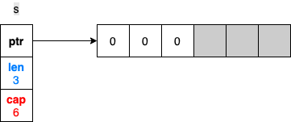
Slices vs. Arrays ( reference )
Go Lang
The data in a slice is stored contiguously in an array. A slice also deals with adding an element if the backing array is full, or shrinking the backing array if it’s near empty.
Internally, a slice holds a pointer to the backing array plus a length and a capacity.
The length is the number of elements the slice contains, whereas the capacity is the number of elements in the backing array, counting from the first element in the slice.
Another implementation of slice discussion
  s := make([]int, 3, 6) // declare 3-length, 6-capacity slice
  // ^ 2nd arg (capacity) is optional
  // zero filled by default

Slide 16
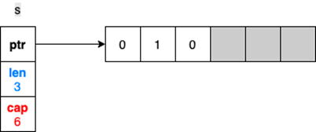
Slices vs. Arrays ( reference )
Go Lang
Make creates an underlying array with 6 elements (capacity), then creates the slice data structure to point to the array
Only the first “len” elements are initialized ( using 0 since the elements are int )
fmt.Println(s) // prints range 0..2, the len, get [ 0 0 0 ]
s[1] = 1 // alters the second element value in the array
No change to len or capacity

Slide 17
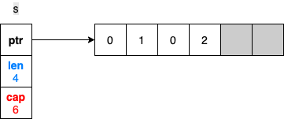
Slices vs. Arrays ( reference )
Go Lang
Accessing an element outside the len range is forbidden, even though the underlying array seems to have space
Use the append built-in function to extend a slice
s[4] = 2 // generates panic, since the slice has no [4] element
s = append(s, 2) // extends slice len, cap stays same
<-- Changes the len
property of the slice

Slide 18
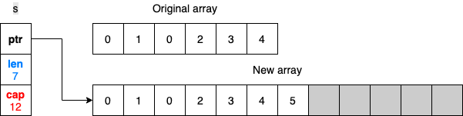
Slices vs. Arrays ( reference )
Go Lang
What happens if we need to add three more elements so that the backing array isn’t large enough?
The append can handle this, and here is what happens
s = append(s, 3, 4, 5)
fmt.Println(s) // output is [0 1 0 2 3 4 5]
<-- might now be garbage
cap is doubled

Slide 19
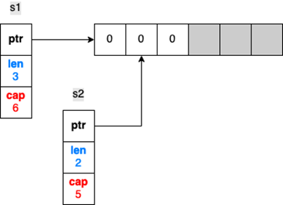
Slices vs. Arrays ( reference )
Go Lang
The old array will be garbage collected (if it is not referenced by other slices)
Slicing can be done on an array or another slice
s1 := make([]int, 3, 6) // Three-length, six-capacity slice
s2 := s1[1:3] // Slicing from indices 1 to (not including) 3
cant go beyond underlying array

Slide 20

Slices vs. Arrays ( reference )
Go Lang
If we update s1[1] or s2[0] ( or any common elements), the change is made to the same array, hence, visible in both slices
s1[1] = 1 // or s2[0] = 1
Fmt.Println(s2[0]) // prints 1, both slices see common values

Slide 21
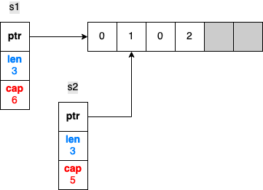
Slices vs. Arrays ( reference )
Go Lang
What happens if we append an element to s2? Does this code change s1 as well?
s1
s2 = append(s2, 2)
s2
len of s1 does
not change
<-- len of s2 changes
fmt.Println(s1) // output is [0 1 0]
fmt.Println(s2) // output is [1 0 2]

Slide 22
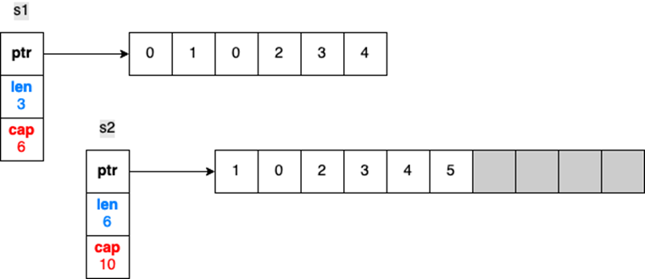
Slices vs. Arrays ( reference )
Go Lang
What if we keep appending elements to s2 until the backing array is full?
Let’s add three more elements so that the backing array will not have enough capacity:
s2 = append(s2, 3)
s2 = append(s2, 4) // At this stage, backing is already full
s2 = append(s2, 5)
s1
<-- double original s2 cap

Slide 23
Is Go Object-Oriented?
Go Lang
From the Go language FAQs:
Yes and no.
Although Go has types and methods and allows an object-oriented style of programming, there is no type hierarchy.
The concept of “interface” in Go provides a different approach that the designers believe is easy to use and in some ways more general.
There are also ways to embed types in other types to provide something analogous—but not identical—to subclassing.
Moreover, methods in Go are more general than in C++ or Java: they can be defined for any sort of data, even built-in types such as plain, "unboxed" integers. They are not restricted to structs (classes).

Slide 24
Methods on Struct
Go Lang
Go does not provide classes or object by name
It does provide structs ( like in C )
Methods can be added on structs. This provides the behavior of bundling the data and methods that operate on the data together (encapsulation, akin to a class)
package main
import (
"fmt"
"math"
)
type Vertex struct { X, Y float64 }
func (v Vertex) Abs() float64 {
return math.Sqrt(v.X*v.X + v.Y*v.Y)
}
func main() {
v := Vertex{3, 4}
fmt.Println( v.Abs() )
}

Slide 25
Methods on Struct
Go Lang
Same thing can be done with “normal” functions
package main
import (
"fmt"
"math"
)
type Vertex struct {
X, Y float64
}
func Abs(v Vertex) float64 {
return math.Sqrt(v.X*v.X + v.Y*v.Y)
}
func main() {
v := Vertex{3, 4}
fmt.Println( Abs(v) )
}

Slide 26
Methods on Struct
Go Lang
Lets examine the scope of the variables
package main
import (
"fmt"
"math"
)
type Vertex struct { X, Y float64 }
func (v Vertex) Abs() float64 {
return math.Sqrt(v.X*v.X + v.Y*v.Y)
}
func main() {
v := Vertex{3, 4}
fmt.Println( v.Abs() )
}
Caps… so exported
Wont matter in this demo since all code is in package main
Caps… so must be exported for Abs to see the data needed

Slide 27
Go “Objects”
Go Lang
Example of struct package with methods
package main
import (
"oop/employee"
)
func main() {
e := employee.Employee{
FirstName: "Sam",
LastName: "Aders",
TotalLeaves: 27,
LeavesTaken: 12,
}
e.LeavesRemaining()
}
Method call on Employee struct

Slide 28
Go “Objects”
Go Lang
package employee
import ( "fmt" )
type Employee struct { // upper E-mployee exported
FirstName string // upper F-irtName so these are exported
LastName string // code outside this package CAN use the
TotalLeaves int // fields of the struct
LeavesTaken int
}
func (e Employee) LeavesRemaining() { // exported
fmt.Printf("%s %s has %d leaves remaining\n", e.FirstName, e.LastName, (e.TotalLeaves - e.LeavesTaken))
}
Method with accepting struct

Slide 29
Go “Objects”
Go Lang
Now deal with encapsulation… global visibility via export
The struct is not exported. Its fields are not visible outside package “employee”
package employee
import ( "fmt" )
type employee struct { // lower e-mployee means not exported
firstName string // lower f-irtName so not exported
lastName string // etc.
totalLeaves int
leavesTaken int
}
func New(firstName string, lastName string,
totalLeave int, leavesTaken int) employee {
e := employee {firstName, lastName, totalLeave, leavesTaken}
return e
}
func (e employee) LeavesRemaining() { // exported
fmt.Printf("%s %s has %d leaves remaining\n",e.firstName, e.lastName,
(e.totalLeaves - e.leavesTaken))
}

Slide 30
Go “Objects”
Go Lang
Now deal with encapsulation… global visibility via export
Main, using the “object” cannot reach in and assign to the fields of the employee struct
package main
import (
"oop2/employee"
)
func main() {
e := employee.New("Sam", "Anders", 27, 12)
e.LeavesRemaining()
}
Method call New in package employee struct
New is exported, and LeavesRemaining, but the struct and its contents are not

Slide 31
go f(x, y, z)
Methods on Types (reference)
Go Lang
Not just on Structs
Methods can be attached to any defined type, struct or non-struct
You can even attach methods to base type like int if you define a type that is int
The method always has a receiver and the receiver has a defined type
When you create a method in your code both the receiver and receiver type must be present in the same package
Func (receiver_name Type) method_name(param_list) (return_type) {
// Code
}
func (p *Type) method_name(...Type) Type {
// Code
}

Slide 32
go f(x, y, z)
Methods on Types
Go Lang
// Go program to illustrate attaching a method
// to a non-struct type receiver ( “boxed” int here )
package main
import "fmt"
// Type definition, in this package
type data int
// Defining a method with non-struct type receiver
func (d1 data) mult(d2 data) data { return d1 * d2 }
// if you try to run this code, the compiler will throw an error
//func (d1 int) mult(d2 int) int { // int is not defined in this package
// return d1 * d2
//}
func main() {
val1 := data(23)
val2 := data(20)
res := val1.mult(val2)
fmt.Println("Final result: ", res)
}

Slide 33
go f(x, y, z)
Methods on Types
Go Lang
// Go program to illustrate a method with struct type receiver
package main
import "fmt"
// Author structure, defined in this package; note... lower so not exported
type author struct {
name string
branch string
particles int
salary int
}
// Method with a receiver of author type; also lower, so not exported
func (a author) show() {
fmt.Println("Author's Name: ", a.name)
fmt.Println("Branch Name: ", a.branch)
fmt.Println("Published articles: ", a.particles)
fmt.Println("Salary: ", a.salary)
}
func main() {
res := author{ name: “Sona", branch: "CSE", particles: 203, salary: 34000, }
res.show()
}

Slide 34
go f(x, y, z)
Methods on Types
Go Lang
// Go program to illustrate pointer receiver
package main
import "fmt"
// author structure, declared in this package
type author struct {
name string
branch string
particles int
}
// Method with a receiver of ptr to author type
func (a *author) show(abranch string) {
(*a).branch = abranch
}
func main() {
res := author{
name: "Sona",
branch: "CSE",
}
fmt.Println("Author's name: ", res.name)
fmt.Println("Branch Name(Before): ", res.branch)
// Creating a pointer
p := &res
// Calling the show method
p.show("ECE") // using the ptr like a value variable
fmt.Println("Author's name: ", res.name)
fmt.Println("Branch Name(After): ", res.branch)
}
With the help of a pointer receiver, if a change is made in the method, it will reflect in the caller which is not possible with the value receiver methods.
Using a pointer receiver, if a change is made in the method body, it will reflect in the caller data
This is not possible with the value receiver methods.

Slide 35
go f(x, y, z)
Methods on Types: Overloading
Go Lang
// Go program to illustrate how "the method"
// can accept both pointer and value
package main
import "fmt"
// Author structure
type author struct {
name string
branch string
}
// Method with a pointer receiver of author type
func (a *author) show_p(abranch string) {
(*a).branch = abranch
}
// Method with a value receiver of author type
func (a author) show_v() {
a.name = "Gourav"
fmt.Println("Author's name(Before) : ", a.name)
}

Slide 36
go f(x, y, z)
Methods on Types: Overloading
Go Lang
// using these methods
func main() {
res := author{
name: "Sona",
branch: "CSE",
}
fmt.Println("Branch Name(Before): ", res.branch)
// Calling the show_p method (ptr method) with value
res.show_1("ECE")
fmt.Println("Branch Name(After): ", res.branch)
// Calling the show_v method (val method) with ptr
(&res).show_2()
fmt.Println("Author's name(After): ", res.name)
}

Slide 37
go f(x, y, z)
Methods vs. Functions
Go Lang
Comparing Methods and Functions in Go
Function
It does not contain a receiver.
Functions of the same name but different type are not allowed to be defined in the program.
It can be used as first-order entity, and can be passed
Method
It contains a receiver.
Methods of the same name but different types can be defined in the program.
It cannot be used as a first-order entity.

Slide 38
Closures
Go Lang
When functions are first class entities
A closure is a first class function which captures the lexical bindings of free variables in its defining environment.
Practical definition means a function that can execute properly because the runtime system has set up a collection of any non-local variables it might need
When a function is written its text may depend on variables in the calling environment (globals, vars local to the function calling it, etc.
A closure makes a referencing environment that allows the function to run when called in any circumstances, even ones where the needed environment is not extant
So a closure is a run-time creation

Slide 39
Closure Example
Go Lang
package main
import "fmt"
func adder() func(int) int {
sum := 0 // needed by the returned func
// but not inside the func defn
return func(x int) int {
sum += x
return sum
}
}
func main() {
pos, neg := adder(), adder()
// pos and neg are int -> int functions
for i := 0; i < 10; i++ {
fmt.Println( pos(i), neg(-2*i))
}
}

Slide 40
Closure Example in Go
Go Lang
package main
import "fmt"
func adder() func(int) int {
sum := 0
return func(x int) int {
sum += x
return sum
}
}
func main() {
pos, neg := adder(), adder()
for i := 0; i < 10; i++ {
fmt.Println( pos(i), neg(-2*i))
}
}
Closures have some object characteristics
Encapsulation
You can make many of them from one definition

Slide 41
Closure Example
Go Lang
package main // makes closure using a global var
import "fmt"
var g_fac int = 0
func adder() func(int) int {
sum := 0
return func(x int) int {
sum, g_fac = sum+x*(g_fac), g_fac+1
return sum
}
}
func main() {
fmt.Println(g_fac)
g_fac++ // btw in go the inc operator is a statement
// not an expression
fmt.Println(g_fac)
pos, neg := adder(), adder() // both using one global?
for i := 0; i < 10; i++ {
fmt.Println( pos(i), neg(-2*i))
}
}

Slide 42
go f(x, y, z)
Goroutines
Go Lang
Concurrent threads/tasks/processes in Go
Basics… any function can be “spawned” off as a concurrent activity
Termed a “goroutine”
Runs until the code is exhausted, or until end of the spawning function
When we do this
go f(x, y, z)
we evaluate f, x, y, and z in the thread doing the “go” command
and we execute the f(x,y,z) call in the new thread, new environment
Goroutines run is the same address space, so go supports traditional shared memory access methods for concurrent threads
Watch Rob Pike explain Go-style Concurrency

Slide 43
Goroutines: Simple Example
Go Lang
Concurrent threads/tasks/processes in Go
package main
import (
"fmt"
"time"
)
func hello(n int) {
if n>0 {
fmt.Printf("Hello world goroutine %p \n“, n)
go hello(n-1) // fires off a goroutine, concurrent
}
}
func main() {
go hello(5)
//time.Sleep(1 * time.Second)
time.Sleep(3100)
fmt.Println("main function")
}

Slide 44
Channels
Go Lang
Not quite mailboxes
We noted that goroutines all run in a common address space
So you can code goroutines like Java threads… you can use various traditional synchronization primitives such as lock/unlock (Mutex), condition variable (Cond) and atomic read/write operations (atomic).
Package sync has these things if you wish to use them
Go also has other features that will do synchronization automatically: channel
Recall that Erlang uses a concurrency model called the Actor model (from Carl Hewitt, 1973)
Go concurrency is based on the CSP model, “Communicating Sequential Processes” first described by Tony Hoare (1978)

Slide 45
Channels
Go Lang
Channels are a typed conduit through which you can send and receive values using the channel operator, <-
ch := make(chan int)
ch <- v // Send v to channel ch in some goroutine g1
v := <- ch // Receive from ch, and in another goroutine g2
// assign value to v.
By default, sends and receives block until the other side is ready. This allows goroutines to synchronize without explicit locks or condition variables.
Channels declared this way are bi-directional, meaning any process that can see it can both read and write from it ( and can close it, even if other goroutines are still using it )
Direction restrictions:
var bidirectionalChan chan string // read, write and close()
var receiveOnlyChan <-chan string // read only
var sendOnlyChan chan<- string // write and close() only

Slide 46
Channels
Go Lang
Channels are blocking. If a goroutine tries to read from a empty channel then it will be blocked and program execution keeps on waiting until it receives a value.
By default, sends and receives block until the other side is ready. This allows goroutines to synchronize without explicit locks or condition variables.
For an unbuffered channel a write operation will block the writing goroutine until another goroutine is ready to read from that channel. When the reading goroutine is ready to read (i.e. executes <-ch), then the write and read take place, and both goroutines continue running.
Channel is not a mailbox, as a channel is an entity apart from a process (goroutine)
There is syntax in Go to tell the compiler to enforce “direction” a particular goroutine uses to access a channel… a process can indicate it intends to “only read” from a channel or “only write” to a channel
However a process is also free to both read and write to a channel if declared that way

Slide 47
Channels
Go Lang
Exercise:
Can you design a Go code structure (or useage convention) that will provide the semantics of an Erlang mailbox?
What are the properties of an Erlang mailbox?
Can we find some Go structure(s) that will create or simulate these properties?
Followup Exercise:
Can you do something in Go with goroutines that Erlang cannot do with mailboxes?

Slide 48
Channels Example
Go Lang
package main
import (
"fmt"
)
func main() {
n := 3
out := make(chan int)
go multByTwo(n, out)
fmt.Println(<-out)
}
func multByTwo(num int, res_ch chan<- int) {
result := num * 2
res_ch <- result
}

Slide 49
Channels Example
Go Lang
package main
import (
"fmt"
"time"
)
func main() {
n := 8
ich := make(chan int)
go multByTwo(n, ich)
go report(ich)
time.Sleep(2*time.Second) // try leaving this out
}
func multByTwo(num int, res_ch chan int) {
prod := num * 2
res_ch <- prod
}
func report (pch chan int) { fmt.Println(<-pch) }

Slide 50
Waitgroups
Go Lang
Another synchronization technique
Channels provide synchronization mixed with communication
If you don’t need interprocess communication, but you do need processes to coordinate their activities in time you can use one or more waitgroups
import “sync”
var wg sync.WaitGroup
wg.Add(1) // goroutine asks to be counted on startup
wg.Done() // goroutine checks out at its end
wg.Wait() // the “parent” blocks until all the
// counted goroutines in the group are done

Slide 51
Waitgroup Example
Go Lang
package main
import (
"fmt"
"sync"
"time"
)
func worker(id int, w *sync.WaitGroup) { // must pass wg as a poiner
fmt.Printf("Worker %d starting\n", id)
time.Sleep(4*time.Second)
w.Done() // dec the wg counter
fmt.Printf("Worker %d done\n", id)
}
func main() {
var wg sync.WaitGroup
for i := 1; i <= 5; i++ {
wg.Add(1) // inc the wg counter
go worker(i,&wg) // pass a pointer to wg
}
fmt.Println("main is ready to end but we will wait...")
fmt.Println("ending now would kill gorutines still running")
time.Sleep(2*time.Second) // is this long enough?? maybe... maybe not
//wg.Wait() // do the synch ... wait for all in group to end
fmt.Println("ok main is done")
}

Slide 52
END

Slide 53
Escape Analysis
Go Lang
Dynamic Scope of Pointers from compiler optimization
When a variable is allocated on a function call, pointers to that storage may “escape” into other parts of the code… into the calling function for example ( if a pointer is returned )
In language like Java, all pointers are compiler-managed ; put another way, there is no way for a programmer to manipulate a pointer directly
So in Java, escape analysis is easier
In C, in Go… in languages that have pointers as data values, we have to think about how memory is accessed, and results of escape analysis can lead to allocating pointer-based data in stack frames for speed

Slide 54
Error Handling
Go Lang
Error values and Panic
The error type is an interface type.
An error variable represents any value that can describe itself as a string.
type error interface {
Error() string
}
// function os.Open returns a value of type Error
func Open(name string) (file *File, err error)
f, err := os.Open("filename.ext")
if err != nil { log.Fatal(err) }
// do something with the open *File f

Slide 55
Interfaces
Go Lang
Major Subtitle
Place holder

Slide 56
Scope Summary
Go Lang
Major Subtitle
All items declared in a package visible to all files in the package directory?
Upper vs lower for exported names
Global vs. local
Package vs. module

Slide 57
You Tube
Go Lang
Major Subtitle
https://www.youtube.com/watch?v=qQXXI5QFUfw
Programming languages
https://www.youtube.com/watch?v=vcFBwt1nu2U
Worst languages
https://www.youtube.com/watch?v=YZV8Zv_YW7I
History of PLs
https://www.youtube.com/watch?v=JhCl-GeT4jw
Large language models and end of programming
https://www.youtube.com/watch?v=ND_AjF_KTD8
Next decade of development

Slide 58
Slices vs. Arrays ( reference )
Go Lang
What happens if we append an element to s2? Does this code change s1 as well?
s2 = append(s2, 2)
s1
s2
len of s1 does
not change
<-- len of s2 changes

Slide 59
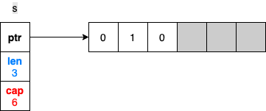
Arrays vs. Slices ( reference )
Go Lang
Pics 1 to 4

Slide 60



Arrays vs. Slices ( reference )
Go Lang
Pictures 5 through 7

