Slide 1

On Beyond Objects
Programming in the 21th century
COMP 590-059
Fall 2024
David Stotts
Computer Science Dept
UNC Chapel Hill

Slide 2
COMP 301 Threads Review (a)
Motivating example
Baking cookies!

Slide 3
Baking cookies
Measure the dry ingredients
Measure the wet ingredients
Combine the wet and dry ingredients
Put the cookie dough on the sheet
Preheat the oven
Bake the cookies
progress of time

Slide 4
Improving the algorithm
time
Dry ingredients
Wet ingredients
Mix cookie dough
Baking sheet
Preheat oven
Bake
Dry ingredients
Wet ingredients
Mix cookie dough
Baking sheet
Preheat oven
Bake
Saved time!
Make individual computation steps take less time
“speed them up”
You got a new mixer! Now you can mix the ingredients faster!

Slide 5
Improving the algorithm
time
Dry ingredients
Wet ingredients
Mix cookie dough
Baking sheet
Preheat oven
Bake
Dry ingredients
Wet ingredients
Mix cookie dough
Baking sheet
Bake
Preheat oven
You can preheat the oven while mixing the ingredients!
Two steps overlap in time;
they do not affect each other so we do them “at the same time”
Saved time!

Slide 6
Improving the algorithm
time
Dry ingredients
Wet ingredients
Mix cookie dough
Baking sheet
Bake
You can have a friend help you!
Preheat oven
Dry ingredients
Mix cookie dough
Baking sheet
Bake
Wet ingredients
Preheat oven
two separate bakers,
two “computers” working at “the same time”
More Saved time!

Slide 7
How to speed up completing a task
Strategy | Baking cookies | Executing a program
Do the same steps, only faster | Upgrade your mixer | Upgrade your computer
Rearrange tasks so you can do one while waiting for the other to finish | Preheat while portioning on the baking sheet | Asynchronous programming
Get a friend to help you do tasks at the same time | Wet ingredients and dry ingredients at the same time | Parallel programming
Concurrent Computing

Slide 8
Concurrent vs sequential computing

Slide 9
Definitions
Sequential computing – When a series of computations are executed one at a time, such that each computation must finish before the next can begin
task1()
task2()
task3()
Time

Slide 10
Definitions
Concurrent computing – When a series of computations are executed during overlapping time periods
The tasks might be executed simultaneously…
task1()
task2()
…or maybe one computer is taking turns switching back and forth between them
task3()
Time

Slide 11
Synchronous and asynchronous programming models

Slide 12
Definitions
Synchronous programming
A model of programming where a task may be started, and the program waits for it to complete before continuing on
Task
task() method
executed
task() method completed
Main program
Main program
Time

Slide 13
Definitions
Asynchronous programming
A model of programming where a task may be started, but the program continues on without waiting for it to complete
Task
task() method
executed
task() method completed
Main program
Main program
Time

Slide 14
Summary
Computing models
Sequential Computing
Only one task can be executed at a time; the current task must complete before the next one can begin
Concurrent Computing
Multiple tasks can be executed during overlapping time periods, either in parallel or by context switching
Parallel Computing
Multiple tasks can simultaneously be executed on separate processing elements
Programming models
Synchronous Programming
The program waits for a task to finish completely before continuing on
Asynchronous Programming
The program continues on without waiting for a method to finish

Slide 15
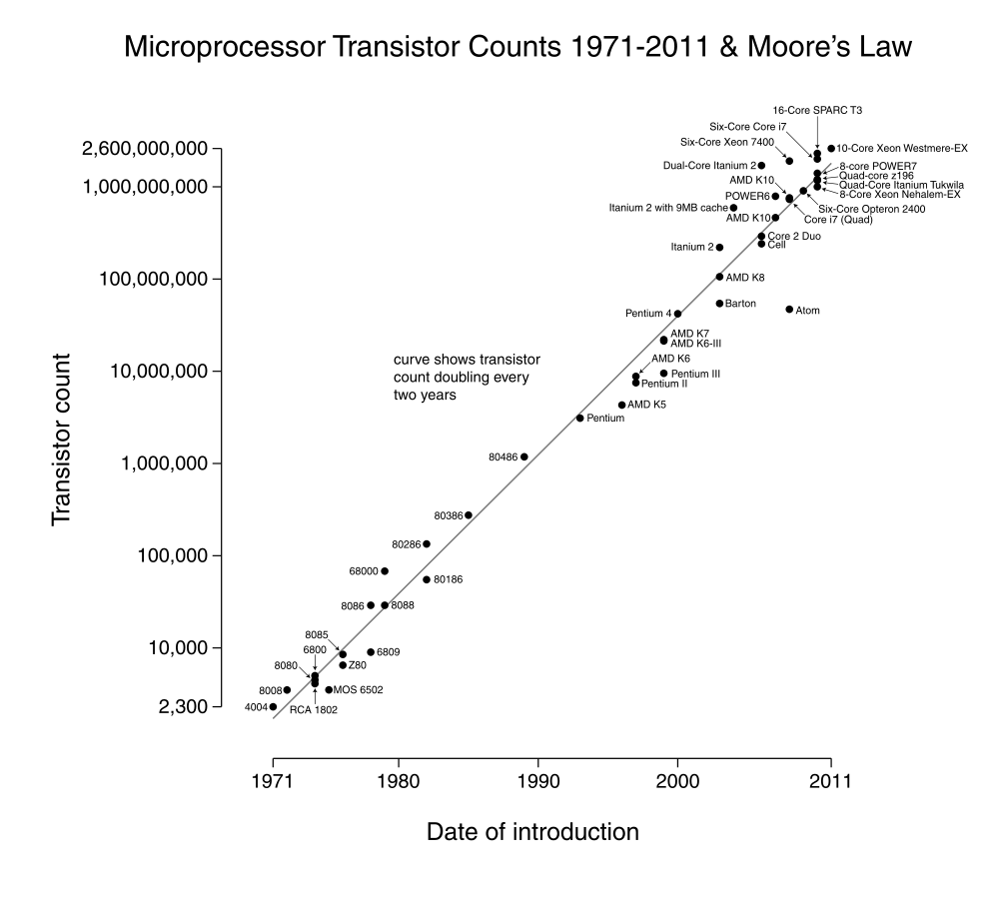
The Multicore Revolution

Slide 16


Slide 18
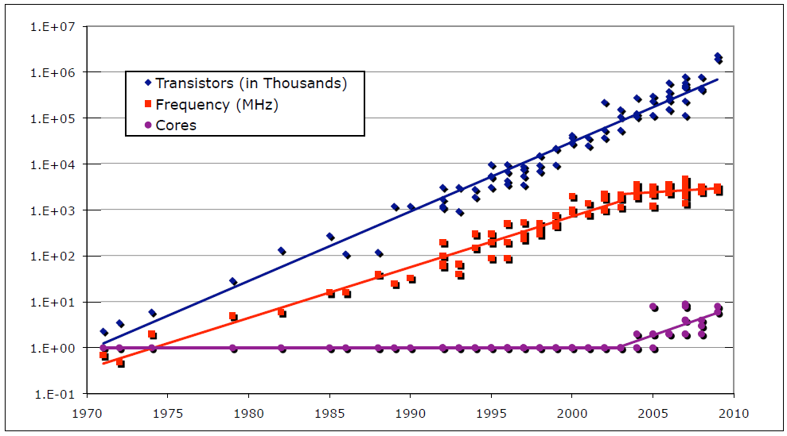
Core Count Driving Moore’s Law
https://madusudanan.com/blog/scala-tutorials-part-9-intro-to-functional-programming/

Slide 19
Parallel Programming
Multicore increases performance only if we can find ways to parallelize our task.
Sometimes very easy.
  No data or logic dependencies.
  Aggregating data operations (arrays, matrices)
Sometimes very hard.

Slide 20
Threads and multithreading

Slide 21
Definitions
A “thread” is an abstraction for executing a program
  To execute any program, your operating system creates a thread
A thread encapsulates the following information
  Instruction pointer: the current point of execution
  Call stack: which methods are currently executing
  Memory: the contents of memory, including the heap
A single program can run multiple threads at the same time
  Separate instruction pointer
  Separate call stack
  Shared memory

Slide 22
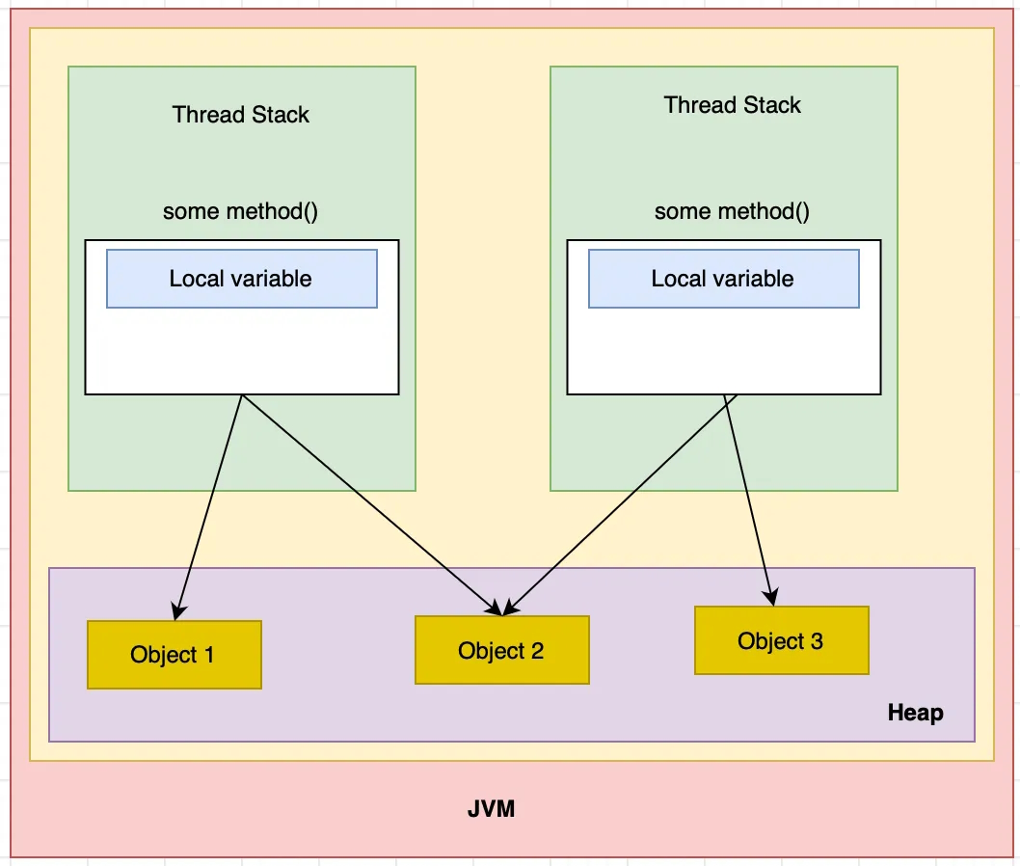
Java Process vs. Thread
program that is under execution is a process
A process has
-- one (or more) thread
-- a heap for dynamic stuff
-- memory for call stack
Each thread has
-- its own call stack (its own private
chunk of the process stack space
-- shares the one heap in the
process with all other threads
medium.com

Slide 23
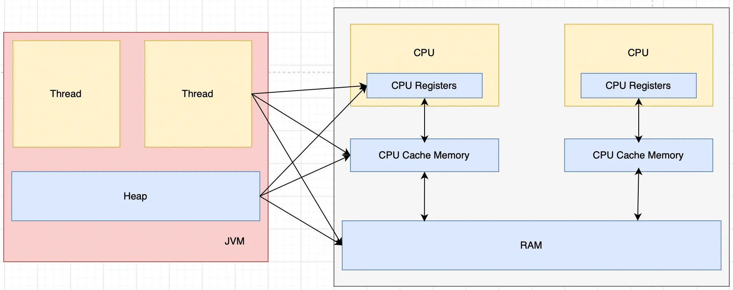
Java Process vs. Thread
CPU is a Core
medium.com

Slide 24
Java Runnable interface
The Runnable interface is built-in to Java
A Runnable object represents a task that can be performed
The task is performed by calling the run() method
The task might be performed synchronously or asynchronously
public interface Runnable {
void run();
}
What Java syntax shortcut might be used to create a new Runnable object?

Slide 25
Creating a Runnable object
public class Multithreader {
public static void main(String[] args) {
Runnable task1 =
() -> {
for (int i = 0; i < 10; i++) {
System.out.println(i + 1);
}
};
}
}

Slide 26
Poll Everywhere
public class Multithreader {
public static void main(String[] args) {
Runnable task1 =
() -> {
for (int i = 0; i < 10; i++) {
System.out.println(i + 1);
}
};
}
}
Prompt: What will this program print?
To answer, visit https://pollev.com/pds

Slide 27
Alt: No anonymous class, no lambda
public class Main {
public static void main(String[] args) {
Runnable task1 = new AlgOne();
}
}
public class AlgOne implements Runnable {
public void run() {
for (int i=0; i<10; i++) { System.out.println(i+1); }
}
}

Slide 28
Running a Runnable object synchronously
This program will execute sequentially and synchronously
public class Multithreader {
public static void main(String[] args) {
Runnable task1 =
() -> {
for (int i = 0; i < 10; i++) {
System.out.println(i + 1);
}
};
System.out.println("Printing 1 to 10");
task1.run();
System.out.println("Done");
}
}
No concurrency here; we simply created a Runnable object and executed its run() method

Slide 29
Alt: No anonymous class, no lambda
public class Main {
public static void main(String[] args) {
Runnable task1 = new AlgOne();
System.out.println("Printing 1 to 10");
task1.run();
System.out.println("Done");
}
}
public class AlgOne implements Runnable {
public void run() {
for (int i=0; i<10; i++) { System.out.println(i+1); }
}
}

Slide 30
Java Thread class
Java’s Thread class
  Built-in to Java
  Represents a thread of execution
  Must be given a Runnable object to execute in the constructor
  Has a special start() method for executing the Runnable
  Executes the Runnable asynchronously (in parallel)
Thread thread = new Thread(task1);
thread.start();

Slide 31
Running a Runnable object asynchronously
This program will execute concurrently and asynchronously
public class Multithreader {
public static void main(String[] args) {
Runnable task1 =
() -> {
for (int i = 0; i < 10; i++) {
System.out.println(i + 1);
}
};
System.out.println("Printing 1 to 10");
Thread thread = new Thread(task1);
thread.start();
System.out.println("Done");
}
}
The Runnable’s run() method will execute at the same time as the rest of the program
What happens at this line?

Slide 32
Alt: No anonymous class, no lambda
public class Main {
public static void main(String[] args) {
Runnable task1 = new AlgOne();
Thread thread = new Thread(task1);
System.out.println("Printing 1 to 10");
thread.start();
System.out.println("Done");
}
}
public class AlgOne implements Runnable {
public void run() {
for (int i=0; i<10; i++) { System.out.println(i+1); }
}
}

Slide 33
Waiting for a Thread to finish
Alt title: Synchronizing Threads
The join() method

Slide 34
Waiting for a Thread to finish
0 1 2 3 4 5 6 7 8 9
public static void main(String[] args) {
Runnable task =
() -> {
for (int i = 0; i < 10; i++) {
System.out.print(i);
System.out.print(" ");
}
};
Thread thread1 = new Thread(task);
thread1.start();
Thread thread2 = new Thread(task);
thread2.start();
System.out.println("Finished!");
}
This task prints the numbers 1 – 10 with a space in between
Perform the task twice asynchronously
Print “Finished!”

Slide 35
Waiting for a Thread to finish
public static void main(String[] args) {
Runnable task =
() -> {
for (int i = 0; i < 10; i++) {
System.out.print(i);
System.out.print(" ");
}
};
Thread thread1 = new Thread(task);
thread1.start();
Thread thread2 = new Thread(task);
thread2.start();
System.out.println("Finished!");
}
Sample output:
Finished!
00 1 1 2 3 2 4 3 5 4 5 6 7 8 6 9 7 8 9
Will this line run after the threads complete?
No! It’s asynchronous

Slide 36
Waiting for a Thread to finish
public static void main(String[] args) {
Runnable task =
() -> {
for (int i = 0; i < 10; i++) {
System.out.print(i);
System.out.print(" ");
}
};
Thread thread1 = new Thread(task);
thread1.start();
Thread thread2 = new Thread(task);
thread2.start();
System.out.println("Finished!");
}
Sample output:
Finished!
00 1 1 2 3 2 4 3 5 4 5 6 7 8 6 9 7 8 9
Note: each thread has a separate call stack, so the local var “ i “ here in thread1 does not conflict with “ i “ in thread2

Slide 37
Waiting for a Thread to finish
public static void main(String[] args) {
Runnable task =
() -> {
for (int i = 0; i < 10; i++) {
System.out.print(i);
System.out.print(" ");
}
};
Thread thread1 = new Thread(task);
thread1.start();
Thread thread2 = new Thread(task);
thread2.start();
thread1.join();
thread2.join();
System.out.println("Finished!");
}
Sample output:
0 1 2 3 0 1 2 3 4 5 64 7 8 9 5 6 7 8 9 Finished!
Pause the main() thread until thread1 and thread2 are finished

Slide 38
A Question . . .
public static void main(String[] args) {
Runnable task =
() -> {
for (int i = 0; i < 10; i++) {
System.out.print(i);
System.out.print(" ");
}
};
Thread thread1 = new Thread(task);
thread1.start();
Thread thread2 = new Thread(task);
thread2.start();
thread1.join();
thread2.join();
System.out.println("Finished!");
}
Sample output:
0 1 2 3 0 1 2 3 4 5 64 7 8 9 5 6 7 8 9 Finished!
Numbers are still interleaved
What can we do to get the sequences printed not interleaved?
Like: 0 1 2 3 4 5 6 7 8 9 0 1 2 3 4 5 6 7 8 9

Slide 39
View example threads code from github

